Slide 1

AWS Application Discovery Service
Discover on-premises server inventory and behavior to plan cloud migrations

Slide 2
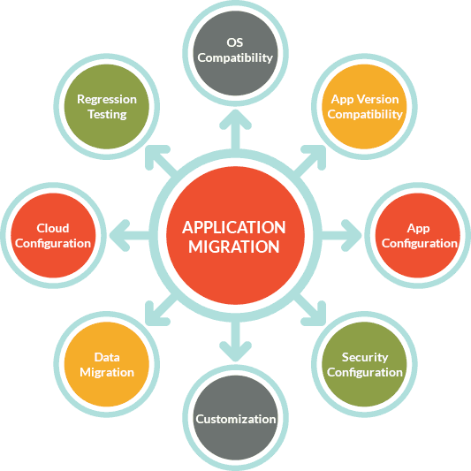
What is Application Migration?
Application migration is the process of moving an application program from one environment to another

Slide 3
Application Migration Types
Rehost. Rehosting, or lift-and-shift, refers to the strategy in which an organization moves the application without making any changes. The long-term costs of this can be higher than other options.
Refactor. Also known as rearchitect, this strategy calls for an application to undergo significant changes so that it will scale within a cloud environment.
Replatform. An application undergoes minor tweaks so it can benefit from cloud architecture. This revision can look like upgrading the application, containerizing the application or changing the operating systems.
Rebuild. During a rebuild, developers rewrite an application specifically for the cloud. This option is also called a forklift replacement of a whole application, which is usually disruptive.
Retire/replace. In some instances, it is in an organization's best interest to decommission the application or choose a new one.

Slide 4
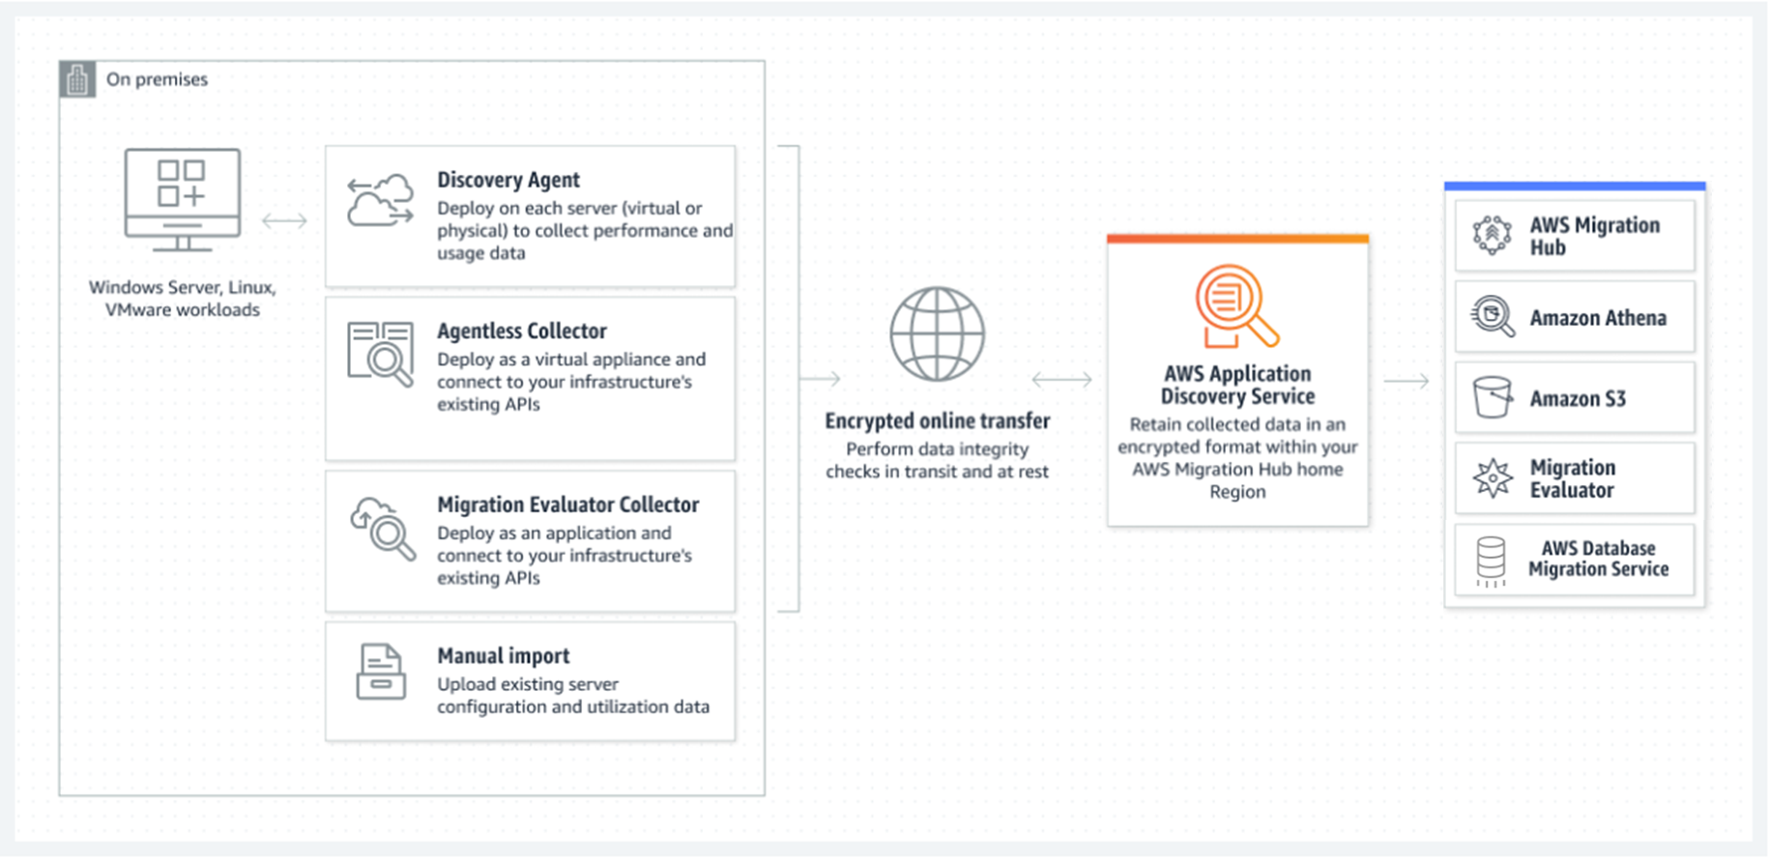
AWS Application Discovery Service

Slide 5
AWS Application Discovery Service Use cases
Discover on-premises server and database inventory
Conduct inventory discovery to help accelerate migration by gathering server and database configuration information, operating system version history, and key resource allocation details.
Map network communication patterns
Examine the connections between applications and servers to uncover unknown servers, better understand dependencies, and establish move groups.
Mobilize for migration
Gather utilization data to generate rightsized Amazon Elastic Compute Cloud (EC2) instances and plan for migration in Migration Hub or in AWS Database Migration Service.

Slide 6
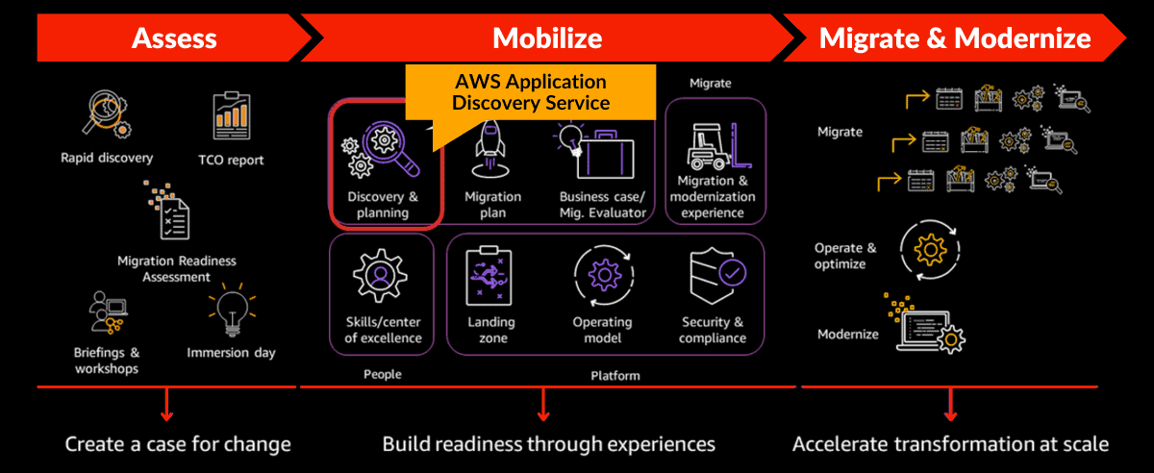
At what stage is ADS used?

Slide 7
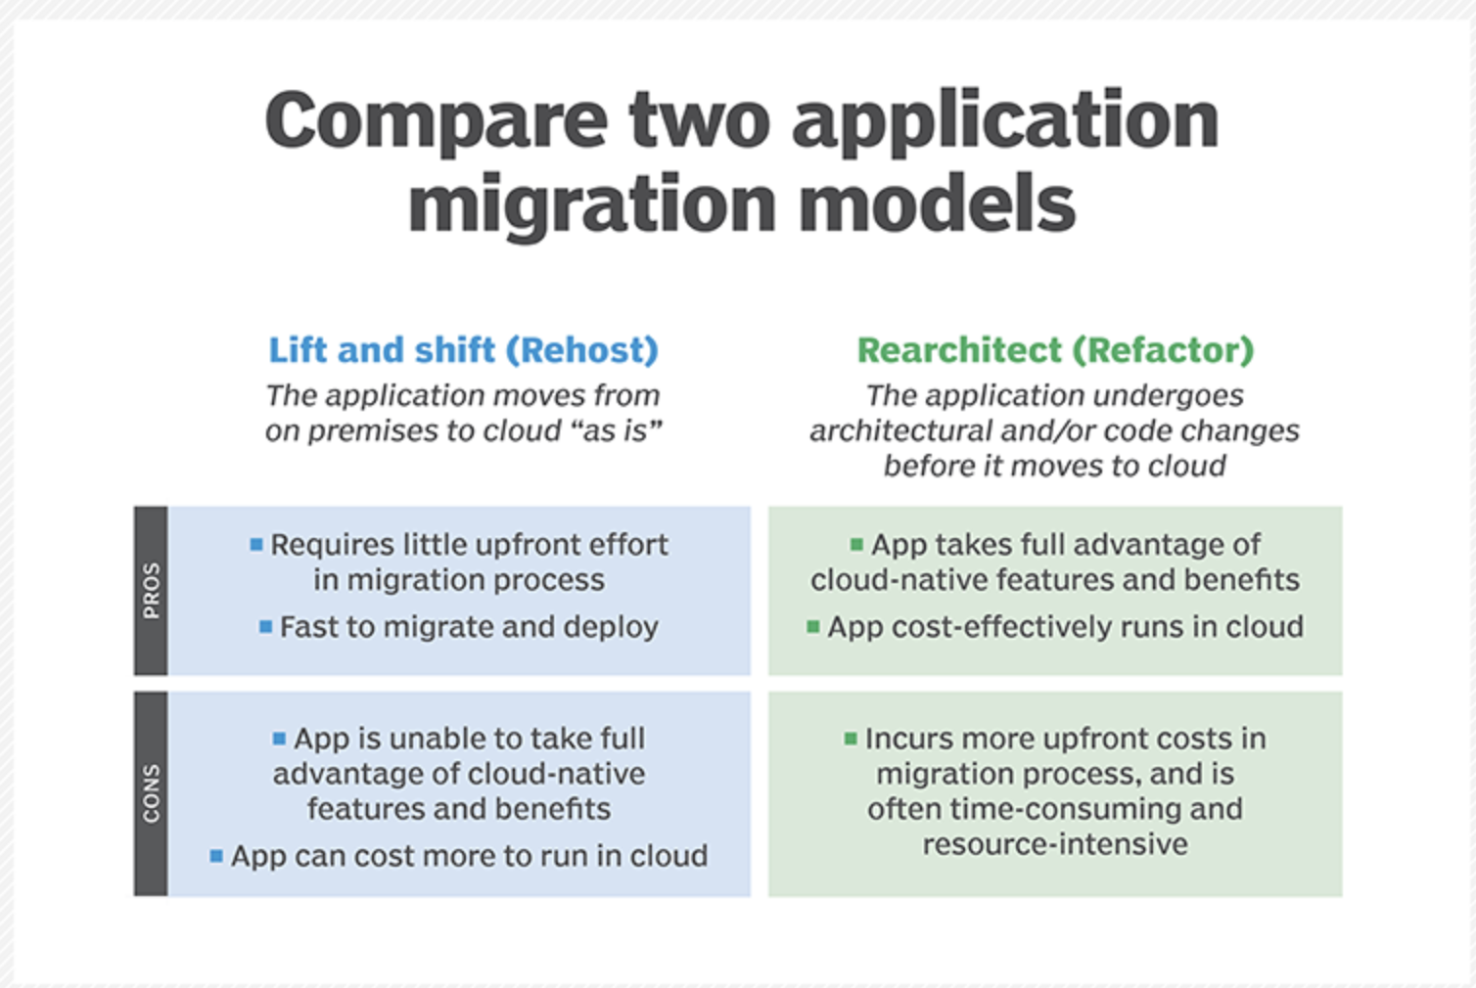
Lift and Shift (Rehost) vs Reachitect (Refactor)

Slide 8
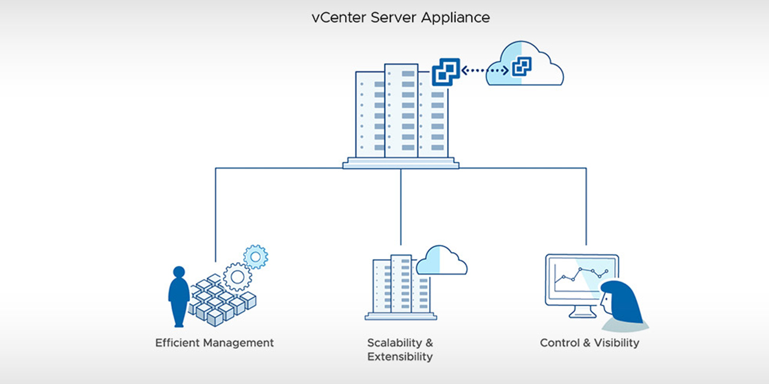
What is VMware vCenter Server (formerly VMware VirtualCenter)
VMware vCenter Server is the centralized monitoring and resource management software for VMware vSphere virtual infrastructure.
VMware vCenter Server performs a number of tasks, including resource provisioning and allocation, performance monitoring, workflow automation and user privilege management

Slide 9
AWS ADS Agentless
The agentless model enables an organization to gather data about its infrastructure without having to install the AWS Application Discovery agent onto its host servers or virtual machines (VMs).
The agentless model, which Amazon recommends for enterprises that use VMware vCenter Server, can also collect data regardless of the server operating system in use.
Agentless discovery collects configuration data, such as IP addresses, CPU allocation and network throughput, but is limited to 10 GB of data per day.
To use agentless discovery, an IT professional must deploy and configure the AWS Agentless Discovery Connector virtual appliance.

Slide 10
AWS ADS Agent-based models
Agent-based discovery requires a user to install the AWS Application Discovery agent onto its host servers or VMs, but collects a higher level of data, such as data related to network connections, compared to the agentless models.
Amazon encrypts the data that its agents collect an Application Discovery Service data store.
Agent-based discovery limits a user to 1,000 active hosts, 10,000 inactive hosts, 10 GB of data per day and 90 days of data storage.
Agent-based discovery is compatible with the following operating systems:
Amazon Linux 2012.03 or newer;
Ubuntu 12.04 or newer;
RHEL 5.11 or newer;
CentOS 5.11 or newer;
SUSE 11 with service pack 4 or newer;
Windows Server 2003 R2;
Windows Server 2008 R1 SP2 or R2 SP1;
Windows Server 2012 R1 or R2;
Windows Server 2016.
Agent-based discovery works in VMware and non-virtualized environments. Users can also choose to run both the agent-based and agentless modes simultaneously on their infrastructure.

Slide 11
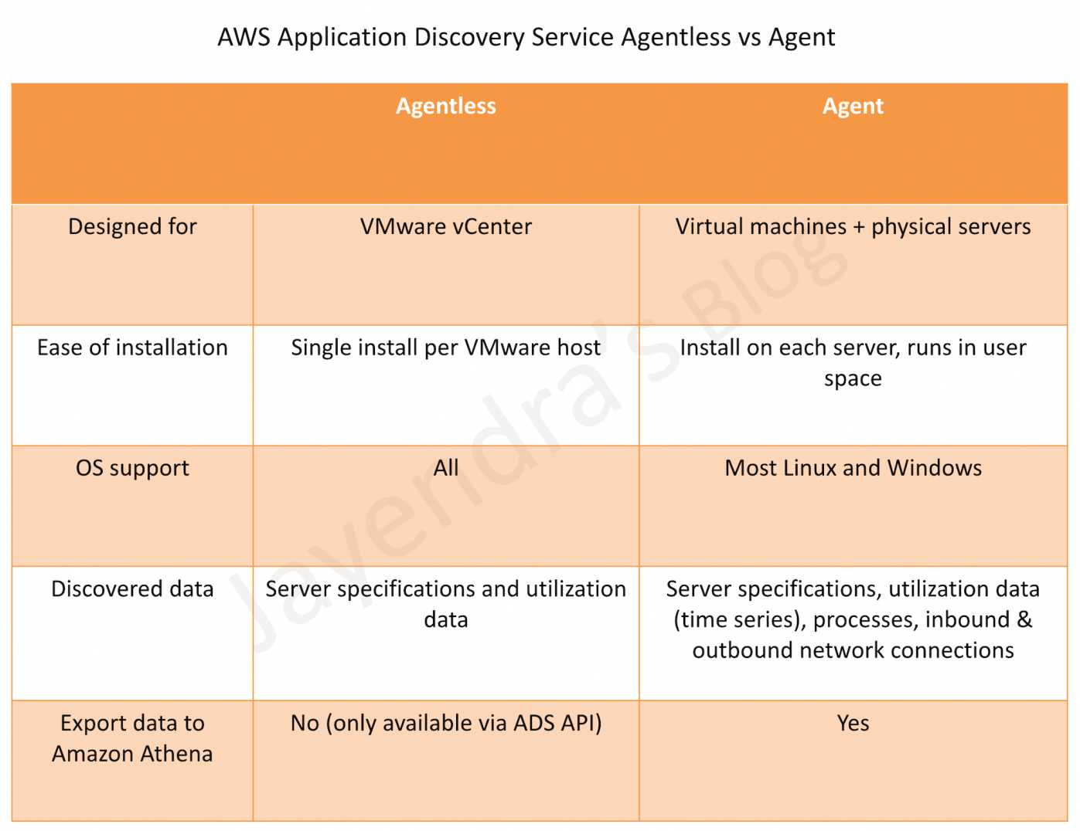
AWS ADS Agentless vs Agent

Slide 12
AWS Application Migration Service VS AWS Application Discovery Service
AWS Application Discovery Service
Purpose:
The primary aim of AWS Application Discovery Service is to help enterprises better understand their on-premises, data center architectures before migrating to AWS.
It provides detailed information about the IT infrastructure, including servers, applications, dependencies, and performance metrics.
Functionality:
Discovery: It automatically identifies servers, virtual machines, and applications running in the data center.
Data Collection: It collects detailed information about the configuration, usage, and behavior of the applications and infrastructure.
Dependency Mapping: It offers insights into how applications interact and depend on each other within the IT environment.
Planning Support: The data collected and insights generated are crucial for planning migration projects, including estimating costs and identifying the best strategies for migration (such as rehosting, replatforming, or refactoring).
Usage: This service is used in the initial phases of the migration journey, helping to assess and plan migrations effectively.
AWS Application Migration Service (formerly known as AWS Server Migration Service)
Purpose:
The main goal of AWS Application Migration Service is to simplify and expedite the migration of applications, servers, and databases from on-premises or other cloud environments to AWS.
Functionality:
Migration: It automates the process of migrating servers and applications to AWS.
Agentless and Agent-Based Options: Depending on the specific needs and source environment, it supports both agentless migrations (ideal for virtualized environments) and agent-based migrations.
Multiple Migration Strategies: It supports various migration strategies, including lift-and-shift (rehosting), replatforming, and refactoring, providing flexibility in how applications are migrated to AWS.
Integration and Testing: It integrates with AWS services and allows for testing of migrated applications before making them live.
Usage: This service is utilized in the execution phase of the migration journey, where the actual migration of applications and workloads takes place.
Key Differences
Stage in Migration Process:
Application Discovery Service is used for the initial assessment and planning stages, helping to understand the existing environment and plan the migration.
Application Migration Service is used later, to actually migrate the applications to AWS.
Functionality:
Discovery Service focuses on discovering, assessing, and planning by providing insights into the existing environment.
Migration Service focuses on the migration execution, providing tools and processes to move applications and workloads to AWS efficiently.

