Slide 1
AWS DataSync
Simplify and accelerate secure data migrations

Slide 2
AWS DataSync
AWS DataSync is a data transfer service that simplifies, automates, and accelerates moving data between on-premises storage systems and AWS services, as well as between different AWS services.
It is designed to make it easy to move large volumes of data over the internet or AWS Direct Connect links efficiently, securely, and quickly.
Key Features of AWS DataSync
High-Speed Transfer:
AWS DataSync uses a purpose-built network protocol and parallel transfer techniques to achieve high-speed data transfer, significantly faster than traditional transfer protocols like FTP or HTTP.
Data Synchronization:
It can synchronize files and objects between your on-premises storage and AWS storage services, such as Amazon S3, Amazon EFS (Elastic File System), and Amazon FSx for Windows File Server, or between AWS storage services directly.
Automated and Managed:
DataSync automates and manages the entire data transfer process, including copying data, scheduling transfers, data validation, and encryption.
This reduces the complexity and operational overhead of data migrations and transfers.
Encryption and Data Integrity:
Data transferred using AWS DataSync is encrypted in transit.
The service also performs data integrity checks both during and after the transfer to ensure the data is not corrupted.
Cost-Effective:
DataSync optimizes data transfer costs by compressing and deduplicating data before it is moved, reducing the amount of data transferred and, consequently, the cost.

Slide 3
AWS DataSync
Securely discover and migrate your data to AWS with end-to-end security, including data encryption and data integrity validation.
Simplify migration planning and reduce expensive on-premises data movement costs with a fully managed service that seamlessly scales as data loads increase.
Easily manage data movement workloads with bandwidth throttling, migration scheduling, task filtering, and task reporting
Rapidly migrate file and object data to the cloud for data replication or archival

Slide 4
AWS DataSync Use cases
Migrate your data
Quickly move file and object data to AWS. Your data is secure with in-flight encryption and end-to-end data validation.
Protect your data
Securely replicate your data into cost-efficient AWS storage services, including any Amazon S3 storage class.
Archive your cold data
Reduce on-premises storage costs by moving data directly to Amazon S3 Glacier archive storage classes
Manage your hybrid data workflows
Seamlessly move data between on-premises systems and AWS to accelerate your critical hybrid workflows

Slide 5
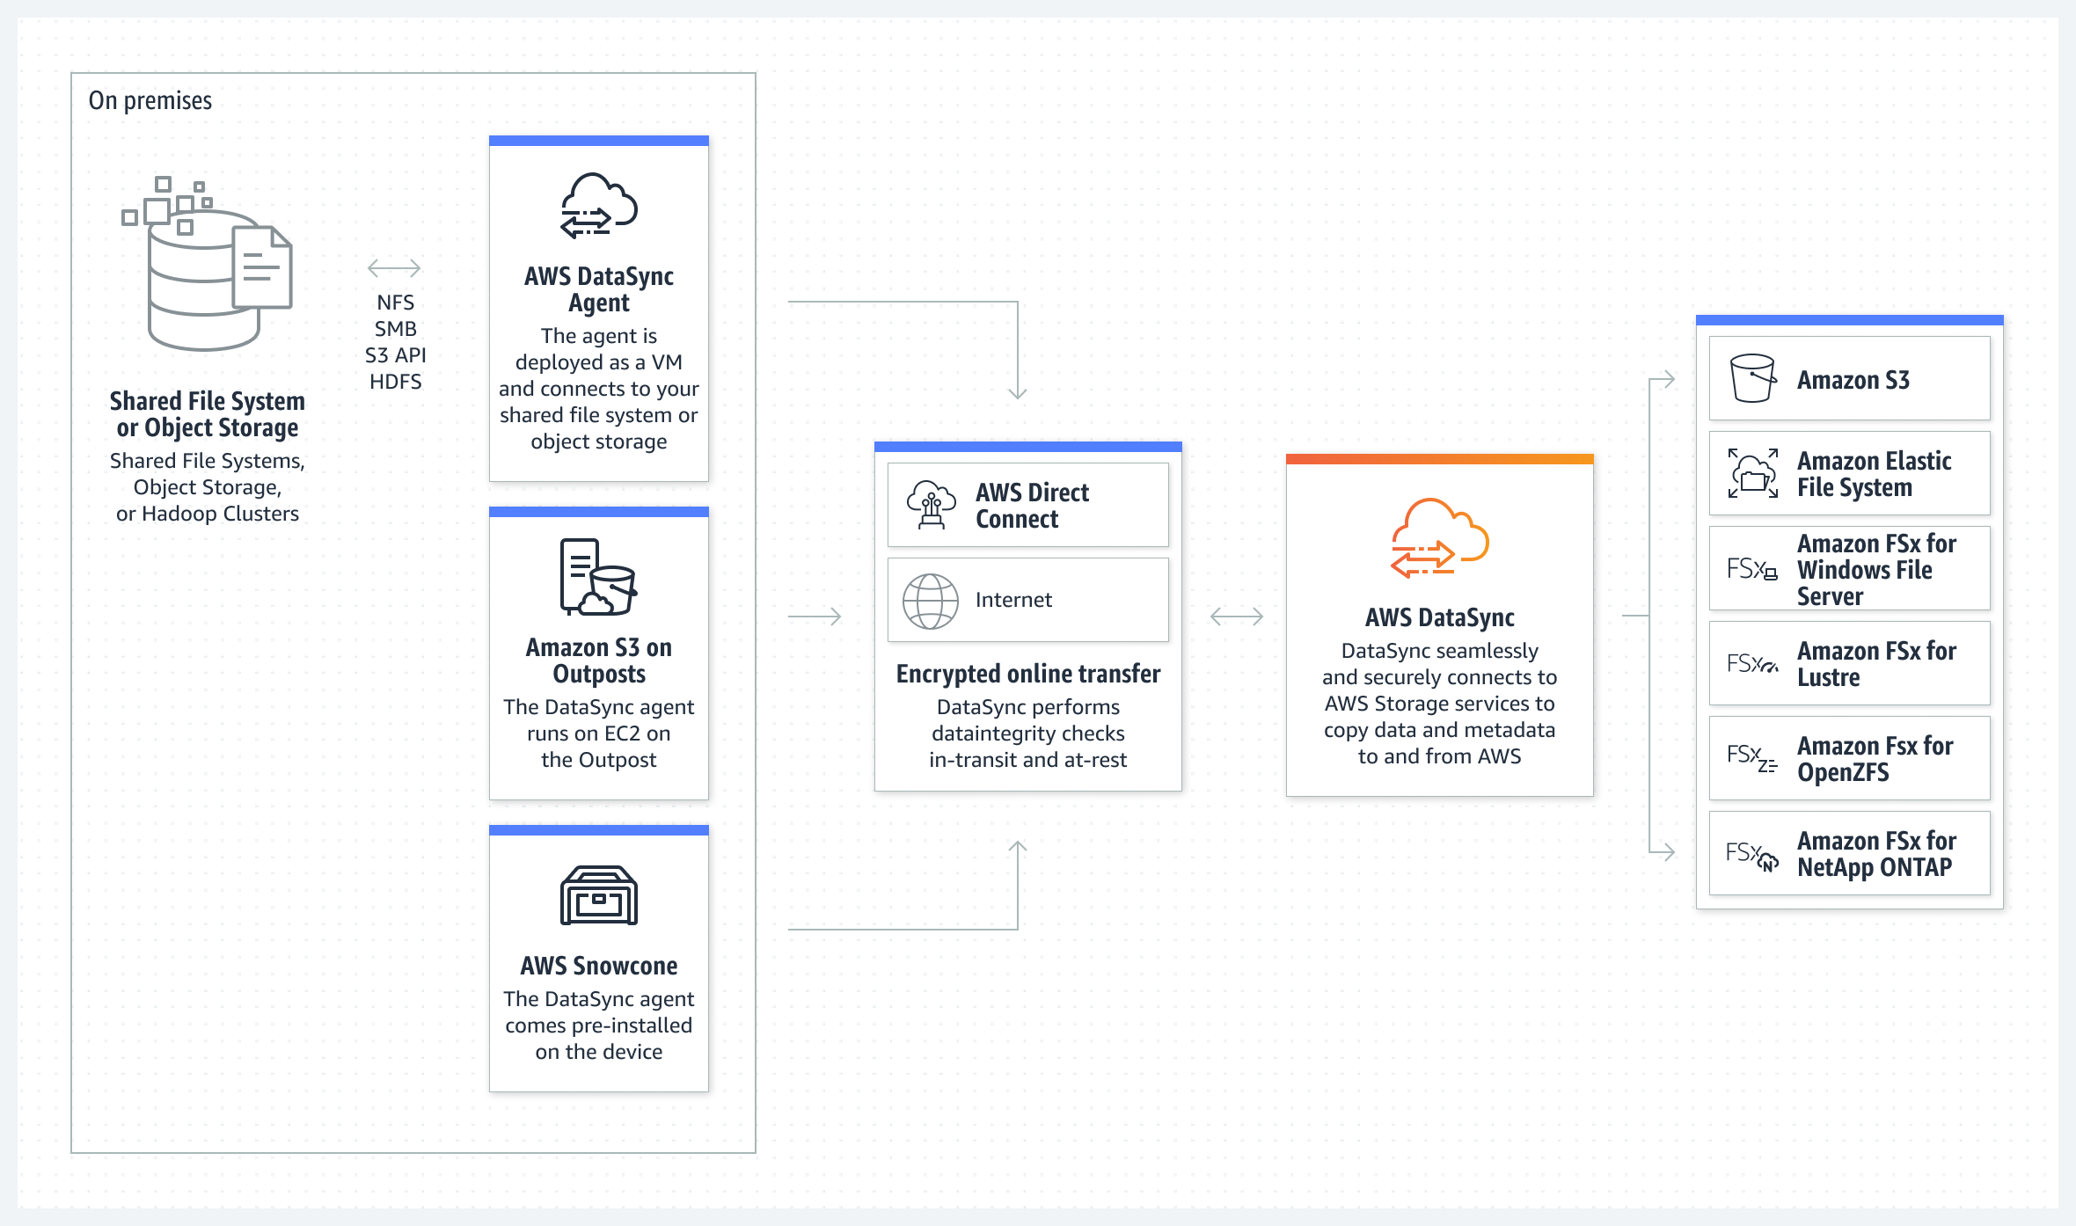
Transfer data between on premises and AWS

Slide 6
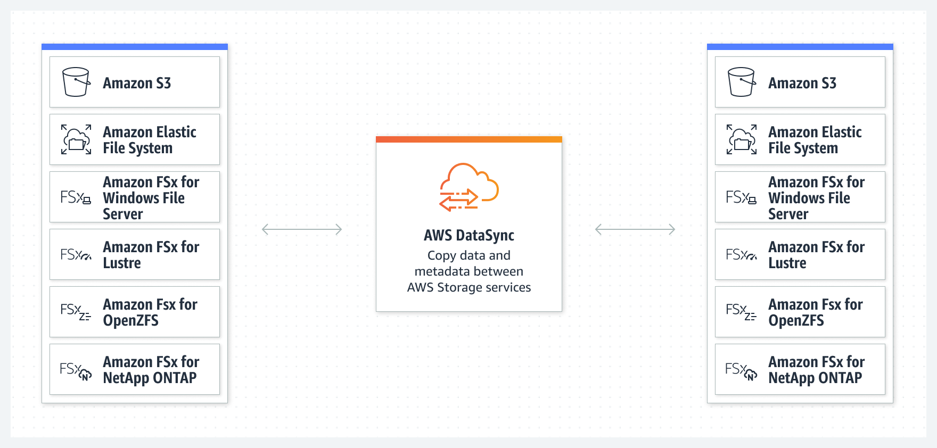
Transfer data between AWS storage services

Slide 7
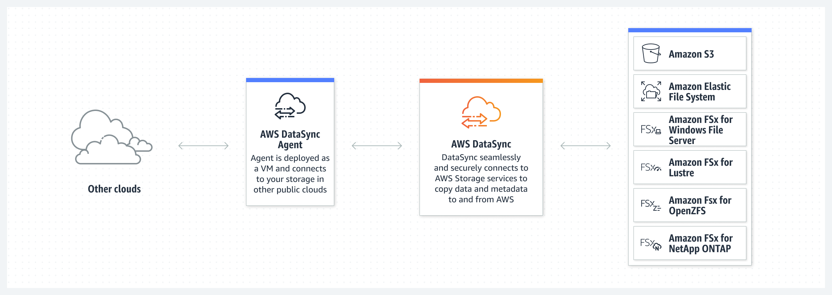
Transfer data between AWS and other locations

Slide 8
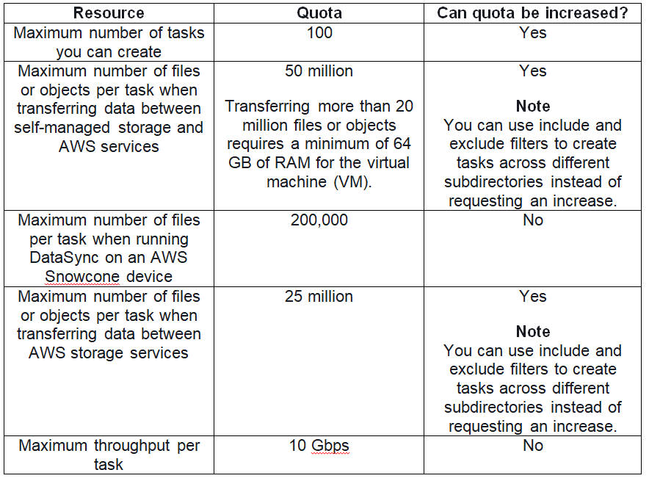
AWS DataSync Limits

Slide 9
AWS Datasync Pricing
DataSync charges a flat fee per gigabyte for network acceleration technology, managed cloud infrastructure, data validation, and automation capabilities.
AWS services, such as Amazon S3, Amazon EFS, Amazon FSx for Windows File Server, and AWS Key Management Service (KMS) charge standard request, storage, and data transfer rates.
You pay AWS Data Transfer at your standard rate when copying data from AWS to an on-premises storage system.
In addition, Amazon CloudWatch Logs, Amazon CloudWatch Events, and Amazon CloudWatch Metrics are charged at standard rates.
The AWS PrivateLink service will charge you for interface VPC endpoints that you create to manage and control traffic between your agent(s) and the DataSync service.
https://aws.amazon.com/datasync/pricing/

