Slide 1

AWS Database Migration Service
Trusted by customers globally to securely migrate 1M+ databases with minimal downtime

Slide 2
AWS DMS
AWS Database Migration Service (AWS DMS) is a cloud service provided by Amazon Web Services designed to make it easier for users to migrate relational databases, data warehouses, NoSQL databases, and other types of data stores to AWS.
AWS DMS can also be used to migrate data between databases in AWS, facilitating migrations from one database engine to another, or for replicating data for continuous synchronization with minimal downtime.
Key Features of AWS DMS
Support for Multiple Database Types:
AWS DMS supports a wide range of source and target databases, including popular relational databases like Oracle, MySQL, PostgreSQL, Microsoft SQL Server, and MariaDB, as well as data warehouses such as Amazon Redshift, and NoSQL databases like MongoDB and DynamoDB.
Minimal Downtime:
DMS is designed to enable migrations with minimal downtime, allowing businesses to continue their operations while the migration is in progress.
This is particularly beneficial for organizations that require their databases to be up and running 24/7.
Continuous Data Replication:
AWS DMS can facilitate ongoing replication from any supported source to any supported target, enabling use cases such as database consolidation, continuous backup, or cross-region disaster recovery.
Simplified Migration Process:
The service simplifies the migration process by managing all aspects of the migration workflow, including the replication of data changes that occur in the source database during the migration process.
Highly Scalable and Secure:
AWS DMS is designed to be scalable, handling large and complex migrations with ease. It also offers encryption at rest and in transit, ensuring that data is secure both during and after the migration.

Slide 3
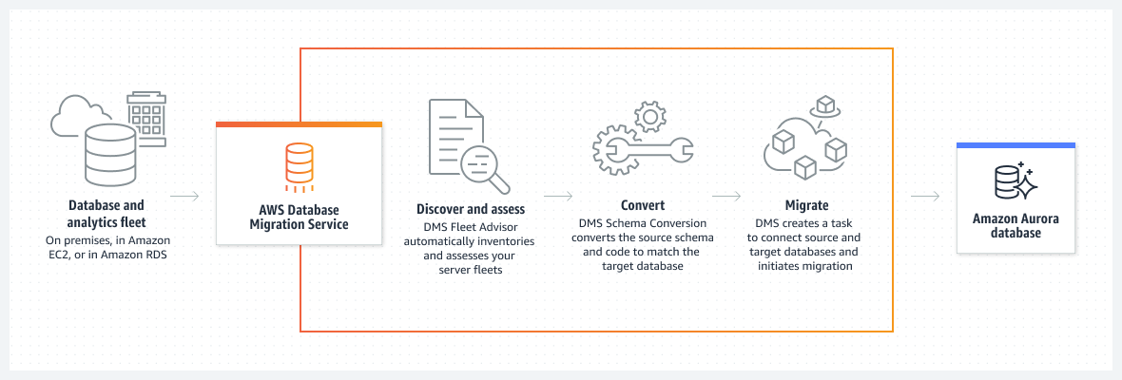
AWS DMS

Slide 4
AWS DMS Use cases
Move to managed databases
Migrate from legacy or on-premises databases to managed cloud services through a simplified migration process, removing undifferentiated database management tasks.
Remove licensing costs and accelerate business growth
Modernize to purpose-built databases to innovate and build faster for any use case at scale for one-tenth the cost.
Replicate ongoing changes
Create redundancies of business-critical databases and data stores to minimize downtime and protect against any data loss.
Improve integration with data lakes
Build data lakes and perform real-time processing on change data from your data stores.

Slide 5
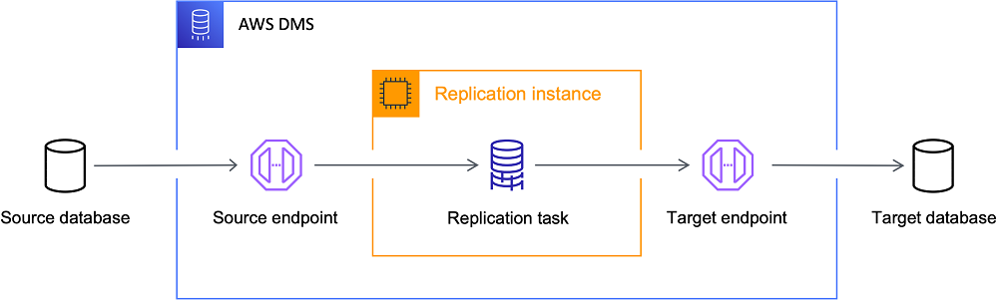
AWS DMS Replication Process

Slide 6
AWS DMS High Level view
Discover databases in your network environment that are good candidates for migration.
Automatically convert your source database schemas and most of the database code objects to a format compatible with the target database.
Create a replication server.
Create source and target endpoints that have connection information about your data stores.
Create one or more migration tasks to migrate data between the source and target data stores.

Slide 7
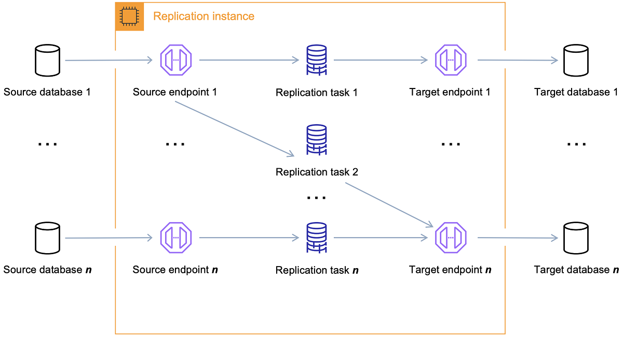
Components of AWS DMS
An AWS DMS migration consists of five components:
discovery of databases to migrate
automatic schema conversion
replication instance
source and target endpoints
replication task

Slide 8
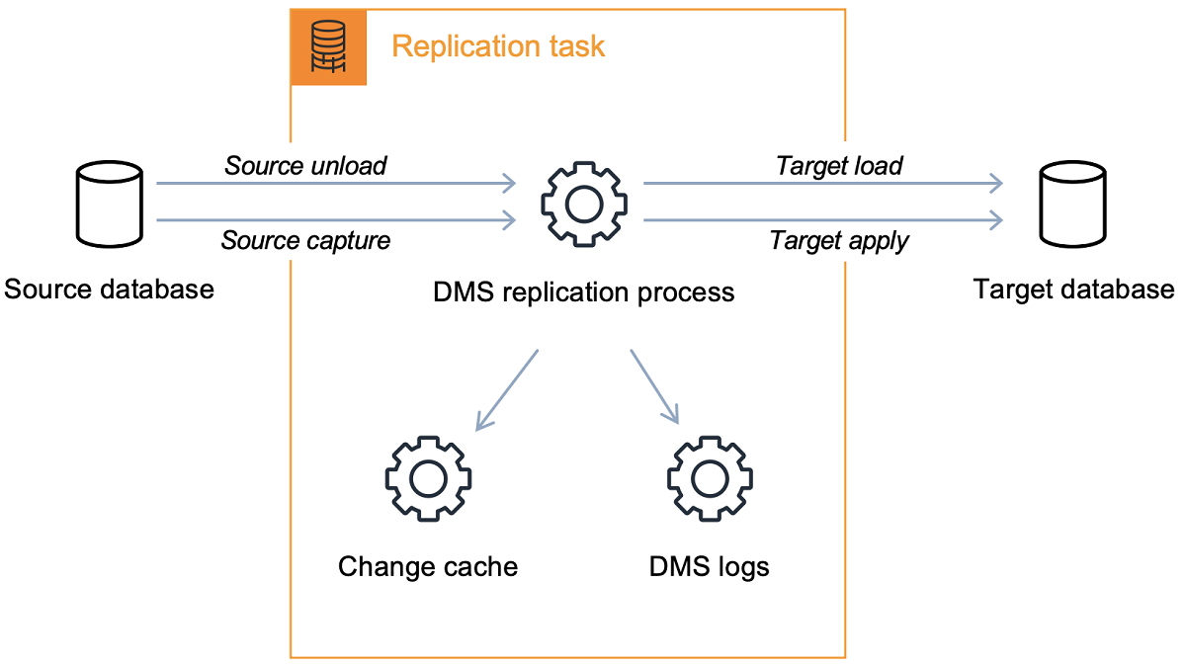
AWS DMS Replication Task
You use an AWS DMS replication task to move a set of data from the source endpoint to the target endpoint.
Creating a replication task is the last step you need to take before you start a migration.
The full load process is straight-forward to understand.
Data is extracted from the source in a bulk extract manner and loaded directly into the target.
You can specify the number of tables to extract and load in parallel on the AWS DMS console under Advanced Settings.

Slide 9
AWS DMS Schema Conversion
DMS Schema Conversion in AWS Database Migration Service (AWS DMS) makes database migrations between different types of databases more predictable.
Use DMS Schema Conversion to assess the complexity of your migration for your source data provider, and to convert database schemas and code objects.
You can then apply the converted code to your target database.
DMS Schema Conversion automatically converts your source database schemas and most of the database code objects to a format compatible with the target database.
This conversion includes tables, views, stored procedures, functions, data types, synonyms, and so on.
Any objects that DMS Schema Conversion can't convert automatically are clearly marked.
To complete the migration, you can convert these objects manually.

Slide 10
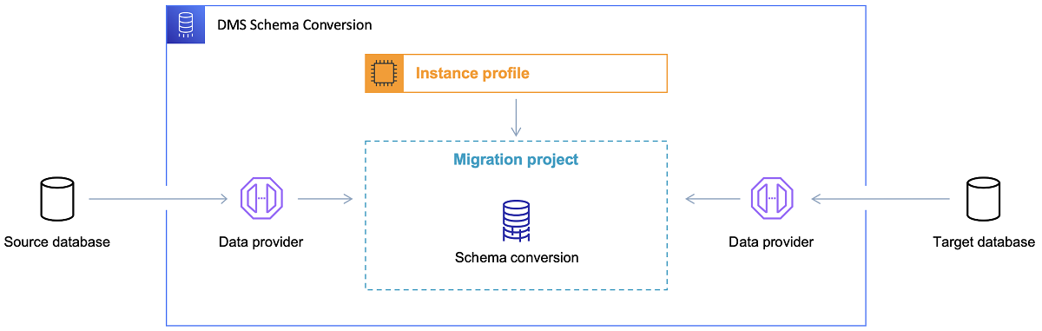
AWS DMS Schema Conversion

Slide 11
AWS DMS Fleet Advisor Benefits
Build a migration plan in hours instead of weeks
Automatically build database and analytics inventories, analyze them, and create a customized migration plan with virtually no downtime in a few hours instead of weeks or months.
Save on costs associated with migration planning and migrating workloads
Avoid investing in expensive migration experts and third-party tools by automating your inventory and migration planning. Get started with just a few clicks in the AWS Management Console.
Identify databases to migrate at scale with minimal effort
Discover and analyze fleets of database and analytics servers to identify potential AWS migration targets and migrate your fleet to the cloud with minimal effort.

Slide 12
AWS DMS Fleet Advisor Overview
AWS DMS Fleet Advisor is a free, fully managed capability of AWS DMS.
It automates migration planning and helps you migrate database and analytics fleets to the cloud at scale with minimal effort.
To accelerate migrations, AWS DMS Fleet Advisor automatically inventories and assesses your on-premises database and analytics server fleet and identifies potential migration paths.
Fleet Advisor can also gather performance metrics and usage patterns of self-managed databases and combines this information with database license and feature information to recommend potential database engine and instance options for migration to AWS.
DMS helps you confidently migrate your databases and analytics systems to AWS with virtually no downtime.
Sources: Oracle, Microsoft SQL Server, MySQL, PostgreSQL, and more.

Slide 13
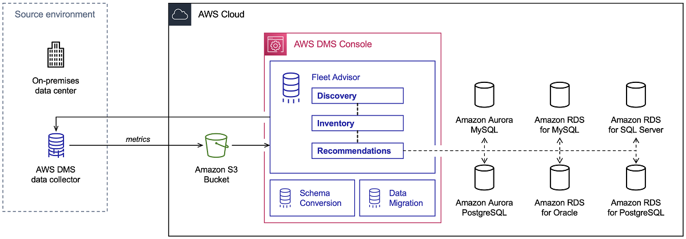
AWS DMS Fleet Advisor
Accelerate database and analytics migration planning by automating inventory and receiving tailored migration advice

Slide 14
Benefits of AWS Database Migration Service
AWS DMS is serverless and can deploy, maintain, and monitor all hardware and software required for migration automatically, allowing you to eliminate traditional duties such as capacity analysis, hardware, and software procurement, system installation and administration, and system testing/debugging.
Sources: Oracle, SQL Server, PostgreSQL, MySQL, Amazon Redshift, SAP ASE, Amazon S3, and Amazon DynamoDB are among the targets supported by AWS DMS.
Minimal downtime – DMS constantly transfers the modifications to your data source during the migration process while keeping it functioning. As a result, you can change databases at any time without having to shut down.
Reliability – Database Migration Service is a self-healing service that, in the event of an interruption, will start again right away. For disaster recovery, DMS enables you to configure Multi-AZ (availability zone) replica.
Supports Most Notable Databases – Your data may be moved across the most well-liked corporate and accessible databases with the help of AWS Database Migration Service.
Low cost – Data Migration Service is a free migration solution for switching to DocumentDB, Redshift, Aurora, or DynamoDB. You must pay for other databases based on the volume of log storing and the computational load.

