Slide 1

AWS Migration Hub
Discover the tools that you need to simplify your migration and modernization

Slide 2
AWS Migration Hub
AWS Migration Hub provides a central location to monitor and manage migrations to AWS from on-premises environments, other cloud platforms, or different AWS regions.
It is designed to simplify the process of migrating applications, workloads, and databases to AWS by offering a unified view of the entire migration journey.
AWS Migration Hub allows organizations to track the progress of their migrations, making it easier to manage multiple migration projects at once.
Key Features of AWS Migration Hub
Centralized Dashboard:
AWS Migration Hub offers a single place to track the status of migrations across different AWS services and partner tools.
This dashboard provides visibility into the progress of each migration task, helping teams stay informed and coordinate efforts more effectively.
Integration with Migration Tools:
It integrates with various AWS migration services, such as AWS Application Discovery Service, AWS Database Migration Service, AWS Application Migration Service, and others.
Migration Hub also supports third-party migration tools, offering flexibility in choosing the right tools for specific migration needs.
Discovery and Planning Support:
By integrating with AWS Application Discovery Service, Migration Hub helps organizations gather necessary data about their on-premises environments to inform migration planning and strategies.
This includes information on server utilization, dependencies between applications, and more.
Tracking and Progress Monitoring:
Users can monitor the progress of each migration project, including individual applications and servers being migrated.
Migration Hub aggregates statuses and metrics, providing a comprehensive overview of the migration effort.
Flexibility in Migration Approaches:
Migration Hub supports various migration strategies, including rehosting (lift-and-shift), replatforming, and refactoring.
This allows organizations to choose the migration approach that best suits their needs while using the Hub to manage and track the process.

Slide 3
AWS Migration Hub
Access essential discovery, analysis, and planning tools from a single location to build your migration plan.
Accelerate your migration to AWS by building an automated migration factory.
Access AWS expertise to plan your migration and meet your business objectives.
Use proven workflow templates to save time migrating enterprise applications like SAP and Microsoft SQL Server.

Slide 4
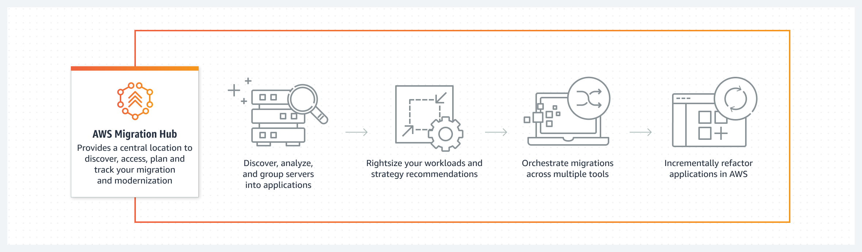
AWS Migration Hub

Slide 5
AWS Migration Hub Use Cases
Assess and plan your migration
Discover applications to determine whether they can be migrated and review modernization strategy recommendations.
Automate lift-and-shift migrations to AWS
End many of the manual tasks involved in migrating large-scale enterprise applications and managing dependencies between different tools.
Refactor legacy applications
Fast-track application refactoring, simplify development, and manage existing applications and microservices as one application.

Slide 6
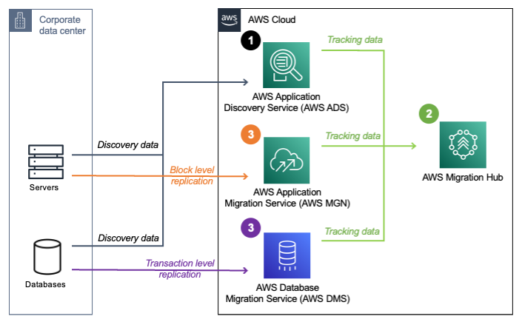
Migration Solution Architecture

Slide 7
AWS Application Discovery Service vs Application Migration service vs AWS Migration Hub
AWS Application Discovery Service
Purpose:
Helps enterprises understand their on-premises, data center architectures by identifying servers, applications, and dependencies.
It's geared towards the initial assessment phase of a migration project.
Functionality:
It collects and presents detailed inventory and configuration data, performance data, and on-premises application dependencies.
This information is critical for planning and optimizing migration strategies.
AWS Application Migration Service (formerly AWS Server Migration Service)
Purpose:
Simplifies and accelerates the migration of applications, servers, and databases to AWS. It's focused on the execution phase of migration projects.
Functionality:
It supports both agentless and agent-based migrations, allowing for various migration strategies such as lift-and-shift, replatforming, or refactoring.
The service automates the migration process, making it easier and faster to move applications to AWS.
AWS Migration Hub
Purpose:
Provides a central location to track the progress of application migrations across multiple AWS and partner solutions.
It's designed to give you visibility and control over the entire migration process.
Functionality:
Centralized Tracking: Allows users to view the status of migrations from a single place, regardless of the AWS tools or partner services used.
Discovery and Planning: Integrates with AWS Application Discovery Service to incorporate the discovered data for planning migrations.
Migration Execution: Works with AWS Application Migration Service and other AWS migration tools to execute and monitor migrations.
Flexibility: Supports migrations using various AWS services and third-party tools, offering flexibility in how migrations are managed and executed.

Slide 8
AWS Application Discovery Service vs Application Migration service vs AWS Migration Hub
Key Differences and How They Work Together
Stage in Migration Process:
Application Discovery Service is used for initial discovery and planning.
Application Migration Service is focused on the actual migration execution.
Migration Hub offers a unified view and management of the entire migration journey, integrating data from both the discovery and migration phases.
Functionality and Focus:
Discovery Service is about understanding and planning;
Migration Service is about executing the migration;
Migration Hub is about overseeing and managing the migration process from start to finish.

