Slide 1
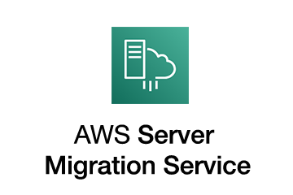
AWS Application Migration Service
Move and improve your on-premises and cloud-based applications

Slide 2
AWS Application Migration Service
AWS Application Migration Service (MGN) is a highly automated lift-and-shift (rehost) solution that simplifies, expedites, and reduces the cost of migrating applications to AWS.
It allows companies to lift-and-shift a large number of physical, virtual, or cloud servers without compatibility issues, performance disruption, or long cutover windows.
MGN replicates source servers into your AWS account.
When you’re ready, it automatically converts and launches your servers on AWS so you can quickly benefit from the cost savings, productivity, resilience, and agility of the Cloud.
Once your applications are running on AWS, you can leverage AWS services and capabilities to quickly and easily replatform or refactor those applications – which makes lift-and-shift a fast route to modernization.
Originally CloudEndure or Server Migration Service was migration tools to replicate the servers from on-prem or other clouds to AWS.
In 2019 AWS acquired CloudEndure and in march 2022 AWS introduce Application Migration service which is became primary migration service for lift-and-shift migration to AWS.
AWS MGN enables the customers to migrate their applications to AWS with minimal downtime and without having to make any changes to the applications and the source servers.

Slide 3
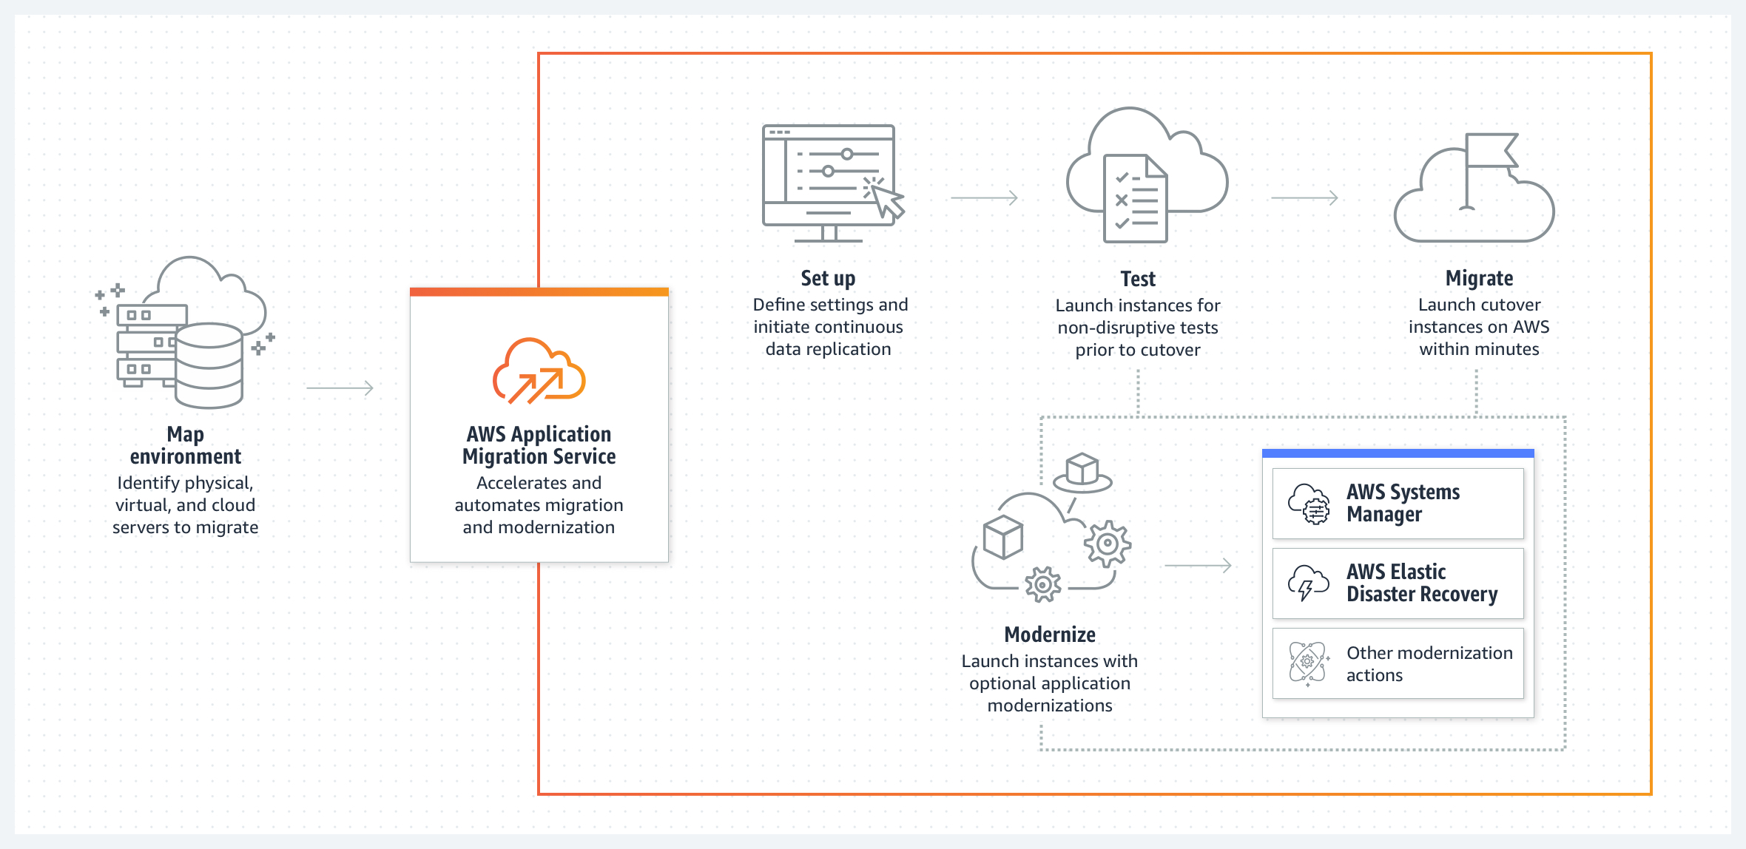
AWS Application Migration Service

Slide 4
AWS Application Migration Service
Agentless Migration: AWS MGN supports agentless migration, which means you don't need to install agents on your source servers.
Continuous Replication: AWS MGN continuously replicates your source server data, including operating system, applications, and data, to AWS. This ensures that your AWS target instances are up to date with the latest changes from your source environment.
Automated Server Conversion: AWS MGN automatically converts source servers into AWS instances, allowing you to choose the target instance type that best matches your requirements.
Integrated with AWS Migration Hub: AWS MGN is integrated with AWS Migration Hub, providing a centralized dashboard for tracking the progress of your migration projects. You can view the status of your applications and servers in one place.
Multi-Server Migrations: AWS MGN supports the migration of multiple servers as part of an application, making it suitable for complex, multi-tier applications.
Testing and Validation: You can perform testing and validation of migrated applications in a staging environment before fully migrating them to AWS.
Zero-Downtime Migration: AWS MGN is designed to minimize downtime during the migration process, allowing you to maintain business continuity.
Application Cutover: You can plan and execute the cutover of your applications to AWS when you are ready, ensuring a smooth transition.
Cost Estimation: AWS MGN provides cost estimation tools to help you understand the cost implications of running your applications in AWS.
Application Dependency Mapping: You can visualize and understand the dependencies between servers and applications to plan your migration effectively.
Security and Compliance: AWS MGN provides security features, such as encryption of data in transit and at rest, to ensure the security of your migrated applications.
Global Reach: AWS MGN is available in multiple AWS regions, allowing you to migrate applications to the AWS region of your choice.

Slide 5
Agentless snapshot based replication for vCenter source environments
AWS Application Migration Service (AWS MGN) allows you to perform agentless snapshot replication from your vCenter source environment into AWS.
This is achieved by installing the AWS MGN vCenter Client in your vCenter environment. AWS MGN recommends using agent-based replication when possible, as it supports CDP (Continuous Data Protection) and provides the shortest cutover window.
Agentless replication should be used when your company’s policies prevent you from installing the AWS Replication Agent on each individual server.
In order to use agentless replication, you must dedicate at least one VM in your vCenter environment to host the AWS MGN vCenter Client. The AWS MGN vCenter Client is a software bundle distributed by AWS MGN and is available for installation as a binary installer. The installation process will install services on the client VM which will allow AWS MGN to remotely discover your VMs that are suitable for agentless replication, and to perform data replication between your vCenter environment and AWS though the use of periodic snapshot shipping.
https://docs.aws.amazon.com/mgn/latest/ug/agentless-mgn.html

Slide 6
Agentless snapshot based replication for vCenter source environments
Agentless snapshot based replication is divided into two main operations: discovery and replication
The discovery process involves periodically scanning your vCenter environment to detect source server VMs that are suitable for agentless replication, and adding these VMs to the AWS MGN Console.
Once a source server has been added, you may choose to initiate agentless replication on the source VM using the MGN API or Console.
The discovery process also collects all of the necessary information from vCenter in order to perform an agentless conversion process once a migration job is launched.
The replication process involves continuously starting and monitoring the “snapshot shipping processes” on the source server VM being replicated.
A “snapshot shipping process” is a long running logical operation which consists of taking a VMware snapshot on the replicated VM, and launching an ephemeral replication agent process which uses VMware’s Changed Block Tracking (CBT) feature to identify changed volume data location, using Virtual Disk Development Kit (VDDK) to read the modified data, and sending the data from the source environment to the customer’s target AWS account.
The first snapshot shipping process performs an “initial sync” which sends the entire disk contents of the replicating VM into AWS.
Following snapshot shipping processes will leverage CBT in order to only sync disk changes to the customer’s target AWS account.
Each successful snapshot shipping process completes the replication operation by creating a group of consistent EBS snapshots in the customer’s AWS account, which can then be used by the customer to launch test and cutover instances through the regular MGN mechanisms.
The following are the main system components of agentless replication:
AWS MGN vCenter Client – A software bundle that is installed on a dedicated VM in your vCenter environment in order to facilitate agentless replication.
vCenter Replication Agent – A java agent that is based on the AWS Replication Agent, which replicates a single VM using VDDK and CBT as the data source instead of the AWS MGN driver (that is used by the AWS Replication Agent)
AWS MGN Service
AWS MGN Console

Slide 7
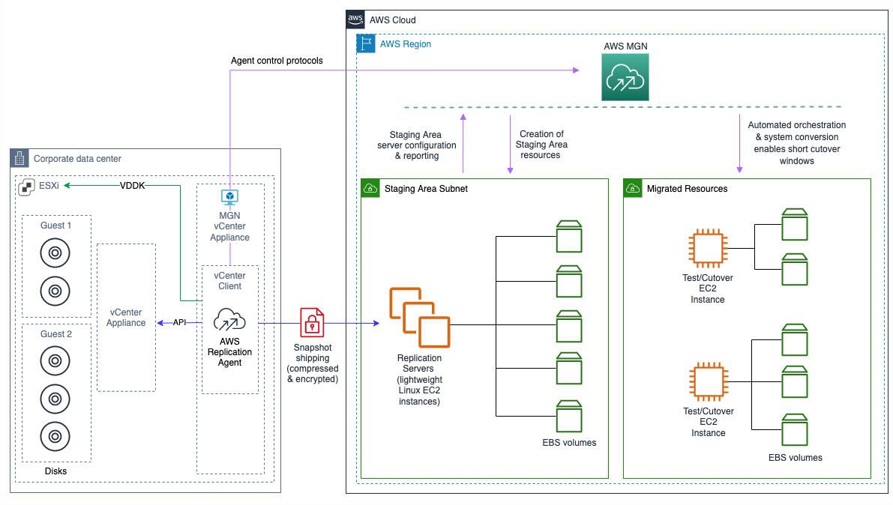
Agentless snapshot based replication for vCenter source environments

Slide 8
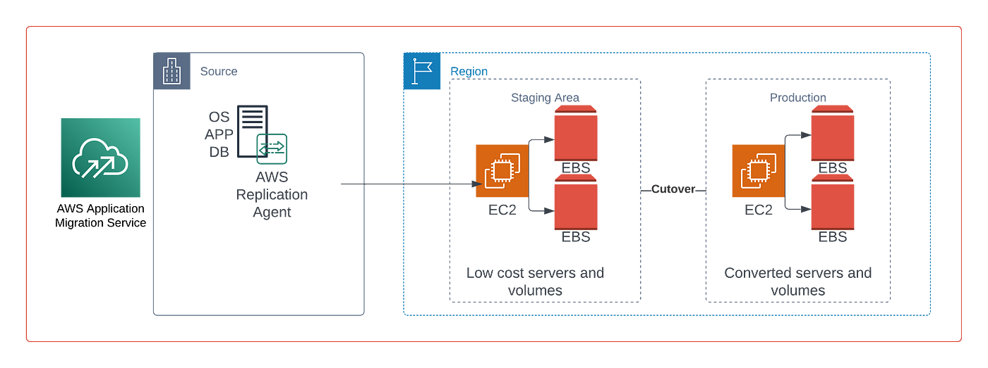
AWS MGN Architecture

Slide 9
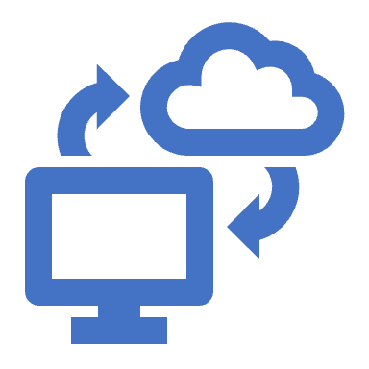
AWS Application Migration Service Use cases
Data center to cloud migration
Use AWS Application Migration Service to rapidly move your virtual and physical servers to AWS.
The automated rehosting capabilities of Application Migration Service help you avoid complications that can be caused by manual replication, reconfiguration, and rebuilds.
Cross-cloud migration
Easily migrate workloads running on another public or private cloud to AWS.
AWS Application Migration Service automatically converts your cloud-based servers to run natively on AWS as EC2 instances.
Cross-region migration
Use AWS Application Migration Service to simplify migration between different AWS accounts, Availability Zones, or regions.

