Slide 1

AWS Snow Family
Process data at the edge or move petabytes of data to and from AWS

Slide 2

AWS Snow Family
The AWS Snow Family is a set of physical devices offered by Amazon Web Services (AWS) to securely transfer large amounts of data into and out of the AWS Cloud when network-based transfer methods are not feasible or practical.
The Snow Family includes several devices designed for different use cases and data transfer scenarios.
AWS Snowcone:
AWS Snowcone is the smallest and most portable member of the Snow Family.
It is a rugged, secure, and lightweight device that can be carried in a backpack or deployed in harsh environments.
Snowcone is designed for edge computing, remote field operations, and scenarios where space and power are limited.
AWS Snowball:
AWS Snowball is a larger, ruggedized data transfer device designed for moving large amounts of data to and from AWS.
It is available in two form factors: the original Snowball and the Snowball Edge.
Snowball devices are equipped with built-in encryption, tamper-resistant enclosures, and secure data transfer protocols.
AWS Snowmobile:
AWS Snowmobile is an exabyte-scale data transfer service designed for large-scale data migrations.
It is a secure, ruggedized shipping container filled with storage devices that can transfer up to 100 petabytes of data per Snowmobile.
Snowmobile is typically used for massive data center migrations, data lake transfers, and other high-volume data transfer scenarios.

Slide 3

AWS Snow Family
Purpose-built devices to cost effectively move petabytes of data, offline.
Lease a Snow device to move your data to the cloud.
Field-tested for the most extreme conditions, delivering high security and ruggedization into compute and storage-compatible devices.
Device options range to optimize for space- or weight-constrained environments, portability, and flexible networking options.

Slide 4
AWS Snow Family Service Models
AWS Snowcone
AWS Snowcone is the most compact and portable device.
Weighing in at 4.5 pounds (2.1 kg) and
available with SSD or HDD options,
Snowcone is ruggedized, secure, and purpose-built for use outside of a traditional data center.
AWS Snowball
AWS Snowball is available as a Compute Optimized device or a Storage Optimized device.
Explore the options best suited for your needs.
All devices are suited for extreme conditions, tamper proof, and highly secure.
AWS Snowmobile
AWS Snowmobile is an Exabyte-scale data migration device used to move extremely large amounts of data to AWS.
Migrate up to 100PB in a 45-foot long ruggedized shipping container, pulled by a semi-trailer truck.

Slide 5
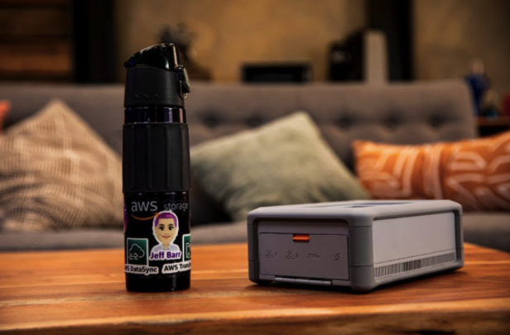
What is AWS Snowcone?
Edge computing – collection and processing of data for real-time insights and then transferring the data to AWS via online and offline methods
Data transfer in factories – data generated by machine sensors can be transferred to AWS
Content aggregation – transferring of media and other scientific data from the edge location to your AWS.
One-time data migration – a simple, fast, and inexpensive transfer of up to 8TB of data into AWS by shipping the Snowcone device to AWS

Slide 6
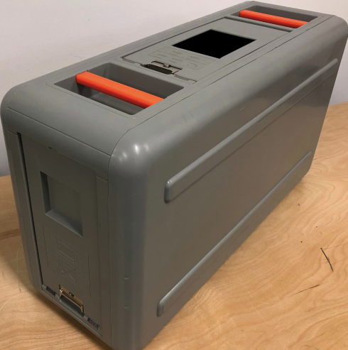
What is AWS Snowball? Use cases
Cloud data migration – you can use Snowball to migrate huge quantities of data into AWS without having to worry about the bandwidth costs.
Secure content dissemination – banks, airlines, studios, hospitals, and other industries that require secure dissemination of data can take advantage of the secure data transfer services of AWS snowball
Machine learning – image labeling, document classification, and other AI applications that require real-time analysis of data can be deployed on AWS snowball.
Data can also be transported from remote locations to support in-cloud machine learning
Manufacturing – on-site data in factories can be collected and analyzed to fine-tune the operations for better efficiency.
The data can then be migrated to AWS for more comprehensive analytics to discover trends and patterns.
Remote location – AWS snowball can be used for pre-processing applications e.g. image tagging, compression, organization, and validation.
The data can be gathered and analyzed remotely to get quick insights and then migrated to AWS later on.

Slide 7
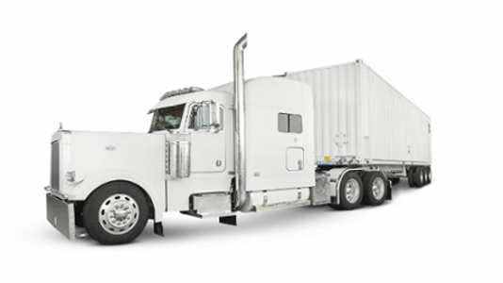
What is AWS Snowmobile?
Shutting down legacy data centers – before you shut down your data center, you will want to make sure you have migrated all your data to the cloud.
The AWS Snowmobile will help you move all your data efficiently and inexpensively.
Huge data migration – Snowmobile can help businesses that collect huge amounts (exabytes of data) from their premises to AWS in a low-cost and yet secure and efficient manner.
Examples of applications include satellite images, genomic sequences, seismic data, video libraries, image repositories, financial data, etc.

Slide 8
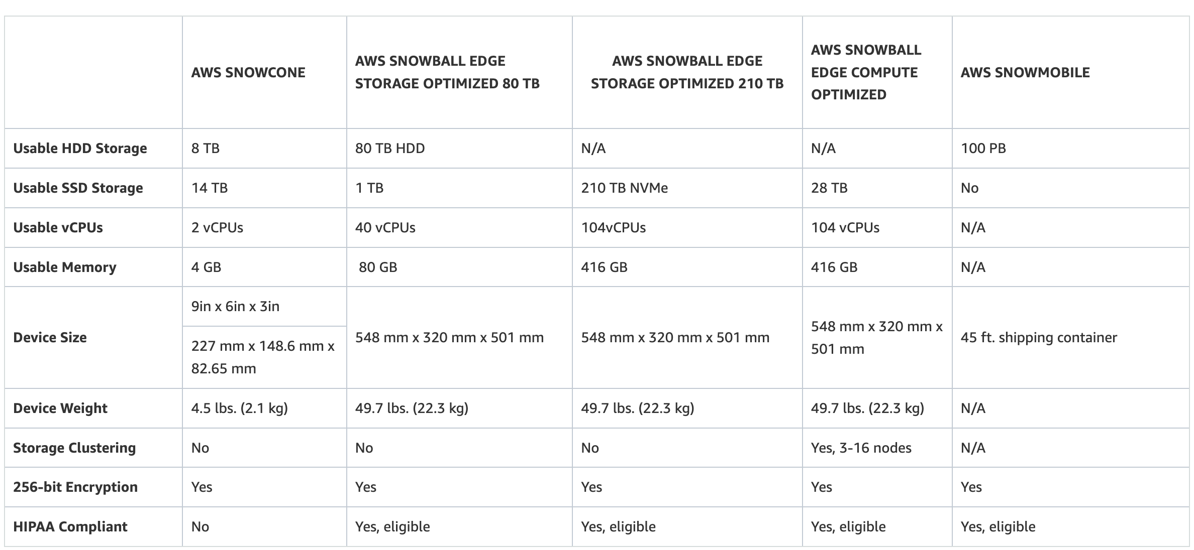
AWS Snow Family Comparison

Slide 9

AWS Snowball Compute vs Storage Optimized
Snowball Edge Storage Optimized
Primary Use: Designed for large-scale data transfer and storage.
Storage Capacity: Offers a higher storage capacity compared to the Compute Optimized version. Typically around 80 TB of usable storage.
Compute Capability: Has some compute functionality but is less powerful than the Compute Optimized version. Suitable for light processing tasks.
Use Cases: Ideal for data migration, transport, and edge local storage where high storage capacity is more important than compute power. Common in media data transfers, data center decommission, or large-scale data collection scenarios.
Snowball Edge Compute Optimized
Primary Use: Focused on providing both data transfer capabilities and more powerful edge computing.
Storage Capacity: Lower storage capacity than the Storage Optimized version, usually around 42 TB of usable storage.
Compute Capability: Features more powerful compute options, including more CPU and GPU power. It's equipped with Amazon EC2 instances and AWS Lambda support for edge computing workloads.
Use Cases: Suitable for situations where both data transfer and on-site data processing or machine learning inference are needed. Commonly used in remote locations, industrial sites, or in situations requiring local processing and real-time decision making
Key Decision Factors
Data Volume vs. Compute Needs: If your primary need is to move large amounts of data with minimal processing, the Storage Optimized version is more suitable. If you need to process data on-site, go with the Compute Optimized version.
Application Requirements: For advanced edge computing tasks such as machine learning, IoT, and real-time analytics, the Compute Optimized variant is the better choice.
Budget and Cost: The cost can vary based on the type of device and the duration of the usage. It's important to consider both the storage and compute needs against the budget available.

