Slide 1

AWS Transfer Family
Easily manage and share data with simple, secure, and scalable file transfers

Slide 2
AWS Transfer Family Overview
AWS Transfer Family is a secure transfer service that enables you to transfer files into and out of AWS storage services.
AWS Transfer Family is a fully managed service that enables the secure transfer of files into and out of Amazon S3 and Amazon EFS (Elastic File System).
AWS Transfer Family supports transferring data over the following protocols:
Secure Shell (SSH) File Transfer Protocol (SFTP): version 3
File Transfer Protocol Secure (FTPS)
File Transfer Protocol (FTP)
Applicability Statement 2 (AS2)

Slide 3
AWS Transfer Family Use Case
Background: A large healthcare organization operates multiple hospitals and research facilities. They regularly generate and share a vast amount of medical imaging data, such as MRI, CT scans, and X-rays, which are critical for patient diagnosis and treatment, as well as for medical research.
Challenge: Medical images are large files and often need to be shared securely and quickly between different hospitals, research institutions, and specialists for various purposes:
Patient Care: Quick and secure transfer of patient imaging data is essential for timely diagnosis and treatment, especially in cases requiring specialist consultation.
Research Collaboration: For research purposes, de-identified medical images need to be shared with research partners and institutions globally.
Compliance with Health Data Regulations: The transfer and storage of medical data are subject to strict regulations like HIPAA (Health Insurance Portability and Accountability Act) in the United States.
Data Integrity and Security: Ensuring the integrity and security of medical data during transfer is paramount to maintain patient confidentiality and trust.
Solution with AWS Transfer Family:
Secure and Compliant Data Transfer: The healthcare organization uses AWS Transfer Family to securely transfer medical imaging files to Amazon S3. The service ensures compliance with HIPAA and other health data regulations.
Integration with AWS Services for Data Processing and Analysis: Once in S3, these images can be integrated with other AWS services for processing, analysis, and machine learning purposes, assisting in both patient care and research.
User Authentication and Access Control: They set up role-based access controls and user authentication to ensure that only authorized personnel can access or transfer specific data sets, maintaining patient privacy.
Scalable and Reliable Transfer Mechanism: AWS Transfer Family's scalability ensures efficient handling of the high volume of imaging data, and its high reliability minimizes the risk of data transfer failures or delays.
Global Accessibility for Collaboration: The solution allows for global access, enabling specialists from around the world to access necessary imaging data for collaborative diagnosis or research.
Outcome:
The healthcare organization manages to transfer large medical imaging files quickly and securely across its network and to external partners.
They maintain compliance with healthcare data regulations, ensuring patient data security and privacy.
The integration with AWS services streamlines the workflow from image acquisition to analysis, improving both patient care and research capabilities.

Slide 4
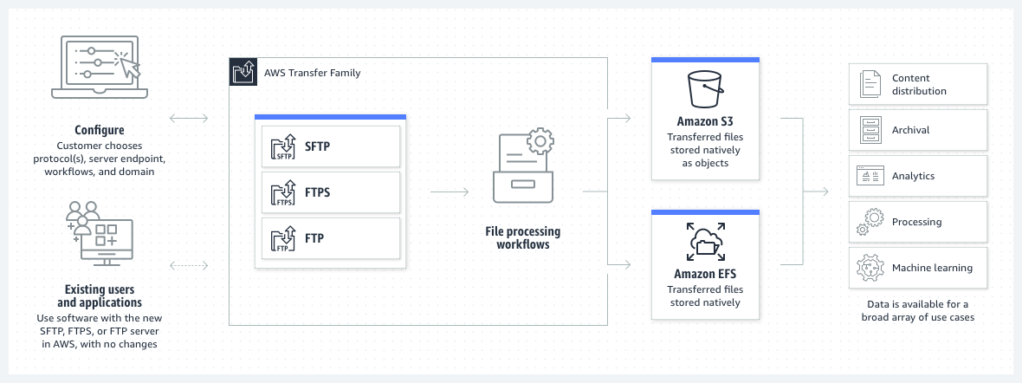
AWS Transfer Family Endpoints for file sharing

Slide 5
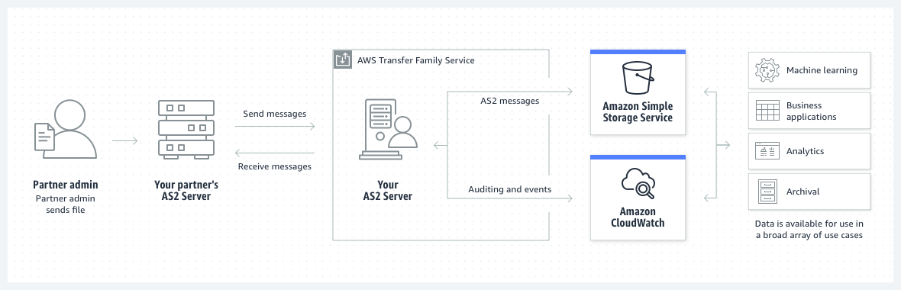
AWS Transfer Family Applicability Statement 2

Slide 6
What is AS2?
AS2 (Applicability Statement 2) is a http based protocol to transmit messages (especially EDI-Electronic data interchange messages) safely, cheaply and quickly.
In the last 20 years AS2 has become the most widely used protocol for EDI in many industries, such as the retail and the consumer goods industry.
To establish an AS2 connection you need two computers, a server and a client. Both connect to the Internet via a point-to-point connection.
In order to transmit the desired data, AS2 creates an ‘envelope’ that enables secure transmission via the Internet using digital certificates and encryption.

Slide 7
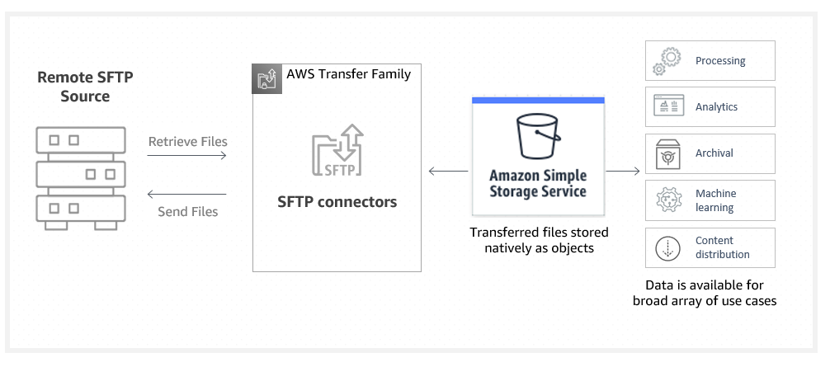
AWS Transfer Family SFTP connectors

Slide 8
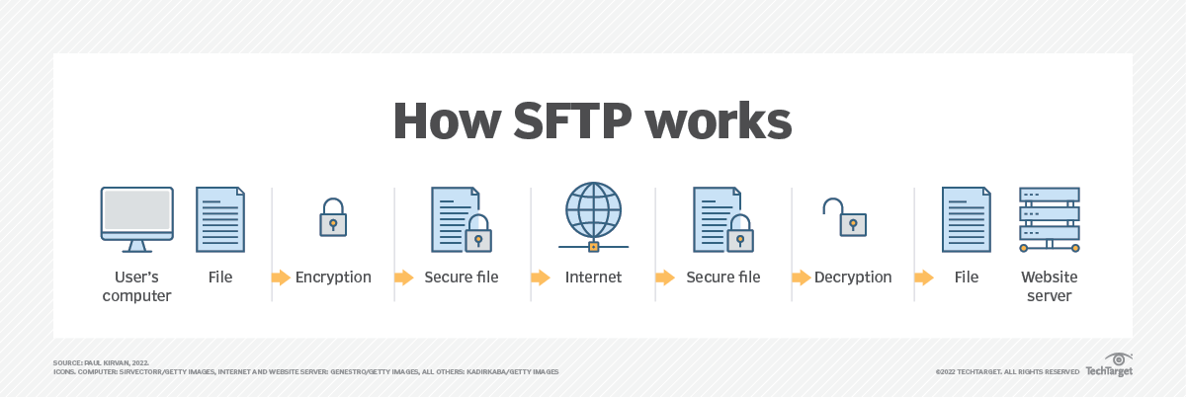
What is SFTP?
Secure File Transfer Protocol (SFTP) is a network protocol for securely accessing, transferring and managing large files and sensitive data.
Designed by the Internet Engineering Task Force as an extension of Secure Shell (SSH), SFTP enables access, transfer and management of files over a network.
It's used for secure file transfers over Transport Layer Security and the transfer of data for virtual private network (VPN) applications.

Slide 9
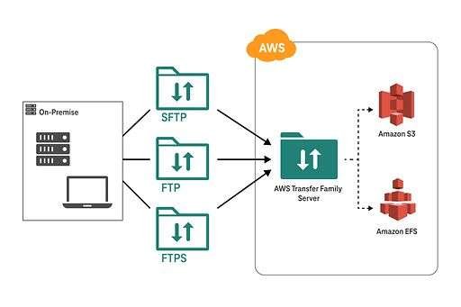
AWS Transfer Family Architecture

Slide 10
AWS Transfer Family vs AWS Storage Gateway
AWS Transfer Family:
Purpose:
AWS Transfer Family is a fully managed service that enables the transfer of files over the Secure File Transfer Protocol (SFTP), FTPS, and FTP protocols directly into and out of Amazon S3 or Amazon EFS.
It simplifies the process of migrating file transfer workloads to AWS without the need to manage underlying infrastructure.
Use Cases:
AWS Transfer Family is suitable for organizations that need to securely transfer files between on-premises systems and AWS storage services, such as backup and recovery, data ingestion, content distribution, and data exchange with partners or customers.
Managed Service:
AWS Transfer Family is a fully managed service, meaning AWS handles the underlying infrastructure, scaling, security, and maintenance tasks, allowing customers to focus on their file transfer workflows.
Integration with S3 and EFS:
AWS Transfer Family integrates seamlessly with Amazon S3 and Amazon EFS, providing scalable and durable storage options for transferred files.
AWS Storage Gateway:
Purpose:
AWS Storage Gateway is a hybrid cloud storage service that enables seamless integration between on-premises environments and AWS storage services.
It provides three different types of storage gateways: File Gateway, Volume Gateway, and Tape Gateway, each serving different storage use cases.
Use Cases:
AWS Storage Gateway is suitable for organizations that need to extend their on-premises storage to AWS, implement hybrid cloud storage architectures, enable cloud-backed file shares, perform data backup and archive, and integrate with other AWS services.
Storage Protocols:
Storage Gateway supports different storage protocols, including NFS, SMB, iSCSI, and Virtual Tape Library (VTL), allowing applications running on-premises to access AWS storage services using familiar interfaces.
Deployment Options:
AWS Storage Gateway can be deployed as a virtual appliance on-premises, in VMware or Microsoft Hyper-V environments, or as a hardware appliance in AWS Direct Connect locations.
Storage Tiers:
Storage Gateway provides options to tier data between on-premises storage and AWS storage services, allowing organizations to optimize costs based on access patterns and performance requirements.
AWS Transfer Family is focused on file transfer protocols and direct integration with S3 and EFS,
while AWS Storage Gateway provides a broader range of storage gateway options for hybrid cloud storage scenarios, including file, volume, and tape storage.

