Slide 1
Route53

Slide 2
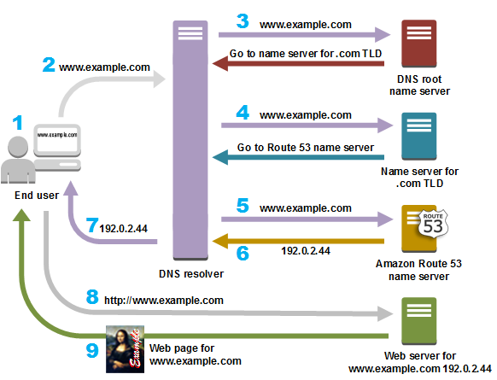
What is DNS?
The domain name system (DNS) is a naming database in which internet domain names are located and translated into IP-addresses.
The domain name system maps the name people use to locate a website to the IP address that a computer uses to locate that website.
For example, if someone types "example.com" into a web browser, a server behind the scenes maps that name to the corresponding IP address.
An IP address is similar in structure to 203.0.113.72.

Slide 3
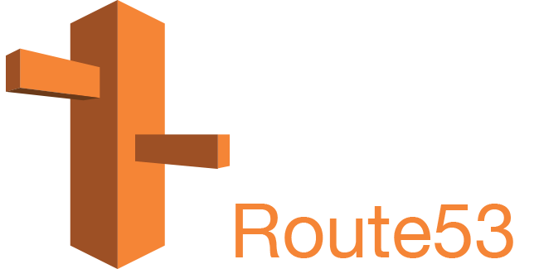
What is Amazon Route 53?
Amazon Route 53 is a highly available and scalable Domain Name System (DNS) web service.
You can use Route 53 to perform three main functions in any combination: domain registration, DNS routing, and health checking.
If you choose to use Route 53 for all three functions, be sure to follow the order below:
1. Register domain names
Your website needs a name, such as example.com. Route 53 lets you register a name for your website or web application, known as a domain name.
2. Route internet traffic to the resources for your domain
When a user opens a web browser and enters your domain name (example.com) or subdomain name (acme.example.com) in the address bar, Route 53 helps connect the browser with your website or web application.
3. Check the health of your resources
Route 53 sends automated requests over the internet to a resource, such as a web server, to verify that it's reachable, available, and functional.
You also can choose to receive notifications when a resource becomes unavailable and choose to route internet traffic away from unhealthy resources.

Slide 4
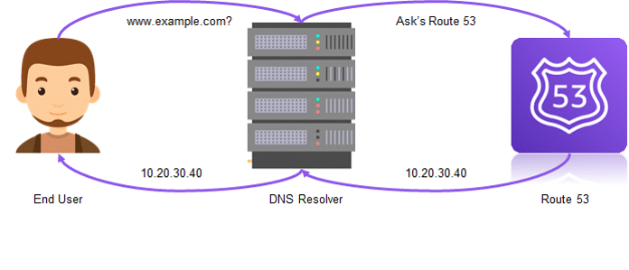
What is Amazon Route 53?
Amazon Route 53 is a highly available and scalable Domain Name System (DNS) web service.
Route 53 performs four main functions:
Domain registration – Route 53 helps lets you register domain names such as example.com.
Domain Name System (DNS) service – Route 53 translates friendly domains names like www.example.com into IP addresses like 192.0.2.1. Route 53 responds to DNS queries using a global network of authoritative DNS servers, which reduces latency.
Health checking – Route 53 sends automated requests over the internet to your application to verify that it's reachable, available, and functional.
Resolver – Route 53 Resolver lets you forward DNS queries from a VPC that you created using Amazon VPC to DNS resolvers in your network, and from your network to resolvers in your VPC.

Slide 5
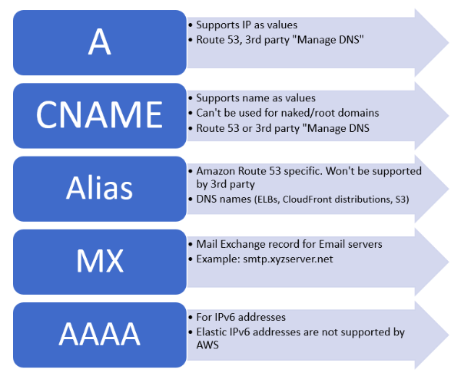
Record type
Route 53 provides an extension to DNS functionality known as alias records.
Similar to CNAME records, alias records let you route traffic to selected AWS resources, such as CloudFront distributions and Amazon S3 buckets.

Slide 6
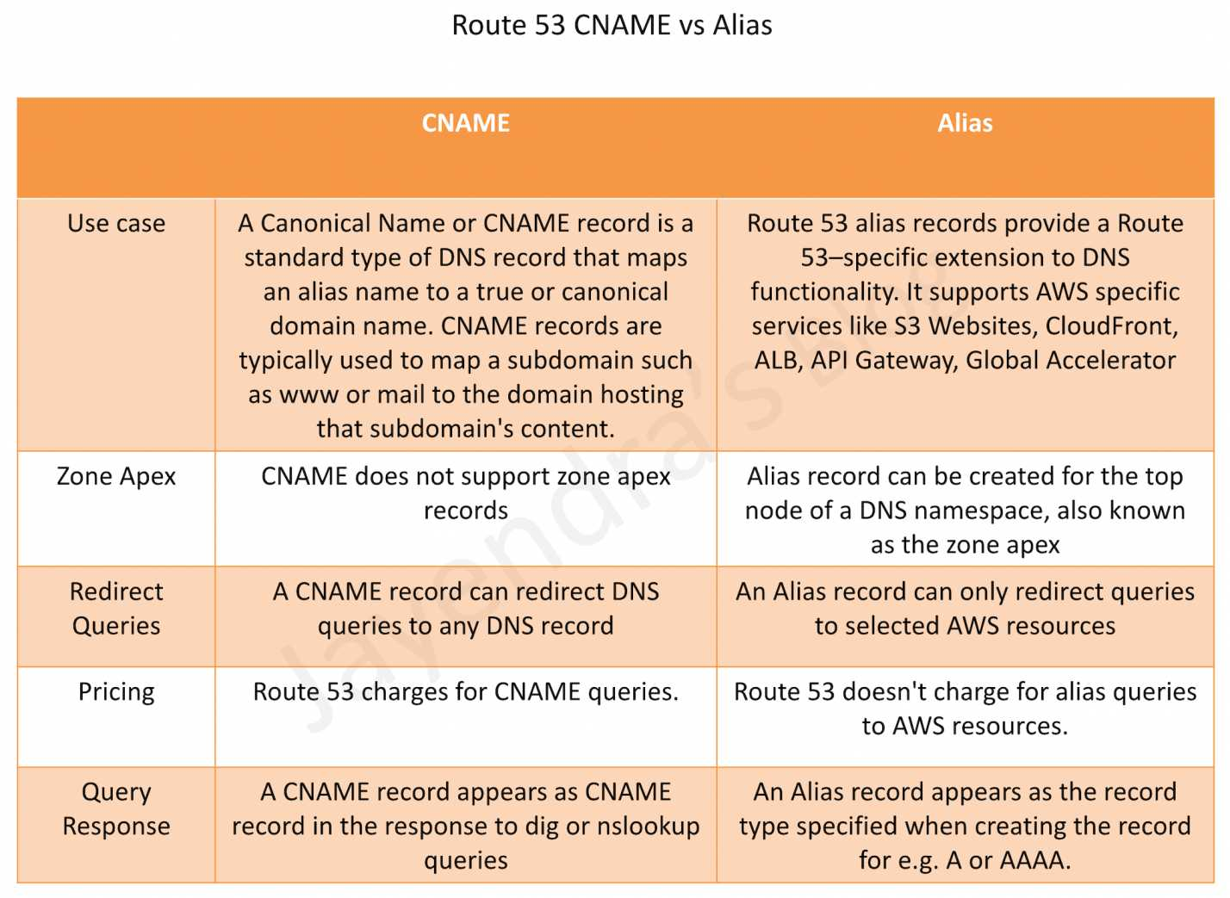

Slide 7
Routing Policies
When you create a record, you choose a routing policy, which determines how Amazon Route 53 responds to queries:
Simple routing policy
Failover routing policy
Geolocation routing policy
Geoproximity routing policy
Latency routing policy
IP-based routing policy
Multivalue answer routing policy
Weighted routing policy

Slide 8
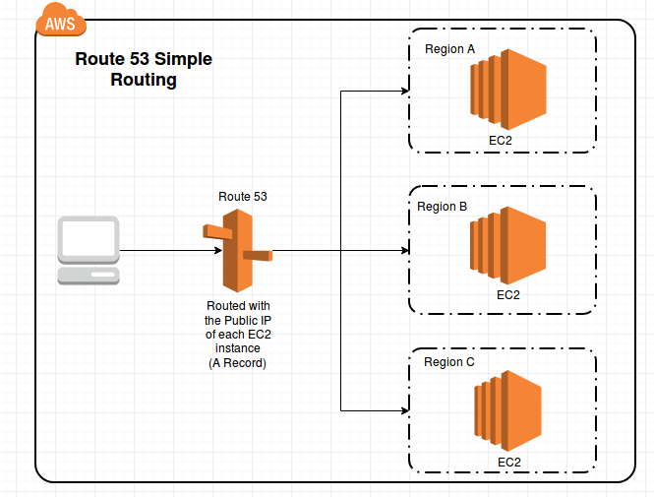
Simple routing
Simple routing lets you configure standard DNS records, with no special Route 53 routing such as weighted or latency.
With simple routing, you typically route traffic to a single resource, for example, to a web server for your website.
You can use simple routing policy for records in a private hosted zone.

Slide 9
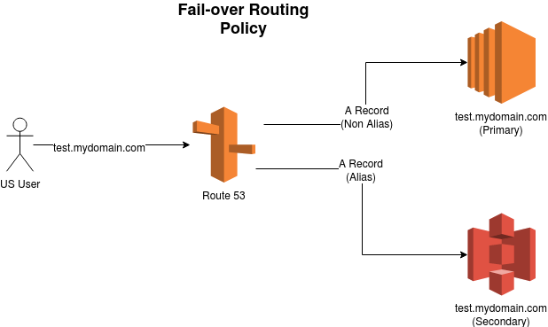
Failover routing
Failover routing lets you route traffic to a resource when the resource is healthy or to a different resource when the first resource is unhealthy.
The primary and secondary records can route traffic to anything from an Amazon S3 bucket that is configured as a website to a complex tree of records
You can use failover routing policy for records in a private hosted zone.

Slide 10
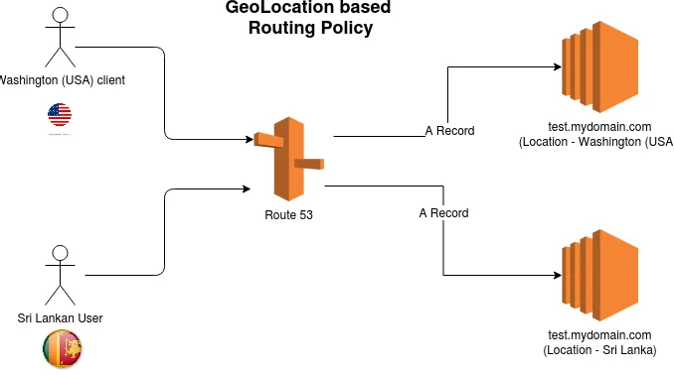
Geolocation routing
Geolocation routing lets you choose the resources that serve your traffic based on the geographic location of your users, meaning the location that DNS queries originate from.
For example, you might want all queries from Europe to be routed to an Elastic Load Balancing load balancer in the Frankfurt Region.
When you use geolocation routing, you can localize your content and present some or all of your website in the language of your users.
You can also use geolocation routing to restrict distribution of content to only the locations in which you have distribution rights.
Another possible use is for balancing load across endpoints in a predictable, easy-to-manage way, so that each user location is consistently routed to the same endpoint.
You can use geolocation routing policy for records in a private hosted zone.

Slide 11
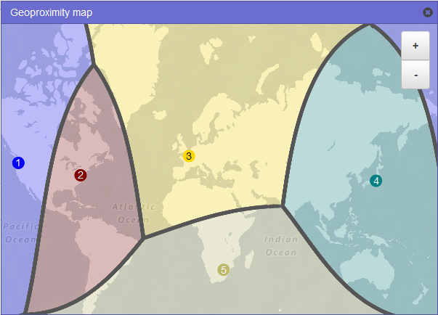
Geoproximity routing (traffic flow only)
Geoproximity routing lets Amazon Route 53 route traffic to your resources based on the geographic location of your users and your resources.
You can also optionally choose to route more traffic or less traffic to a given resource by specifying a value, known as a bias.
A bias expands or shrinks the size of the geographic region from which traffic is routed to a resource.
To use geoproximity routing, you must use Route 53 traffic flow.
You create geoproximity rules for your resources and specify one of the following values for each rule:
If you're using AWS resources, specify the AWS Region or Local Zone that you created the resource in.
If you're using non-AWS resources, specify the latitude and longitude of the resource.
To use AWS Local Zones, you have to first enable them.
You cannot use geoproximity routing policy for records in a private hosted zone.

Slide 12
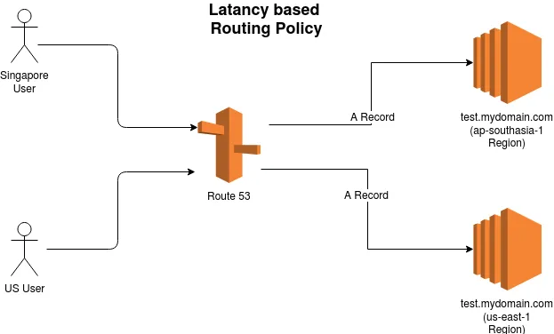
Latency-based routing
If your application is hosted in multiple AWS Regions, you can improve performance for your users by serving their requests from the AWS Region that provides the lowest latency.
To use latency-based routing, you create latency records for your resources in multiple AWS Regions.
When Route 53 receives a DNS query for your domain or subdomain (example.com or acme.example.com), it determines which AWS Regions you've created latency records for, determines which Region gives the user the lowest latency, and then selects a latency record for that Region.
Route 53 responds with the value from the selected record, such as the IP address for a web server.

Slide 13
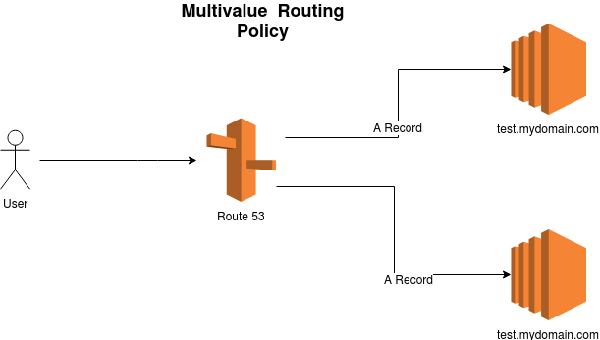
Multivalue answer routing
Multivalue answer routing lets you configure Amazon Route 53 to return multiple values, such as IP addresses for your web servers, in response to DNS queries.
You can specify multiple values for almost any record, but multivalue answer routing also lets you check the health of each resource, so Route 53 returns only values for healthy resources.
It's not a substitute for a load balancer, but the ability to return multiple health-checkable IP addresses is a way to use DNS to improve availability and load balancing.
Note the following:
If you associate a health check with a multivalue answer record, Route 53 responds to DNS queries with the corresponding IP address only when the health check is healthy.
If you don't associate a health check with a multivalue answer record, Route 53 always considers the record to be healthy.
If you have eight or fewer healthy records, Route 53 responds to all DNS queries with all the healthy records.
When all records are unhealthy, Route 53 responds to DNS queries with up to eight unhealthy records.
You can use multivalue answer routing policy for records in a private hosted zone.

Slide 14
IP-based routing
With IP-based routing in Amazon Route 53, you can fine-tune your DNS routing by using your understanding of your network, applications, and clients to make the best DNS routing decisions for your end users.
IP-based routing gives you granular control to optimize performance or reduce network costs by uploading your data to Route 53 in the form of user-IP-to-endpoint mappings.
Geolocation and latency-based routing is based on data that Route 53 collects and keeps up to date.
This approach works well for the majority of customers, but IP-based routing offers you the additional ability to optimize routing based on specific knowledge of your customer base.
Common use-cases for IP-based routing are the following:
You want to route end users from certain ISPs to specific endpoints so you can optimize network transit costs or performance.
You want to add overrides to existing Route 53 routing types, such as geolocation routing, based on your knowledge of your clients' physical locations.

Slide 15
IP-based routing
Geographic Traffic Control:
IP-based routing can be used to route traffic from specific geographic regions or countries to different resources.
For example, you can route traffic from North America to one set of servers and traffic from Europe to another set.
This allows you to tailor the user experience based on the location of the user.
Regional Failover:
You can use IP-based routing to implement regional failover.
If you have resources in different AWS regions, you can route traffic to a secondary region in the event of a failure in the primary region.
By monitoring the health of your primary region, you can automatically fail over to the secondary region when necessary.
Traffic Segmentation:
If you want to segment your traffic based on specific criteria, such as the type of user or application, IP-based routing can help.
For example, you might route traffic from internal corporate users to one set of servers and traffic from external users to another.
Security and Access Control:
IP-based routing can be used for access control and security purposes.
You can restrict access to specific resources based on the source IP address of the incoming requests.
This can help protect your resources from unauthorized access.
Load Distribution:
By routing traffic based on the source IP address, you can distribute the load across different resources or regions.
This can help balance the traffic and prevent overloading of specific resources.
Customized Experiences:
You can provide customized experiences to different sets of users based on their IP address.
For example, you might serve different content or applications to users from different IP ranges.
IP Whitelisting/Blacklisting:
IP-based routing allows you to whitelist or blacklist specific IP addresses or ranges.
This can be useful for controlling which IP addresses are allowed to access your services or for blocking malicious traffic.
Compliance Requirements:
Some compliance requirements or industry regulations may necessitate routing traffic based on the geographic location of users.
IP-based routing can help you meet these requirements.

Slide 16
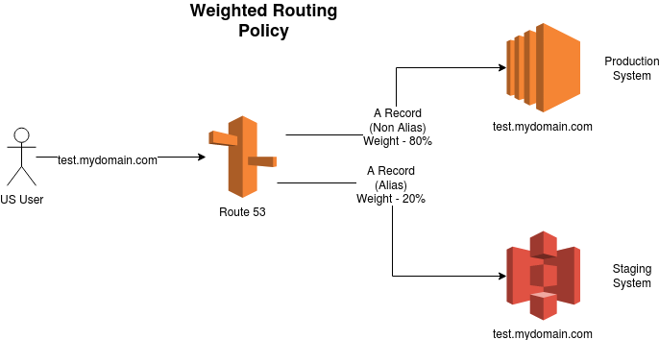

Weighted routing
Weighted routing lets you associate multiple resources with a single domain name (example.com) or subdomain name (acme.example.com) and choose how much traffic is routed to each resource.
This can be useful for a variety of purposes, including load balancing and testing new versions of software.
To configure weighted routing, you create records that have the same name and type for each of your resources.
You assign each record a relative weight that corresponds with how much traffic you want to send to each resource.
Amazon Route 53 sends traffic to a resource based on the weight that you assign to the record as a proportion of the total weight for all records in the group:

Slide 17
Health Checks
Amazon Route 53 health checks monitor the health and performance of your web applications, web servers, and other resources.
Each health check that you create can monitor one of the following:
The health of a specified resource, such as a web server.
The status of other health checks.
The status of an Amazon CloudWatch alarm.
Additionally, with Amazon Route 53 Application Recovery Controller, you can set up routing control health checks with DNS failover records to manage traffic failover for your application.

Slide 18
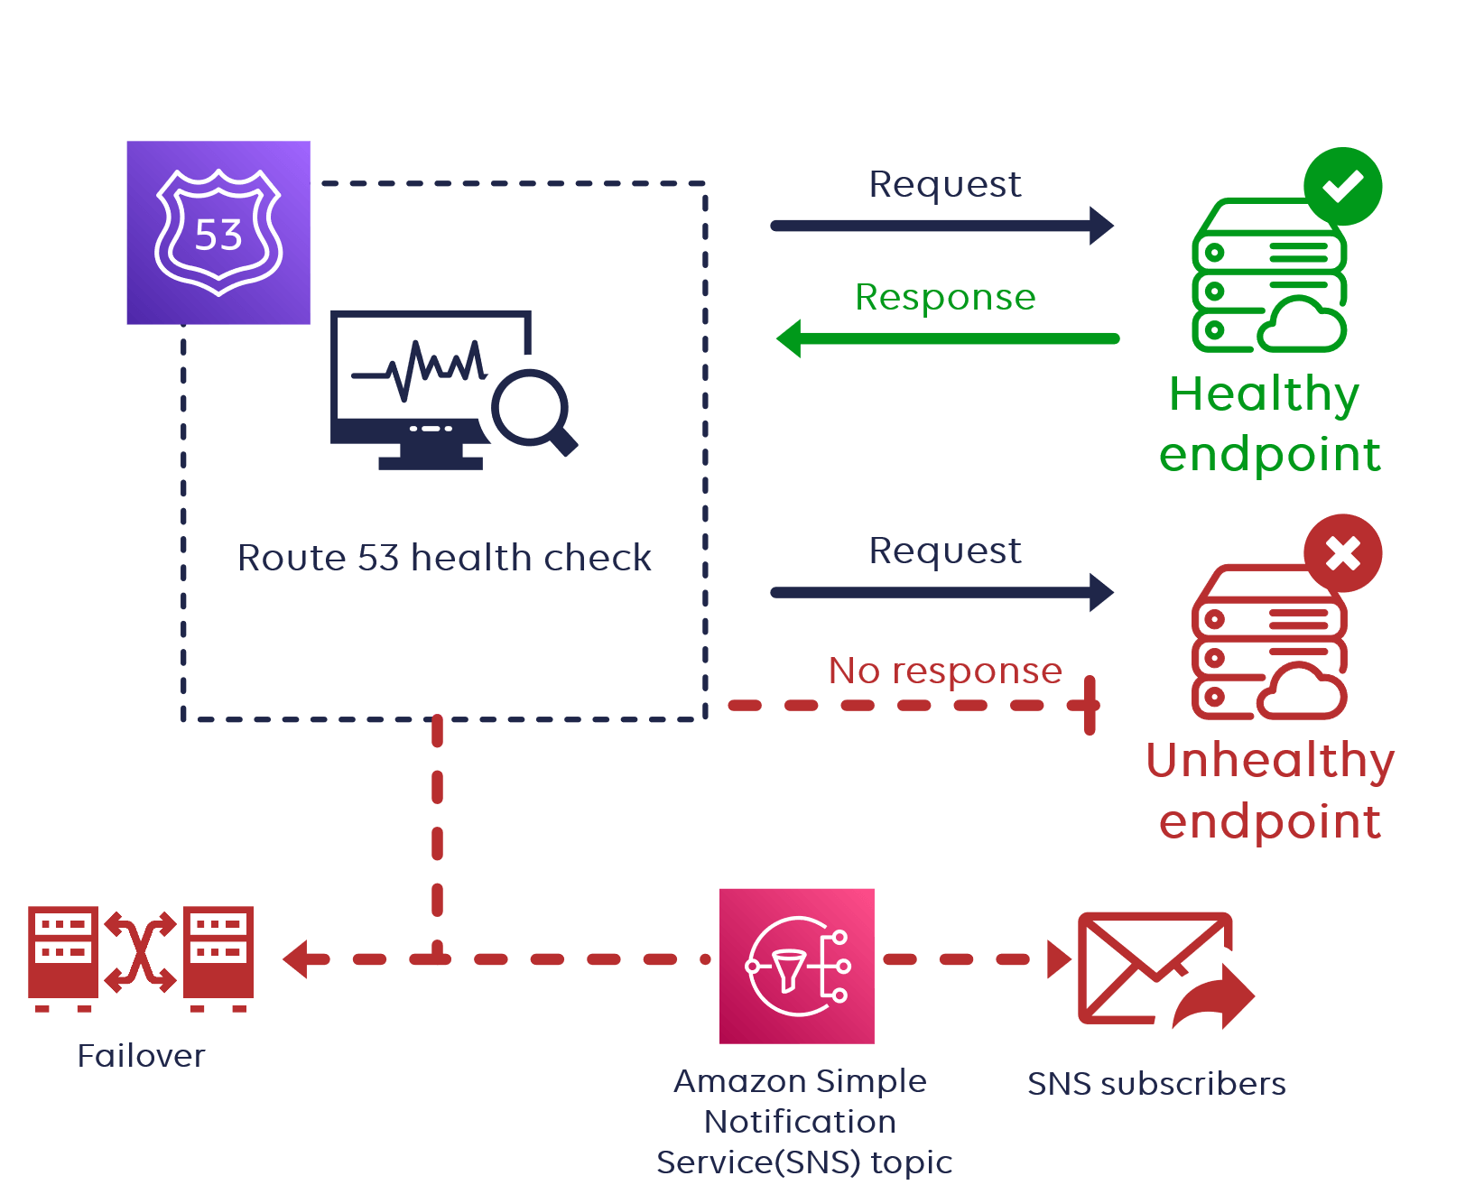
Health Checks

Slide 19
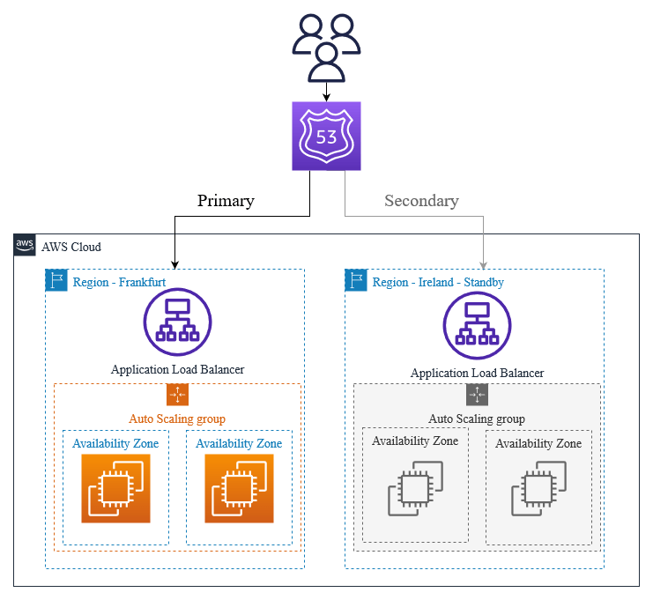
Health Checks

Slide 20
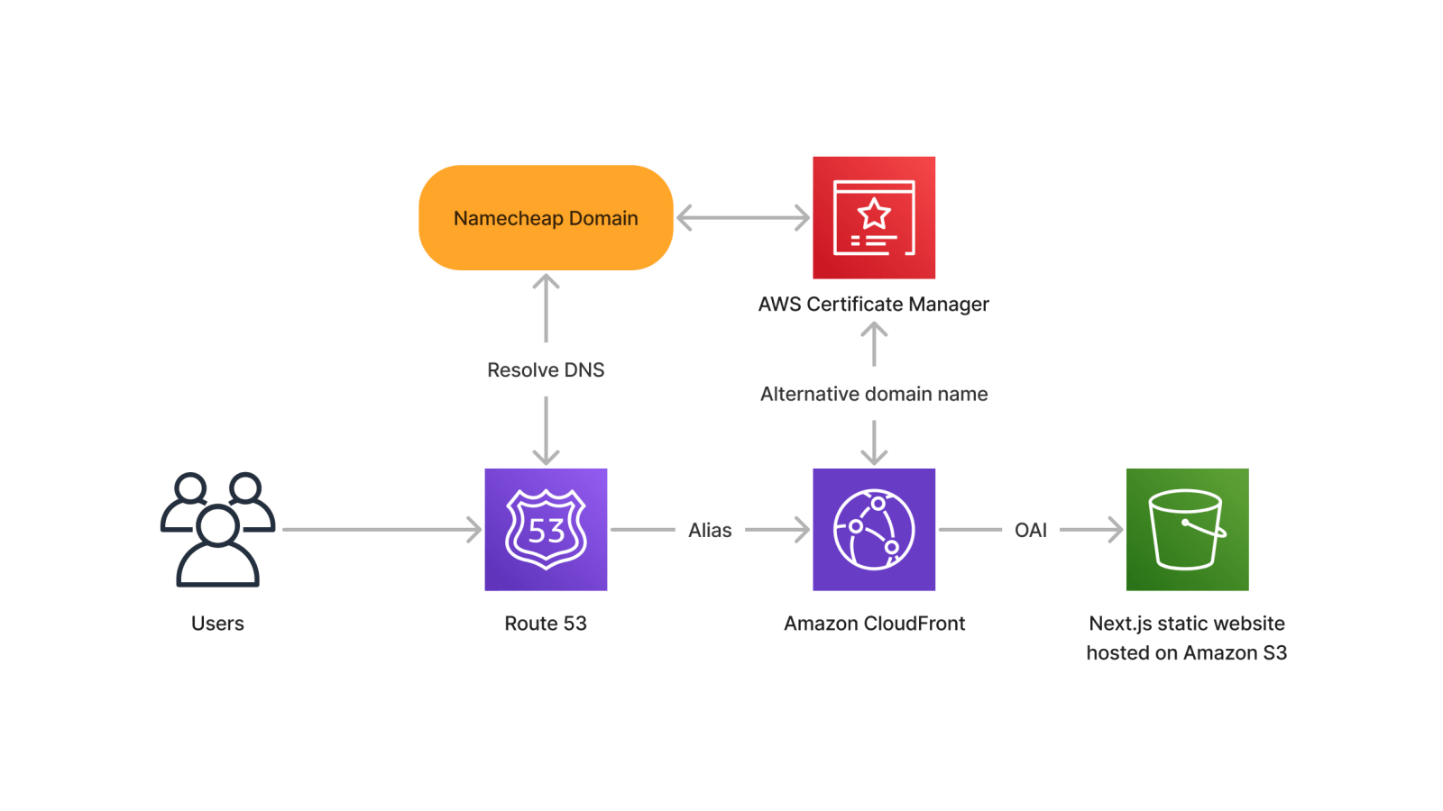
3rd Party Domains & Route 53

Slide 21
Import and purchase domains using route53
You can use Amazon Route 53 with domains you register with Route 53, and with domains you have registered with other DNS providers.
Depending on your DNS provider, choose one of the following procedures to register and use a new domain with Route 53
You can transfer domain registration from another registrar to Amazon Route 53, from one AWS account to another, or from Route 53 to another registrar.
There is no cost for transferring domains from one AWS account to another.
The default maximum number of domains per AWS account is 20.
The maximum number of name servers per domain in Route 53 is 6.

Slide 22
Advanced

Slide 23
Amazon Route 53 Application Recovery Controller
Route 53 Application Recovery Controller (ARC) is a service offered by AWS that helps customers build and execute recovery plans for their applications.
ARC is designed to enhance application availability by allowing users to define and automate recovery strategies.
Health Checking and Monitoring:
The service continuously monitors the health of your application and its components (like load balancers, EC2 instances, etc.). It uses Amazon Route 53 health checks to assess the status and performance of your applications.
Controlled and Fast Failover:
In case of any failure or degradation in performance, the Application Recovery Controller allows you to manually or automatically failover to a standby application stack in another AWS Region or Availability Zone. This ensures minimal disruption and maintains the availability of your applications.
Safety Mechanisms for DNS Routing:
The service integrates with Amazon Route 53 DNS routing to control how user traffic is directed to your application's endpoints. It offers safety mechanisms to prevent "flapping" (frequent, rapid changes in routing state) and ensures that DNS routing changes are conducted safely and predictably.
Readiness Checks:
The Application Recovery Controller performs readiness checks to ensure that your standby resources are scaled correctly and configured properly to handle traffic when a failover occurs. This helps in maintaining consistent performance and availability standards.
Disaster Recovery and High Availability:
The service is particularly useful for disaster recovery and high availability strategies. It is designed for mission-critical applications where maintaining continuous availability is a top priority.

Slide 24
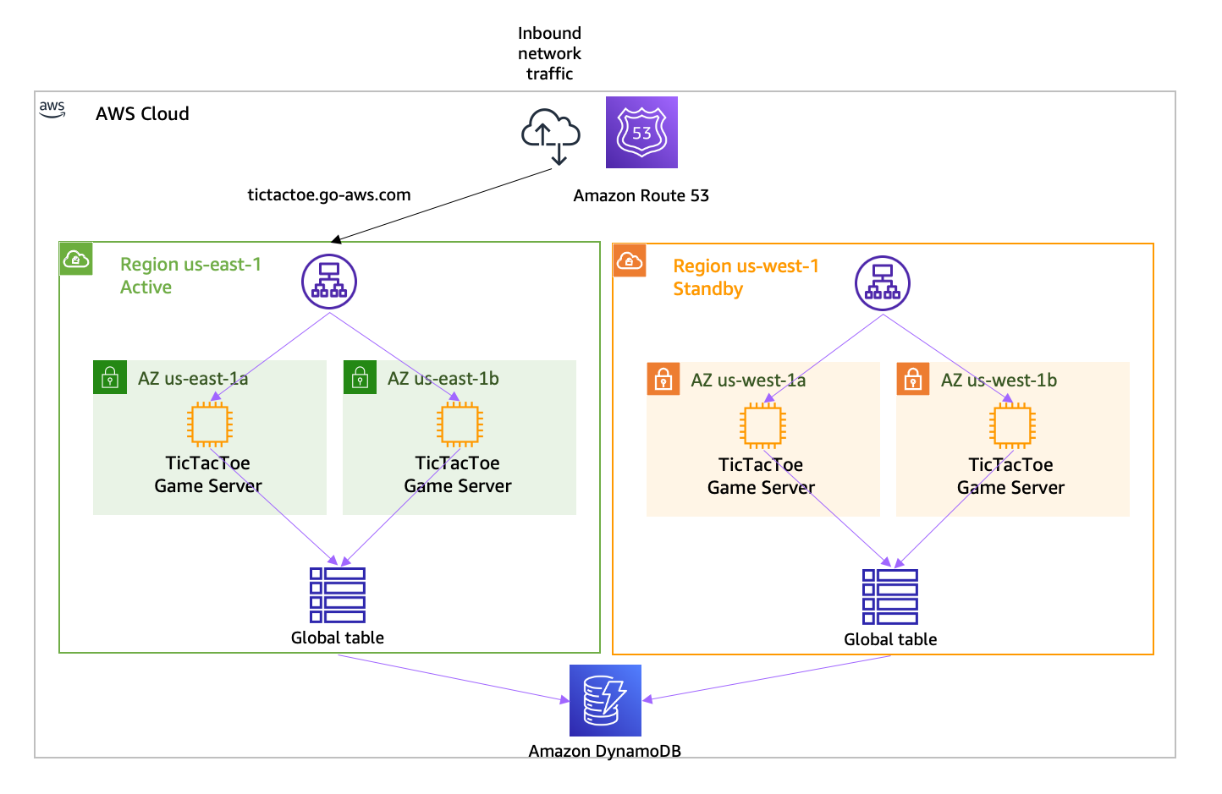
Route53 ARC

Slide 25
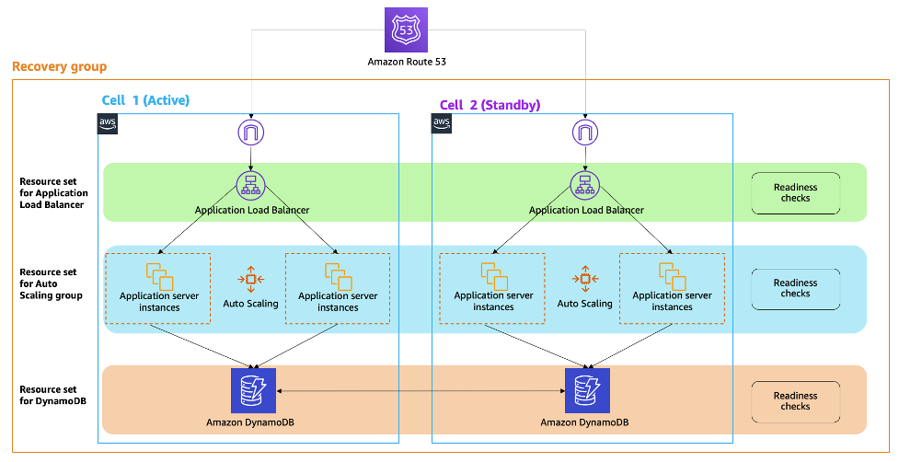
Route53 ARC

Slide 26
Amazon Route 53 ARC Features
Recovery Plans:
ARC enables users to create recovery plans that define the steps and procedures to be executed during application recovery.
Recovery plans can include actions such as redirecting traffic, adjusting configurations, and launching additional instances.
Real-Time Monitoring:
ARC continuously monitors the health of applications and their dependencies in real-time.
It uses health checks and other metrics to assess the status of resources involved in application operation.
Automated Recovery:
In the event of an application or infrastructure failure, ARC can automatically execute recovery plans to restore the application's functionality.
This automation helps minimize downtime and accelerate the recovery process.
Integration with AWS Services:
ARC integrates with other AWS services, such as Amazon Route 53 for DNS management and AWS Elastic Load Balancing for traffic distribution.
Integration with AWS services enhances the coordination of recovery actions.
Visibility and Reporting:
ARC provides visibility into the recovery process by offering detailed reports and metrics.
Users can gain insights into the effectiveness of recovery plans and identify areas for improvement.
Customizable Recovery Strategies:
Users can define custom recovery strategies based on their application's specific requirements.
This customization allows for flexibility in designing recovery plans tailored to different use cases.

Slide 27
Route53 Resolver
Amazon Route 53 Resolver responds recursively to DNS queries from AWS resources for public records, Amazon VPC-specific DNS names, and Amazon Route 53 private hosted zones, and is available by default in all VPCs
An Amazon VPC connects to a Route 53 Resolver at a VPC+2 IP address. This VPC+2 address connects to a Route 53 Resolver within an Availability Zone.
if your VPC's CIDR block is 10.0.0.0/16, the VPC+2 address would likely be 10.0.0.2.
A Route 53 Resolver automatically answers DNS queries for:
Local VPC domain names for EC2 instances (for example, ec2-192-0-2-44.compute-1.amazonaws.com).
Records in private hosted zones (for example, acme.example.com).
For public domain names, Route 53 Resolver performs recursive lookups against public name servers on the internet.
If you have workloads that leverage both VPCs and on-premises resources, you also need to resolve DNS records hosted on-premises.
Similarly, these on-premises resources may need to resolve names hosted on AWS.
Through Resolver endpoints and conditional forwarding rules, you can resolve DNS queries between your on-premises resources and VPCs to create a hybrid cloud setup over VPN or Direct Connect (DX). Specifically:
Inbound Resolver endpoints allow DNS queries to your VPC from your on-premises network or another VPC.
Outbound Resolver endpoints allow DNS queries from your VPC to your on-premises network or another VPC.
Resolver rules enable you to create one forwarding rule for each domain name and specify the name of the domain for which you want to forward DNS queries from your VPC to an on-premises DNS resolver and from your on-premises to your VPC.
Rules are applied directly to your VPC and can be shared across multiple accounts.

Slide 28
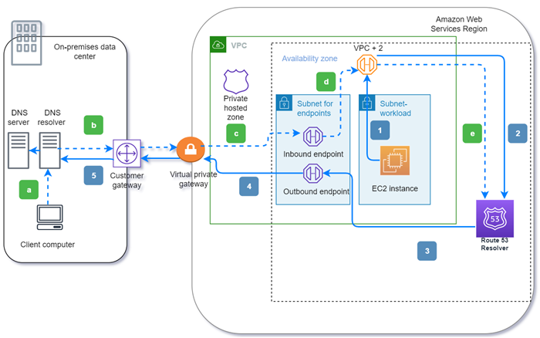
Route53 Resolver
Outbound (solid arrows 1–5):
An Amazon EC2 instance needs to resolve a DNS query to the domain internal.example.com. The authoritative DNS server is in the on-premises data center. This DNS query is sent to the VPC+2 in the VPC that connects to Route 53 Resolver.
A Route 53 Resolver forwarding rule is configured to forward queries to internal.example.com in the on-premises data center.
The query is forwarded to an outbound endpoint.
The outbound endpoint forwards the query to the on-premises DNS resolver through a private connection between AWS and the data center. The connection can be either AWS Direct Connect or AWS Site-to-Site VPN, depicted as a virtual private gateway.
The on-premises DNS resolver resolves the DNS query for internal.example.com and returns the answer to the Amazon EC2 instance via the same path in reverse.
Inbound (dashed arrows a–e):
A client in the on-premises data center needs to resolve a DNS query to an AWS resource for the domain dev.example.com. It sends the query to the on-premises DNS resolver.
The on-premises DNS resolver has a forwarding rule that points queries to dev.example.com to an inbound endpoint.
The query arrives at the inbound endpoint through a private connection, such as AWS Direct Connect or AWS Site-to-Site VPN, depicted as a virtual gateway.
The inbound endpoint sends the query to Route 53 Resolver at the VPC +2.
Route 53 Resolver resolves the DNS query for dev.example.com and returns the answer to the client via the same path in reverse.

Slide 29
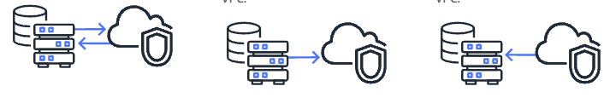
Route53 Resolver Strategies
Inbound and Outbound (Both):
This configuration involves setting up both Inbound and Outbound Resolver endpoints.
Inbound Resolver Endpoint: Allows DNS queries from your on-premises network to be resolved by AWS resources in your VPC.
It's used when on-premises systems need to resolve DNS names of resources in AWS.
Outbound Resolver Endpoint: Allows DNS queries originating from your VPC to be resolved by on-premises or external DNS servers.
This is useful when you have resources in AWS that need to resolve domain names hosted outside of AWS, such as in your on-premises data center.
Inbound Only:
In this setup, you only configure an Inbound Resolver endpoint.
It allows on-premises systems to resolve DNS names of AWS resources, but it does not allow AWS resources to use external DNS servers for name resolution.
This might be suitable in scenarios where only one-way DNS resolution is required – from on-premises to AWS.
Outbound Only:
Here, only an Outbound Resolver endpoint is configured.
It allows AWS resources to resolve DNS names outside the VPC (like on-premises or internet resources) but does not support queries from on-premises systems to AWS resources.
This configuration is useful when the primary requirement is for AWS resources to access external or on-premises services and there's no need for on-premises systems to resolve AWS resource names.

Slide 30
When to use Route53 Resolver?
Using Direct Connect:
DNS Resolution for AWS Resources: If you need on-premises systems to resolve DNS names of AWS resources (like EC2 instances, load balancers, etc.), Route 53 Resolver can facilitate this.
It can handle DNS queries from your on-premises network for AWS resources.
Private DNS Names in AWS: If you're using Amazon Route 53 private hosted zones for internal DNS names within your VPCs, and you want these DNS names to be resolvable from your on-premises network, Route 53 Resolver is required.
Custom DNS Forwarding: If you have custom DNS forwarding rules that need to be applied (e.g., forwarding certain DNS queries to specific on-premises DNS servers), Route 53 Resolver can be configured to handle these.
Using Site-to-Site VPN:
DNS Queries Between On-premises and AWS: Similar to Direct Connect, if you need to resolve DNS names between your on-premises network and AWS resources, Route 53 Resolver can manage these queries.
Split-View DNS: In some cases, you might use split-view DNS (different DNS responses based on query origin) for on-premises and cloud environments.
Route 53 Resolver can help manage this by directing queries to the correct DNS server based on the origin of the request.
Centralized DNS Management: For a setup involving multiple VPCs connected via Site-to-Site VPN, Route 53 Resolver can simplify the management of DNS across these VPCs.

Slide 31
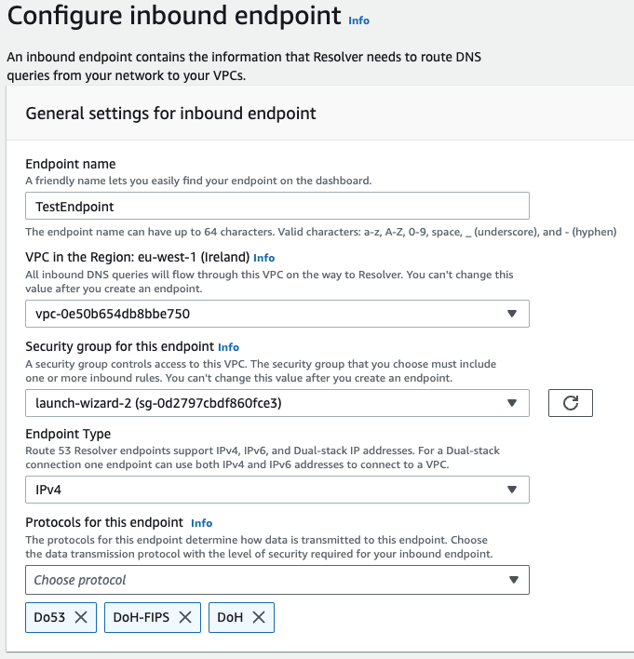
Route53 Resolver Protocols for Inbound endpoint
https://aws.amazon.com/blogs/aws/dns-over-https-is-now-available-in-amazon-route-53-resolver/
https://docs.aws.amazon.com/Route53/latest/DeveloperGuide/resolver-forwarding-inbound-queries.html
when you create or update an inbound or outbound Resolver endpoint, you can specify which protocols to use:
DNS over port 53 (Do53), which is using either UDP or TCP to send the packets.
DNS over HTTPS (DoH), which is using TLS to encrypt the data.
Both, depending on which one is used by the DNS client.
For FIPS compliance, there is a specific implementation (DoH-FIPS) for inbound endpoint
(Federal Information Processing Standards)

Slide 32
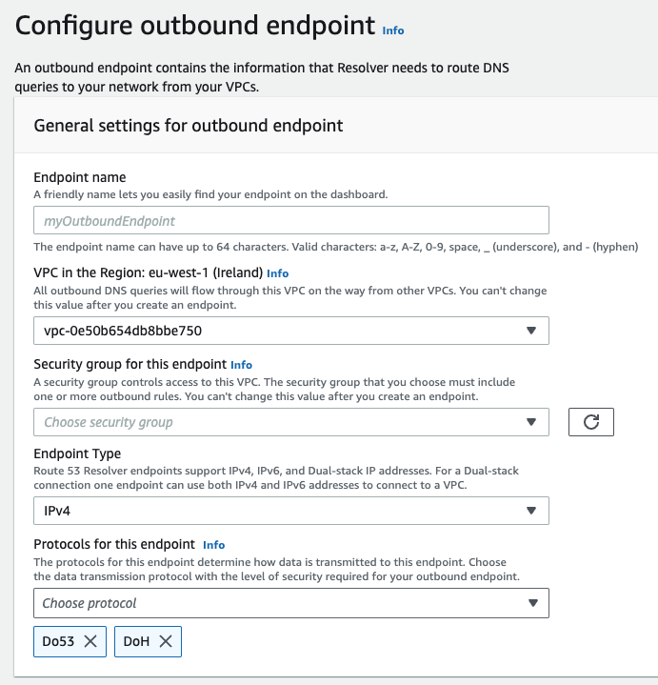
Route53 Resolver Protocols for Outbound endpoint
https://aws.amazon.com/blogs/aws/dns-over-https-is-now-available-in-amazon-route-53-resolver/
https://docs.aws.amazon.com/Route53/latest/DeveloperGuide/resolver-forwarding-outbound-queries.html
when you create or update an inbound or outbound Resolver endpoint, you can specify which protocols to use:
DNS over port 53 (Do53), which is using either UDP or TCP to send the packets.
DNS over HTTPS (DoH), which is using TLS to encrypt the data.
DoH-FIPS is not available for outbound

Slide 33
DNSSEC
DNSSEC adds layers of authentication to the DNS protocol by enabling DNS responses to be digitally signed.
By checking the digital signature, a DNS resolver is able to verify if the information is authentic, meaning it hasn't been tampered with and is from a legitimate source.
Why
Prevent DNS Spoofing and Cache Poisoning Attacks: Traditional DNS does not include authentication, making it vulnerable to attacks where a user is unknowingly redirected to a malicious website. DNSSEC protects against such attacks by verifying the authenticity of the response to a DNS query.
DNS Spoofing (DNS hijacking) introducing corrupt DNS cache data or by maliciously modifying DNS communication
DNS Cache Poisoning is a specific type of DNS Spoofing where the attacker corrupts the DNS cache stored on a DNS server
Integrity of DNS Data: DNSSEC ensures that the data you receive from a DNS query hasn't been tampered with in transit. It guarantees the integrity of the data, so you can trust that the IP address you receive for a website is actually the correct one.
How DNSSEC Works
Digital Signatures: DNSSEC adds digital signatures to DNS data. When a DNS resolver queries for a DNS record, it receives both the record and a digital signature.
Public Key Infrastructure (PKI): The authenticity of these digital signatures is verified using a PKI. Each DNS zone has a private key to sign DNS records and a public key to verify the signatures. The public key of a zone is signed by the parent zone, creating a chain of trust up to the root DNS zone.
Validation of Responses: A DNS resolver that is DNSSEC-aware can validate these signatures using the public key, ensuring the response is authentic and has not been tampered with.
Use Cases
Securing Websites: Protects users from being redirected to fraudulent websites, crucial for e-commerce, banking, and other sensitive online activities.
Protecting Email Servers: Ensures that emails are routed to the correct server, guarding against man-in-the-middle attacks.
Secure Cloud Services: In cloud computing, where resources are dynamically allocated, DNSSEC ensures that domain names reliably point to the correct resources.
Internet of Things (IoT): As IoT devices often rely on domain names for communicating with central servers, DNSSEC can be crucial for securing these communications.

Slide 34
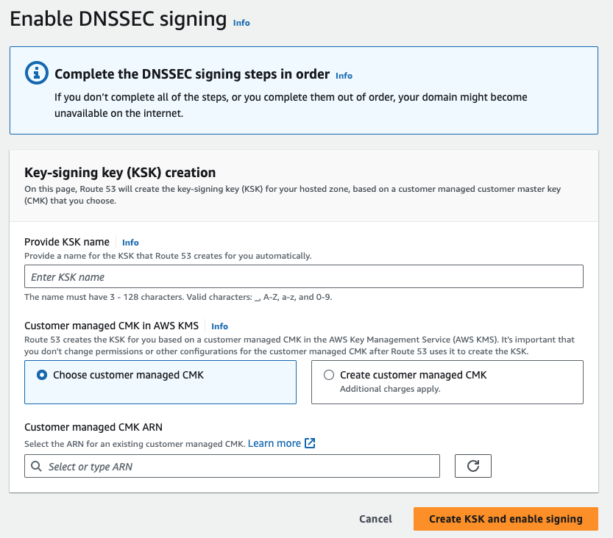
Route53 DNSSEC singing
https://docs.aws.amazon.com/Route53/latest/DeveloperGuide/domain-configure-dnssec.html
https://aws.amazon.com/blogs/networking-and-content-delivery/configuring-dnssec-signing-and-validation-with-amazon-route-53/
When you configure DNSSEC for your domain, a DNS resolver establishes a chain of trust for responses from intermediate resolvers.
The chain of trust begins with the TLD registry for the domain (your domain's parent zone) and ends with the authoritative name servers at your DNS service provider.
Not all DNS resolvers support DNSSEC.
Only resolvers that support DNSSEC perform any signature or authenticity validation.

