Slide 1
AWS Gateway Load Balancer

Slide 2
Gateway ELB
Gateway Load Balancers enable you to:
deploy, scale, and manage virtual appliances,
such as:
Firewalls
intrusion detection
prevention systems
deep packet inspection systems.
It combines a transparent network gateway and distributes traffic while scaling your virtual appliances with the demand.
A typical use case features customer AWS deployments, with one or more VPCs, with a requirement to protect and inspect network traffic with Check Point's CloudGuard Network Security Gateways.

Slide 3
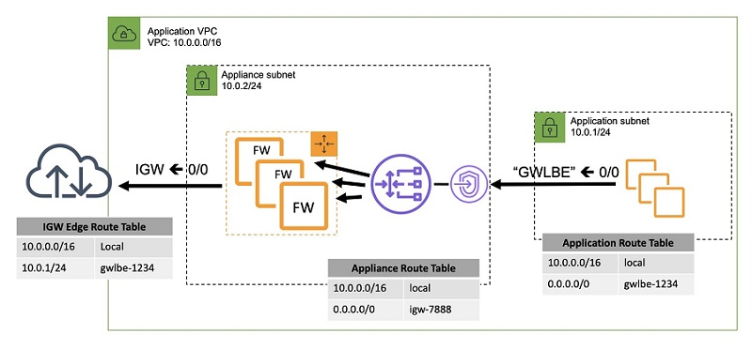

Slide 4
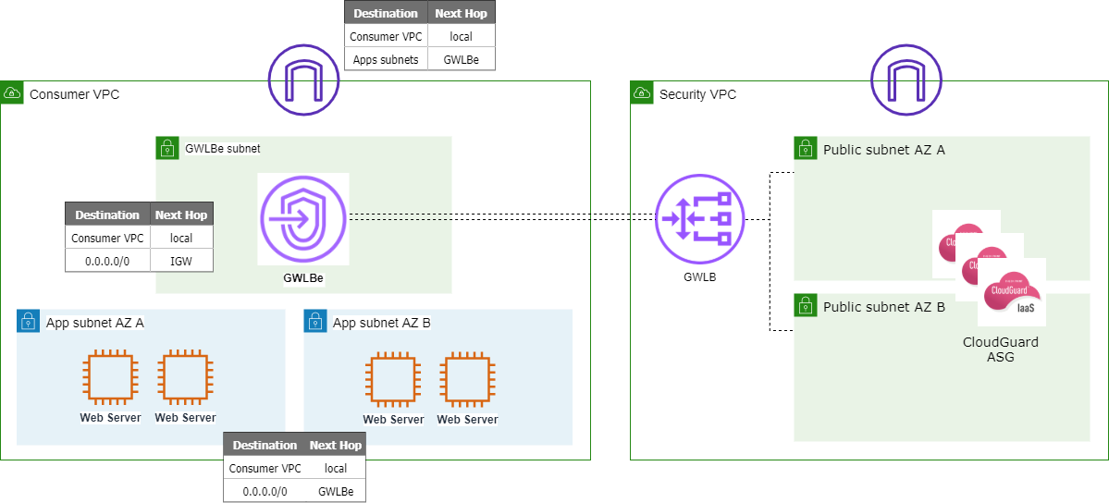

Slide 5
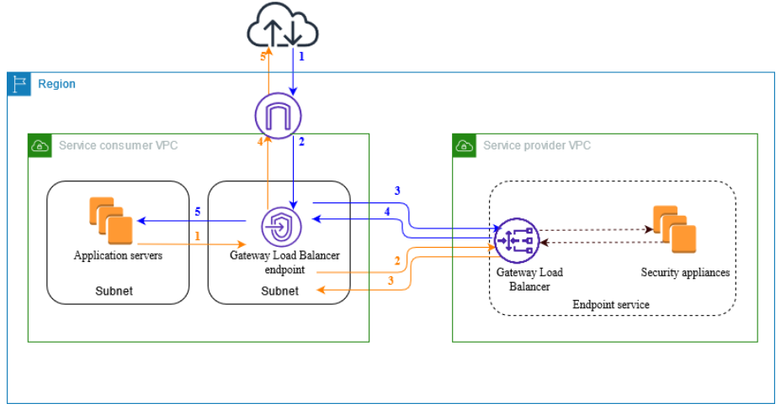
VPC endpoint services Gateway ELB
The following diagram shows how application servers access security appliances through AWS PrivateLink.
The application servers run in a subnet of the service consumer VPC.
You create a Gateway Load Balancer endpoint in another subnet of the same VPC.
All traffic entering the service consumer VPC through the internet gateway is first routed to the Gateway Load Balancer endpoint for inspection and then routed to the destination subnet.
Similarly, all traffic leaving the application servers is routed to the Gateway Load Balancer endpoint for inspection before it is routed back through the internet gateway.

