Slide 1
AWS IAM Identity Center (Successor to AWS Single Sign-On)
Centrally manage workforce access to multiple AWS accounts and applications

Slide 2

What is IAM Identity Center?
With AWS IAM Identity Center (successor to AWS Single Sign-On), you can manage sign-in security for your workforce identities, also known as workforce users.
IAM Identity Center provides one place where you can create or connect workforce users and centrally manage their access across all their AWS accounts and applications.
You can use multi-account permissions to assign your workforce users access to AWS accounts.
You can use application assignments to assign your users access to IAM Identity Center enabled applications, cloud applications, and customer Security Assertion Markup Language (SAML 2.0) applications.

Slide 3
AWS IAM Identity Center
Create or connect your workforce identities only once for use across AWS.
Centrally manage your workforce access to multiple AWS accounts.
Assign user permissions based on common job functions or user attributes
Provide your workforce single sign-on access to cloud applications.

Slide 4
IAM Identity Center rename
Legacy term | Current term
AWS SSO user or SSO user | workforce user or user
AWS SSO user portal or user portal | AWS access portal
AWS SSO-integrated applications | Identity Center enabled applications
AWS SSO directory | Identity Center directory
AWS SSO store or AWS SSO identity store | identity store used by IAM Identity Center

Slide 5
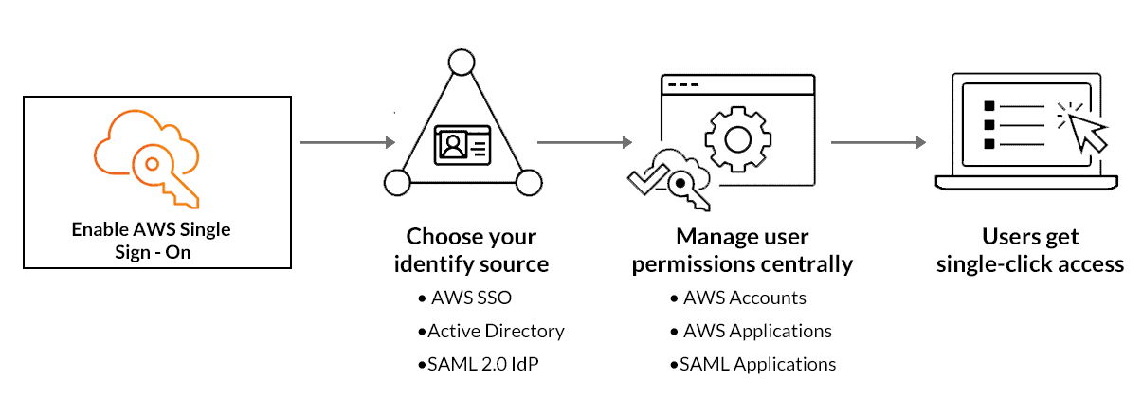
AWS SSO Flow

Slide 6
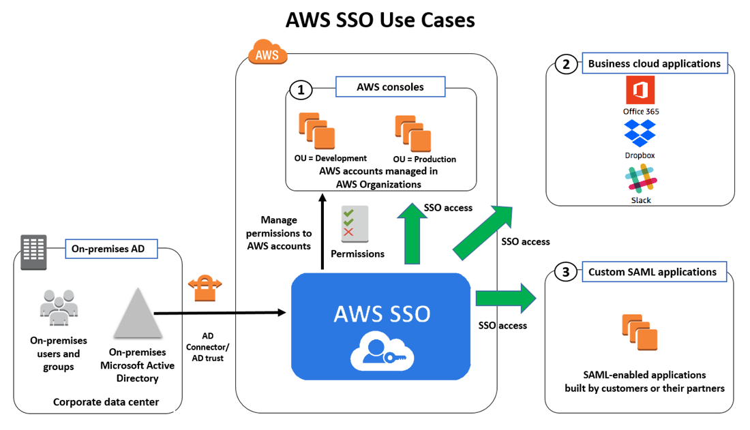
AWS SSO

