Slide 1

AWS CloudHSM

Slide 2

Hardware Security Module (HSM)
A hardware security module (HSM) is a physical device that provides extra security for sensitive data.
This type of device is used to provision cryptographic keys for critical functions such as encryption, decryption and authentication for the use of applications, identities and databases.

Slide 3
What is FIPS 140-2 and why is it important?
FIPS (Federal Information Processing Standard) 140-2 is the benchmark for validating the effectiveness of cryptographic hardware.
Level 1:
Requires production-grade equipment and externally tested algorithms.
Level 2:
Adds requirements for physical tamper-evidence and role-based authentication. Software implementations must run on an Operating System approved to Common Criteria at EAL2.
Level 3:
Adds requirements for physical tamper-resistance and identity-based authentication.
There must also be physical or logical separation between the interfaces by which “critical security parameters” enter and leave the module.
Private keys can only enter or leave in encrypted form.
Level 4:
This level makes the physical security requirements more stringent, requiring the ability to be tamper-active, erasing the contents of the device if it detects various forms of environmental attack.
The FIPS 140-2 standard technically allows for software-only implementations at level 3 or 4 but applies such stringent requirements that none have been validated.

Slide 4
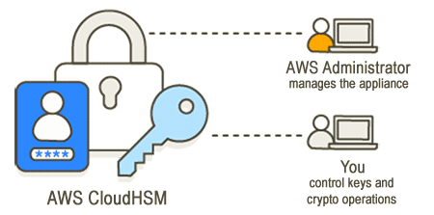
CloudHSM
AWS CloudHSM is a cryptographic service for creating and maintaining hardware security modules (HSMs) in your AWS environment.
HSMs are computing devices that process cryptographic operations and provide secure storage for cryptographic keys.

Slide 5
What is AWS CloudHSM?
AWS CloudHSM offers customers a variety of benefits:
HSMs are FIPS 140-2 level-3 validated AWS CloudHSM uses general purpose HSMs that are standards-compliant, single-tenant, and FIPS 140-2 level-3 validated.
They provide more flexibility when compared to the fully-managed AWS services that have predetermined algorithms and key lengths for your application.
E2E encryption is not visible to AWS Because your data plane is end-to-end (E2E) encrypted and not visible to AWS, you control your own user management (outside of IAM roles).
The trade off for this control is you have more responsibility than if you used a managed AWS service.
Full control of your keys, algorithms, and application development AWS CloudHSM gives you full control of the algorithms and keys you use.
You can generate, store, import, export, manage, and use cryptographic keys (including, session keys, token keys, symmetric keys and asymmetric key pairs)
Additionally, AWS CloudHSM SDKs give you full control over application development, application language, threading, and where your applications physically exist.
Migrate your cryptographic workloads to the cloud Customers migrating public key infrastructure that use Public Key Cryptography Standards #11 (PKCS #11), Java Cryptographic Extension (JCE), Cryptography API: Next Generation (CNG), or key storage provider (KSP) can migrate to AWS CloudHSM with fewer changes to their application.

Slide 6
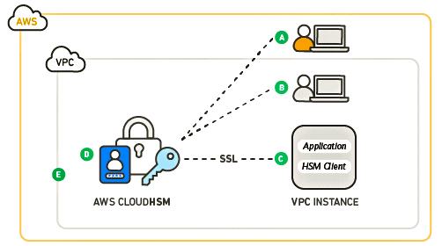
How AWS CloudHSM works
AWS CloudHSM operates in your own Amazon Virtual Private Cloud (VPC).
Before you can use AWS CloudHSM, you first create a cluster, add HSMs to it, create users and keys, and then use Client SDKs to integrate your HSMs with your application.

Slide 7
AWS CloudHSM clusters
Problem: Making individual HSMs work together in a synchronized, redundant, highly-available cluster can be difficult, but AWS CloudHSM does the heavy lifting for you by providing hardware security modules (HSMs) in clusters.
Cluster: A cluster is a collection of individual HSMs that AWS CloudHSM keeps in sync.
Replication: When you perform a task or operation on one HSM in a cluster, the other HSMs in that cluster are automatically kept up to date.
High Availability: To meet your availability, durability, and scalability goals, you set the number of HSMs in your cluster across multiple availability zones.
HSM limits: You can create a cluster that has 1 to 28 HSMs (the default limit is 6 HSMs per AWS account per AWS Region).
You can place the HSMs in different Availability Zones in an AWS region.
Adding more HSMs to a cluster provides higher performance.
Spreading clusters across Availability Zones provides redundancy and high availability.

Slide 8
AWS HSM Users
Unlike most AWS services and resources, you do not use IAM users or IAM policies to access resources within your cluster.
Instead, you use HSM users directly on HSMs in your AWS CloudHSM cluster.
HSM users are distinct from IAM users.
IAM users who have the correct credentials can create HSMs by interacting with resources through the AWS API.
Since E2E encryption is not visible to AWS, you must use HSM user credentials to authenticate operations on the HSM because credentials takes place directly on the HSM.
The HSM authenticates each HSM user by means of credentials that you define and manage.
Each HSM user has a type that determines which operations that user can perform on the HSM.
An HSM user has a type that defines which operations they can perform on HSM.
Precrypto officer (PRECO) – temporary user on the first HSM in a cluster.
Crypto officer (CO | PCO) – performs user management operations and supports 2FA.
Crypto user (CU) – performs key management and cryptographic operations.
Appliance user (AU) – performs cloning and synchronization operations.

Slide 9

HSM Client SDKs
AWS CloudHSM has SDKs for:
Public Key Cryptography Standards #11 (PKCS #11)
JCE provider
OpenSSL Dynamic Engine
Cryptography API: Next Generation (CNG) and key storage provider (KSP) for Microsoft Windows
(https://docs.aws.amazon.com/cloudhsm/latest/userguide/use-hsm.html)

Slide 10
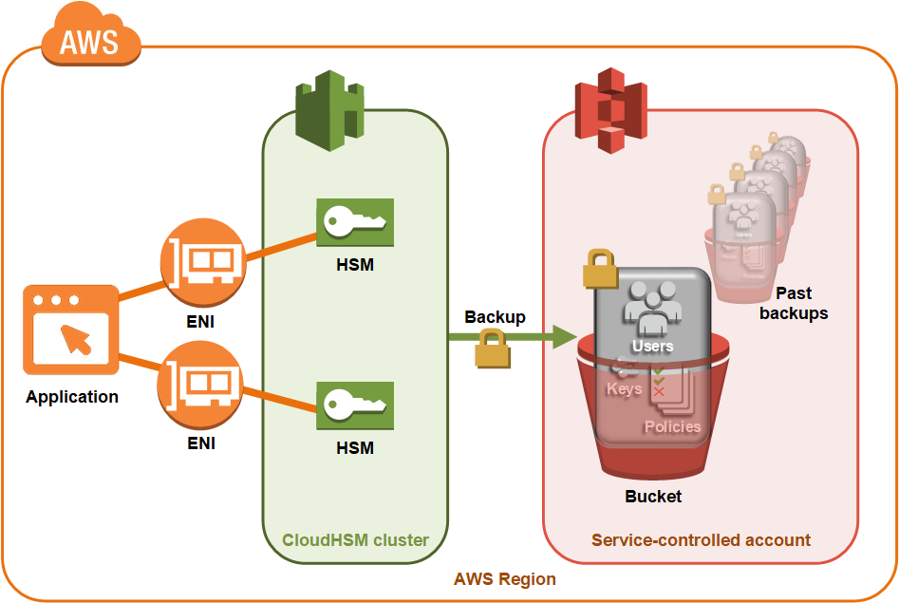
AWS CloudHSM cluster backups
AWS CloudHSM makes periodic backups of the users, keys, and policies in the cluster.
Backups are secure, durable, and updated on a predictable schedule.
The following illustration shows the relationship of your backups to the cluster.
Security When AWS CloudHSM makes a backup from the HSM, the HSM encrypts all of its data before sending it to AWS CloudHSM.
The data never leaves the HSM in plaintext form.
Additionally, backups cannot be decrypted by AWS because AWS doesn’t have access to key used to decrypt the backups.
Durability AWS CloudHSM stores backups in a service-controlled S3 bucket in the same region as your cluster.
Backups have a 99.999999999% durability level, the same as any object stored in Amazon S3.

Slide 11
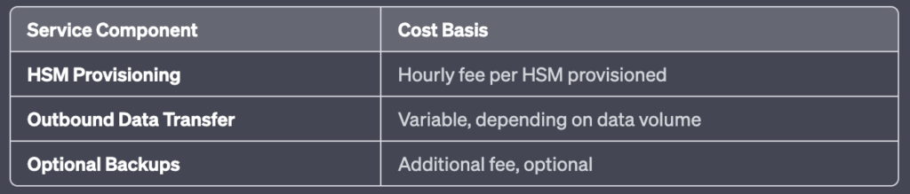
AWS HSM Pricing
With AWS CloudHSM, you pay by the hour with no long-term commitments or upfront payments.
For more information, see AWS CloudHSM Pricing on the AWS website.

Slide 12
AWS CloudHSM vs Vault: What are the differences?
AWS CloudHSM can be classified as a tool in the "Data Security Services" category, while Vault is grouped under "Secrets Management".
AWS CloudHSM features:
Protect and store your cryptographic keys with industry standard, tamper-resistant HSM appliances.
No one but you has access to your keys (including Amazon administrators who manage and maintain the appliance).
Use your most sensitive and regulated data on Amazon EC2 without giving applications direct access to your data's encryption keys.
Store and access data reliably from your applications that demand highly available and durable key storage and cryptographic operations.
Vault provides the following key features:
Secure Secret Storage: Arbitrary key/value secrets can be stored in Vault.
Vault encrypts these secrets prior to writing them to persistent storage, so gaining access to the raw storage isn't enough to access your secrets.
Vault can write to disk, Consul, and more.
Dynamic Secrets: Vault can generate secrets on-demand for some systems, such as AWS or SQL databases.
For example, when an application needs to access an S3 bucket, it asks Vault for credentials, and Vault will generate an AWS keypair with valid permissions on demand.
After creating these dynamic secrets, Vault will also automatically revoke them after the lease is up.
Data Encryption: Vault can encrypt and decrypt data without storing it.
This allows security teams to define encryption parameters and developers to store encrypted data in a location such as SQL without having to design their own encryption methods.

Slide 13
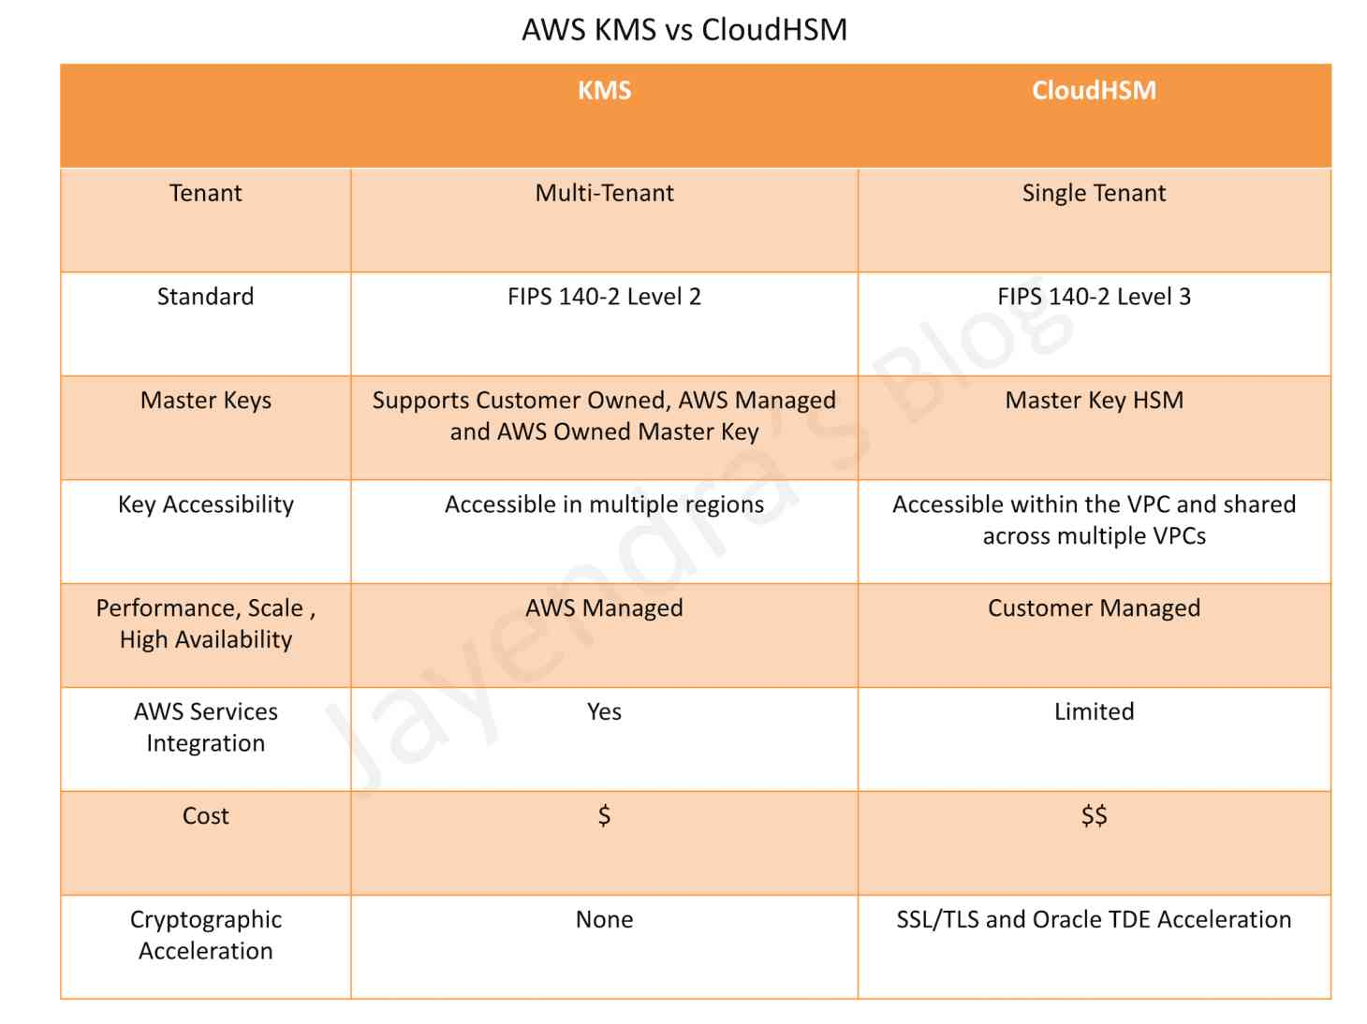
AWS KSM vs CloudHSM

Slide 14
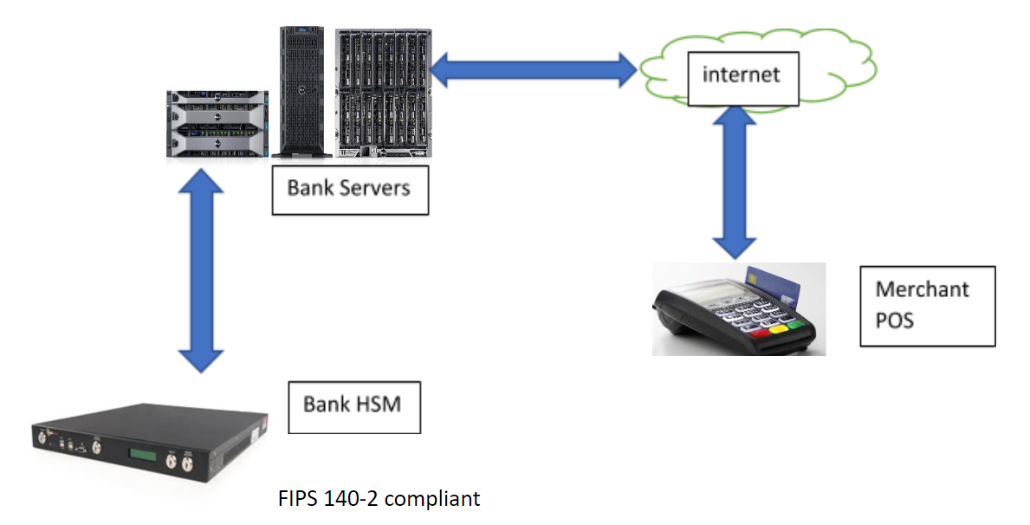
HSM In Payment Industry for PCI DSS compliance

Slide 15
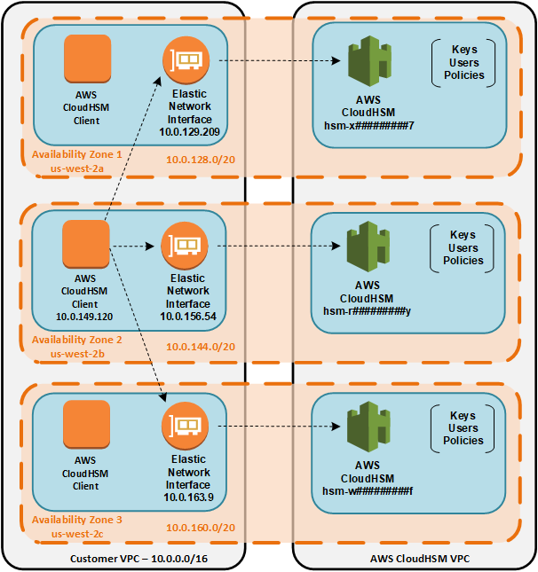
Understanding AWS CloudHSM Cluster Synchronization

Slide 16
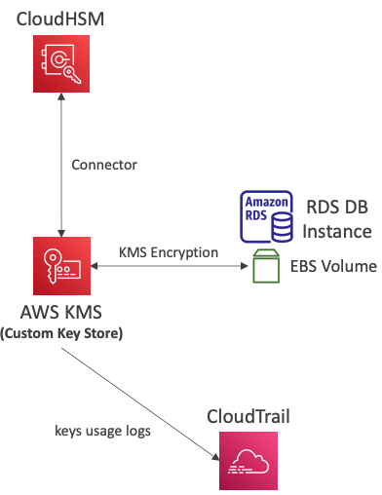
CloudHsm Intergation with AWS and 3rd party services
Integration with AWS Services
Through integration with AWS KMS
Configure KMS Custom Key Store with CloudHSM
Example: EBS, S3, RDS
Supports RDS Oracle TDE (through KMS)
Integration with 3rd Party Services
Allows creating and storing keys in CloudHSM
Use cases: SSL/TLS Offload, Windows Server Certificate Authority (CA), Oracle TDE, Microsoft SignTool, Java Keytool

Slide 17
Exam takeaway
A hardware security module (HSM) performs cryptographic operations and provides secure storage for cryptographic keys.
Use Case
Offload SSL/TLS processing for web servers.
Protect private keys for an issuing certificate authority (CA).
Enable transparent data encryption (TDE) for Oracle databases.
Concepts:
Cluster
Backups
HSM users
SDKs
Pricing

