Slide 1
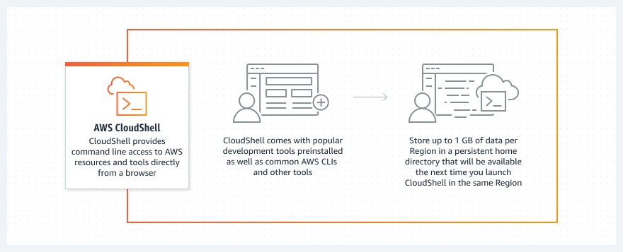
CloudShell
Using AWS CloudShell, a browser-based shell, you can quickly run scripts with the AWS Command Line Interface (CLI), experiment with service APIs using the AWS CLI, and use other tools to increase your productivity.
The CloudShell icon appears in AWS Regions where CloudShell is available.

Slide 2
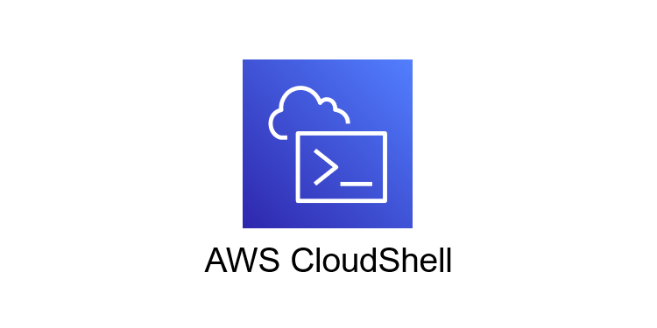
AWS CloudShell Why?
Sign in quickly with your preconfigured AWS Management Console credentials.
Save time with preinstalled tools and automatic updates within a fully managed Amazon Linux 2 environment.
Run scripts and commands at no extra cost, with up to 1 GB of persistent storage per AWS Region.
Customize your home directory with scripts, files, configuration preferences, and other tools.

