Slide 1

AWS STS

Slide 2


AWS STS - Temporary security credentials in IAM
AWS provides AWS Security Token Service (AWS STS) as a web service that enables you to request temporary, limited-privilege credentials for AWS Identity and Access Management (IAM) users or for users you authenticate (federated users).
By default, AWS Security Token Service (AWS STS) is available as a global service, and all AWS STS requests go to a single endpoint at https://sts.amazonaws.com. Global requests map to the US East (N. Virginia) Region.
AWS recommends using Regional AWS STS endpoints instead of the global endpoint to reduce latency, build in redundancy, and increase session token validity
AWS STS supports AWS CloudTrail, a service that records AWS calls for your AWS account and delivers log files to an Amazon S3 bucket.
By using information collected by CloudTrail, you can determine the requests successfully sent to AWS STS, as well as who sent the request, and when it was sent.

Slide 3
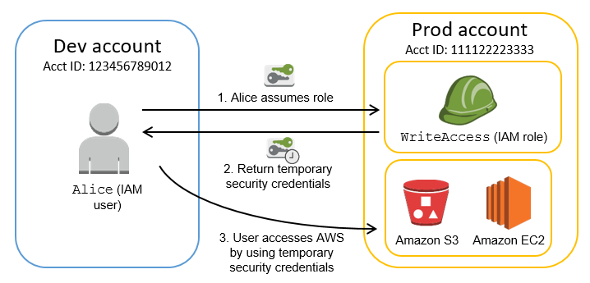
AWS STS - Temporary security credentials in IAM

Slide 4
AWS STS - Temporary security credentials in IAM
AssumeRole
Returns a set of temporary security credentials that you can use to access AWS resources that you might not normally have access to.
These temporary credentials consist of an access key ID, a secret access key, and a security token.
DecodeAuthorizationMessage
Decodes additional information about the authorization status of a request from an encoded message returned in response to an AWS request.
The message is encoded because the details of the authorization status can contain privileged information that the user who requested the operation should not see.
To decode an authorization status message, a user must be granted permissions through an IAM policy to request the DecodeAuthorizationMessage (sts:DecodeAuthorizationMessage) action.

Slide 5
AWS STS - Temporary security credentials in IAM
GetFederationToken
Returns a set of temporary security credentials (consisting of an access key ID, a secret access key, and a security token) for a federated user.
A typical use is in a proxy application that gets temporary security credentials on behalf of distributed applications inside a corporate network.
You must call the GetFederationToken operation using the long-term security credentials of an IAM user.
As a result, this call is appropriate in contexts where those credentials can be safely stored, usually in a server-based application.
The temporary credentials are valid for the specified duration, from 900 seconds (15 minutes) up to a maximum of 129,600 seconds (36 hours).
The default session duration is 43,200 seconds (12 hours).
Temporary credentials obtained by using the AWS account root user credentials have a maximum duration of 3,600 seconds (1 hour).
GetSessionToken
Returns a set of temporary credentials for an AWS account or IAM user. The credentials consist of an access key ID, a secret access key, and a security token.
The GetSessionToken operation must be called by using the long-term AWS security credentials of the AWS account root user or an IAM user.
Credentials that are created by IAM users are valid for the duration that you specify. This duration can range from 900 seconds (15 minutes) up to a maximum of 129,600 seconds (36 hours), with a default of 43,200 seconds (12 hours).
Credentials based on account credentials can range from 900 seconds (15 minutes) up to 3,600 seconds (1 hour), with a default of 1 hour.

Slide 6
STS – Version 1 vs Version 2
STS Version 1
By default, STS is available as Global singe endpoint https://sts.amazonaws.com
Only support AWS Regions that are enabled by default.
Version 1 tokens are valid only in AWS Regions that are available by default. These tokens do not work in manually enabled Regions, such as Asia Pacific (Hong Kong).
Version 2 tokens are valid in all Regions. However, version 2 tokens include more characters and might affect systems where you temporarily store tokens.
STS Version 2
Version 1 tokens DO NOT WORK for new AWS Regions
Regional STS endpoints is available in all AWS Regions
Reduce latency, increase session token validity
STS Session Tokens from regional endpoints (v2) are valid in all AWS regions.

Slide 7
STS Error
Error: An error occurred (AuthFailure) when calling the DescribeInstances operation: AWS was not able to validate the provided access credentials.
Two options to solve:
Use the Regional STS Endpoint (any region) which will return STS Tokens Version 2. Use the closes regional endpoint for lowest latency.
By default, the AWS STS calls to the STS global endpoint issues session tokens which are Version 1 (default regions). You can configure STS global endpoint to issue STS tokens Version 2 (all regions).

