Slide 1
What is Dos and Ddos?

Slide 2
The Anatomy of a DoS Attack: Story of Burger
Instead of delving into technical details, let’s instead consider an analogy.
Suppose that you run a takeaway burger joint. Customers place their orders by phone and pick them up when they are ready.
One day, a prankster makes multiple calls to your place, ordering 100 burgers in total.
This is enough to keep all your cooks occupied, so you stop taking new orders. However, the prankster never picks up the burgers. Not only were all your resources wasted on entertaining fake orders, you were also not able to cater to real customers.
This can be annoying but easy to prevent since it’s just one person placing all the false orders. You can simply block their number, and the problem is solved. The same situation can happen on a server. One malicious client can send tons of fake requests to a server, hampering its ability to respond to real users.
But just like in our example, detecting one fake client is easy; the server can just block all incoming requests from it.
This type of attack is known as a denial-of-service (DoS) attack, the precursor of modern DDoS attacks.

Slide 3
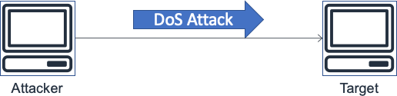
Dos Attack
A Denial of Service (DoS) attack, or event, is a deliberate attempt to make a website or application unavailable to users, such as by flooding it with network traffic.
Attackers use a variety of techniques that consume large amounts of network bandwidth or tie up other system resources, disrupting access for legitimate users.
In its simplest form, a lone attacker uses a single source to carry out a DoS attack against a target, as shown in the following figure.

Slide 4
DDos attack: Story of Burger
Now, let’s suppose there are multiple pranksters calling your burger joint.
Your landline never stops ringing, and it’s virtually impossible to tell a real customer from a fake one.
You can’t just block numbers either, as some of them may belong to actual customers. Your entire operation is paralyzed.
This is exactly what happens when a server experiences a DDoS attack.
Hackers make fake traffic coming in from multiple machines, look just like real, and a server/network/website inevitably breaks down

Slide 5
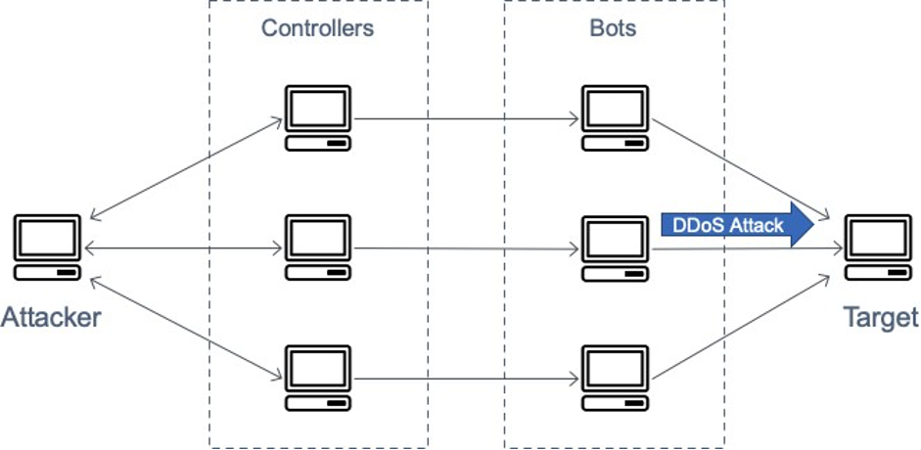
Ddos attack
In a Distributed Denial of Service (DDoS) attack, an attacker uses multiple sources to orchestrate an attack against a target.
These sources can include distributed groups of malware infected computers, routers, IoT devices, and other endpoints.
The following figure shows a network of compromised hosts that participate in the attack, generating a flood of packets or requests to overwhelm the target.

Slide 6
Why do DDoS Attacks Happen?
Some of the main reasons for DDoS attacks are:
Ransom: Attackers usually demand ransom after conducting DDoS attacks. However, at times, a ransom note threatening an attack can also be sent beforehand.
Hacktivism: DDoS attacks are also used to voice opinion. Hacktivists can carry out a DDoS attack to show their support or opposition to a regulation, person, or company.
Competition: A 2017 survey revealed that over 40% of companies that were hit by a DDoS attack blame their competition for it. This seems even more plausible considering that you can now buy a week-long DDoS attack for a mere $150.

Slide 7
DDos attacks by OSI model
# | Layer | Unit | Description | Vector examples
7 | Application | Data | Network process to application | HTTP floods, DNS query floods
6 | Presentation | Data | Data representation and encryption | Transport Layer Security (TLS) abuse
5 | Session | Data | Interhost communication | N/A
4 | Transport | Segments | End-to-end connections and reliability | Synchronize (SYN) floods
3 | Network | Packets | Path determination and logical addressing | User Datagram Protocol (UDP) reflection attacks
2 | Data Link | Frames | Physical addressing | N/A
1 | Physical | Bits | Media, signal, and binary transmission | N/A

Slide 8
DDos attacks: Application Level Attacks, Protocol Attacks, and Volumetric Attacks
Application Level Attacks | Protocol Attacks | Volumetric Attacks
HTTP Flood | SYN Flood | UDP Flood
GET/POST Floods | Ping of Death | ICMP (Ping) Flood
Slowloris | Smurf Attack | Other Reflection Amplification
Zero-day DDoS | Fraggle Attack | DNS Amplification
Low-and-Slow Attacks | ICMP Flood | NTP Amplification
SSL/TLS Exhaustion | TCP Reset Attack | IP/ICMP Fragmentation
Layer 7 Flood | NTP Amplification | Direct-to-IP
DNS Flood | SSDP Attack | Multicast Flood
Cache Bypass | SNMP Reflection | CharGEN Flood
WordPress XML-RPC Flood | DNS Amplification | Misused Application Attack

Slide 9
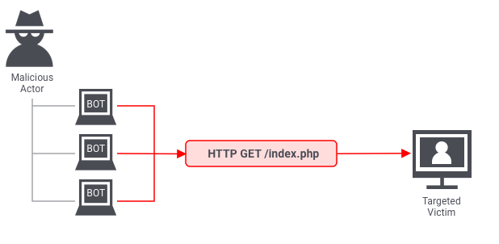
Application level Attack HTTP Flood attack
The application layer is where the server generates the response to an incoming client request.
For example, if a user enters http://www.xyz.com/learning/ on their browser, an HTTP request is sent to the server, requesting the learning page.
The server will fetch all the information related to the page, package it in a response, and send it back to the browser.
This information fetching and packaging happens on the application layer.
An application layer attack occurs when a hacker uses different bots/machines to repeatedly request the same resource from the server, eventually overwhelming it.
The most common type of application layer attacks are the HTTP flood attacks in which malicious actors just keep sending various HTTP requests to a server using different IP addresses.
One example of this is asking a server to generate PDF documents over and over again.
Since the IP address and other identifiers change in every request, the server can’t detect that it’s being attacked.

Slide 10
Layer 3 & 4 Infrastructure layer attacks
The most common DDoS attacks are infrastructure layer attacks
User Datagram Protocol (UDP) reflection attacks
SYN floods
TCP middlebox reflection
An attacker can use either of these methods to generate large volumes of traffic that can inundate the capacity of a network or tie up resources on systems such as servers, firewalls, intrusion prevention system (IPS), or load balancer.
While these attacks can be easy to identify, to mitigate them effectively, you must have a network or systems that scale up capacity more rapidly than the inbound traffic flood.
This extra capacity is necessary to either filter out or absorb the attack traffic freeing up the system and application to respond to legitimate customer traffic.

Slide 11
Infra layer attacks: UDP Reflection
Reflection Attacks: These are types of cyber attacks where the attacker sends requests to a server (the reflector) with a forged source IP address (the target's address). The server responds to the target, unaware of the spoofing. This results in amplified traffic being sent to the victim, overwhelming their network.
IP Spoofing: This is a key technique in reflection attacks. The attacker falsifies the source IP address in the packets sent to the reflector servers, making it appear as though the requests came from the victim.
UDP reflection attacks exploit the fact that UDP is a stateless protocol. Unlike TCP, UDP does not establish a connection before sending data and does not confirm if the data is received. It simply sends packets to the recipient. This makes it faster, but also susceptible to being used in reflection attacks.
The amplification factor is the ratio of response size to request size, and it varies depending on which protocol the attacker uses:
DNS Network
Time Protocol (NTP)
Simple Service Directory Protocol (SSDP)
Connectionless Lightweight Directory Access Protocol (CLDAP)
Memcached
Character Generator Protocol (CharGen)
Quote of the Day (QOTD).
For example, the amplification factor for DNS can be 28 to 54 times (general numbers, depends on particular dns server, request and etc; shows show dns response can be amplified) the original number of bytes. So, if an attacker sends a request payload of 64 bytes to a DNS server, they can generate over 3400 bytes of unwanted traffic to an attack target. UDP reflection attacks are accountable for larger volume of traffic in comparison to other attacks.
It should be noted that reflection attacks, while they provide attackers with "free" amplification, require IP spoofing capability and as increasing numbers of network providers adopt Source Address Validation Everywhere (SAVE) or BCP38, this capability is removed, requiring DDoS service providers cease reflection attacks or to relocate to data centers and network providers who do not implement source address validation.
SAVE (Source Address Validation Everywhere) and BCP38 (Best Current Practice 38) are initiatives aimed at improving internet security by preventing IP address spoofing.
SAVE: SAVE is a filtering method that prescribes the use of valid and legitimately reachable source addresses. In other words, SAVE blocks IP addresses that are forged or not assigned to the device that is sending them. This means devices in the receiving network will know the packet they are receiving will contain a legitimate IP address.
BCP38: Specifically focuses on preventing IP spoofing at the network edge (filtering on the edge), where ISPs (Internet Service Providers) connect to their customers.

Slide 12
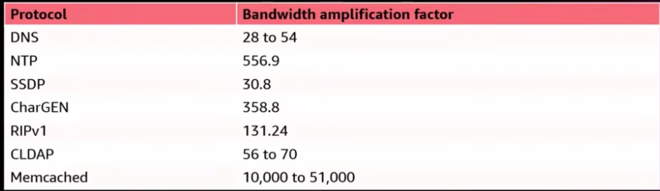
Protocols Amplification factor

Slide 13
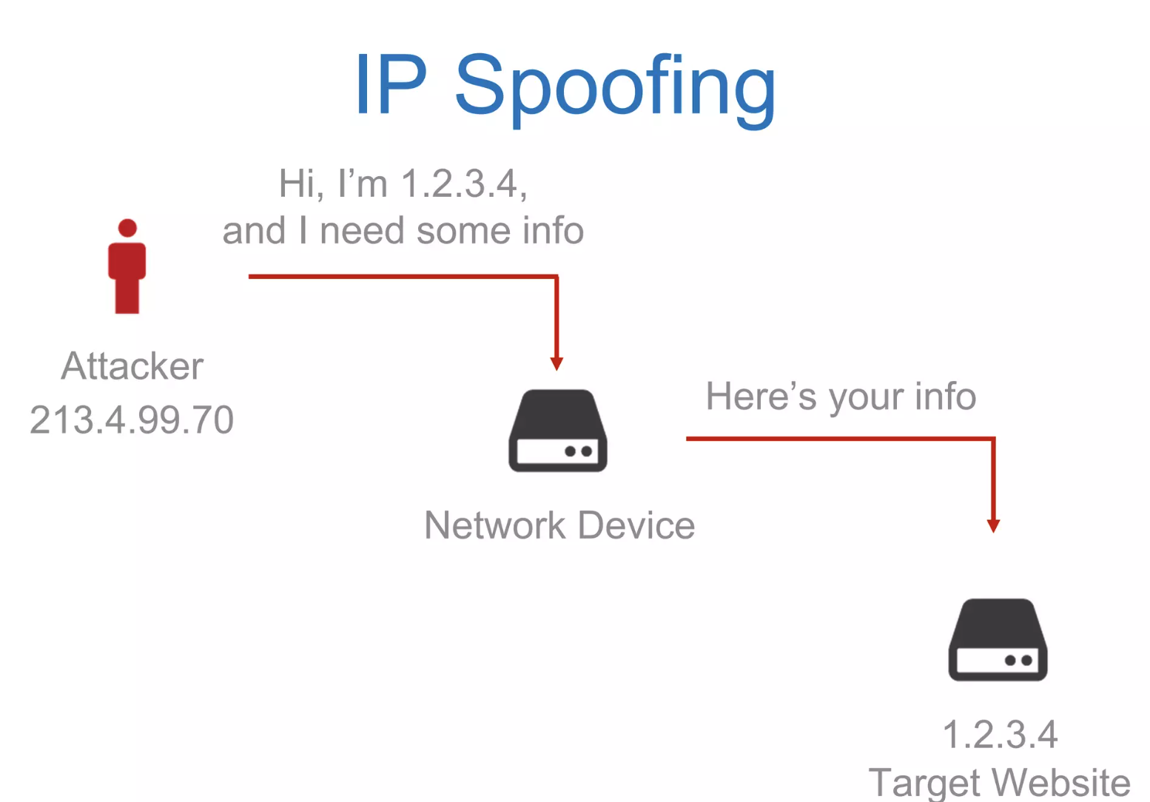
IP Spoofing

Slide 14
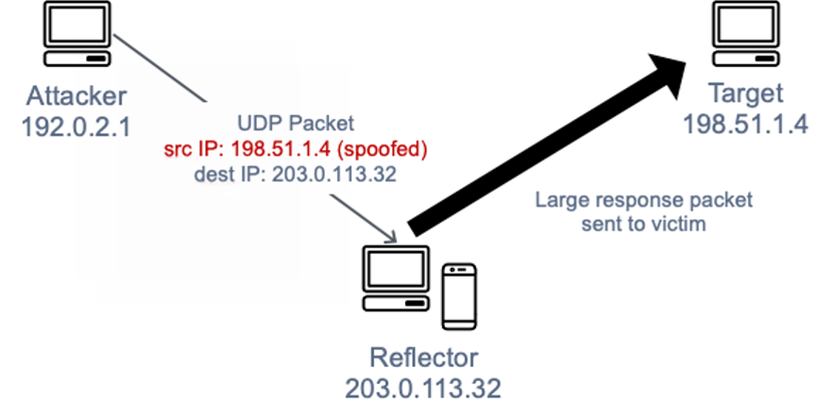
Infra layer attacks: UDP Reflection
Attackers can craft a valid UDP request packet listing the attack target’s IP address as the UDP source IP address.
The attacker has now falsified—spoofed—the UDP request packet’s source IP.
The UDP packet contains the spoofed source IP and is sent by the attacker to an intermediate server.
The server is tricked into sending its UDP response packets to the targeted victim IP rather than back to the attacker’s IP address.
The intermediate server is used because it generates a response that is several times larger than the request packet, effectively amplifying the amount of attack traffic sent to the target IP address.
Attacker: The individual initiating the attack has an IP address of 192.0.2.1.
UDP Packet: The attacker sends a UDP packet to a reflector server. The source IP is spoofed, which means it's falsified to appear as if it's coming from the target's IP address, 198.51.1.4.
Reflector: This is the server that receives the spoofed request. Its IP address is 203.0.113.32.
Target: The intended victim of the attack, with an IP address of 198.51.1.4.
Large Response: The reflector server responds to the spoofed source IP, sending the large response packet to the target, not the attacker, which can overload the target’s system

Slide 15
Infra layer attacks: SYN flood
TCP Three-Way Handshake: Normally, a TCP connection starts with a three-way handshake. The client sends a SYN (synchronize) packet to the server, the server responds with a SYN-ACK (synchronize-acknowledge) packet, and the client responds with an ACK (acknowledge) packet.
SYN Flood Mechanics: In a SYN Flood attack, the attacker sends a large number of SYN packets to the target's IP address, often using fake IP addresses.
Half-Open Connections: The server, expecting to complete the handshake, replies with SYN-ACK packets and waits for the ACK response, which never comes. These incomplete handshakes are known as half-open connections.
Resource Exhaustion: Each half-open connection consumes server resources. As the number of such connections increases, the server spends more time and resources managing these connections.
Server Overload: Eventually, the server's connection table fills up, preventing it from accepting new legitimate connections. This can lead to server slowdown or even a complete shutdown, effectively denying service to legitimate users.
Amplification through Botnets: Often, SYN Flood attacks are distributed, meaning they originate from multiple sources simultaneously. Attackers often use botnets (networks of infected computers) to increase the attack's volume and effectiveness.
Mitigation and Defense: Defending against SYN Flood attacks involves steps like setting SYN-ACK timeout values, using SYN cookies, and employing firewalls and anti-DDoS solutions that can identify and mitigate such traffic patterns.

Slide 16
Infra layer attacks: SYN flood SYN Cookies
SYN cookies are a technique used to protect a server from a SYN Flood DDoS attack. SYN cookies allow the server to handle many connection requests without needing to keep a record of each connection until it is fully established, thereby conserving resources and mitigating the attack.
Initial SYN Request: When a client sends a SYN request to initiate a TCP connection, the server normally allocates resources for this connection and responds with a SYN-ACK packet.
Cookie Generation: Instead of allocating resources, the server uses the SYN cookie technique. It calculates a cryptographic hash (the SYN cookie) based on the client's IP address, port number, and other parameters. This cookie is encoded in the sequence number field of the SYN-ACK packet sent back to the client.
Server Statelessness: The server does not store any state or information about this half-open connection. This is the key difference from the normal operation where the server would keep track of each connection attempt.
Client Response: If the client's request was legitimate, it responds with an ACK packet. This ACK contains the sequence number which, when received by the server, can be used to decode the SYN cookie.
Cookie Verification: The server verifies the SYN cookie using the same hashing algorithm. If the cookie is valid, the server concludes that the initial SYN request was legitimate and proceeds to establish the connection, allocating resources at this point.
Handling Legitimate Connections: Legitimate clients, unaware of the SYN cookie process, seamlessly complete the handshake, enabling a normal connection.
Blocking Malicious Requests: Attackers sending large volumes of SYN requests do not usually respond correctly to the SYN-ACK packets. Since the server doesn’t allocate resources for each SYN request and only does so for requests with a valid ACK response, it effectively mitigates the impact of the SYN Flood attack.
SYN cookies are particularly effective because they allow the server to handle legitimate traffic normally while filtering out malicious connection attempts. This technique is a form of stateless connection management, which is crucial in defending against resource-exhaustion attacks like SYN Floods.

Slide 17
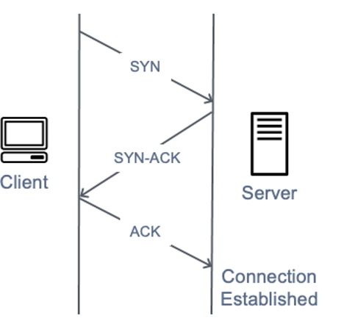
Infra layer attacks: SYN flood
When a user connects to a Transmission Control Protocol (TCP) service, such as a web server, their client sends a SYN packet
SYN: The client sends a SYN (synchronize) packet to the server to initiate a conversation.
SYN-ACK: The server responds with a SYN-ACK (synchronize-acknowledge) packet to acknowledge the client's request.
ACK: Finally, the client sends an ACK (acknowledge) packet back to the server. After this, the connection is established, and data transmission can begin.

Slide 18
Infra layer attacks: TCP middlebox
https://www.usenix.org/system/files/sec21fall-bock.pdf
The TCP middlebox reflection attack is a type of cyber attack that exploits vulnerabilities in TCP middleboxes, such as firewalls, which do not fully comply with TCP standards.
In this attack, an attacker sends packets to these middleboxes with a forged source IP address—that of the intended victim.
The middlebox, upon receiving these packets, responds to the victim's address.
This technique amplifies the volume of traffic directed at the victim, overwhelming their network resources.
The amplification effect varies based on how different vendors have implemented their TCP middlebox features.
Discovered in academic research in 2021, this attack vector has been observed in real-world scenarios since early 2022, posing a significant threat due to its potential for high amplification, sometimes exceeding known UDP-based amplification methods.

Slide 19
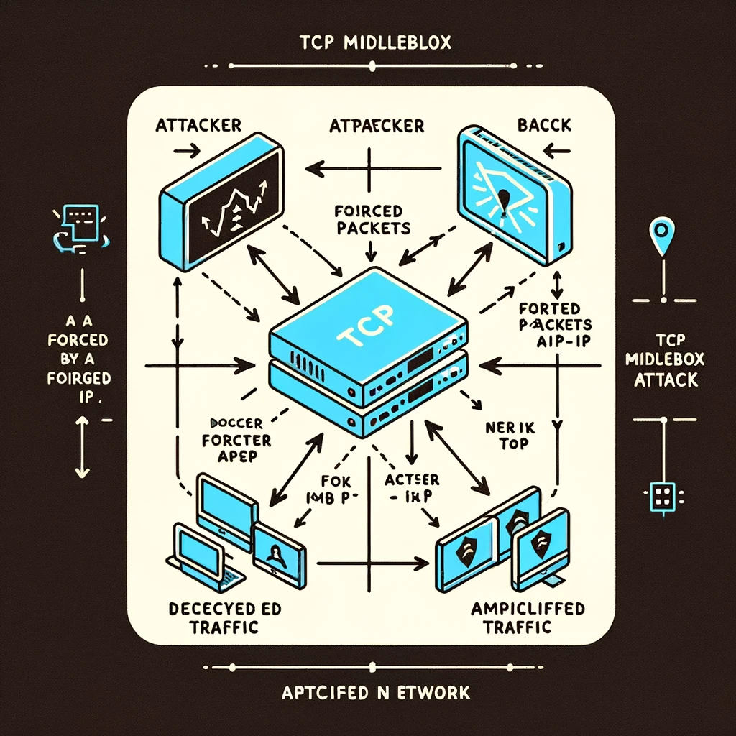
Infra layer attacks: TCP middlebox
Attacker: This is typically an entity or system that sends malicious traffic.
Forged Packets:
The attacker sends packets to the TCP middlebox.
These packets are "forged" in the sense that they carry a false source IP address, which is the IP address of the victim.
TCP Middlebox (Firewall):
In the center of the diagram is the TCP middlebox, often a firewall.
This device is supposed to inspect and control the flow of network traffic.
However, in this scenario, it's tricked by the forged packets from the attacker.
Amplified Traffic to Victim's Network:
The TCP middlebox, deceived by the forged source IP in the packets, sends a response to what it believes is the initiating source.
However, since the source IP is forged, this traffic is sent to the victim's network.
This response is typically larger in volume compared to the initial packets sent by the attacker, creating an amplification effect.
Victim's Network:
On the right side of the diagram, the victim's network receives the unwanted, amplified traffic.
This can overwhelm the network's resources, leading to a denial of service.

Slide 20
Stopping an In-Progress DDoS Attack
To be able to stop a DDoS attack, you must know the most common symptoms.
Usual DDoS symptoms
Large amounts of traffic coming from clients with same or similar characteristics. E.g. device type, browser type/version, IP or IP range, and location etc.
An exponential, unexpected rise in traffic at a single endpoint/server.
A server starts repeatedly crashing for no reason.
Your website is taking too long to respond to requests.
Responding to a DDoS attack
Once you have identified a DDoS attack, it’s important to act quickly as it gives you an opportunity to prevent serious downtime. If you wait too long, your server may start crashing, and full recovery may take hours.
The hardest part about mitigating a DDoS attack is that often it’s virtually impossible to do so without impacting legitimate traffic. This is because attackers go to great lengths to masquerade fake traffic as real. With that said, here are some ways you can respond:
Blackhole filtering: Go through incoming traffic and determine a limitation criterion. Use the criterion to route malicious traffic into a blackhole, essentially dropping it.
Casting: Distribute the traffic across multiple servers, increasing your capacity, and decreasing the chances of individual servers getting overwhelmed.
IP Blocking: If you are noticing unexpectedly high traffic from the same range of IP addresses, block them.

Slide 21
Preventing a DDoS Attack
Stopping an active DDoS attack can be hard and may affect your legitimate users. This is why it’s important to take a preemptive approach.
In addition to the preventive measures mentioned below, you should also create an emergency DDoS incident response plan, as even the best defenses can sometimes succumb to sophisticated attacks.
Real-time packet analysis: Analyze packets based on different rules, as they enter your system, discarding the potentially malicious ones.
DDoS defense system (DDS): A DDS can detect legitimate-looking content with malicious intent. It protects against both protocol and volumetric attacks, without requiring any human intervention.
Web application firewall: Web application firewalls (WAF) are a great tool to mitigate application layer DDoS attacks. They give you a way to filter incoming requests, based on different rules, which can also be added on-the-fly, in response to an attack.
Rate limiting: Limit the number of requests a server can entertain over a certain time period.

Slide 22
Ddos Simulation Testing on AWS
https://aws.amazon.com/security/ddos-simulation-testing/
DDoS simulation testing must be performed by an AWS Partner Network (APN) Partner that has been pre-approved by AWS to conduct DDoS simulation tests (AWS DDoS Test Partner).
The target of the DDoS simulation test must be either registered as a Protected Resource in an AWS account you own that is subscribed to AWS Shield Advanced or an Amazon API Gateway edge-optimized API endpoint that resides in an account you own subscribed to AWS Shield Advanced.
The bit volume of the DDoS simulation test may not exceed 20 gigabits per second.
The packet volume of the DDoS simulation test may not exceed 5 million packets per second when testing an Amazon CloudFront distribution and may not exceed 50,000 packets per second when testing any other type of AWS resource.
The request volume of the DDoS simulation test may not exceed 50,000 requests per second.
The DDoS simulation test may not originate from an AWS resource and may not use an AWS resource in an attempt to simulate an amplification attack.
You assume the risk of all DDoS simulation testing and are responsible for the actions of the test vendor.
AWS may instruct the test vendor to terminate the simulation testing at any time.
Your performance of the testing and the results of the testing are AWS Confidential Information, as defined in the AWS Customer Agreement.

Slide 23
AWS Best Practices for Ddos Resiliency
https://docs.aws.amazon.com/whitepapers/latest/aws-best-practices-ddos-resiliency/aws-best-practices-ddos-resiliency.html
https://docs.aws.amazon.com/whitepapers/latest/aws-best-practices-ddos-resiliency/introduction-denial-of-service-attacks.html

Slide 24
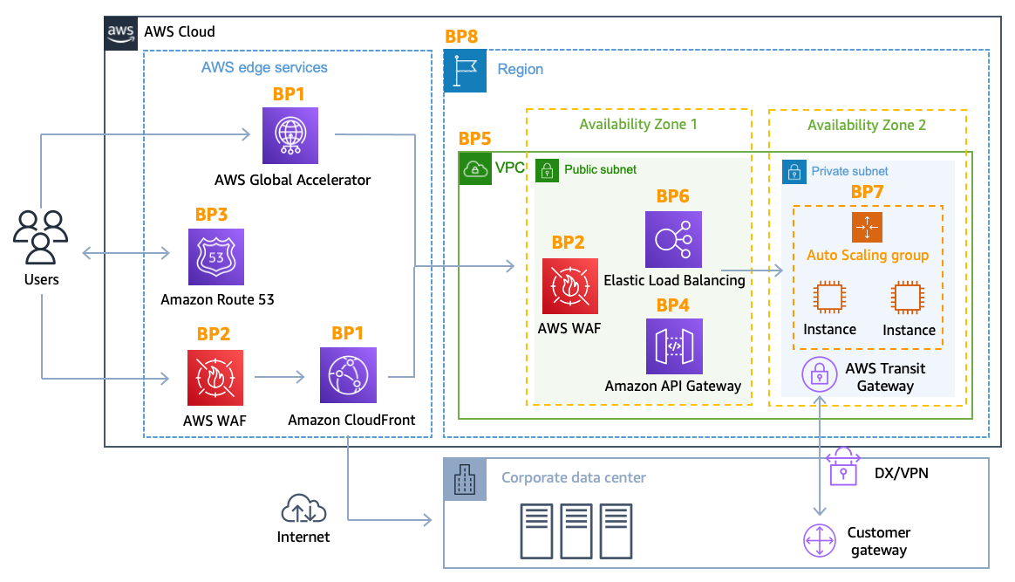
Mitigation techniques in AWS

Slide 25
Elastic Load Balancing (BP6)
For web applications, you can use the Application Load Balancer to route traffic based on content and accept only well-formed web requests.
Application Load Balancer blocks many common DDoS attacks, such as SYN floods or UDP reflection attacks, protecting your application from the attack.
Application Load Balancer automatically scales to absorb the additional traffic when these types of attacks are detected.
Scaling activities due to infrastructure layer attacks are transparent for AWS customers and do not affect your bill.
For non HTTP/HTTPS applications, you can use Network Load Balancer to route traffic to targets (for example, Amazon EC2 instances) at ultra-low latency.
One key consideration with Network Load Balancer is that any TCP SYN or UDP traffic that reaches the load balancer on a valid listener will be routed to your targets, not absorbed, however this does not apply for TLS-listeners which terminate the TCP connection.
For Network Load Balancers with TCP listeners AWS recommends deploying Global Accelerator to protect against SYN flood.
You can use Shield Advanced to configure DDoS protection for Elastic IP addresses. When an Elastic IP address is assigned per Availability Zone to the Network Load Balancer, Shield Advanced will apply the relevant DDoS protections for the Network Load Balancer traffic.

Slide 26
Elastic Load Balancing (BP6)
https://docs.aws.amazon.com/AWSEC2/latest/UserGuide/security-group-connection-tracking.html#untracked-connections
Security Groups and Connection Tracking:
Security groups control inbound and outbound traffic to AWS resources. They can be configured to allow traffic from any IP address, but this means they need to keep track of each connection to ensure that response traffic is allowed back out. This is known as connection tracking.
Impact on Load Balancers:
Connection tracking requires resources and memory. There is a limit to how many concurrent connections a security group can track.
If a load balancer is behind a security group that tracks connections, during a DDoS attack, the number of connections can quickly exhaust the tracking limits, preventing new legitimate connections from being established.
Configuring Security Groups for DDoS Resilience:
To make an AWS load balancer more resilient to DDoS attacks, you can configure its security group to avoid using connection tracking.
This is done by setting both inbound and outbound rules to allow traffic from any IP address. By doing so, the response traffic is allowed by the security group rules directly, rather than relying on connection tracking.
This configuration allows load balancers like the Classic and Application Load Balancer to scale and handle traffic increases without being limited by connection tracking resources.
When Avoiding Connection Tracking is Beneficial:
Avoiding connection tracking is particularly useful when the DDoS traffic comes from IP addresses that are allowed by the security group. If the attack originates from disallowed sources, it won't impact the connection tracking because these connections would be blocked outright.
When Connection Tracking is Not a Concern:
If your security group is configured to allow traffic only from trusted sources (like a corporate firewall, VPN, or CDN), you may not need to avoid connection tracking because the likelihood of these trusted sources participating in a DDoS attack is low.

Slide 27
Domain name resolution at the edge (BP3)
Amazon Route 53 is a highly available and scalable Domain Name System (DNS) service that can be used to direct traffic to your web application.
It's the only AWS service that has a 100% data plane availability SLA.
An NXDOMAIN attack is a type of DDoS attack where an attacker queries a DNS server with random, non-existent subdomain requests.
Since the subdomains don't exist, the server responds with NXDOMAIN (non-existent domain) responses.
The volume of these queries can overwhelm the DNS server, leading to legitimate queries being dropped or delayed.

Slide 28
Load testing & Incident Response
https://docs.aws.amazon.com/prescriptive-guidance/latest/load-testing/welcome.html
https://docs.aws.amazon.com/whitepapers/latest/aws-security-incident-response-guide/aws-security-incident-response-guide.html
https://aws.amazon.com/security/penetration-testing/
https://aws.amazon.com/ec2/testing/

