Slide 1
AWS Graviton Processors

Slide 2
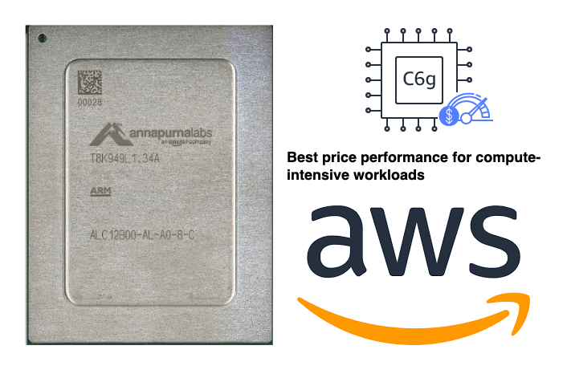
Introduction to AWS Graviton Processors
Introduce AWS Graviton Processors as cutting-edge, ARM-based CPUs developed by AWS.
Historical perspective: Trace the development from the first Graviton processor to the advanced Graviton3.
Key attributes: Exceptional performance per watt, reduced costs, and custom-built for cloud-native application

Slide 3
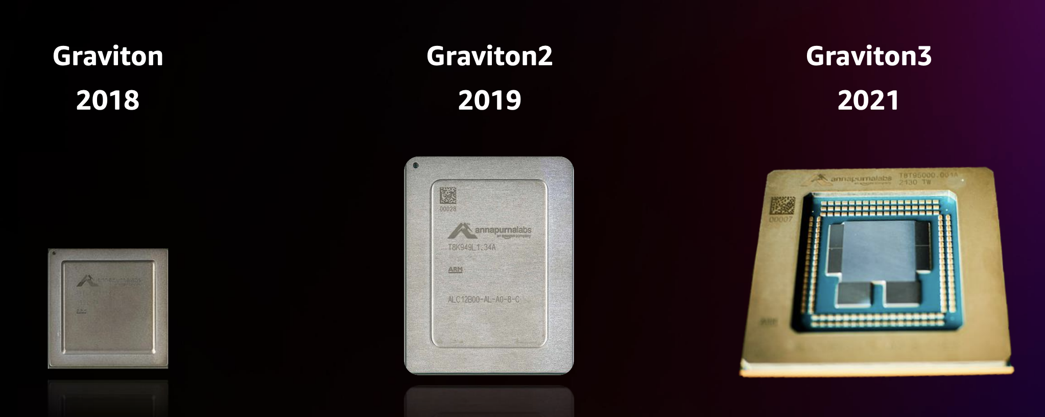
Graviton vs Graviton2 vs Graviton3

Slide 4
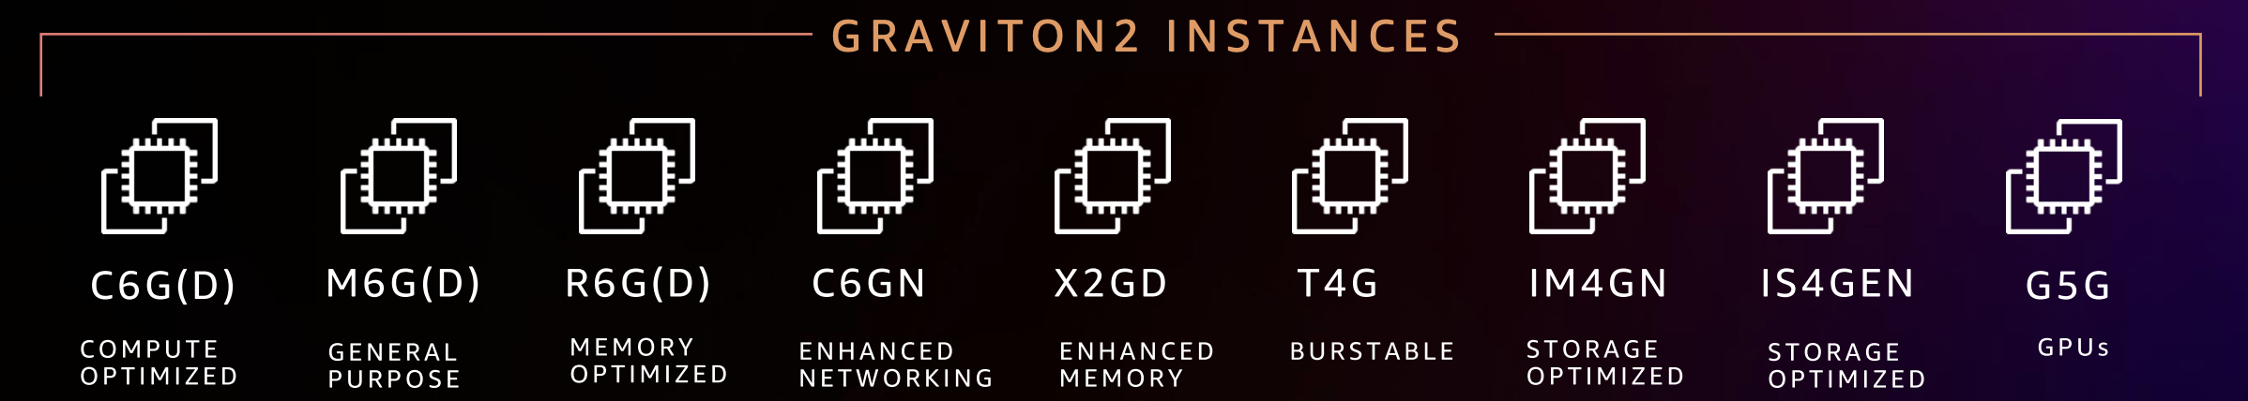
AWS Graviton2 instances

Slide 5
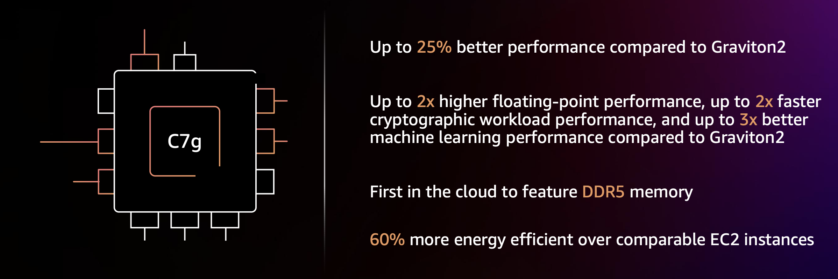
AWS Graviton3 based instance

Slide 6
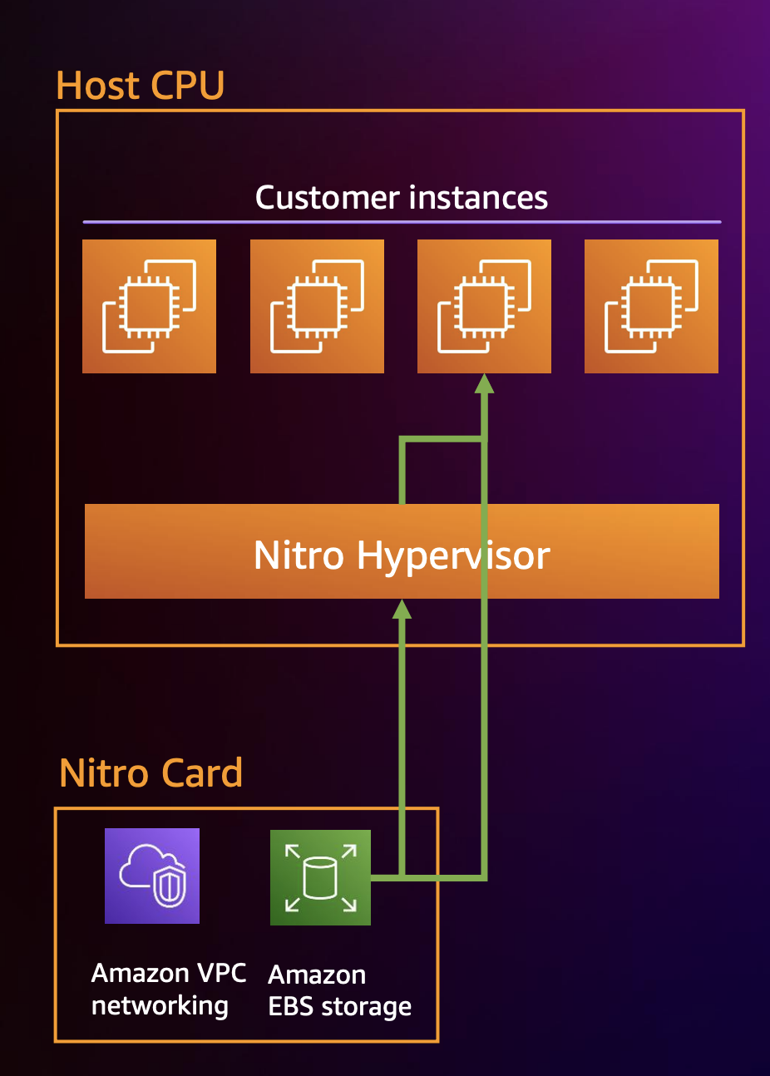
AWS Graviton 2 & 3 Direct interrupt Injection

Slide 7
Performance Benefits of AWS Graviton
Detail the performance superiority: Benchmarks showing significant improvement in compute-intensive operations compared to traditional x86 processors.
Focus on energy efficiency: Emphasize the environmental benefits of Graviton's lower power requirements.
Illustrate ideal workload scenarios: Enhanced performance for web servers, containerized applications, data analytics, and gaming servers.

Slide 8
Integration with AWS Ecosystem
Explore the seamless synergy with AWS services: Enhanced compute capabilities when used with Amazon EC2 instances, AWS Lambda functions, and AWS container services.
Dive into software ecosystem compatibility: Support for a wide range of operating systems, programming languages, and software stacks.
Future outlook: Discuss the evolving role of Graviton processors in shaping next-generation cloud solutions and AWS's vision for an ARM-based cloud ecosystem.

Slide 9
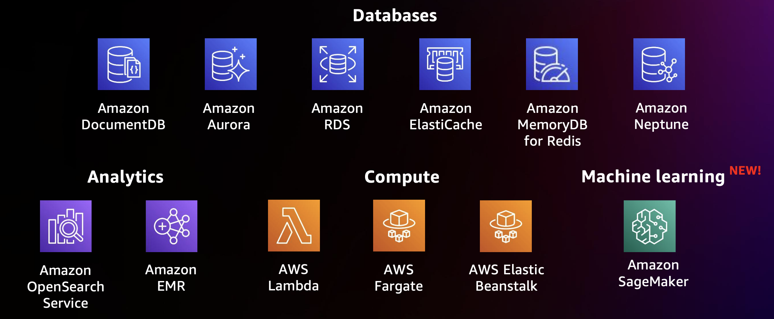
AWS Managed services supporting Graviton

Slide 10
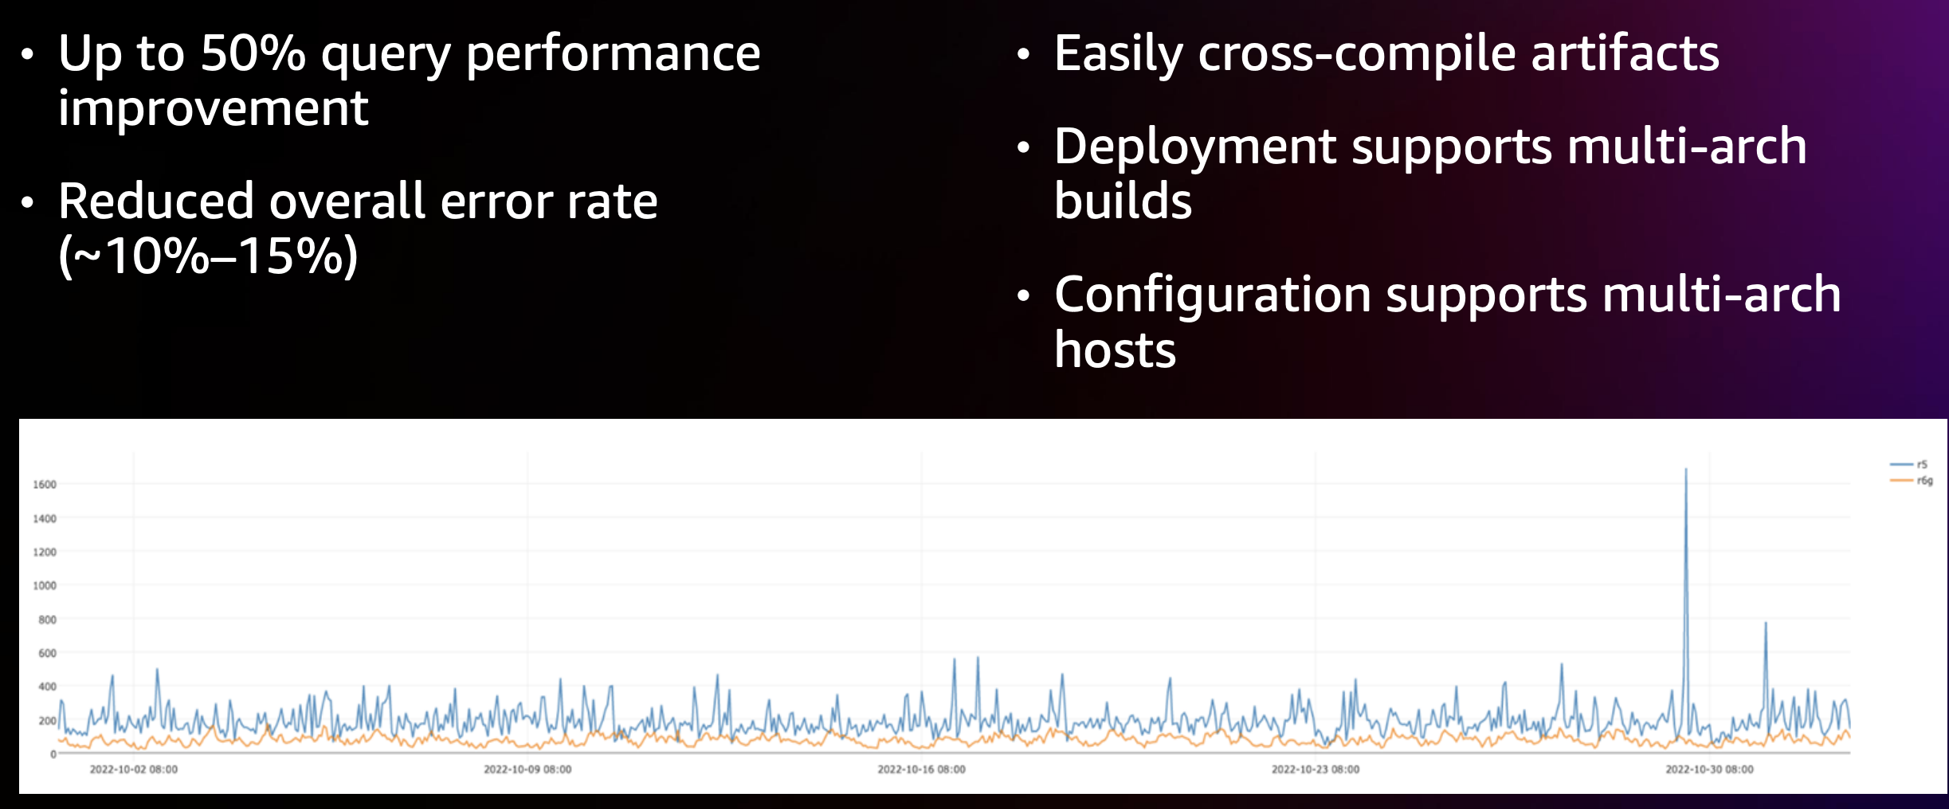
Stripe migration results

Slide 11

AWS Graviton
Best practices:
https://github.com/aws/aws-graviton-getting-started
Fast Start:
https://aws.amazon.com/ec2/graviton/fast-start/

