Slide 1
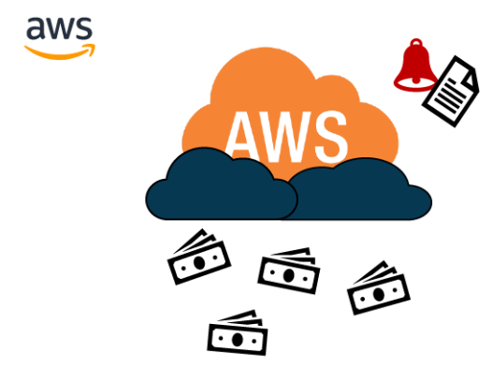
AWS Budget
With AWS Budgets, you can set custom spending plans on AWS for a specific period. You will also receive an alert if your AWS costs or usage exceeds or is projected to exceed your set spending limit.
AWS Budgets enable you to plan your service usage, service costs, and instance reservations. Budgets provide you with a way to see the following information:
How close your plan is to your budgeted amount or to the free tier limits
Your usage to date, including how much you have used of your Reserved Instances (RIs)
Your current estimated charges from AWS and how much your redicted usage will incur in charges by the end of the month
How much of your budget has been used
Create budget and send alarms when costs exceeds the budget
Up to 5 SNS notifications per budget
Can filter by: Service, Linked Account, Tag, Purchase Option, Instance Type, Region, Availability Zone, API Operation
Same options as AWS Cost Explorer!
2 budgets are free, then $0.02/day/budget

Slide 2
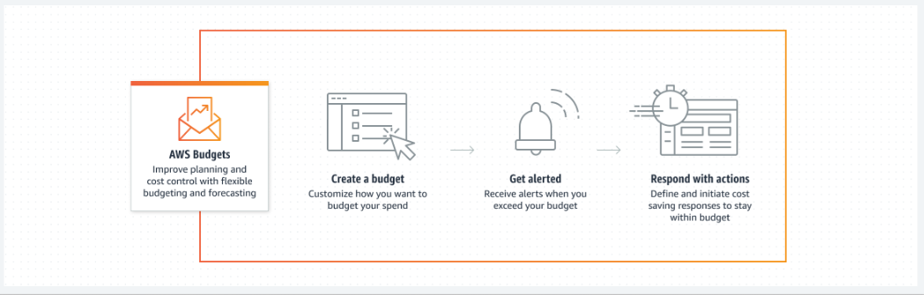
AWS Budget Architecture

Slide 3
There are several ways to set your usage or costs budget:
Fixed budget—monitor a fixed budgeted amount over all periods.
Planned budget—monitor different amounts based on quarterly or monthly budgets. You can plan your budget for up to a year (4 quarters/12 months), after which the last planned budget will become a fixed budget.
Auto-adjusted budget—dynamically set your budgeted amount based on usage or spending over a specified time range. The time range you choose is the baseline for auto-adjusting the budget, with AWS Budgets calculating the budget for each period based on your baseline. Choosing the right time range for your expected usage or costs is important to avoid receiving too few or too many alerts.

Slide 4
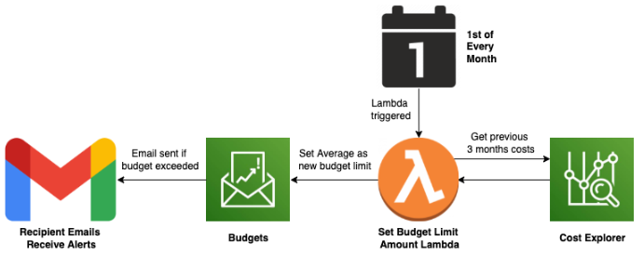
Auto-adjusting AWS Budget Alerts
AWS Budgets are a part of AWS Billing. Budgets are configured to send alert emails when we exceed customisable thresholds or when we’re forecast to exceed them. Currently we have two active budgets for all expenditures, one for actual expenditure and the other for forecast expenditure. The threshold is the same for both budgets, and can be set individually withing the module.
On the first of each month the set_budget_limit_amount_lambda runs. This lambda accesses the AWS Cost Explorer Client via Boto3. It then calculates the average expenditure over the past three months and sets that amount as the new threshold limit for both the actual and forecast Budgets. This ensures that the budget thresholds remains relevant.
The Lambda automatically sets the actual and forecast budget to the same value, but could be refactored to set them individually, should the need arise.

Slide 5
Types of budgets
Cost budgets – Plan how much you want to spend on a service.
Usage budgets – Plan how much you want to use one or more services.
RI utilization budgets – Define a utilization threshold and receive alerts when your RI usage falls below that threshold. This lets you see if your RIs are unused or under-utilized.
RI coverage budgets – Define a coverage threshold and receive alerts when the number of your instance hours that are covered by RIs fall below that threshold. This lets you see how much of your instance usage is covered by a reservation.
Savings Plans utilization budgets – Define a utilization threshold and receive alerts when the usage of your Savings Plans falls below that threshold. This lets you see if your Savings Plans are unused or under-utilized.
Savings Plans coverage budgets – Define a coverage threshold and receive alerts when your Savings Plans eligible usage that is covered by Savings Plans fall below that threshold. This lets you see how much of your instance usage is covered by Savings Plans.
Note : For Reserved Instances (RI):
• Track utilization
• Supports EC2, ElastiCache, RDS, Redshift

Slide 6

What Is AWS Cost Explorer?
AWS Cost Explorer is a tool that enables you to view and analyze your costs and usage. You can explore your usage and costs using the main graph, the Cost Explorer cost and usage reports, or the Cost Explorer RI reports.
You can view data for up to the last 12 months, forecast how much you're likely to spend for the next 12 months, and get recommendations for what Reserved Instances to purchase.
You can use Cost Explorer to identify areas that need further inquiry and see trends that you can use to understand your costs.

Slide 7
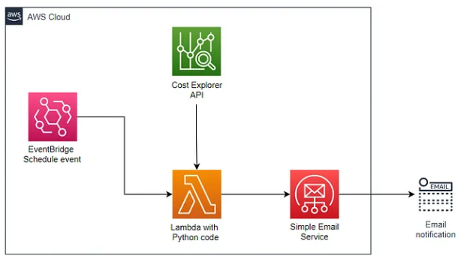
Example architecture
To enable email sending through AWS SES, we need to add and verify an email identity within the SES console.
To schedule the execution of the solution, we will create an EventBridge event rule. In the rule configuration, we will select the rule type as “schedule” and set a cron expression to specify the desired execution time.
In this case, the cron expression used is “030 5 ? *”, which corresponds to 11:00 AM IST (Indian Standard Time). Additionally, we will set the Lambda function as the target for this event rule, ensuring that it gets triggered at the specified time for generating the cost report.

Slide 8
Cost Explorer reports
Cost Explorer provides default reports, but also enables you to change the filters and constraints used to create the reports.
Cost Explorer also provides you ways to save the reports that you made. You can save them as a bookmark, download the CSV file, or save them as a report.

Slide 9
The Differences Between AWS Budgets And Cost Explorer
Cost Explorer :
Cost Explorer creates custom reports to help analyze usage and cost data.
With Cost Explorer, you visualize, analyze, and report costs after incurring them.
Cost Explorer does not just display historical data. It also provides recommendations for optimizing your cloud spend.
Usage:
Use Cost Explorer to analyze your existing costs.
Still, you can use Cost Explorer's filters and grouping mechanisms to figure out where your AWS money is going. You can also calculate future cost allocations with its historical cost and usage data (past 13 months).
Cost Explorer also uses rule-based models to offer optimization recommendations to reduce unnecessary spending.
Budgets:
Budgets helps set custom spending plans so you can control costs and forecast future spending.
In addition, Budgets focus on cost planning, enforcement, and forecasting costs that are yet to occur.
AWS Budgets displays current, budgeted, and forecasted cost and usage data.
Usage:
Budgets are helpful when you want to set a custom spending limit and compare your actual spending to your budget. The goal here is to let you know when you are approaching your AWS spending limit so you can take action to avoid overspending.
Using AWS Budgets, you can also project the costs for the following month based on the last five months and the current one. This feature requires at least five weeks of usage and cost data.

Slide 10
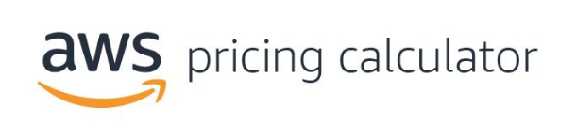
How calculate price of your AWS solution?
Estimate the cost of your architectural solution using AWS Pricing Calculator
AWS Pricing Calculator is a web-based planning tool that you can use to create estimates for your AWS use cases. You can use it to model your solutions before building them, explore the AWS service price points, and review the calculations behind your estimates.
You can use it to help you plan how you spend, find cost saving opportunities, and make informed decisions when using Amazon Web Services.
AWS Pricing Calculator is useful for those who have never used AWS. It's also useful for those who want to reorganize or expand their AWS usage. You don't need any experience with the cloud or AWS to use AWS Pricing Calculator.

Slide 11
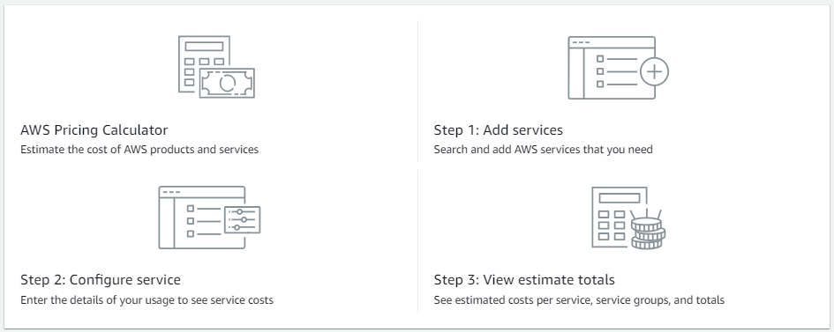
How it works

Slide 12
Features of AWS Pricing Calculator
With AWS Pricing Calculator, you can do the following tasks:
View transparent prices – See the calculations behind the estimated prices for your service configurations. You can view price estimates by service or by groups of services to analyze your architecture costs.
Use groups for hierarchical estimates – Sort your estimates into groups to align with your architecture for clear service cost analysis.
Share your estimates – Save the link to each estimate to share or revisit at a later time. Estimates are saved to the AWS public servers.
Export your estimates – Export your estimates in CSV or PDF format to share locally with your stakeholders.

Slide 13
Pricing for AWS Pricing Calculator
AWS Pricing Calculator is provided at no charge. It provides an estimate of your AWS fees and charges, but the estimate doesn't include any taxes that might apply.
AWS Pricing Calculator provides pricing details for only the information you enter. If the prices on the marketing pages are different from the prices that AWS Pricing Calculator uses, AWS honors the prices from the marketing pages.

