Slide 1

AWS Shield

Slide 2

AWS Shield
AWS Shield is a managed Distributed Denial of Service (DDoS) protection service that safeguards applications running on AWS.
AWS Shield provides always-on detection and automatic inline mitigations that minimize application downtime and latency, so there is no need to engage AWS Support to benefit from DDoS protection.
There are two tiers of AWS Shield – Standard and Advanced.

Slide 3
AWS Shield Standard
All AWS customers benefit from the automatic protections of AWS Shield Standard, at no additional charge.
AWS Shield Standard defends against most common, frequently occurring network and transport layer DDoS attacks that target web sites or applications.
When using AWS Shield Standard with Amazon CloudFront and Amazon Route 53, you receive comprehensive availability protection against all known infrastructure (Layer 3 and 4) attacks.

Slide 4
AWS Shield Advanced
Optional DDoS mitigation service ($3,000 per month per organization)
Protect against more sophisticated attack on Amazon EC2, Elastic Load Balancing (ELB), Amazon CloudFront, AWS Global Accelerator, and Route 53
24/7 access to AWS DDoS response team (DRP)
Protect against higher fees during usage spikes due to DDoS
Shield Advanced automatic application layer DDoS mitigation automatically creates, evaluates and deploys AWS WAF rules to mitigate layer 7 attacks

Slide 5
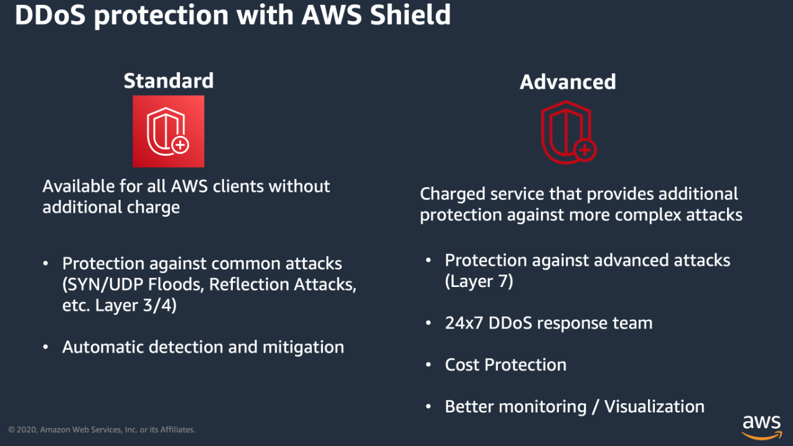
AWS Shield take away

Slide 6
Important Metrics Shield Advanced
This metrics can help you detect if there is a Ddos attack happening:
DDosDetected
DDosAttackbitsPerSecond
DDosAttackPacketsPerSecond
DDosAttackRequestsPerSecond

Slide 7
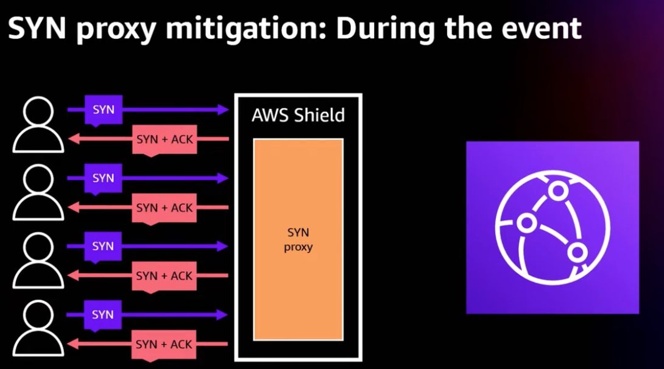
AWS Shied SYN mitigation

Slide 8
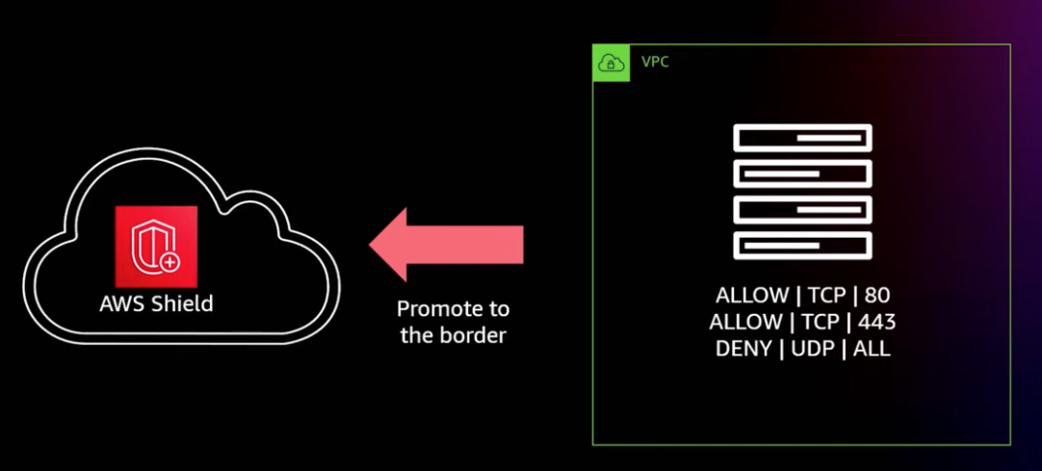
AWS Shield Advanced NACL usage

