Slide 1
AWS WAF

Slide 2
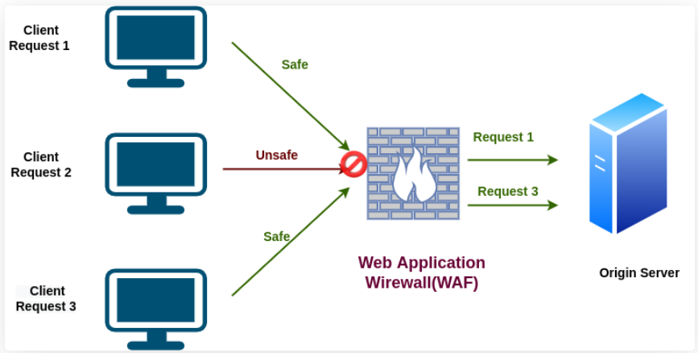
AWS Web Application Firewall (WAF)
AWS WAF is a web application firewall that helps protect your web applications from common web exploits that could affect application availability, compromise security, or consume excessive resources.
AWS WAF helps protect web applications from attacks by allowing you to configure rules that allow, block, or monitor (count) web requests based on conditions that you define.
These conditions include IP addresses, HTTP headers, HTTP body, URI strings, SQL injection and cross-site scripting.
Can allow or block web requests based on strings that appear in the requests using string match conditions.

Slide 3
AWS Web Application Firewall (WAF)
AWS WAF can match values in the following request parts:
Header – A specified request header, for example, the User-Agent or Referer header.
HTTP method – The HTTP method, which indicates the type of operation that the request is asking the origin to perform. CloudFront supports the following methods: DELETE, GET, HEAD, OPTIONS, PATCH, POST, and PUT.
Query string – The part of a URL that appears after a ? character, if any.
URI – The URI path of the request, which identifies the resource, for example, /images/daily-ad.jpg.
Body – The part of a request that contains any additional data that you want to send to your web server as the HTTP request body, such as data from a form.
Single query parameter (value only) – Any parameter that you have defined as part of the query string.
All query parameters (values only) – As above buy inspects all parameters within the query string.

Slide 4
AWS Web Application Firewall (WAF)
Protects your web applications from common web exploits (Layer 7)
WAF is not for DDos protection
Layer 7 is HTTP (vs Layer 4 is TCP/UDP)
Deploy on :
Application Load Balancer (localized rules)
API Gateway (running at the regional or edge level)
CloudFront (rules globally on edge locations)
AppSync GraphQL API
Cognito User Pool

Slide 5
AWS Web Application Firewall (WAF)
Define Web ACL (Web Access Control List) Rules:
IP Set: up to 10,000 IP addresses – use multiple Rules for more IPs
HTTP headers, HTTP body, or URI strings Protects from common attack - SQL
injection and Cross-Site Scripting (XSS)
Size constraints, geo-match (block countries)
Rate-based rules (to count occurrences of events) – for DDoS protection
Web ACL are Regional except for CloudFront
A rule group is a reusable set of rules that you can add to a web ACL

Slide 6
AWS Web Application Firewall (WAF) - Full feature API
AWS WAF can be completely administered via APIs.
This provides organizations with the ability to create and maintain rules automatically and incorporate them into the development and design process.
For example, a developer who has detailed knowledge of the web application could create a security rule as part of the deployment process.
This capability to incorporate security into your development process avoids the need for complex handoffs between application and security teams to make sure rules are kept up to date.
AWS WAF can also be deployed and provisioned automatically with AWS CloudFormation sample templates that allow you to describe all security rules you would like to deploy for your web applications delivered by Amazon CloudFront.
AWS WAF is integrated with Amazon CloudFront, which supports custom origins outside of AWS – this means you can protect web sites not hosted in AWS.
Support for IPv6 allows the AWS WAF to inspect HTTP/S requests coming from both IPv6 and IPv4 addresses.
AWS WAF provides real-time metrics and captures raw requests that include details about IP addresses, geo locations, URIs, User-Agent and Referers.

Slide 7
Types of rules
AWS Managed rules (more that 190)
Custom rules
You can write custom rules specific to your web application/database to block undesired patterns in parts of the HTTP/HTTPS request, such as headers, method, query string, URI, body and IP address. These custom rules can be used together with AWS Managed Rules.
AWS Marketplace Rules
You can also find rules created by security vendors that have built their own rule sets on an AWS WAF on the AWS Marketplace.
Advanced Automated Mitigations
AWS provides the AWS WAF Security Automations Solution which automatically deploys a set of AWS WAF rules that filter common web-based attacks, but also provide advanced log analysis. This automated solution leverages AWS WAFs APIs to react to threats detected from logs, honeypot URLs, and more to automatically update rules and block malicious IP addresses. An example of this is shown below.

Slide 8
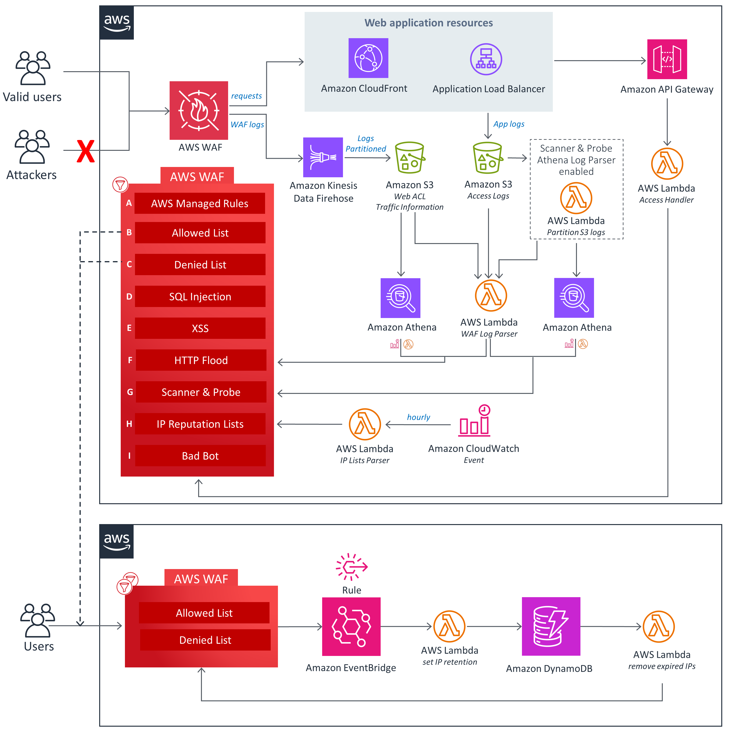
AWS WAF Security Automations Solution

Slide 9
AWS Managed Rules rule groups list
Baseline rule groups
Baseline managed rule groups provide general protection against a wide variety of common threats.
Use-case specific rule groups
Use-case specific rule groups provide incremental protection for many diverse AWS WAF use cases.
IP reputation rule groups
IP reputation rule groups block requests based on their source IP address.
AWS WAF Bot Control rule group
The Bot Control managed rule group provides rules to block and manage requests from bots. Bots can consume excess resources, skew business metrics, cause downtime, and perform malicious activities.
AWS WAF Fraud Control account takeover prevention (ATP) rule group

Slide 10
Baseline rule groups
Core rule set (CRS) managed rule group
VendorName: AWS, Name: AWSManagedRulesCommonRuleSet, WCU: 700
The Core rule set (CRS) rule group contains rules that are generally applicable to web applications. This provides protection against exploitation of a wide range of vulnerabilities, including some of the high risk and commonly occurring vulnerabilities.
Admin protection managed rule group
VendorName: AWS, Name: AWSManagedRulesAdminProtectionRuleSet, WCU: 100
The Admin protection rule group contains rules that allow you to block external access to exposed administrative pages. This might be useful if you run third-party software or want to reduce the risk of a malicious actor gaining administrative access to your application.
Known bad inputs managed rule group
VendorName: AWS, Name: AWSManagedRulesKnownBadInputsRuleSet, WCU: 200
The Known bad inputs rule group contains rules to block request patterns that are known to be invalid and are associated with exploitation or discovery of vulnerabilities. This can help reduce the risk of a malicious actor discovering a vulnerable application.

Slide 11
Use-case specific rule groups
SQL database managed rule group
VendorName: AWS, Name: AWSManagedRulesSQLiRuleSet, WCU: 200
The SQL database rule group contains rules to block request patterns associated with exploitation of SQL databases, like SQL injection attacks. This can help prevent remote injection of unauthorized queries. Evaluate this rule group for use if your application interfaces with an SQL database.
Linux operating system managed rule group
VendorName: AWS, Name: AWSManagedRulesLinuxRuleSet, WCU: 200
The Linux operating system rule group contains rules that block request patterns associated with the exploitation of vulnerabilities specific to Linux, including Linux-specific Local File Inclusion (LFI) attacks. This can help prevent attacks that expose file contents or run code for which the attacker should not have had access.
POSIX operating system managed rule group
VendorName: AWS, Name: AWSManagedRulesUnixRuleSet, WCU: 100
The POSIX operating system rule group contains rules that block request patterns associated with the exploitation of vulnerabilities specific to POSIX and POSIX-like operating systems, including Local File Inclusion (LFI) attacks.

Slide 12
Use-case specific rule groups
Windows operating system managed rule group
VendorName: AWS, Name: AWSManagedRulesWindowsRuleSet, WCU: 200
The Windows operating system rule group contains rules that block request patterns associated with the exploitation of vulnerabilities specific to Windows, like remote execution of PowerShell commands. This can help prevent exploitation of vulnerabilities that permit an attacker to run unauthorized commands or run malicious code.
PHP application managed rule group
VendorName: AWS, Name: AWSManagedRulesPHPRuleSet, WCU: 100
The PHP application rule group contains rules that block request patterns associated with the exploitation of vulnerabilities specific to the use of the PHP programming language, including injection of unsafe PHP functions. This can help prevent exploitation of vulnerabilities that permit an attacker to remotely run code or commands for which they are not authorized.
WordPress application managed rule group
VendorName: AWS, Name: AWSManagedRulesWordPressRuleSet, WCU: 100
The WordPress application rule group contains rules that block request patterns associated with the exploitation of vulnerabilities specific to WordPress sites. This rule group should be used in conjunction with the SQL database and PHP application rule groups.

Slide 13
IP reputation rule groups
Amazon IP reputation list managed rule group
VendorName: AWS, Name: AWSManagedRulesAmazonIpReputationList, WCU: 25
The Amazon IP reputation list rule group contains rules that are based on Amazon internal threat intelligence. This is useful if you would like to block IP addresses typically associated with bots or other threats. Blocking these IP addresses can help mitigate bots and reduce the risk of a malicious actor discovering a vulnerable application.
Anonymous IP list managed rule group
VendorName: AWS, Name: AWSManagedRulesAnonymousIpList, WCU: 50
The Anonymous IP list rule group contains rules to block requests from services that permit the obfuscation of viewer identity. These include requests from VPNs, proxies, Tor nodes, and hosting providers. This rule group is useful if you want to filter out viewers that might be trying to hide their identity from your application. Blocking the IP addresses of these services can help mitigate bots and evasion of geographic restrictions.

Slide 14
AWS WAF Bot Control rule group
VendorName: AWS, Name: AWSManagedRulesBotControlRuleSet, WCU: 50
The Bot Control managed rule group provides rules to block and manage requests from bots. Bots can consume excess resources, skew business metrics, cause downtime, and perform malicious activities.
Protection levels
The Bot Control managed rule group provides two levels of protection that you can choose from:
Common – Detects a variety of self-identifying bots, such as web scraping frameworks, search engines, and automated browsers. Bot Control protections at this level identify common bots using traditional bot detection techniques, such as static request data analysis. The rules label traffic from these bots and block the ones that they cannot verify.
Targeted – Includes the common-level protections and adds detection for advanced bots that do not self identify. Targeted protections use advanced detection techniques such as browser interrogation, fingerprinting, and behavior heuristics to identify bad bot traffic. The protections target these bots using a combination of rate limiting and CAPTCHA and background browser challenges. The rules that provide targeted protection have names that begin with TGT_.

Slide 15
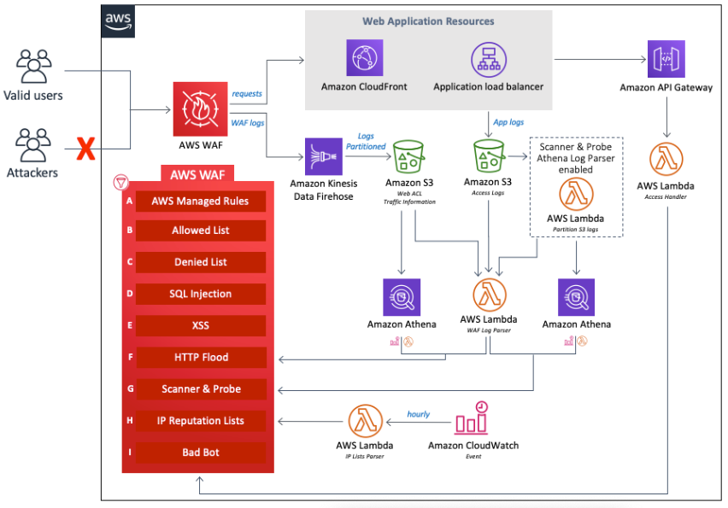
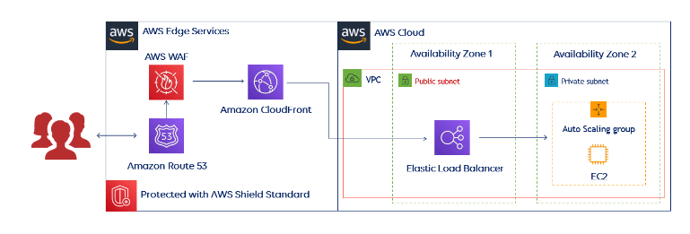
AWS WAF Architecture diagram

Slide 16
AWS WAF Features
Protection Against Web Attacks: With minimum latency impact on incoming traffic, WAF AWS offers many rules to inspect any element of a web request. WAF AWS protects web applications against threats by filtering traffic according to the rules created.
Establish Rules Accordingly: WAF AWS is a versatile and valuable tool for protecting the infrastructures of applications. And this is because it allows users to establish rules according to their needs and vulnerabilities that they wish to stop. We can consider it a great solution to protect any web application environment at the enterprise level.
Web traffic filtering: WAF allows users to create rules to filter web traffic. It filters IP addresses, HTTP headers, HTTP bodies, or URI strings from a web request.
Flexible Integration With AWS Services: AWS Firewall offers easy integration with other AWS services like Amazon EC2, CloudFront, Load balancer, etc.
Monitor Rules: Web Application Firewall AWS allows us to create rules and review and customize them to prevent unknown attracts.

Slide 17
AWS Exam take away
Request parts
Layer 7 is HTTP (vs Layer 4 is TCP/UDP)
Deploy on :
Application Load Balancer
API Gateway
CloudFront
AppSync GraphQL API
Cognito User Pool
Types of rules
WAF Features
AWS WAF Bot Control rule group!
IP reputation rule groups!

Slide 18
Links, AWS WAF Whitepaper
https://docs.aws.amazon.com/whitepapers/latest/guidelines-for-implementing-aws-waf/guidelines-for-implementing-aws-waf.html
https://owasp.org/www-project-top-ten/
https://aws.amazon.com/solutions/implementations/security-automations-for-aws-waf/

