Slide 1

AWS Security Hub

Slide 2

What is AWS Security Hub?
AWS Security Hub is a cloud security posture management (CSPM) service that performs security best practice checks, aggregates alerts, and enables automated remediation.
Security Hub also receives findings from other AWS services:
Amazon GuardDuty
Amazon Inspector
Amazon Macie
AWS Systems Manager Patch Manager
Amazon Detective
AWS Firewall Manager
AWS Config
supported third-party products.
Security Hub supports multiple security standards:
AWS Foundational Security Best Practices (FSBP) standard developed by AWS
Center for Internet Security (CIS)
Payment Card Industry Data Security Standard (PCI DSS)
National Institute of Standards and Technology (NIST).

Slide 3
AWS Security Hub
Central security tool to manage security across several AWS accounts and automate security checks
Integrated dashboards showing current security and compliance status to quickly take actions
Must first enable the AWS Config Service
Security Hub generates findings and continuous checks against the rules in a set of supported security standards
Security Hub supports the following standards:
CIS AWS Foundations, PCI DSS, AWS Foundational Security Best Practices…

Slide 4
AWS Security Hub Main Features
Cross-Region Aggregation – aggregate findings, insights, and security scores from multiple Regions to a single aggregation Region
AWS Organizations Integration
Manage all accounts in the Organization
Security Hub automatically detects new accounts
By default, Organization management account is the Security Hub administrator
Ability to have a designated Security Hub administrator from member accounts
AWS Config must be enabled
Security Hub uses AWS Config to perform its security checks
Must be enabled on all accounts (Security Hub does NOT manage AWS Config)

Slide 5
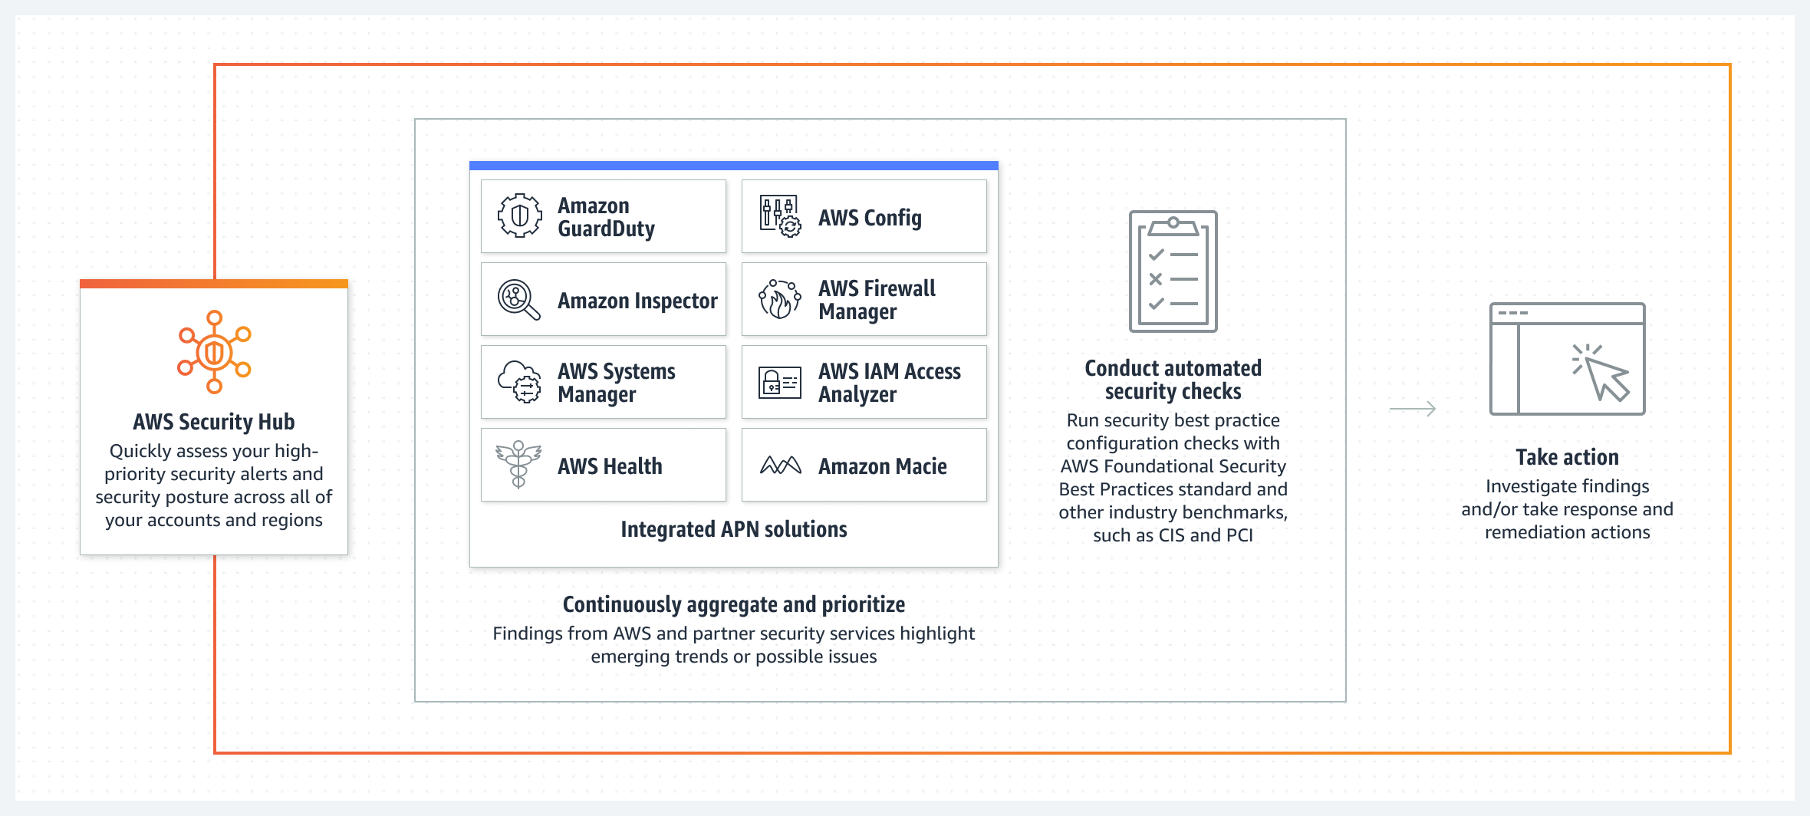
AWS Security Hub

Slide 6
Security Hub Intergration with GuardDuty
Automatically enabled when Security Hub is enabled (can be disabled)
GuardDuty will send findings to Security Hub
Findings are sent in AWS Security Finding Format (ASFF)
Findings are usually sent within 5 minutes
Archiving a GuardDuty finding will NOT update the finding in Security Hub

Slide 7
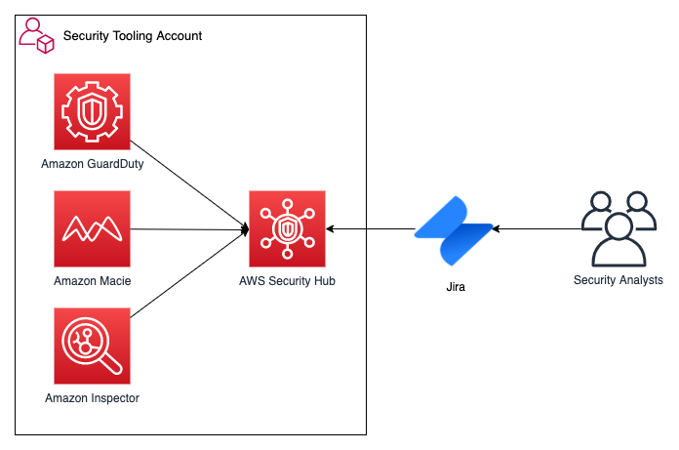
Security Hub 3party integration Atlassian

Slide 8
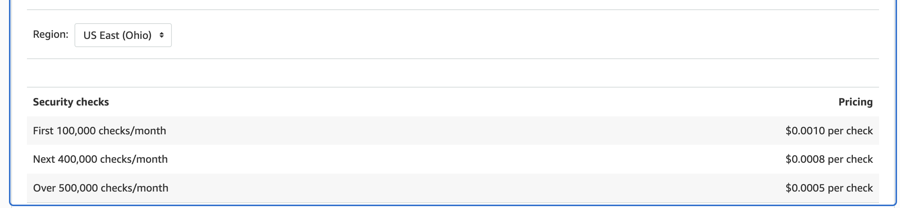
Security Hub Pricing
for the first time a 30-day Security Hub free trial.
https://aws.amazon.com/security-hub/pricing/

Slide 9
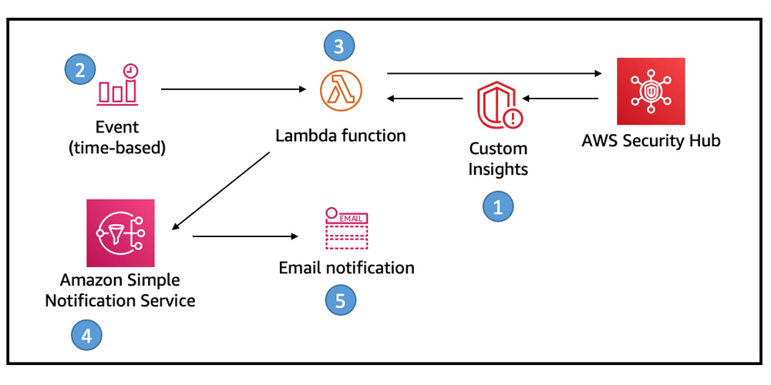
Sucurity Hub SNS Notification

Slide 10
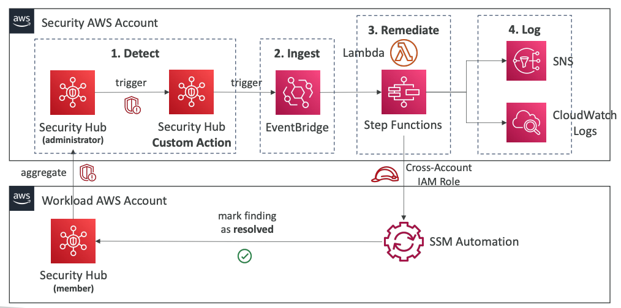
Security Hub Security Account

Slide 11
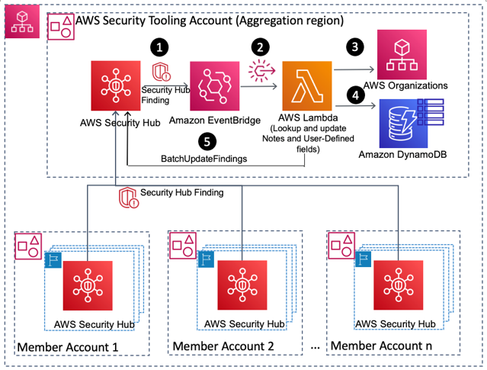
Solution Architecture

