Slide 1

Amazon Detective
Analyze and visualize security data to investigate potential security issues

Slide 2

Amazon Detective How it works
Amazon Detective simplifies the investigative process and helps security teams conduct faster and more effective investigations.
With the Amazon Detective prebuilt data aggregations, summaries, and context, you can quickly analyze and determine the nature and extent of possible security issues.

Slide 3
Amazon Detective
GuardDuty, Macie, and Security Hub are used to identify potential security issues, or findings
Sometimes security findings require deeper analysis to isolate the root cause and take action – it’s a complex process
Amazon Detective analyzes, investigates, and quickly identifies the root cause of security issues or suspicious activities using ML and graphs
Automatically collects and processes events from VPC Flow Logs, CloudTrail, and GuardDuty to create a unified view
Produces visualizations with details and context to get to the root cause

Slide 4
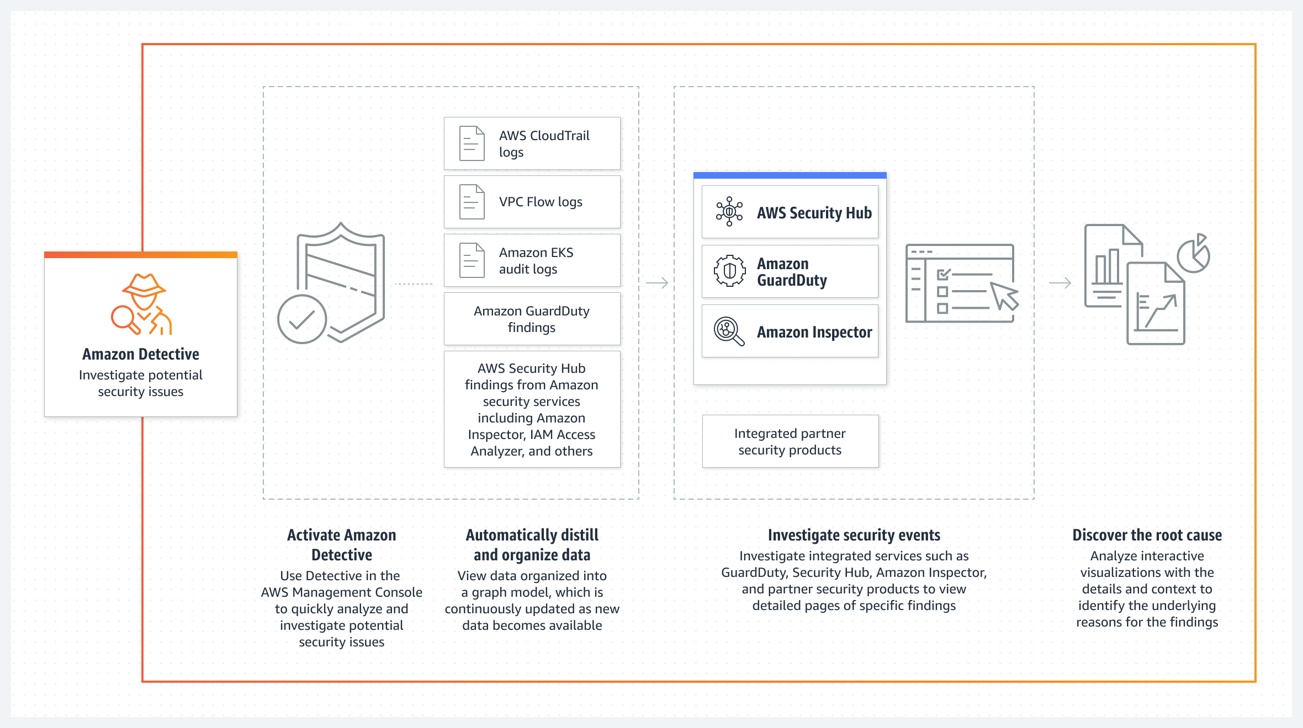
Amazon Detective

Slide 5
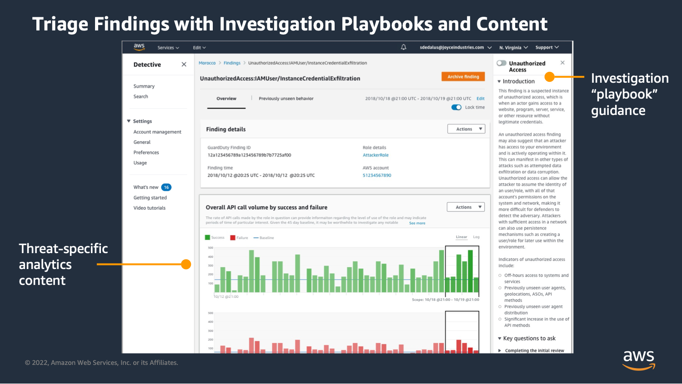
Amazon Detective

