Slide 1

Security Best Practice

Slide 2
Compromised AWS Credentials
Identify the affected IAM user using GuardDuty
Rotate the exposed AWS Credentials
Invalidate temporary credentials by attaching an explicit Deny policy to the affected IAM user with an STS date condition
Check CloudTrail logs for other unauthorized activity
Review your AWS resources (e.g., delete unauthorized resources)
Verify your AWS account information

Slide 3
Compromised IAM Role
Invalidate temporary credentials by attaching an explicit Deny policy to the affected IAM role with an STS date condition
Revoke access for the identity to the linked AD if any
Check CloudTrail logs for other unauthorized activity
Review your AWS resources (e.g., delete unauthorized resources)
Verify your AWS account information

Slide 4
Compromised Account
Rotate and delete exposed AWS Access Keys
Rotate and delete any unauthorized IAM user credentials (rotate existing IAM users’ passwords)
Rotate and delete all EC2 Key Pairs
Check CloudTrail logs for other unauthorized activity
Review your AWS resources (e.g., delete unauthorized resources)
Verify your AWS account information

Slide 5
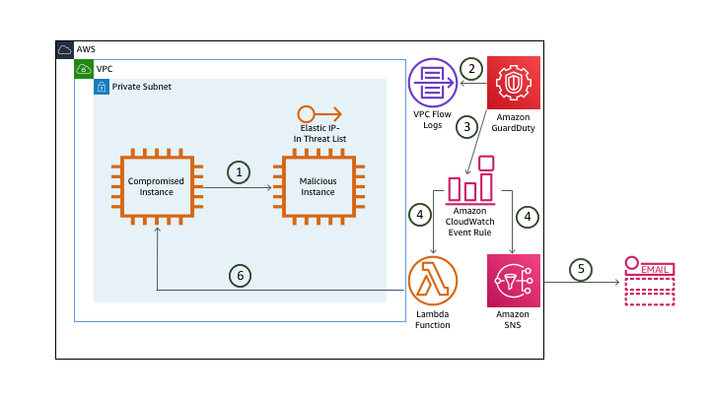
Compromised Ec2
Steps to address compromised instances:
Capture the instance’s metadata
Enable Termination Protection
Isolate the instance (replace instance’s SG – no outbound traffic authorized)
Detach the instance from any ASG (Suspend processes)
Deregister the instance from any ELB
Snapshot the EBS volumes (deep analysis)
Tag the EC2 instance (e.g., investigation ticket)
Offline investigation: shutdown instance
Online investigation (e.g., snapshot memory or capture network traffic)
Automate the isolation process: Lambda
Automate memory capture: SSM Run Command

Slide 6
Compromised S3 Bucket
Identify using GuardDuty
Identify malicious activity using CloudTrail and Amazon Detective
Secure S3 bucket
S3 block Public Access
S3 bucket policies
VPC Endpoints for S3
S3 Pre-signed Url
S3 access points
S3 ACLs

Slide 7
Compromized RDS Database
Identify the affected DB instance and DB user using GuardDuty
If it is NOT legitimate behavior:
Restrict network access (SGs & NALCs)
Restrict the DB access for the suspected DB user
Rotate the suspected DB users’ passwords
Review DB Audit Logs to identify leaked data
Secure your RDS DB instance, recommended settings:
Use Secrets Manager to rotate the DB password •
Use IAM DB Authentication to manage DB users’ access without passwords

Slide 8
Key Pair

Slide 9
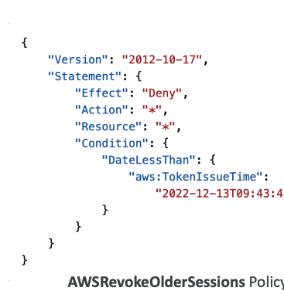
Revoking IAM Role Temporary Credentials
Users usually have a long session duration time (e.g., 12 hours)
If credentials are exposed, they can be used for the duration of the session
Immediately revoke all permissions to the IAM role’s credentials issued before a certain time
AWS attaches a new inline IAM policy to the IAM role that denies all permissions (forces users to reauthenticate) if the token is too old
Doesn’t affect users who assumes the IAM role after you revoke sessions (don’t worry about deleting the policy

Slide 10
Ec2 Instance Metadata - IMDS
Information about an EC2 instance (e.g., hostname, instance type, network settings, …)
Can be accessed from within the EC2 instance itself by making a request to the EC2 metadata service endpoint http://169.254.169.254/latest/meta-data
Can be accessed using EC2 API or CLI tools (e.g., curl or wget)
Metadata is stored in key-value pairs
Useful for automating tasks such as setting up an instance's hostname, configuring networking, or installing software
Examples:
ami-id, block-device-mapping/, instance-id, instance-type, network/
hostname, local-hostname, local-ipv4, public-hostname, public-ipv4
Iam – InstanceProfileArn, InstanceId
iam/security-credentials/role-name – temporary credentials for the role attached to your instance
placement/ – launch Region, launch AZ, placement group name…
security-groups – names of security groups
tags/instance – tags attached to the instance

Slide 11
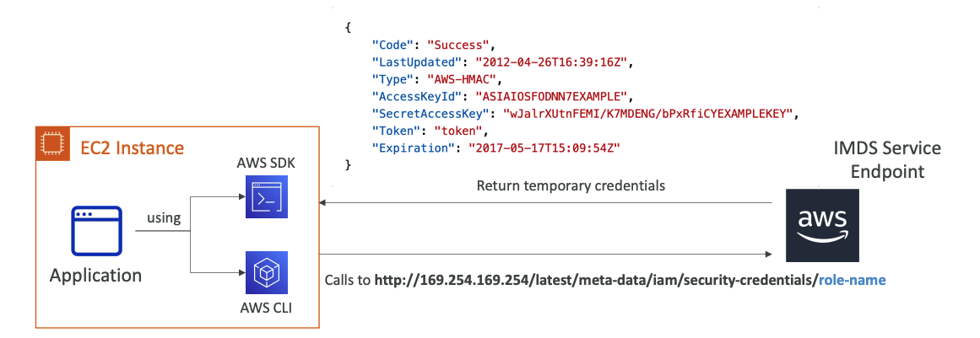
EC2 Instance Role – How it works

Slide 12
EC2 Instance Metadata – Restrict Access
You can use local firewall rules to disable access for some or all processes
$ sudo iptables --append OUTPUT --proto tcp --destination 169.254.169.254 \ --match owner --uid-owner apache --jump REJECT
iptables for Linux, PF or IPFW for FreeBSD • Turn off access using AWS Console or AWS CLI (HttpEndpoint=disabled)

Slide 13
Ec2 Instance Metadata – IMDSv1 vs IMDSv2
IMDSv1 is accessing http://169.254.169.254/latest/meta-data directly
IMDSv2 is more secure and is done in two steps:
1. Get Session Token (limited validity) – using headers & PUT
$ TOKEN=`curl -X PUT "http://169.254.169.254/latest/api/token" \ -H "X-aws-ec2-metadata-token-ttl-seconds: 21600"`
2. Use Session Token in IMDSv2 calls – using headers
$ curl http://169.254.169.254/latest/meta-data/profile \ -H "X-aws-ec2-metadata-token: $TOKEN"

Slide 14
Requiring the usage of IMDSv2
Both IMDSv1 and IMDSv2 are available (enabled by default)
The CloudWatch Metric MetadataNoToken provide information on how much IMDSv1 is used
You can require IMDSv2 when registering an AMI: --imds-support v2.0
You can force Metadata Version 2 at Instance Launch using either: •
AWS console
AWS CLI “HttpTokens: required”

Slide 15
https://wa.aws.amazon.com/wellarchitected/2020-07-02T19-33-23/wat.pillar.security.en.html
https://docs.aws.amazon.com/en_us/wellarchitected/2022-03-31/framework/sec-detection.html
https://docs.aws.amazon.com/en_us/wellarchitected/2022-03-31/framework/a-security.html
https://aws.amazon.com/architecture/security-identity-compliance/?cards-all.sort-by=item.additionalFields.sortDate&cards-all.sort-order=desc&awsf.content-type=*all&awsf.methodology=*all

