Slide 1
AWS Firewall Manager

Slide 2
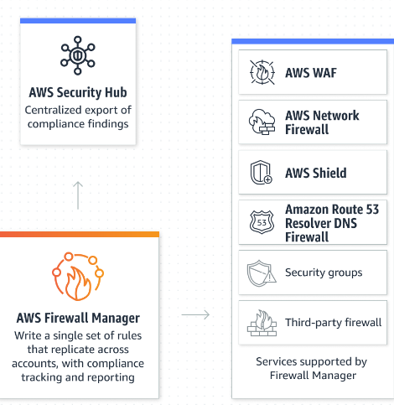
AWS Firewall Manager
AWS Firewall Manager simplifies your administration and maintenance tasks across multiple accounts and resources for a variety of protections, including AWS WAF, AWS Shield Advanced, Amazon VPC security groups, AWS Network Firewall, and Amazon Route 53 Resolver DNS Firewall.

Slide 3
AWS Firewall Manager
Firewall Manager provides these benefits:
Helps to protect resources across accounts
Helps to protect all resources of a particular type, such as all Amazon CloudFront distributions
Helps to protect all resources with specific tags
Automatically adds protection to resources that are added to your account
Allows you to subscribe all member accounts in an AWS Organizations organization to AWS Shield Advanced, and automatically subscribes new in-scope accounts that join the organization
Allows you to apply security group rules to all member accounts or specific subsets of accounts in an AWS Organizations organization, and automatically applies the rules to new in-scope accounts that join the organization
Lets you use your own rules, or purchase managed rules from AWS Marketplace
Firewall Manager is particularly useful when you want to protect your entire organization rather than a small number of specific accounts and resources, or if you frequently add new resources that you want to protect. Firewall Manager also provides centralized monitoring of DDoS attacks across your organization.

Slide 4
AWS Firewall Manager
Security policy: common set of security rules
WAF rules (Application Load Balancer, API Gateways, CloudFront)
AWS Shield Advanced (ALB, CLB, NLB, Elastic IP, CloudFront)
Security Groups for EC2, Application Load Balancer and ENI resources in VPC
AWS Network Firewall (VPC Level)
Amazon Route 53 Resolver DNS Firewall
Policies are created at the region level
Rules are applied to new resources as they are created (good for compliance) across all and future accounts in your Organization

Slide 5
WAF vs Firewall Manager vs Shield
WAF, Shield and Firewall Manager are used together for comprehensive protection
Define your Web ACL rules in WAF
For granular protection of your resources, WAF alone is the correct choice
If you want to use AWS WAF across accounts, accelerate WAF configuration, automate the protection of new resources, use Firewall Manager with AWS WAF
Shield Advanced adds additional features on top of AWS WAF, such as dedicated support from the Shield Response Team (SRT) and advanced reporting.
If you’re prone to frequent DDoS attacks, consider purchasing Shield Advanced

