Slide 1
Amazon GuardDuty

Slide 2
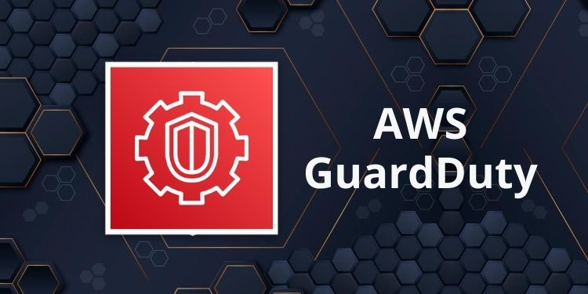
Amazon GuardDuty
Amazon GuardDuty is a threat detection service that continuously monitors for malicious activity and unauthorized behavior to protect AWS accounts, workloads, and data stored in Amazon S3.
The managed cloud-hosted service immediately begins analyzing the AWS environment once an IT or security administrator enables GuardDuty within the AWS Management Console.

Slide 3
Amazon GuardDuty – Multi Account Strategy
GuardDuty allows for the administration of several accounts by linking member accounts to a primary admin account.
This can be achieved within the scope of an AWS Organization or by extending invitations directly via the GuardDuty console.
The responsibilities of the admin account include:
Onboarding and offboarding member accounts.
Overseeing the GuardDuty settings across these member accounts.
Handling detections, configuring suppression rules, and updating lists of trusted IPs and potential threats.
Within an AWS Organization, it's possible to designate one of the member accounts as the chosen administrator for GuardDuty, enabling centralized management of security findings. (Delegated Administrator)

Slide 4
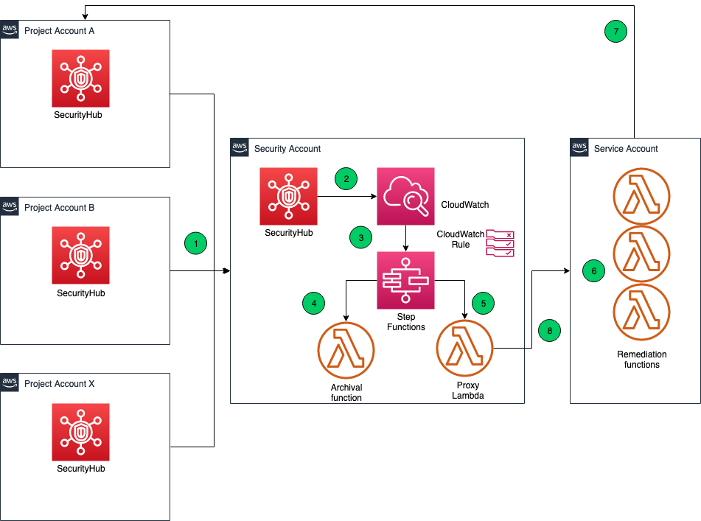
Amazon GuardDuty Security Account

Slide 5
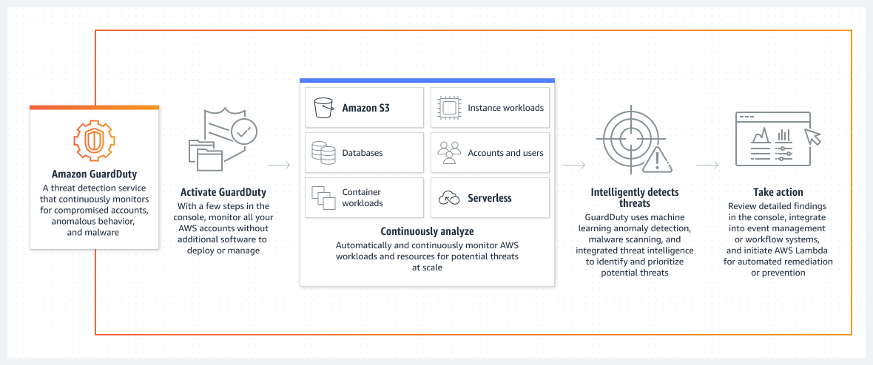
GuardDuty

Slide 6
How does GuardDuty work?
The service uses machine learning, anomaly detection, and integrated threat intelligence to identify and prioritize potential threats.
GuardDuty analyzes tens of billions of events across multiple AWS data sources, such as AWS CloudTrail event logs, Amazon VPC Flow Logs, and DNS logs.

Slide 7
How does GuardDuty work?
GuardDuty detects three main types of threats:
Compromised instances. GuardDuty will detect any unusual spikes in network traffic, as well as hijacked resources — such as an external IP address hijacking EC2 instances.
Reconnaissance.
Reconnaissance is when an attacker gathers information about the network. GuardDuty detects activity that suggests reconnaissance, such as unblocked port probing from a known malicious IP, VPC port scanning, and unusual API activity.
Compromised accounts.
GuardDuty will detect common patterns that indicate an account compromise, such as API calls from unusual locations, updates that weaken the account’s password policy and API calls from known malicious IPs.

Slide 8
How does GuardDuty work?
The service categorizes its alerts into three severity levels: low, medium and high.
Low severity threats are typically threats that have been blocked without compromising resources.
Medium severity threats indicate suspicious activity. This can include a spike in traffic directed to bitcoin-related domains, which could be a sign of cryptocurrency mining.
High severity threats indicate a compromised resource and should be immediately remediated.
Finding naming convention ThreatPurpose:ResourceTypeAffected/ThreatFamilyName.DetectionMechanism!Artifact
ThreatPurpose – primary purpose of the threat (e.g., Backdoor, CryptoCurrency)
ResourceTypeAffected – which AWS resource is the target (e.g., EC2, S3)
ThreatFamilyName – describes the potential malicious activity (e.g., NetworkPortUnusual)
DetectionMechanism – method GuardDuty detecting the finding (e.g., Tcp, Udp)
Artifact – describes a resource that is used in the malicious activity (e.g., DNS)

Slide 9
Amazon GuardDuty Finding Types
EC2 Finding Types
UnauthorizedAccess:EC2/SSHBruteForce, CryptoCurrency:EC2/BitcoinTool.B!DNS
IAM Finding Types •
Stealth:IAMUser/CloudTrailLoggingDisabled, Policy:IAMUser/RootCredentialUsage
Kubernetes Audit Logs Finding Types
CredentialAccess:Kubernetes/MaliciousIPCaller
Malware Protection Finding Types
Execution:EC2/SuspiciousFile, Execution:ECS/SuspiciousFile
RDS Protection Finding Types
CredentialAccess:RDS/AnomalousBehavior.SuccessfulLogin
S3 Finding Types
Policy:S3/AccountBlockPublicAccessDisabled, PenTest:S3/KaliLinux

Slide 10
Amazon GuardDuty –Trusted and Threat IP Lists
Works only for public IP addresses
Trusted IP List
List of IP addresses and CIDR ranges that you trust
GuardDuty doesn’t generate findings for these trusted lists
Threat IP List
List of known malicious IP addresses and CIDR ranges
GuardDuty generates findings based on these threat lists
Can be supplied by 3rd party threat intelligence or created custom for you
In a multi-account GuardDuty setup, only the GuardDuty administrator account can manage those lists

Slide 11
Amazon GuardDuty – Suppression Rules
Set of criteria that automatically filter and archive new findings
Example: low-value findings, false-positive findings, or threats you don’t intend to act on
Can suppress entire findings types or define more granular criteria (e.g., suppress only specific EC2 instances)
Suppressed findings are NOT sent to Security Hub, S3, Detective, or EventBridge
Suppressed findings can be still viewed in the Archive

Slide 12
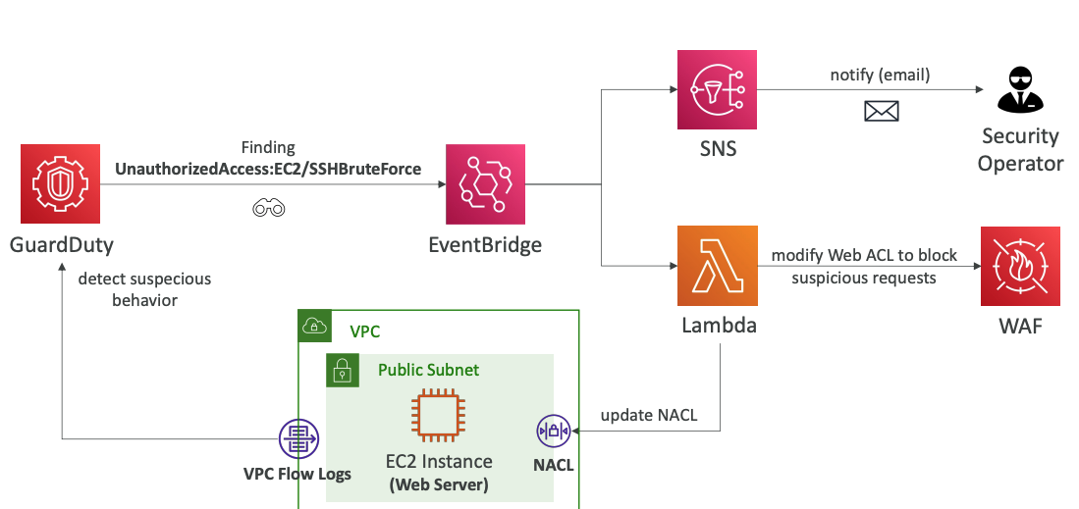
Amazon GuardDuty Brute Force

Slide 13
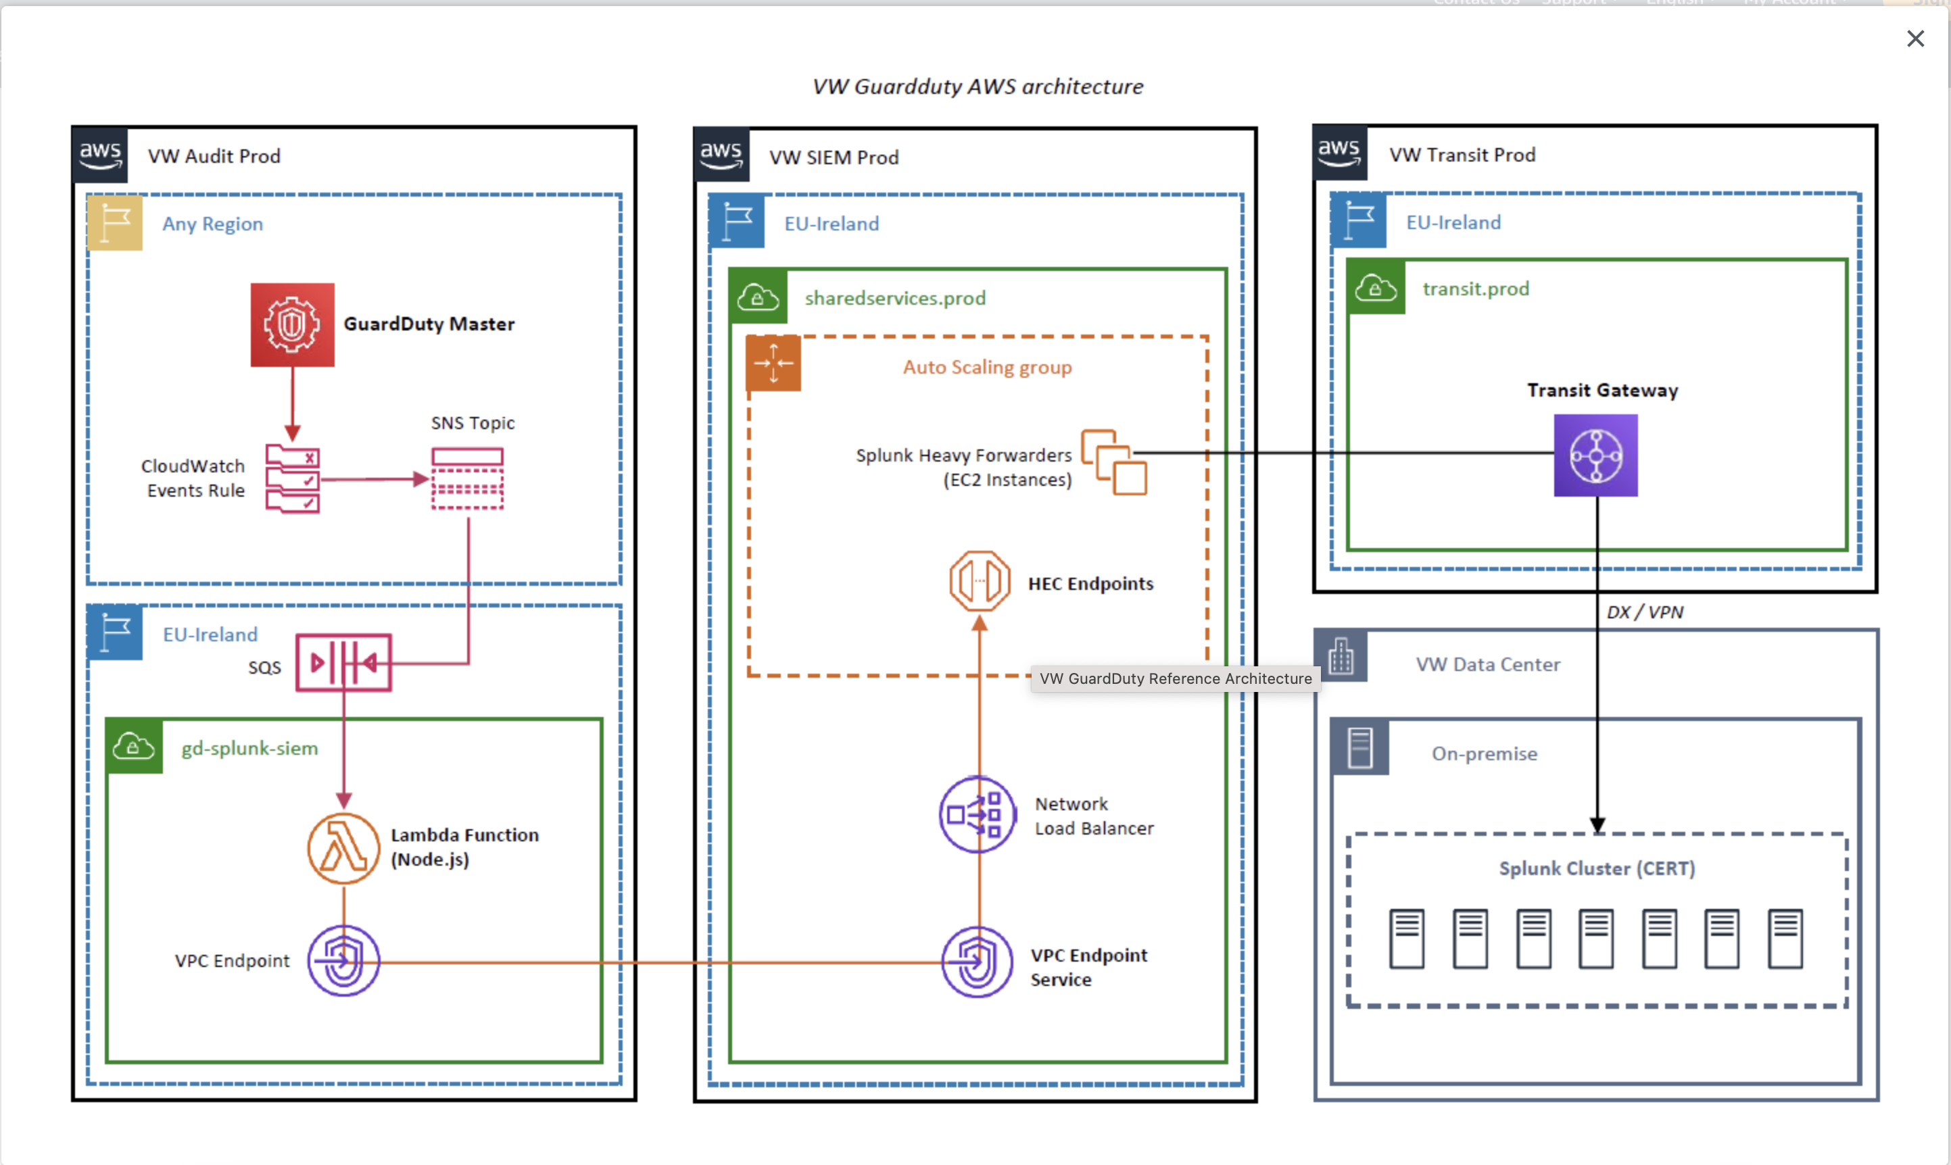
VW Group GuardDuty usecase

