Slide 1
AWS Macie

Slide 2

What is Amazon Macie?
Amazon Macie is a security service that uses machine learning to automatically discover, classify and protect sensitive data in the AWS.
It currently only supports S3, but more AWS data stores are planned.
Macie can recognize any PII or Protected Health Information (PHI) that exists in your S3 buckets.
Macie also monitors the S3 buckets themselves for security and access control.
This all can help you meet regulations, such as the Health Insurance Portability and Accountability Act (HIPAA) and General Data Privacy Regulation (GDPR) or just continually achieve the security you require in the AWS Cloud environment.

Slide 3
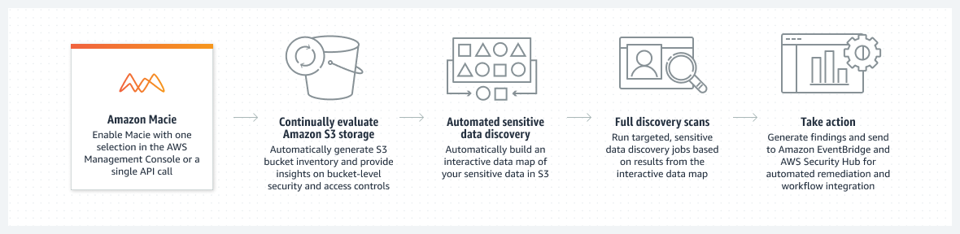
Amazon Macie
Discover and protect your sensitive data at scale

Slide 4
How does Macie work?
Macie summary dashboard
The dashboard provides you with a summary that shows you how the data is accessed or moved. This dashboard gives you a view of the total number of buckets, the total number of objects, and the total number of S3 storage consumed.
Macie Jobs
Create and run sensitive data discovery jobs to automatically discover, record, and report sensitive data in Amazon S3 buckets.
You can configure the job to run only once for on-demand analysis, or periodically for periodic analysis and monitoring.
Macie Findings
A finding is a detailed report of potential policy violations for sensitive data in S3 buckets or S3 objects. Macie provides two types of findings: policy findings and sensitive data findings.
Macie automated data discovery
AWS announced on Re-Invent 2022 new Macie feature called automated data discovery, that can automatically and continuously detect sensitive data and potential data security risks across bucket sets, aggregated at the AWS Organizations level.
By default, Macie automated data discovery is enabled for every new customer. However, current customers can instantly toggle this setting on or off by clicking a button in the AWS Management Console.

Slide 5
Macie benefits
Easy to set up
Constant monitoring of S3 buckets
Meet privacy regulations
GDPR, PCI-DSS, HIPAA
Custom-defined sensitive data types
discover unique sensitive data for your business.

Slide 6

Macie use cases
Simplify your data privacy and security
Maintaining compliance
Discover your sensitive data at scale

Slide 7
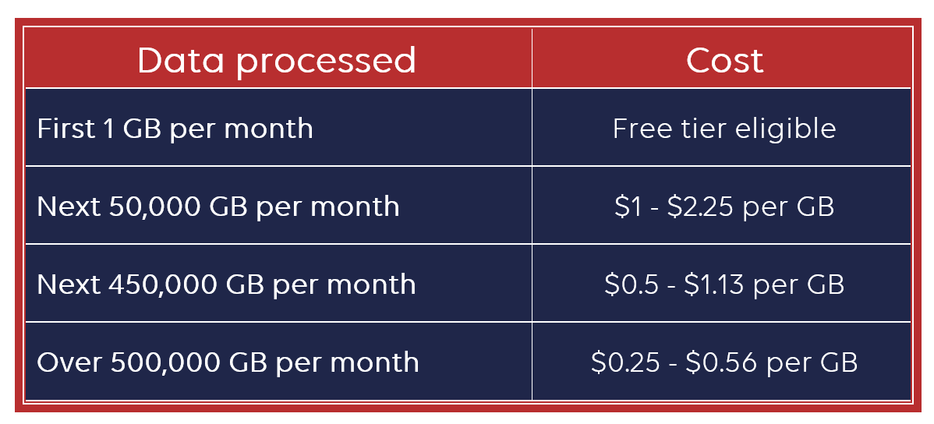
Macie pricing
Free-tier of Macie includes:
The 30-day free trial for each account with S3 buckets evaluation (breaks down S3 buckets by whether they are shared publicly, encrypted or not, and shared inside and outside your AWS account).
And for the discovery of sensitive data, you get the first 1 GB per month for free.
Macie monthly cost is based on:
The number of Amazon S3 buckets evaluated: cost is the same for every AWS Region.
All buckets evaluated in the first 30-days are free
After the first 30-days - $0.10 per S3 bucket and month

Slide 8
AWS Macie Findings Types
Policy Findings
A detailed report of policy violation or issue with the security of S3 bucket
Examples: default encryption is disabled, bucket is public, …
Policy:IAMUser/S3BucketEncryptionDisabled, Policy:IAMUser/S3BucketPublic
Detect changes only after you enable Macie
Sensitive Data Findings
A detailed report of sensitive data that’s found in S3 buckets
Examples: Credentials (private keys), Financial (credit card numbers), …
SensitiveData:S3Object/Credentials, SensitiveData:S3Object/Financial
For Custom Data Identifier SensitiveData:S3Object/CustomIdentifier

Slide 9
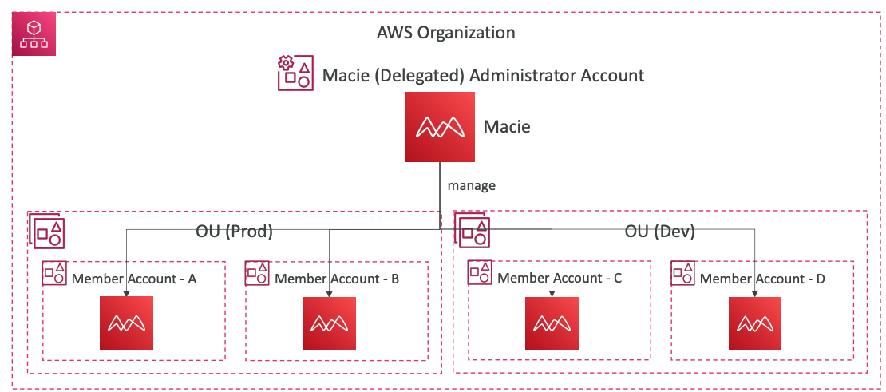
AWS Macie Multi Account
You can manage multiple accounts in Macie
Associate the Member accounts with the Administrator account
Through an AWS Organization
Sending invitation through Macie
Supports Delegated Administrator in an AWS Organization
Administrator account can:
Add and remove member accounts
Have access to all S3 sensitive data and settings for all accounts
Manage Automated Sensitive Data Discovery and run Data Discovery jobs
Manage Data Identifiers and Findings

Slide 10
Amazon Macie vs. Amazon GuardDuty
Macie only looks into S3 buckets and intelligently classifies data to help you ensure the proper access controls are applied to those data.
Amazon GuardDuty uses intelligent and continuous threat detection of your AWS accounts, data stored in Amazon S3, and workloads to reduce risk.
GuardDuty monitors:
Abnormal API activity
Attempts to disable AWS CloudTrail logging
Potential unauthorized deployment and compromised instances
S3 bucket compromise

