Slide 1
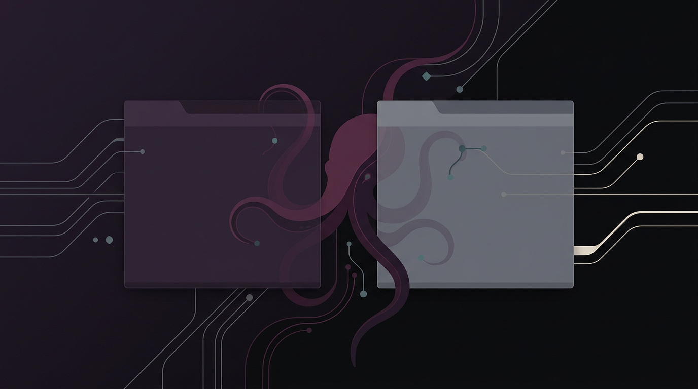

NATIVE FILE OPERATIONS · SELECTED BRAND DIRECTION 03
FileOctopus
Dual-pane desktop file manager with a safe Rust boundary and a command-first workflow.
2×
Rust
VFS
active panes
privileged boundary
local + remote providers
AUBERGINE
MUTED TECH
NO NEON

Slide 2
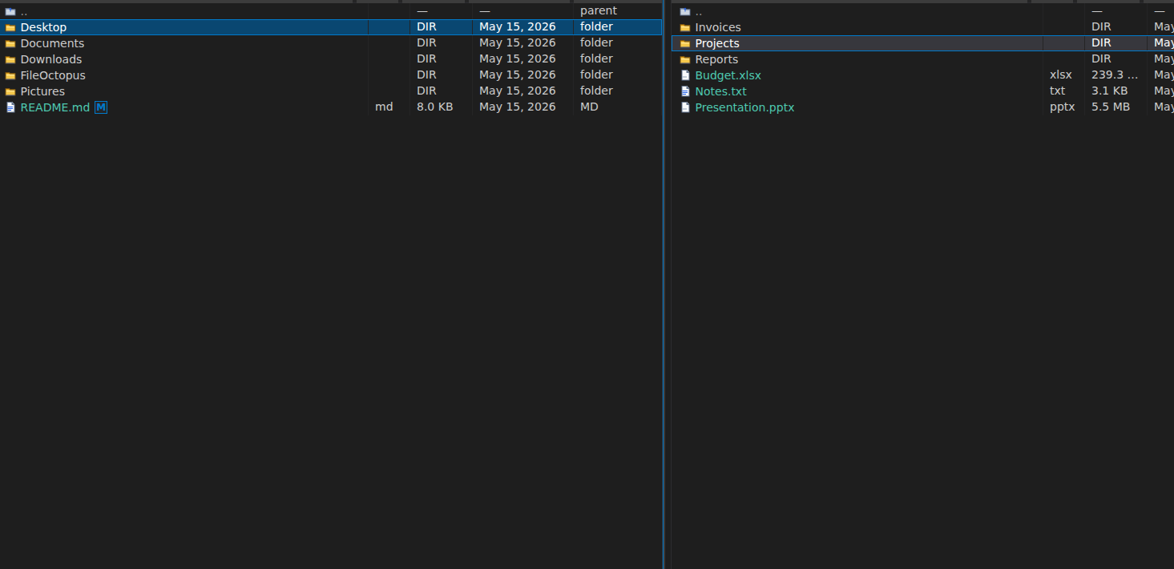
FILEOCTOPUS
The file manager for operators, not spectators
Commander speed
Native boundary
Two panes, visible actions, keyboard rhythm, less window juggling.
Tauri/Rust owns privileged file work; UI speaks typed intent.
Power-user clarity
Remote-ready
Menus, toolbar, palette and shortcuts converge on the same commands.
Local, SFTP, SMB, S3 and cloud targets keep one pane model.
Brand posture: split-pane first, octopus as controlled workflow motion — not a mascot.
03 / Aubergine Muted Technical
Tauri v2 · Rust · React/TypeScript

Slide 3
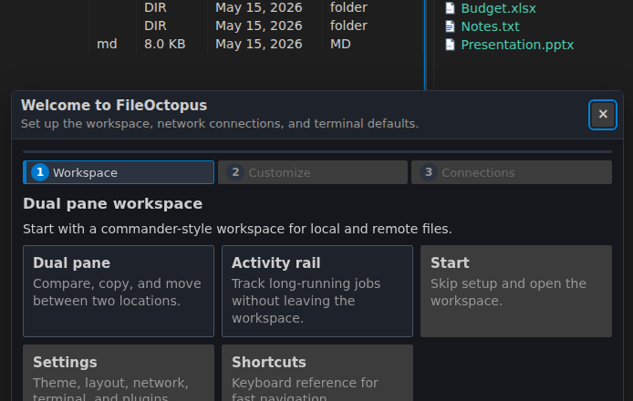
FILEOCTOPUS
First run: make the desktop app feel deliberate
Onboarding should explain the workspace contract before the user trusts destructive file operations.
Workspace · layout · terminal · connection defaults become explicit choices instead of hidden defaults.
WORKSPACE
TERMINAL
REMOTE
Not a toy demo
Trust starts early
Power without surprise
First-run flow signals a real desktop product.
The app states what it will manage and how.
Defaults are visible before advanced usage.
03 / Aubergine Muted Technical
Tauri v2 · Rust · React/TypeScript

Slide 4
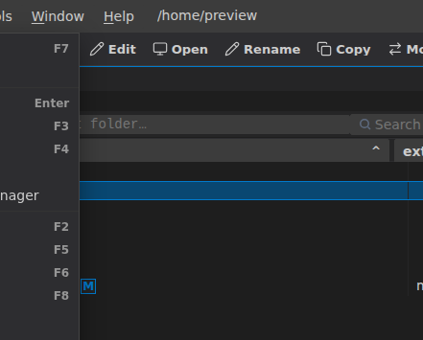
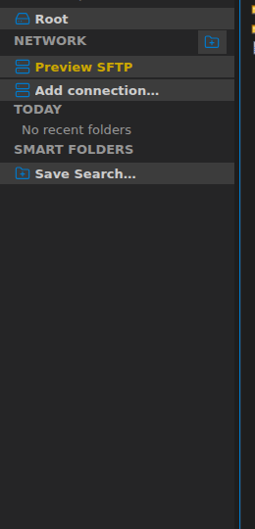
FILEOCTOPUS
One command model, many surfaces
Toolbar
Function keys
Visible frequent actions.
Commander muscle memory.
Menus still matter
Left rail
They make destructive and advanced actions discoverable.
Network, favorites, drives, recent paths.
03 / Aubergine Muted Technical
Tauri v2 · Rust · React/TypeScript

Slide 5
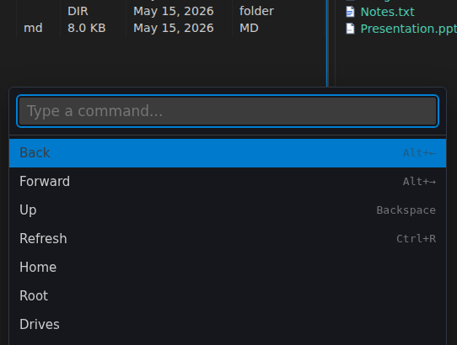
FILEOCTOPUS
Command palette: power without mode switching
The command palette becomes the mutation point: typed intent enters, safe actions leave.
Search intent
Shared registry
Keyboard-first entry for commands, files and remote actions.
Menu, toolbar and palette resolve to one command source.
Automatable
No mystery UX
A clean command model makes QA and docs much easier.
Power stays discoverable.
03 / Aubergine Muted Technical
Tauri v2 · Rust · React/TypeScript

Slide 6
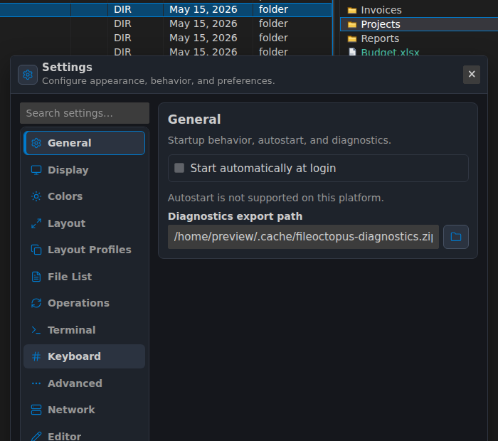
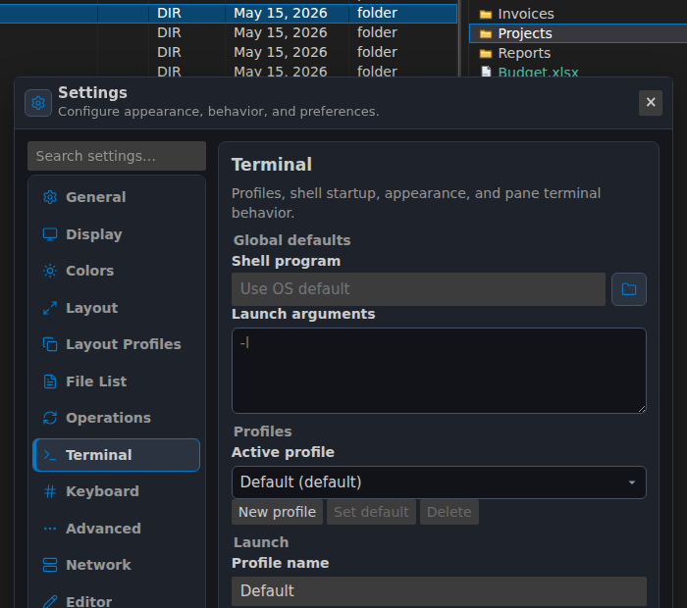
FILEOCTOPUS
Preferences: small controls, big product signal
A desktop tool earns trust when its defaults are inspectable.
Density, terminal, layout, connections and operation behavior should be first-class, not buried.
DENSITY
SHELL
03 / Aubergine Muted Technical
Tauri v2 · Rust · React/TypeScript

Slide 7
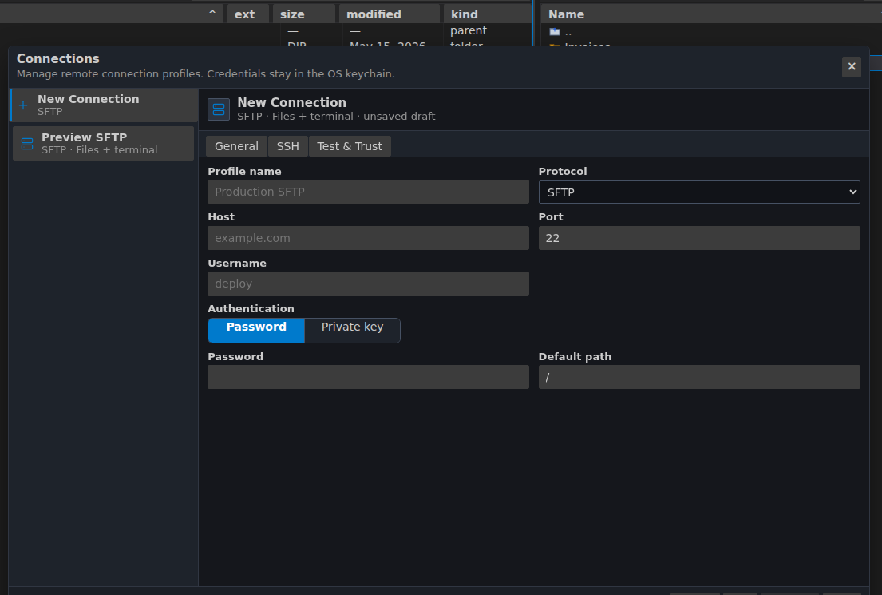
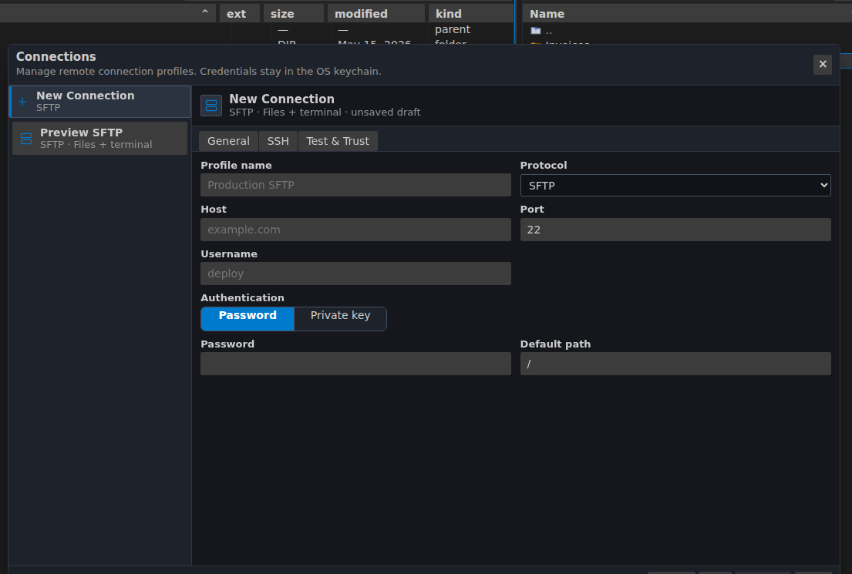
FILEOCTOPUS
Remote connections keep the pane model intact
Protocol grid
Typed profiles
Local-feeling remote
SFTP, SMB, S3, SSH and cloud connector foundations.
Structured settings instead of ad-hoc connection strings.
Mounted locations should behave like first-class pane roots.
03 / Aubergine Muted Technical
Tauri v2 · Rust · React/TypeScript

Slide 8
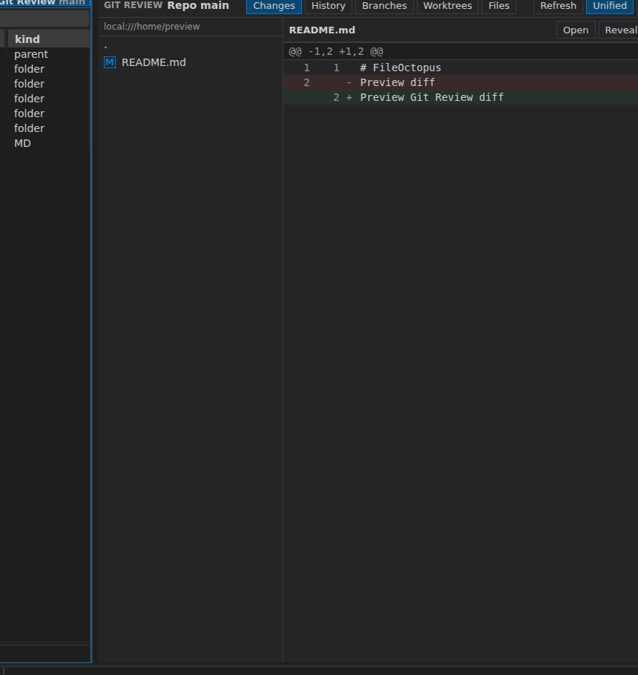
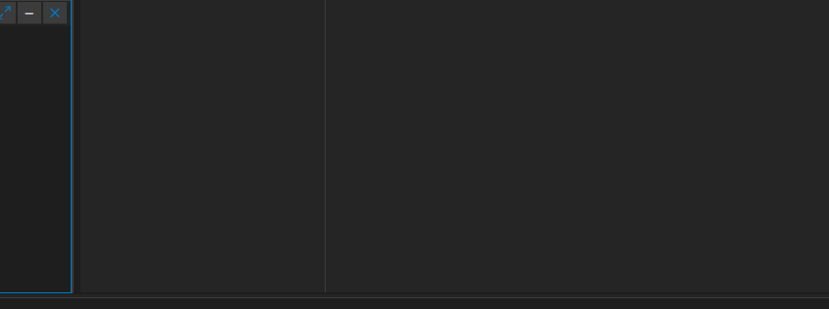
FILEOCTOPUS
Developer workflows live where files live
Git review
Terminal panel
Branch status, changed files and diffs in workspace context.
Local or SSH terminal without leaving the file operation frame.
Design rule
Developer utilities should be contextual, not separate modal worlds.
03 / Aubergine Muted Technical
Tauri v2 · Rust · React/TypeScript

Slide 9
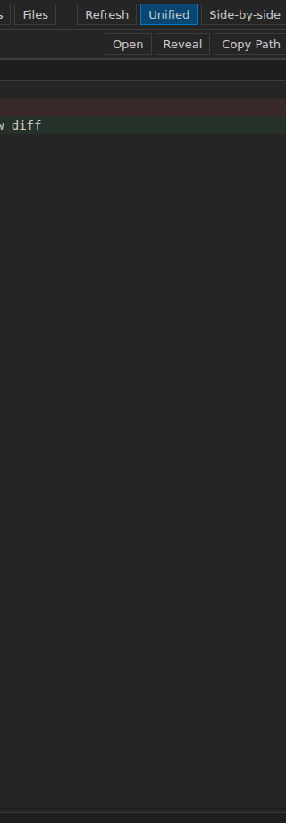
FILEOCTOPUS
Activity rail keeps long operations visible
state
rail
Activity rail
Path bar
copy
72%
Jobs, history, terminal and feedback remain visible.
Breadcrumb plus editable path keeps navigation precise.
sync
ok
ssh
live
Long operations
No context loss
git
+3
Copy/move/search become jobs with progress and cancellation.
Filesystem state, terminal and task state stay connected.
03 / Aubergine Muted Technical
Tauri v2 · Rust · React/TypeScript

Slide 10
FILEOCTOPUS
Architecture: safety belongs at the boundary
React/TS UI
typed IPC
Rust core
providers
Storage
panes · dialogs · commands
vfs · jobs · app-ipc
local · sftp · smb · s3
No raw filesystem access
ResourceUri model
Job pipeline
The frontend does not get unrestricted FS plugin power.
Resources cross the boundary as typed URI strings.
Mutations are planned, cancellable and observable.
Mirrored DTOs
Stable errors
Rust and TypeScript contracts stay synchronized.
Errors cross as codes and user-visible messages.
03 / Aubergine Muted Technical
Tauri v2 · Rust · React/TypeScript

Slide 11
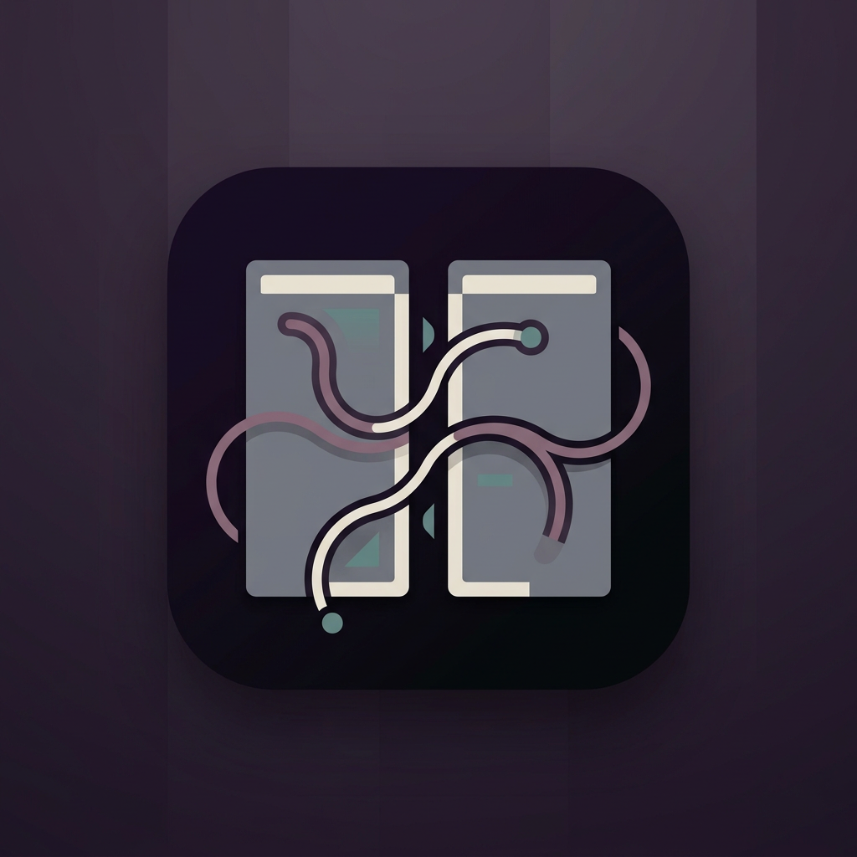
OPEN SOURCE NATIVE DESKTOP TOOL
FileOctopus
Aubergine technical identity for a safer, faster file operations workflow.
Presentation deck
Brand system
Product story in selected brand direction 03.
Aubergine, bone, muted steel and controlled tentacle motif.
Next asset
GitHub
Vectorized logo and README/social hero from this direction.
github.com/ilyafedotov-ops/FileOctopus
github.com/ilyafedotov-ops/FileOctopus

