Slide 1

careloop.
01 / 05
RESEARCH FOLLOW-UP ON CARDANO
Careloop
Research check-ins.
Verified rewards.
Groth16 / BLS12-381
Aiken / Plutus V3 / Masumi
Prototype on Cardano Preprod. Fictional reports and test assets.
Notes:
Careloop connects study participants, clinics and sponsors. Participants submit reports on a program-defined cadence. Off-chain policy authorizes completion rewards. Cardano verifies settlement rules. The current app is a research prototype using fictional data and test assets. Sources: https://github.com/IlyaKats2005/Careloop/blob/main/README.md https://github.com/IlyaKats2005/Careloop/blob/main/docs/ARCHITECTURE.md. Cover artwork is an AI-generated conceptual glass loop, not a technical diagram.

Slide 2
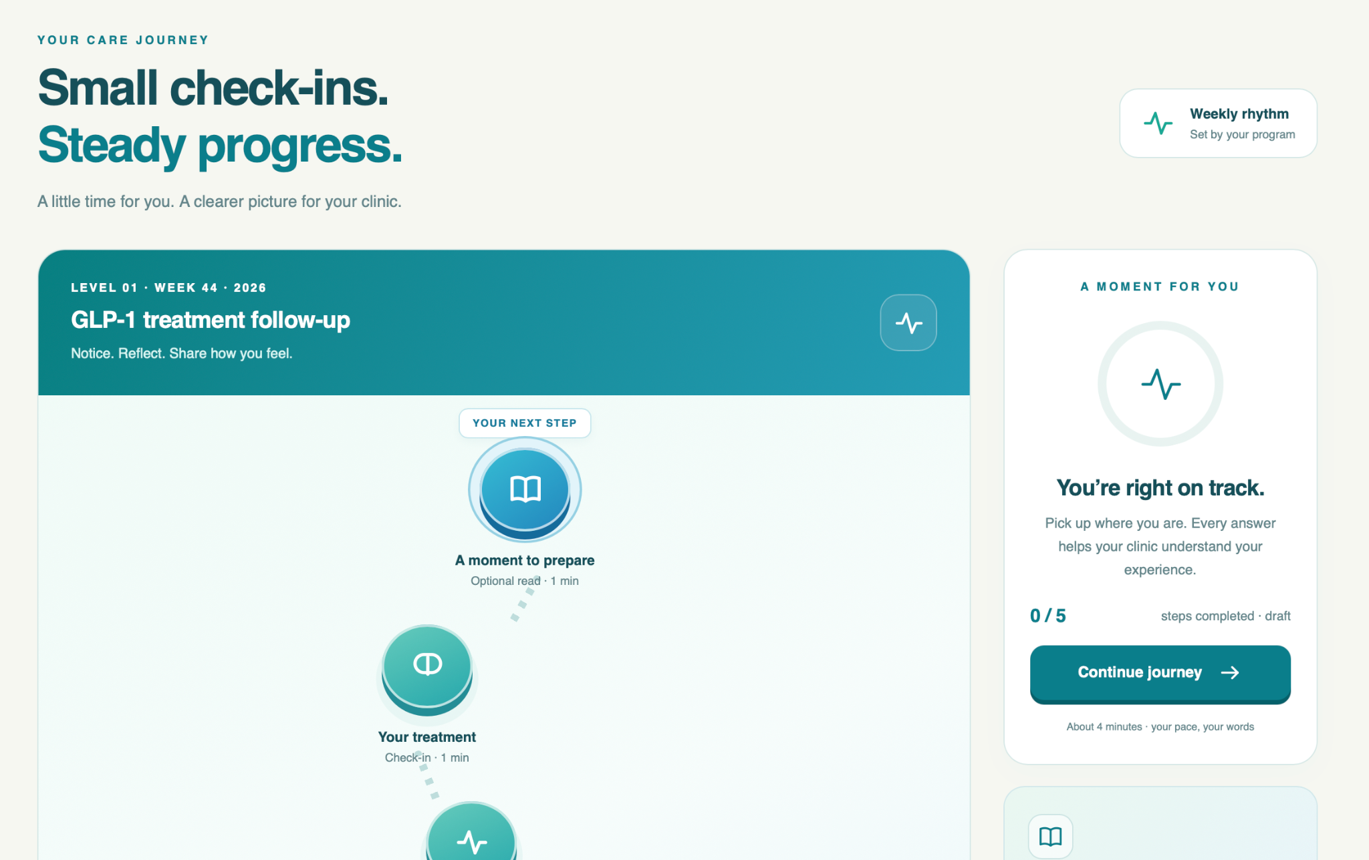
careloop.
02 / 05
The report-to-reward workflow
01
Report
Participant completes a program check-in.
02
Review
AI supplies evidence. Server policy decides eligibility.
03
Prove
The browser proves approved membership.
04
Settle
The sponsor relay submits the Cardano claim.
Participant journey / prototype interface
Notes:
The screenshot is user-provided prototype material. It illustrates the participant interface and should not be presented as clinical evidence. The clinic handles exceptions, while clinical review and completion-reward eligibility are separate. The server and database retain reports, AI output and program snapshots. The relay pays transaction fees. Sources: https://github.com/IlyaKats2005/Careloop/blob/main/docs/ARCHITECTURE.md https://github.com/IlyaKats2005/Careloop/blob/main/src/reward-policy.js https://github.com/IlyaKats2005/Careloop/blob/main/scripts/sponsor-relay.mjs

Slide 3
careloop.
03 / 05
Zero knowledge, from browser to chain
Groth16 over BLS12-381, with a Circom membership circuit
PRIVATE WITNESS
PROOF GENERATION
ON-CHAIN VERIFIER
Enrollment secret
Groth16 proof
Aiken validator
Local secret
Merkle siblings
Path directions
Commitment membership
Program and period scope
Recipient binding
Verify the proof
Check recipient and amount
Reject a used nullifier
Retained in the browser
Circom + Poseidon
Plutus V3 on Cardano
PUBLIC INPUTS
root, nullifier, program, period, amount, recipient, domain, binding
Report answers stay off chain. The backend and AI provider receive the questionnaire.
Notes:
Editable technical diagram. The circuit uses a depth-3 Merkle tree with eight leaves including synthetic entries. Poseidon forms the enrollment commitment and scoped nullifier. Recipient binding prevents redirecting an existing proof. The proof establishes possession of an enrollment secret in the approved root, not medical truth, unique human identity or AI correctness. All eight public inputs are listed on the slide. Sources: https://github.com/IlyaKats2005/Careloop/blob/main/zk/reward.circom https://github.com/IlyaKats2005/Careloop/blob/main/src/zk-core.js https://github.com/IlyaKats2005/Careloop/blob/main/contracts/validators/rewards.ak

Slide 4
careloop.
04 / 05
Contract-enforced settlement
2
Fixed recipient and amount
The proof binds the claim to the payout terms.
Unique pool identity
A state NFT preserves the continuing pool.
test ADA per reward
Replay protection
The pool records each consumed nullifier.
20 funded / 18 remain after one claim
Sponsor-paid fees
The relay signs and covers transaction costs.
Current demo: one 20-test-ADA pool per report. Remaining funds have no refund route yet.
Notes:
The numbers describe the current demo, using Cardano Preprod test ADA. The validator requires the matching state NFT, unchanged scope, valid proof, exact recipient payout and append-only used-nullifier state. Duplicate prevention applies within the pool. Fees come from the sponsor wallet. Historical live payout evidence: https://preprod.cardanoscan.io/transaction/822634daddc045a367669ebba5d6c07af7d3ec071c984cabb1c26c27e479f2e5 . Sources: https://github.com/IlyaKats2005/Careloop/blob/main/src/cardano.js https://github.com/IlyaKats2005/Careloop/blob/main/contracts/validators/rewards.ak https://github.com/IlyaKats2005/Careloop/blob/main/contracts/lib/careloop/state.ak

Slide 5
careloop.
05 / 05
Paid AI through Masumi
1 test USDM
NEXT ENGINEERING MILESTONES
Always-on payment workers
Role-based report isolation
Pool refunds and security audit
A separate escrow payment
for each sponsored analysis job.
Confirmed funding
AI analysis and result-hash commitment
Tracked seller settlement
Experimental trusted setup. Clinical validation and production hardening remain ahead.
Notes:
Masumi analysis payments are separate from participant test-ADA rewards. In paid mode, an immutable job maps to the saved report. The worker purchases escrow, waits for confirmed funding, runs Gemini, commits the result hash, and only releases the matching confirmed result into completion policy. Final seller withdrawal has separate status. Next milestones are proposed development priorities. Current limits include a single-machine development trusted setup and demo roles that do not enforce production confidentiality. Sources: https://github.com/IlyaKats2005/Careloop/blob/main/integrations/masumi/README.md https://github.com/IlyaKats2005/Careloop/blob/main/docs/ARCHITECTURE.md https://github.com/IlyaKats2005/Careloop/blob/main/README.md

