Slide 1

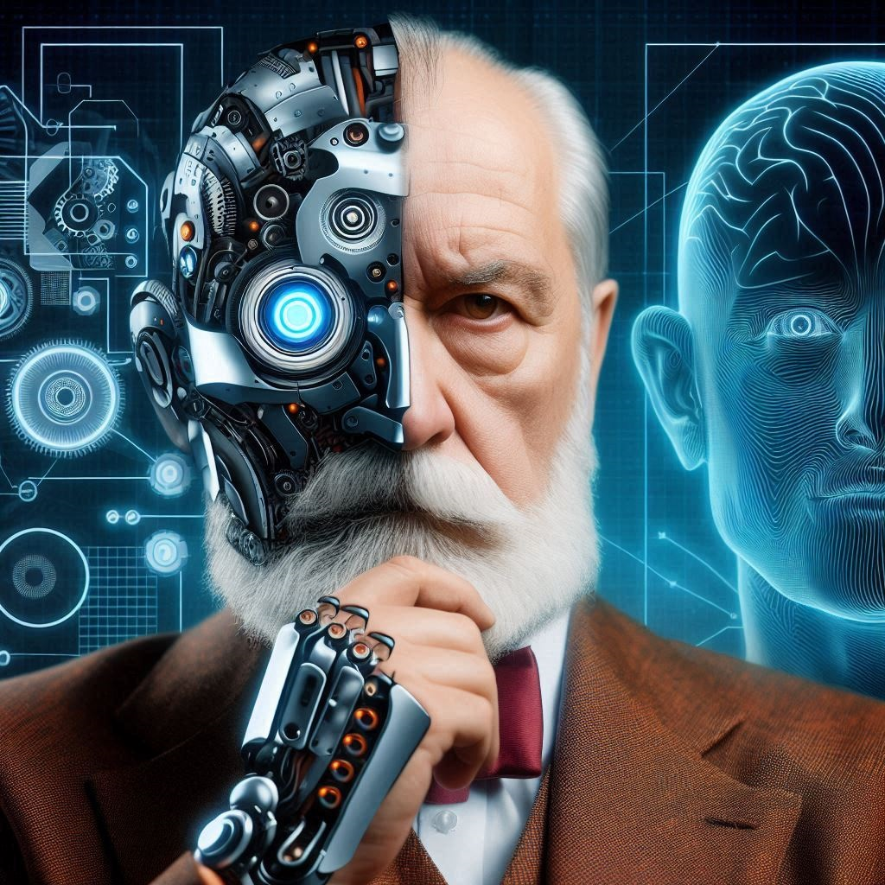
LLM Project AI Psychologist
Ilya Zutler
Shahar Gottliv
2024
Ramat Gan, Israel

Slide 2
Relevance of the "mechanical Psychologist"
1
Since October 7, the Clalit Health Services Center for Mental Health Research has reported a 52% rise in anxiety disorders, a 45% increase in post-traumatic stress disorder, and a staggering 900% surge in cases of acute stress.
As of April, 38,240 children and young people under 24 have sought help from Aran since the beginning of the war. A third of the calls were related to anxiety and trauma, while one in five addressed mental pain, depression, or other mental health issues.
Given these alarming statistics and the high cost of psychological treatment, we have decided to implement a project that offers an accessible and practical solution to address the challenges of the current reality.

Slide 3
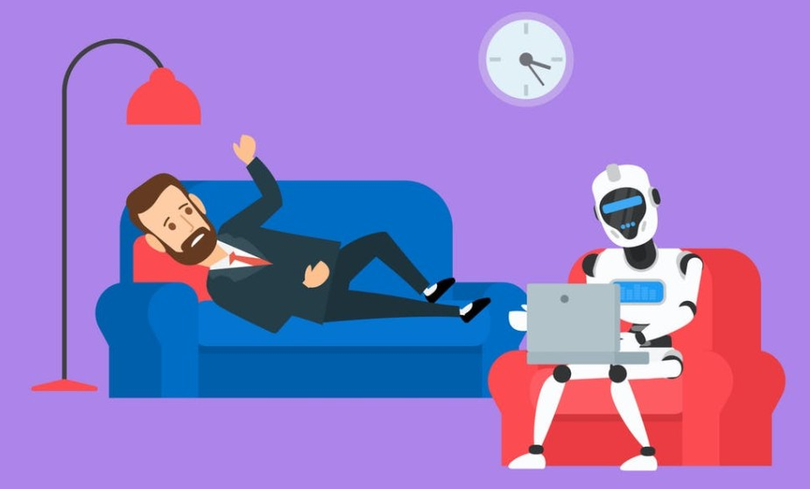
The history of "mechanical Psychologist"
2
0. Robert Sheckley. Bad Medicine (1956).
Year 2103. A man suffers from a manic desire to kill his friend. He buys a robot psychotherapist, which is mistakenly configured to treat aliens from Mars. But Martians fundamentally lack the desire to kill. The robot does not understand the patient's motives. Therefore, it treats the patient from mania for murder by instilling in him a Martian psychological diseases.
1. Early Automated Systems and ELIZA (1960s)
In 1966, Joseph Weizenbaum published program called ELIZA, which could chat to the user. The program applied pattern matching rules to statements to figure out its replies. Driven by a script named DOCTOR, it was capable of engaging humans in a conversation like empathic psychologist. Program use style after Carl Rogers, who introduced open-ended questions to encourage patients to communicate more effectively with therapists.
A robot-Psychologist listens to the patient and thinks to itself: "Damn, how great that my antivirus won't let depression virus through."
2. Rule-Based Models (1980-1990s)
In the 1980s and 1990s, "electronic psychologist" programs were based on rigid rules and logic. Programs that used cognitive-behavioral techniques offered basic scripts and simple logical chains to respond to users, but they lacked adaptability to complex or unusual questions.
3. The Internet and Online Counseling (1990s)
In the 1990s, as the Internet developed, experiments with web-based psychological support services began. Online chat assistants, which used databases of relevant information, could direct users to useful resources. Some of these systems applied basic forms of diagnostics by asking questions to assess users’ mental states.

Slide 4

The history of "mechanical Psychologist"
3
4. Systems Using Statistical and Linguistic Models (2000s)
During the 2000s, with the advancement of NLP (Natural Language Processing) and statistical modeling, electronic psychologists became more flexible and "sensitive" to context.
5. Integration of AI and Machine Learning (2010s)
Around the 2010s, machine learning allowed electronic psychologists to process large datasets and identify connections that were previously unclear. Commercial applications, like Woebot and Replika, began using AI for adaptive therapy. These programs could adjust to users depending on their moods and preferences.
6. Modern Systems with Deep Learning and Emotional Intelligence (2020s)
In recent years, deep learning and multi-layered neural networks have enabled electronic psychologists to reach high levels of personalization. Speech recognition, emotion analysis in text, voice tone analysis, and facial expression reading now make it possible not only to understand but also to empathize with the user. Modern systems, like ChatGPT, can understand context and "retain memory," offering not just advice but also emotional support. Tools based on Retrieval-Augmented Generation (RAG) allow models to access various external data sources, broadening their expertise.
7. Future: Automation and Expanded Functionality
In the future, electronic psychologists are expected to possess an even deeper understanding of emotional and cognitive states, predict tendencies toward psychological issues, and provide real-time support based on biometrics and behavioral analysis.
Judging by the patient's biometrics, he is lying even to me.

Slide 5
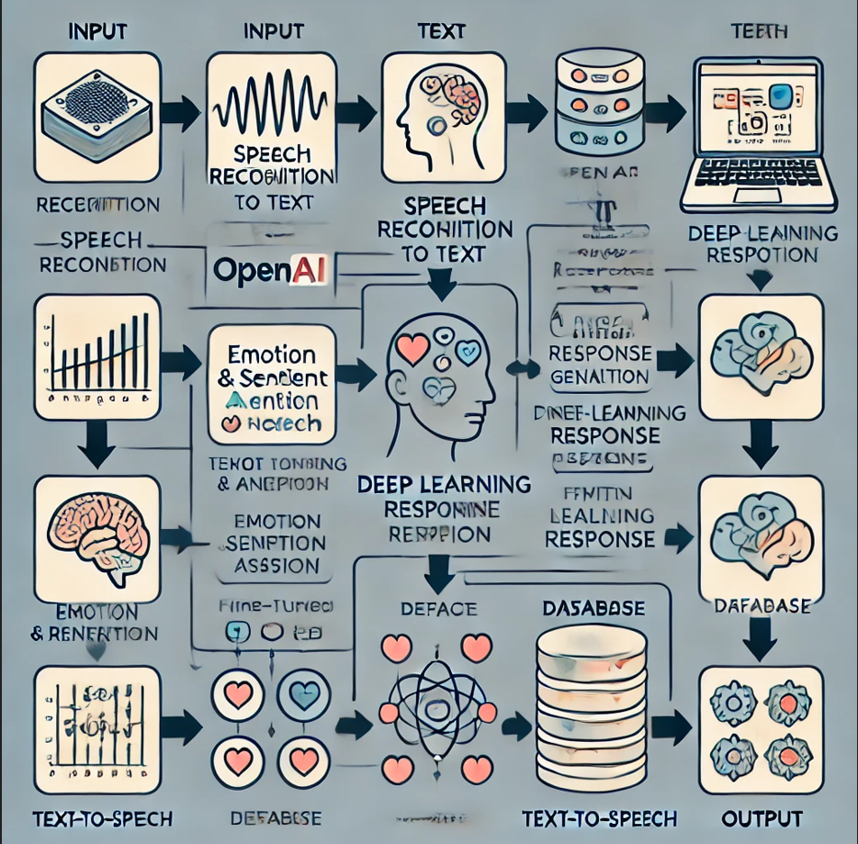
The main methods of our Psychologist program
4
Fine-tuned LLM model for Socratic-style questions therapy:
"What do you mean by that? Can you explain it further?"
"Why do you think this is true or important?"
"Why does this evoke strong emotions in you?"
"What assumptions are you making here?"
"Could you provide another perspective on this?"
"What would happen if everything were to change?"
"How might someone else see this situation?"
Retrieval-Augmented Generation
In addition to recording the current conversation, relevant information from the patient's previous conversations is transmitted to LLM model
Analysis of emotions
simple function based on two primary features of speech: energy and pitch
This image is just for show — don’t worry, the actual program logic is coming right up!

Slide 6
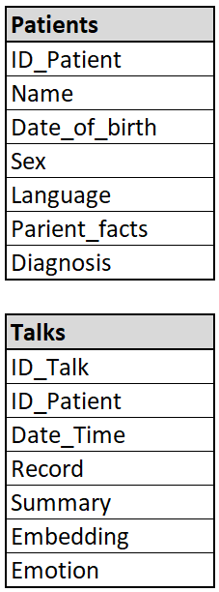
Database Structure Overview
5
The database contains two primary tables: Patients and Sessions.
The Patients table includes a text field Patient_facts, which stores unstructured information about each patient. Initially, this field is filled in by the patient, then further enriched by the program based on insights gained from ongoing sessions.
The Sessions table stores the complete text of each session along with a summarized version tailored for search and embedding purposes. It also contains embedding of talk - a vector that enables finding similar or dissimilar sessions. Emotion - an evaluation of the patient’s emotional tone based on voice analysis during the session.

Slide 7
Program operation scheme
6
Retrieve Patient Information from Database
Patient Identification or New Patient Registration
Notes:
The original data frame takes up 250 MB.
Therefore, the data frame is divided into two tables:
Comments of guests (with apartment ID)
Apartment data (once for one apartment).
The tables take up 37 MB and 3.5 MB respectively.

Slide 8

Program operation scheme
7
Retrieve Patient Information from Database
Search Similar and Dissimilar Sessions in Database
Patient Identification or New Patient Registration
Record and Recognize Patient’s Speech
Analyse Emotional Tone of Voice
Notes:
The original data frame takes up 250 MB.
Therefore, the data frame is divided into two tables:
Comments of guests (with apartment ID)
Apartment data (once for one apartment).
The tables take up 37 MB and 3.5 MB respectively.

Slide 9
Program operation scheme
8
Retrieve Patient Information from Database
Search Similar and Dissimilar Sessions in Database
Fine-tuned LLM “Psychologist” Receives for answer: current session transcript, patient information, diagnosis, summary of the previous session, similar and dissimilar sessions, emotion description.
Patient Identification or New Patient Registration
Record and Recognize Patient’s Speech
Analyse Emotional Tone of Voice
Notes:
The original data frame takes up 250 MB.
Therefore, the data frame is divided into two tables:
Comments of guests (with apartment ID)
Apartment data (once for one apartment).
The tables take up 37 MB and 3.5 MB respectively.

Slide 10

Program operation scheme
9
Retrieve Patient Information from Database
Search Similar and Dissimilar Sessions in Database
Fine-tuned LLM “Psychologist” Receives for answer: current session transcript, patient information, diagnosis, summary of the previous session, similar and dissimilar sessions, emotion description.
Patient Identification or New Patient Registration
Record and Recognize Patient’s Speech
Analyse Emotional Tone of Voice
Speak LLM answer to Patient
Notes:
The original data frame takes up 250 MB.
Therefore, the data frame is divided into two tables:
Comments of guests (with apartment ID)
Apartment data (once for one apartment).
The tables take up 37 MB and 3.5 MB respectively.

Slide 11
Program operation scheme
10
Retrieve Patient Information from Database
Search Similar and Dissimilar Sessions in Database
Fine-tuned LLM “Psychologist” Receives for answer: current session transcript, patient information, diagnosis, summary of the previous session, similar and dissimilar sessions, emotion description.
Patient Identification or New Patient Registration
Record and Recognize Patient’s Speech
Analyse Emotional Tone of Voice
Speak LLM answer to Patient
End of Session
Fine-tuned LLM “Psychologist”: generates a session summary, update diagnosis, extracts relevant facts, and updates patient information.
The session summary embedding is calculated.
Record and Update Information in the Database
Notes:
The original data frame takes up 250 MB.
Therefore, the data frame is divided into two tables:
Comments of guests (with apartment ID)
Apartment data (once for one apartment).
The tables take up 37 MB and 3.5 MB respectively.

