Slide 1
Automatic Migration of a relational database to nosql.
Participants :
Ilyess Aggour
Alexandre Caro
Mohamed-Ahsan Gull
Manip Séthi

Slide 2
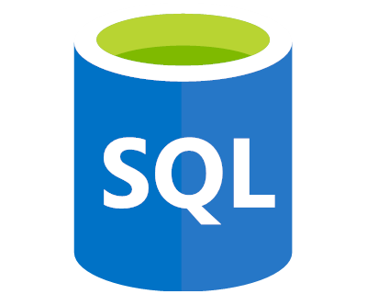
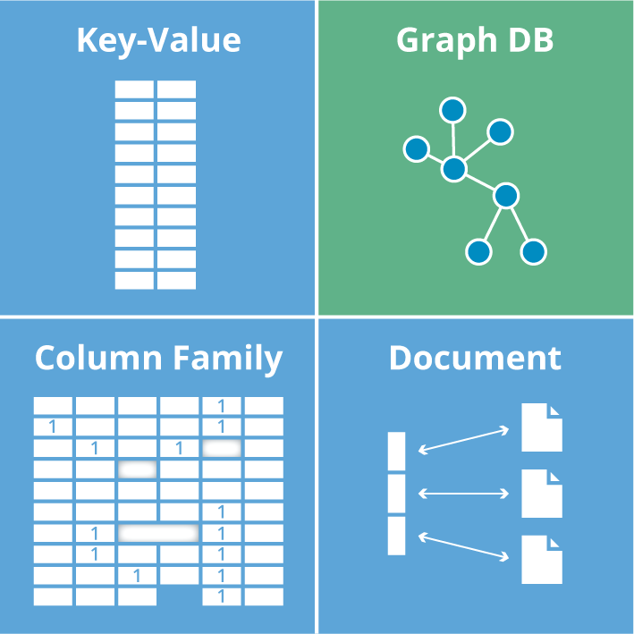

Subject

Slide 3
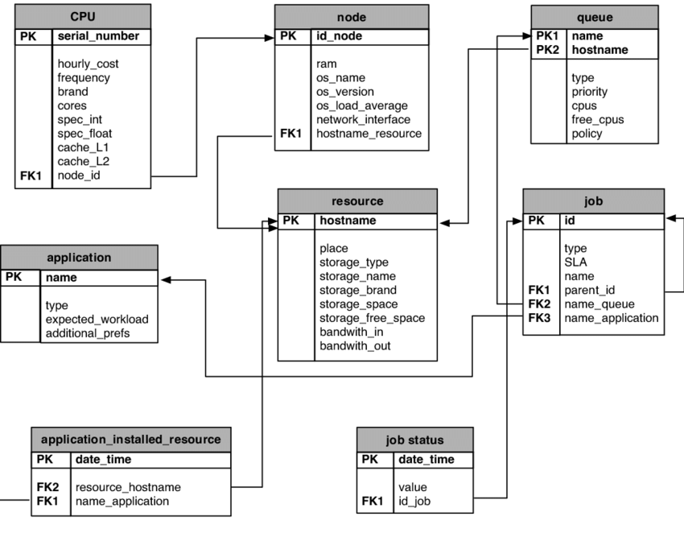
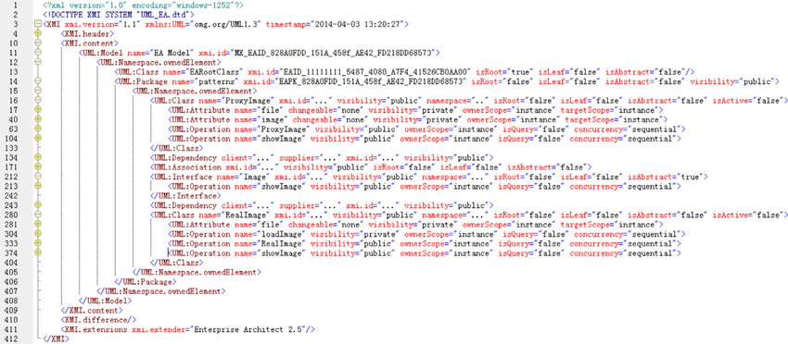
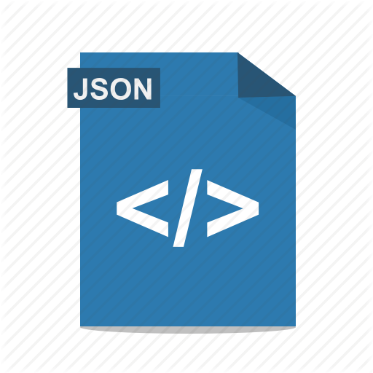

Procedure
Export to XMI
Schema importation and modelization
Extract the data into JSON with the form prescribed by the XMI
Import the JSON to MongoDB

Slide 4
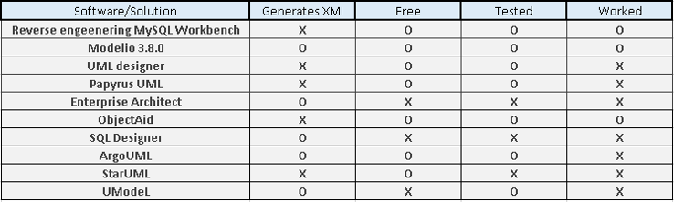
RESEARCH

Slide 5

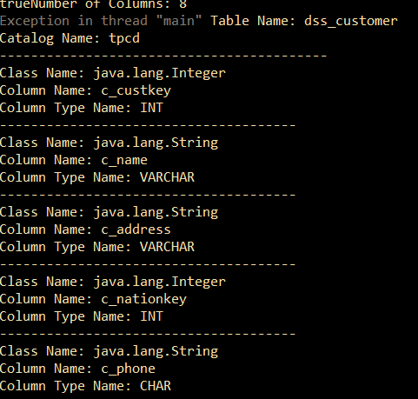
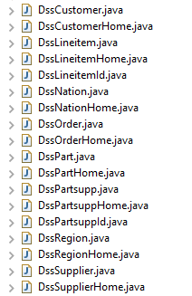
Mapping to Java classes
Corresponding Java classes

Slide 6


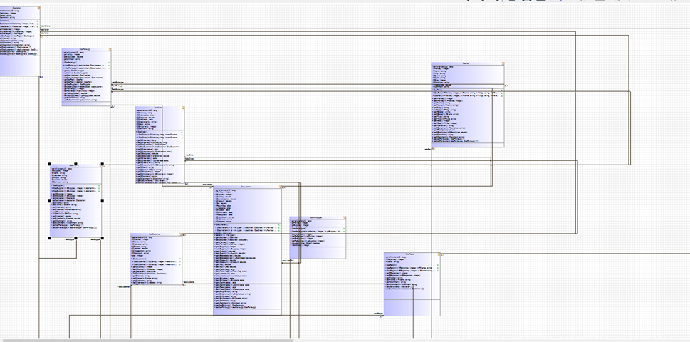
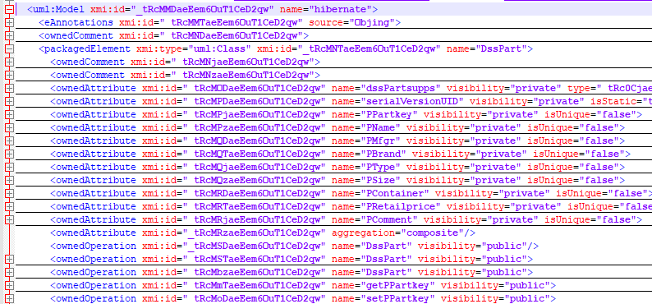
Schema and XMI exportation

Slide 7
XMI Reading

Slide 8
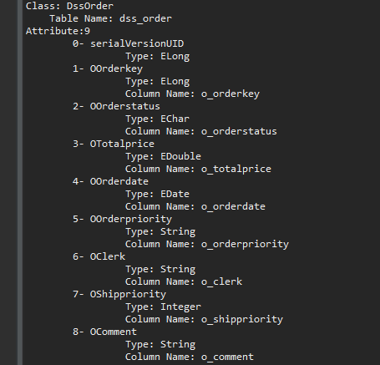
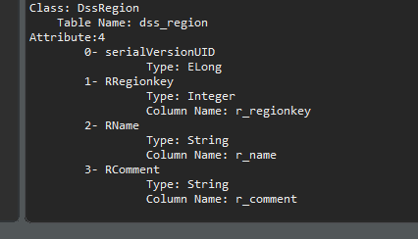
XMI READING

Slide 9
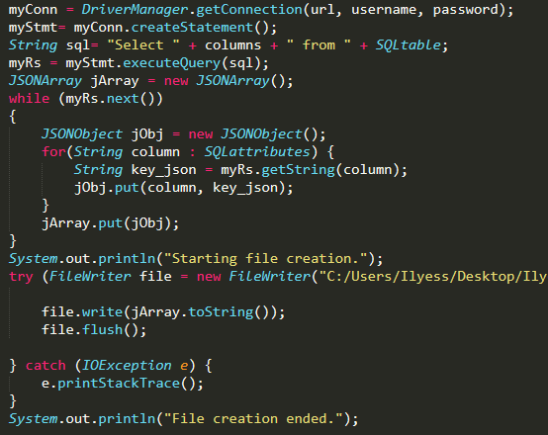
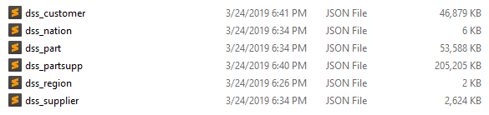
JSON CREATION

Slide 10
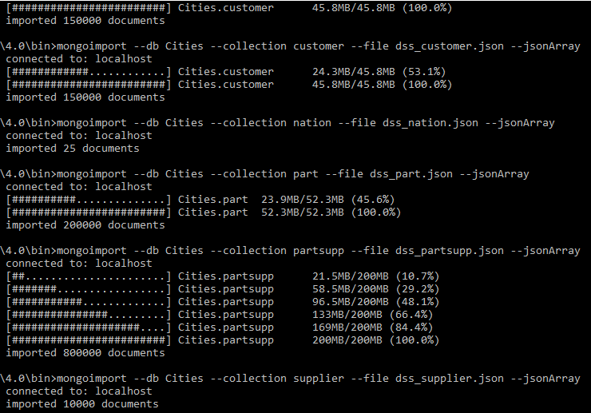
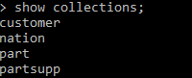
MongoDB importation

Slide 11
CONCLUSION

