Slide 1
Data Squad
Yann Wen, Omer Mogultay, Rawan Joudeh

Slide 2
Problem Statement
Our purpose is to apply technical skills we have learned on real-world data and to use our skill set to derive insights that generate business growth
Quantifying the decision-making world we live in
Predicted Business Sales for 2015
Best predictors of successfully meeting store sales goals and the contribution of factors of these models
KPI’s to assess performance of plant
Notes:
Rawan

Slide 3
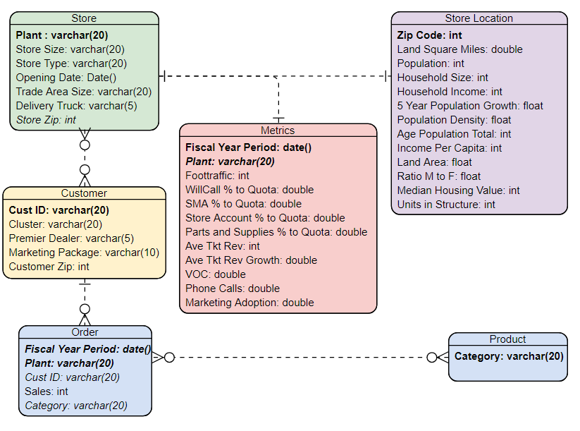
Data
Relationship
Notes:
A customer can have 0 or many orders but each order has only 1 customer

Slide 4
Initial Data Visualization
Initial data visualization was done in Tableau to find trends
Foot traffic data was plotted with Sales and by Fiscal Year Period and correlation was found between the predictor and response
Foot traffic also increases in the summer months, especially in June, and is lower during the winter months with a small spike in December.

Slide 5
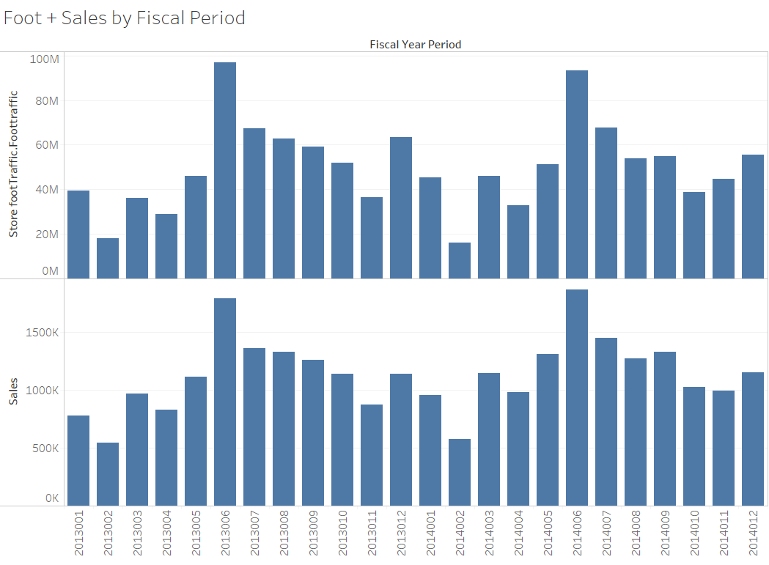

Slide 6
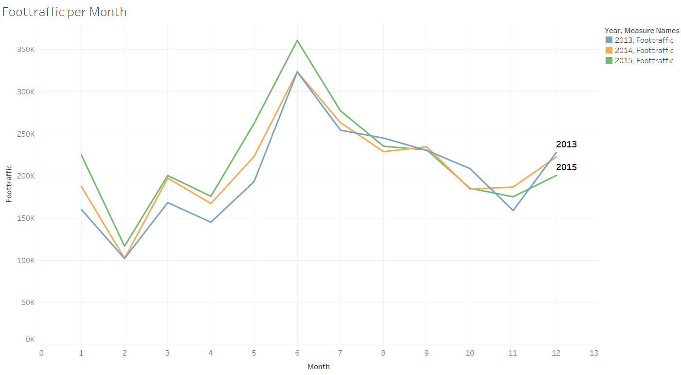
Notes:
Rawan

Slide 7
Initial Data Visualization
Sales plotted by Category for each year and Category was found to be a highly dependent variable of Sales
Sales plotted against store opening date as validation (stores opened earlier should have higher total sales than stores recently opened)
Top Sales by Plant
Notes:
Yann

Slide 8
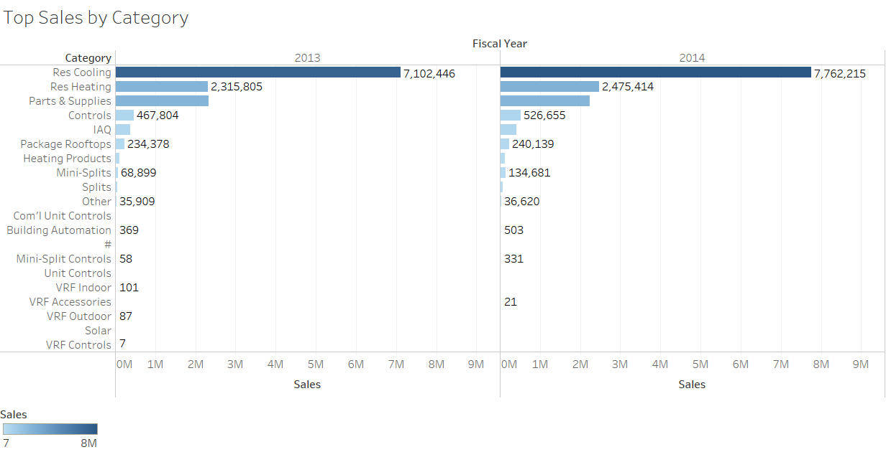

Slide 9
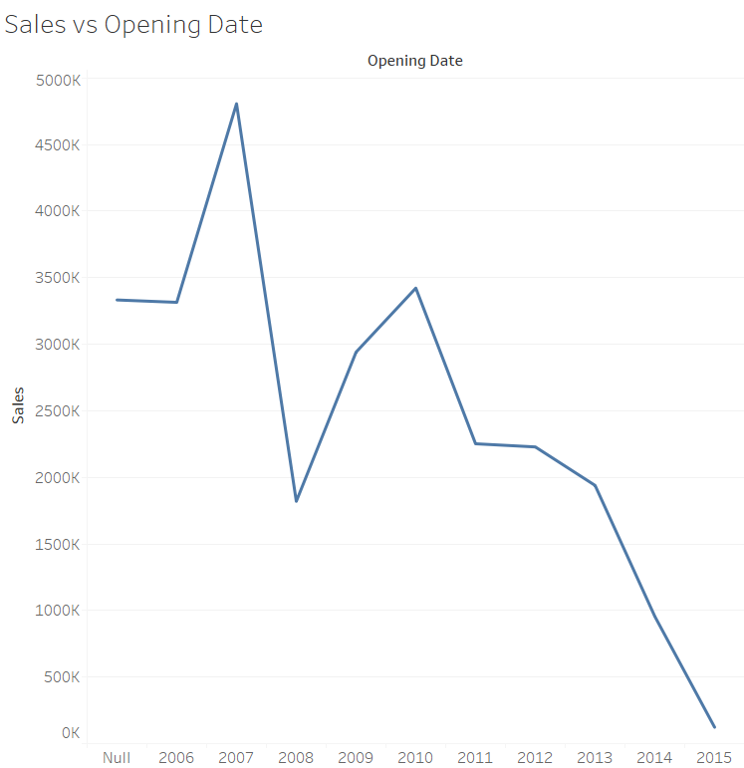
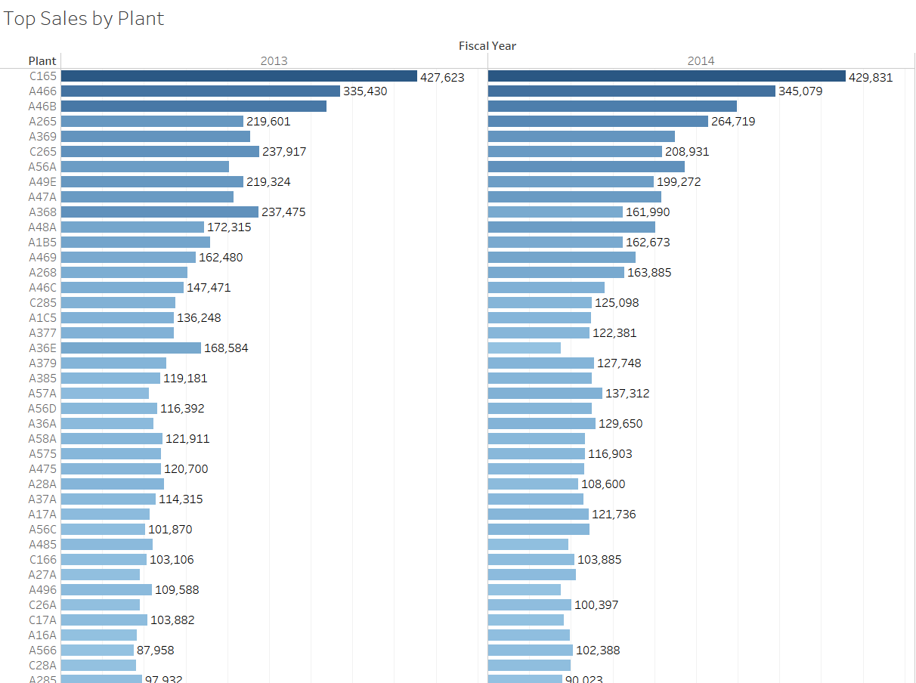
Sales validation and Top Sales Plants

Slide 10
Initial Data Visualization
Customer Characteristics data was tested for possible statistical significance
Marketing Package was found to be correlated with both Customer Cluster and Premier Dealer. Hence, marketing package was left out of the predictor dataset for modelling

Slide 11
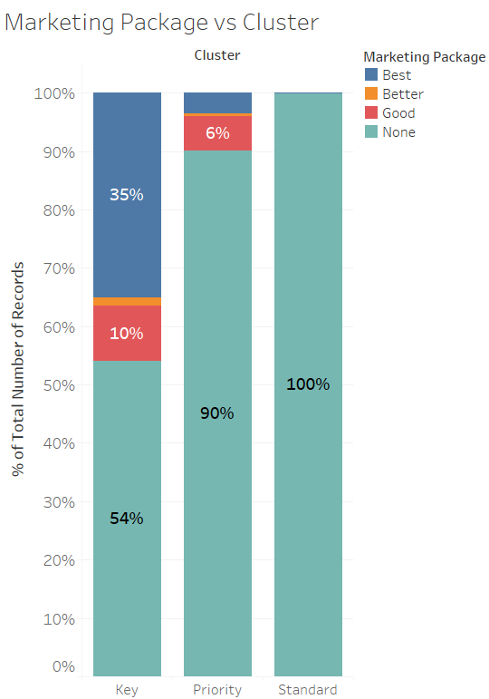
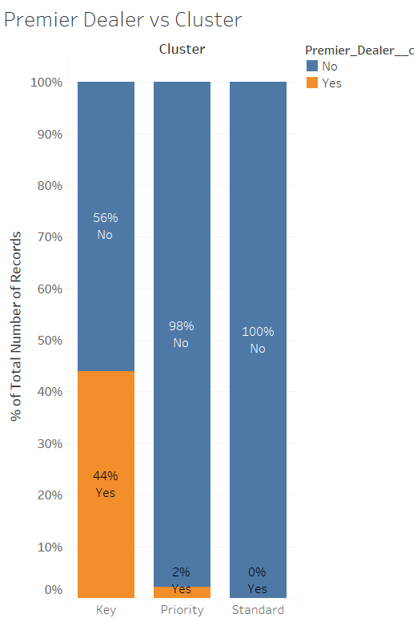
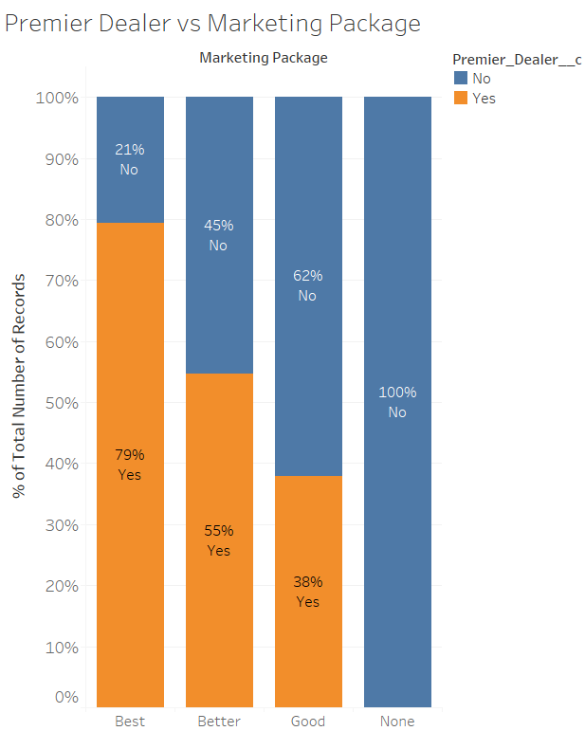

Slide 12
Initial Data Visualization
Amount of Sales in each store characteristic category
The total Sales was greatest for Large Market, followed by Small Market
The most Sales was make in Store revenue group 2
The most Sales was made in New stores followed by remodeled and relocated
This data found was as we would have expected

Slide 13
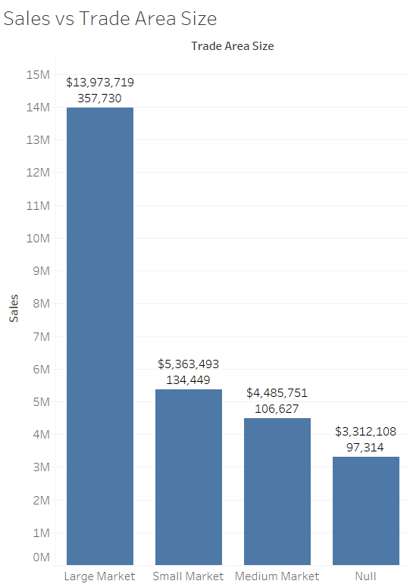
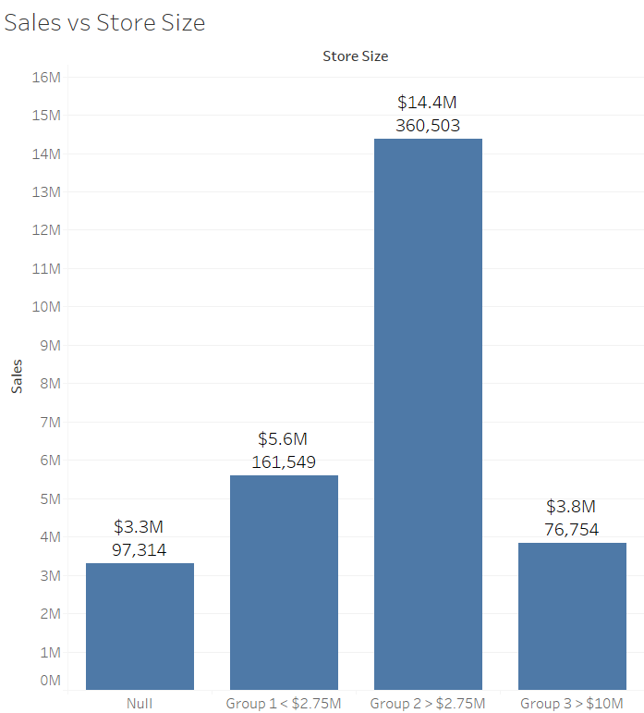
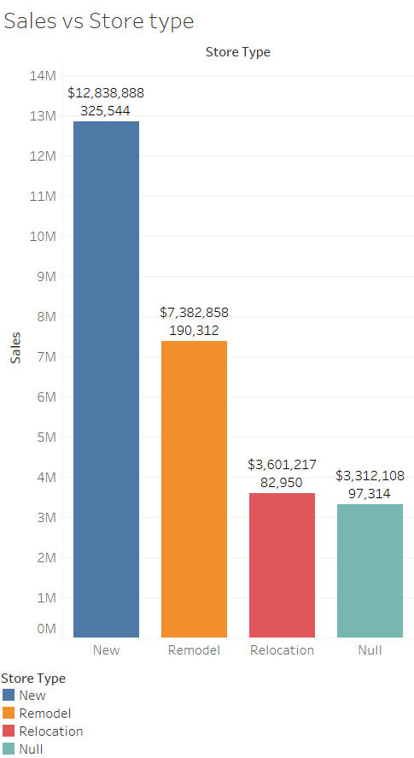

Slide 14
Data Preprocessing
Merged data by left joining Billing datasets with others by customer ID, zip, or plant accordingly.
Error analysis was done with MICE package in R
Computed missing values using MICE for continuous variables in R
Computed missing values using KNN for categorical variables in R

Slide 15
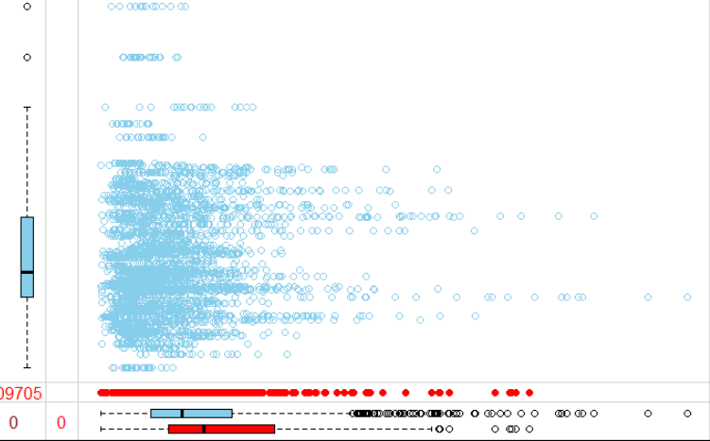
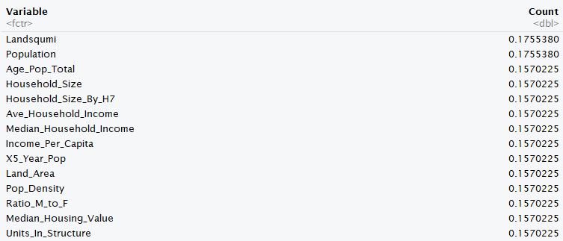
Data Preprocessing
MICE na Analysis
Checked for cases:
MCAR - Missing Completely at Random
missing values can be thought of as a random sample of all the cases
MAR - Missing at Random
missingness can be modelled using the observed data
MNAR - Missing Not at Random
require strong assumptions about the patterns of missingness
Population
Median Household Income
Notes:
Yann
###SAY : in mice package is a Markov Chain Monte Carlo (MCMC) method that uses correlation structure of the data and imputes missing values for each incomplete variable m times by regression of incomplete variables on the other variables iteratively.

Slide 16
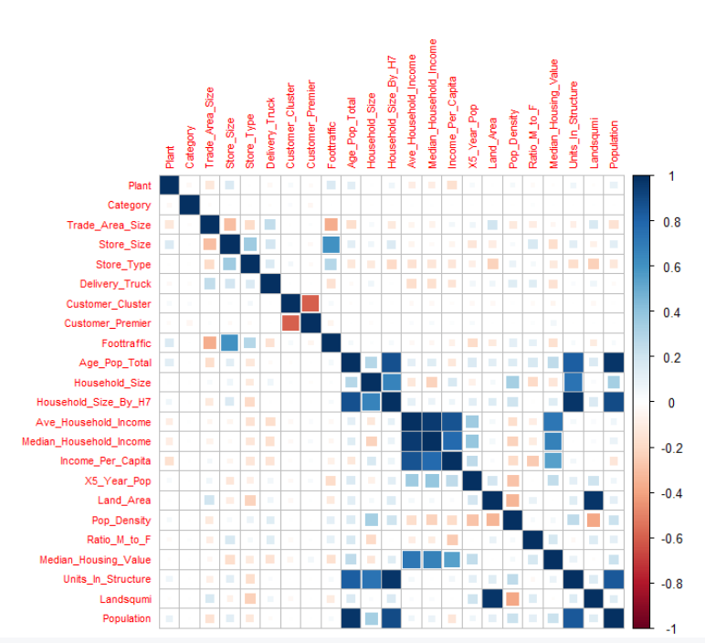
Analysis
Correlation of All Features
Notes:
Omer

Slide 17
Modeling
Initial Modeling
Attempted models:
Linear regression
Elastic Net
Lasso
Neural Networks
Random Forests
Gradient boosting
Polynomial regression
KNN
XGBoost
KNN and XGBoost:
Model performance - lowest RMSE
Robust to outliers
Robust against correlation
Speed
Notes:
Omer

Slide 18
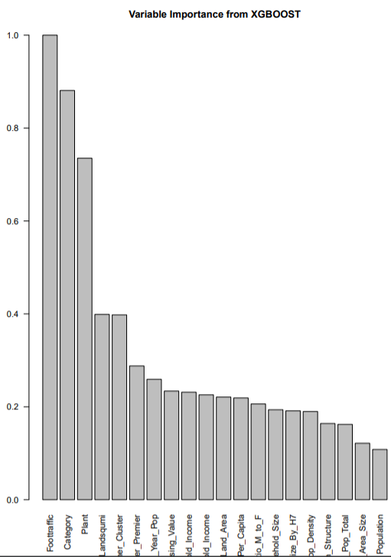
Modeling
XGBoost
XGBoost with CV
RMSE = 109 Unscaled
RMSE = 0.89 Scaled
XGBoost after Parameter Tuning(CV)
RMSE = 101 Unscaled
RMSE = 0.88 Scaled
Notes:
Omer

Slide 19
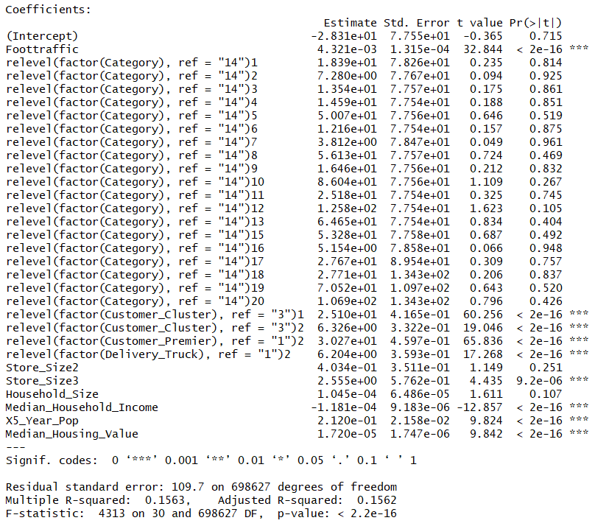
Modeling
Fit a linear model of Sales with top features
How do these affect change in Sales?
Changing Increase Ave Sales
Standard cluster to Priority $6.33
Standard cluster to Key $25.10
Converting to Premier $30.27
Delivery Truck $6.20
Increase Store Size to g2 $0.40
Increase Store Size to g3 $2.56
Increase 1 unit of
Foottraffic $0.0043
5 Year Projected Population $0.2120
Household Size $0.0001
Median Household Income -$0.0001
Notes:
Omer

Slide 20
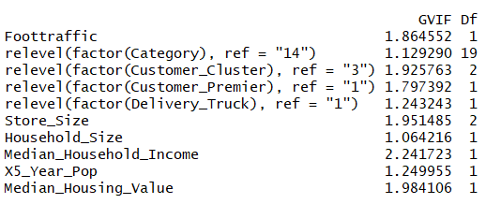
Modeling
Variance Inflation Factor (VIF) of Linear Regression
Notes:
Omer

Slide 21
Category Subset Analysis
Category was found to be one of the most significant feature for most models
Therefore split the data into category subsets based off category
Subset the dataset by Categories (factors 1 to 20) as the variable was our highest selected feature in previous modelling with whole data set
Analyze the distribution by plotting density plot of Sales ($) for each Category
Notes:
Rawan
A different approach we tried is ...

Slide 22
Nested Model
Step 1
Step 2
Step 3
Step 4
Used 4 sets of transformed predictors -
Unscaled
Scaled
Box Cox
Squared
Used 4 models on each set of the transformed predictors -
KNN
Rpart
XGB Tree
Random Forest
Combined Step 1 and Step 2 to create prediction-model combinations for each Category
Chose model with lowest RMSE for each category
Computed final predictions for each category
Notes:
Rawan

Slide 23
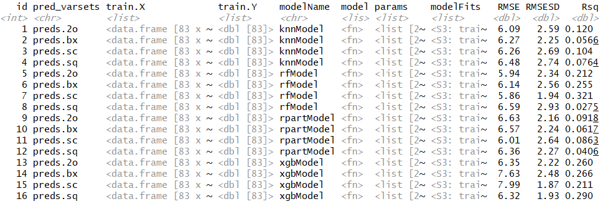
Nested Model
Output Example
16 models for each category
Notes:
Rawan

Slide 24
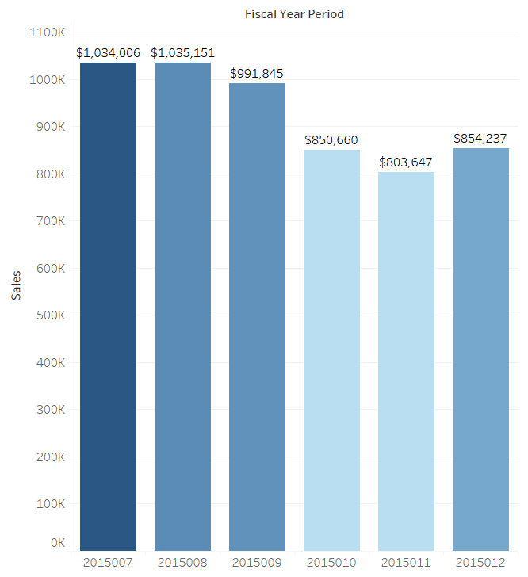
Nested Model
Predicted Sales

Slide 25
Metrics Data Analysis
Combined training and metrics data together by Fiscal Year Period
Each of the four ‘% to Quota’ metrics was taken separately as responses
Logistic Regression was performed for classification with
factor ‘1’ , store met quota (>1)
factor ‘0’, store did not meet quota (<1)
Initial confusion matrix and accuracy obtained
Feature selection performed and final model chosen with best accuracy
Notes:
Yann

Slide 26
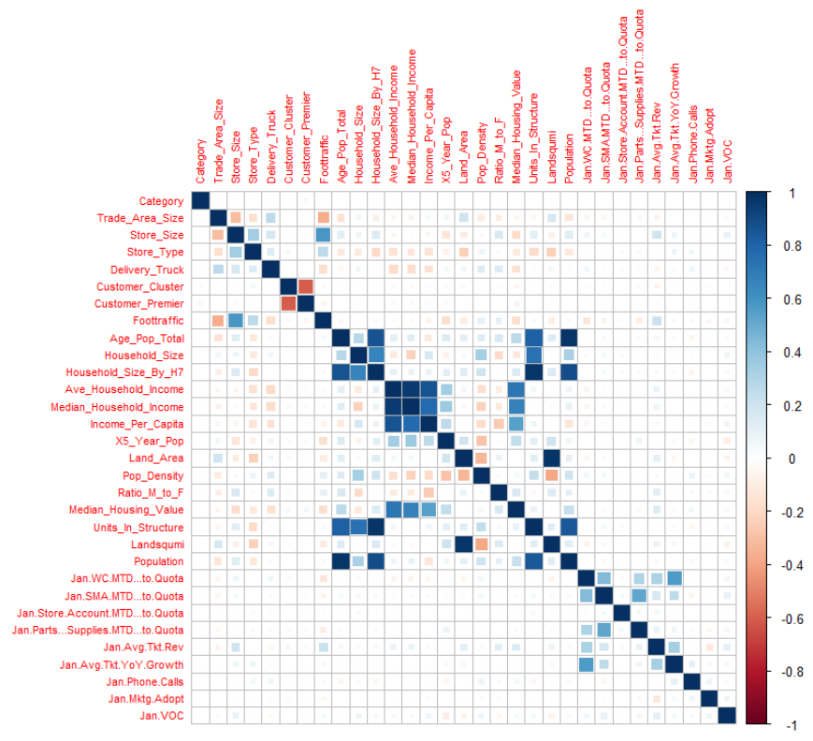
Metrics Data Analysis
Correlation of all Features
Notes:
Yann

Slide 27
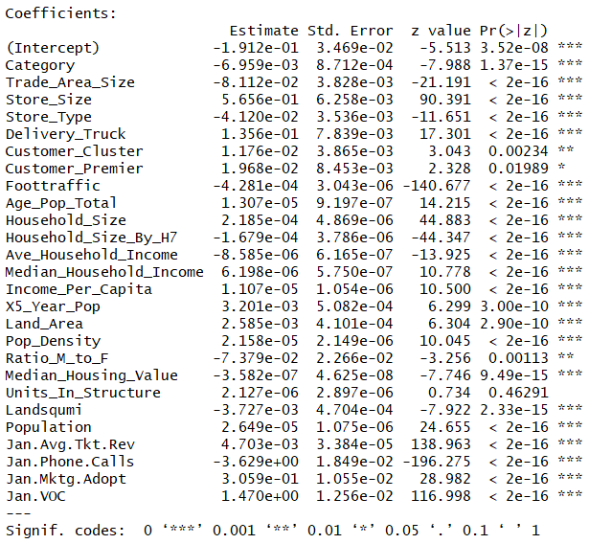

Metrics Data Analysis
Summary of Initial Log Reg Model
Confusion Matrix
Accuracy = 0.6595

Slide 28
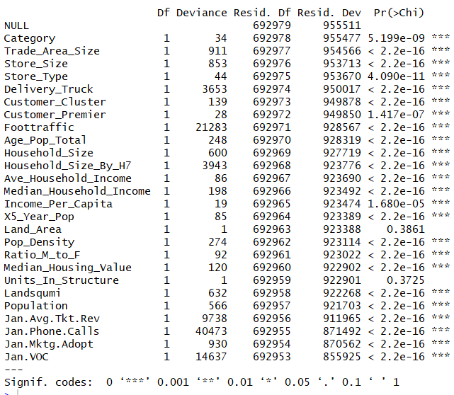
Metrics Data Analysis
Summary of Initial Log Reg Model
Likelihood Ratio Test

Slide 29





Metrics Data Analysis
Anova Two Way χ² Testing - Feature Selection
-Units In Structure
BIC: 856288.1
-Land Area
BIC: 856275.2
-Customer Premier
BIC: 856294.3
-Customer Cluster
BIC: 856284.9
-Ratio M to F
BIC: 856293.2

Slide 30
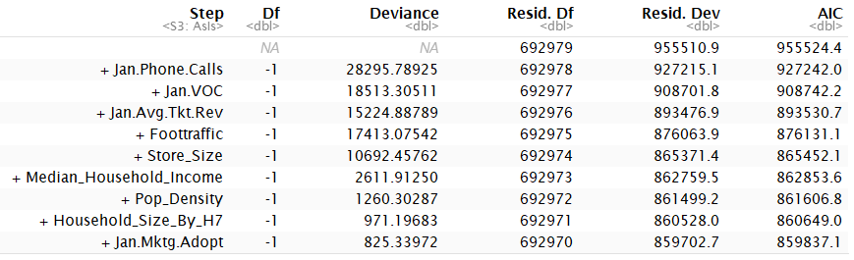
Metrics Data Analysis
Forward Step BIC
23 more variables
BIC: 856257.9

Slide 31

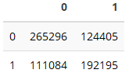
Metrics Data Analysis
Anova test for last model (1) and fstep model (2)
Confusion Matrix
Deviance increases significantly for fstep model, so we choose last model with dropped variables.
Accuracy = 0.6602

Slide 32
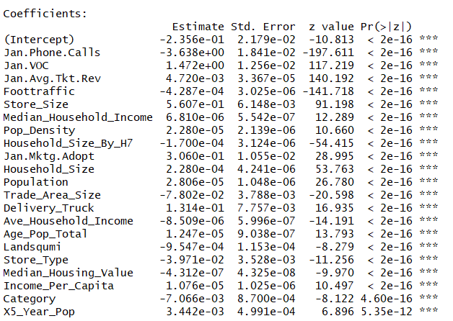
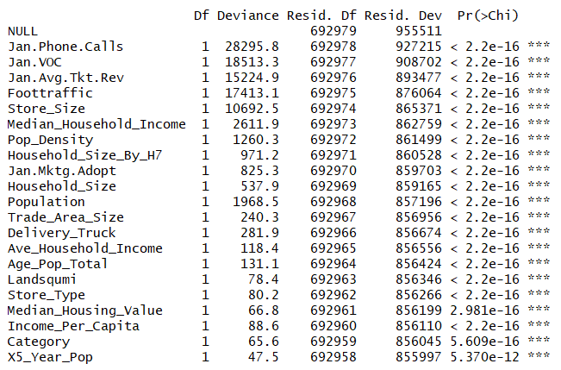
Metrics Data Analysis
Final Model Summary
Likelihood Ratio Test

Slide 33
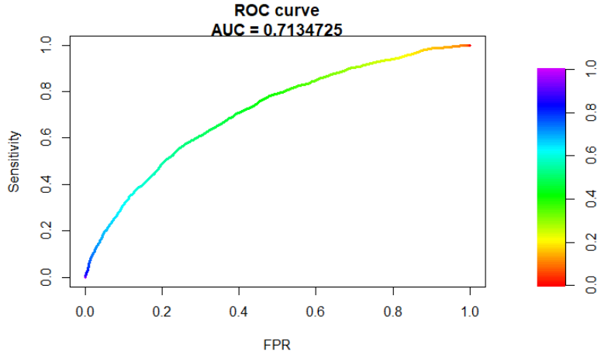
Metrics Data Analysis

Slide 34
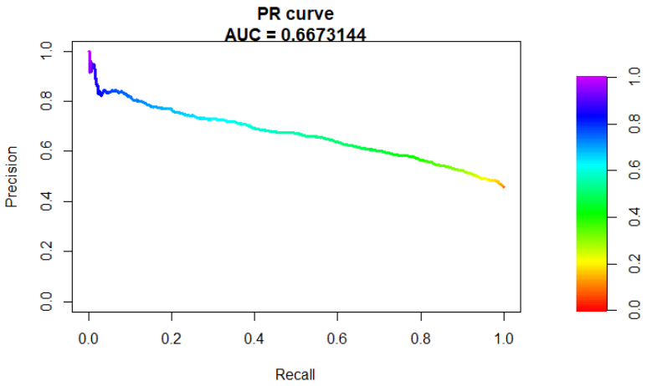
Metrics Data Analysis

Slide 35
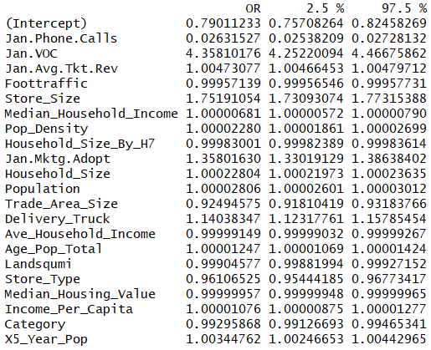
Metric Data Analysis
Odds Ratio
Holding all other variables at a fixed value, we will see a 335% increase in the odds of a store meeting WC % to Quota goals for one unit increase in VOC
Notes:
Odds ratio for voice of customer says that holding all other variables at a fixed value, we will see a 335% increase in odds of a store meeting WC goals for one unit increase in voc.

Slide 36
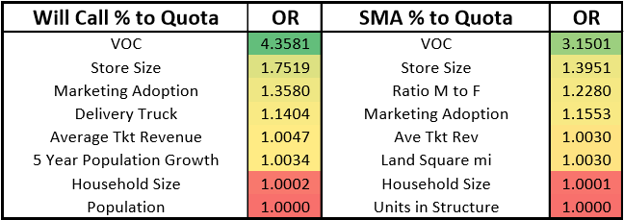
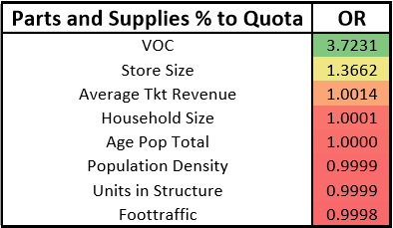
Top Factors to Meeting Quotas
Summary of % to Quota

Slide 37
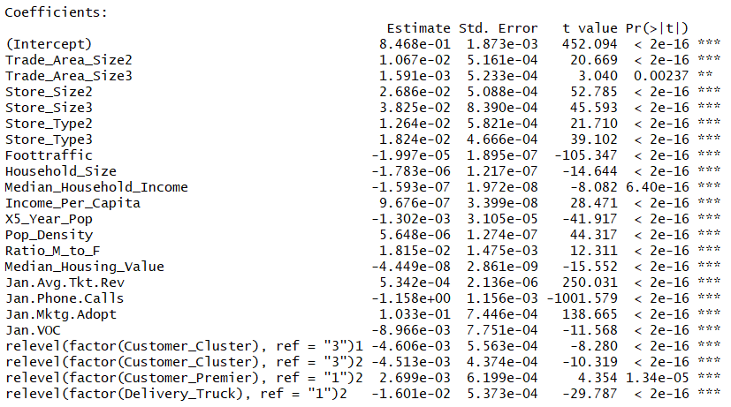
Year Over Year Growth Factors
Linear Model Fit

Slide 38
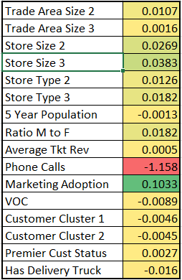
Year Over Year Growth Factors
One unit increase in predictor corresponds to y unit increase in year over year growth on average

Slide 39
Factor Levels Key
Category
# - 1
Building Automation - 2
Com'l Unit Controls - 3
controls - 4
Heating Products - 5
IAQ - 6
Mini-Split Controls - 7
Mini-Splits - 8
Other - 9
Package Rooftops - 10
parts & supplies - 11
res cooling - 12
Res Heating - 13
Solar - 14
Splits - 15
Unit Controls - 16
VRF Accessories - 17
VRF Controls - 18
VRF Indoor - 19
VRF Outdoor - 20
Customer Cluster
standard - 3
priority - 2
key - 1
Customer Premier
no - 1
yes - 2
Trade Area Size
large = 1
medium = 2
small = 3
Store Size
group 1 = 1
group 2 = 2
group 3 = 3
Store Type
new = 1
remodel = 3
relocation =2
Delivery Truck
N - 1
Y - 2

