Slide 1
Color-Based Hand Motion Recognition with OpenCV
NAME: Shivaprakash S
NM-ID:au711721243099
KGiSL Institute Of Technology
3/21/2024 Annual Review

Slide 2
PROJECT TITLE
Color-Based Hand Motion Recognition with OpenCV
3/21/2024 Annual Review

Slide 3


AGENDA
Problem Statement.
Project Overview.
End Users.
Our Solution and Proposition.
Key Features.
Modelling Approach
Results and Evaluation
3/21/2024 Annual Review

Slide 4

PROBLEM STATEMENT
Enables real-time hand motion recognition based on color detection using OpenCV in Python. By detecting color changes in a live video feed, the script tracks hand movements and draws corresponding trajectories on the screen.
3/21/2024 Annual Review

Slide 5

PROJECT OVERVIEW
Hand motion recognition is a fundamental aspect of human-computer interaction, with applications ranging from virtual reality gaming to sign language translation. This project utilizes the power of OpenCV, a popular computer vision library, to detect and track hand movements based on predefined color thresholds.
3/21/2024 Annual Review

Slide 6

WHO ARE THE END USERS?
The primary end users for this application are presenters who want to incorporate a more dynamic and interactive element into their presentations. This could include:
Business Professionals: They can use it to create engaging presentations for clients, colleagues, or investors.
Educators: Teachers, lecturers, and professors can leverage it to explain concepts in a visually stimulating way, fostering student engagement.
Trainers and Workshop Leaders: They can use it to create interactive workshops where participants can contribute ideas by "writing in the air."
YouTubers and Content Creators: This can be a unique tool to visually explain concepts in their videos, increasing audience retention.
3/21/2024 Annual Review

Slide 7

YOUR SOLUTION AND ITS VALUE PROPOSITION
Value Proposition:
Enhanced audience engagement: Move beyond static slides and capture attention with dynamic writing that appears as you move your hand.
Improved information retention: Visual elements and interaction can enhance audience focus and understanding of key points.
Increased presenter control: Emphasize important information through hand gestures like underlining or circling.
Creative freedom: Illustrate concepts with drawings or diagrams directly on the screen, fostering a visually stimulating experience.
Cost-effective and accessible: Leverages free and open-source tools (Python, OpenCV) for a budget-friendly solution.
3/21/2024 Annual Review

Slide 8

THE WOW IN YOUR SOLUTION
Imagine this: Captivate your audience by literally writing in the air! Ditch the clicker and projector dance – presentations just got a futuristic upgrade.
Real-time magic: Watch your ideas come alive on screen as you move your hand. It's like having a digital whiteboard that follows your every gesture.
Engagement amplified: Forget passive slideshows. This tool transforms presentations into interactive experiences, keeping your audience hooked and participating.
3/21/2024 Annual Review
8

Slide 9
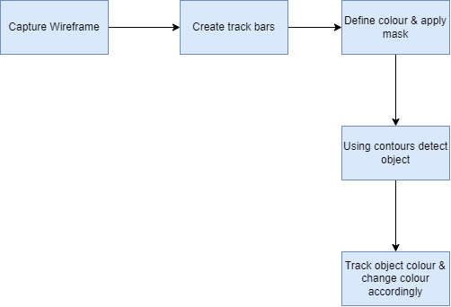
MODELLING
3/21/2024 Annual Review
9

Slide 10
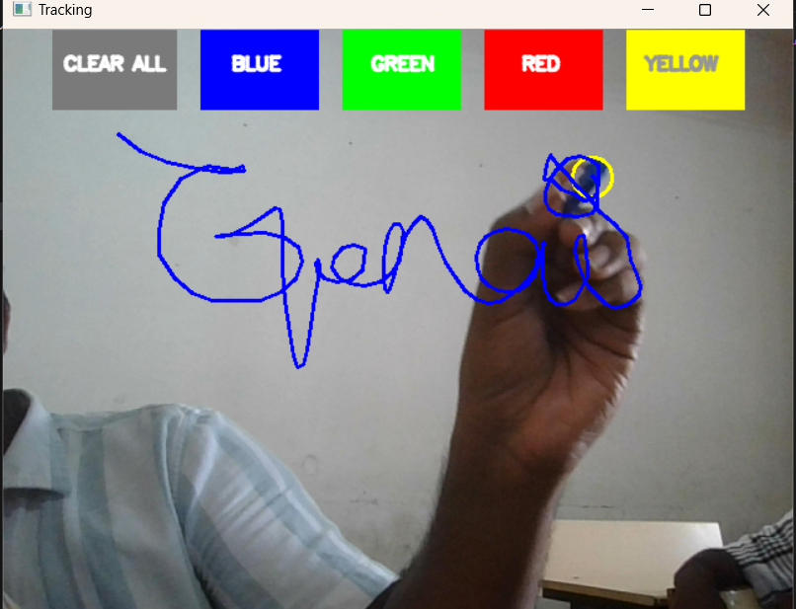
RESULTS
3/21/2024 Annual Review
10

