Slide 1
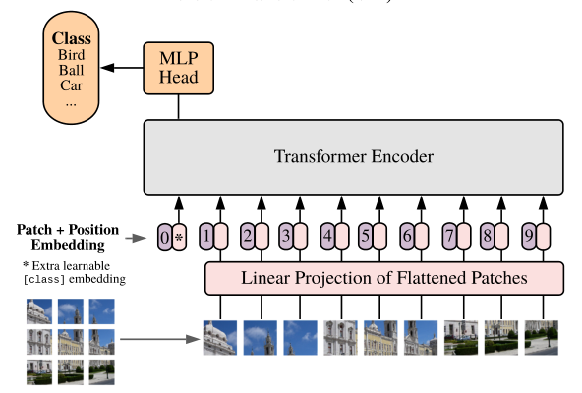
class_token
position embedding

