Slide 1
Study of Terrorism in South Asia
for the Big Data Analysis class

Slide 2
Data source
Global terrorism database at Kaggle (https://www.kaggle.com/START-UMD/gtd)
The Global Terrorism Database (GTD) is an open-source database including information on terrorist attacks around the world from 1970 through 2017.
The GTD includes systematic data on domestic as well as international terrorist incidents that have occurred during this time period and now includes more than 180,000 attacks. The database is maintained by researchers at the National Consortium for the Study of Terrorism and Responses to Terrorism (START), headquartered at the University of Maryland.

Slide 3

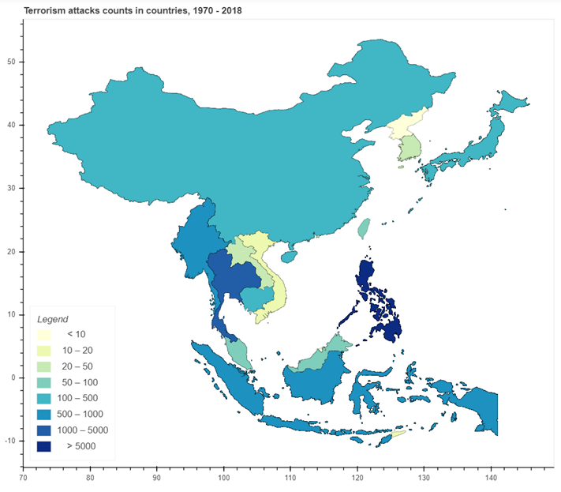
Geographical distribution of the attacks

Slide 4

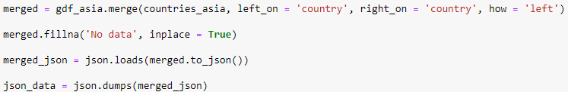

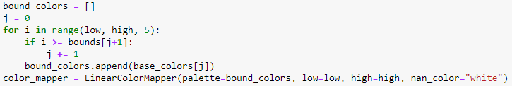
Map code
Terrorism and geographical data preparation
Legend ranges edit

Slide 5
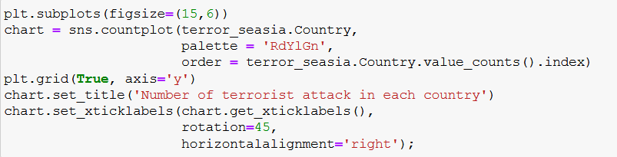
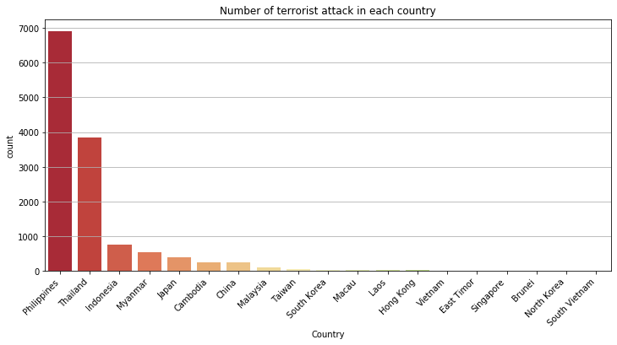
Let's start by comparing the impact of terrorism in the different countries

Slide 6
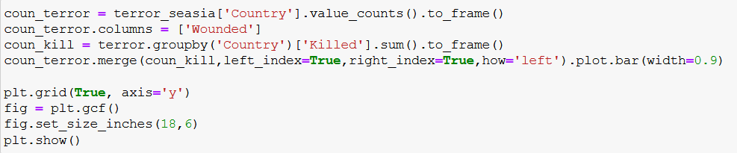
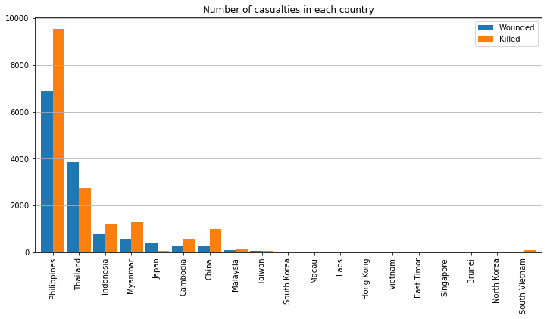
How are these countries impacted by terrorism?

Slide 7
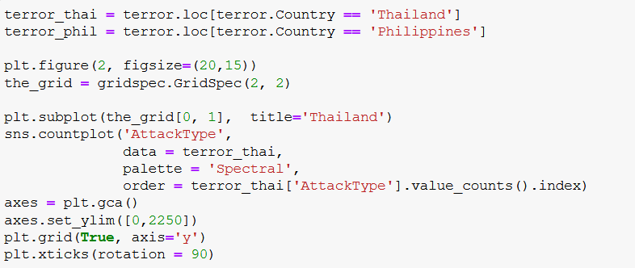
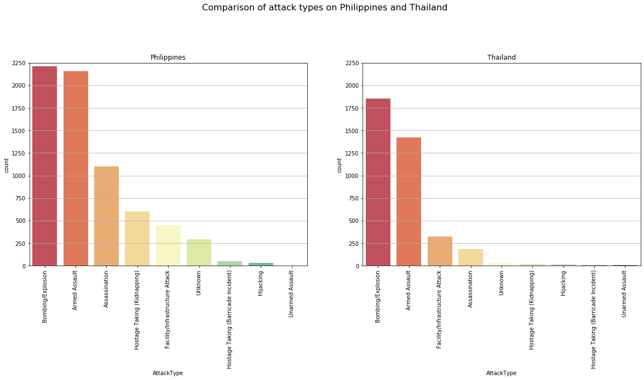
How are these countries impacted by terrorism?

Slide 8
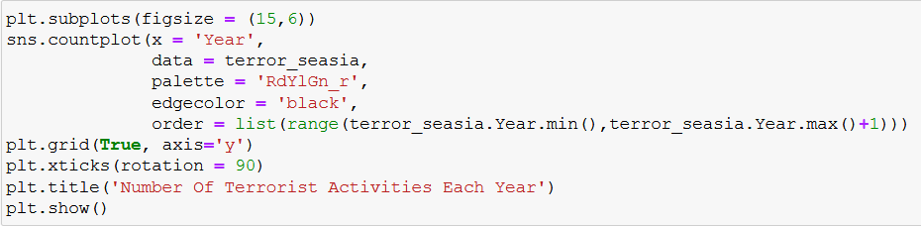
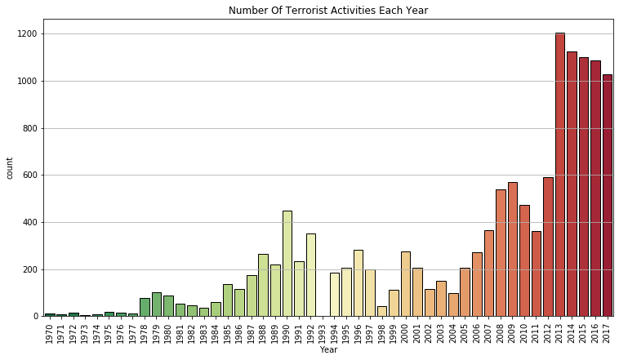
Number of Attacks over Years

Slide 9
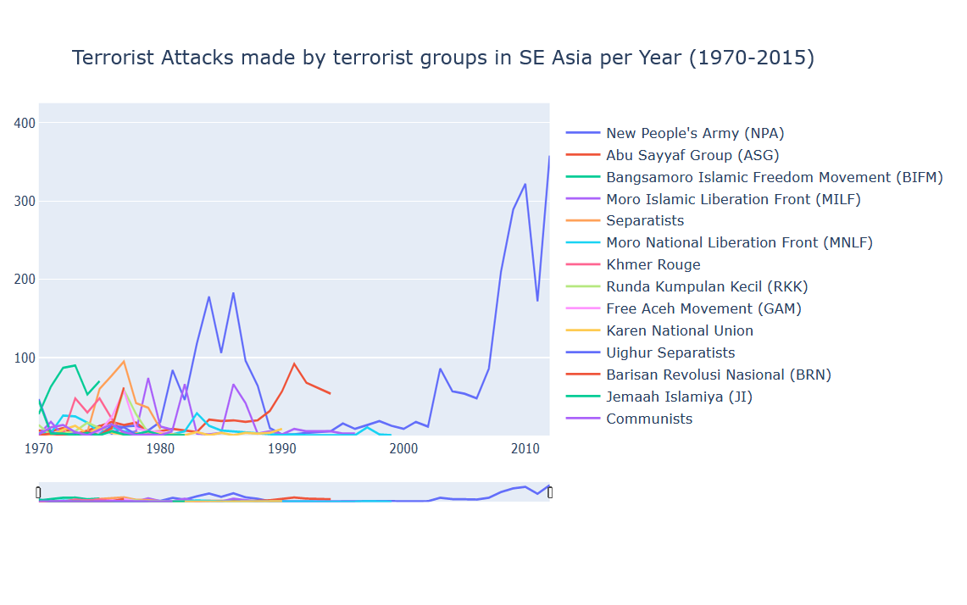
Terrorist groups activity over Years

Slide 10
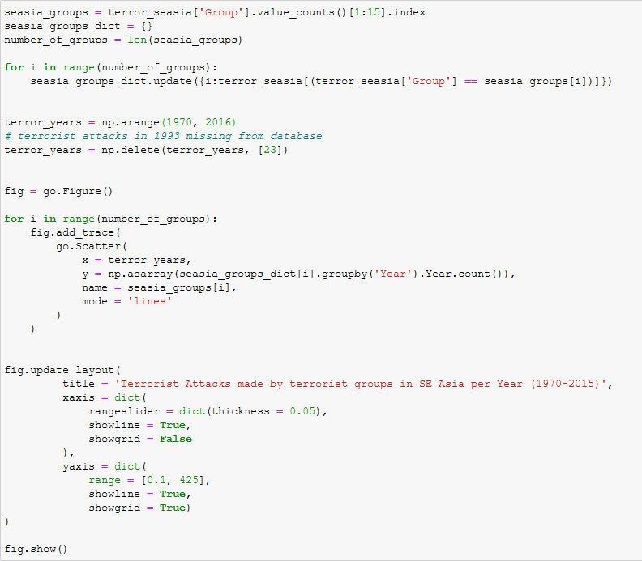
Terrorist groups activity over Years (code)

Slide 11
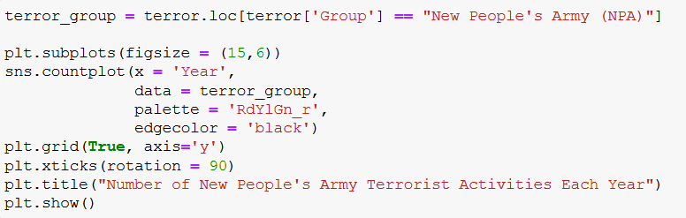
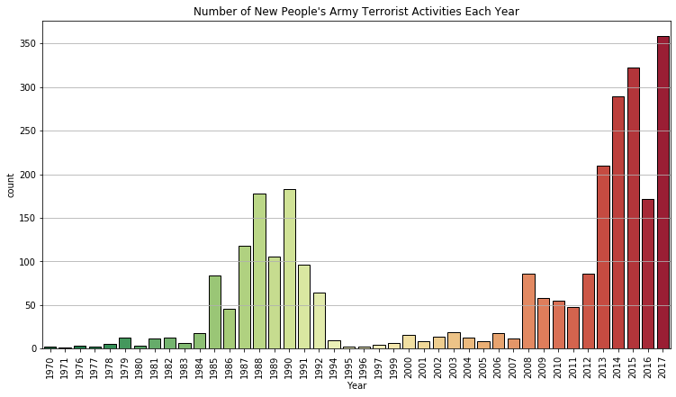
NPA activities over years

Slide 12
Conclusion
Most terrorist groups operates only in few countries
Most attacks come from Philippines and Thailand
Terrorist groups are usually active in short period, with the exception of NPA

Slide 13
Source
Dataset: https://www.kaggle.com/START-UMD/gtd
Code: https://github.com/ImAFK/NTUST-Big-Terrorism

