Slide 1
Study of Terrorism in South Asia
for the Big Data Analysis class

Slide 2
Data source
Global terrorism database at Kaggle (https://www.kaggle.com/START-UMD/gtd)
The Global Terrorism Database (GTD) is an open-source database including information on terrorist attacks around the world from 1970 through 2017.
The GTD includes systematic data on domestic as well as international terrorist incidents that have occurred during this time period and now includes more than 180,000 attacks. The database is maintained by researchers at the National Consortium for the Study of Terrorism and Responses to Terrorism (START), headquartered at the University of Maryland.

Slide 3

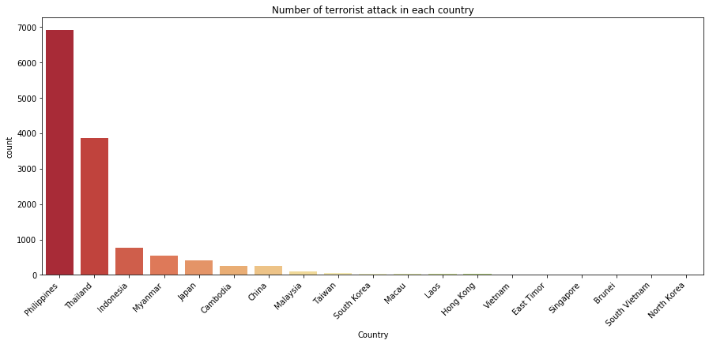
Let's start by comparing the impact of terrorism in the different countries
We can see that Philippines and Thailand are the most afflicted countries in South Asia by a large margin (Thailand has had more than 4 times as many as the third one).

