Slide 1
Secure Data Hiding in Image Using Steganography
CAPSTONE PROJECT
Presented By:
Student Name : Abhinav Ranjan
College Name & Department : Graphic Era Deemed to be University, B.Tech CSE

Slide 2
OUTLINE
Problem Statement
Technology used
Wow factor
End users
Result
Conclusion
Git-hub Link
Future scope

Slide 3
Problem Statement
Steganography is the practice of hiding information within digital media, such as images, audio, or video, without altering the medium's noticeable properties. While it ensures secrecy by concealing the presence of the message, traditional steganography techniques are vulnerable if attackers decode the embedding pattern.
This project addresses the limitations of standard steganography by combining it with Caesar cipher encryption. The Caesar cipher secures the embedded message, making it incomprehensible even if the steganographic method is reverse-engineered. The goal is to provide a secure and user-friendly solution for hiding sensitive information within images.

Slide 4
Technology used
Programming Language:
Python: Used for implementing the logic of embedding and extracting messages.
Libraries:
OpenCV: For image processing and manipulation.
Google Colab: For running and sharing the project efficiently.
Encryption Technique:
Caesar Cipher: To encrypt the message by shifting the alphabetic characters based on a key derived from the passcode.
Steganography: The hidden message is embedded within the pixel values of an image. Modifications are subtle and imperceptible to the human eye, ensuring that the image appears unchanged.
Platform:
Google Colab: A cloud-based platform that simplifies running Python notebooks, making the project accessible without local installations.

Slide 5
Wow factors
Enhanced Security with Caesar Cipher:
The project stands out by integrating Caesar cipher encryption with traditional steganography.
This ensures that even if the image's steganographic method is reverse-engineered, the embedded message remains encrypted and secure.
The cipher uses a dynamic key based on the ASCII value of the passcode, making it highly secure and unique for every session.
User-Friendly Implementation:
The entire process—from embedding to extraction—is straightforward and easy to follow, thanks to the Google Colab interface.
Non-alphabetic characters in the message are preserved as-is, ensuring flexibility in hiding various types of data.
Invisible Embedding:
The project ensures no noticeable change to the original image, maintaining its visual integrity while securely hiding the data.
Cross-Platform Accessibility:
By running on Google Colab, the project eliminates the need for specialized hardware or software installations, making it accessible to anyone with an internet connection.

Slide 6
End users
Cybersecurity Professionals:
Can use this tool to securely transmit sensitive information over public networks.
Students and Educators:
Ideal for learning and teaching concepts of encryption, steganography, and image processing.
Journalists and Whistleblowers:
Enables the safe sharing of confidential information without raising suspicion.
Software Developers:
A practical demonstration of combining encryption and steganography, inspiring further innovations.
General Users:
Anyone looking for a simple yet secure way to embed and share hidden messages within images.

Slide 7
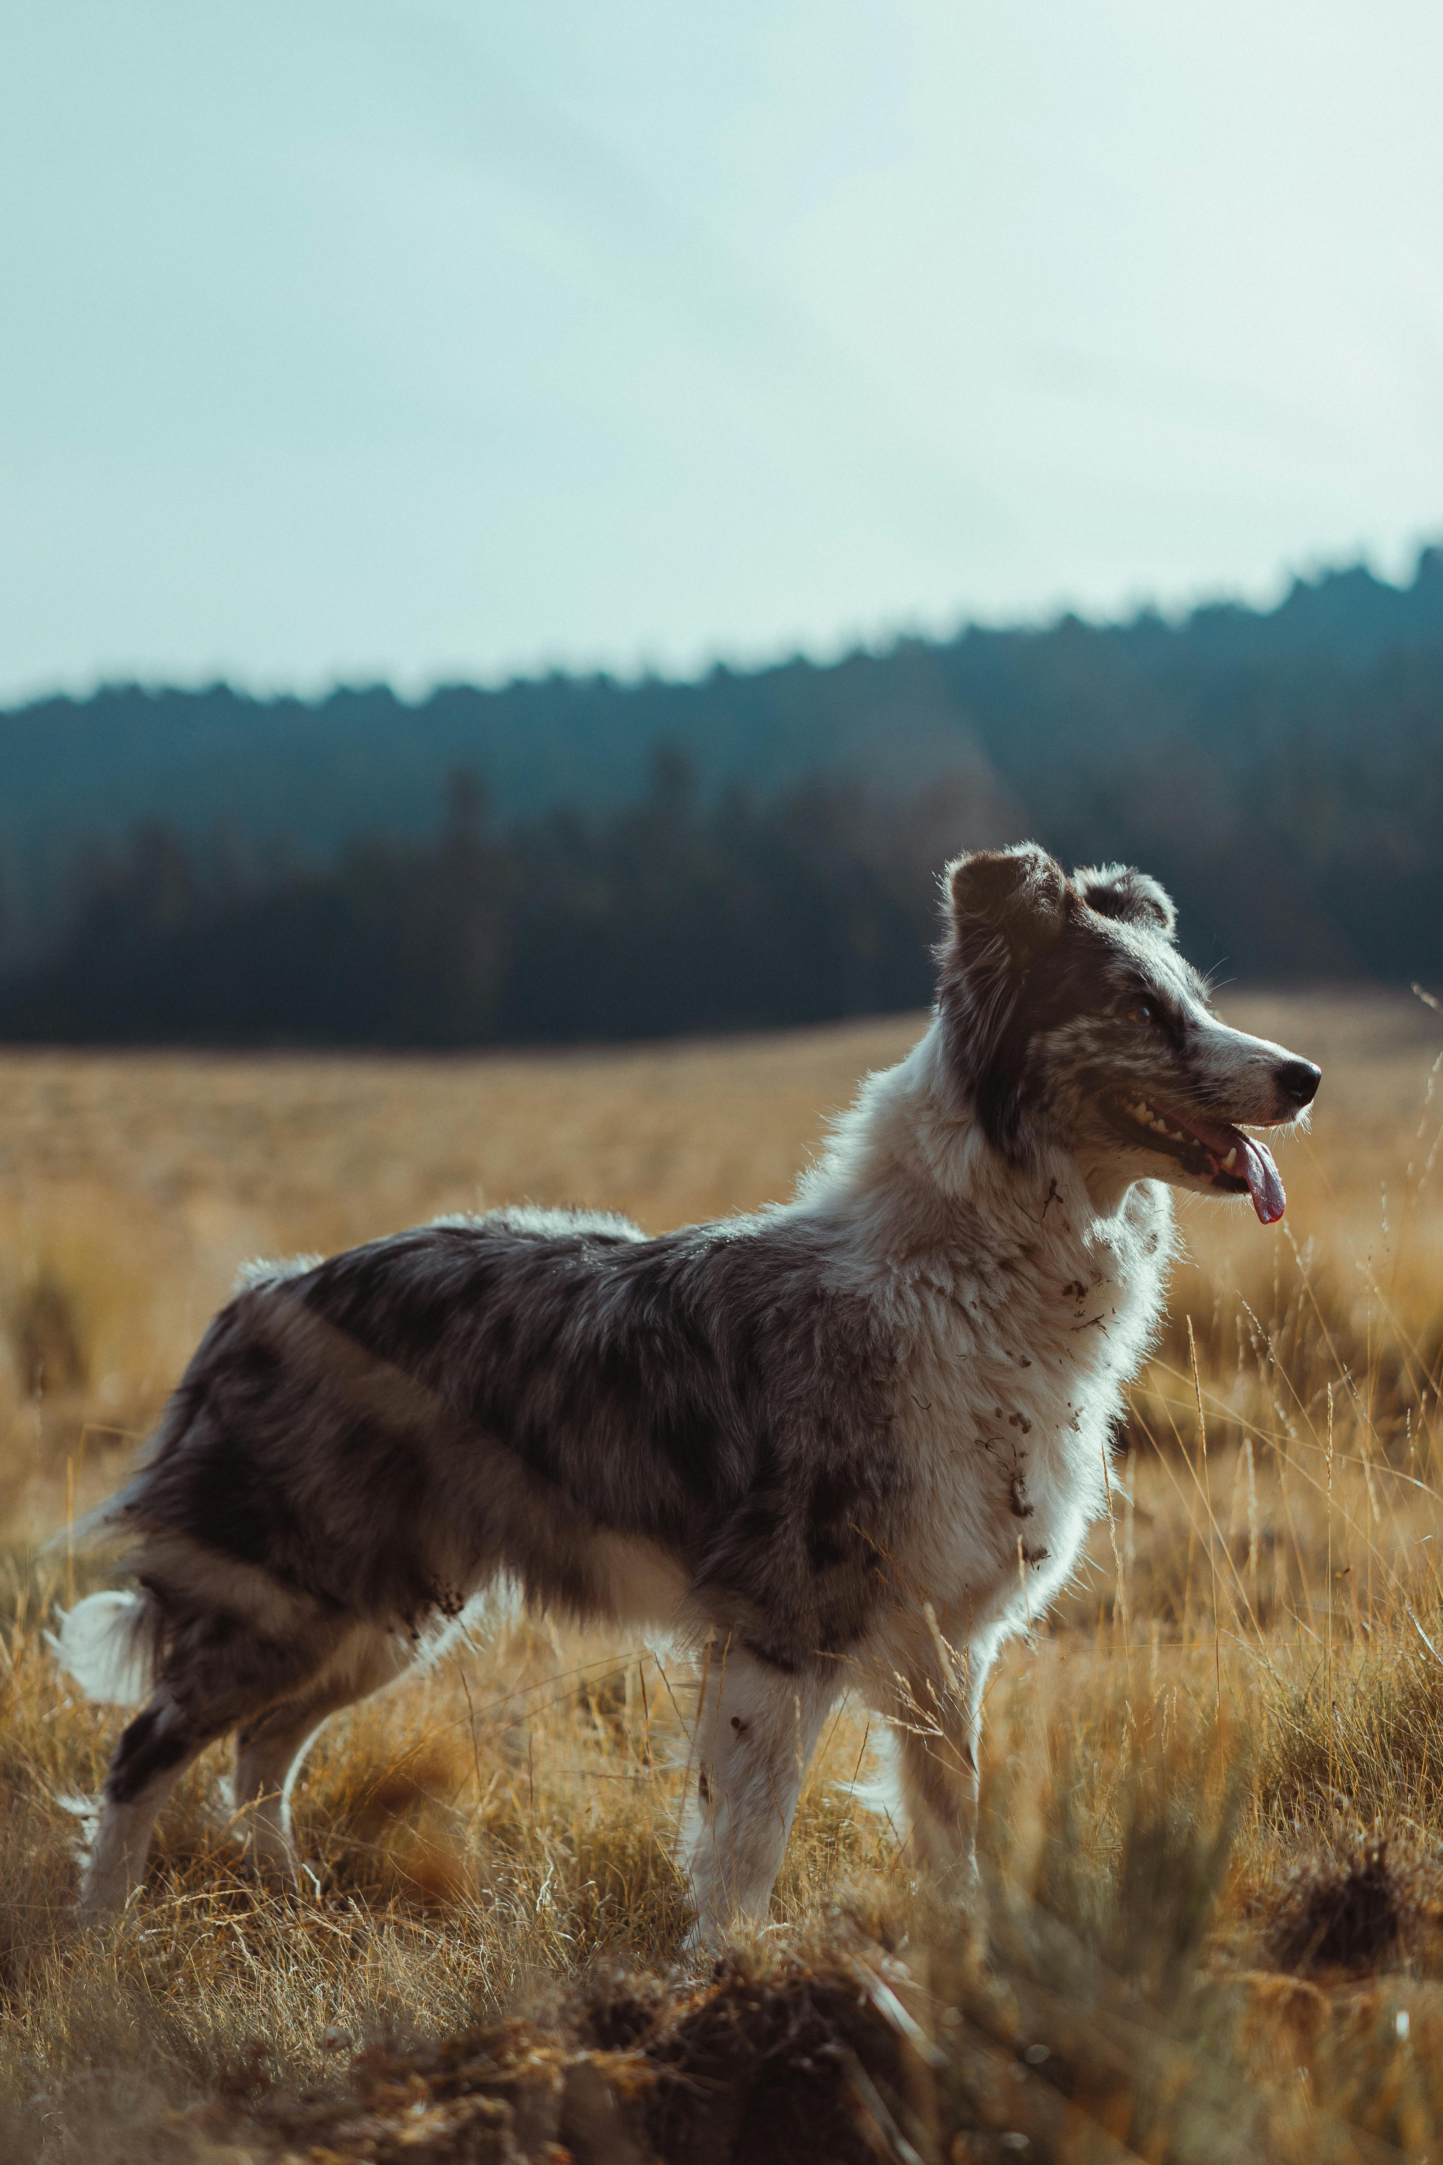



Results
Example 1:
pic.jpg
encryptedImage.png

Slide 8





Results
Example 2:
pic2.jpg
encryptedImage.png

Slide 9

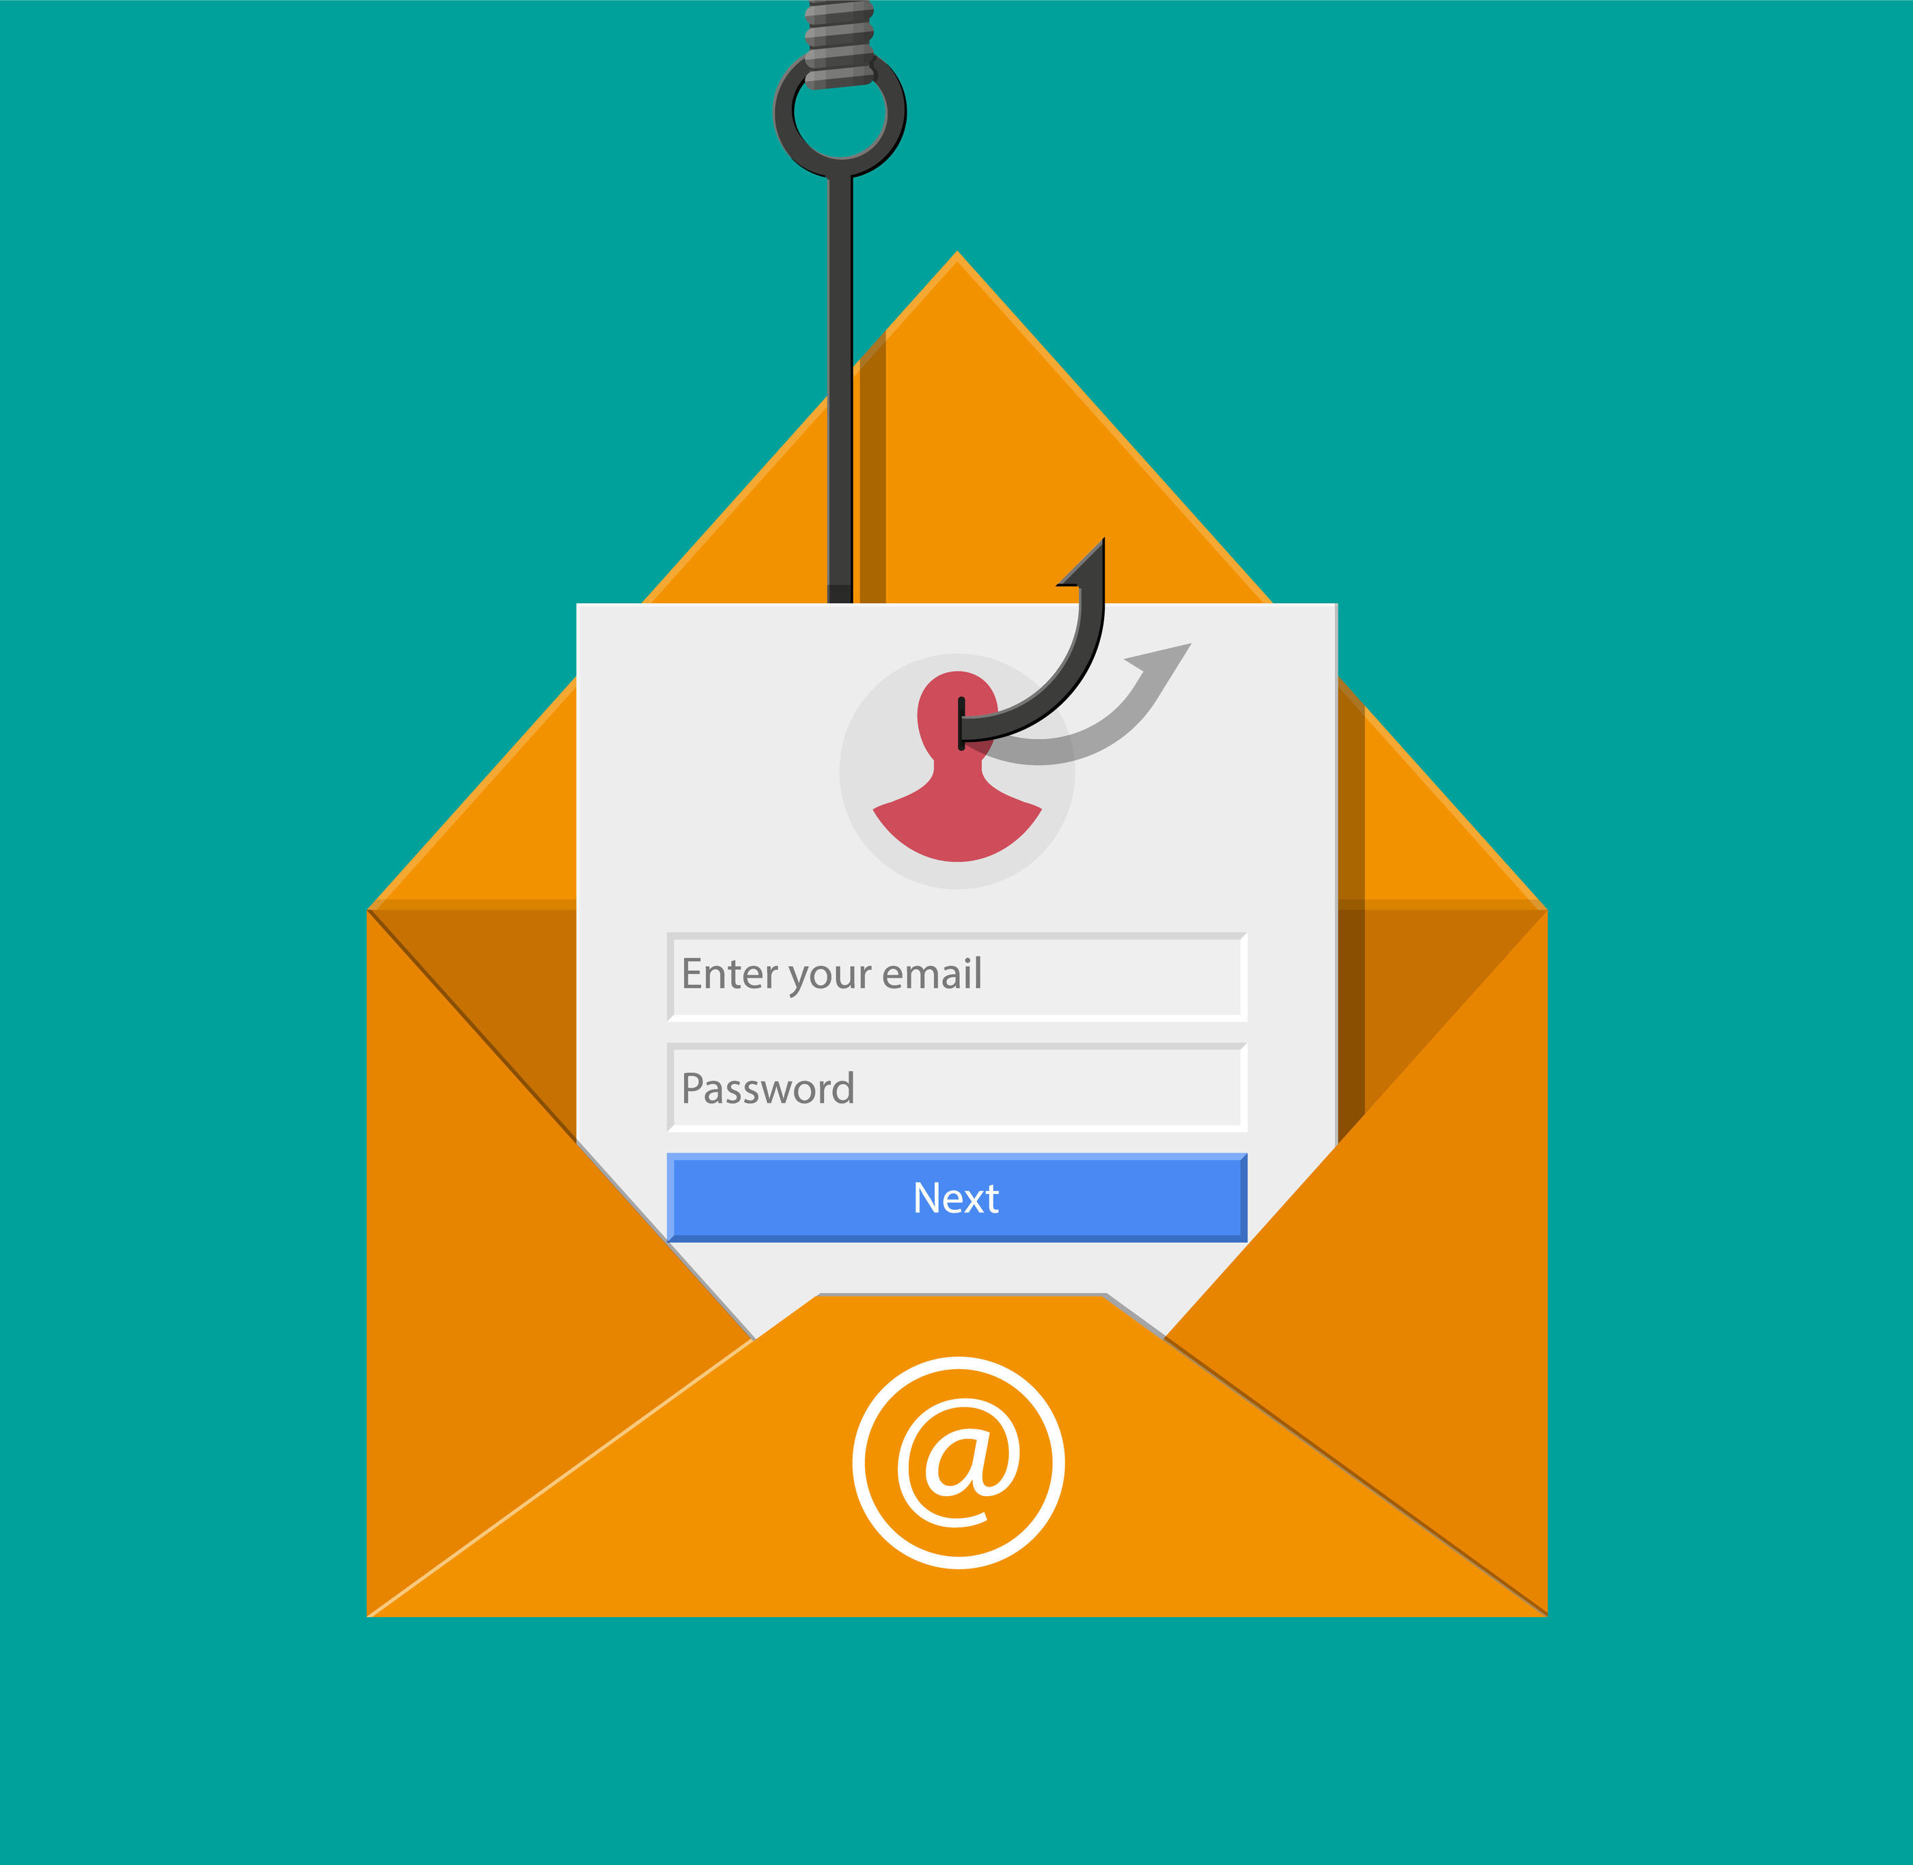
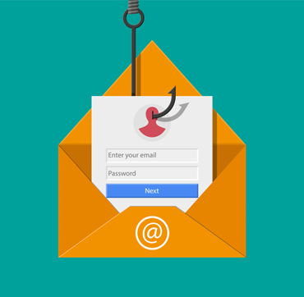


Results
Example 3:
pic3.jpg
encryptedImage.png

Slide 10
Conclusion
This project successfully demonstrates the integration of Caesar cipher encryption with steganography to enhance the security of hidden messages. By encrypting the message before embedding it into an image, the project ensures that sensitive information remains protected even if the steganographic method is compromised.
The use of Python and OpenCV provides an efficient platform for implementing the solution, while Google Colab offers an accessible environment for users. The project highlights the importance of combining encryption with steganography for secure data transmission, offering a practical and innovative approach to safeguarding digital communications.

Slide 11
GitHub Link
The complete code and detailed instructions for this project are available on GitHub: https://github.com/ImAbhinavRanjan/Steganography

Slide 12
Future scope(optional)
Support for Additional File Types: Expanding the project to embed and extract messages in other media formats such as audio and video.
Advanced Encryption: Integrating more robust encryption algorithms like AES or RSA to enhance security further.
Automated Key Management: Implementing a mechanism to securely generate, share, and store encryption keys for easier access and enhanced usability.
GUI Integration: Developing a graphical user interface (GUI) to make the tool more user-friendly for non-technical users.

Slide 13
THANK YOU

