Slide 1

Sparse R-CNN Object Detection
Ozan Berk Gultegin
2025 – 12 – 08

Slide 2
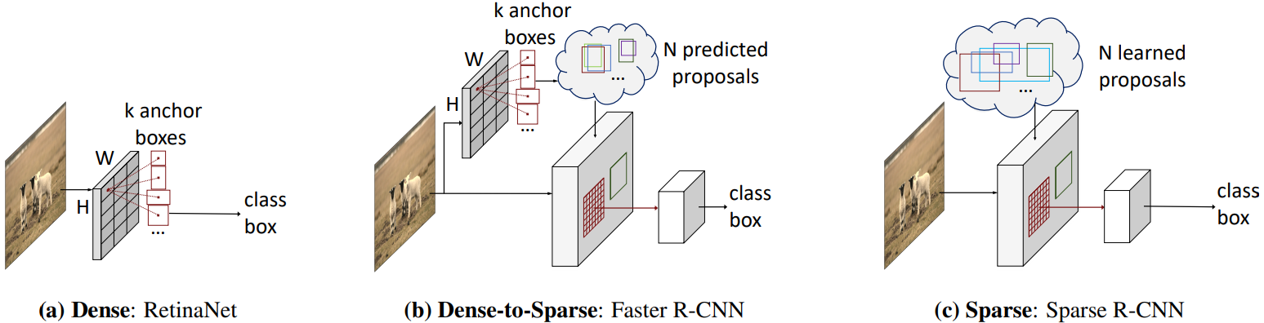

Background: Traditional Detectors
Dense detectors: RetinaNet, YOLO, SSD
Dense-to-sparse: Faster R-CNN
Pain Points:
Anchor design
RPN heuristics
Label assignment
Redundant boxes -> Need for NMS
Sparse R-CNN Object Detection

Slide 3
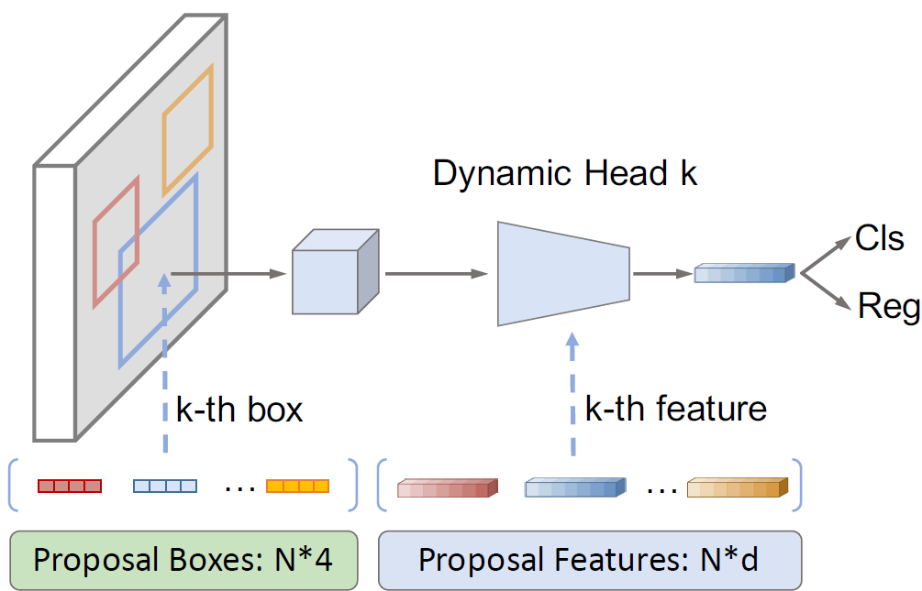
What is Sparse R-CNN?
N learnable initial proposals (100 - 300)
No anchors, no RPN, no NMS
Backbone + Dynamic Head
Iterative refinement
Sparse R-CNN Object Detection

Slide 4
Learnable Proposal Boxes
Proposals = learned parameters (N x 4)
Represent center, width, height
Random initialization works
Cover the full image after training
No anchor design needed
Sparse R-CNN Object Detection

Slide 5
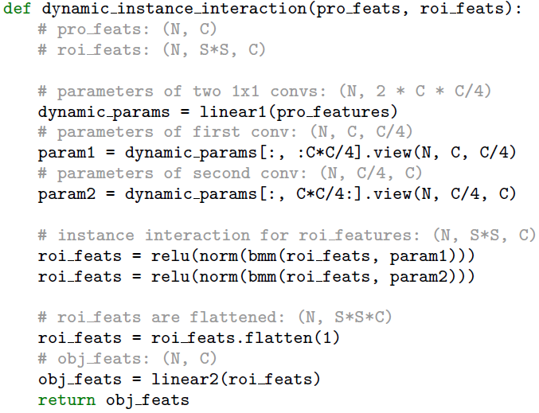
Proposal Features
&
Dynamic Instance Head
Each proposal has a feature vector (N x d)
Head is dynamically generated from proposal features
Allows for per-instance specialization
More flexible than static shared heads
Sparse R-CNN Object Detection

Slide 6
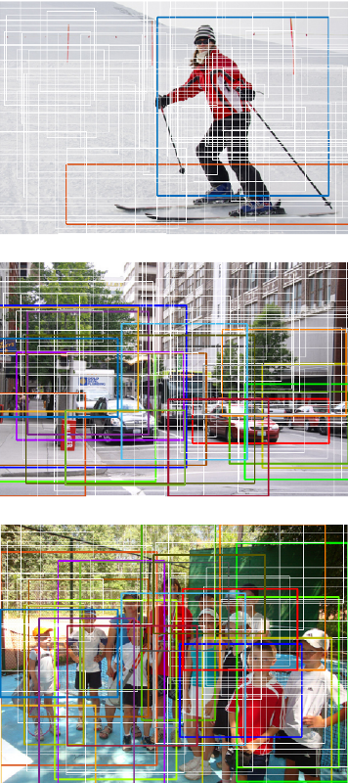
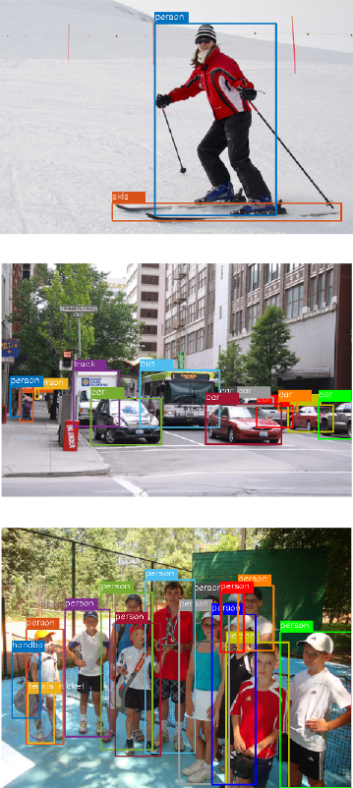
Iterative Refinement Architecture
6 refinement stages
Each stage updates boxes + features
Uses self-attention for cross-proposal reasoning
Reuse of features gives major accuracy gains
Sparse R-CNN Object Detection

Slide 7
Training &Losses
Set prediction loss (Hungarian matching)
Losses: classification, L1, GIoU
Trained for 36 epochs
Backbone: ResNet – 50/101 FPN
Inference: Directly output 100 boxes
Sparse R-CNN Object Detection

Slide 8
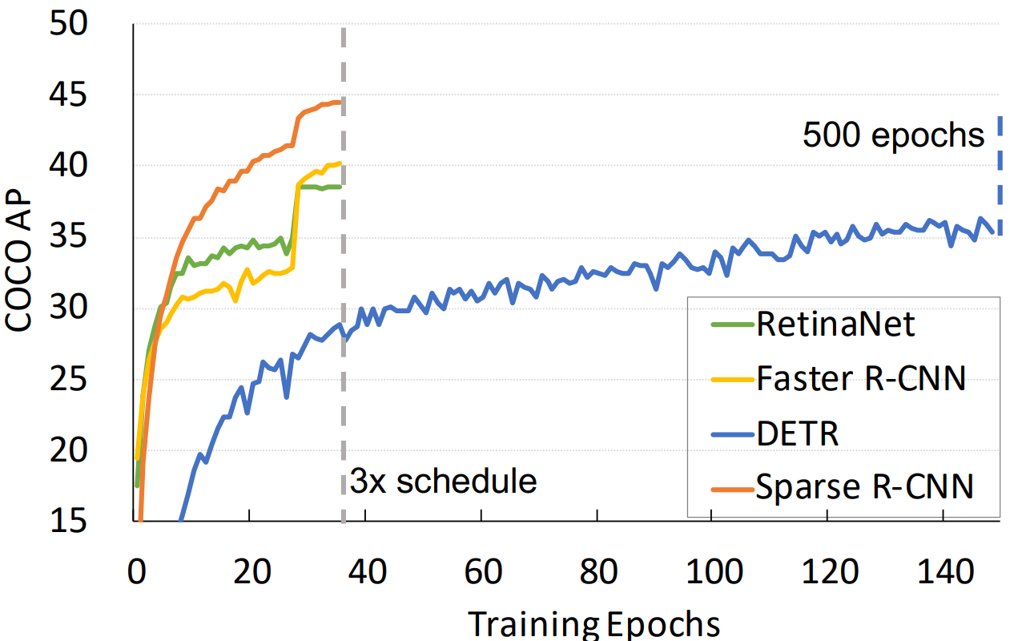
Results:
Accuracy & Efficiency
Competitive AP on COCO
Converges 10x faster than DETR
On par with Faster R-CNN / RetinaNet
Runs at ~ 22-23 FPS
Sparse R-CNN Object Detection

Slide 9
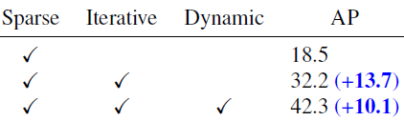
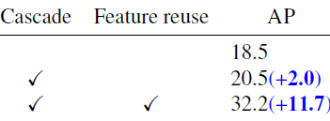
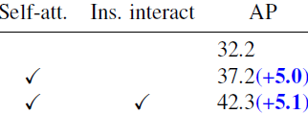
Ablation Studies & Key Insights
Proposal count: 100 -> 300 -> 500 improves AP
Initialization: random, grid, centered
Dynamic head > multi-head attention (improves by +6.6 AP)
Iterative stages 2 -> 6 improves AP dramatically
Sparse R-CNN Object Detection

Slide 10
Conclusion
Fully sparse, end-to-end detector
Removes anchors, RPN, NMS, label assignment
Strong accuracy + fast convergence
Opens the door for sparse detection methods
Sparse R-CNN Object Detection

