Slide 1
INVESTIGATION OF DEEP LEARNING METHODS FOR
Bee Behavior Recognition
A two-stage computer vision pipeline:
YOLOv11 + SAHI → ByteTracker → DINOv2 → Temporal Transformer
Master's Thesis Defense
Vilnius Gediminas Technical University · 2026

Slide 2
MOTIVATION & OBJECTIVE
PROBLEM
▸ Honeybees pollinate ~1/3 of food supply; colony health matters.
▸ Hive-entrance video offers non-invasive monitoring.
▸ Rules don't generalize and can't recognize appearance-based behaviors like trophallaxis.
AIM
▸ Prepare two purpose-built datasets
▸ Train YOLOv11 + SAHI detector
▸ Train temporal transformer on frozen DINOv2 features
▸ Integrate both models end-to-end with ByteTracker
▸ Compare to prior work
Bee Behavior Recognition — Master's Thesis Defense
2 / 13

Slide 3
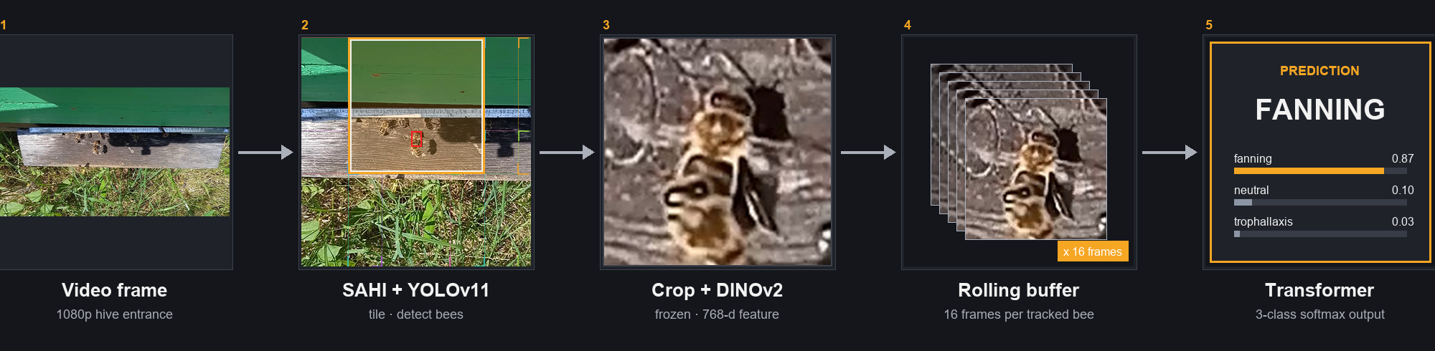
THE PIPELINE AT A GLANCE
Bee Behavior Recognition — Master's Thesis Defense
3 / 13

Slide 4
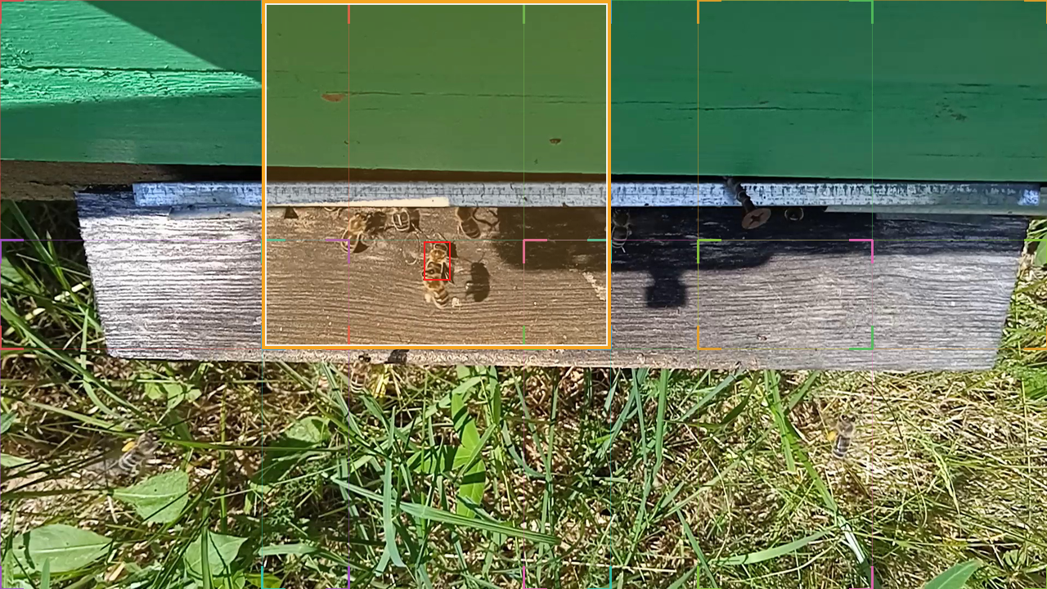
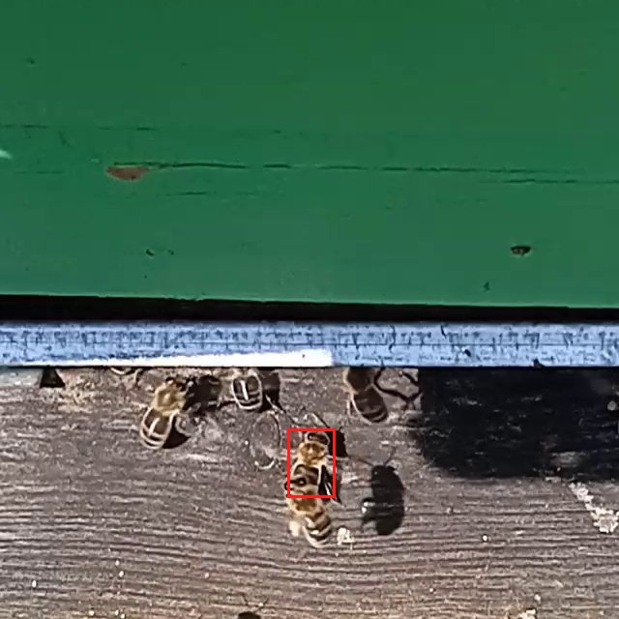
DATA · DETECTION DATASET
CONSTRUCTION
▸ Source video 60 fps sample every 6th frame – 1920X1080p
▸ Cut each frame into overlapping 640×640 tiles (25% overlap).
Bee Behavior Recognition — Master's Thesis Defense
4 / 13

Slide 5
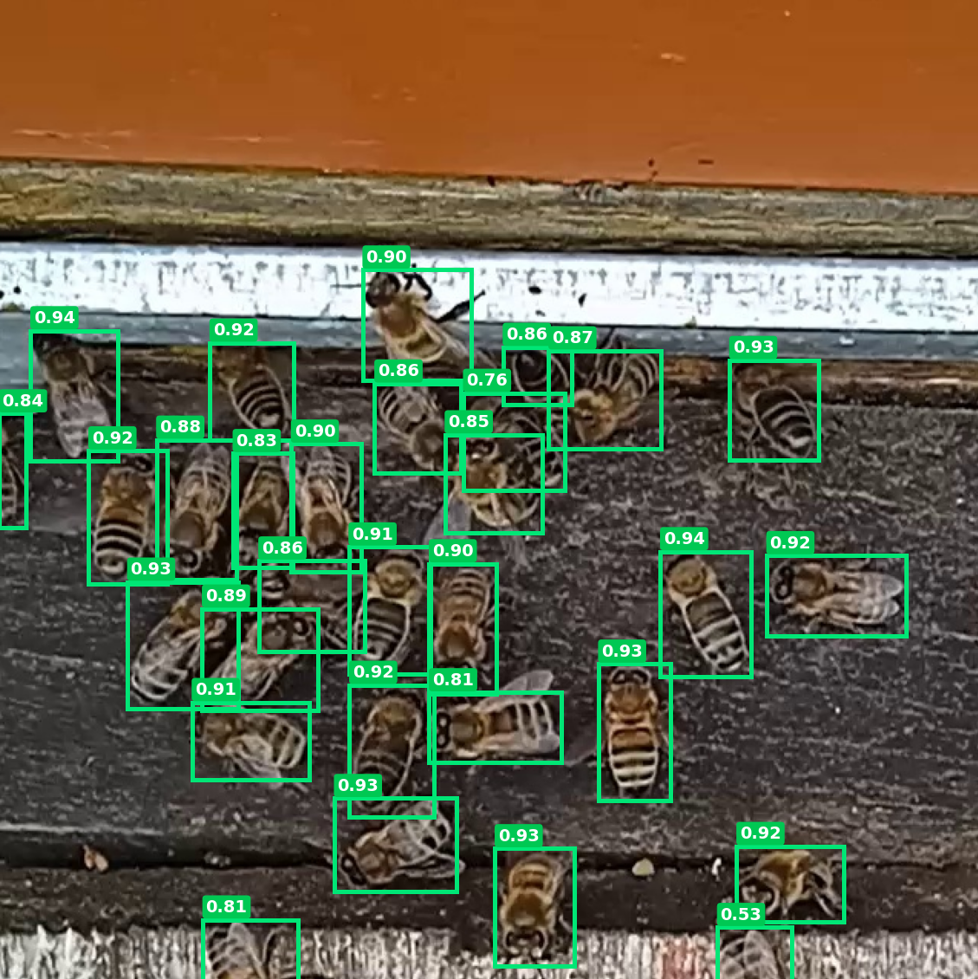
DETECTION · RESULTS
MODEL SETUP
▸ YOLOv11m – Single stage, anchor free.
▸ AdamW.
▸ Learning Rate = 8×10⁻⁴ + cosine decay.
▸ Trained 238 epochs (early stop 50).
▸ Confidence threshold 0.45.
Metric | YOLOv11-m | YOLOv8-m (prior)
Precision | 0.983 | 0.98
Recall | 0.973 | 0.97
mAP@0.5 | 0.992 | 0.97
mAP@0.5:0.95 | 0.853 | 0.65
Bee Behavior Recognition — Master's Thesis Defense
5 / 13

Slide 6
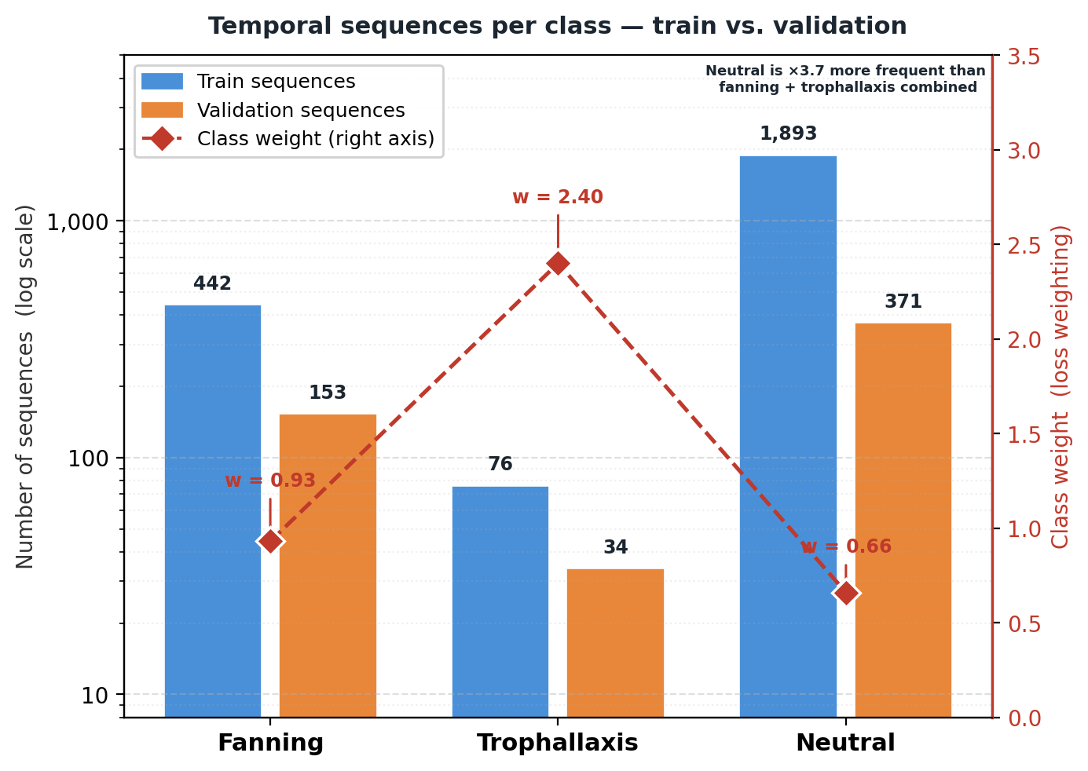
DATA · ACTION RECOGNITION DATASET CONSTRUCTION
THREE CLASSES
▸ Fanning — wing motion, stationary body.
▸ Trophallaxis — two or more bees mouth-to-mouth
▸ Neutral — ordinary walking, flying (baseline).
▸ Grouped by Bytetracker ID
HANDLING DATA IMBALANCE
▸ Proportional sampling: n = max(1, ⌊L/16⌋) windows/seq.
▸ ~76 → thousands of windows per epoch.
▸ Weights stay moderate: 0.93 · 0.66 · 2.40.
Bee Behavior Recognition — Master's Thesis Defense
6 / 13

Slide 7
TRACKING & FEATURE EXTRACTION
TRACKING (BYTETRACKER)
▸ Two-round IoU matching: high-conf first, low-conf to recover occluded bees.
▸ Kalman filter propagates positions between frames.
▸ Tracks unmatched for 30 frames are dropped.
▸ Result: Same physical bee -> same persistent ID = same feature buffer.
FEATURE EXTRACTION (DINOV2)
▸ Crop with 35% padding (context for trophallaxis + fanning location).
▸ Resize 224×224, ImageNet normalize.
▸ Forward through frozen DINOv2-small (21.7M params).
▸ Output = CLS (384) + mean of patch tokens (384) = 768-d.
WHY 35% PADDING?
Tight crops discard the very cues the model needs — for trophallaxis, the neighbor bee must be visible. For fanning, substrate texture shows location context.
Bee Behavior Recognition — Master's Thesis Defense
7 / 13

Slide 8
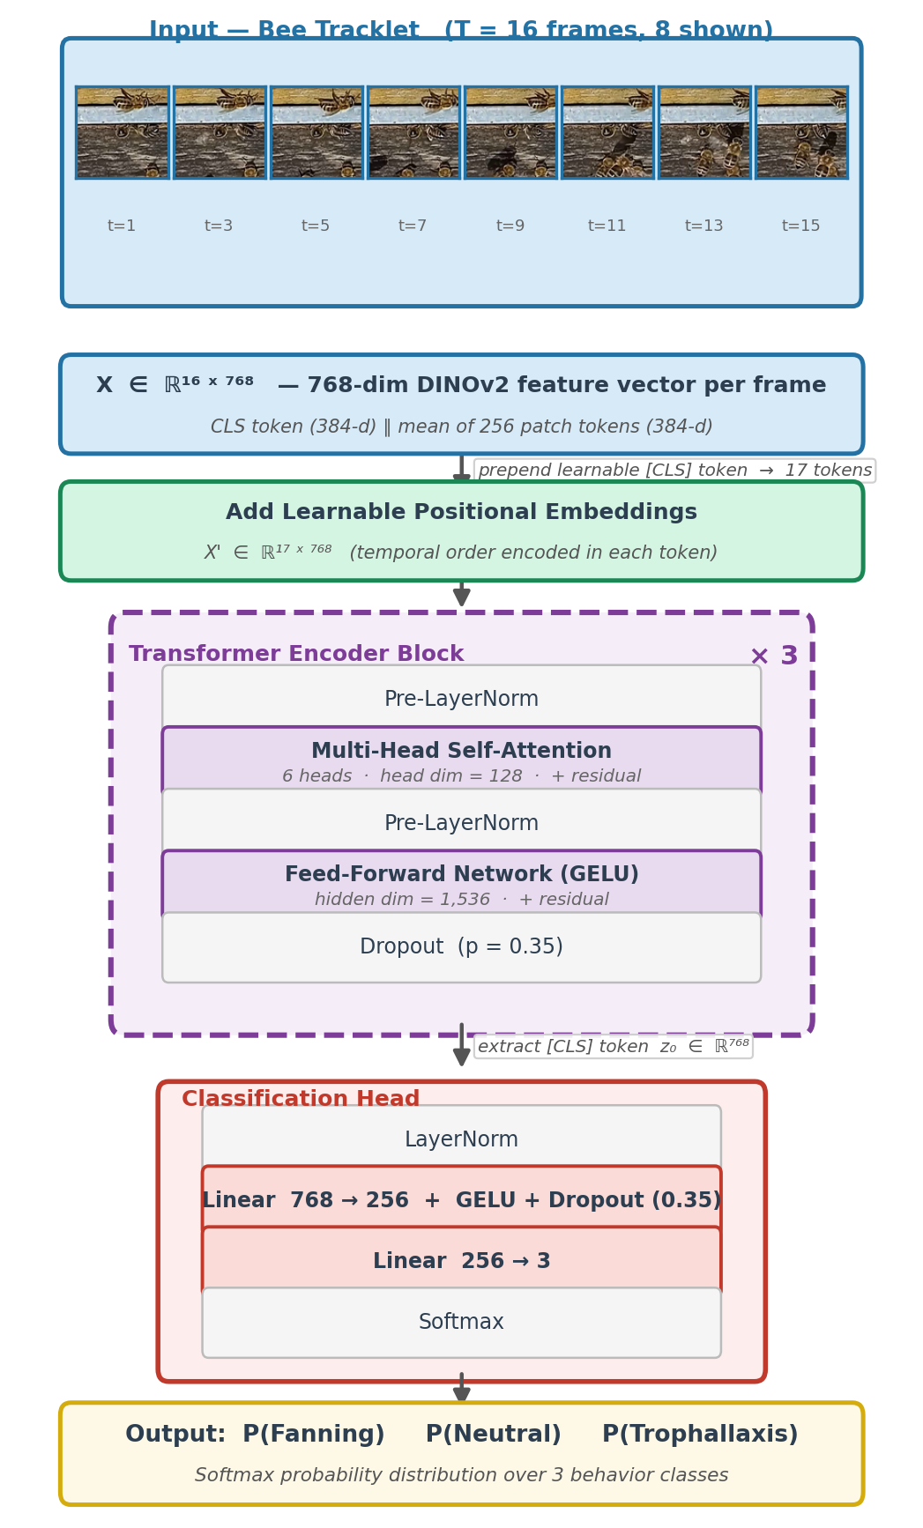
TEMPORAL SEQUENCE CLASSIFIER
INTUITION
Self-attention — every frame attends to every other frame.
FORWARD PASS
X' = [c, x₁, …, x₁₆] + P
Z = X' + MHA(LN(X’))
X' = Z + FFN(LN(Z)) × 3 layers · 6 heads
ŷ = softmax(MLP(LN(X'[CLS])))
TRAINING — AGGRESSIVE REGULARIZATION (small dataset)
▸ Label smoothing — never reward 100% confidence.
▸ MixUp — blended pairs, smoother decision boundary.
▸ R-Drop — penalize disagreement between two dropout passes.
Bee Behavior Recognition — Master's Thesis Defense
8 / 13

Slide 9
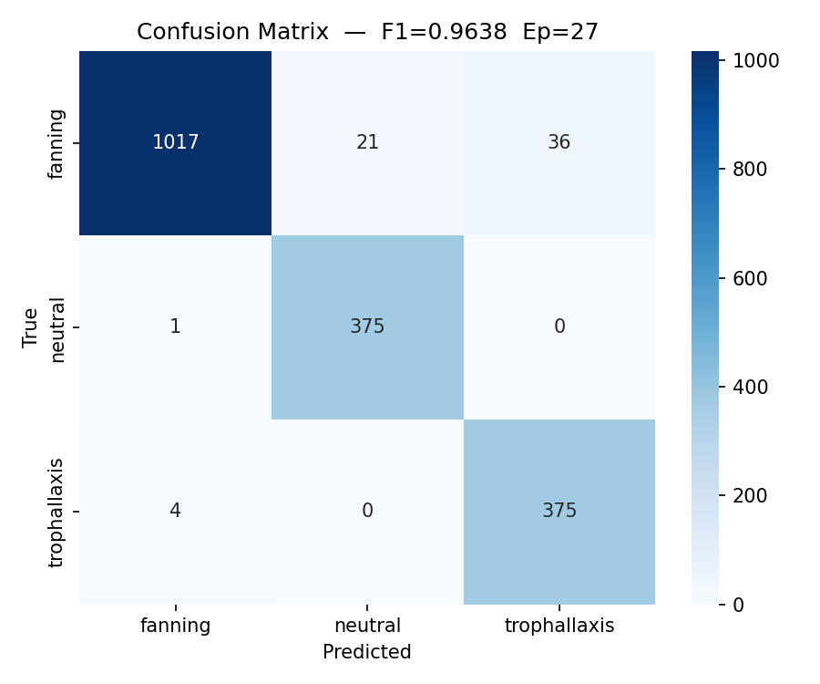
RESULTS · ISOLATED CLASSIFIER
Class | Prec. | Recall | F1 | Support
Fanning | 1.00 | 0.95 | 0.97 | 1,074
Neutral | 0.95 | 1.00 | 0.97 | 376
Trophallaxis | 0.91 | 0.99 | 0.95 | 379
Macro avg | 0.95 | 0.98 | 0.96 | 1,829
WHY THIS ISN'T OVERFITTING / LEAKAGE
Source-video-level split · macro F1 ≠ 1.00 (real errors) · E2E drops to 75–93%
Bee Behavior Recognition — Master's Thesis Defense
9 / 13

Slide 10
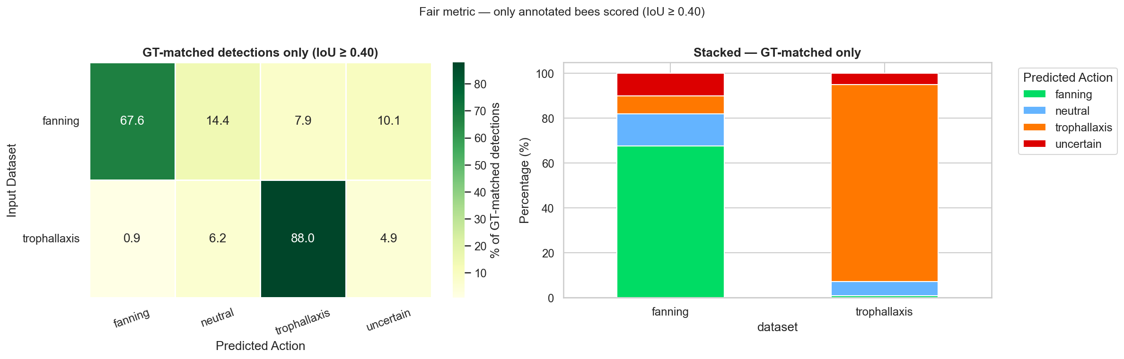
RESULTS · END-TO-END PIPELINE
44,680 frames · IoU-matched to human-annotated ground truth
TWO SCORING MODES
Scoring mode | Fanning | Trophallaxis
Conservative (uncertain = error) | 67.6% | 88.0%
Confident predictions only (headline) | 75.2% | 92.6%
OBSERVATION ON FANNING GAP
Bees that fail to enter the hive sometimes use wing motion to push themselves in visually similar to stationary fanning. The classifier correctly stays conservative on those, which contributes to the fanning recall gap.
Bee Behavior Recognition — Master's Thesis Defense
10 / 13

Slide 11
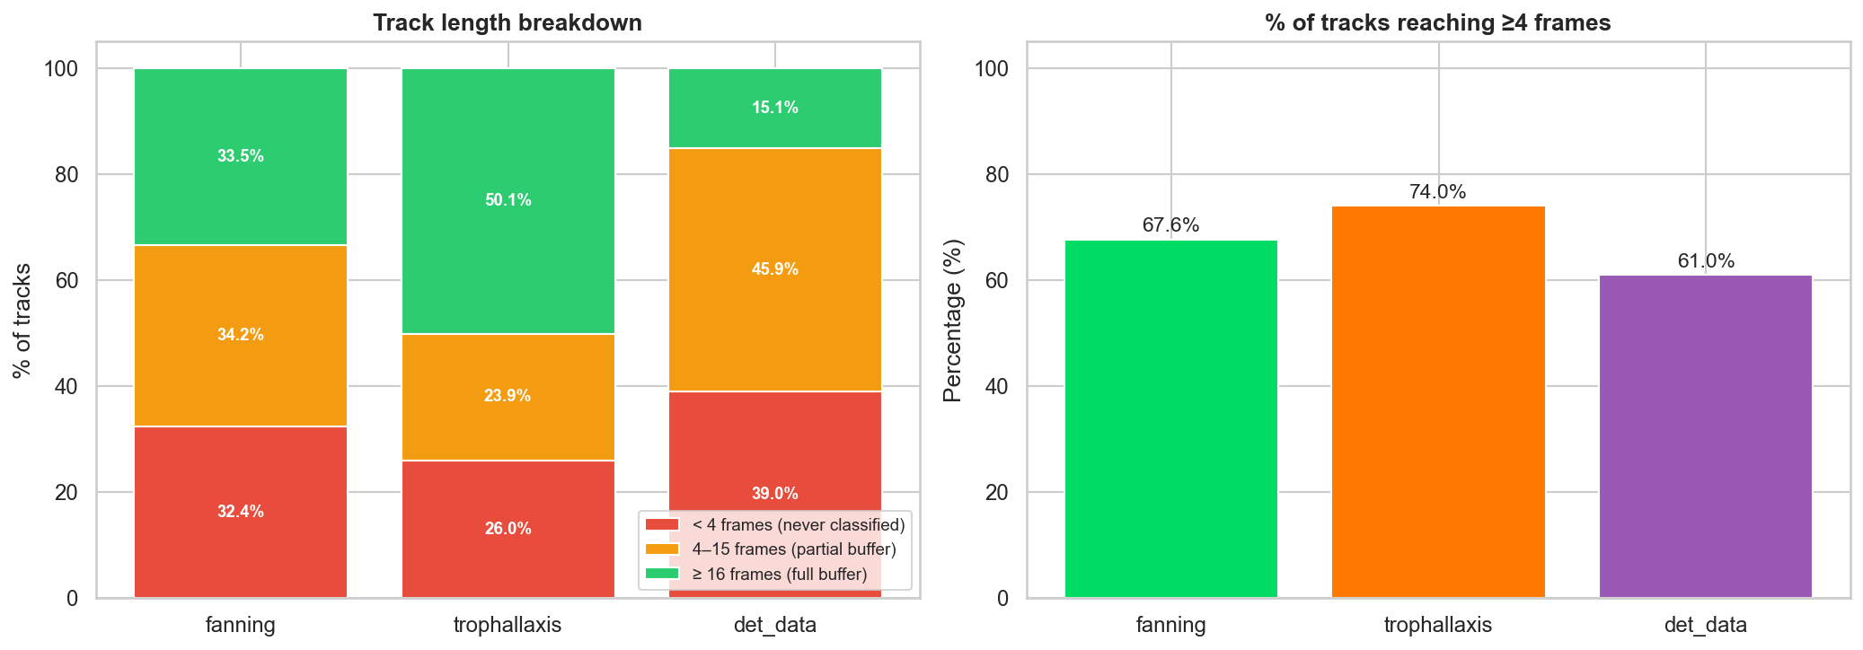
RESULTS · THE GAPS
Isolated F1 = 0.96 vs end-to-end 75-93% —Tracker fragmentation, Frame loss
THE BOTTLENECK
▸ ~1/3 of fanning tracks never reach the 4-frame minimum buffer.
▸ ByteTracker fragments under dense activity at the hive entrance.
Bee Behavior Recognition — Master's Thesis Defense
11 / 13

Slide 12
COMPARISON & CONCLUSIONS
Capability | Prior VGTU [3,4,16,18] | This work
mAP@0.5 / mAP@0.5:0.95 | 0.97 / 0.65 | 0.992 / 0.853
Behavior inference | Heuristic | Learned per-bee classifier
Individual-level attribution | Partial / region-based | Yes (per tracked bee)
Trophallaxis recognition | Not addressed at individual level | F1 = 0.96
CONTRIBUTIONS
▸ First per-individual trophallaxis recognition in bee literature.
▸ Replaced heuristic rules with learned classifier.
▸ Multi-window sampling — made 76 trophallaxis sequences usable.
LIMITATIONS & FUTURE WORK
▸ Trained on one hive — cross-domain untested.
▸ Tracker fragmentation = primary end-to-end bottleneck.
▸ True consecutive-video evaluation still to run.
Bee Behavior Recognition — Master's Thesis Defense
12 / 13

Slide 13
THANK YOU
Questions?
Detection mAP@0.5 = 0.992 · Macro F1 = 0.96 · E2E trophallaxis 92.6%
13 / 13

