Slide 1
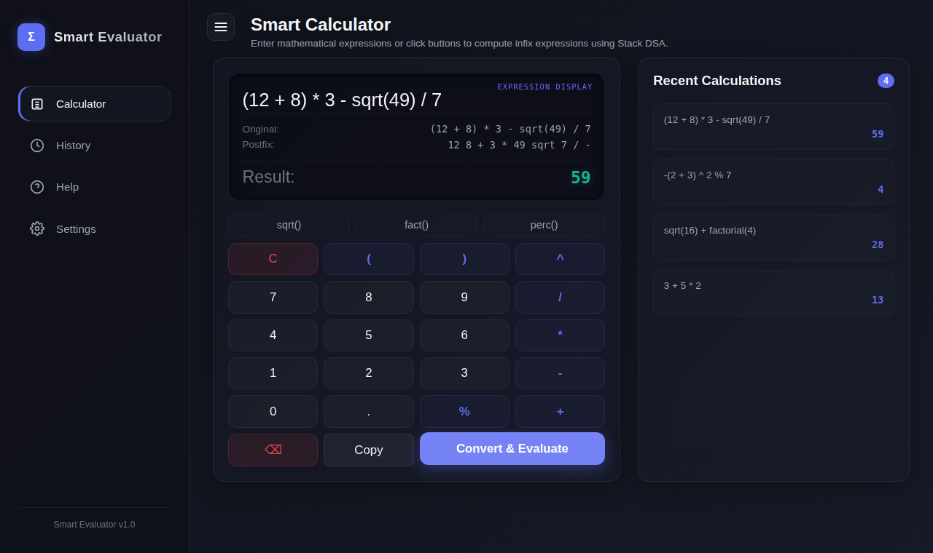
B.TECH CSE | DSA PROJECT
Smart Calculator
Stack-Based Expression Evaluator
C++ • WebAssembly • JavaScript
Vaishnavi Ojha
Registration No.: 12405374
B.Tech CSE
3 + 5 * 2 → 3 5 2 * + → 13
Notes:
Good morning everyone. My name is Vaishnavi Ojha and my registration number is 12405374. My project is called Smart Calculator, a stack-based expression evaluator. It is a calculator that runs in the browser, but the actual calculation is done by a C++ program compiled to WebAssembly. I mainly built it to show how the stack data structure can be used in a real application.

Slide 2
Introduction
A calculator that evaluates complete infix expressions in one step
Parsing is done with the Stack data structure (infix → postfix)
Core engine written in C++, running in the browser via WebAssembly
Supports functions, constants, variables and saved history
Basic calculator
One operation at a time
No brackets or functions
No memory of past work
Smart Calculator
Whole expression, correct precedence
Brackets, unary signs, sqrt, factorial
Shows postfix + saves history
Smart Calculator – Stack-Based Expression Evaluator
Vaishnavi Ojha | 12405374 | 2
Notes:
This project is a calculator that understands full mathematical expressions, like (12 + 8) * 3 - sqrt(49) / 7, in one go. A basic calculator makes you press operations one at a time. Here you type the whole expression and the program decides the correct order using operator precedence. The main idea is that the expression is first converted from infix to postfix, and then a stack is used to evaluate it. So this project is really about using DSA in a practical way.

Slide 3






Problem Statement
Complex expressions
Operator precedence
Parentheses
Long expressions mixing many operators
3 + 5 * 2 must give 13, not 16
Nested brackets change the order
Unary operators
Scientific operations
History
Signs like -(2+3) or +5
sqrt, factorial, percentage, pi, e
Past calculations should be saved
Need: an efficient way to evaluate any expression correctly, and report errors clearly.
Smart Calculator – Stack-Based Expression Evaluator
Vaishnavi Ojha | 12405374 | 3
Notes:
Normal calculators are fine for simple work, but they struggle with longer expressions. If I write 3 + 5 * 2, the answer should be 13 and not 16, so the calculator must respect precedence. It also has to handle brackets, negative signs and scientific functions. And usually there is no proper history. This project solves these problems by using a stack-based algorithm so that any valid expression is evaluated correctly and invalid ones give a clear error.

Slide 4
Objectives
1
Build an interactive browser-based calculator
5
Integrate a C++ evaluation engine using WebAssembly
2
Implement expression evaluation using the Stack DSA
6
Provide history and variable management
3
Convert infix expressions to postfix notation
7
Provide proper error handling
4
Handle operator precedence and associativity
Smart Calculator – Stack-Based Expression Evaluator
Vaishnavi Ojha | 12405374 | 4
Notes:
These are the seven objectives I set for this project. First, build an interactive calculator. Second, use the stack data structure to evaluate expressions. Third, convert infix to postfix. Fourth, handle precedence and associativity properly. Fifth, connect the C++ engine to the browser using WebAssembly. Sixth, provide history and variable management. And last, give proper error messages for invalid input like division by zero or mismatched brackets.

Slide 5







Technology Stack
C++
DSA
Stack
WebAssembly
Core evaluator, C++17
Tokenizing, parsing, precedence
std::stack for operators and values
Runs compiled C++ in the browser
JavaScript
HTML5
CSS3
LocalStorage
Loads WASM, handles UI and events
Calculator layout and views
Responsive dark theme, animations
Saves history and variables
No React, Node.js, Python or database is used – only the technologies above.
Smart Calculator – Stack-Based Expression Evaluator
Vaishnavi Ojha | 12405374 | 5
Notes:
Here are the technologies I used. C++ is the language of the core engine. DSA and the stack are the main concept. WebAssembly lets the C++ code run inside the browser. JavaScript is the glue, it loads the wasm file and updates the screen. HTML5 gives the structure, CSS3 gives the dark modern design, and LocalStorage keeps the history and variables even after the page is closed. I did not use any framework like React or Node.

Slide 6
System Architecture / Workflow
LocalStorage
Variables + History
User Input
Infix expression
HTML / CSS / JS
Interface
JavaScript
Application layer
WebAssembly
calculator.wasm
C++ Evaluator
SmartExpression-
Evaluator
Browser UI
Display + history
Result + Postfix
Returned as JSON
Evaluation
Stack of values
Infix → Postfix
Stack of operators
Tokenization
Numbers, ops, funcs
C++ engine (green/amber) runs entirely inside the browser – no server-side calculation.
Smart Calculator – Stack-Based Expression Evaluator
Vaishnavi Ojha | 12405374 | 6
Notes:
This is how the whole system works. The user types an expression in the interface. JavaScript takes it, copies the text into WebAssembly memory, and calls the evaluate_expression function. Inside, the C++ evaluator first tokenizes the expression, then converts it to postfix using a stack, and then evaluates the postfix using another stack. The result comes back as a JSON string with the answer and the postfix expression, and JavaScript shows it on screen. At the top, LocalStorage is connected to the JavaScript layer and stores variables and history.

Slide 7
DSA Implementation – Stack
Infix 3 + 5 * 2
Postfix 3 5 2 * +
Result 13
Operators are pushed on a stack; precedence decides when to pop
Parentheses: "(" is pushed, ")" pops until its match
Equal precedence: pop only if left-associative (^ is right)
Postfix removes the need for brackets and precedence
A second stack of values evaluates the postfix
Evaluating 3 5 2 * + (value stack)
2
5
5
10
3
3
3
3
13
push 3
push 5
push 2
* → 5*2
+ → 3+10
Smart Calculator – Stack-Based Expression Evaluator
Vaishnavi Ojha | 12405374 | 7
Notes:
This is the most important slide. I use the stack in two places. In infix to postfix conversion, operators go onto a stack. When a new operator comes, I compare its precedence with the operator on top, and pop if the top is stronger, or equal and left associative. Opening brackets are pushed, and a closing bracket pops everything until the opening one. Then for evaluation, I use a second stack of numbers. In the example, 3 5 2 star plus: push 3, 5, 2, then star pops 5 and 2 and pushes 10, then plus pops 3 and 10 and pushes 13. That is the final answer.

Slide 8



Key Features / Modules
Calculator Module
Expression Parser
Stack Evaluator
Scientific Functions
Button grid + expression input
Tokenizer, unary +/-, brackets
Infix → postfix → result
sqrt, factorial, percentage, pi, e
Variable Management
History Management
Error Handling
WASM / C++ Engine
Named values, saved in localStorage
Search, sort, delete records
Clear messages for bad input
calculator.wasm via JS bindings
Smart Calculator – Stack-Based Expression Evaluator
Vaishnavi Ojha | 12405374 | 8
Notes:
The project is divided into eight modules. The calculator module is the interface with buttons. The expression parser does tokenization and handles unary signs and brackets. The stack-based evaluator does infix to postfix and then the calculation. Scientific functions are sqrt, factorial and percentage, with constants pi and e. Variable management stores named values. History management saves every calculation with date, postfix and result, and you can search, sort and delete it. Error handling catches things like division by zero. And the WASM C++ engine ties it together.

Slide 9
Implementation / Code Overview
C++ – operator precedence (evaluator.cpp)
C++ – WebAssembly binding (wasm_bindings.cpp)
if (op == "U-" || op == "U+") return 4;
if (op == "^") return 3;
if (op == "*" || op == "/" || op == "%") return 2;
if (op == "+" || op == "-") return 1;
extern "C" {
const char* evaluate_expression(const char* expr) {
bool ok = evaluator.evaluate(expr, postfix,
answer, error);
... // builds JSON result
} }
Higher number = binds tighter. Unary sign is highest.
C++ – stack pop rule (evaluator.cpp)
if (p2 > p1 || (p2 == p1 && isLeftAssociative(o1))) {
postfixList.push_back(o2);
opStack.pop();
}
Exports the evaluator to JavaScript; returns a JSON string.
JavaScript – calling WASM (app.js)
const { instance } =
await WebAssembly.instantiate(bytes, importObject);
const resultJsonPtr =
wasmExports.evaluate_expression(exprPtr);
const resultObj = JSON.parse(wasmToString(resultJsonPtr));
Pop if top has higher precedence, or equal and left-associative.
C++ – unary detection in tokenizer
if (prev.type == Token::OPERATOR ||
prev.type == Token::LPAREN)
isUnary = true; // becomes "U-" / "U+"
A sign after an operator or "(" is unary.
Loads calculator.wasm, calls the C++ function, parses the JSON reply.
Smart Calculator – Stack-Based Expression Evaluator
Vaishnavi Ojha | 12405374 | 9
Notes:
Here are small snippets from my actual code. First, getPrecedence gives unary minus the highest priority, then power, then multiply divide and modulus, then plus and minus. Second, this line is the heart of the shunting-yard algorithm. It decides when to pop an operator from the stack. Third, in the tokenizer, a plus or minus is treated as unary if it comes at the start or after an operator or an opening bracket. Fourth, the wasm bindings file exposes evaluate_expression as an extern C function that returns JSON. And fifth, in JavaScript I load calculator.wasm and call that function.

Slide 10
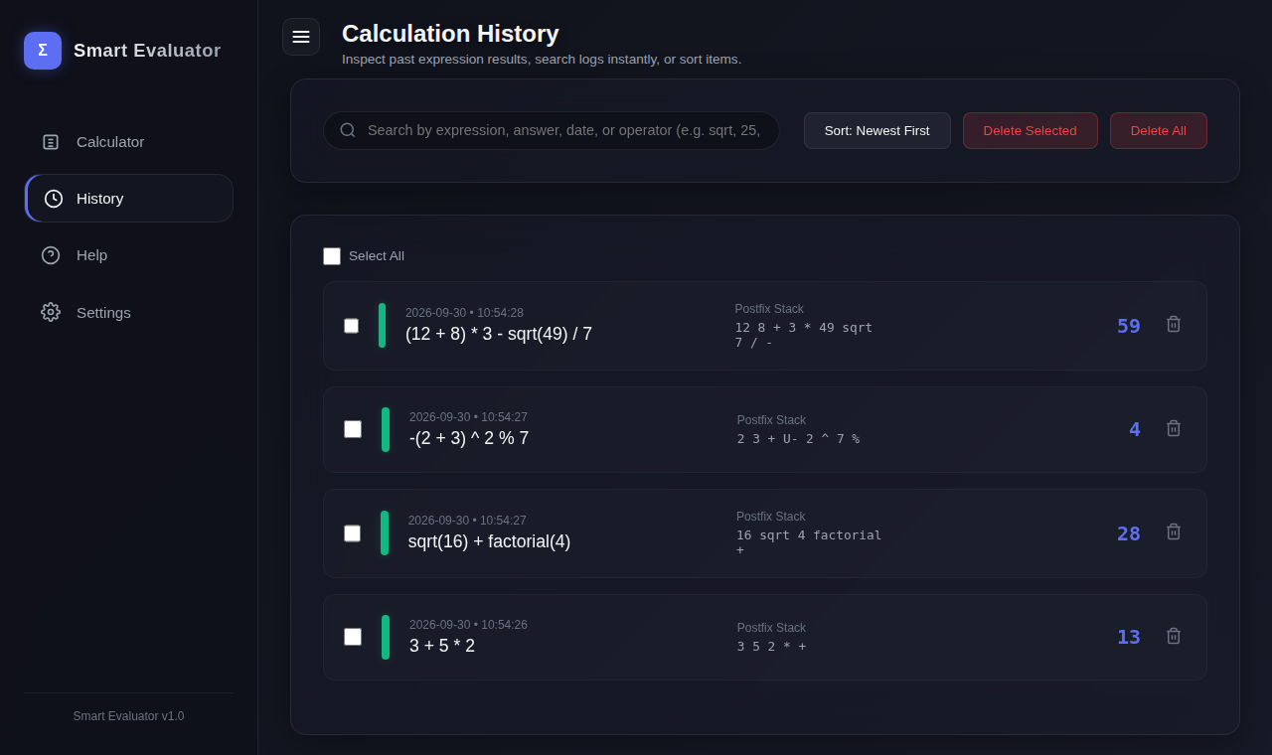
User Interface / Screenshots
History: date, postfix stack, result; search, sort, delete
Also in the app
Help page (user manual)
Settings: 3 themes, reset storage, WASM status
Calculator: expression, postfix output and result shown together
Smart Calculator – Stack-Based Expression Evaluator
Vaishnavi Ojha | 12405374 | 10
Notes:
These are real screenshots from my project. On the left is the calculator screen. It shows the original expression, the postfix form, and the result. Here I typed (12 + 8) * 3 - sqrt(49) / 7, the postfix is 12 8 + 3 * 49 sqrt 7 / -, and the answer is 59. On the right is the history page, where each record shows the date, the expression, the postfix stack and the result. I can search, sort and delete records. There is also a Help page and a Settings page with three colour themes, a reset button and the WebAssembly status.

Slide 11


Advantages, Applications & Future Scope
Advantages
Applications
Future Scope
Efficient expression evaluation
DSA concepts used practically
Handles complex expressions
Fast C++ computation
Browser-based interface
Persistent history and variables
Educational calculator
DSA / stack demonstration
Mathematical expression evaluation
Learning programming and algorithms
More scientific functions
Graph plotting
Matrix calculations
Better mobile UI
Advanced expression parser
More constants and functions
Smart Calculator – Stack-Based Expression Evaluator
Vaishnavi Ojha | 12405374 | 11
Notes:
Now the advantages, applications and future scope. The main advantages are efficient evaluation, practical use of DSA, support for complex expressions, fast C++ calculation, a browser interface, and saved history. It can be used as an educational calculator or as a demo to teach infix, postfix and stack. In the future I can add more scientific functions like sin and log, graph plotting, matrix calculations, a better mobile interface and a more advanced parser.

Slide 12
Conclusion
DSA combined with web technologies in one working project
Stack is used for both parsing and evaluation
C++ provides the core evaluation engine
WebAssembly connects the C++ engine to the browser
Result: an interactive, feature-rich calculator
Thank You
Questions?
Vaishnavi Ojha
12405374
Vaishnavi Ojha | 12405374 | 12
Notes:
To conclude, this project shows how data structures can be used in a real application. The stack does the main work in both parsing and evaluation. C++ is the engine, and WebAssembly lets it run in the browser with JavaScript connecting everything. The final result is an interactive calculator with postfix output, history and error handling. Thank you for listening, I am happy to answer any questions.

