Slide 1
Large-Scale and Multi-Structured Databases Project Design SYP (Share Your Playlist)
Lorenzo Massagli
Antonio Patimo
Fabio Buchignani

Slide 2
Application Highlights
Share your playlist and follow other’s playlist
Vote your favorite playlists
Give a comment about your favorite songs and read them about songs that you don’t know
Follow other users to be ever updated about what they do and when they create a new playlist
Search a song, find the playlists that contains it and view its comments and lyrics

Slide 3
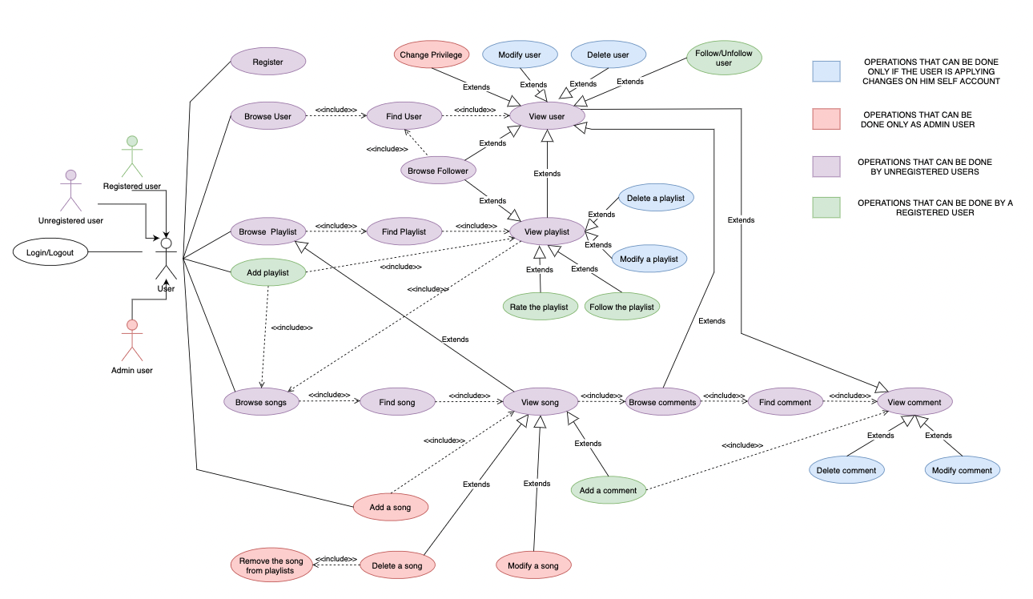
Actors and main supported functionalities

Slide 4
Dataset Description
Source:
Kaggle (Spotify playlists)
Data scraping from Genius (users, comments and lyrics)
Random generated vote (playlist and songs)
Description: The dataset is composed taking the Kaggle’s dataset (spotify playlist) which contains user that created a playlist, playlist name, song in the playlist. To this dataset we add the users (that will use the social),comments of them and the lyrics of a specific song. At the end, we add the votes of playlist and songs random generating them.
Volume: 1GB + volume data scraping + volume random generated votes
Variety: Kaggle_db (file csv) + Scraping from Genius + Random generation of votes
Velocity/Variability: The velocity of the dataset is high because the data arrives in a big amount in short time (creation of new playlists, new comments, new account registered, new playlist’s vote …)

Slide 5
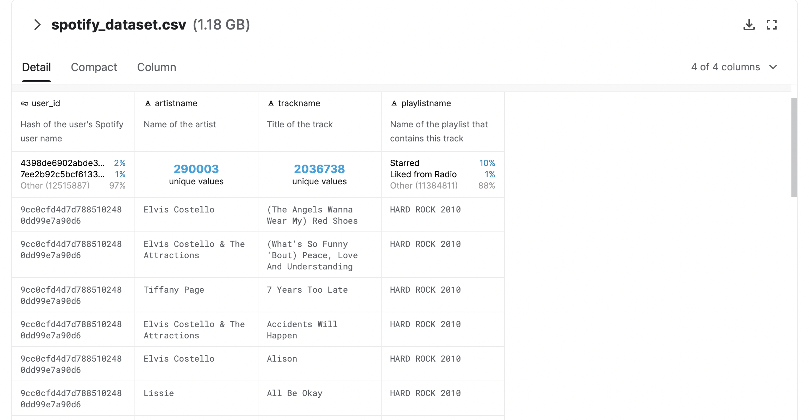
Kaggle Dataset Example
Dataset Name: Spotify Playlists

Slide 6
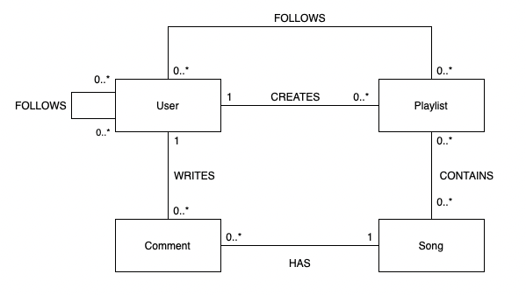
Preliminary UML Class Diagram

Slide 7
Requirements and Entities handled by Document DB
Entities handled: Users, songs and playlists.
Requirements handled
1) Find all the playlist created by a user
2) Find all the songs contained in a playlist
3) Find all the playlists that contains a specific song
4) Find a user, playlist, song by ID
5) Find a user, playlist, song starting from a string ( ex: song name, playlist name, user username )
6) Find the top k users that has created the highest number of playlists. -- Aggregation
7) Find the top k users that have added to them playlist the highest number of song of a specific period. -- Aggregation
8) Find the k most popular songs (based on how many playlist contains that specific song) -- Aggregation
9) Find the k playlist that has the highest rating based on the songs that it contains. – Aggregation
10) On average a playlist how many songs contains? -- Statistics and analytics
11) On average a song in how many playlists is contained? -- Statistics and analytics
12) On average a user how many playlist creates? -- Statistics and analytics

Slide 8
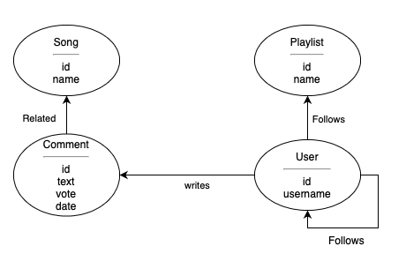
Requirements and Entities handled by Graph DB
Requirements handled
1) Show all the comments related to a song
2) Retrive the number of playlist's follows
3) Retrive the user’s followers
4) Retrive all the comments wrote by a user
5) Find the most k followed users – On graph queries
6) Find the most k followed playlists -- On graph queries
7) Find the users that follows at least k same playlists of the User provided in input -- On graph queries
8) Find the k songs that has the highest number of comments -- On graph queries
9) On average how many followers has a playlist? -- Statistics and analytics
10) On average how many comments has a song? -- Statistics and analytics
11) On average how many follows has a user? -- Statistics and analytics
12) On average how many comments a user writes? -- Statistics and analytics

Slide 9
Software Architecture Preliminary Idea
Programming language: Java
Frontend: Console or JavaFX/JavaWebApplication
Backend:
DocumentDB: MongoDB
GraphDB: neo4J
Java

