Slide 1
Ⅱ. Mathmatical background
two-dimensional Discrete Fourier Transform
https://homepages.inf.ed.ac.uk/rbf/HIPR2/fourier.htm

Slide 2
4.1 The two-Dimensional Discrete Fourier Transform
The 2-D Discrete Fourier Transform (DFT) of N×N array f(y, x), denoted by F(v, u), is given by the equation
F(v, u) = Σ Σ f (y, x)×W_{N}^{-vy}×W_{N}^{-ux}
N-1
N-1
(4.1)
y = 0
x = 0
where W_{N} = exp(i2π/N) .
The inverse 2-D Discrete Fourier Transform (IDFT) of F(v, u) is given by the equation
f(y, x) = Σ Σ F(v, u )×W_{N}^{vy}×W_{N}^{ux}
1
N-1
N-1
(4.2)
NN
v = 0
u = 0
where W_{N} = exp(i2π/N) .

Slide 3
4.2 How to calculate two-Dimensional DFT
F(v, u) = Σ Σ f (y, x)×W^{-vy}×W^{-ux}
N-1
N-1
(4.1)
y = 0
x = 0
where W = exp(i2π/N) and v, u, y, x =0,1,2, . . . , N-1.
.
For simplicity, let N (the number of data) equal 4.
F(v, u) = Σ Σ f (y, x)×W^{-vy}×W^{-ux}
3
3
y = 0
x = 0
where W = exp(i2π/4) and v, u, y, x =0,1,2, 3.
.

Slide 4
Let v = 0 and u = 0. Then,
F(0, 0) = Σ Σ f (y, x) ; DC component
3
3
y = 0
x = 0
Let v = 0 and u = 1. Then,
F(0, 1) = Σ Σ f (y, x) W^{-1*x}
3
3
y = 0
x = 0
Let v = 1 and u = 0. Then,
F(1, 0) = Σ Σ f (y, x) W^{-1*y}
3
3
y = 0
x = 0
Let v = 1 and u = 1. Then,
F(1, 1) = Σ Σ f (y, x) W^{-1*y}×W^{-1*x}
3
3
y = 0
x = 0

Slide 5
Let v = 0 and u = 2. Then,
F(0, 2) = Σ Σ f (y, x) W^{-2*x}
3
3
y = 0
x = 0
Let v = 2 and u = 0. Then,
F(2, 0) = Σ Σ f (y, x) W^{-2*y}
3
3
y = 0
x = 0
Let v = 3 and u = 3. Then,
F(3, 3) = Σ Σ f (y, x) W^{-3*y}×W^{-3*x}
3
3
y = 0
x = 0

Slide 6

Let f be 4 x 4 array (N=4).
f = [ f (0,0) f (0,1) f (0,2) f (0,3) ;
f (1,0) f (1,1) f (1,2) f (1,3) ;
f (2,0) f (2,1) f (2,2) f (2,3) ;
f (3,0) f (3,1) f (3,2) f (3,3) ; ]
F = [ F(0,0) F(0,1) F(0,2) F(0,3) ;
F(1,0) F(1,1) F(1,2) F(1,3) ;
F(2,0) F(2,1) F(2,2) F(2,3) ;
F(3,0) F(3,1) F(3,2) F(3,3) ; ]

Slide 7
4.3 Characteristics of the Discrete Fourier Transform
F(v, u) = F( N-v, N-u )
complex conjugate
Let f be 4 x 4 array (N=4).
0 1 2 3
u
0
1
2
3
F(0,0)
F(0,1)
F(0,3)
DC
component
F(1,0)
F(1,1)
complex conjugate
F(2,1)
F(2,2)
F(2,3)
F(3,0)
F(3,3)
v
complex conjugate
complex conjugate

Slide 8
Characteristics of the Discrete Fourier Transform
F(v, u) = F( N-v, N-u )
Let f be 8 x 8 array (N=8).
0 1 2 3 4 5 6 7
u
0
1
2
3
4
5
6
7
F(0,0)
F(0,1)
F(0,7)
F(1,0)
complex conjugate
DC
component
F(3,3)
F(3,4)
F(4,4)
complex conjugate
complex conjugate
F(5,4)
F(5,5)
F(6,7)
complex conjugate
F(7,0)
F(7,6)
F(7,7)
v

Slide 9
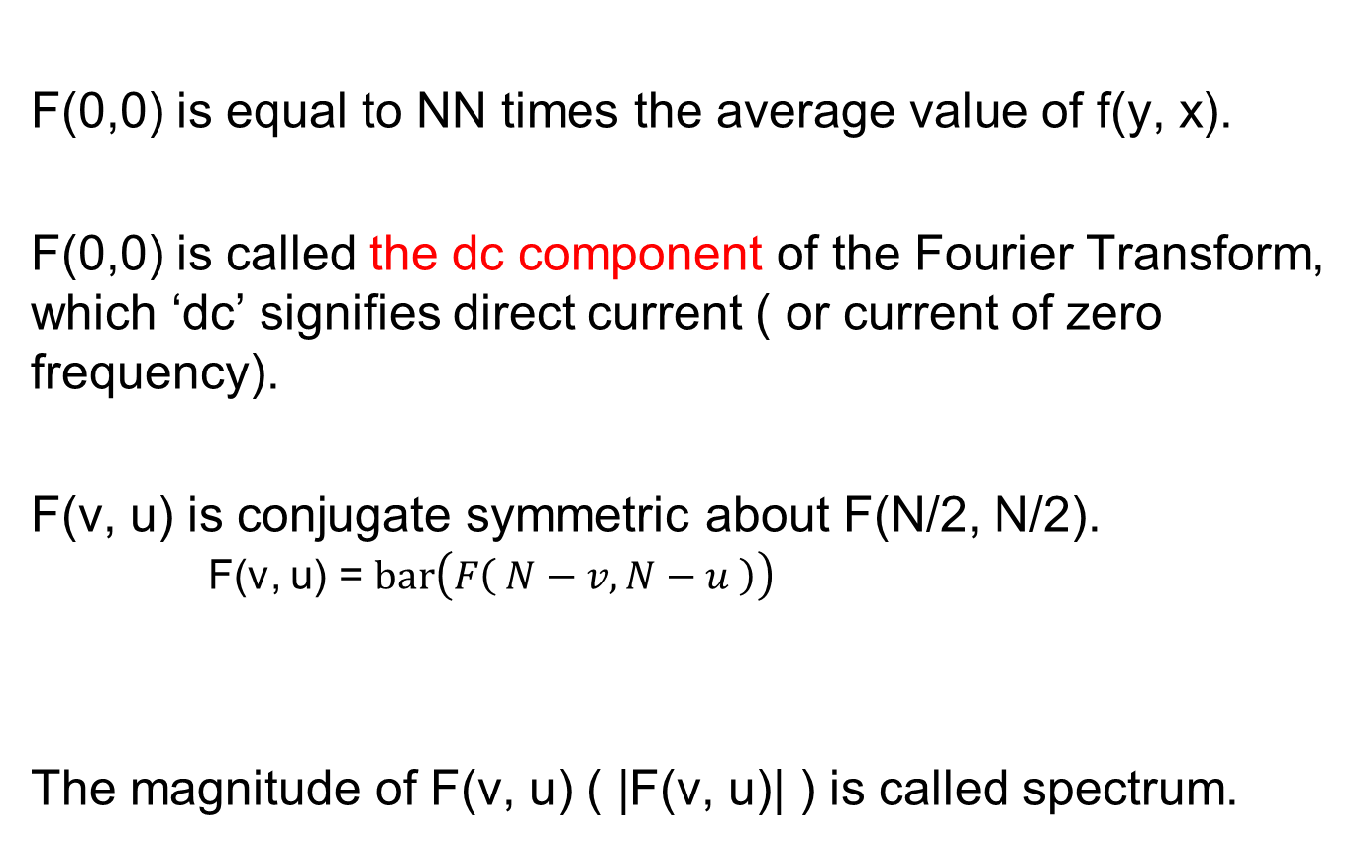
Characteristics of the Discrete Fourier Transform

Slide 10
4.4 MATLAB commands for 2-D DFT/ IDFT and a filtering in the frequency domain
>> f=imread('LENNA.bmp') ;
>> F=fft2(f) ;
>> F1=F;
>> F1(20:238, 20:238)=0 ;
>> f1=ifft2(F1) ;
>> F2=F;
>> F2(10:248, 10:248)=0 ;
>> f2=ifft2(F2) ;
>> figure,
>> subplot(1,3,1), imshow(f,[ ]), title('Original')
>> subplot(1,3,2), imshow(f1,[ ]), title('F1(20:238, 20:238)=0')
>> subplot(1,3,3), imshow(f2,[ ]), title('F1(10:248, 10:248)=0')
fft2( ) : 2-D DFT
ifft2( ) : 2-D IDFT
Check the three images; f, f1, and f2.

Slide 11
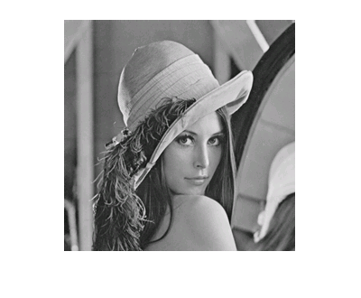
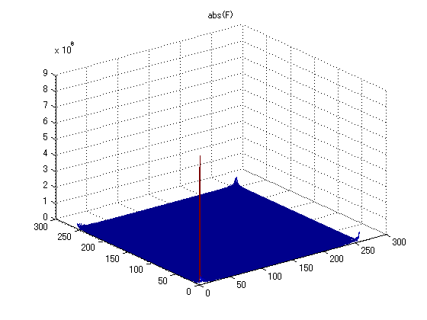
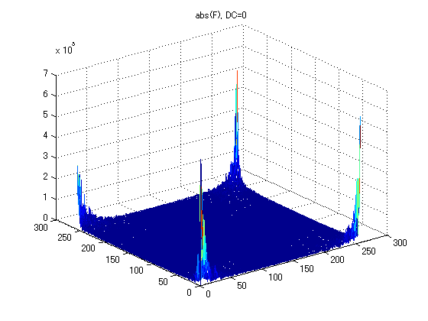
MATLAB commands to display complex valued matrix F
>> figure, mesh(abs(F)), title('abs(F)'), view(3)
>> F(1,1)=0 ; % F(1,1) is DC component. It has large value.
% Meaningful Bar graph can not be displayed.
% we set F(1,1)=0.
>> figure, mesh(abs(F)), title('abs(F)'), view(3)
function mesh() : bar graph
function view() : view point
‘LENNA.bmp’
DC component F(1,1) is too large.
F(1,1) = 0

Slide 12
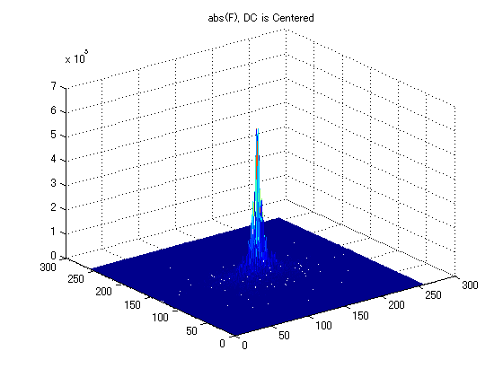
4.5 MATLAB commands for moving the origin of the transform to the center
Function fftshift() is used to center the DFT such that DC component is at the center of the array.
>> Fc = fftshift(F);
>> figure, mesh(abs(Fc)), title('abs(Fc)'), view(3);
fftshift
DC component

Slide 13
The function fftshift() operates by swapping quadrants of F.
DC component moves to the center of the array.
F =
1 1 1 1 1
1 0 0 0 0
1 0 0 0 0
1 0 1 0 0
1 0 0 0 0
1 0 0 0 0
1 0 0 0 0
1 0 0 0 1
Fc =
0 0 1 0 0
0 0 1 0 0
0 0 1 0 0
0 1 1 0 0
1 1 1 1 1
0 0 1 0 0
0 0 1 0 0
0 0 1 0 1
Fc = fftshift(F)
F=ifftshift(Fc)

Slide 14
4.6 Fundamental Concepts
for Filtering in the Frequency Domain
Spatial Domain
Frequency Domain
1
N
1
N
x
DFT
u
1
1
F=fft2(f)
F(v, u)
f (y, x)
Fc = fftshift(F)
IDFT
N
N
f= ifft2(F)
1
N
u
v
1
y
F = ifftshift(Fc)
Fc(v, u)
N
v

Slide 15
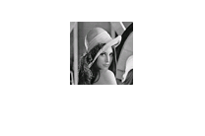
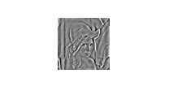
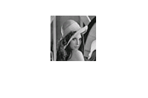
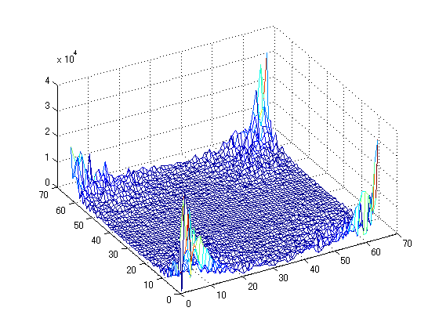
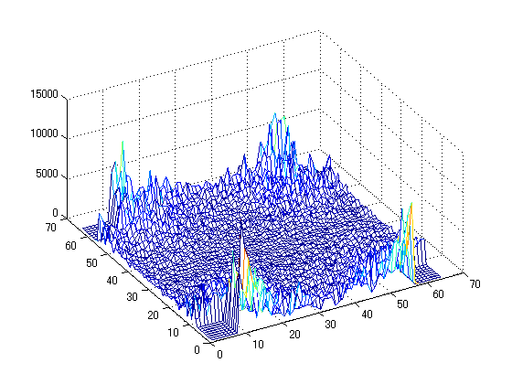

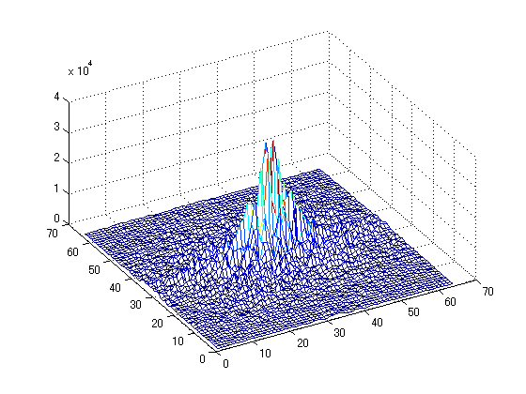
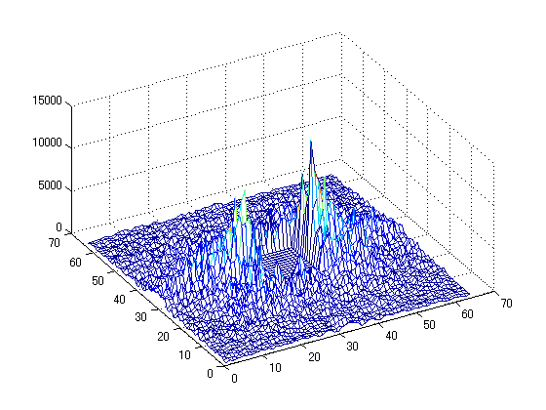
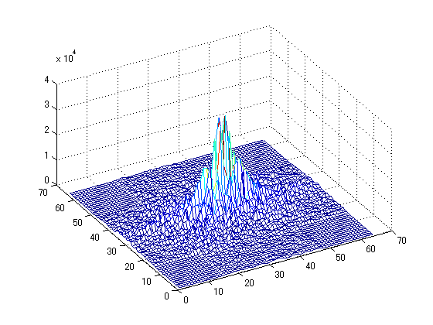
4.6 Fundamental Concepts
for Filtering in the Frequency Domain
input image
Low freq. removed
High freq. removed
fft2
ifft2
fft2
ifft2
fft2
ifft2
fftshift
ifftshift
fftshift
ifftshift
fftshift
ifftshift

Slide 16
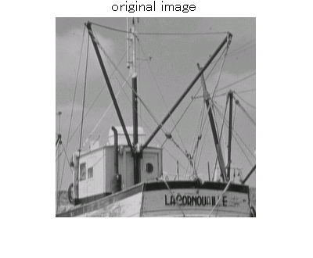
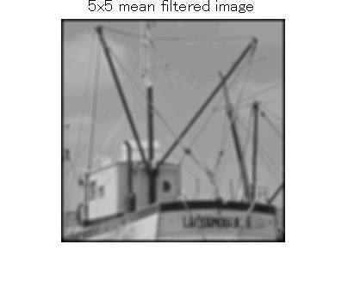
4.6 Fundamental Concepts for Filtering in the Frequency Domain
DFT
F=fft2(f)
FFTSHIFT
/ IFFTSHIFT
Fc=fftshift(F)
Fc=Fc .* M
F=ifftshift(Fc)
IDFT
G=ifft2(F.*M)
Filtering in the Frequency Domain
M : a filter mask
input image f(y,x)
filtered image g(y,x)

Slide 17
4.7 The meaning of DFT and Inverse DFT
Eq. (4.2) (or IDFT) can be represented as follows:
where
B_{(v, u)}(y, x) is 2-dimensional orthogonal function called basis image, which satisfies the following relation:
f(y, x) = Σ Σ F(v, u)× B_{(v, u)}(y, x)
1
N-1
N-1
NN
(4.5)
v = 0
u = 0
B_{(v, u)}(y, x) = exp(j2π(vy/N + ux/N))
(4.6)
N-1
Σ Σ B_{(v, u)}(y, x)×B_{(v’, u’)}(y, x)
=
N-1
y = 0
x = 0
(4.7)
0 if v is not equal to v’ or u not equal to u’
NN if otherwise

Slide 18
What does the equation of Inverse DFT mean?
Eq. (4.5) shows that any given image can be expressed as a weighted sum of the basis images.
f (y, x) = Σ Σ F(v, u)× B_{(v, u)}(y, x)
= F(0, 0) B_{(0, 0)}(y, x) + F(0, 1) B_{(0, 1)}(y, x)
+ . . . + F(N-1, N-2) B_{(N-1, N-2)}(y, x)
+ F(N-1, N-1) B_{(N-1, N-1)}(y, x)
1
N-1
N-1
NN
v = 0
u = 0
1
NN

Slide 19
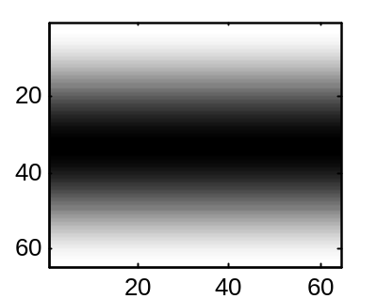
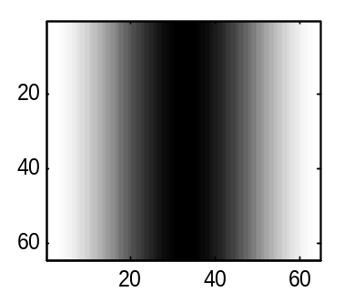
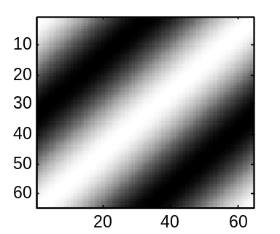
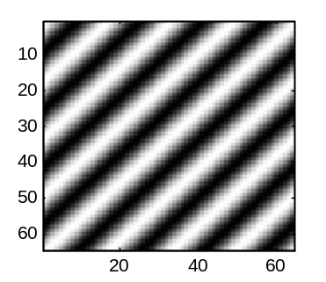
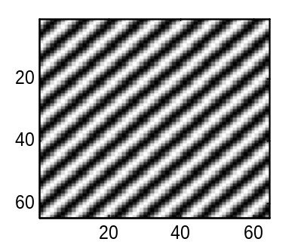
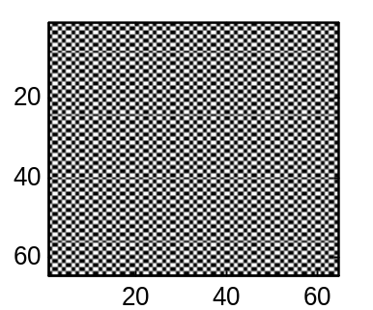
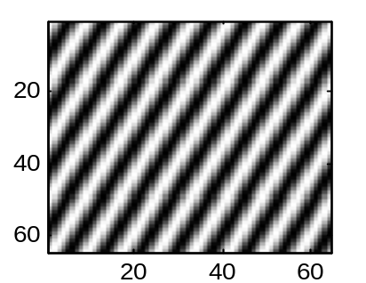
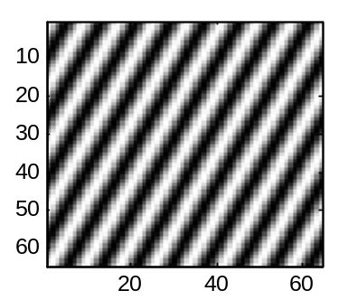
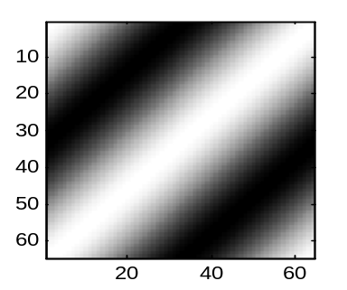
examples of basis image (N=64)
v
B_{(1,0)}
B_{(0,1)}
B_{(1,1)}
u
B_{(4, 4)}
B_{(8, 8)}
B_{(32, 32)}
B_{(4, 8)}
B_{(60, 56)}
B_{(63, 63)}

Slide 20
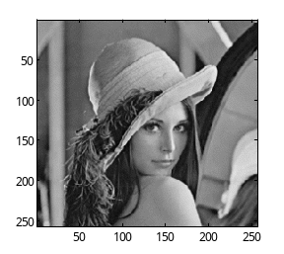
4.7 The meaning of DFT and Inverse DFT
a Fourier coefficient
a basis image
. . .
64
=
F(0,0)
+
F(0,1)
+
64
B_{(0,0)}
B_{(0,1)}
Any given image can be expressed as a weighted sum of the 64 x 64 basis images.
And those weights are given as Fourier coefficients.
. . .
+
F(1,0)
+
F(1,1)
+
B_{(1,0)}
B_{(1,1)}
. . .
+
F(4,4)
+
+
F(63,63)
B_{(4, 4)}
B_{(63,63)}

