Slide 1
Ⅱ. Mathmatical background
The meaning of
Inverse Discrete Fourier Transform

Slide 2
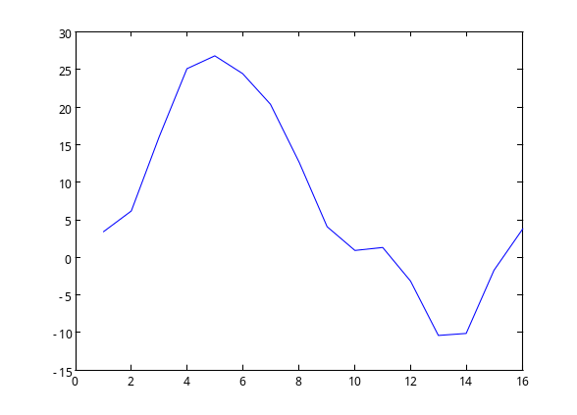
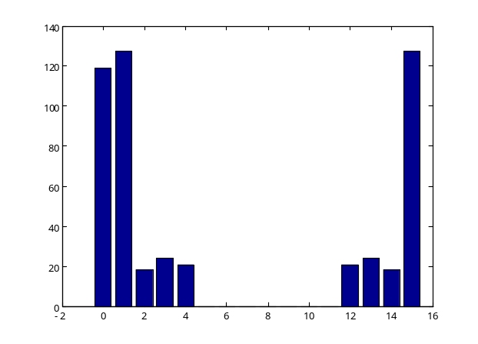
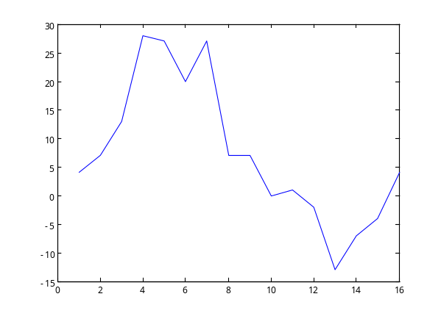
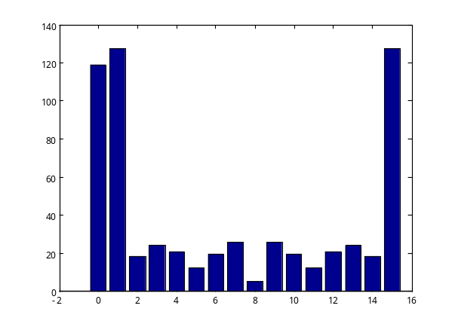
signals in the spatial/time domain and in the frequency domain
Spatial /time Domain
Frequency Domain
DFT
I DFT
DFT
I DFT
This signal contains higher frequency components.
High frequency components

Slide 3
An Example of MATLAB commands for 1-D DFT and IDFT
>> f = [ 7 28 16 20 10 14 -5 1 ] ;
>> figure(1), plot(f)
>> F=fft(f)
>> abs(F)
>> figure(2), bar( abs(F) )
>> g = ifft(F) ;
>> figure(3), plot(g)
function plot( )
function fft( ) : 1-D DFT
function abs( ) : absolute
function bar( ) : bar graph
function ifft( ) : 1-D Inverse DFT

Slide 4
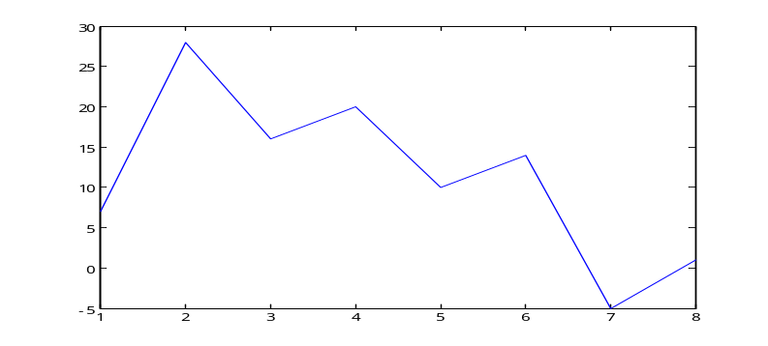
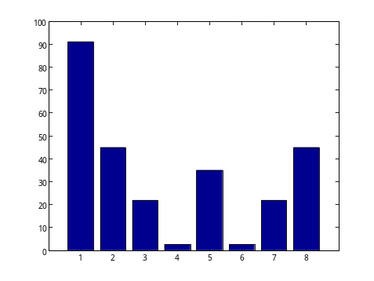
Results of the 1-D DFT and 1-D UDFT Execution
f = [ 7 28 16 20 10 14 -5 1 ]
DFT
F = fft ( f )
IDFT
f = ifft ( F )
F = [ 91 -6.5-44i 6.0-21i 0.54-2.3i
-35 0.54+2.3i 6.0+21i -6.5+44i ]
| F | = abs ( F )
| F | = [ 91 45 22 2.4 35 2.4 22 45 ]
figure, plot ( f )
figure, bar ( abs(F) )

Slide 5
Characteristics of the DFT (1)
Complex conjugate
F = [ 91 -6.5-44i 6.0-21i 0.54-2.3i
-35 0.54+2.3i 6.0+21i -6.5+44i ]
| F | = abs ( F )
Both absolute values are the same.
| F | = [ 91 45 22 2.4 35 2.4 22 45 ]

Slide 6
Characteristics of the DFT (2)
F(u) is conjugate symmetric about F(N/2).
F(u) = F(N-u)
Example. Let N = 8.
0 1 2 3 4 5 6 7
u
F(0)
F(1)
F(2)
F(3)
F(4)
F(5)
F(6)
F(7)
F(0) is equal to N times the average value of f(x), and called the dc (direct current) component.
complex conjugate

Slide 7

Let N=8.
f = [ f(0) f(1) f(2) f(3) f(4) f(5) f(6) f(7) ]
F = [ F(0) F(1) F(2) F(3) F(4) F(5) F(6) F(7) ]
IDFT

Slide 8
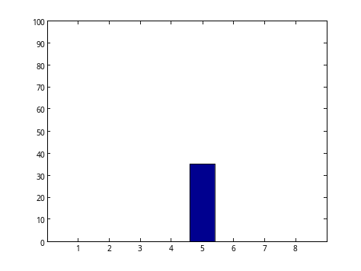
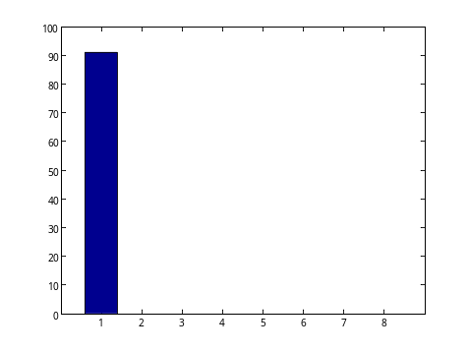
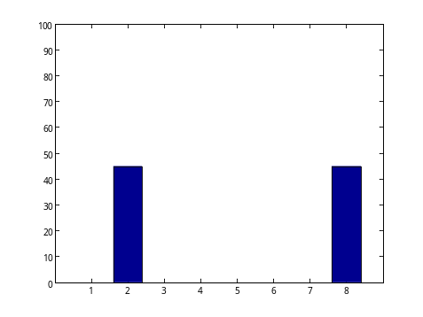
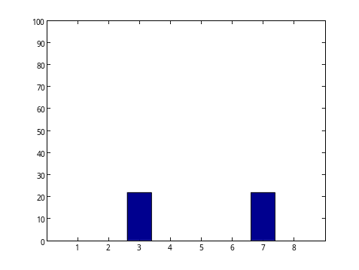
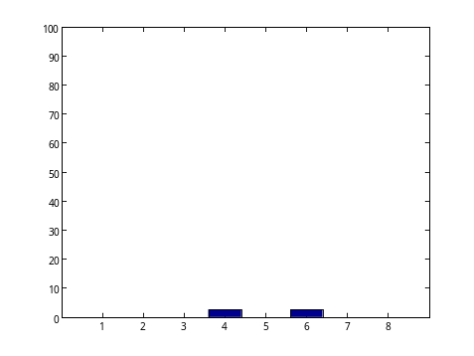
Results of 1-D IDFT Execution
DFT
IDFT
4
IDFT
IDFT
IDFT
IDFT
0
1
2
3

Slide 9
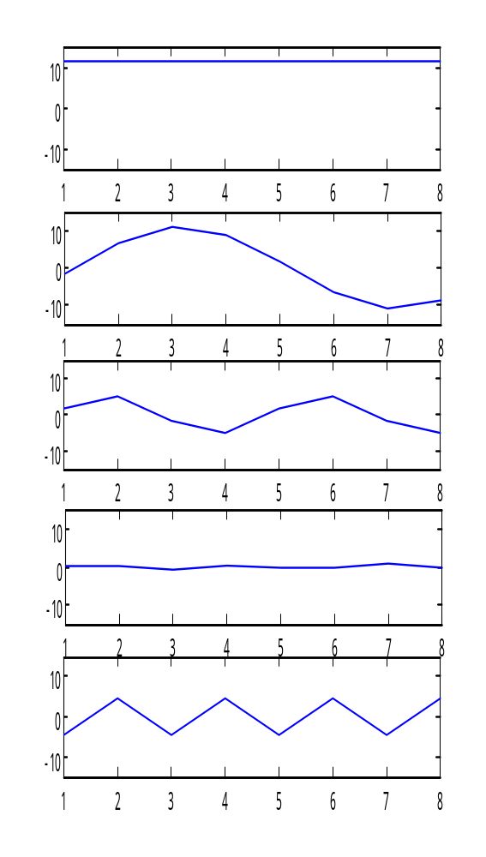
A 1x8 signal can be expressed as a weighted sum of the 1 x 8 trigonometric functions shown on the left.
0
0 frequency : DC
1
Low frequency
2
3
4
High frequency

