Slide 1
Ⅰ. How to handle digital images with MATLAB

Slide 2
1.1 What is MATLAB? How to use it.
The name MATLAB stands for matrix (i.e., two-dimensio nal array) laboratory.
MATLAB is a high-performance language for technical computing, and an array-oriented language.

Slide 3
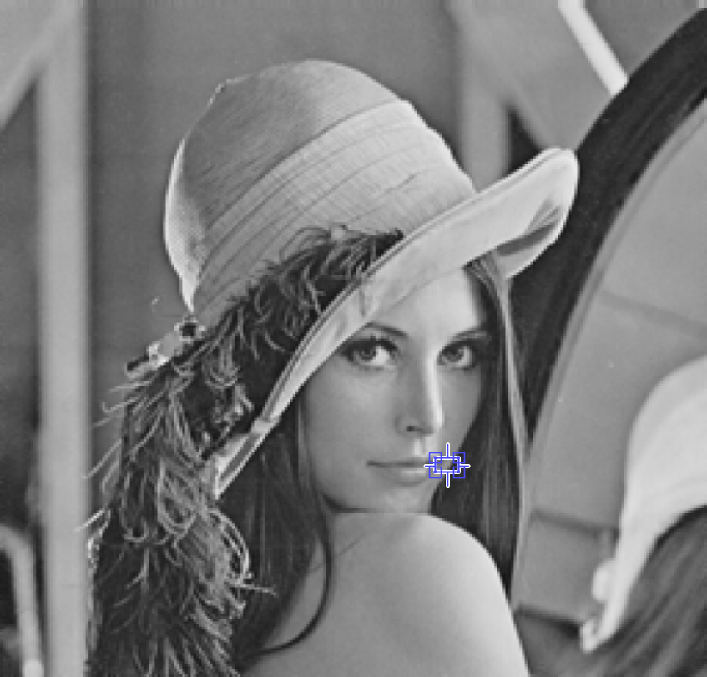
1.2 A digital image
f ( 1, 1 )
f ( 1, 256 )
A digital image is composed of a finite number of picture elements or pixels.
A digital image is defined as two-dimensional numerical arrays f(y,x), where y and x are spatial coordinates, and f(y,x) is called the intensity or gray level of the image.
x
f ( 256, 1 )
f ( 256, 256 )
y
MATLAB provides us with a powerful and extensive set of functions for processing digital images or multi-dimensional arrays.

Slide 4
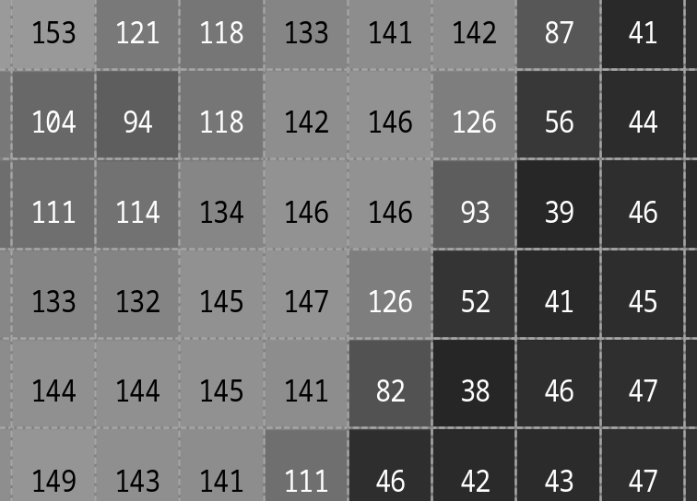
An example of 256×256 digital image representation in MATLAB
A digital image can be represented naturally as a matrix.
f ( 1, 1 )
f ( 1, 256 )
pixel or image element
f ( p, q )
p : row number
q : column number
f ( 256, 1 )
f ( 256, 256 )

Slide 5
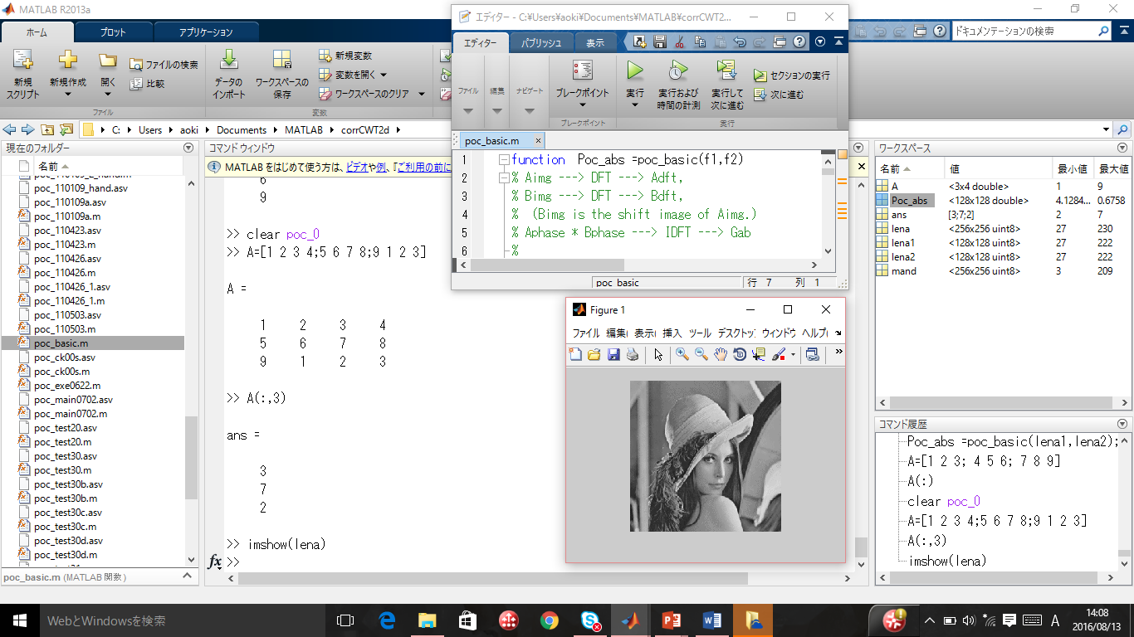
1.3 The MATLAB desktop and its principal components
Editor Window
Current Directory
Workspace Browser
Command Window
Figure Window
Command History

Slide 6
1.4 Basic Operation in MATLAB (1)
>>
>> 2+3*4
ans =
14
>> x = 2+3*4
>> x =
14
>> 2*x
ans =
28
>> y = 2*3 ;
Prompt symbol designates the beginning of command line.
You can use arithmetic operators +, -, *, and / .
If you do not specify an output variable, MATLAB uses a default variable ans.
You may assign a value to a variable.
This variable name can always be used to refer to the results of the previous computations.
The semicolon at the end is for suppressing output. If a semicolon is included, MATLAB doesn’t display the results of the operation.

Slide 7
1.4 Basic Operation in MATLAB (2)
(The colon notation)
>> n1 = 1:5
n1 =
1 2 3 4 5
>> n2 = 1:2:5
n2 =
1 3 5
>> n3 = 5:-1:1
n3 =
5 4 3 2 1
>>n4 = 5:-2:1
n4 =
5 3 1
The colon notation is very useful to access blocks of elements.
The notation 1:5 says to start at 1, count up by 1 and stop when the count reaches 5.
The notation 1:2:5 says to start at 1, count up by 2 and stop when the count reaches 5.
The notation 5:-1:1 says to start at 5, decrease by 1 and stop when it reaches 1.

Slide 8
1.4 Basic Operation in MATLAB (3)
(Vector Manipulations)
>> v=[ 1 3 5 7 9 ]
v =
1 3 5 7 9
>> v(2)
ans =
3
>> v(1:3)
ans =
1 3 5
A row vector, or an array of dimension 1xN, is created by square brackets. The elements are separated by spaces or by commas.
v(2) is the second element of vector v.
To access the first three elements of v, we write v(1:3).

Slide 9
1.4 Basic Operation in MATLAB (4)
(Vector Manipulations)
>> v(2:4)
ans =
3 5 7
>> v(2:end)
ans =
3 5 7 9
>> v(1:2:5)
ans =
1 5 9
>> v(end:-2:1)
ans =
9 5 1
The notation v(2:4) means we can access the second through the fourth elements.
v was defined by [1 3 5 7 9 ]
The notation ‘end’ signifies the last element.
The index is not restricted to contiguous elements.
The index count starts at the last element, decreases by 2, and stops when it reaches the first element.

Slide 10
1.4 Basic Operation in MATLAB (5)
(Matrix Manipulations)
>> A=[1 2 3 4; 5 6 7 8; 9 1 2 3]
A =
1 2 3 4
5 6 7 8
9 1 2 3
>> B=A’
B =
1 5 9
2 6 1
3 7 2
4 8 3
A matrix is entered row by row,
And each row is separated by the semicolon(;).
Within each row, elements are separated by a space or a comma(,).
A’ is a transpose of matrix A.

Slide 11
1.4 Basic Operation in MATLAB (6)
(Matrix Manipulations)
>> A
A =
1 2 3 4
5 6 7 8
9 1 2 3
>> A(2, 3)
ans = 7
>> A(2, 3) = 0
A =
1 2 3 4
5 6 0 8
9 1 2 3
If we want to check the A matrix again,
we simply type A.
If we want to extract the element in the second row, third column, we write A(2,3).
A(2, 3)
If we want to set the element to 0, we write A(2, 3)=0.
A = 1 2 3 4
5 6 7 8
9 1 2 3

Slide 12
1.4 Basic Operation in MATLAB (7)
(Matrix Manipulations)
>> A(:, 3)
ans =
3
0
2
>> A(1, :)
ans =
1 2 3 4
>> A(1, :) + A(3, :)
ans = 10 3 5 7
A(:, 3) is the third column of matrix A.
The colon operator (:) stands for all columns or all rows.
A(1, :) represents the first row of matrix A.
This means addition of the first and third rows of A

Slide 13
1.4 Basic Operation in MATLAB (8)
(Matrix Manipulations)
>> A(:, 1) = 0
A =
0 2 3 4
0 6 0 8
0 1 2 3
>> A(end, end) = 0
A =
0 2 3 4
0 6 0 8
0 1 2 0
>> A(end, end-1)
ans =
2
If we want to set the first column to 0s, we write A(:, 1)=0.

Slide 14
1.4 Basic Operation in MATLAB (9)
(Matrix Manipulations)
>> A(:, 2:4)
ans =
2 3 4
6 0 8
1 2 0
>> A(:, 2) = [ ]
A =
0 3 4
0 0 8
0 2 0
A(:, 2:4)
A(:, 2:4) is a sub-matrix with the last three columns of A.
A = 0 2 3 4
0 6 0 8
0 1 2 0
A row or a column of a matrix can be deleted by setting it to a null vector, [ ].
A(:, 2)
A = 0 2 3 4
0 6 0 8
0 1 2 0

Slide 15
1.4 Basic Operation in MATLAB (10)
(Matrix Manipulations)
>> A(1:2, 2:3)
ans =
3 4
0 8
>> A(2:end, 1:2)
ans =
0 0
0 2
A(1:2, 2:3)
A = 0 3 4
0 0 8
0 2 0
A(2:end, 1:2)
A = 0 3 4
0 0 8
0 2 0

Slide 16
1.4 Basic Operation in MATLAB (11)
(Matrix Manipulations)
>> C=[1 3 5; 7 9 2; 4 6 8] ;
>> C
C =
1 3 5
7 9 2
4 6 8
>> D=C(end:-1:1, :)
D =
4 6 8
7 9 2
1 3 5
MATLAB does not display output on the screen
when an operation ends with the semicolon(;).
If we want to check the C matrix again,
we simply type C.

Slide 17
1.4 Basic Operation in MATLAB (12)
(Matrix Manipulations)
>>D(:)
ans=
4
7
1
6
9
3
8
2
5
>> sum(D(:))
ans =
45
The use of a single colon as an index selects all the elements of the array and arrange them in the form of a column vector.
This notation finds the sum of all the elements of a matrix.

Slide 18
1.4 Basic Operation in MATLAB (13)
(Matrix Manipulations)
>> max(D(:))
ans =
9
>> min(D(:))
ans =
1
>>E=[C D]
E =
1 3 5 4 6 8
7 9 2 7 9 2
4 6 8 1 3 5
This notation returns the maximum value of a matrix.
This notation returns the minimum value of a matrix.
The notation [C D] means concatenation of matrix C with matrix D.

Slide 19
1.4 Basic Operation in MATLAB (14)
(Summary: Matrix Manipulations – Array Indexing )
MATLAB supports a number of powerful indexing schemes that simplify array manipulation.
Basic indexing in two dimensions is illustrated as below.
A(:, 2)
A is given as the 4x4 matrix.
A(2, 3) and A(end, end) represent elements, respectively.
A(2, :) represents a row vector.
A(:, 2) represents a column vector.
A(2:3, 1:3) represents a submatrix.
A = 1 2 3 4
5 6 7 8
9 8 2 1
A(2, 3)
A(2, :)
A(2:3, 1:3)
A(end, end)= A(3, 4)

Slide 20
1.5 Digital Image Representation
An image is defined as a two-dimensional function, f (y, x) , where y and x are spatial coordinates, and the amplitude of f at any pair of coordinates (y, x) is called the intensity of the image at that point.
An image is continuous with respect to the x- and y- coordinates, and also in amplitude.
Converting such an image to digital form :
Digitizing the coordinate value is called sampling.
Digitizing the amplitude value is called quantization.
The result of sampling and quantization is a matrix of real numbers.
If the resulting image has M rows and N columns, we say that the image is of size M x N. The values of the coordinates (y, x) are discrete quantities.

Slide 21
1.5 Digital Image Representation
The difference of coordinate conventions
between many image processing books and MATLAB
0 1 2 …….. N-1
1 2 3 …….. N
0
1
2
.
.
.
.
M-1
x
1
2
3
.
.
.
.
M
x
pixel
f (3, N)
Coordinate conventions used in many image processing books
Coordinate conventions used in MATLAB
pixel
f (M, 3)
y
y

Slide 22
1.5 Digital Image Representation
( Image types and Data Classes )
Image types :
  Intensity image ( gray-scale image) = a data matrix
  Binary image = a logical array of 0s and 1s (logical data class)
  Indexed image = a data matrix of integers and a colormap matrix(m×3)
  RGB color image = an M×N×3 array, Red, Green, Blue component
Data classes for representing pixel values :
  double Double-precision floating-point (8 bytes/element)
  uint8 Unsigned 8-bit integers [0, 255] (1 byte/element)
  uint16 Unsigned 16-bit integers [0, 65535] (2 bytes/element)
  uint32 Unsigned 16-bit integers (4 bytes/element)
  int8 Signed 8-bit integers [-128, 127] (1 byte/element)
  int16 Signed 16-bit integers (2 bytes/element)
  int32 Signed 32-bit integers (4 bytes/element)
  single Single-precision floating-point (4 bytes/element)
  char Characters (2 bytes/element)
  logical Values are 0 or 1 (1 byte/element)

Slide 23
An example of 256×256 digital image representation with uint8 data class
pixel or image element
f ( p, q )
p : row number
q : column number
f ( 1, 1 )
f ( 1, 256 )
One pixel value is represented by one byte.
f ( p, q) =0 ⇒ black
f ( p, q) =255 ⇒ white
f ( 256, 1 )
f ( 256, 256 )

Slide 24
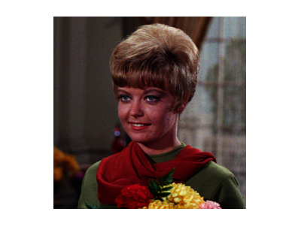
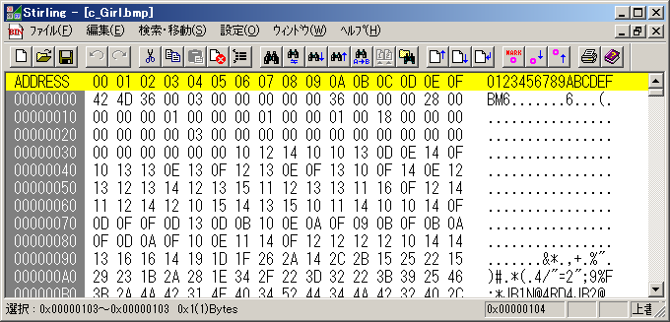
The structure of a bmp file (c_Girl.bmp)
( Binary Editor ;
https://freesoft-100.com/download/stirling/ )
B
M
width
height
Header
(54 bytes)
(0,0) Blue
(0,1) Blue
(0,0) Green
(0,0) Red

Slide 25
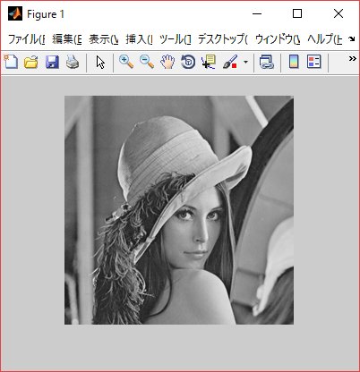
1.6 Reading and displaying intensity images (1)
>> f = imread(‘lenna.bmp’) ;
>> whos
Name Size Bytes Class
f 256x256 65536 uint8
>> size(f)
ans =
256 256
>> imshow(f)
Function imread reads intensity images, that is, gray-scale images into an array f. A gray-scale image is a data matrix.
The whos function displays information about array in MATLAB environment.
Function size gives the row and column dimensions of an array.
Function imshow displays an image on the MATLAB desktop.

Slide 26
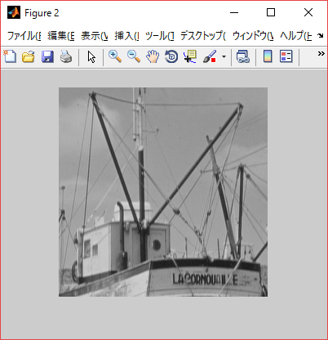
1.6 Reading and displaying intensity images (2)
>> g = imread(‘boat.bmp’) ;
>> figure, imshow(g)
>> whos
Name Size Bytes Class
f 256x256 65536 uint8
g 256x256 65536 uint8
Another BMP image is read into image array g.
Function figure creates a new figure window.
Function whos displays information about array f and g.

Slide 27
⇒ Try Exercise1.1
⇒ Try Exercise1.2

Slide 28
1.7 Reading and displaying color images (1)
>>clear all
>>f_c = imread(‘c_lenna.bmp’);
>> size(f_c)
ans =
256 256 3
>>f_r = f_c(:, :, 1) ; % Read red component
>>f_g = f_c(:, :, 2) ; % Read green component
>>f_b = f_c(:, :, 3) ; % Read blue component
>>whos
f_b 256x256 65536 uint8
f_c 256x256x3 196608 uint8
f_g 256x256 65536 uint8
f_r 256x256 65536 uint8
Clear all variables on working space.
An RGB color image is an M×N×3 array, and consists of three, that is, red, green and blue component image.

Slide 29
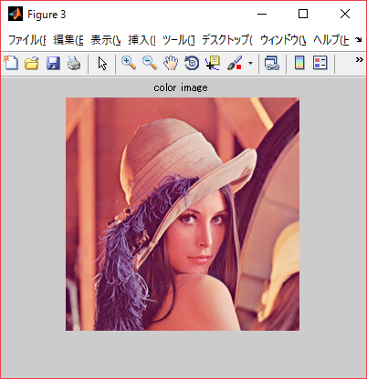
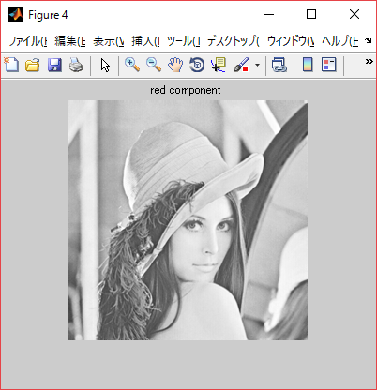
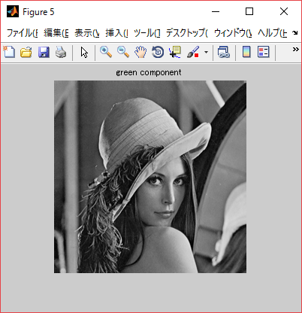
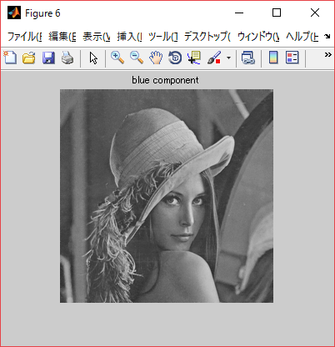
1.7 Reading and displaying color images (2)
>> figure, imshow(f_c), title('color image')
>> figure, imshow(f_r), title('red component')
>> figure, imshow(f_g), title('green component')
>> figure, imshow(f_b), title('blue component')

Slide 30
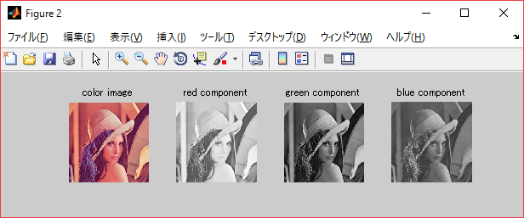
1.7 Reading and displaying color images (3) using subplot( ) function
>> figure
>> subplot(1,4,1), imshow(f_c), title('color image')
>> subplot(1,4,2), imshow(f_r), title('red component')
>> subplot(1,4,3), imshow(f_g), title('green component')
>> subplot(1,4,4), imshow(f_b), title('blue component')
4
1
1
2
3
4

Slide 31

1.7 Reading and displaying color images (4)
Conversion of color images to gray-scale images
>>f = rgb2gray(f_c);
>> f0 = mat2gray(f)
>>figure, imshow(f0), title(‘gray scale image’)
>> whos
f 256x256 65536 uint8
f0 256x256 524288 double
g 256x256 65536 uint8
Function rbg2gray converts a color image to a gray-scale image. The term gray level is used often to refer to the intensity of monochrome images.
f : uint8
Function mat2gray converts an arbitrary array of class double to an array of class double scaled to the range [0, 1]
f0 : double
If an image is of class uint8 or double, the range of valued is [0, 255] or [0, 1], respectively.

Slide 32
⇒ Try Exercise1.3

Slide 33
1.8 Intensity Transformations
Orign
Intensity transformations are denoted by the expression
g(y, x) = T[ f(y, x) ]
where f(y, x) is the input image, g(y, x) is the output image, and T is an operator on f.
The value of g(y, x) depends only on the intensity of f(y, x).
T becomes an intensity or gray-level transformation function.
x
(y, x)
Image f(y, x)
y
x
(y, x)
Image g(y, x)
y

Slide 34
1.8 Intensity Transformation
Thresholding transformation (binary images) (1)
>> a = [1 2; 3 4]
a =
1 2
3 4
>> b = mat2gray(a)
b =
0 0.3333
0.6667 1.0000
You need to check the following MATLAB functions first.
Function mat2gray converts an arbitrary array to an array of class double scaled to the range [0(black), 1(white)]

Slide 35
1.8 Intensity Transformation
Thresholding transformation (binary images) (2)
>>b1 = b > 0.7
b1 =
0 0
0 1
>> b2 = b > 0.5
b2 =
0 0
1 1
>> b3 = b > 0.1
b3 =
0 1
1 1
MATLAB relational operators
> (Greater than)
>= (Greater than or equal to)
< (Less than)
<= (Less than or equal to)
== (Equal to)
~= (Not equal to)
The element of b is greater than 0.7.
b has been given as
0 0.3333
0.6667 1.0000

Slide 36
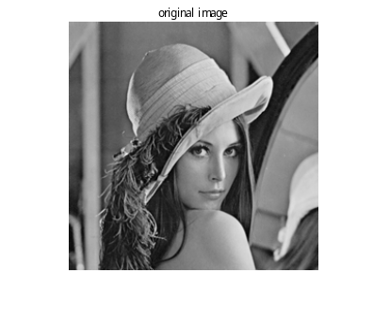
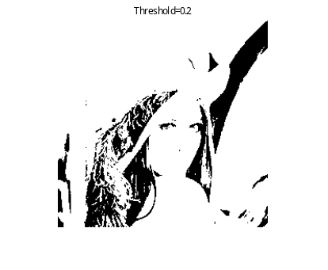
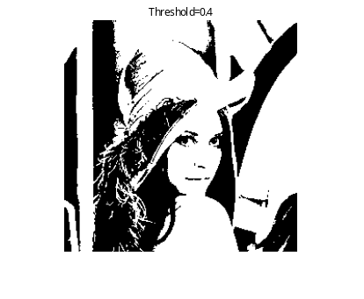
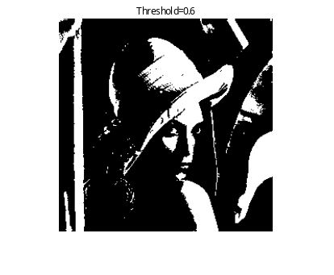
1.8 Intensity Transformation
Thresholding transformation (binary images) (3)
Example Program 1
>>
>> f02 = f0 > 0.2;
>> f04 = f0 > 0.4;
>> f06 = f0 > 0.6;
>>
>> subplot(1,4,1), imshow(f0), title('Original image');
>> subplot(1,4,2), imshow(f02), title(‘Threshold=0.2');
>> subplot(1,4,3), imshow(f04), title('Threshold=0.4');
>> subplot(1,4,4), imshow(f06), title('Threshold=0.6');
>>
Image array f0 has already been given as f0 = mat2gray(f).

Slide 37
⇒ Try Exercise1.4

Slide 38
1.8 Intensity Transformation
Power-law transformation (1)
>> a = [1 2; 3 4] , b=[0 1; 1 3]
a =
1 2
3 4
b =
0 1
1 3
>> c1 = a * b
c1 =
2 3
4 15
>> c2 = a .* b
c2 =
0 2
3 12
You need to check the following MATLAB functions first.
MATLAB has two different types of arithmetic operations.
・ Matrix arithmetic operations are defined by the rules of linear algebra.
・ Array arithmetic operations are carried out element by element.
The period character ( . ) distinguishes array operations from matrix operations.

Slide 39
1.8 Intensity Transformation
Power-law transformation (2)
>> a1 = a ^ 2
a1 =
7 10
15 22
>> a2 = a .^ 2
a2 =
1 4
9 16
>> b = mat2gray(a)
b =
0 0.3333
0.6667 1.0000
MATLAB arithmetic operators
* Matrix multiplication
.* Array multiplication
^ Matrix power
.^ Array power
/ Matrix right division
./ Array right division
Function mat2gray converts an arbitrary array of class double to an array of class double scaled to the range [0(black), 1(white)]

Slide 40
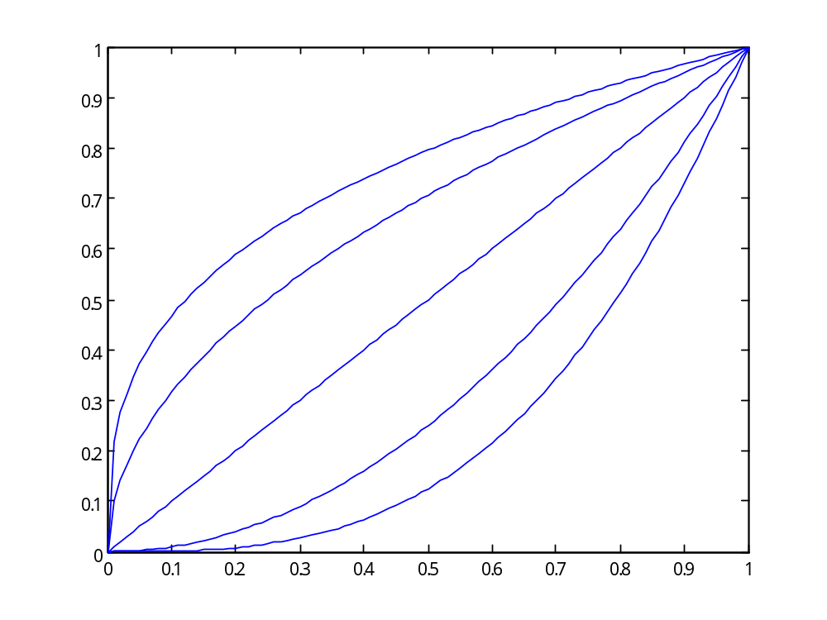
1.8 Intensity Transformation
Power-law transformation (3)
g
If gamma is less than 1, the mapping is weighted toward higher (brighter) output values.
If gamma is greater than 1, the mapping is weighted toward lower (darker) output values.
gamma＝0.33
gamma＝0.5
gamma＝1
gamma＝2
gamma＝3
f
g = f ^{gamma}

Slide 41
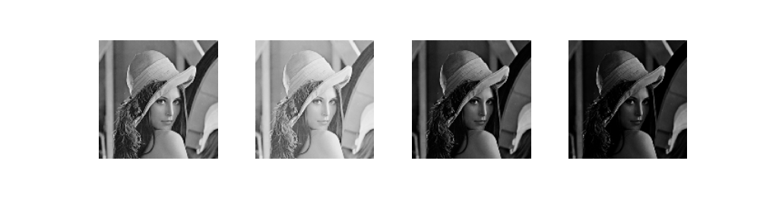
1.8 Intensity Transformation
Power-law transformation (4)
Example Program 2
>> g_1 = f0 .^ 0.5 ;
>> g_2 = f0 .^ 2 ;
>> g_3 = f0 .^ 3 ;
>> figure, imshow(f0), title(‘original)
>> figure, imshow(g_1), title(‘gamma=0.5’)
>> figure, imshow(g_2), title(‘gamma=2’)
>> figure, imshow(g_3), title(‘gamma=3’)
>>
original
Gamma=0.5
Gamma=2
Gamma=3

Slide 42
⇒ Try Exercise1.5

Slide 43
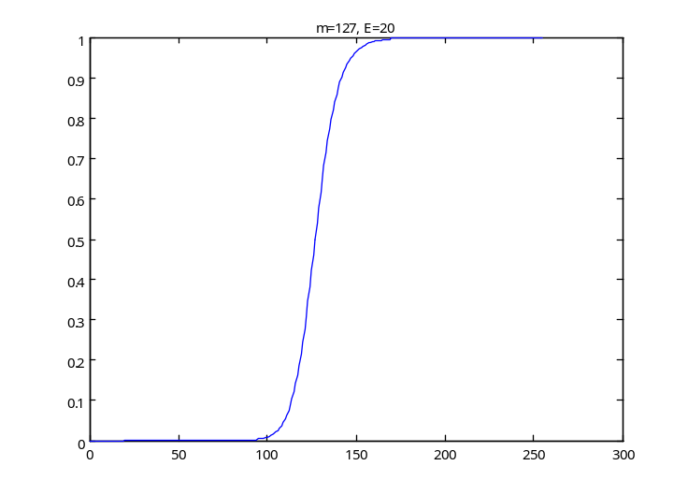
1.8 Intensity Transformation
Contrast-stretching transformation (1)
The function shown in the following figure is called a contrast-stretching transformation function because it compresses the input level lower than m into a narrow range of dark levels in the output image; similarly, it compresses the values above m into a narrow band of light levels in the output.
g=T( f )
The function has the form
g=T( f )=1/( 1 + ( m / f ) ^E)
where f represents the intensities of the input images, g is the corresponding intensity values in the output image, and E controls the slope of the function.
m = 0.5
Light
g = 0.5
Dark
Dark
Light
f

Slide 44
1.8 Intensity Transformation
Contrast-stretching transformation (2)
>> a = [1 8 ; 9 17] ;
>> b = mat2gray(a)
b =
0 0.4375
0.5000 1.0000
>> m = 0.5 ; E = 20 ;
>> g = 1./ (1+ (m./b) .^ E)
g =
0 0.0647
0.5000 1.0000
You need to check the following MATLAB functions first.
Output values are scaled to the range [0, 1].
It compresses the input level lower than m into a narrow range of dark levels in the output image.

Slide 45
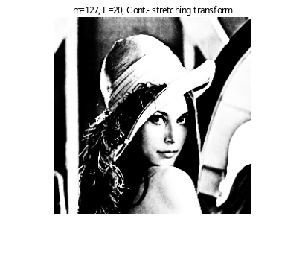
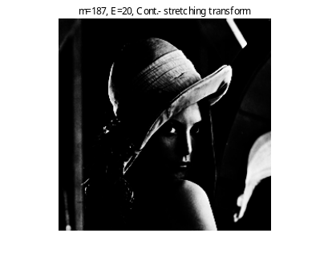
1.8 Intensity Transformation
Contrast-stretching transformation (3)
Example Program 3
>> figure, imshow(f0), title('original image')
>>
>> m = 0.5; E = 20 ;
>> g0520 = 1 ./ (1+ (m./f0) .^ E);
>> figure, imshow(g0520), title('m=0.5, E=20, Cont.-stretching trans') ;
>>
>> m = 0.7; E = 20 ;
>> g0720 = 1 ./ (1+ (m./f0) .^ E);
>> figure, imshow(g0720), title('m=0.7, E=20, Cont.-stretching trans‘) ;

Slide 46
Note About function imshow( )
Using the syntax
imshow(A, [ low high ])
displays as black all values less than or equal to low, and as white all values greater than or equal to high.
The syntax
imshow(A, [ ])
set valuable low to the minimm value of array A and high to its maximum value. This form of imshow is useful for displaying images that have a low dynamic range or that have positive and negative values. This form means imshow(A, [min(A(:)) max(A(:))] ).
The syntax
imshow(A)
means imshow(A, [0 1]) in the case that A is a gray-scale image and the class of it is single or double.

Slide 47
⇒ Try Exercise1.6

Slide 48
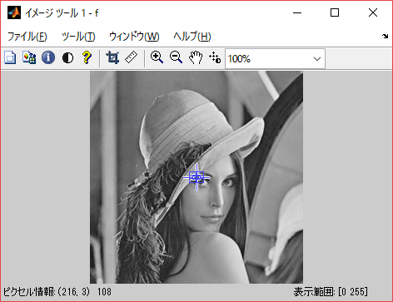
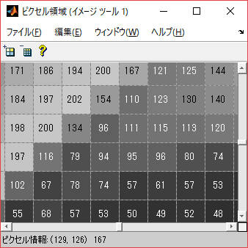
1.9 imtool( )
>> imtool(f)
imtool(f) :
Navigate image using over view, Inspect pixel values,
Display image information(Width:, Height:, Class:, Image type:, Minimum intensity:, Maximum intensity:), Adjust contrast, Crop Image, Measure Distance, Zoom in / Zoom out,
Adjust contrast/brightness via mouse motion(horizontal/vertical)

Slide 49
⇒ Try Exercise1.7

Slide 50
☆ MATLAB functions/commands
you have learned on the first day
  Matrix Manipulations
  Array Indexing
  Collon notation
  Arithmetic operators
  Relational operators
  >>max
  >>min
  >>sum
  >>size
  >>rgb2gray
  >>mat2gray
  >>f .^ gamma
  >>f > threshold
  >>imtool
  >>
  >>whos
  >>
  >>imread
  >>imshow
  >>figure
  >>subplot
  >>plot

