Slide 1
Ⅱ. Basic mathematics applied to Image Processing
one-dimensional convolution
two-dimensional convolution

Slide 2
2.1 one-dimensional convolution
One-dimensional convolution is described as follows:
where f(x) is an input vector, w(x) is called a filter mask, g(x) is a filtered vector (output), and <conv> denotes the convolution.
g(x) = f(x) <conv> w(x)

Slide 3
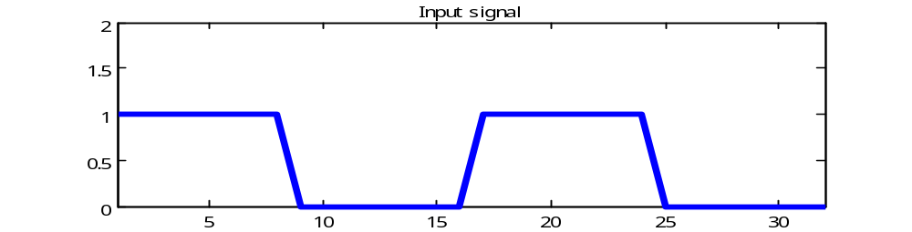
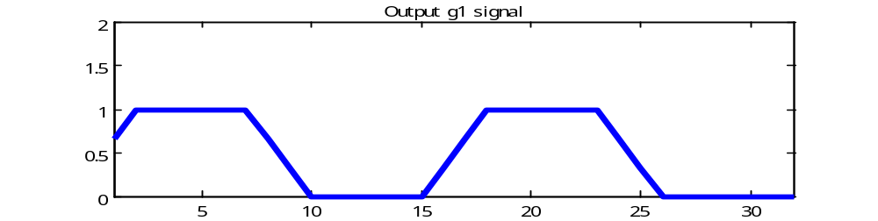
Example1:
f : Input signal
W is given by
g = f <conv> w
W = [ 1 1 1 ]/3
g : Output signal

Slide 4
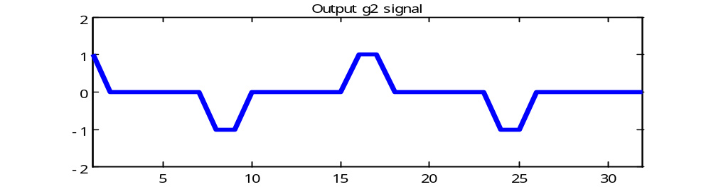
Example2:
f : Input signal
W is given by
g = f <conv> w
Edge detection mask
W = [ 1 0 -1 ]
g : Output signal

Slide 5
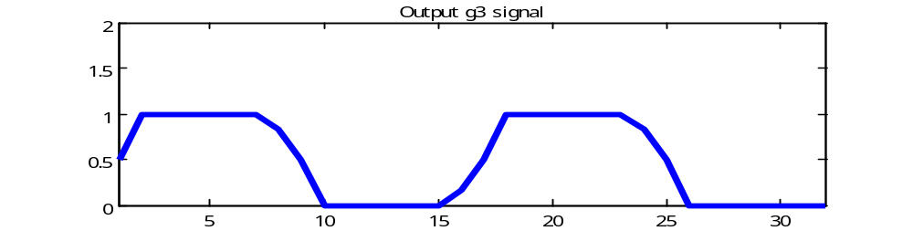
Example3:
f : Input signal
W is given by
g = f <conv> w
W = [ 1 2 3 ]
g : Output signal

Slide 6
How to calculate 1-D convolution
Example:
When f(x) and w(x) are given by [ 0 0 1 1 0 0 ] and [ 1 2 3 ], respectively,
the process of “f(x) <conv> w(x)” is shown below.

Slide 7
Illustration of one-dimensional convolution (1)
f(x)
0 0 1 1 0 0
w(x)
1 2 3
Initial position for w
0 0 0 1 1 0 0 0
Zero padding
The sum of products
0 - - - - -
0*3+0*2+0*1= 0
3 2 1
w after one shift
0 0 0 1 1 0 0 0
The sum of products
0 1 - - - -
0*3+0*2+1*1= 1
g = f <conv> w
(1) w is rotated.
(2) w shifts one by one.
(3) we can get the sum of products for every position.
3 2 1
w after two shifts
0 0 0 1 1 0 0 0
The sum of products
0 1 3 - - -
0*3+1*2+1*1= 3
3 2 1

Slide 8
Illustration of one-dimensional convolution (2)
w after three shifts
0 0 0 1 1 0 0 0
The sum of products
0 1 3 5 - -
1*3+1*2+0*1= 5
3 2 1
w after four shifts
0 0 0 1 1 0 0 0
The sum of products
0 1 3 5 3 -
1*3+0*2+0*1= 3
3 2 1
convolution
result
g(x)
0 1 3 5 3 0
w after five shifts
0 0 0 1 1 0 0 0
The sum of products
0 1 3 5 3 0
0*3+0*2+0*1= 0
3 2 1

Slide 9
⇒ Try Exercise.2-2

Slide 10
MATLAB program to execute the process of one-dimensional convolution (1)
>> f = [ 0 0 1 1 0 0 ] ;
>>X = length( f )
X =
6
>>f2 = zeros(1, X+2)
f2 =
0 0 0 0 0 0 0 0
You should check the following MATLAB functions, before building program.
Function length() gives the length of a vector.
Function zeros(M, N) generates an M x N matrix of 0s of class double.

Slide 11
MATLAB program to execute the process of one-dimensional convolution (2)
>> f2(1, 2:X+1) = f
f2 =
0 0 0 1 1 0 0 0
>> g2 = zeros(1, X+2)
g2 =
0 0 0 0 0 0 0 0
>> w = [ 1 2 3 ] ;
>> w2 = w(1, 3:-1:1)
w2 =
3 2 1

Slide 12
MATLAB program to execute the process of one-dimensional convolution (3)
>> gw = f2(2:4) .* w2
gw =
0 0 1
>>g2(3) = sum(gw(:))
g2 =
0 0 1 0 0 0 0 0
>> gw = f2(3:5) .* w2
gw =
0 2 1
>>g2(4) = sum(gw(:))
g2 =
0 0 1 3 0 0 0 0
Function sum() adds the value of all the elements of a vector. In this case, the following addition is done.
0+0+1 = 1
In this case, the following addition is done.
0+2+1 = 3

Slide 13
MATLAB program to execute the process
of one-dimensional convolution (4)
About M-files:
So-called M-files in MATLAB can be scripts that simply execute a series of MATLAB statements.
M-files are created using a text editor and are stored with a name of the form filename.m.
A function M-files has the form
function [ outputs ] = name( inputs )
We define a function named conv_1d( ) to compute one-dimensional convolution as follows:
function [ g ] = conv_1d( f, w )
where f is an input vector, w is a filter mask, and g is a filtered vector.

Slide 14
MATLAB program to execute the process
of one-dimensional convolution (5)
function [ g ] = conv_1d( f, w ) % the function definition
X = length(f) ;
f2 = zeros(1, X+2) ; % create zero array as f2
f2(2:X+1) = f ; % copy f to f2
g2 = zeros(1, X+2) ; % create output matrix
w2 = w(3: -1 :1) ; % rotate w by 180 dgree
for n = 2:X+1
s = f2(n-1:n+1) .* w2 ;
g2(n) = sum(s(:)) ;
end
g = g2(2:X+1) ;
end
To calculate the sum of products

Slide 15
MATLAB program to execute the process
of one-dimensional convolution (6)
>> f = [0 0 1 1 0 0]
f =
0 0 1 1 0 0
>> w = [1 2 3 ]
w =
1 2 3
>>g = conv_1d(f, w)
g =
0 1 3 5 3 0
A result of execution of the function g=conv_1d(f, w )

Slide 16
2.2 two-dimensional convolution
g(y, x) = f(y, x) <conv> w(y, x)
The process of convolution consists of
(1) defining a center point, (y, x);
(2) performing an operation that involves only the pixels in a predefined neighborhood about that center point;
(3) letting the result of that operation be the “response” of the process at that point;
(4) repeating the process for every point in the image.
Orign
g(y, x)
x
w(y, x)
Image f(y, x)
y

Slide 17
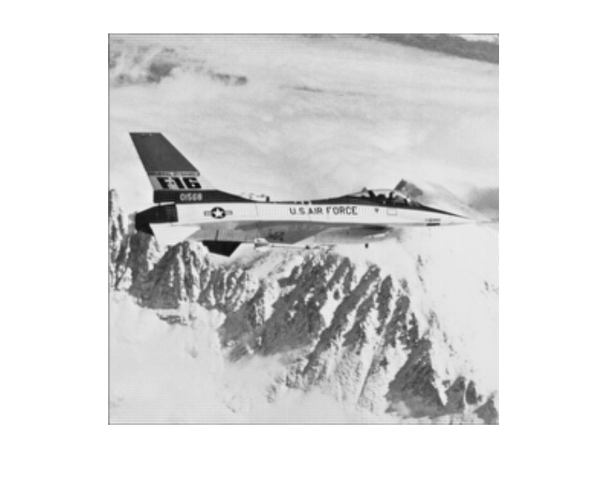
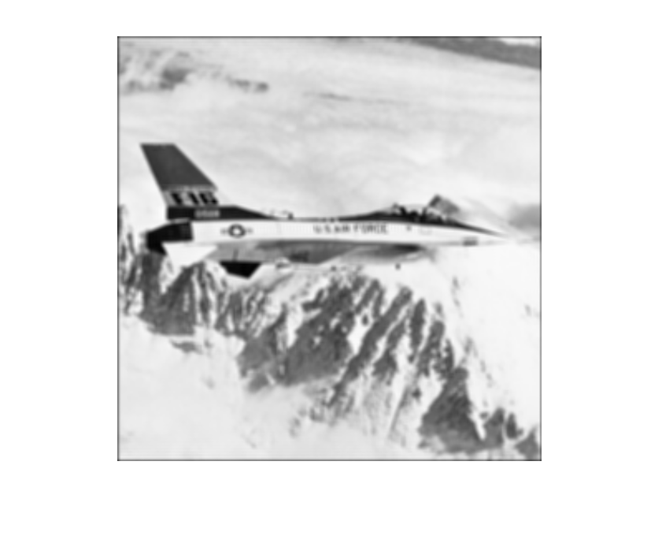
Example1:
W is given by
W = [ 1 1 1 ;
1 1 1 ;
1 1 1 ]/9
g = f <conv> w
f : Input image
g : Output image

Slide 18
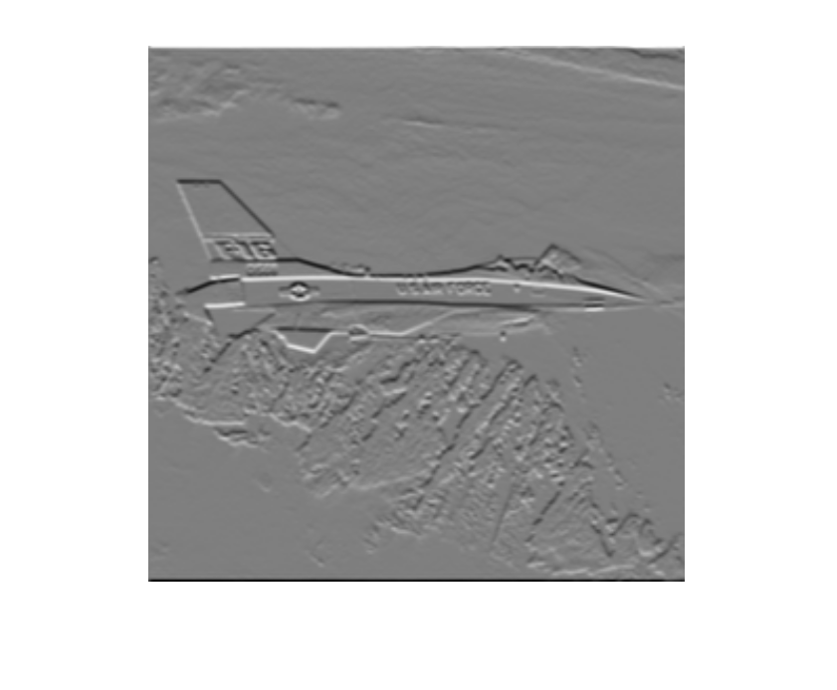
Example2:
W is given by
W = [ -1 -2 -1 ;
0 0 0 ;
1 2 1 ]
g = f <conv> w
f : Input image
g : Output image

Slide 19
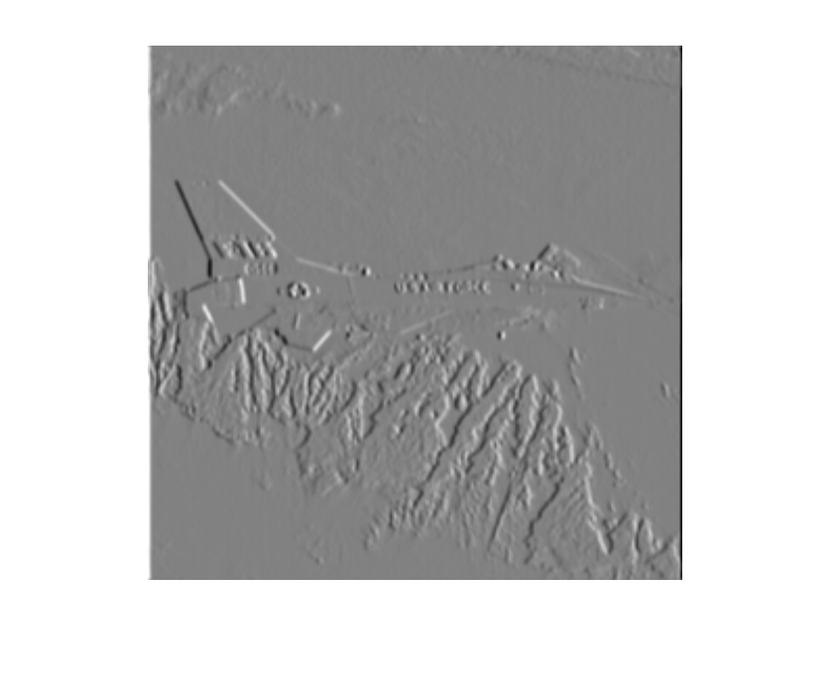
Example3:
W is given by
W = [ -1 0 1 ;
-2 0 2 ;
-1 0 1 ]
g = f <conv> w
f : Original image
g : Filtered image

Slide 20
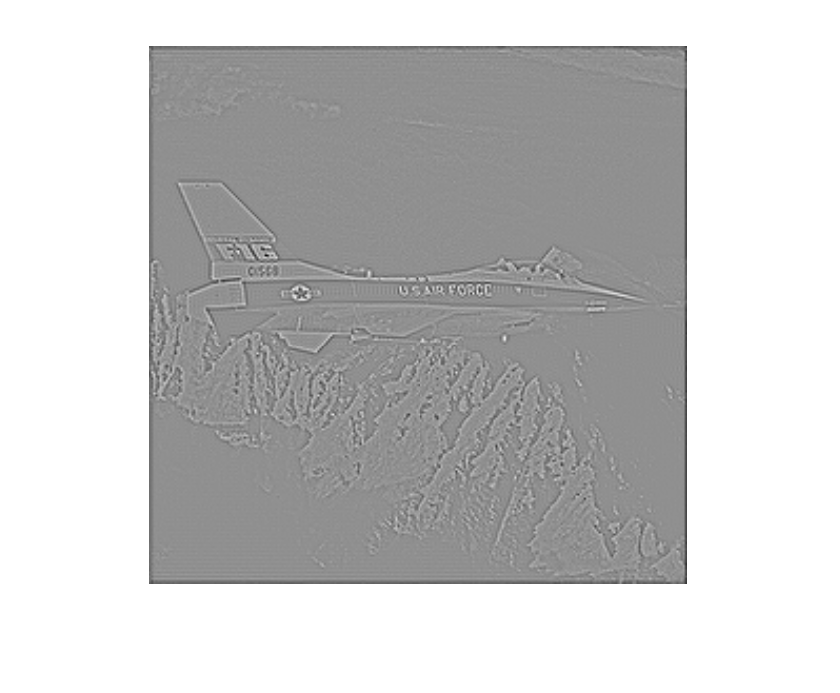
Example4:
W is given by
W = [ 0 1 0 ;
1 -4 1 ;
0 1 0 ]
g = f <conv> w
f : Input image
g : Output image

Slide 21
Illustration of two-dimensional convolution
This example shows the filter mask w is given by 3x3.
At each point (y,x), the sum of products of the mask coefficients and the corresponding neighborhood pixels is calculated. The sum of products is given as g(y, x) of output image.
image f(y, x)
Pixels of image section
under mask
f(y-1, x-1) | f(y-1, x) | f(y-1,x+1)
f(y, x-1) | f(y, x) | f(y, x+1)
f(y+1,x-1) | f(y+1,x-1) | f(y+1,x-1)
w(-1, -1) | w(-1, 0) | w(-1, +1)
w(0, -1) | w(0, 0) | w(0, +1)
w(+1, -1) | w(+1, 0) | w(+1, +1)
Mask
coefficients
g(y, x) : the sum of products

Slide 22
The process of two-dimensional convolution: g = f <conv> w (1)
f(y, x) w(y, x)
0 0 0 0 0 1 2 3
0 0 0 0 0 4 5 6
0 0 1 0 0 7 8 9
0 0 0 0 0
0 0 0 0 0
Initial position for w
0 0 0 0 0 0 0
0 0 0 0 0 0 0
0 0 0 0 0 0 0
0 0 0 1 0 0 0
0 0 0 0 0 0 0
0 0 0 0 0 0 0
0 0 0 0 0 0 0
The sum of products
0 - - - -
- - - - -
- - - - -
- - - - -
- - - - -
9 8 7
6 5 4
3 2 1
position for w after 4 shifts
0 0 0 0 0 0 0
0 0 0 0 0 0 0
0 0 0 0 0 0 0
0 0 0 1 0 0 0
0 0 0 0 0 0 0
0 0 0 0 0 0 0
0 0 0 0 0 0 0
The sum of products
0 0 0 0 0
- - - - -
- - - - -
- - - - -
- - - - -
The filter mask w is rotated by 180 degree prior to passing it by f.

Slide 23
The process of two-dimensional convolution: g = f <conv> w (2)
f(y, x) w(y, x)
0 0 0 0 0 1 2 3
0 0 0 0 0 4 5 6
0 0 1 0 0 7 8 9
0 0 0 0 0
0 0 0 0 0
position for w after 5 shifts
0 0 0 0 0 0 0
0 0 0 0 0 0 0
0 0 0 0 0 0 0
0 0 0 1 0 0 0
0 0 0 0 0 0 0
0 0 0 0 0 0 0
0 0 0 0 0 0 0
The sum of products
0 0 0 0 0
0 - - - -
- - - - -
- - - - -
- - - - -
9 8 7
6 5 4
3 2 1
Position for w after 6 shifts
0 0 0 0 0 0 0
0 0 0 0 0 0 0
0 0 0 0 0 0 0
0 0 0 1 0 0 0
0 0 0 0 0 0 0
0 0 0 0 0 0 0
0 0 0 0 0 0 0
The sum of products
0 0 0 0 0
0 1 - - -
- - - - -
- - - - -
- - - - -
The sum of products:
0*9+0*8+0*7
+ 0*6+0*5+0*4
+ 0*3+0*2+1*1 = 1

Slide 24
The process of two-dimensional convolution: g = f <conv> w (3)
f(y, x) w(y, x)
0 0 0 0 0 1 2 3
0 0 0 0 0 4 5 6
0 0 1 0 0 7 8 9
0 0 0 0 0
0 0 0 0 0
position for w after 7shifts
0 0 0 0 0 0 0
0 0 0 0 0 0 0
0 0 0 0 0 0 0
0 0 0 1 0 0 0
0 0 0 0 0 0 0
0 0 0 0 0 0 0
0 0 0 0 0 0 0
The sum of products
0 0 0 0 0
0 1 2 - -
- - - - -
- - - - -
- - - - -
9 8 7
6 5 4
3 2 1
position for w after 8 shifts
0 0 0 0 0 0 0
0 0 0 0 0 0 0
0 0 0 0 0 0 0
0 0 0 1 0 0 0
0 0 0 0 0 0 0
0 0 0 0 0 0 0
0 0 0 0 0 0 0
The sum of products
0 0 0 0 0
0 1 2 3 -
- - - - -
- - - - -
- - - - -
The sum of products:
0*9+0*8+0*7
+ 0*6+0*5+0*4
+ 1*3+0*2+0*1 = 3

Slide 25
The process of two-dimensional convolution: g = f <conv> w (4)
f(y, x) w(y, x)
0 0 0 0 0 1 2 3
0 0 0 0 0 4 5 6
0 0 1 0 0 7 8 9
0 0 0 0 0
0 0 0 0 0
position for w after 9 shifts
0 0 0 0 0 0 0
0 0 0 0 0 0 0
0 0 0 0 0 0 0
0 0 0 1 0 0 0
0 0 0 0 0 0 0
0 0 0 0 0 0 0
0 0 0 0 0 0 0
The sum of products
0 0 0 0 0
0 1 2 3 0
- - - - -
- - - - -
- - - - -
9 8 7
6 5 4
3 2 1
position for w after 10shifts
0 0 0 0 0 0 0
0 0 0 0 0 0 0
0 0 0 0 0 0 0
0 0 0 1 0 0 0
0 0 0 0 0 0 0
0 0 0 0 0 0 0
0 0 0 0 0 0 0
The sum of products
0 0 0 0 0
0 1 2 3 0
0 - - - -
- - - - -
- - - - -

Slide 26
The process of two-dimensional convolution: g = f <conv> w (5)
f(y, x) w(y, x)
0 0 0 0 0 1 2 3
0 0 0 0 0 4 5 6
0 0 1 0 0 7 8 9
0 0 0 0 0
0 0 0 0 0
position for w after 11 shifts
0 0 0 0 0 0 0
0 0 0 0 0 0 0
0 0 0 0 0 0 0
0 0 0 1 0 0 0
0 0 0 0 0 0 0
0 0 0 0 0 0 0
0 0 0 0 0 0 0
The sum of products
0 0 0 0 0
0 1 2 3 0
0 4 - - -
- - - - -
- - - - -
9 8 7
6 5 4
3 2 1
position for w after 12 shifts
0 0 0 0 0 0 0
0 0 0 0 0 0 0
0 0 0 0 0 0 0
0 0 0 1 0 0 0
0 0 0 0 0 0 0
0 0 0 0 0 0 0
0 0 0 0 0 0 0
The sum of products
0 0 0 0 0
0 1 2 3 0
0 4 5 - -
- - - - -
- - - - -

Slide 27
The process of two-dimensional convolution: g = f <conv> w (6)
f(y, x) w(y, x)
0 0 0 0 0 1 2 3
0 0 0 0 0 4 5 6
0 0 1 0 0 7 8 9
0 0 0 0 0
0 0 0 0 0
position for w after 13 shifts
0 0 0 0 0 0 0
0 0 0 0 0 0 0
0 0 0 0 0 0 0
0 0 0 1 0 0 0
0 0 0 0 0 0 0
0 0 0 0 0 0 0
0 0 0 0 0 0 0
The sum of products
0 0 0 0 0
0 1 2 3 0
0 4 5 6 -
- - - - -
- - - - -
9 8 7
6 5 4
3 2 1
position for w after 14 shifts
0 0 0 0 0 0 0
0 0 0 0 0 0 0
0 0 0 0 0 0 0
0 0 0 1 0 0 0
0 0 0 0 0 0 0
0 0 0 0 0 0 0
0 0 0 0 0 0 0
The sum of products
0 0 0 0 0
0 1 2 3 0
0 4 5 6 0
- - - - -
- - - - -

Slide 28
The process of two-dimensional convolution: g = f <conv> w (7)
f(y, x) w(y, x)
0 0 0 0 0 1 2 3
0 0 0 0 0 4 5 6
0 0 1 0 0 7 8 9
0 0 0 0 0
0 0 0 0 0
position for w after 15 shifts
0 0 0 0 0 0 0
0 0 0 0 0 0 0
0 0 0 0 0 0 0
0 0 0 1 0 0 0
0 0 0 0 0 0 0
0 0 0 0 0 0 0
0 0 0 0 0 0 0
The sum of products
0 0 0 0 0
0 1 2 3 0
0 4 5 6 0
0 - - - -
- - - - -
9 8 7
6 5 4
3 2 1
position for w after 16 shifts
0 0 0 0 0 0 0
0 0 0 0 0 0 0
0 0 0 0 0 0 0
0 0 0 1 0 0 0
0 0 0 0 0 0 0
0 0 0 0 0 0 0
0 0 0 0 0 0 0
The sum of products
0 0 0 0 0
0 1 2 3 0
0 4 5 6 0
0 7 - - -
- - - - -

Slide 29
The process of two-dimensional convolution: g = f <conv> w (8)
f(y, x) w(y, x)
0 0 0 0 0 1 2 3
0 0 0 0 0 4 5 6
0 0 1 0 0 7 8 9
0 0 0 0 0
0 0 0 0 0
position for w after 17 shifts
0 0 0 0 0 0 0
0 0 0 0 0 0 0
0 0 0 0 0 0 0
0 0 0 1 0 0 0
0 0 0 0 0 0 0
0 0 0 0 0 0 0
0 0 0 0 0 0 0
The sum of products
0 0 0 0 0
0 1 2 3 0
0 4 5 6 0
0 7 8 - -
- - - - -
9 8 7
6 5 4
3 2 1
position for w after 18 shifts
0 0 0 0 0 0 0
0 0 0 0 0 0 0
0 0 0 0 0 0 0
0 0 0 1 0 0 0
0 0 0 0 0 0 0
0 0 0 0 0 0 0
0 0 0 0 0 0 0
The sum of products
0 0 0 0 0
0 1 2 3 0
0 4 5 6 0
0 7 8 9 -
- - - - -

Slide 30
The process of two-dimensional convolution: g = f <conv> w (9)
f(y, x) w(y, x)
0 0 0 0 0 1 2 3
0 0 0 0 0 4 5 6
0 0 1 0 0 7 8 9
0 0 0 0 0
0 0 0 0 0
position for w after 19 shifts
0 0 0 0 0 0 0
0 0 0 0 0 0 0
0 0 0 0 0 0 0
0 0 0 1 0 0 0
0 0 0 0 0 0 0
0 0 0 0 0 0 0
0 0 0 0 0 0 0
The sum of products
0 0 0 0 0
0 1 2 3 0
0 4 5 6 0
0 7 8 9 0
- - - - -
9 8 7
6 5 4
3 2 1
position for w after 20 shifts
0 0 0 0 0 0 0
0 0 0 0 0 0 0
0 0 0 0 0 0 0
0 0 0 1 0 0 0
0 0 0 0 0 0 0
0 0 0 0 0 0 0
0 0 0 0 0 0 0
The sum of products
0 0 0 0 0
0 1 2 3 0
0 4 5 6 7
0 7 8 9 0
0 - - - -

Slide 31
The process of two-dimensional convolution: g = f <conv> w (10)
f(y, x) w(y, x)
0 0 0 0 0 1 2 3
0 0 0 0 0 4 5 6
0 0 1 0 0 7 8 9
0 0 0 0 0
0 0 0 0 0
position for w after 21 shifts
0 0 0 0 0 0 0
0 0 0 0 0 0 0
0 0 0 0 0 0 0
0 0 0 1 0 0 0
0 0 0 0 0 0 0
0 0 0 0 0 0 0
0 0 0 0 0 0 0
The sum of products
0 0 0 0 0
0 1 2 3 0
0 4 5 6 0
0 7 8 9 0
0 0 - - -
9 8 7
6 5 4
3 2 1
position for w after 24 shifts (Final )
0 0 0 0 0 0 0
0 0 0 0 0 0 0
0 0 0 0 0 0 0
0 0 0 1 0 0 0
0 0 0 0 0 0 0
0 0 0 0 0 0 0
0 0 0 0 0 0 0
The sum of products
0 0 0 0 0
0 1 2 3 0
0 4 5 6 7
0 7 8 9 0
0 0 0 0 0

Slide 32
⇒ Try Ex.2-3

Slide 33
MATLAB program to execute the process
of two-dimensional convolution (1)
function [ g ] = conv_2d( f, w ) % the function definition
[Y, X] = size(f) ;
f2 = zeros(Y+2, X+2) ; % create zero array as f2
f2(2:Y+1, 2:X+1) = f ; % copy f to f2
g2 = zeros(Y+2, X+2) ; % create output matrix
w2 = w(3: -1: 1, 3: -1 :1) ; % rotate w by 180 dgree
for ny = 2:Y+1
for nx = 2:X+1
gw = f2(ny-1:ny+1, nx-1:nx+1) .* w2 ;
g2(ny ,nx) = sum(gw(:)) ;
end
end
g = g2(2:Y+1, 2:X+1) ;
end
To calculate the sum of products

Slide 34
MATLAB program to execute the process
of two-dimensional convolution (2)
>> f = [0 0 0 0 0; 0 0 0 0 0; 0 0 1 0 0; 0 0 0 0 0; 0 0 0 0 0]
>> w = [1 2 3; 4 5 6; 7 8 9 ]
w =
1 2 3
4 5 6
7 8 9
>>g = conv_2d(f, w)
g =
0 0 0 0 0
0 1 2 3 0
0 4 5 6 0
0 7 8 9 0
0 0 0 0 0
A result of execution of the function g=conv_2d( f, w )

Slide 35
⇒ Try Ex.2-4
⇒ Try Ex.2-5

Slide 36
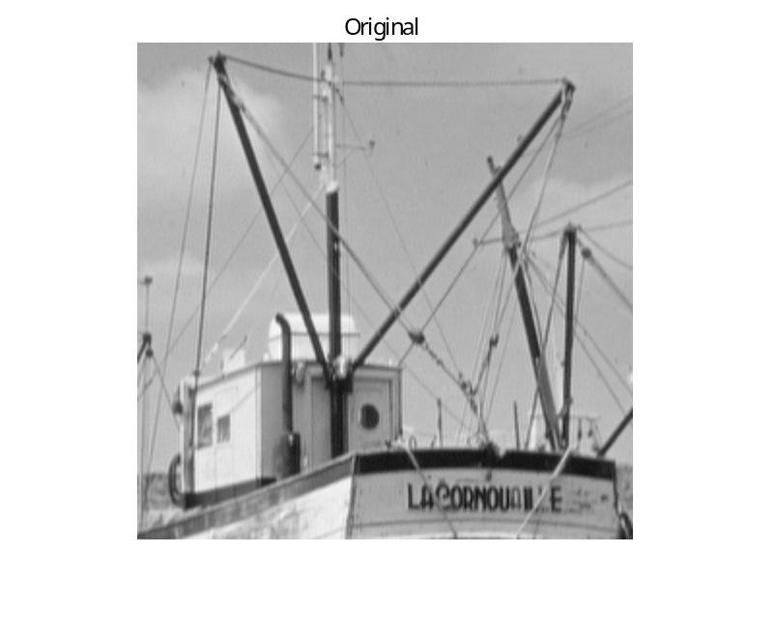
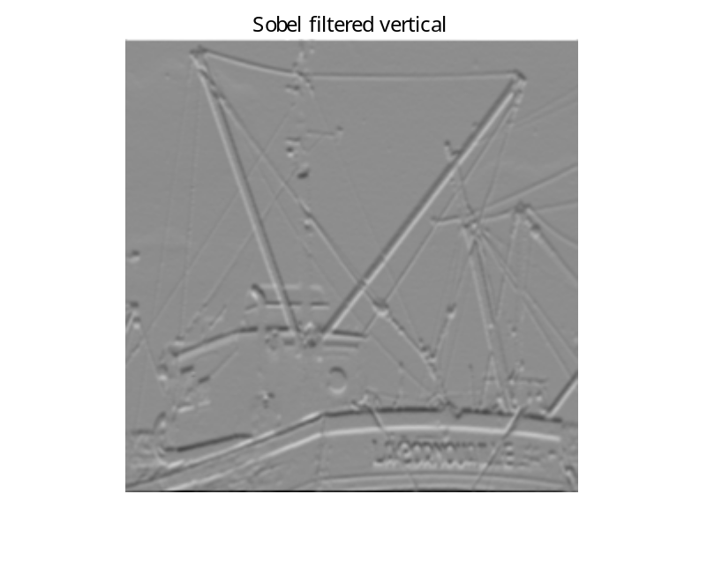
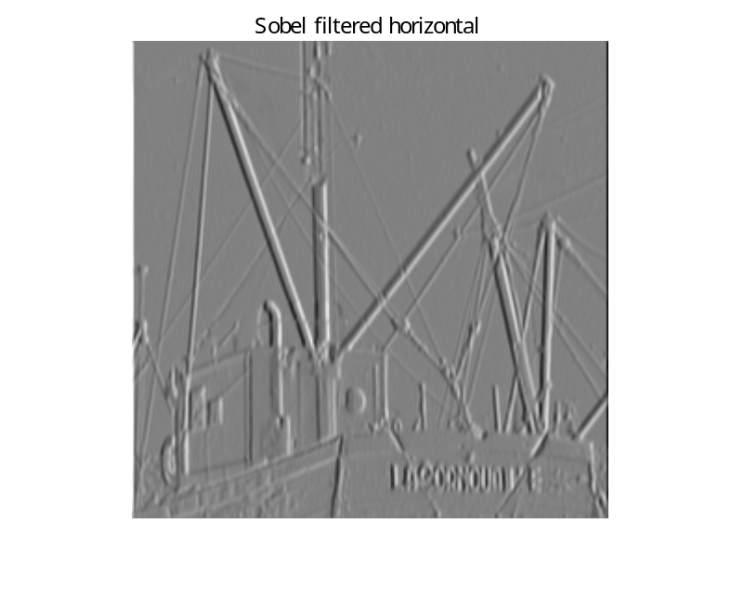
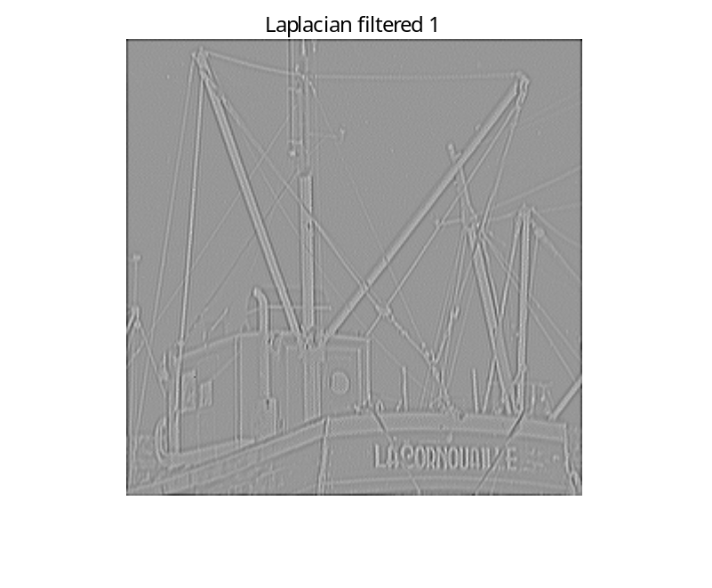
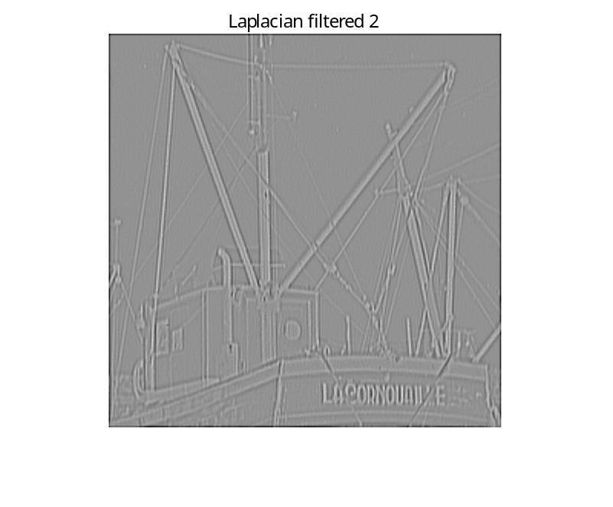
Results of Sobel filtering

Slide 37
Meaning of Mean filter mask
Exercise 2.5 (1)
〇Mean filter mask
w3 = [ 1 1 1
1 1 1
1 1 1 ] / 9
In this case the eq. of convolution can be represented by
g(y, x) = f(y, x) <conv> w3(y, x)
= (z₁ + z₂ + z₃ +z₄ + z₅ + z₆ + z₇ + z₈ + z₉ ) / 9
An output image pixel value g(y, x) is given as the mean value of 9 neighborhood pixels centered at f(y, x).
[ z₁ z₂ z₃
z₄ z₅ z₆
z₇ z₈ z₉ ]
f(y, x)

Slide 38
Meaning of Sobel filter mask (vertical)
Exercise 2.5 (5)
〇 Sobel filter mask
wSv = [ -1 -2 -1
0 0 0
1 2 1 ]
In this case the eq. of convolution can be represented by
g(y, x) = f(y, x) <conv> wSv(y, x)
= (z₁ + 2*z₂ + z₃ )
- (z₇ + 2*z₈ + z₉ )
It approximates digitally the vertical first-order derivatives. In other words, the vertical gradient at the center point in a neighborhood is computed.
[ z₁ z₂ z₃
z₄ z₅ z₆
z₇ z₈ z₉ ]
f(y, x)

Slide 39
Meaning of Sobel filter mask (horizontal)
Exercise 2.5 (6)
〇 Sobel filter mask
wSh = [ -1 0 1
-2 0 2
-1 0 1 ]
In this case the eq. of convolution can be represented by
g(y, x) = f(y, x) <conv> wSh(y, x)
= (z₁ + 2*z₄ + z₇ )
- (z₃ + 2*z₆ + z₉ )
It approximates digitally the horizontal first-order derivatives. In other words, the horizontal gradient at the center point in a neighborhood is computed.
[ z₁ z₂ z₃
z₄ z₅ z₆
z₇ z₈ z₉ ]
f(y, x)

Slide 40
⇒ Try Ex.2-6

Slide 41
3x3 and 5×5 Mean filtering
Exercise 2.6 : MATLAB commands for Mean filtering
>> f=imread('lenna.bmp') ;
>> w3=ones(3,3)/9 ;
>> w5=ones(5,5)/25 ;
>>
>> g3=conv_2d(f,w3) ;
>> g5=conv_2d_55(f,w5) ;
>>
>> figure(1)
>> subplot(1,3,1), imshow(f,[ ]), title('Original Image')
>> subplot(1,3,2), imshow(g3,[ ]), title('3x3 mean filtered')
>> subplot(1,3,3), imshow(g5,[ ]), title('5x5 mean filtered')
>>

Slide 42
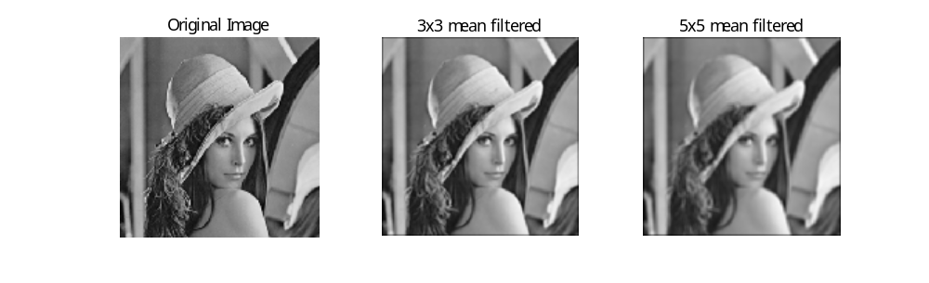
Results of Mean filtering (3x3 and 5x5)

Slide 43
3x3 Median filtering
Exercise 2.7 : MATLAB commands for Median filtering
>> f=imread('lenna.bmp') ;
>> fn=imnoise(f, 'salt & pepper', 0.2) ;
>> figure(2),imshow(fn,[ ]), title('Image corrupted by noise')
>> fout=median_2d(fn) ;
>> figure(3), imshow(fout,[ ]), title('Result of median filtering')
>> figure(4), imshow(f,[ ]), title('Original image')
>>

Slide 44
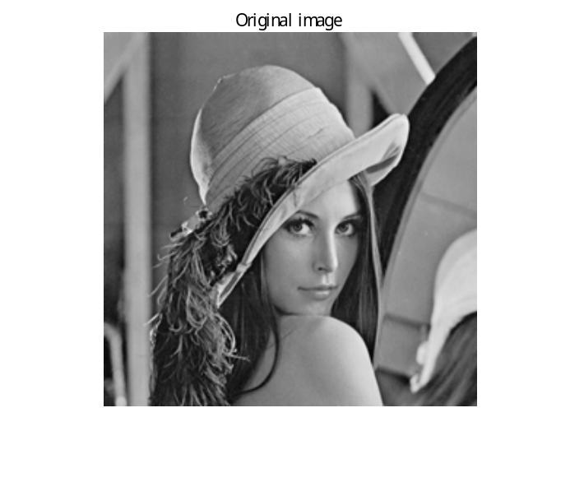

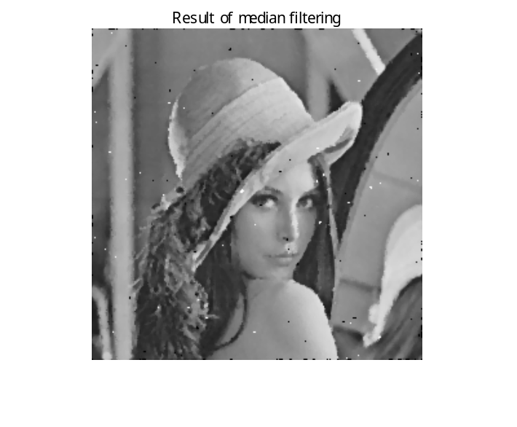
Result of Mean filtering
Median filtering is a useful tool for reducing salt-and-pepper noise in an image.

Slide 45
Conclusion
Filtering is performed by the convolution described by the equation
where f(y, x) is an input image, g(y, x) is a filtered image, and w(y,x) is called a filter mask. And the notation <conv> denotes the convolution.
g(y, x) = f(y, x) <conv> w(y, x)
This operation is performed directly on the pixels of an image. We call it filtering in the spatial domain. You will also learn filtering in the frequency domain later.
Note: There is another concept closely related to convolution. It is correlation. Convolution is the same process as correlation, except that mask w is rotated by 180 degree.

