Slide 1
Ⅱ. Mathmatical background
one-dimensional Discrete Fourier Transform
signals in the spatial domain and in the frequency domain

Slide 2
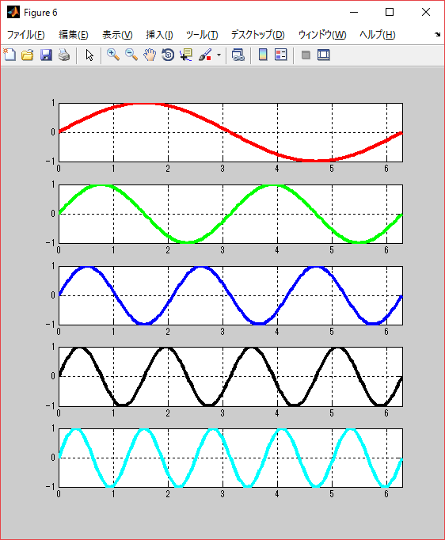
Basic concepts: signals in the spatial/time domain and in the frequency domain
frequency
Sin x
Sin 2x
Sin 3x
Sin 4x
Sin 5x
Lower frequency
1 Hertz
2 Hertz
3 Hertz
4 Hertz
5 Hertz
Higher frequency
1 second (time)

Slide 3
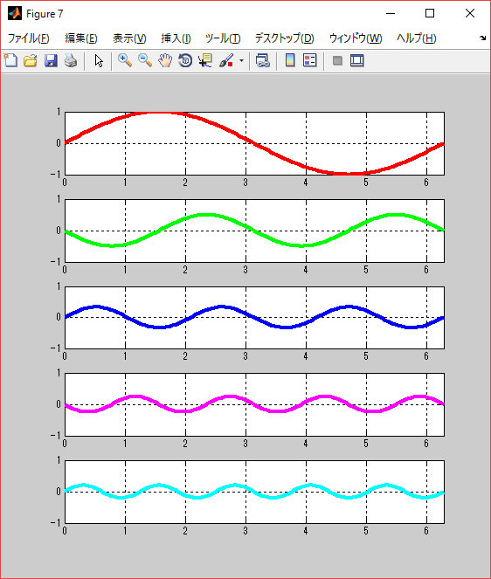
Spatial/time Domain
Frequency Domain
1.0
Sin x
-(1/2)Sin 2x
(1/3)Sin 3x
-(1/4)Sin 4x
(1/5)Sin 5x
1 2 3 4 5
f
0.5
1 2 3 4 5
f
0.33
1 2 3 4 5
f
0.25
1 2 3 4 5
f
0.2
Space, time
1 2 3 4 5
f

Slide 4
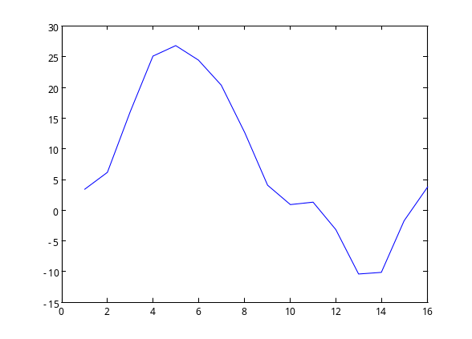
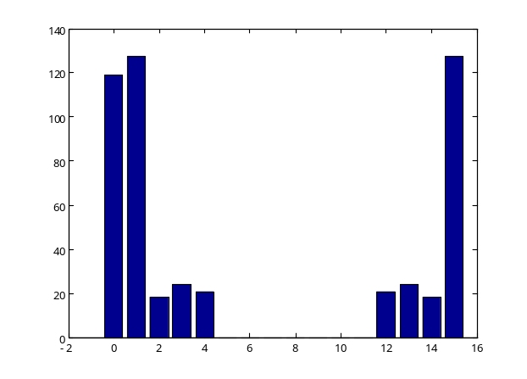
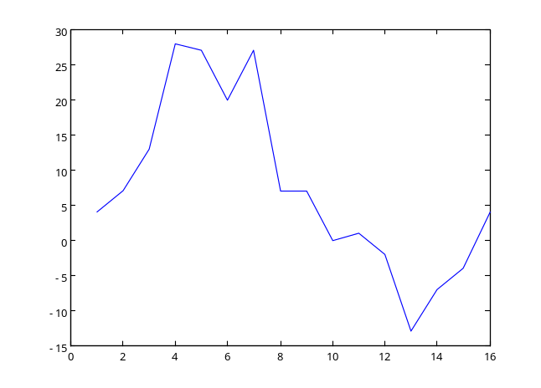
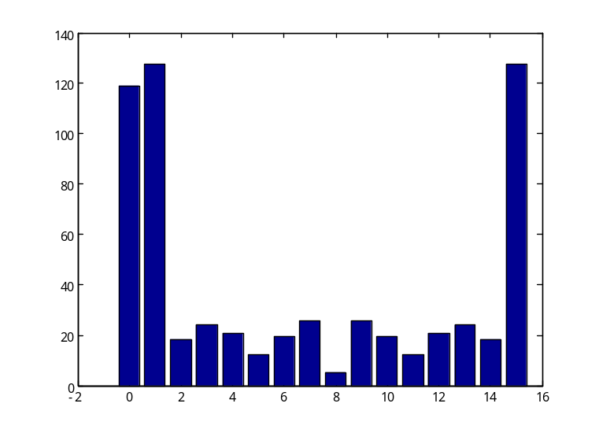
signals in the spatial/time domain and in the frequency domain
Spatial /time Domain
Frequency Domain
DFT
I DFT
DFT
I DFT
This signal contains higher frequency components.
High frequency components

Slide 5



Images in the spatial domain and in the frequency domain
Spatial Domain
Frequency Domain
DFT
0 1 2 3 4
f h
I DFT
f v
DFT
0 1 2 3 4
f h
I DFT
f v
DFT
Higher frequency
0 1 2 3 4
f h
I DFT
f v

Slide 6
3.1 The one-Dimensional Discrete Fourier Transform
The 1-D Discrete Fourier Transform ( DFT ) of f(x), denoted by F(u), is given by the equation
F(u) = Σ f (x)×W^{-ux}
N-1
(3.1)
x = 0
where W = exp(i2π/N) and u, x =0,1,2, . . . , N-1.
The 1-D inverse Discrete Fourier Transform ( IDFT ) of F(u), is given by the equation
N-1
f (x) = Σ F(u)× W^{ux}
1
(3.2)
N
u = 0
where W = exp(i2π/N) and u, x =0,1,2, . . . , N-1.

Slide 7
Euler’s theorem
exp(iθ) = cos θ + i sin θ
For example, if N is given as 4, we can get the values of W, W ⁻¹ , W ⁻² and W ⁻³ as
W = exp(i2π/N) = exp(i2π/4) = exp(iπ/2)
= cos(π/2)+ i sin (π/2) = 0 + 1* i = i
W ⁻¹ = exp(-i2π/N) = exp(-i2π/4) = exp(-iπ/2)
= cos(-π/2)+ i sin (-π/2) = 0 +(-1)* i = -i
W ⁻² = W ⁻¹⁻¹ = W ⁻¹ * W ⁻¹ = (-i) * (-i) = i * i = -1
W ⁻³ = W ⁻²⁻¹ = W ⁻² * W ⁻¹ = (-1) * (-i) = i

Slide 8
For example, if N is given as 8, we can get the value of W as
W = exp(i2π/N) = exp(i2π/8) = exp(iπ/4)
= cos(π/4)+ i sin (π/4) = 1/sqrt(2) + i 1/sqrt(2)
W ⁻¹ = exp(-i2π/N) = exp(-i2π/8) = exp(-iπ/4)
= cos(-π/4)+ i sin (-π/4) = 1/sqrt(2) - i 1/sqrt(2)
Therefore, we can get the result as
W ⁻¹ = W
where W denotes the complex conjugate of W.

Slide 9
⇒ Try Exercise. 3-1
⇒ Try Exercise. 3-2

Slide 10
How to calculate one-dimensional DFT
F(u) = Σ f (x)×W^{-ux}
N-1
x = 0
where W = exp(i2π/N) and u, x =0,1,2, . . . , N-1.
(3.3)
For simplicity, let N (the number of data) equal 4.
F(u) = Σ f (x)×W^{-ux}
3
x = 0
where W = exp(i2π/4) and u, x =0,1,2 and 3.
Let u = 0. Then,
F(0) = Σ f (x)×W^{-ux} = f (0) + f (1) + f (2) + f (3)
3
x = 0

Slide 11
Let u = 1.
F(1) = Σ f (x)×W^{-1x}
= f (0) W^{-1・0} + f (1) W^{-1・1} + f (2) W^{-1・2} + f (3) W^{-1・3}
3
x = 0
Let u = 2.
F(2) = Σ f (x)×W^{-2x}
= f (0) W^{-2・0} + f (1) W^{-2・1} + f (2) W^{-2・2} + f (3) W^{-2・3}
3
x = 0
Let u = 3.
F(3) = Σ f (x)×W^{-3x}
= f (0) W^{-3・0} + f (1) W^{-3・1} + f (2) W^{-3・2} + f (3) W^{-3・3}
3
x = 0

Slide 12
Using matrix form, the one-dimensional DFT can be expressed as follows.
F(0) W⁰ W⁰ W⁰ W⁰ f (0)
F(1) W⁰ W ⁻¹ W ⁻² W ⁻³ f (1)
F(2) W⁰ W ⁻² W ⁻⁴ W ⁻⁶ f (2)
F(3) W⁰ W ⁻³ W ⁻⁶ W ⁻⁹ f (3)
where W = exp(i2π/N) = exp(i2π/4) = i
＝

Slide 13


Let N=4.
f = [ f (0) f (1) f (2) f (3) ]
F = [ F(0) F(1) F(2) F(3) ]
IDFT
Let N=8.
f = [ f(0) f(1) f(2) f(3) f(4) f(5) f(6) f(7) ]
F = [ F(0) F(1) F(2) F(3) F(4) F(5) F(6) F(7) ]
IDFT

Slide 14
Note :
The values of F(u) are given as complex number.
They are referred to as the Fourier coefficients.
The magnitude of F(u) ( |F(u)| ) is called spectrum.
In mathematical equation in the above, array indices start 0. In MATLAB, they start 1 rather than 0.

Slide 15
⇒ Try Exercise. 3-3

Slide 16
An Example of MATLAB commands for 1-D DFT and IDFT
>> f = [ 7 28 16 20 10 14 -5 1 ] ;
>> figure(1), plot(f)
>> F=fft(f)
>> abs(F)
>> figure(2), bar( abs(F) )
>> g = ifft(F) ;
>> figure(3), plot(g)
function plot( )
function fft( ) : 1-D DFT
function abs( ) : absolute
function bar( ) : bar graph
function ifft( ) : 1-D Inverse DFT

Slide 17
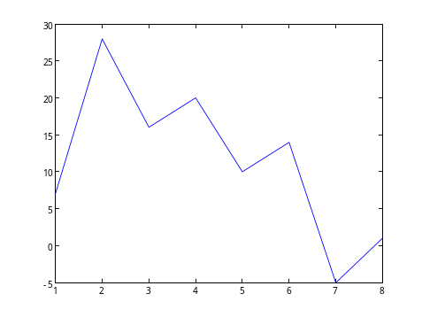
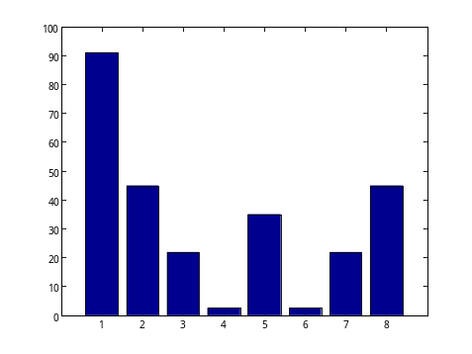
Results of the 1-D DFT and 1-D UDFT Execution
f = [ 7 28 16 20 10 14 -5 1 ]
DFT
F = fft ( f )
IDFT
f = ifft ( F )
F = [ 91 -6.5-44i 6.0-21i 0.54-2.3i
-35 0.54+2.3i 6.0+21i -6.5+44i ]
| F | = abs ( F )
| F | = [ 91 45 22 2.4 35 2.4 22 45 ]
figure, plot ( f )
figure, bar ( abs(F) )

Slide 18
Characteristics of the DFT (1)
Complex conjugate
F = [ 91 -6.5-44i 6.0-21i 0.54-2.3i
-35 0.54+2.3i 6.0+21i -6.5+44i ]
| F | = abs ( F )
Both absolute values are the same.
| F | = [ 91 45 22 2.4 35 2.4 22 45 ]

Slide 19
Characteristics of the DFT (2)
F(u) is conjugate symmetric about F(N/2).
F(u) = F(N-u)
Example. Let N = 8.
0 1 2 3 4 5 6 7
u
F(0)
F(1)
F(2)
F(3)
F(4)
F(5)
F(6)
F(7)
F(0) is equal to N times the average value of f(x), and called the dc (direct current) component.
complex conjugate

Slide 20
Fundamental Concepts for filtering in the frequency domain
Ｅｘａｍｐｌｅ １
A test data f is given. The number of elements, N=16.
f = 4 7 13 28 27 20 27 7 7 0 1 -2 -13 -7 -4 4
f(0) f(1) f(2) ・・・・・・・・・・・・ ・・・ f(15)
DFT
F is the DFT of f.
F(0) F(1) F(2)
F = 119 –11.59–126.89i –17.85+ 2.64i 9.19+22.17i
–12.00+17.00i 11.68+ 2.98i 11.85–15.36i –21.28+13.92i
5.00+ 0.00i –21.28–13.92i 11.85+15.36i 11.68– 2.98i
–12.00–17.00i 9.19–22.17i –17.85– 2.64i –11.59+126.89i
F(15)

Slide 21
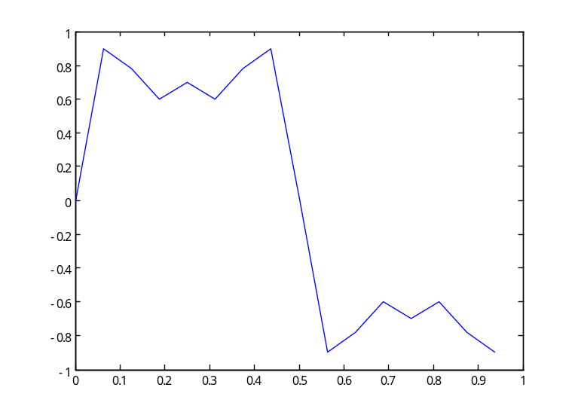
Absolute values of F are obtained as follows.
|F(0)| |F(1)| |F(2)|
| F | = 119 127.4 18.0 24.0 20.8 12.1 19.4 25.4
5.0 25.4 19.4 12.1 20.8 24.0 18.0 127.4
The graphs of Original test data f and its DFT absolute value | F | are displayed in the below.
f (1)
Spatial(time)Domain
Frequency Domain
f (x)
f (3)
|F(1)|
| F(u) |
|F(2)|
f (2)
|F(3)|
f (4)
|F(0)|
f (0)
x
u

Slide 22
Process for filtering in the frequency domain
Spatial /time Domain
Frequency Domain
| F |
F=fft(f) ;
DFT
figure(1), plot(f)
M = ones(1, 16)
M(6:12) = 0
F = F .*M
F(u)s in this region are removed.
| G |
g=ifft(G) ;
IDFT
figure(4), plot(g)

Slide 23
MATLAB commands for Filtering in the frequency domain
>> f=[ 4 7 13 28 27 20 27 7 7 0 1 -2 -13 -7 -4 4 ];
>> figure(1), plot(f)
>> F = fft(f) ; ← function fft( ) : 1-D DFT
>>
>> figure(2), bar( abs(F) )
>> M = ones(1,16)
>> M(6:12) = 0
>> G = F .* M ← Filtering in the frequency domain
>> figure(3), bar( abs(G) )
>> g = ifft(G) ← function ifft( ) : 1-D Inverse DFT
>> figure(4), plot(g) ← g is filtered data
← to make filter M

Slide 24
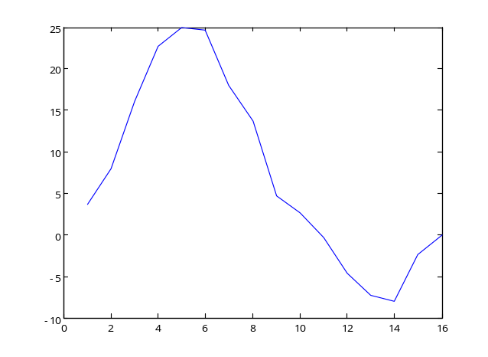
Review: Filtering in the spatial (time) domain
Spatial(time) Domain
Filtering in the spatial (time) domain operations are performed directly on the pixels of an image, for example, performed by the convolution.
test data f
w = [1 1 1 ]/3
g = conv_1d( f, w )
filtered data g of f

Slide 25
Review: MATLAB commands for Filtering in the spatial domain
>> load f
>> figure, plot(f)
>>
>> w3 = [ 1 1 1 ] /3
>> g3 = conv_1d( f, w ) ;
>>
>> figure, plot(g)
function [ g ] = conv_1d( f, w )
% 1-dimensional convolution
%
[Y, X] = size(f) ;
f2 = zeros(1, X+2) ;
f2(1, 2:X+1) = f ; % copy f to f2
g2 = zeros(1, X+2) ;
w2 = w(1, 3:-1:1) ;
for x = 2:X+1
s = f2(1, x-1:x+1) .* w2 ;
g2(1, x) = sum(s(:)) ;
end
g = g2(1, 2:X+1) ;
end
Filtering in the spatial(time) domain

Slide 26
⇒ Try Exercise. 3-4

