Slide 1
Basic Operations in MATLAB for Constructing Neural Network
Day 1

Slide 2
MATLAB Programming
MATLAB (MATrix LABoratory) stands for matrix (i.e., two-dimensional array) laboratory.
MATLAB is a high-performance language for technical computing, and an array-oriented language.
Calculations when constructing or using a neural network are almost represented by matrix operations.
We will use MATLAB in this course to implement neural network model and cultivate a better understanding with several exercises.

Slide 3
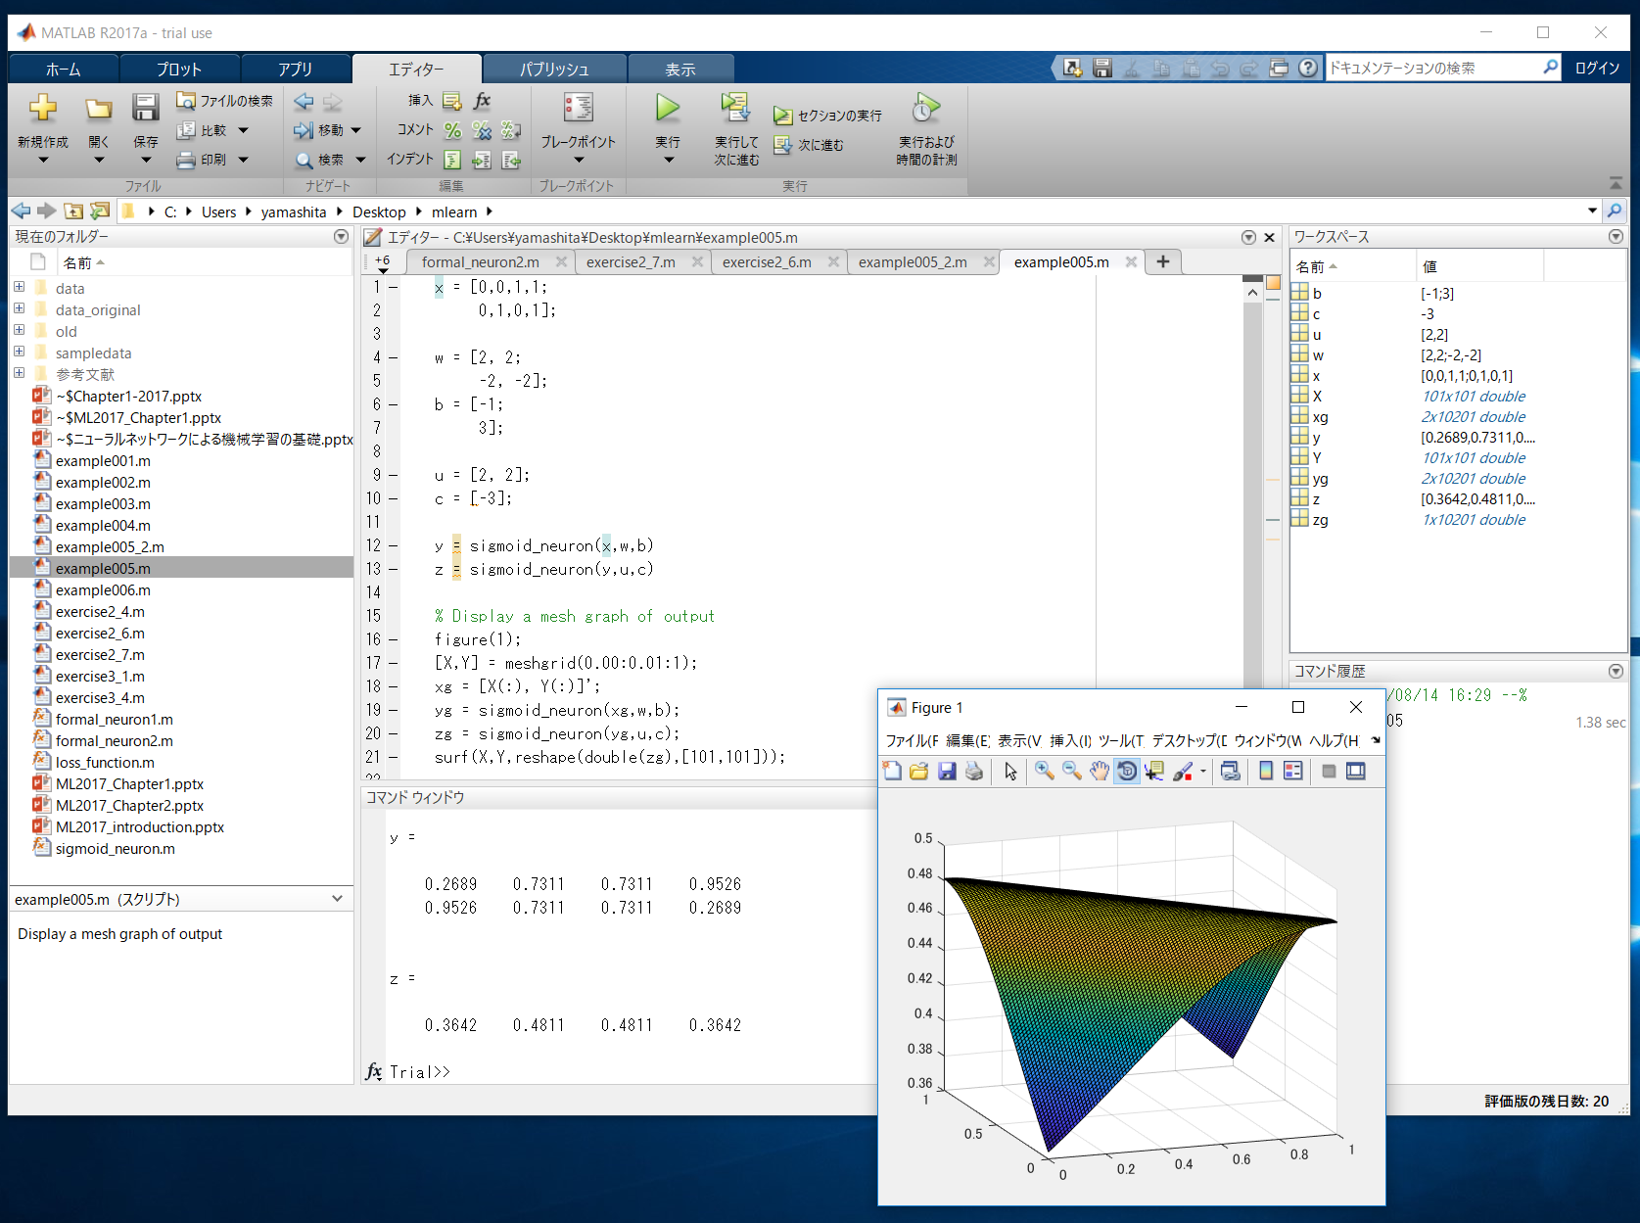
The MATLAB desktop and its principal components
Editor Window
Workspace Browser
Current Directory
Command
History
Command Window
Figure Window

Slide 4

We can use GNU Octave instead of MATLAB for FREE
MATLAB environment is very powerful and useful but EXPENSIVE.
https://www.gnu.org/software/octave/
GNU Octave is a high-level language, primarily intended for numerical computations. It provides a convenient command line interface for solving linear and nonlinear problems numerically, and for performing other numerical experiments using a language that is mostly compatible with Matlab. It may also be used as a batch-oriented language.
Octave has extensive tools for solving common numerical linear algebra problems, finding the roots of nonlinear equations, integrating ordinary functions, manipulating polynomials, and integrating ordinary differential and differential-algebraic equations. It is easily extensible and customizable via user-defined functions written in Octave’s own language, or using dynamically loaded modules written in C++, C, Fortran, or other languages. [from official website]
You can use octave to do exercises on your own computer.

Slide 5

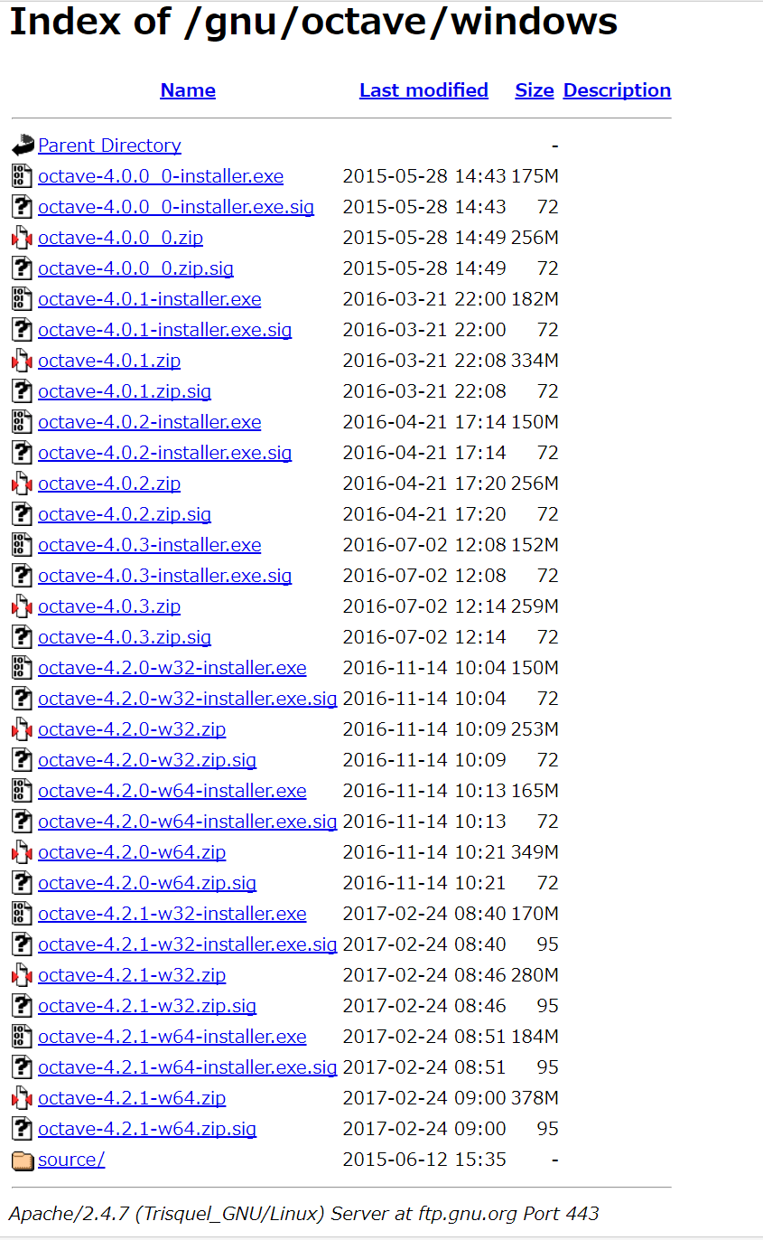
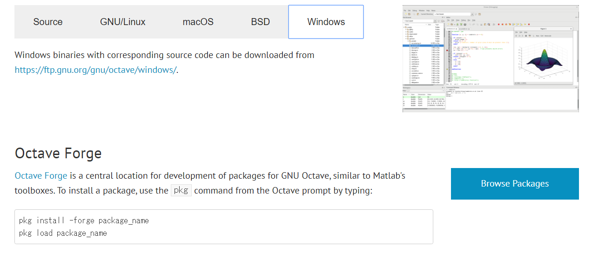
【Appendix】 How to install Octave
Download from https://www.gnu.org/software/octave/
Following installation procedure is for Windows, however we can install on MAC or Linux.
The latest version is 4.2.1 (As of July 2017)

Slide 6
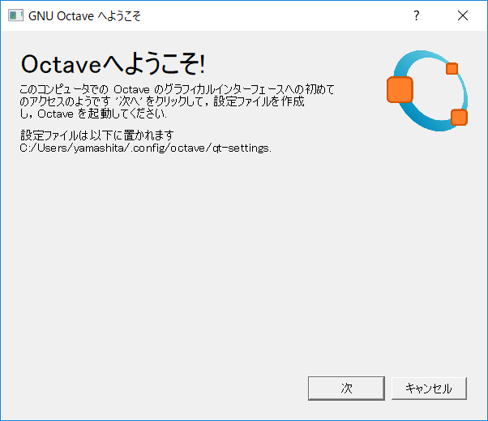
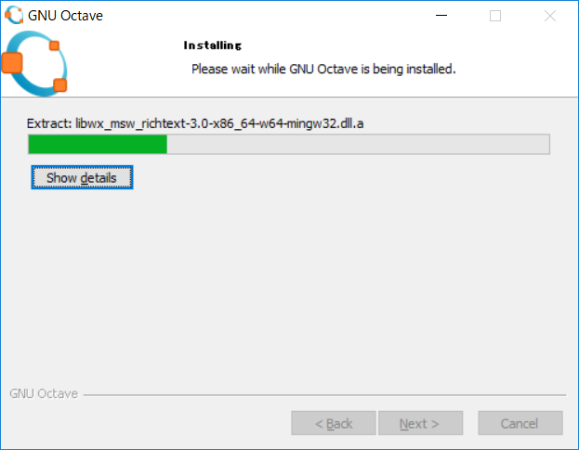
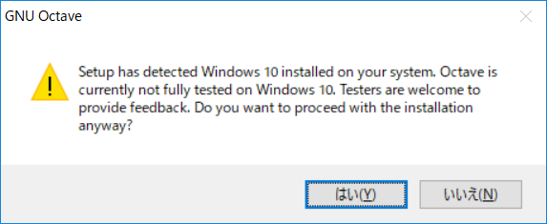
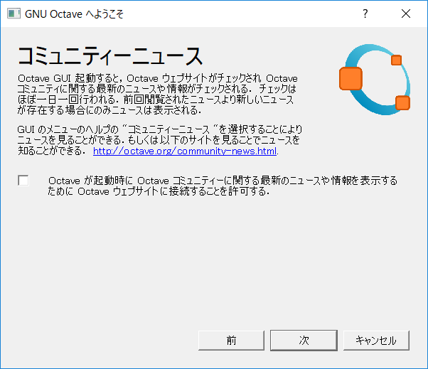
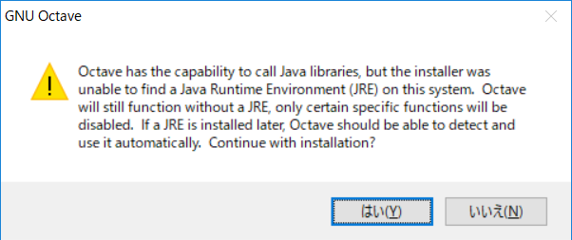
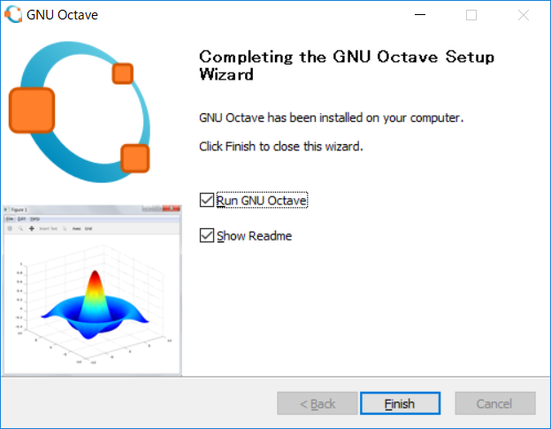


【Appendix】 Installation procedure of Octave
Execute octave-x.x.x-w64-installer.exe

Slide 7
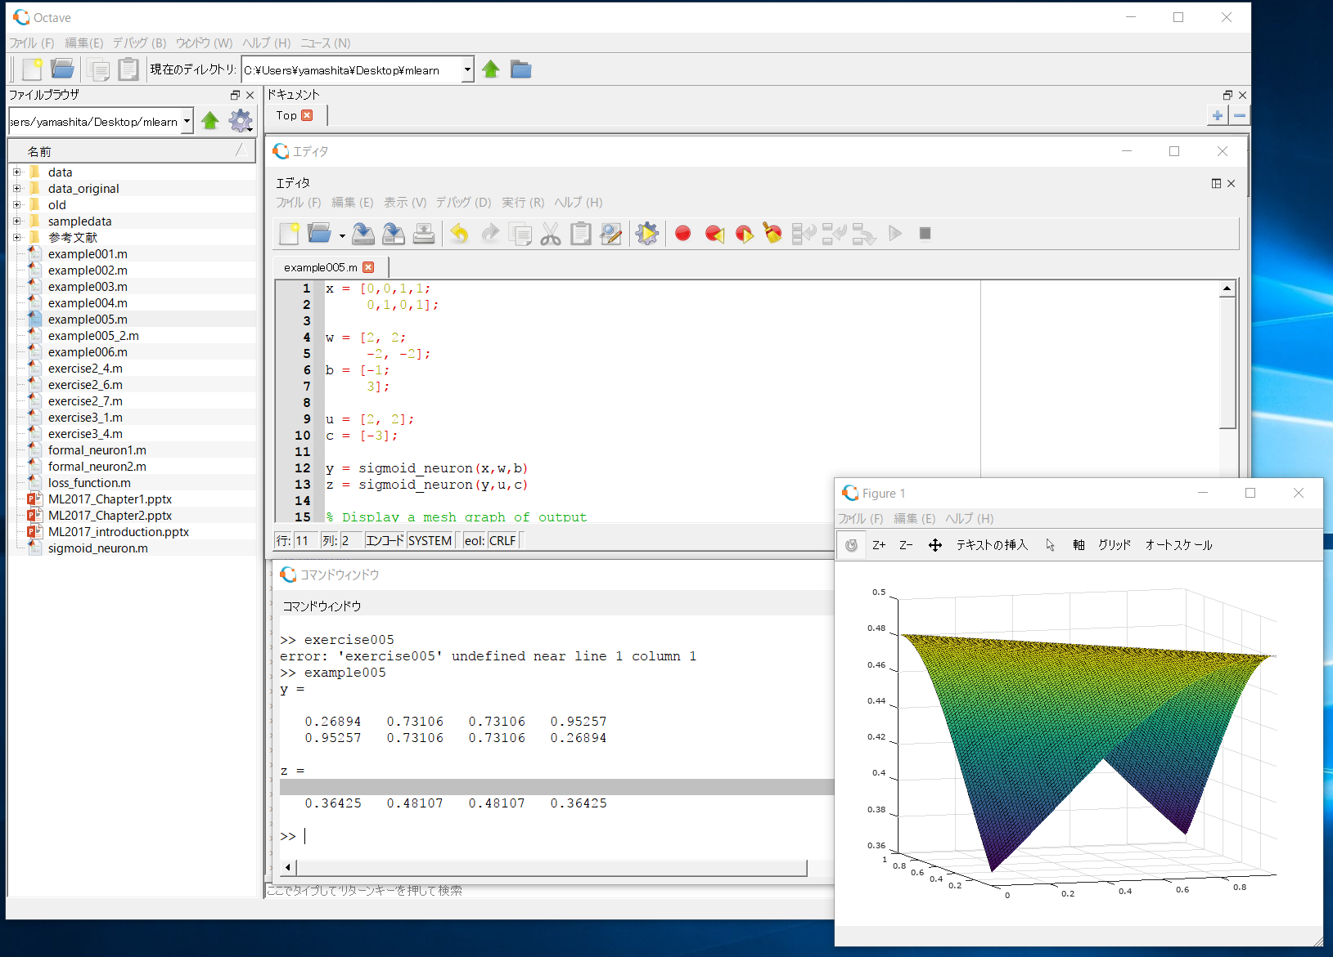
【Appendix】 Octave desktop
Editor Window
Current Directory
Command Window
Figure Window

Slide 8
Basic Operations in MATLAB

Slide 9

Tutorials for MATLAB in Mathworks Website
https://www.mathworks.com/support/learn-with-matlab-tutorials.html

Slide 10
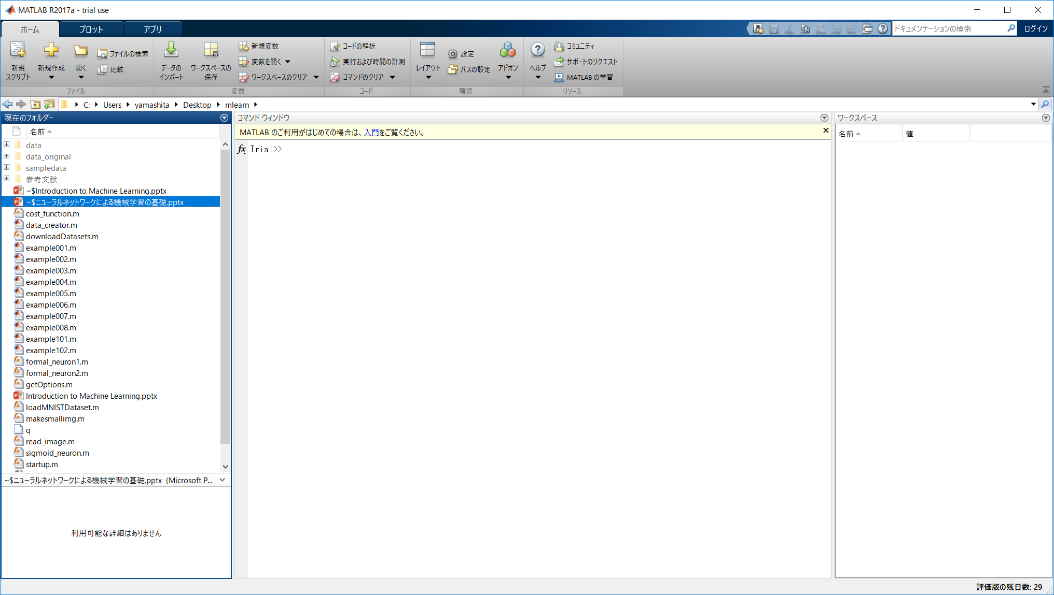
Start MATLAB
When you start MATLAB, the desktop in its default layout.
Current Directory
Command window
Workspace

Slide 11
Basic Operation in MATLAB (1)
>>
>> 2+3*4
ans =
14
>> x = 2+3*4
>> x =
14
>> 2*x
ans =
28
>> y = 2*3 ;
Prompt symbol designates the beginning of command line.
You can use arithmetic operators +, -, *, and / .
If you do not specify an output variable, MATLAB uses a default variable ans.
You may assign a value to a variable.
This variable name can always be used to refer to the results of the previous computations.
The semicolon at the end is for suppressing output. If a semicolon is included, MATLAB doesn’t display the results of the operation.

Slide 12
Basic Operation in MATLAB (2)
(The colon notation)
>> n1 = 1:5
n1 =
1 2 3 4 5
>> n2 = 1:2:5
n2 =
1 3 5
>> n3 = 5:-1:1
n3 =
5 4 3 2 1
>>n4 = 5:-2:1
n4 =
5 3 1
The colon notation is very useful to access blocks of elements.
The notation 1:5 says to start at 1, count up by 1 and stop when the count reaches 5.
The notation 1:2:5 says to start at 1, count up by 2 and stop when the count reaches 5.
The notation 5:-1:1 says to start at 5, decrease by 1 and stop when it reaches 1.

Slide 13
Basic Operation in MATLAB (3)
(Vector Manipulations)
>> v=[ 1 3 5 7 9 ]
v =
1 3 5 7 9
>> v(2)
ans =
3
>> v(1:3)
ans =
1 3 5
A row vector, or an array of dimension 1xN, is created by square brackets. The elements are separated by spaces or by commas.
v(2) is the second element of vector v.
Note that MATLAB array indexing starts from 1 not 0.
To access the first three elements of v, we write v(1:3).

Slide 14
Basic Operation in MATLAB (4)
(Vector Manipulations)
>> v(2:4)
ans =
3 5 7
>> v(2:end)
ans =
3 5 7 9
>> v(1:2:5)
ans =
1 5 9
>> v(end:-2:1)
ans =
9 5 1
The notation v(2:4) means we can access the second through the fourth elements.
The notation ‘end’ signifies the last element.
The index is not restricted to contiguous elements.
The index count starts at the last element, decreases by 2, and stops when it reaches the first element.

Slide 15
Basic Operation in MATLAB (5)
(Matrix Manipulations)
>> A=[1 2 3 4; 5 6 7 8; 9 1 2 3]
A =
1 2 3 4
5 6 7 8
9 1 2 3
>> B=A’
B =
1 5 9
2 6 1
3 7 2
4 8 3
A matrix is entered row by row,
And each row is separated by the semicolon(;).
Within each row, elements are separated by a space or a comma(,).
A’ is a transpose of matrix A.

Slide 16
Basic Operation in MATLAB (6)
(Matrix Manipulations)
>> A
A =
1 2 3 4
5 6 7 8
9 1 2 3
>> A(2, 3)
ans = 7
>> A(2, 3) = 0
A =
1 2 3 4
5 6 0 8
9 1 2 3
If we want to check the A matrix again,
we simply type A.
If we want to extract the element in the second row, third column, we write A(2,3).
A(2, 3)
If we want to set the element to 0, we write A(2, 3)=0.
A = 1 2 3 4
5 6 7 8
9 1 2 3

Slide 17
Basic Operation in MATLAB (7)
(Matrix Manipulations)
>> A(:, 3)
ans =
3
0
2
>> A(1, :)
ans =
1 2 3 4
>> A(1, :) + A(3, :)
ans = 10 3 5 7
A(:, 3) is the third column of matrix A.
The colon operator (:) stands for all columns or all rows.
A(1, :) represents the first row of matrix A.
This means addition of the first and third rows of A

Slide 18
Basic Operation in MATLAB (8)
(Matrix Manipulations)
>> A(:, 1) = 0
A =
0 2 3 4
0 6 0 8
0 1 2 3
>> A(end, end) = 0
A =
0 2 3 4
0 6 0 8
0 1 2 0
>> A(end, end-1)
ans =
2
If we want to set the first column to 0s, we write A(:, 1)=0.

Slide 19
Basic Operation in MATLAB (9)
(Matrix Manipulations)
>> A(:, 2:4)
ans =
2 3 4
6 0 8
1 2 0
>> A(:, 2) = [ ]
ans =
1 3 4
5 0 8
9 2 0
A(:, 2:4)
A(:,2:3) is a sub-matrix with the last three columns of A.
A = 1 2 3 4
5 6 0 8
9 1 2 0
A row or a column of a matrix can be deleted by setting it to a null vector, [ ].

Slide 20
Basic Operation in MATLAB (10)
(Matrix Manipulations)
>> A(2:3, 2:4)
ans =
6 0 8
1 2 0
>> A(2:end, 3:4)
ans =
0 8
2 0
A(end, end)
=A(3,4)
A(2:3, 2:4)
A = 1 2 3 4
5 6 0 8
9 1 2 0
A(2:end, 3:4)
A = 1 2 3 4
5 6 0 8
9 1 2 0

Slide 21
Basic Operation in MATLAB (11)
(Matrix Manipulations)
>> C=[1 3 5; 7 9 2; 4 6 8] ;
>> C
C =
1 3 5
7 9 2
4 6 8
>> C(end:-1:1, :)
ans =
4 6 8
7 9 2
1 3 5
MATLAB does not display output on the screen
when an operation ends with the semicolon(;).
If we want to check the C matrix again,
we simply type C.

Slide 22
Basic Operation in MATLAB (12)
(Summary: Matrix Manipulations – Array Indexing )
MATLAB supports a number of powerful indexing schemes that simplify array manipulation.
Basic indexing in two dimensions is illustrated as below.
A is given as the 4x4 matrix.
A(2, 3) and A(end, end) represent elements, respectively.
A(2, :) represents a row vector.
A(:, 2) represents a column vector.
A(2:3, 1:3) represents a submatrix.
A(:, 2)
A = 1 2 3 4
5 6 7 8
9 8 2 1
A(2, 3)
A(2, :)
A(2:3, 1:3)
A(end, end)= A(3, 4)

Slide 23
Basic Operation in MATLAB (13)
You can use a function such as zeros, ones and rand to create a matrix.
>> zeros(2,3)
ans =
0 0 0
0 0 0
>> ones(4,1)
ans =
1
1
1
1
>> rand(3,4)
ans =
0.56688 0.87818 0.41082 0.62880
0.11144 0.60390 0.51978 0.82911
0.48224 0.80686 0.93745 0.39139
To transpose a matrix, use a single quote (‘).
>> c = [1 2 3; 4 5 6; 7 8 9]
c =
1 2 3
4 5 6
7 8 9
>> c'
ans =
1 4 7
2 5 8
3 6 9

Slide 24
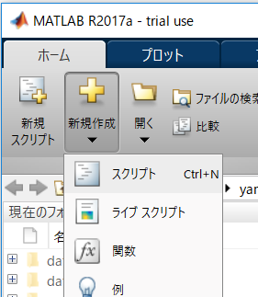
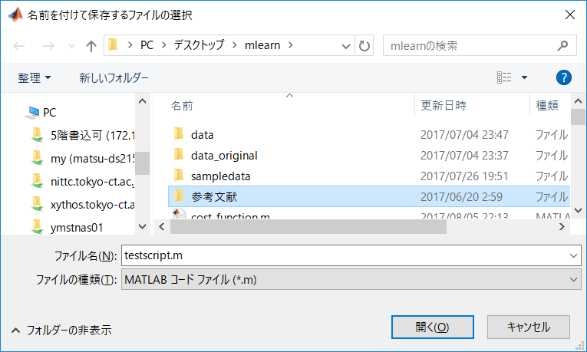
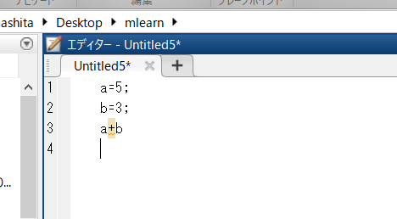
MATLAB script and script file
MATLAB program is called script. A script is a file with a “.m” extension that contains multiple sequential lines of MATLAB commands and function calls. You can run a script by typing its name at the command window.
If you want to create a new script file, press “New” button and select “Script”.
Then, describe a script (i.e., commands and functions) at an editor window.
Finally, save as *.m file in your workfoldar.
Describe a script (commands)
Save as *.m file

Slide 25
Execute a script
We can execute a script by enter the script filename.
testscript.m
Command window
z
z
a=5;
b=3;
a+b
>> testscript
ans =
8
The script filename

Slide 26
Definition of a original function
We can define an original function on MATLAB as follows.
testfunc.m
Command window
z
z
function x=testfunc(a, b)
x = a+b;
end
>> x =testfunc(3,4)
ans =
7
The function name
【NOTICE】
You have to use a same name for the function name and the filename.

Slide 27
Operations for vectors and matrices(1)
You can add scalar to vector or add two vectors
>> a = [1,2,3,4,5];
>> b = 2;
>> a+b
ans =
3 4 5 6 7
z
z
>> a = [1,2,3,4,5];
>> b = [1,3,5,7,9];
>> a+b
ans =
2 5 8 11 14
Add scalar to vector
Add two vectors
Similarly, you can add scalar to array (matrix) or add two arrays (matrices)
z
>> a = [1,2,3;4,5,6;7,8,9];
>> b = 3;
>> a+b
ans =
4 5 6
7 8 9
10 11 12
>> a = [1,2,3;4,5,6;7,8,9];
>> b = [1,3,5;7,9,2;4,6,8];
>> a+b
ans =
2 5 8
11 14 8
11 14 17
z
Add scalar to array
Add two arrays

Slide 28
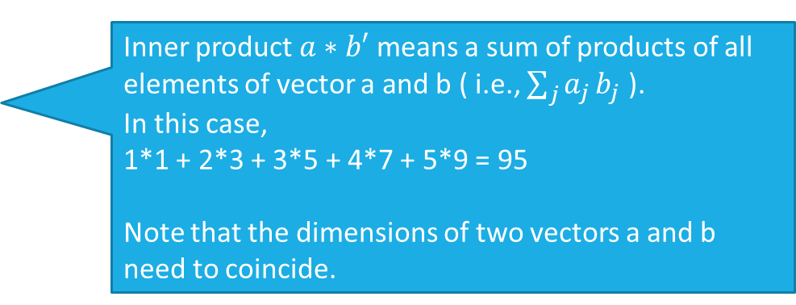
Operations for vectors and matrices(2)
You can calculate a product of scalar and vector.
>> a = [1,2,3,4,5];
>> b = 2;
>> a*b
ans =
2 4 6 8 10
z
A product of scalar and vector
You can calculate a inner product of two vectors.
z
>> a = [1,2,3,4,5];
>> b = [1,3,5,7,9];
>> a*b'
ans =
95
Inner product $a∗b′$ means a sum of products of all elements of vector a and b ( i.e., $\sum_{j}{a_{j}}b_{j}$ ).
In this case,
1*1 + 2*3 + 3*5 + 4*7 + 5*9 = 95
Note that the dimensions of two vectors a and b need to coincide.

Slide 29
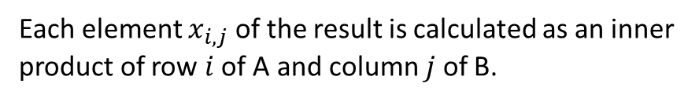
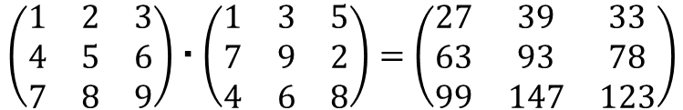
Operations for vectors and matrices(2)
You can calculate a product of scalar and matrix.
>> A=[1,2,3;4,5,6;7,8,9];
>> b=2;
>> A*b
ans =
2 4 6
8 10 12
14 16 18
z
A product of scalar and matrix
You can calculate a product of two matrices.
z
Each element $x_{i,j}$ of the result is calculated as an inner product of row $i$ of A and column $j$ of B.
>> A=[1,2,3;4,5,6;7,8,9];
>> B=[1,3,5;7,9,2;4,6,8];
>> A*B
ans =
27 39 33
63 93 78
99 147 123
1*1+2*7+3*4=27
$$\left(\begin{matrix}1 & 2 & 3 \\ 4 & 5 & 6 \\ 7 & 8 & 9\end{matrix}\right)・\left(\begin{matrix}1 & 3 & 5 \\ 7 & 9 & 2 \\ 4 & 6 & 8\end{matrix}\right)=\left(\begin{matrix}27 & 39 & 33 \\ 63 & 93 & 78 \\ 99 & 147 & 123\end{matrix}\right)$$

Slide 30
Perceptron

Slide 31

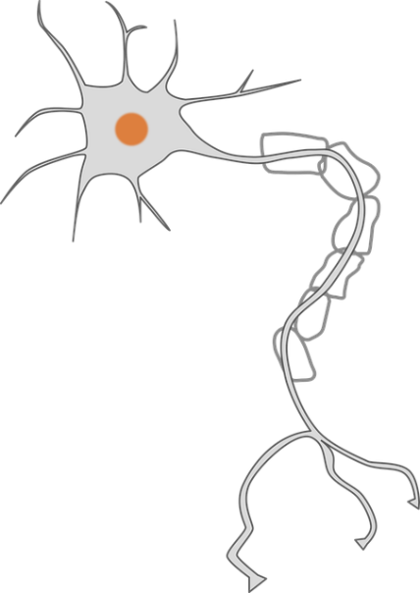










Formal Neuron (McCulloch-Pitts Model)
Formal neuron model was proposed by Warren McCulloch and Walter Pitts in 1943.
A formal neuron is a simplified mathematical function obtained from a simplification of a biological neuron.
Output to other neurons
Input from other neurons
Conceptual figure of biological neuron
A formal neuron obtains several binary values $x_{1},x_{2},⋯,x_{I}$ as input and send out one binary value $y$ as output.
$$x_{1}$$
$$w_{1}$$
Inputs
$$x_{2}$$
$$w_{2}$$
Output
$$h$$
$$y$$
$$⋮$$
$$w_{I}$$
$$x_{I}$$
Formal neuron model

Slide 32

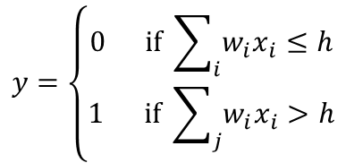


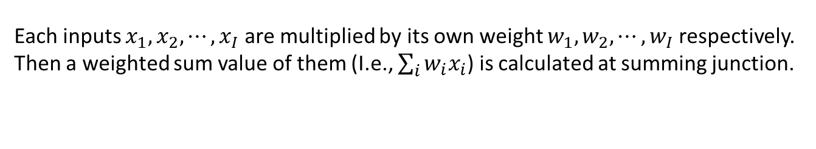






Formal Neuron (McCulloch-Pitts Model)
Formal neuron model
$$x_{1}$$
$$w_{1}$$
Inputs
$$x_{2}$$
$$w_{2}$$
Output
$$h$$
$$y$$
$$⋮$$
$$w_{I}$$
$$x_{I}$$
Summing junction
Threshold function
Summing junction
Each inputs $x_{1},x_{2},⋯,x_{I}$ are multiplied by its own weight $w_{1},w_{2},⋯,w_{I}$ respectively. Then a weighted sum value of them (I.e., $\sum_{i}{w_{i}x_{i}}$) is calculated at summing junction.
Threshold function
If the weighted sum value is greater than a threshold $h$, the output $y$ becomes 1, if not the output $y$ becomes 0. That is,
$$y=\left\{\begin{aligned}0 if \sum_{i}{w_{i}x_{i}≤h} \\ &1 if \sum_{j}{w_{i}x_{i}>h}\end{aligned}\right.$$

Slide 33




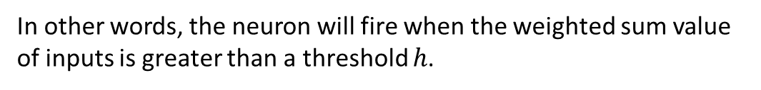














Formal Neuron (McCulloch-Pitts Model)
Formal neuron model
$$x_{1}$$
$$w_{1}$$
Inputs
$$x_{2}$$
$$w_{2}$$
Output
$$h$$
$$y$$
$$⋮$$
$$w_{I}$$
$$x_{I}$$
Summing junction
Threshold function
We use following description
$$x_{1}$$
$$w_{1}$$
Inputs
$$x_{2}$$
$$w_{2}$$
Output
$$h$$
$$y$$
$$w_{I}$$
$$⋮$$
$$x_{I}$$
In other words, the neuron will fire when the weighted sum value of inputs is greater than a threshold $h$.

Slide 34

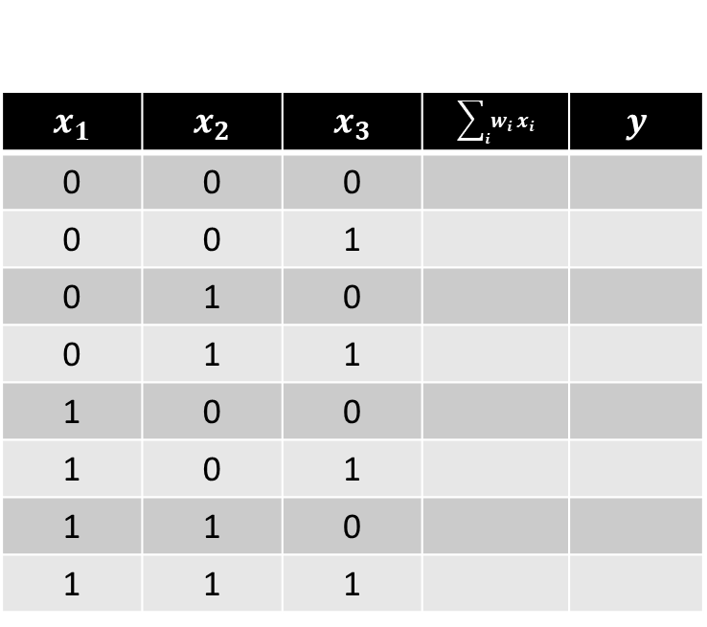

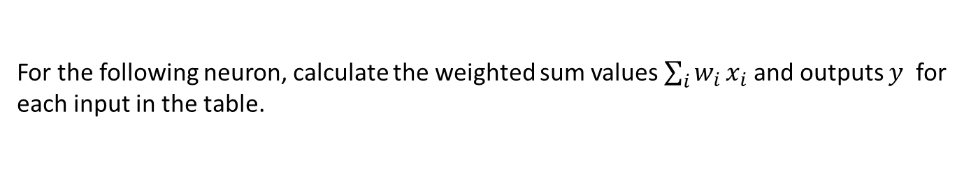


Exercise 1.1
For the following neuron, calculate the weighted sum values $\sum_{i}{w_{i}}x_{i}$and outputs $y$ for each input in the table.
$$x_{1}$$ | $$x_{2}$$ | $$x_{3}$$ | $$\sum_{i}{w_{i}}x_{i}$$ | $$y$$
0 | 0 | 0
0 | 0 | 1
0 | 1 | 0
0 | 1 | 1
1 | 0 | 0
1 | 0 | 1
1 | 1 | 0
1 | 1 | 1
$$x_{1}$$
2
$$x_{2}$$
3
2
$$y$$
1
$$x_{3}$$

Slide 35

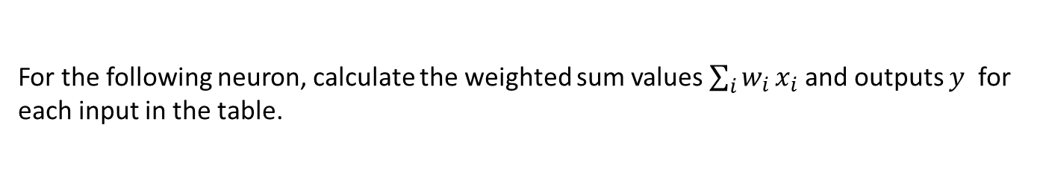

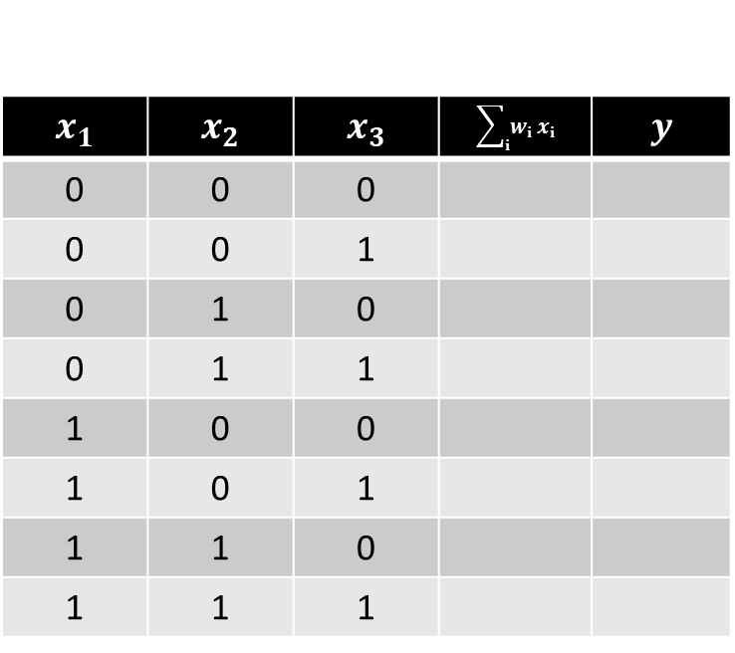


Exercise 1.2
For the following neuron, calculate the weighted sum values $\sum_{i}{w_{i}}x_{i}$and outputs $y$ for each input in the table.
$$x_{1}$$ | $$x_{2}$$ | $$x_{3}$$ | $$\sum_{i}{w_{i}}x_{i}$$ | $$y$$
0 | 0 | 0
0 | 0 | 1
0 | 1 | 0
0 | 1 | 1
1 | 0 | 0
1 | 0 | 1
1 | 1 | 0
1 | 1 | 1
$$x_{1}$$
2
$$x_{2}$$
-3
-1
$$y$$
-1
$$x_{3}$$

Slide 36

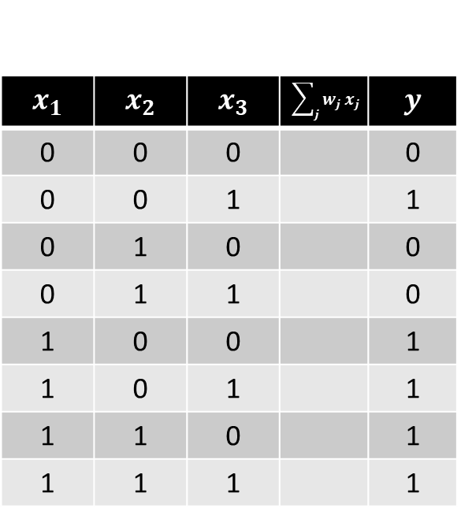



Exercise 1.3
For the following neuron, determine weights and thresholds so that the outputs $y$ for each of inputs are as shown in the table.
$$x_{1}$$ | $$x_{2}$$ | $$x_{3}$$ | $$\sum_{j}{w_{j}}x_{j}$$ | $$y$$
0 | 0 | 0 |  | 0
0 | 0 | 1 |  | 1
0 | 1 | 0 |  | 0
0 | 1 | 1 |  | 0
1 | 0 | 0 |  | 1
1 | 0 | 1 |  | 1
1 | 1 | 0 |  | 1
1 | 1 | 1 |  | 1
$$x_{1}$$
$$x_{2}$$
$$y$$
$$x_{3}$$
Can you find these values?

Slide 37
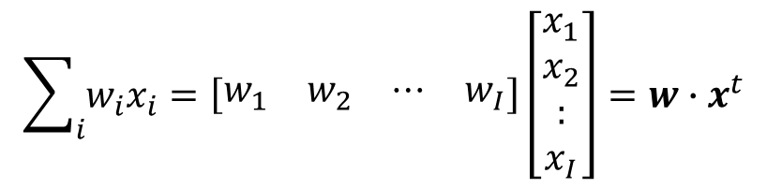
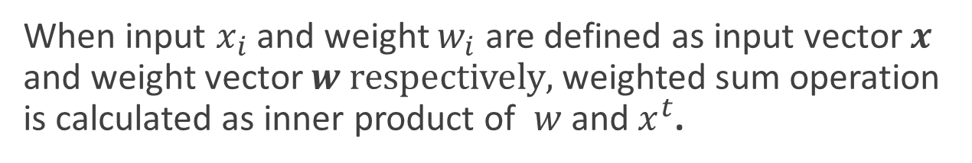
Weighted sum operation and inner-product
When input $x_{i}$ and weight $w_{i}$ are defined as input vector $x$ and weight vector $w respectively,$ weighted sum operation is calculated as inner product of $w$ and $x^{t}$.
$$\sum_{i}{w_{i}x_{i}}=\left[\begin{matrix}w_{1} & w_{2} & ⋯ & w_{I}\end{matrix}\right]\left[\begin{matrix}x_{1} \\ x_{2} \\ : \\ x_{I}\end{matrix}\right]=w∙x^{t}$$
It is easy to calculate on MATLAB.
For example,
z
>> x=[1 0 1];
>> w=[2 3 -1];
>> w*x’
ans =
1
z
>> x=[1; 0; 1];
>> w=[2 3 -1];
>> w*x
ans =
1

Slide 38
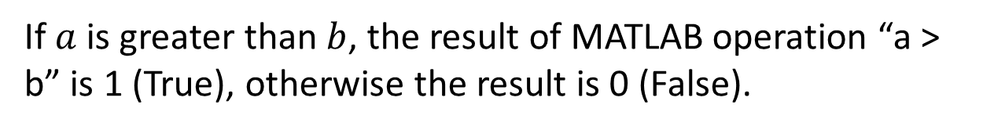
Threshold calculation
If $a$ is greater than $b$, the result of MATLAB operation “a > b” is 1 (True), otherwise the result is 0 (False).
z
z
>> a=3;
>> b=2;
>> a>b
ans =
logical
1
>> a=2;
>> b=3;
>> a>b
ans =
logical
0

Slide 39




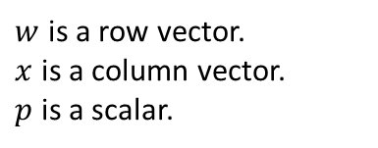
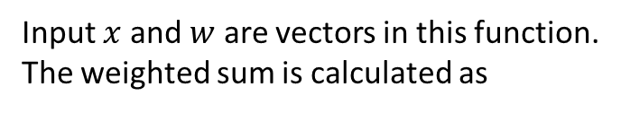

Let’s implement formal neuron function on MATLAB (1)
Test script
example1_1.m
1
0.5
x = [1;
1;
0];
w = [0.5, 1.0, 0.5];
h = 1;
y = formal_neuron(x,w,h)
1.0
$$1$$
1
$$?$$
0.5
0
A function for formal neuron calculation
Input $x$ and $w$ are vectors in this function.
The weighted sum is calculated as
Create formal_neuron.m as a function file as follows.
formal_neuron.m
*
$$\left[\begin{matrix}x_{1} \\ x_{2} \\ x_{3}\end{matrix}\right]$$
$$p=$$
$$\left[w_{1}, w_{2}, w_{3}\right]$$
function y = formal_neuron(x,w,h)
p = w*x;
y = p>h;
end
Note
$w$ is a row vector.
$x$ is a column vector.
$p$ is a scalar.

Slide 40


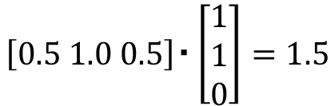
Results
Execution and results
$$\left[0.5 1.0 0.5\right]・\left[\begin{matrix}1 \\ 1 \\ 0\end{matrix}\right]=1.5$$
1
>> example1_1
y =
logical
1
> 1 (Threshold)
1
0.5
1.0
$$1$$
1
$$1$$
0.5
0

Slide 41

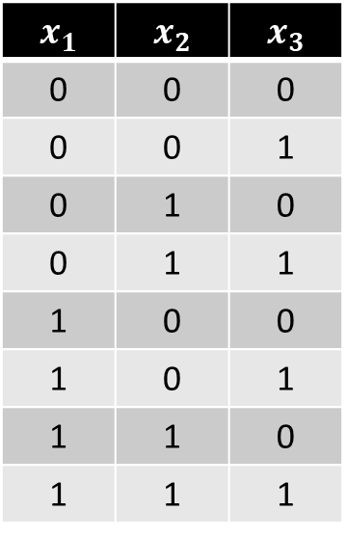

Exercise1.4
Implement example1_1.m and formal_neuron.m on MATLAB.
Check the outputs where inputs, weights and a threshold are given as follows by both hand calculation and MATLAB scripts execution.
$$x_{1}$$ | $$x_{2}$$ | $$x_{3}$$
0 | 0 | 0
0 | 0 | 1
0 | 1 | 0
0 | 1 | 1
1 | 0 | 0
1 | 0 | 1
1 | 1 | 0
1 | 1 | 1
$$w=\left[2,−1, 3\right]$$
$$h=1$$

Slide 42

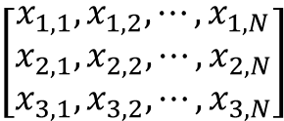






Let’s implement formal neuron function on MATLAB (2)
If we use multiple sample data, we prepare it in an input matrix.
Test script
example1_2.m
x = [0,0,0,0,1,1,1,1;
0,0,1,1,0,0,1,1;
0,1,0,1,0,1,0,1];
w = [0.5, 1.0, 0.5];
h = 1;
y = formal_neuron(x,w,h)
0 0 0 0 1 1 1 1
0.5
0 0 1 1 0 0 1 1
1.0
1
$$?$$
0.5
0 1 0 1 0 1 0 1
Formal neuron function
We can use a same function!
$$N$$
$($number of sample data )
formal_neuron.m
$$\left[\begin{matrix}x_{1,1}, x_{1,2},⋯,x_{1,N} \\ x_{2,1}, x_{2,2},⋯,x_{2,N} \\ x_{3,1}, x_{3,2},⋯,x_{3,N}\end{matrix}\right]$$
$$\left[p_{1},⋯, p_{N}\right]$$
$$=$$
$$\left[w_{1}, w_{2}, w_{3}\right]$$
*
3
function y = formal_neuron(x,w,h)
p = w*x;
y = p>h;
end
Note
$w$ is a row vector.
$x$ is a 3*N matrix.
$p$ is a row vector.
Input Matrix

Slide 43
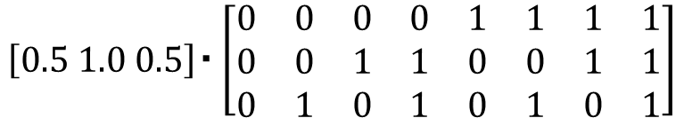



Results
Execution and results
$$\left[0.5 1.0 0.5\right]・\left[\begin{matrix}0 & 0 & 0 & 0 & 1 & 1 & 1 & 1 \\ 0 & 0 & 1 & 1 & 0 & 0 & 1 & 1 \\ 0 & 1 & 0 & 1 & 0 & 1 & 0 & 1\end{matrix}\right]$$
>> example1_2
y =
0 0 0 1 0 0 1 1
$$=[0 0.5 1.0 1.5 0.5 1.0 1.5 2.0]$$
> 1 (Threshold)
$$[0 0 0 1 0 0 1 1]$$
0 0 0 0 1 1 1 1
0.5
0 0 1 1 0 0 1 1
1.0
1
$$0 0 0 1 0 0 1 1$$
0.5
0 1 0 1 0 1 0 1

Slide 44




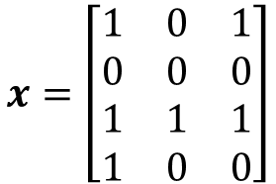








Exercise1.5
Consider a 4 input neuron (the input dimension is 4) as follows.
$$x_{1}$$
$$w_{1}$$
$$x_{2}$$
$$w_{2}$$
$$w_{3}$$
$$h$$
$$y$$
$$x_{3}$$
$$w_{4}$$
$$x_{4}$$
Calculate outputs by hand calculation where inputs, weights and a threshold are given as follows. Then check the answer using MATLAB.
There are 3 samples.
$$x=\left[\begin{matrix}1 & 0 & 1 \\ 0 & 0 & 0 \\ 1 & 1 & 1 \\ 1 & 0 & 0\end{matrix}\right]$$
$$w=\left[0.5 1 1.5 0\right]$$
Input dimension is 4.
$h=$ 1.5

Slide 45













Using multiple neurons
We can construct a neural network with two or more neurons as follows,
$$x_{1}$$
$$w_{1,1}$$
$$w_{1,2}$$
$$h_{1}$$
$$y_{1}$$
$$w_{1,3}$$
$$x_{2}$$
Outputs
Inputs
$$w_{2,1}$$
$$w_{2,2}$$
$$w_{2,3}$$
$$h_{2}$$
$$y_{2}$$
$$x_{3}$$

Slide 46










Using multiple neurons
Generally,
$$w_{j,i}$$
$$x_{1}$$
$$h_{1}$$
$$y_{1}$$
・・・
・・・
・・・
$$x_{i}$$
$$y_{j}$$
Inputs
$$h_{j}$$
Outputs
・・・
・・・
・・・
$$x_{I}$$
$$h_{J}$$
$$y_{J}$$

Slide 47








Let’s implement formal neuron function on MATLAB (3)
If there are multiple neuron, the outputs are calculated as follows.
Test script
example1_3.m
0.5
0 0 0 0 1 1 1 1
1.0
$$0.5$$
?
x = [0,0,0,0,1,1,1,1;...
0,0,1,1,0,0,1,1;...
0,1,0,1,0,1,0,1];
w = [0.5, 1.0, 0.5;...
0.0, 0.5, 1.0];
h = [0.5;...
1.0];
y = formal_neuron(x,w,h)
0.5
0 0 1 1 0 0 1 1
0.0
0.5
0 1 0 1 0 1 0 1
1.0
$$1.0$$
?
Formal neuron function
We can use a same function again this time!
$$N$$
$($number of sample data )
formal_neuron.m
function y = formal_neuron(x,w,h)
p = w*x;
y = p>h;
end
=
$$\left[\begin{matrix}x_{1,1}, x_{1,2},⋯,x_{1,N} \\ x_{2,1}, x_{2,2},⋯,x_{2,N} \\ x_{3,1}, x_{3,2},⋯,x_{3,N}\end{matrix}\right]$$
$$\left[\begin{aligned}p_{1,1},⋯, p_{1,N} \\ p_{2,1},⋯, p_{2,N}\end{aligned}\right]$$
$$\left[\begin{aligned}w_{1,1}, w_{1,2}, w_{1,3} \\ w_{2,1}, w_{2,2}, w_{2,3}\end{aligned}\right]$$
*
3
Note
$w$ is a 2*3 matrix.
$x$ is a 3*N matrix.
$p$ is a 2*N matrix.
Input Matrix

Slide 48



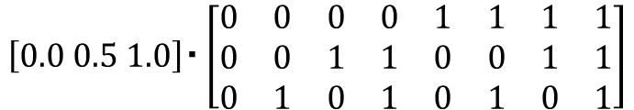
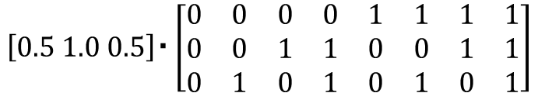
Results
$$\left[0.5 1.0 0.5\right]・\left[\begin{matrix}0 & 0 & 0 & 0 & 1 & 1 & 1 & 1 \\ 0 & 0 & 1 & 1 & 0 & 0 & 1 & 1 \\ 0 & 1 & 0 & 1 & 0 & 1 & 0 & 1\end{matrix}\right]$$
Execution and results
$$=[0 0.5 1.0 1.5 0.5 1.0 1.5 2.0]$$
>> example1_3
y =
0 0 1 1 0 1 1 1
0 0 0 1 0 0 0 1
> 0.5 (Threshold)
[0 0 1 1 0 1 1 1]
$$\left[0.0 0.5 1.0\right]・\left[\begin{matrix}0 & 0 & 0 & 0 & 1 & 1 & 1 & 1 \\ 0 & 0 & 1 & 1 & 0 & 0 & 1 & 1 \\ 0 & 1 & 0 & 1 & 0 & 1 & 0 & 1\end{matrix}\right]$$
$$=[0 1.0 0.5 1.5 0.0 1.0 0.5 1.5]$$
> 1.0 (Threshold)
[0 0 0 1 0 0 0 1]
0.5
0 0 0 0 1 1 1 1
1.0
$$0.5$$
0 0 1 1 0 1 1 1
0.5
0 0 1 1 0 0 1 1
0.0
0.5
0 1 0 1 0 1 0 1
1.0
$$1.0$$
0 0 0 1 0 0 0 1

Slide 49










Layers in Neural Network Model
N inputs
Layer
N outputs
$$w_{j,i}$$
$$h_{1}$$
$$y_{1}$$
$$x_{1}$$
・・・
・・・
・・・
・・・
$$x_{i}$$
$$y_{j}$$
$$h_{j}$$
・・・
・・・
・・・
・・・
$$x_{I}$$
$$h_{J}$$
$$y_{J}$$
Layers are made up of a number of interconnected neurons.

Slide 50












Layers in Neural Network Model
Layer
$$N$$
$$I$$
$$N$$
$$1$$
$$X$$
$$W$$
$$h$$
$$Y$$
$$I$$
$$O$$
$$O$$
$$O$$

Slide 51
Implementation using FormalNeuronClass
example1_4.m
FormalNeuronClass.m
x = [0,0,0,0,1,1,1,1;
0,0,1,1,0,0,1,1;
0,1,0,1,0,1,0,1];
w = [0.5, 1.0, 0.5;
0.0, 0.5, 1.0];
h = [0.5;...
1.0];
layer1 = FormalNeuronLayer(w,h);
y = layer1.forward(x)
classdef FormalNeuronLayer
properties
weights;
threshold;
end
methods
function obj = FormalNeuronLayer(w,h)
obj.weights = w;
obj.threshold = h;
end
function y = forward(obj, x)
p = obj.weights * x;
y = p > obj.threshold;
end
end
end

Slide 52




























Multiple Layer Neural Network (Perceptron)
We can construct a three layer neural network as follows. The first layer simply copies the inputs. The outputs of the second layer are the inputs of the third layer.
First layer
Second layer
Third layer
$$w_{1,1}$$
$$x_{1}$$
$$y_{1}$$
$$w_{1,2}$$
$$h_{1}$$
$$u_{1,1}$$
$$w_{1,3}$$
$$u_{1,2}$$
$$g_{1}$$
$$z_{1}$$
$$w_{2,1}$$
$$u_{1,3}$$
Input
$$w_{2,2}$$
Output
$$x_{2}$$
$$h_{2}$$
$$w_{2,3}$$
$$y_{2}$$
$$u_{2,1}$$
$$u_{2,2}$$
$$u_{2,3}$$
$$g_{2}$$
$$z_{2}$$
$$w_{3,1}$$
$$w_{3,2}$$
$$x_{3}$$
$$h_{3}$$
$$y_{3}$$
$$w_{3,3}$$

Slide 53
Multiple Layer Neural Network (Perceptron)
We refer to each layer as “input layer”, “hidden layer” and “output layer” respectively.
Input layer
Hidden layer
Output layer
$$w_{1,1}$$
$$x_{1}$$
$$y_{1}$$
$$w_{1,2}$$
$$h_{1}$$
$$u_{1,1}$$
$$w_{1,3}$$
$$u_{1,2}$$
$$g_{1}$$
$$z_{1}$$
$$w_{2,1}$$
$$u_{1,3}$$
Input
$$w_{2,2}$$
Output
$$x_{2}$$
$$h_{2}$$
$$w_{2,3}$$
$$y_{2}$$
$$u_{2,1}$$
$$u_{2,2}$$
$$u_{2,3}$$
$$g_{2}$$
$$z_{2}$$
$$w_{3,1}$$
$$w_{3,2}$$
$$x_{3}$$
$$h_{3}$$
$$y_{3}$$
$$w_{3,3}$$

Slide 54
















Multiple Layer Neural Network (Perceptron)
Generally,
Input layer
Hidden layer
Output layer
$$w_{j,i}$$
$$u_{k,j}$$
$$x_{1}$$
$$y_{1}$$
$$h_{1}$$
$$g_{1}$$
$$z_{1}$$
・・・
Input
$$x_{i}$$
$$h_{j}$$
$$g_{1}$$
$$z_{k}$$
Output
$$y_{j}$$
・・・
$$x_{I}$$
$$h_{J}$$
$$g_{K}$$
$$z_{K}$$
$$y_{J}$$

Slide 55








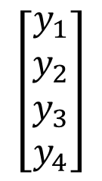





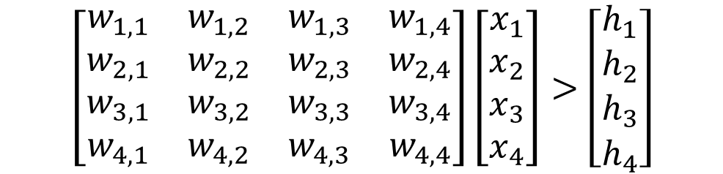









Feedforward calculation (1)
$$y_{1}$$
$$x_{1}$$
$$w_{1,i}$$
$$h_{1}$$
$$y_{2}$$
$$g_{1}$$
$$z_{1}$$
$$x_{2}$$
$$w_{2,i}$$
$$h_{2}$$
$$y_{3}$$
$$g_{2}$$
$$z_{2}$$
$$x_{3}$$
$$w_{3,i}$$
$$h_{3}$$
$$y_{4}$$
$$g_{3}$$
$$z_{3}$$
$$x_{4}$$
$$w_{4,i}$$
$$h_{4}$$
$$\left[\begin{matrix}w_{1,1} & w_{1,2} & w_{1,3} & w_{1,4} \\ w_{2,1} & w_{2,2} & w_{2,3} & w_{2,4} \\ w_{3,1} & w_{3,2} & w_{3,3} & w_{3,4} \\ w_{4,1} & w_{4,2} & w_{4,3} & w_{4,4}\end{matrix}\right]\left[\begin{matrix}x_{1} \\ x_{2} \\ x_{3} \\ x_{4}\end{matrix}\right]>\left[\begin{matrix}h_{1} \\ h_{2} \\ h_{3} \\ h_{4}\end{matrix}\right]$$
$$\left[\begin{matrix}y_{1} \\ y_{2} \\ y_{3} \\ y_{4}\end{matrix}\right]$$

Slide 56












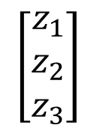

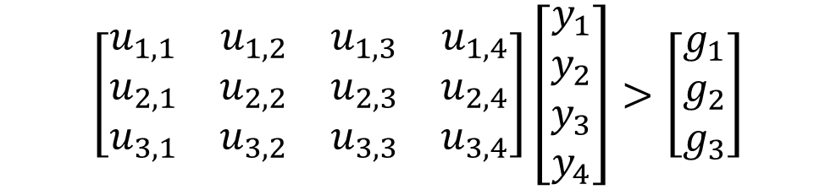



Feedforward calculation (2)
$$y_{1}$$
$$x_{1}$$
$$h_{1}$$
$$y_{2}$$
$$u_{1,j}$$
$$g_{1}$$
$$z_{1}$$
$$x_{2}$$
$$h_{2}$$
$$y_{3}$$
$$u_{2,j}$$
$$g_{2}$$
$$z_{2}$$
$$x_{3}$$
$$h_{3}$$
$$y_{4}$$
$$u_{3,j}$$
$$g_{3}$$
$$z_{3}$$
$$x_{4}$$
$$h_{4}$$
$$\left[\begin{matrix}u_{1,1} & u_{1,2} & u_{1,3} & u_{1,4} \\ u_{2,1} & u_{2,2} & u_{2,3} & u_{2,4} \\ u_{3,1} & u_{3,2} & u_{3,3} & u_{3,4}\end{matrix}\right]\left[\begin{matrix}y_{1} \\ y_{2} \\ y_{3} \\ y_{4}\end{matrix}\right]>\left[\begin{matrix}g_{1} \\ g_{2} \\ g_{3}\end{matrix}\right]$$
$$\left[\begin{matrix}z_{1} \\ z_{2} \\ z_{3}\end{matrix}\right]$$

Slide 57
Let’s implement “Perceptron” on MATLAB
Test script
Execution and results
example1_5.m
>> example1_5
y =
0 0 1 1 0 1 1 1
0 0 0 1 0 0 0 1
0 0 1 1 1 1 1 1
z =
0 0 0 1 0 0 0 1
0 0 1 1 1 1 1 1
x = [0,0,0,0,1,1,1,1;
0,0,1,1,0,0,1,1;
0,1,0,1,0,1,0,1];
w = [0.5, 1.0, 0.5;
0.0, 0.5, 1.0;
1.0, 0.5, 0.0];
h = [0.5;
1.0;
0.0];
u = [1.0, 0.5, 0.0;
0.5, 0.0, 1.0];
g = [1.0;
0.0];
layer1 = FormalNeuronLayer(w,h);
layer2 = FormalNeuronLayer(u,g);
y = layer1.forward(x)
z = layer2.forward(y)

Slide 58



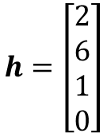





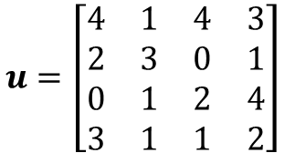
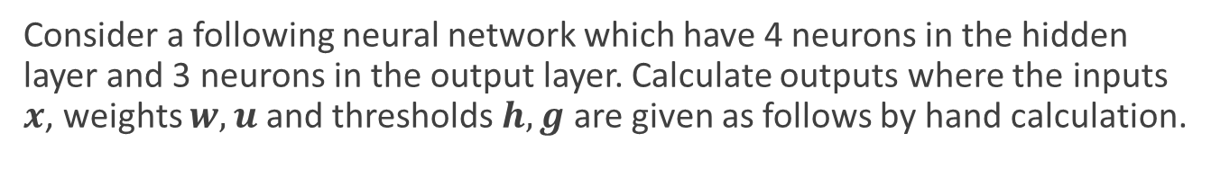





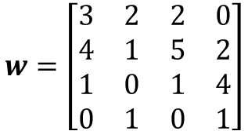


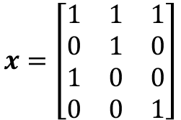








Exercise1.6
Consider a following neural network which have 4 neurons in the hidden layer and 3 neurons in the output layer. Calculate outputs where the inputs $x$, weights $w,u$ and thresholds $h,g$ are given as follows by hand calculation.
$$w_{j,i}$$
$$y_{1}$$
$$u_{k,j}$$
$$x_{1}$$
$$h_{1}$$
$$g_{1}$$
$$z_{1}$$
$$y_{2}$$
$$x_{2}$$
$$h_{2}$$
$$g_{2}$$
$$z_{2}$$
Outputs
Inputs
$$y_{3}$$
$$x_{3}$$
$$h_{3}$$
$$g_{3}$$
$$z_{3}$$
$$y_{4}$$
$$g_{4}$$
$$z_{4}$$
$$x_{4}$$
$$h_{4}$$
There are 3 samples.
$$x=\left[\begin{matrix}1 & 1 & 1 \\ 0 & 1 & 0 \\ 1 & 0 & 0 \\ 0 & 0 & 1\end{matrix}\right]$$
$$w=\left[\begin{matrix}3 & 2 & 2 & 0 \\ 4 & 1 & 5 & 2 \\ 1 & 0 & 1 & 4 \\ 0 & 1 & 0 & 1\end{matrix}\right]$$
$$h=\left[\begin{matrix}2 \\ 6 \\ 1 \\ 0\end{matrix}\right]$$
$$u=\left[\begin{matrix}4 & 1 & 4 & 3 \\ 2 & 3 & 0 & 1 \\ 0 & 1 & 2 & 4 \\ 3 & 1 & 1 & 2\end{matrix}\right]$$
$$g=\left[\begin{matrix}1 \\ 4 \\ 3 \\ 5\end{matrix}\right]$$

