Slide 1
Making Logic Functions Using Neurons and How to Determine the Weights
Day2

Slide 2

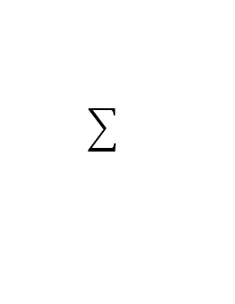
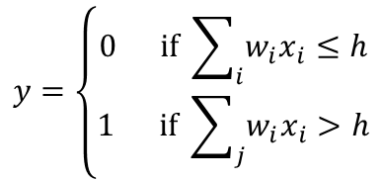


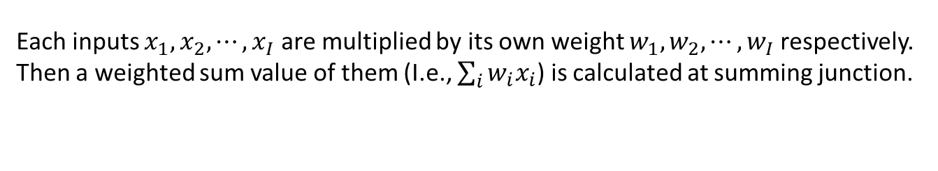






【review】 Formal Neuron (McCulloch-Pitts Model)
Formal neuron model
$$x_{1}$$
$$w_{1}$$
Inputs
$$x_{2}$$
$$w_{2}$$
Output
$$h$$
$$y$$
$$⋮$$
$$w_{I}$$
$$x_{I}$$
Summing junction
Threshold function
Summing junction
Each inputs $x_{1},x_{2},⋯,x_{I}$ are multiplied by its own weight $w_{1},w_{2},⋯,w_{I}$ respectively. Then a weighted sum value of them (I.e., $\sum_{i}{w_{i}x_{i}}$) is calculated at summing junction.
Threshold function
If the weighted sum value is greater than a threshold $h$, the output $y$ becomes 1. If not, the output $y$ becomes 0. That is,
$$y=\left\{\begin{aligned}0 if \sum_{i}{w_{i}x_{i}≤h} \\ &1 if \sum_{j}{w_{i}x_{i}>h}\end{aligned}\right.$$

Slide 3




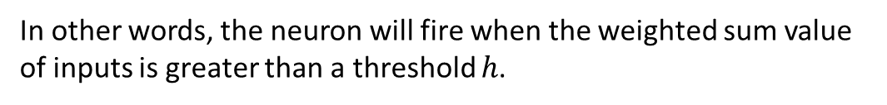














【review】 Formal Neuron (McCulloch-Pitts Model)
Formal neuron model
$$x_{1}$$
$$w_{1}$$
Inputs
$$x_{2}$$
$$w_{2}$$
Output
$$h$$
$$y$$
$$⋮$$
$$w_{I}$$
$$x_{I}$$
Summing junction
Threshold function
We use following description
$$x_{1}$$
$$w_{1}$$
Inputs
$$x_{2}$$
$$w_{2}$$
Output
$$h$$
$$y$$
$$w_{I}$$
$$⋮$$
$$x_{I}$$
In other words, the neuron will fire when the weighted sum value of inputs is greater than a threshold $h$.

Slide 4






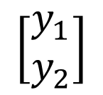



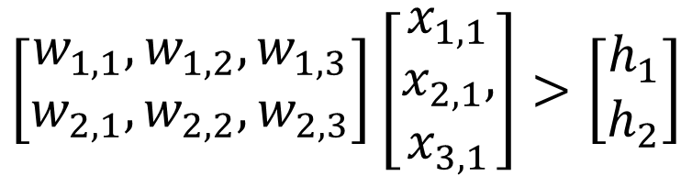




【review】 Feedforward calculation (1)
$$x_{1}$$
$$w_{1,1}$$
$$w_{1,2}$$
$$h_{1}$$
$$y_{1}$$
$$w_{1,3}$$
correspond to
the first row
$$x_{2}$$
$$w_{2,1}$$
$$w_{2,2}$$
$$h_{2}$$
$$y_{2}$$
correspond to
the second row
$$x_{3}$$
$$w_{2,3}$$
Weight matrix
$$\left[\begin{aligned}w_{1,1}, w_{1,2}, w_{1,3} \\ w_{2,1}, w_{2,2}, w_{2,3}\end{aligned}\right]\left[\begin{matrix}x_{1,1} \\ x_{2,1}, \\ x_{3,1}\end{matrix}\right]>\left[\begin{matrix}h_{1} \\ h_{2}\end{matrix}\right]$$
$$\left[\begin{matrix}y_{1} \\ y_{2}\end{matrix}\right]$$
Calculation for
Summing junction
Calculation for
Threshold function

Slide 5

















【review】 Multiple Layer Neural Network (Perceptron)
Generally, three layer neural network is often used.
Input layer
Hidden layer
Output layer
$$w_{j,i}$$
$$u_{k,j}$$
$$x_{1}$$
$$y_{1}$$
$$h_{1}$$
$$g_{1}$$
$$z_{1}$$
・・・
・・・
・・・
Input
$$x_{i}$$
$$h_{j}$$
$$g_{1}$$
$$z_{k}$$
Output
$$y_{j}$$
・・・
・・・
・・・
$$x_{I}$$
$$h_{J}$$
$$g_{K}$$
$$z_{K}$$
$$y_{J}$$

Slide 6








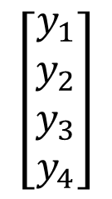





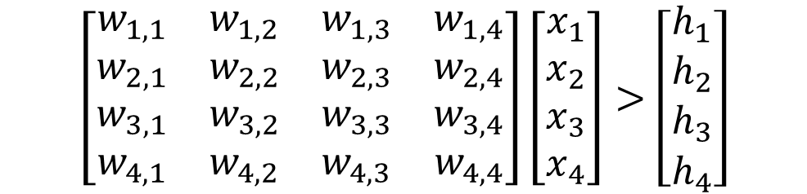









【review】 Feedforward calculation (1)
$$y_{1}$$
$$x_{1}$$
$$w_{1,i}$$
$$h_{1}$$
$$y_{2}$$
$$g_{1}$$
$$z_{1}$$
$$x_{2}$$
$$w_{2,i}$$
$$h_{2}$$
$$y_{3}$$
$$g_{2}$$
$$z_{2}$$
$$x_{3}$$
$$w_{3,i}$$
$$h_{3}$$
$$y_{4}$$
$$g_{3}$$
$$z_{3}$$
$$x_{4}$$
$$w_{4,i}$$
$$h_{4}$$
$$\left[\begin{matrix}w_{1,1} & w_{1,2} & w_{1,3} & w_{1,4} \\ w_{2,1} & w_{2,2} & w_{2,3} & w_{2,4} \\ w_{3,1} & w_{3,2} & w_{3,3} & w_{3,4} \\ w_{4,1} & w_{4,2} & w_{4,3} & w_{4,4}\end{matrix}\right]\left[\begin{matrix}x_{1} \\ x_{2} \\ x_{3} \\ x_{4}\end{matrix}\right]>\left[\begin{matrix}h_{1} \\ h_{2} \\ h_{3} \\ h_{4}\end{matrix}\right]$$
$$\left[\begin{matrix}y_{1} \\ y_{2} \\ y_{3} \\ y_{4}\end{matrix}\right]$$

Slide 7












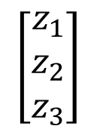

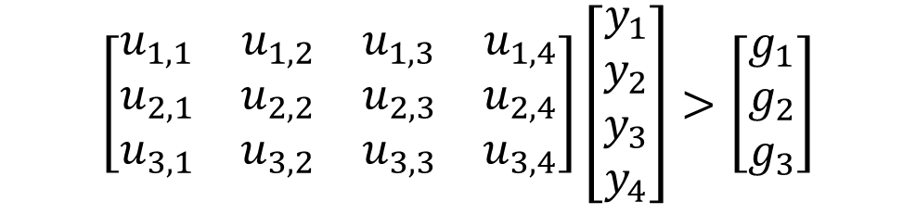



【review】 Feedforward calculation (2)
$$y_{1}$$
$$x_{1}$$
$$h_{1}$$
$$y_{2}$$
$$u_{1,j}$$
$$g_{1}$$
$$z_{1}$$
$$x_{2}$$
$$h_{2}$$
$$y_{3}$$
$$u_{2,j}$$
$$g_{2}$$
$$z_{2}$$
$$x_{3}$$
$$h_{3}$$
$$y_{4}$$
$$u_{3,j}$$
$$g_{3}$$
$$z_{3}$$
$$x_{4}$$
$$h_{4}$$
$$\left[\begin{matrix}u_{1,1} & u_{1,2} & u_{1,3} & u_{1,4} \\ u_{2,1} & u_{2,2} & u_{2,3} & u_{2,4} \\ u_{3,1} & u_{3,2} & u_{3,3} & u_{3,4}\end{matrix}\right]\left[\begin{matrix}y_{1} \\ y_{2} \\ y_{3} \\ y_{4}\end{matrix}\right]>\left[\begin{matrix}g_{1} \\ g_{2} \\ g_{3}\end{matrix}\right]$$
$$\left[\begin{matrix}z_{1} \\ z_{2} \\ z_{3}\end{matrix}\right]$$

Slide 8
Making Your Own Hand-Written Digit Images

Slide 9

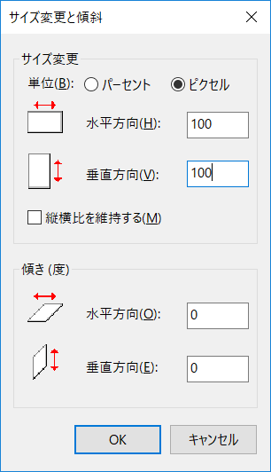

Making your own hand-written digit images
Start “MS Paint” and set the resolution to 100x100px. ( To write digits easily, we use 100x100px now. The image size will be reduced to 28x28px using a script when we import them to MATLAB).
Use pixel

Slide 10

Making your hand-written digit images
margin
Use bold brush
margin
margin
Write a digit by mouse
Use enlarge display
margin
Save as “png file”.

Slide 11
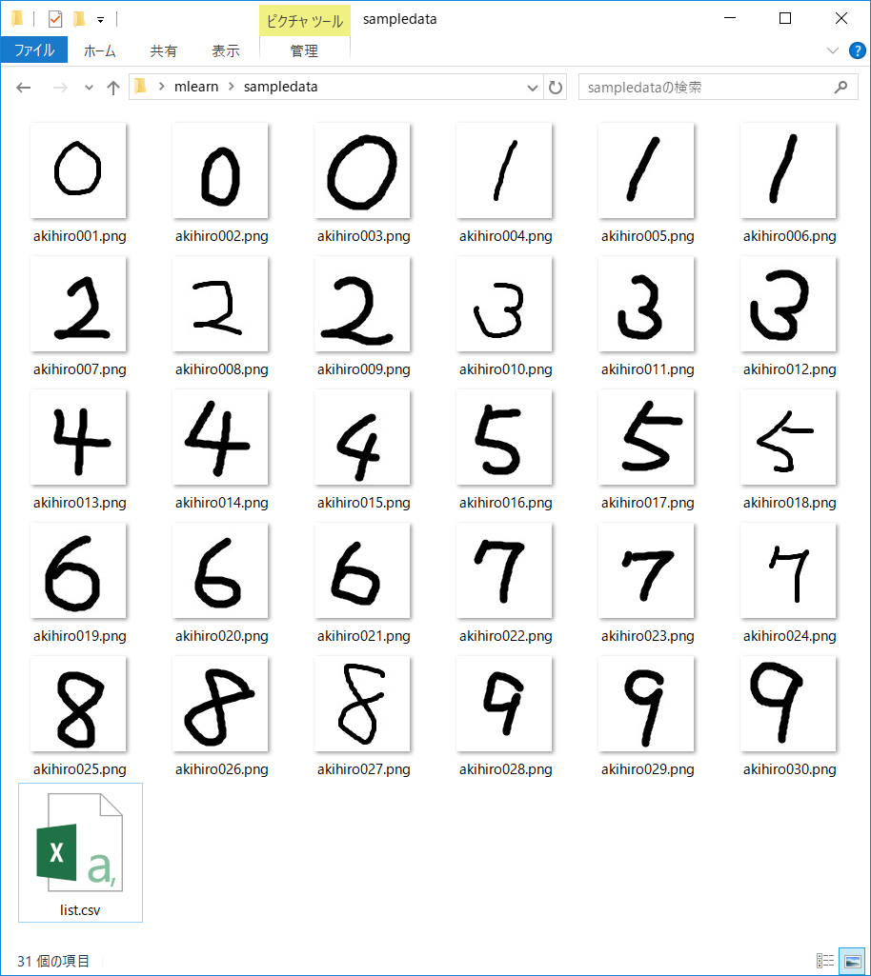
Example data
Please make 3 images per each digit.
[first name]001.png - [first name]030.png
“akihiro001.png” for example

Slide 12
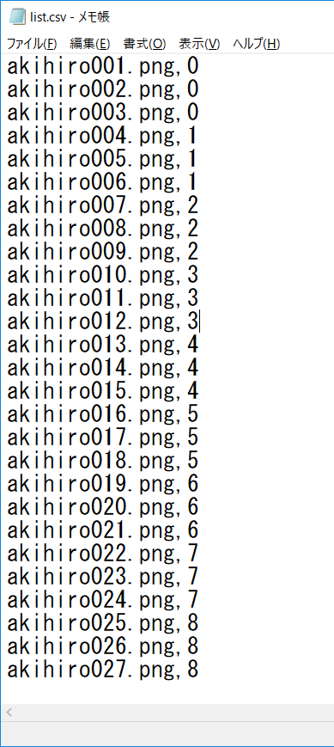

Example data
Please make list file (csv file) too.
[firstname]_list.csv
comma
filename
answer (label)

Slide 13
How to submit them
Please make zip file including the image data and csv list file.
Then, submit the zip file to Assignments on “https://oma.metropolia.fi” by 20:00 on Wednesday.

Slide 14
Making Logic Functions Using Neurons

Slide 15




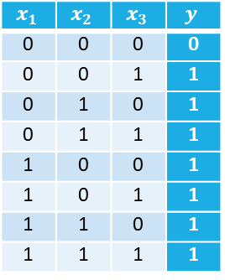





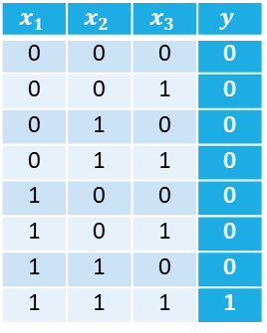









Representation of logic functions using formal neurons (1)
Some of basic logic functions can be constructed with a formal neuron.
Truth table for AND
$$x_{1}$$ | $$x_{2}$$ | $$x_{3}$$ | $$y$$
0 | 0 | 0 | 0
0 | 0 | 1 | 0
0 | 1 | 0 | 0
0 | 1 | 1 | 0
1 | 0 | 0 | 0
1 | 0 | 1 | 0
1 | 1 | 0 | 0
1 | 1 | 1 | 1
AND
$$x_{1}$$
2
$$x_{1}$$
$$2$$
$$x_{2}$$
$$y$$
$$x_{2}$$
5
$$y$$
$$x_{3}$$
2
$$x_{3}$$
Truth table for OR
OR
$$x_{1}$$ | $$x_{2}$$ | $$x_{3}$$ | $$y$$
0 | 0 | 0 | 0
0 | 0 | 1 | 1
0 | 1 | 0 | 1
0 | 1 | 1 | 1
1 | 0 | 0 | 1
1 | 0 | 1 | 1
1 | 1 | 0 | 1
1 | 1 | 1 | 1
$$x_{1}$$
2
$$x_{1}$$
$$2$$
$$x_{2}$$
$$y$$
$$x_{2}$$
1
$$y$$
$$x_{3}$$
2
$$x_{3}$$

Slide 16






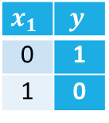



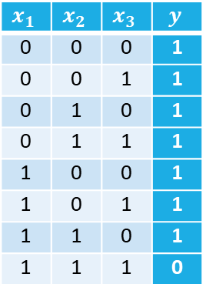




Representation of logic functions using formal neurons (2)
NAND and NOT gate can be constructed by using a negative values as weights and a threshold.
Truth table for NAND
$$x_{1}$$ | $$x_{2}$$ | $$x_{3}$$ | $$y$$
0 | 0 | 0 | 1
0 | 0 | 1 | 1
0 | 1 | 0 | 1
0 | 1 | 1 | 1
1 | 0 | 0 | 1
1 | 0 | 1 | 1
1 | 1 | 0 | 1
1 | 1 | 1 | 0
NAND
$$x_{1}$$
$$x_{1}$$
-2
$$x_{2}$$
$$y$$
$$x_{2}$$
$$−2$$
-5
$$y$$
$$x_{3}$$
-2
$$x_{3}$$
NOT
Truth table for NOT
$$x_{1}$$
$$y$$
$$x_{1}$$ | $$y$$
0 | 1
1 | 0
-2
$$x_{1}$$
-1
$$y$$
※ Any logical circuits can be constructed with only NAND gates.

Slide 17






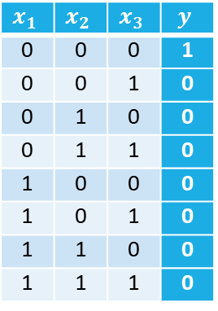


Exercise2.1
Construct a NOR gate with a formal neuron by setting appropriate weights and a threshold.
Truth table for NOR
$$x_{1}$$ | $$x_{2}$$ | $$x_{3}$$ | $$y$$
0 | 0 | 0 | 1
0 | 0 | 1 | 0
0 | 1 | 0 | 0
0 | 1 | 1 | 0
1 | 0 | 0 | 0
1 | 0 | 1 | 0
1 | 1 | 0 | 0
1 | 1 | 1 | 0
NOR
$$x_{1}$$
$$x_{1}$$
$$x_{2}$$
$$y$$
$$x_{2}$$
$$y$$
$$x_{3}$$
$$x_{3}$$

Slide 18



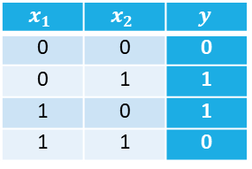
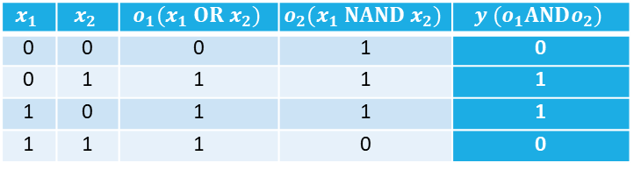





Representation of XOR function
XOR (Exclusive OR) gate is constructed as two layer logic circuit.
XOR
Truth table for XOR
$$x_{1}$$ | $$x_{2}$$ | $$y$$
0 | 0 | 0
0 | 1 | 1
1 | 0 | 1
1 | 1 | 0
$$x_{1}$$
$$y$$
$$x_{2}$$
$$x_{1}$$
$$x_{1}$$ | $$x_{2}$$ | $$o_{1}(x_{1} OR x_{2})$$ | $$o_{2}(x_{1} NAND x_{2})$$ | $$y (o_{1}ANDo_{2})$$
0 | 0 | 0 | 1 | 0
0 | 1 | 1 | 1 | 1
1 | 0 | 1 | 1 | 1
1 | 1 | 1 | 0 | 0
$$o_{1}$$
$$y$$
$$x_{2}$$
$$o_{2}$$

Slide 19


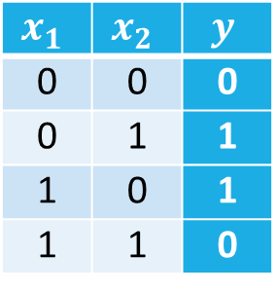

Exercise2.2
Construct a XOR gate with three formal neurons by using appropriate weighs and thresholds. Then, please check the answer by implementing a test script with all input pattern (i.e., {(0,0), (0,1), (1,0), (1,1)}) on MATLAB. Display results of mid-term calculation as necessary.
exercise2_2.m
x = [0,0,1,1;
0,1,0,1];
w = [*, *;
*, *];
h = [*;
*];
u = [*, *];
g = [*];
layer1 = FormalNeuronLayer(w,h);
layer2 = FormalNeuronLayer(u,g);
y = layer1.forward(x)
z = layer2.forward(y)
$$x_{1}$$
$$y$$
Please implement these values.
$$x_{2}$$
Truth table for XOR
$$x_{1}$$ | $$x_{2}$$ | $$y$$
0 | 0 | 0
0 | 1 | 1
1 | 0 | 1
1 | 1 | 0

Slide 20

















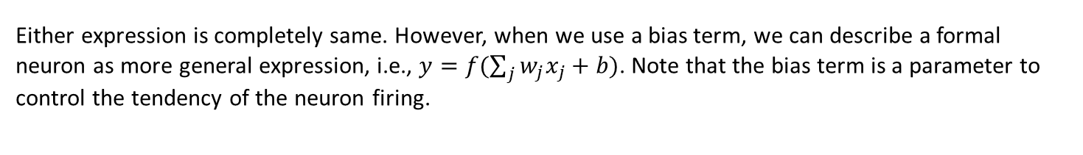







Using “a bias term” instead of a threshold
Formal neuron with threshold $h$
←threshold
$$x_{1}$$
$$w_{1}$$
$$y=\left\{\begin{aligned}0 if \sum_{j}{w_{j}x_{j}≤h} \\ &1 if \sum_{j}{w_{j}x_{j}>h}\end{aligned}\right.$$
1
$$x_{2}$$
$$w_{2}$$
$$y$$
$$h$$
$$w_{3}$$
$$x_{3}$$
$$h$$
$$x$$
Formal neuron with bias term $b$
Let $b=−h$
This is called
“Step function” or
“Heaviside function”
$$x_{1}$$
$$w_{1}$$
$$y=\left\{\begin{aligned}0 if \sum_{j}{w_{j}x_{j}+b≤0} \\ &1 if \sum_{j}{w_{j}x_{j}+b>0}\end{aligned}\right.$$
$$x_{2}$$
$$w_{2}$$
1
step
$$y$$
$$w_{3}$$
$$x_{3}$$
$$b$$
1
0
$$x$$
Either expression is completely same. However, when we use a bias term, we can describe a formal neuron as more general expression, i.e., $y=f(\sum_{j}{w_{j}x_{j}}+b)$. Note that the bias term is a parameter to control the tendency of the neuron firing.

Slide 21




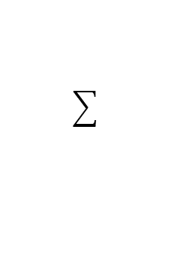







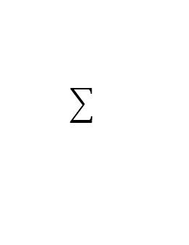
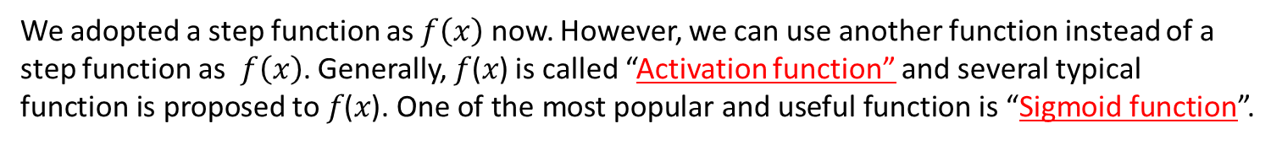









Review of Formal Neuron
$$x_{1}$$
$$w_{1}$$
Inputs
$$x_{2}$$
$$w_{2}$$
Output
$$h$$
$$y$$
$$⋮$$
$$w_{N}$$
$$x_{N}$$
Summing junction
Threshold function
$$x_{1}$$
$$w_{1}$$
Inputs
$$x_{2}$$
$$w_{2}$$
Output
$$f$$
$$y$$
$$⋮$$
$$w_{N}$$
$$x_{N}$$
$$b$$
$$1$$
Affine transformation
Step function
(Activation function)
We adopted a step function as $f\left(x\right)$ now. However, we can use another function instead of a step function as $f\left(x\right)$. Generally, 𝑓(𝑥) is called “Activation function” and several typical function is proposed to 𝑓(𝑥). One of the most popular and useful function is “Sigmoid function”.

Slide 22


【review】Multiple Layer Neural Network (Perceptron)
Generally,
Input layer
Hidden layer
Output layer
$$w_{j,i}$$
$$u_{k,j}$$
$$x_{1}$$
$$y_{1}$$
$$h_{1}$$
$$g_{1}$$
$$z_{1}$$
・・・
Input
$$x_{i}$$
$$h_{j}$$
$$g_{1}$$
$$z_{k}$$
Output
$$y_{j}$$
・・・
$$x_{I}$$
$$h_{J}$$
$$g_{K}$$
$$z_{K}$$
$$y_{J}$$

Slide 23

















Multiple Layer NN using Bias Term and Activation Function
Input layer
Hidden layer
Output layer
$$w_{j,i}$$
$$y_{1}$$
$$u_{k,j}$$
$$x_{1}$$
Step
Step
$$z_{1}$$
・・・
$$b_{1}$$
$$c_{1}$$
$$y_{j}$$
Input
$$x_{i}$$
Step
Step
$$z_{k}$$
Output
$$b_{j}$$
$$c_{k}$$
・・・
$$y_{J}$$
$$x_{I}$$
Step
Step
$$z_{K}$$
$$b_{J}$$
$$c_{K}$$

Slide 24

















Multiple Layer NN using Bias Term and Activation Function
Input layer
Affine
Step
Affine
Step
$$w_{j,i}$$
$$y_{1}$$
$$u_{k,j}$$
$$x_{1}$$
Step
Step
$$z_{1}$$
・・・
$$b_{1}$$
$$c_{1}$$
$$y_{j}$$
Input
$$x_{i}$$
Step
Step
$$z_{k}$$
Output
・・・
$$b_{j}$$
$$c_{k}$$
$$y_{J}$$
$$x_{I}$$
Step
Step
$$z_{K}$$
$$b_{J}$$
$$c_{K}$$
“Affine transformation” or “affine map “ is usually used in geometry.
Affine layer is also called “fully-connected layer”.

Slide 25
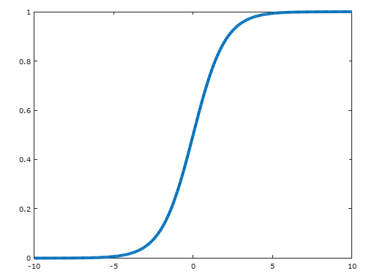
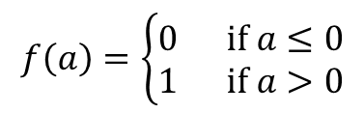
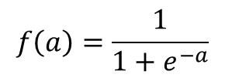
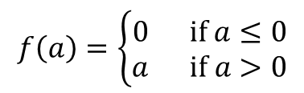
Variety of Activation Function
1
0
Step function
Sigmoid function
$$f\left(a\right)=\left\{\begin{aligned}0 if a≤0 \\ &1 if a>0\end{aligned}\right.$$
$$f\left(a\right)=\frac{1}{1+e^{−a}}$$
1
0
1
ReLU (Rectified Linear Unit)
$$f\left(a\right)=\left\{\begin{aligned}0 if a≤0 \\ &a if a>0\end{aligned}\right.$$

Slide 26
Rewriting scripts with bias term and activation function
Affine.m
FormalNeuronLayer.m
classdef Affine < handle
properties
weights;
bias;
end
methods
function obj = Affine(w,b)
obj.weights = w;
obj.bias = b;
end
function y = forward(obj, x)
p = obj.weights * x;
y = p + b;
end
end
end
classdef FormalNeuronLayer < handle
properties
weights;
threshold;
end
methods
function obj = FormalNeuronLayer(w,h)
obj.weights = w;
obj.threshold = h;
end
function y = forward(obj, x)
p = obj.weights * x;
y = p > obj.threshold;
end
end
end
Step.m
classdef Step < handle
methods
function y = forward(obj, x)
y = x > 0;
end
end
end

Slide 27



Exercise2.3
Based on the XOR function created in exercise 2.2, rewrite the neural network with bias term and step function (i.e., using a class “Affine.m” and “Step.m”) and make sure that the output does not change.
Test script
exercise2_3.m
x = [0,0,1,1;
0,1,0,1];
w = [*, *;
*, *];
b = [*;
*];
u = [*, *];
c = [*];
layer1 = Affine(w,b);
layer2 = Step();
layer3 = Affine(u,c);
layer4 = Step();
p = layer1.forward(x);
y = layer2.forward(p)
q = layer3.forward(y);
z = layer4.forward(q)
$$x_{1}$$
1
$$y$$
$$x_{2}$$
1
1
NOTE
b = -h
c = -g

Slide 28
Sigmoid Function

Slide 29
Basic operation in MATLAB (14)
Array operation on MATLAB
a =
1 2 3
4 5 6
7 8 9
b =
1 1 1
2 2 2
3 3 3
>> a.*b
ans =
1 2 3
8 10 12
21 24 27
MATLAB arithmetic operators
* Matrix multiplication
.* Array multiplication
^ Matrix power
.^ Array power
/ Matrix right division
./ Array right division
The period character ( . ) distinguishes array operations from matrix operations.

Slide 30












What’s Sigmoid Neuron
$$x_{1}$$
$$w_{1}$$
$$x_{2}$$
$$w_{2}$$
$$f$$
$$y$$
$$⋮$$
$$w_{N}$$
$$x_{N}$$
$$b$$
$$1$$
Affine transformation
Activation function
Sigmoid function
$$f\left(a\right)=\frac{1}{1+e^{−a}}$$

Slide 31
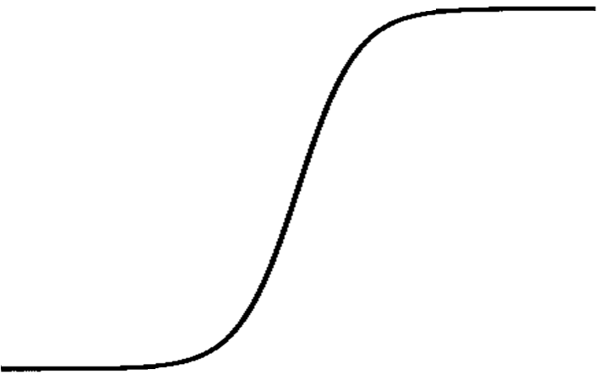








Difference Between Step Function and Sigmoid Function
Step function
$$y$$
$$w$$
1
1
$$y$$
0
1
0
$$w$$
The output value is 0 or 1 (two-value output)
Sigmoid function
$$y$$
$$w$$
1
1
$$y$$
0
1
0
$$w$$
The output value is a real number between 0 and 1.

Slide 32
Exercise2.4
Implement Sigmoid.m as follows.
Then, execute XOR function with sigmoid function and display the output values.
Sigmoid.m
exercise2_4.m
x = [0,0,1,1;
0,1,0,1];
w = [*,*;
*,*];
b = [*;
*];
u = [*, *];
c = [*];
layer1 = Affine(w,b);
layer2 = Sigmoid();
layer3 = Affine(u,c);
layer4 = Sigmoid();
p = layer1.forward(x);
y = layer2.forward(p)
q = layer3.forward(y);
z = layer4.forward(q)
classdef Sigmoid < handle
methods
function y = forward(obj, x)
y = 1 ./ (1 + exp(-x));
end
end
end
Please use the values obtained in exercise 2.3.
Please change here from Step() to Sigmoid().

Slide 33
Displaying output graph with sigmoid neuron
example2_1.m
Output graph with sigmoid neuron
x = [0,0,1,1;
0,1,0,1];
w = [2.1, 2;
-2, -2];
b = [-1;
3];
u = [2, 2];
c = [-3];
layer1 = Affine(w,b);
layer2 = Sigmoid();
layer3 = Affine(u,c);
layer4 = Sigmoid();
p = layer1.forward(x);
y = layer2.forward(p)
q = layer3.forward(y);
z = layer4.forward(q)
% Display a mesh graph of output
figure(1);
[X,Y] = meshgrid(0.00:0.01:1);
xg = [X(:), Y(:)]';
pg = layer1.forward(xg);
yg = layer2.forward(pg);
qg = layer3.forward(yg);
zg = layer4.forward(qg);
surf(X,Y,reshape(double(zg),[101,101]));
Values are for example
Please insert these codes to exercise2_4.m
We can see an output graph.

Slide 34
Displaying output graph with formal neuron
example2_2.m
x = [0,0,1,1;
0,1,0,1];
w = [2.1, 2;
-2, -2];
b = [-1;
3];
u = [2, 2];
c = [-3];
layer1 = Affine(w,b);
layer2 = Step();
layer3 = Affine(u,c);
layer4 = Step();
p = layer1.forward(x);
y = layer2.forward(p)
q = layer3.forward(y);
z = layer4.forward(q)
% Display a mesh graph of output
figure(1);
[X,Y] = meshgrid(0.00:0.01:1);
xg = [X(:), Y(:)]';
pg = layer1.forward(xg);
yg = layer2.forward(pg);
qg = layer3.forward(yg);
zg = layer4.forward(qg);
surf(X,Y,reshape(double(zg),[101,101]));
If we use a step function, what kind of graph is outputted?
?

Slide 35
Exercise 2.5
If we slightly change the value of weights or biases in exercise2_4.m, please check how the output value changes.
exercise2_5.m
x = [0,0,1,1;
0,1,0,1];
w = [*,*;
*,*];
b = [*;
*];
u = [*, *];
c = [*];
layer1 = Affine(w,b);
layer2 = Sigmoid();
layer3 = Affine(u,c);
layer4 = Sigmoid();
p = layer1.forward(x);
y = layer2.forward(p)
q = layer3.forward(y);
z = layer4.forward(q)
Change these values slightly.

Slide 36
Learning Neural Network

Slide 37



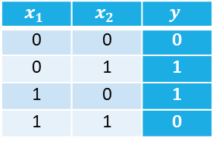



Why we use sigmoid function?
Ｉｎ the exercise 2.2 and 2.3, you could find appropriate value for the parameters (i.e, weights and thresholds).
When we want to constract larger neural network in practical, it is hard or impossible to find appropriate value with human power.
We want to find optimal parameters AUTOMATICALY.
XOR
?
$$x_{1}$$
$$x_{1}$$
$$y$$
?
?
$$x_{2}$$
?
Truth table for XOR
?
$$y$$
$$x_{1}$$ | $$x_{2}$$ | $$y$$
0 | 0 | 0
0 | 1 | 1
1 | 0 | 1
1 | 1 | 0
?
?
?
$$x_{2}$$
?

Slide 38
【review】Difference from traditional programming
Traditional Programming
Data (Inputs)
Computer
Output (Results)
Program (Rules)
Human input rules between input and output explicitly.
However, rules of real problems are complex in most cases.
Machine Learning
Computer with
Machine Learning Algorithm
Data (Inputs)
Program (Rules)
Output (Results)
Machine learning provides “automating automation”

Slide 39
Basic Idea of Learning Neural Network (1)
At first, we set random value to each parameter.
0.22
-0.13
0.16
0.36
1
0.32
-0.30
-0.25
0.22
1
1
-0.28

Slide 40
Basic Idea of Learning Neural Network (2)
We input sample data and calculate the output on the neural network with random parameter. Of course, the output value also become random.
0.22
1
-0.13
0.16
0.36
1
-0.30
-0.15
0.32
-0.25
0.22
0
1
Sample data
1
-0.28

Slide 41
Basic Idea of Learning Neural Network (2)
We input sample data and calculate the output on the neural network with random parameter. Of course, the output value also become random.
0.22
1
-0.13
0.16
0.36
1
-0.15
1
0.32
-0.30
-0.25
0.22
Correct output
(Train data)
0
1
Sample data
1
-0.28

Slide 42
Basic Idea of Learning Neural Network (2)
If you change one of the parameters slightly, please think about what the output will change.
If we change this parameter slightly,
What will happen?
0.22
1
-0.13
0.16
Compare
0.36
1
-0.15
1
0.32
-0.30
-0.25
0.22
Correct output
(Train data)
0
1
Sample data
1
-0.28

Slide 43
Difference between Formal Neuron and Sigmoid Neuron
0.22
1
-0.13
0.16
Compare
1
0.36
-0.30
-0.15
1
0.32
-0.25
0.22
Correct output
(Train data)
0
1
Sample data
1
-0.28
$$y$$
1
1
0
0
$$w$$
If we use sigmoid function, we can adjust the parameters gradually.

Slide 44
Exercise2.6
Based on the example1_5.m, create excrcise2_6.m with sigmoid function instead of formal neuron as follows. Then compare the difference between the results of example1_5.m and excrcise2_6.m
example1_5.m
exercise2_6.m
x = [0,0,0,0,1,1,1,1;...
0,0,1,1,0,0,1,1;...
0,1,0,1,0,1,0,1];
w = [0.5, 1.0, 0.5;...
0.0, 0.5, 1.0;...
1.0, 0.5, 0.0];
h = [0.5;...
1.0;...
0.0];
u = [1.0, 0.5, 0.0;...
0.5, 0.0, 1.0];
g = [1.0;...
0.0];
layer1 = FormalNeuronLayer(w,h);
layer2 = FormalNeuronLayer(u,g);
y = layer1.forward(x)
z = layer2.forward(y)
x = [0,0,0,0,1,1,1,1;
0,0,1,1,0,0,1,1;
0,1,0,1,0,1,0,1];
w = [0.5, 1.0, 0.5;
0.0, 0.5, 1.0;
1.0, 0.5, 0.0];
b = [-0.5;
-1.0;
-0.0];
u = [1.0, 0.5, 0.0;
0.5, 0.0, 1.0];
c = [-1.0;
-0.0];
layer1 = Affine(w,b);
layer2 = Sigmoid();
layer3 = Affine(u,c);
layer4 = Sigmoid();
p = layer1.forward(x);
y = layer2.forward(p)
q = layer3.forward(y);
z = layer4.forward(q)
Change

Slide 45
Loss Function

Slide 46
【review】 Basic Idea of Learning Neural Network
We input sample data and calculate the output on the neural network with random parameter. Of course, the output value also become random.
0.22
1
-0.13
Compare
0.16
0.36
1
0.50
1
0.32
-0.30
-0.25
0.22
Trainig label
for the input
0
1
-0.28
We need to evaluate how different between the output and the training label.
Input
1

Slide 47

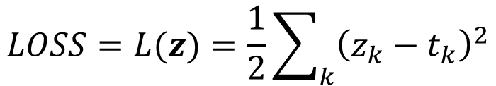
Loss Function (or Cost Function)
A loss function (or a cost function) is a function that calculates how different between an output and a training label, i.e. correct value.
One of the most useful cost function is MSE (Mean Squared Error) as follows.
$$LOSS=L(z)=\frac{1}{2}\sum_{k}{{\left(z_{k}−t_{k}\right)}^{2}}$$
where $k$ is a dimension of output ( i.e., a number of neurons in the output layer) .
MSE is always positive value.

Slide 48
Calculation Example of MSE
0.22
1
-0.13
Compare
0.16
0.36
1
-0.15
1
0.32
-0.30
-0.25
0.22
Trainig label
(Correct value
corresponding to
the input)
0
1
Input
1
-0.28
For example, we can calculate the MSE as follows.
$$LOSS=L\left(z\right)=\frac{1}{2}\sum_{k}{{\left(z_{k}−t_{k}\right)}^{2}}=\frac{1}{2}{(−0.15−1)}^{2}=0.66125$$

Slide 49





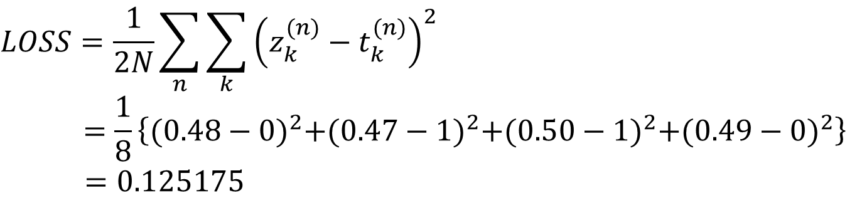







Calculation Example of MSE
0.12
0 0 1 1
-0.13
Outputs
0.96
0.76
$$z^{(1)}$$
$$z^{(2)}$$
$$z^{(3)}$$
$$z^{(4)}$$
1
-0.30
0.48 0.47 0.50 0.49
-0.82
0.25
0.22
0 1 0 1
1
0 1 1 0
$$x^{(1)}$$
$$x^{(2)}$$
$$x^{(3)}$$
$$x^{(4)}$$
-0.28
1
$$t^{(1)}$$
$$t^{(2)}$$
$$t^{(3)}$$
$$t^{(4)}$$
Inputs
Training labels
$$LOSS=\frac{1}{2N}\sum_{n}{\sum_{k}{{\left(z_{k}^{(n)}−t_{k}^{(n)}\right)}^{2}}}$$
$$=\frac{1}{8}\left\{{(0.48−0)}^{2}+{(0.47−1)}^{2}+{(0.50−1)}^{2}+{(0.49−0)}^{2}\right\}$$
$=0.125175$

Slide 50


















Multiple Layer NN with LOSS function
Input layer
Affine
Sigmoid
Affine
Sigmoid
MSE
$$w_{j,i}$$
$$y_{1}$$
$$x_{1}$$
$$u_{k,j}$$
$$z_{1}$$
MSE
・・・
$$b_{1}$$
$$c_{1}$$
$$y_{j}$$
$$z_{k}$$
Input
$$x_{i}$$
LOSS
$$b_{j}$$
$$c_{k}$$
・・・
$$y_{J}$$
$$z_{K}$$
$$x_{I}$$
$$b_{J}$$
$$c_{K}$$
Training labels
$$t_{1}・・・t_{k}・・・t_{K}$$

Slide 51
Loss function
example2_3.m
MSE.m
z
z
x = [0,0,1,1;...
0,1,0,1];
t = [0,1,1,0];
w = [0.12, -0.13;...
-0.82, 0.25];
b = [0.76;...
-0.28];
u = [0.96, -0.30];
c = [0.22];
layer1 = Affine(w,b);
layer2 = Sigmoid();
layer3 = Affine(u,c);
layer4 = Sigmoid();
layer5 = MSE();
p = layer1.forward(x);
y = layer2.forward(p)
q = layer3.forward(y);
z = layer4.forward(q)
loss = layer5.forward(z,t)
classdef MSE < handle
methods
function loss = forward(obj, z, t)
[row, col] = size(z);
loss = sum(sum((z-t).^2)) / (2*col);
end
end
end
NOTE
row ・・・ dimension of output
col・・・ a number of data

Slide 52
Exercise 2.7
Implement loss function (MSE.m), then calculate the loss value of XOR function implemented in exercise2_4.m.

Slide 53
Exercise 2.8
exercise2_8.m
z
clear all
xdata = [0,0,1,1;
0,1,0,1];
labels = [0,1,1,0];
data_num=4;
IU = 2; % a number of input neurons
HU = 2; % a number of hidden neurons
OU = 1; % a number of output neurons
% initialize weights and biases
% as random numbers between -1.0 and 1.0.
w = 2.0*rand(HU,IU) - 1.0;
b = 2.0*rand(HU,1) - 1.0;
u = 2.0*rand(OU,HU) - 1.0;
c = 2.0*rand(OU,1) - 1.0;
layer1 = Affine(w,b);
layer2 = Sigmoid();
layer3 = Affine(u,c);
layer4 = Sigmoid();
layer5 = MSE();
p = layer1.forward(xdata);
y = layer2.forward(p)
q = layer3.forward(y);
z = layer4.forward(q)
loss = layer5.forward(z,labels)
In the XOR function, set the weights and biases as a random number between -1 and 1 as following script. Then calculate and check the LOSS value.

Slide 54







How do we reduce the LOSS (1)
Focus on this weight, for example.
$$x_{1}$$
$$u_{1,1}$$
1
$$z_{1}$$
$t$ (training data)
1
Loss
$$x_{2}$$
1
$$L(u_{1,1})$$
Loss
$$u_{1,1}$$

Slide 55


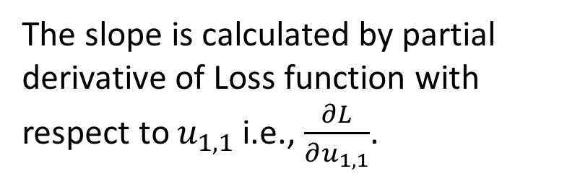
How can we reduce the LOSS (1)
Focus on this weight, for example.
$$x_{1}$$
$$u_{1,1}$$
1
$$z_{1}$$
$t$ (training data)
Loss
$$x_{2}$$
1
1
$$L(u_{1,1})$$
Loss
We can calculate slope of Loss function.
The slope is calculated by partial derivative of Loss function with respect to $u_{1,1}$ i.e., $\frac{∂L}{∂u_{1,1}}$.
$$\frac{∂L}{∂u_{1,1}}$$
$$u_{1,1}$$

Slide 56
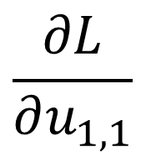
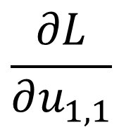



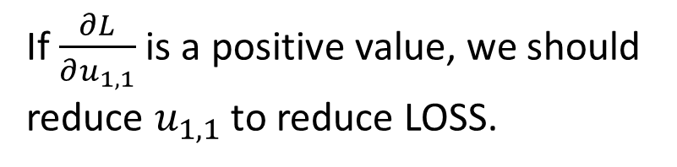

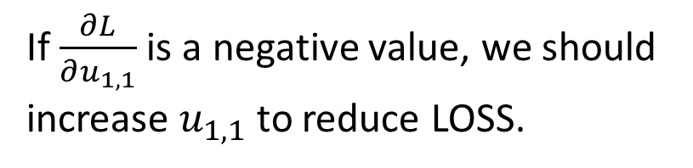
How can we reduce the LOSS (2)
$$L(u_{1,1})$$
Loss
If $\frac{∂L}{∂u_{1,1}}$ is a positive value, we should reduce $u_{1,1}$ to reduce LOSS.
$$\frac{∂L}{∂u_{1,1}}$$
$$u_{1,1}$$
Loss
$$L(u_{1,1})$$
If $\frac{∂L}{∂u_{1,1}}$ is a negative value, we should increase $u_{1,1}$ to reduce LOSS.
$$\frac{∂L}{∂u_{1,1}}$$
$$u_{1,1}$$

Slide 57

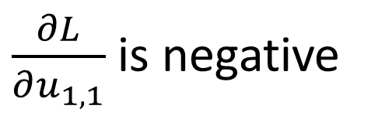

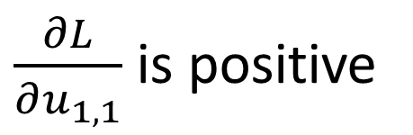

How can we reduce the LOSS (3)
Loss
$$L(u_{1,1})$$
$\frac{∂L}{∂u_{1,1}}$ is negative
$\frac{∂L}{∂u_{1,1}}$ is positive
$$u_{1,1}$$
$$u_{1,1}$$
Loss
Best point! (global minimum)
If $\frac{∂L}{∂u_{1,1}}$ is a positive value, we should reduce $u_{1,1}$ to reduce LOSS.
If $\frac{∂L}{∂u_{1,1}}$ is a negative value, we should increase $u_{1,1}$ to reduce LOSS.

Slide 58
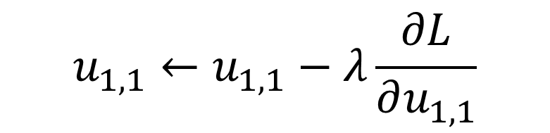

How can we reduce the LOSS (3)
Therefore, we can decline LOSS where $u_{1,1}$is updated as follows.
Update function for weights
$$u_{1,1}←u_{1,1}−λ\frac{∂L}{∂u_{1,1}}$$
We call $λ$ “learning rate”

Slide 59
Neural Network Learning

Slide 60
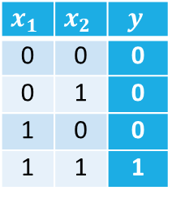
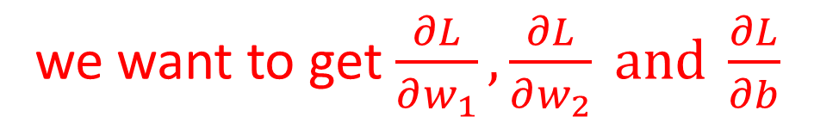












Simple example
AND
$$x_{1}$$
$$y$$
$$x_{1}$$
$$w_{1}$$
$$t$$
$$x_{2}$$
Sigmoid
$$p$$
$$y$$
$$x_{2}$$
$$w_{2}$$
MSE
$$x_{1}$$ | $$x_{2}$$ | $$y$$
0 | 0 | 0
0 | 1 | 0
1 | 0 | 0
1 | 1 | 1
$$LOSS$$
$$b$$
1
we want to get $\frac{∂L}{∂w_{1}},\frac{∂L}{∂w_{2}} and \frac{∂L}{∂b}$

Slide 61
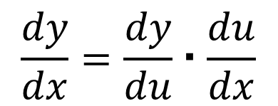
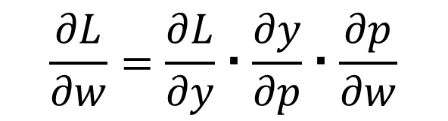
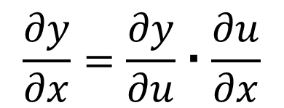
The Composite Function Rule (Chain Rule)
If $y$ is a function of $u$ and $u$ is a function of $x$ i.e, $y=f\left(u\right), u=g\left(x\right)$, then
$$\frac{dy}{dx}=\frac{dy}{du}・\frac{du}{dx}$$
・・・Chain rule
Similarly,
$$\frac{∂y}{∂x}=\frac{∂y}{∂u}・\frac{∂u}{∂x}$$
Furthermore,
$$\frac{∂L}{∂w}=\frac{∂L}{∂y}・\frac{∂y}{∂p}・\frac{∂p}{∂w}$$

Slide 62












Simple example
$$x_{1}$$
$$w_{1}$$
$$t$$
Sigmoid
$$p$$
$$y$$
$$x_{2}$$
$$w_{2}$$
MSE
$$LOSS$$
$$b$$
1
$p=\sum_{i}{w_{i}x_{i}}+b=w_{1}x_{1}$+$w_{2}x_{2}+b$
$$y=σ\left(p\right)=\frac{1}{1−e^{−p}}$$
$$LOSS=L(y)=\frac{1}{2N}\sum_{n}{{\left(y−t\right)}^{2}}$$
MSE is always positive value.

Slide 63










Simple example
Forward calculation
$$x_{1}$$
$$w_{1}$$
$$t$$
Sigmoid
$$p$$
$$y$$
$$x_{2}$$
$$w_{2}$$
MSE
$$LOSS$$
$$b$$
1
$$\frac{∂p}{∂w_{i}}=x_{i}$$
$$\frac{∂p}{∂b}=1$$
$p=\sum_{i}{w_{i}x_{i}}+b=w_{1}x_{1}$+$w_{2}x_{2}+b$
$$y=σ\left(p\right)=\frac{1}{1−e^{−p}}$$
$$\frac{∂y}{∂p}=y (1−y)$$
$$LOSS=L(y)=\frac{1}{2N}\sum_{n}{{\left(y−t\right)}^{2}}$$
$$\frac{∂L}{∂y}=y−t$$

Slide 64



【Appendix】 Differencial of Sigmoid Function
$$y=σ\left(p\right)=\frac{1}{1+e^{−p}} \\ σ^{′\left(p\right)}=\frac{−1}{{\left(1+e^{−p}\right)}^{2}}{\left(1+e^{−p}\right)}^{′} \\ =\frac{e^{−p}}{{\left(1+e^{−p}\right)}^{2}} \\ =\frac{1}{1+e^{−p}}\frac{e^{−p}}{1+e^{−p}} \\ =\frac{1}{1+e^{−p}}\left(\frac{1+e^{−p}}{1+e^{−p}}−\frac{1}{1+e^{−p}}\right) \\ =\frac{1}{1+e^{−p}}\left(1−\frac{1}{1+e^{−p}}\right) \\ =σ\left(p\right)\left(1−σ\left(p\right)\right)$$
reference
$${\left(\frac{1}{x}\right)}^{′}={\left(x^{−1}\right)}^{′} \\ =−\left(x^{−2}\right) \\ =\frac{−1}{x^{2}}$$
$${\left(\frac{1}{f(x)}\right)}^{′}={\left(f^{−1}(x)\right)}^{′} \\ =−\left(f^{−2}\left(x\right)\right)f′(x) \\ =\frac{−1}{f^{2}(x)}f′(x)$$

Slide 65












Simple example
Backward calculation
$$\frac{∂L}{∂w}=\frac{∂L}{∂p}・\frac{∂p}{∂w}$$
$$x_{1}$$
$$\frac{∂L}{∂p}＝\frac{∂L}{∂y}・\frac{∂y}{∂p}$$
$$\frac{∂L}{∂y}$$
$$t$$
Sigmoid
$$x_{2}$$
MSE
$$LOSS$$
1
$$\frac{∂p}{∂w_{i}}=x_{i}$$
$$\frac{∂p}{∂b}=1$$
$$\frac{∂y}{∂p}=y (1−y)$$
$$\frac{∂L}{∂y}=y−t$$
Chain rule
$$\frac{∂L}{∂w}=\frac{∂L}{∂y}・\frac{∂y}{∂p}・\frac{∂p}{∂w}$$

Slide 66
Implementation for Backward Calculation
MSE.m
z
classdef MSE < handle
properties
z;
t;
end
methods
function loss = forward(obj, z, t)
obj.z = z;
obj.t = t;
[row, col] = size(z);
loss = sum(sum((z-t).^2)) / (2*col);
end
function dL = backward(obj)
dL = obj.z - obj.t;
end
end
end
In this class we use variable “z” instead of “y”.
$$t$$
MSE
$$LOSS$$
$$\frac{∂L}{∂y}=y−t$$

Slide 67



Implementation for Backward Calculation
Sigmoid.m
z
dL
dL0
classdef Sigmoid < handle
properties
y;
end
methods
function y = forward(obj, x)
y = 1 ./ (1 + exp(-x));
obj.y = y;
end
function dL = backward(obj, dL0)
dL = dL0 .* obj.y .* (1.0 - obj.y);
end
end
end
$$\frac{∂L}{∂p}＝\frac{∂L}{∂y}・\frac{∂y}{∂p}$$
$$\frac{∂L}{∂y}$$
Sigmoid
$$\frac{∂y}{∂p}=y (1−y)$$

Slide 68






Implementation for Backward Calculation
Affine.m
z
This script is applicable to matrix calculation.
I will explain tomorrow for details!
classdef Affine < handle
properties
weights;
bias;
x;
dw;
db;
end
methods
function obj = Affine(w,b)
obj.weights = w;
obj.bias = b;
end
function y = forward(obj, x)
obj.x = x;
p = obj.weights * x;
y = p + obj.bias;
end
function dL = backward(obj, dL0)
dL = obj.weights' * dL0;
obj.dw = dL0 * obj.x';
obj.db = sum(dL0, 2);
end
function update(obj, learning_rate)
obj.weights = obj.weights - learning_rate * obj.dw;
obj.bias = obj.bias - learning_rate * obj.db;
end
end
end
dL
dL0
$$\frac{∂L}{∂w}=\frac{∂L}{∂p}・\frac{∂p}{∂w}$$
$$\frac{∂L}{∂p}$$
$$x_{1}$$
$$x_{2}$$
1
$$\frac{∂p}{∂w_{i}}=x_{i}$$
$$\frac{∂p}{∂b}=1$$

Slide 69






















Outline of Learning Neural Network
$$w_{1,1}$$
Calculation for outputs
from inputs
$$y_{1,1}$$
Feedforward calculation
$$x_{1}$$
$$w_{1,2}$$
$$u_{1,1}$$
$$b_{1}$$
$$u_{1,2}$$
$$z_{1}$$
$$w_{2,1}$$
$$y_{1,2}$$
$$x_{2}$$
$$w_{2,2}$$
$$c_{1}$$
LOSS Calculation
$$b_{2}$$
$$w_{1,1}$$
Updating weights and biases
to reduce LOSS
$$y_{1,1}$$
backwards propagation of LOSS
$$x_{1}$$
$$w_{1,2}$$
$$u_{1,1}$$
$$w_{2,1}$$
$$b_{1}$$
$$u_{1,2}$$
$$z_{1}$$
$$y_{1,2}$$
$$x_{2}$$
$$w_{2,2}$$
$$c_{1}$$
$$b_{2}$$

Slide 70




Let’s make AND function by learning
example2_4.m
z
AND
clear all
xdata = [0,0,1,1;
0,1,0,1];
labels = [0,0,0,1];
data_num=4;
w = 2.0*rand(1,2) - 1.0;
b = 2.0*rand(1,1) - 1.0;
layer1 = Affine(w,b);
layer2 = Sigmoid();
layer3 = MSE();
% a number of training
EPOCH=1000;
% learning rate
LAMBDA=0.1;
$$x_{1}$$
for epoch=1:EPOCH
p = layer1.forward(xdata);
y = layer2.forward(p);
loss(epoch) = layer3.forward(y,labels);
%calculate gradient
dy = layer3.backward();
dp = layer2.backward(dy);
dx = layer1.backward(dp);
%learning weights and biases
layer1.update(LAMBDA);
end
loss
% Display loss change graph
figure(1);
plot(loss)
xlabel('Epoch');
ylabel('LOSS');
$$y$$
$$x_{2}$$
$$x_{1}$$ | $$x_{2}$$ | $$y$$
0 | 0 | 0
0 | 1 | 0
1 | 0 | 0
1 | 1 | 1

Slide 71



Exercise2.9
Check the values of output y, layer1.weights and layer1.bias after learning in example2_4.m.
$$w=$$
$$b=$$
$$y=$$

Slide 72
Let’s make XOR function by learning
example2_5.m
z
clear all
xdata = [0,0,1,1;
0,1,0,1];
labels = [0,1,1,0];
data_num=4;
IU = 2; % a number of input neurons
HU = 2; % a number of hidden neurons
OU = 1; % a number of output neurons
% initialize weights and biases
% as random numbers between -1.0 and 1.0.
w = 2.0*rand(HU,IU) - 1.0;
b = 2.0*rand(HU,1) - 1.0;
u = 2.0*rand(OU,HU) - 1.0;
c = 2.0*rand(OU,1) - 1.0;
layer1 = Affine(w,b);
layer2 = Sigmoid();
layer3 = Affine(u,c);
layer4 = Sigmoid();
layer5 = MSE();
EPOCH=1000; % a number of training epochs
LAMBDA=0.1; % learning rate
for epoch=1:EPOCH
p = layer1.forward(xdata);
y = layer2.forward(p);
q = layer3.forward(y);
z = layer4.forward(q);
loss(epoch) = layer5.forward(z,labels);
%calculate gradient
dz = layer5.backward();
dq = layer4.backward(dz);
dy = layer3.backward(dq);
dp = layer2.backward(dy);
dx = layer1.backward(dp);
%learning weights and biases
layer1.update(LAMBDA);
layer3.update(LAMBDA);
end
loss
% Display loss change graph
figure(1);
plot(loss)
xlabel('Epoch');
ylabel('LOSS');

Slide 73




Exercise2.10
Check the values of weights and biases after learning in example2_5.m and write down these values to one places of decimals. Then, calculate XOR output by your hand calculation with step function.
$$w=$$
$$b=$$
$$u=$$
$$c=$$

Slide 74




Exercise2.11
At first, freely define a 3 input 1 output logic function. Then freely design the neural network and make the logic function by learning.
$$x_{1}$$
Neural Network
X1 | X2 | X3 | Y
0 | 0 | 0
0 | 0 | 1
0 | 1 | 0
0 | 1 | 1
1 | 0 | 0
1 | 0 | 1
1 | 1 | 0
1 | 1 | 1
$$x_{2}$$
$$y$$
$$x_{3}$$
For example
・Only 1 neuron
・Single layer NN with 3 neuron
・Two layer NN with 3 neuron in in hidden layer and 3 neuron in output layer

