Slide 1
Learning Neural Network - Backpropagation -
Day3

Slide 2


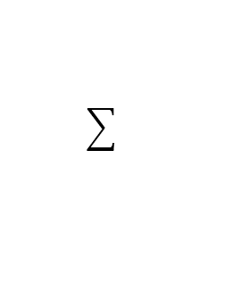


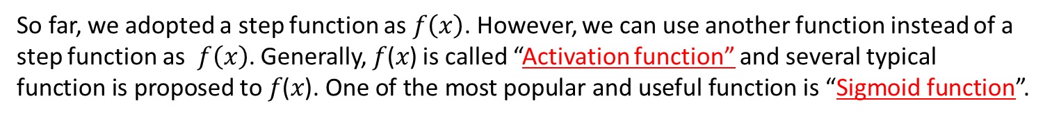

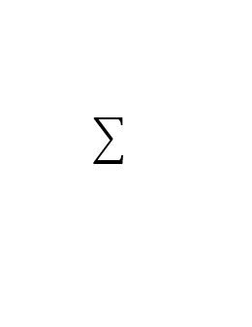















【Review】 Introduction of Activation function
$$x_{1}$$
$$w_{1}$$
Inputs
$$x_{2}$$
$$w_{2}$$
Output
$$h$$
$$y$$
$$⋮$$
$$w_{N}$$
$$x_{N}$$
Summing junction
Threshold function
$$x_{1}$$
$$w_{1}$$
Inputs
$$x_{2}$$
$$w_{2}$$
Output
$$f$$
$$y$$
$$⋮$$
$$w_{N}$$
$$x_{N}$$
$$b$$
$$1$$
Summing junction
Step function
So far, we adopted a step function as $f\left(x\right)$. However, we can use another function instead of a step function as $f\left(x\right)$. Generally, 𝑓(𝑥) is called “Activation function” and several typical function is proposed to 𝑓(𝑥). One of the most popular and useful function is “Sigmoid function”.

Slide 3
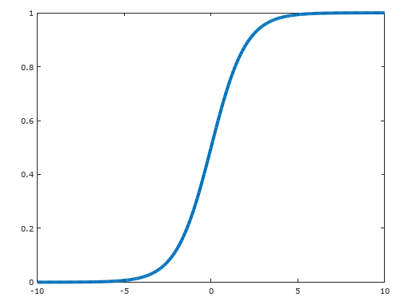
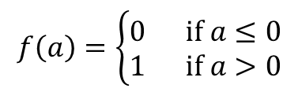
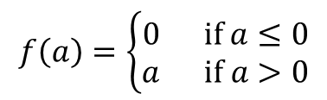
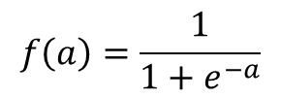
【Review】 Variety of Activation Function
1
0
Step function
Sigmoid function
$$f\left(a\right)=\left\{\begin{aligned}0 if a≤0 \\ &1 if a>0\end{aligned}\right.$$
$$f\left(a\right)=\frac{1}{1+e^{−a}}$$
1
Usually for regression
0
1
ReLU (Rectified Linear Unit)
$$f\left(a\right)=\left\{\begin{aligned}0 if a≤0 \\ &a if a>0\end{aligned}\right.$$
Usually for classification

Slide 4












【Review】What’s Sigmoid Neuron
$$x_{1}$$
$$w_{1}$$
$$x_{2}$$
$$w_{2}$$
$$f$$
$$y$$
$$⋮$$
$$w_{N}$$
$$x_{N}$$
$$b$$
$$1$$
Summing junction
Activation function
Sigmoid function
$$f\left(a\right)=\frac{1}{1+e^{−a}}$$

Slide 5
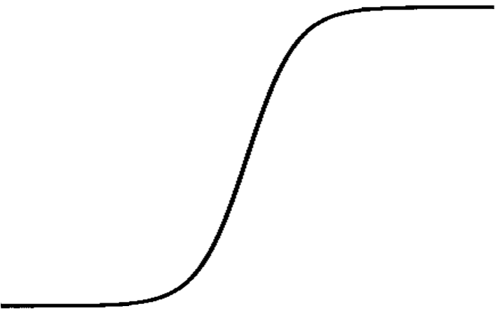








【Review】 Difference between Formal Neuron and Sigmoid Neuron
Formal neuron
$$y$$
$$w$$
1
1
$$y$$
0
1
0
$$w$$
The output value is 0 or 1 (two-value output)
Sigmoid neuron
$$y$$
$$w$$
1
1
$$y$$
0
1
0
$$w$$
The output value is a real number between 0 and 1.

Slide 6
【Review】 Difference between Formal Neuron and Sigmoid Neuron
0.22
1
-0.13
0.16
Compare
1
0.36
-0.30
-0.15
1
0.32
-0.25
0.22
Correct output
(Train data)
0
1
Sample data
1
-0.28
$$y$$
1
1
0
0
$$w$$
If we use sigmoid neuron, we can adjust the parameters gradually.

Slide 7
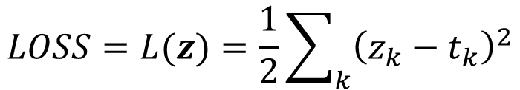
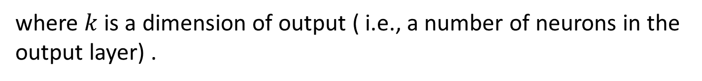
【Review】 Introduction of Loss Function (or Cost Function)
A loss function (or a cost function) is a function that calculates how different between an output and a training value. One of the most useful cost function is MSE (Mean Squared Error) as follows.
$$LOSS=L(z)=\frac{1}{2}\sum_{k}{{\left(z_{k}−t_{k}\right)}^{2}}$$
where $k$ is a dimension of output ( i.e., a number of neurons in the output layer) .

Slide 8
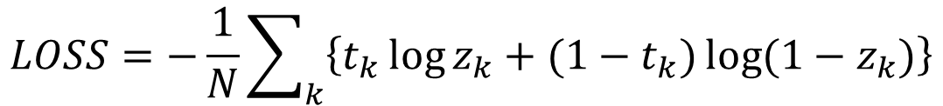
【Appendix】 Another function for Loss function
Another useful cost function is “Cross Entropy” as follows
$$LOSS=−\frac{1}{N}\sum_{k}{\left\{t_{k}\log{z_{k}}+(1−t_{k})\log{(1−z_{k})}\right\}}$$
Cross entropy provides high performance to learn neural network and good compatibility with Sigmoid function.
However, intuitively hard to understand

Slide 9

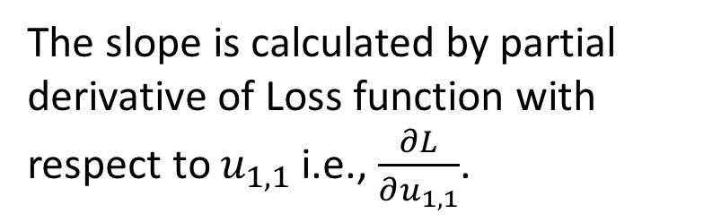







【review】 How can we reduce the LOSS (1)
Focus on this weight, for example.
$$x_{1}$$
$$u_{1,1}$$
1
$$z_{1}$$
$t$ (training data)
Loss
$$x_{2}$$
1
1
$$L(u_{1,1})$$
Loss
We can calculate slope of Loss function.
The slope is calculated by partial derivative of Loss function with respect to $u_{1,1}$ i.e., $\frac{∂L}{∂u_{1,1}}$.
$$\frac{∂L}{∂u_{1,1}}$$
$$u_{1,1}$$

Slide 10
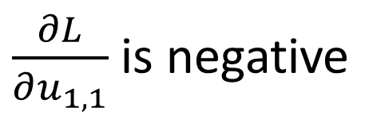

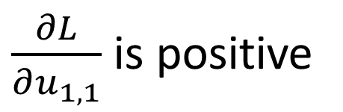


【Review】 How can we reduce the LOSS (2)
Loss
$$L(u_{1,1})$$
$\frac{∂L}{∂u_{1,1}}$ is negative
$\frac{∂L}{∂u_{1,1}}$ is positive
$$u_{1,1}$$
$$u_{1,1}$$
Loss
Best point! (global minimum)
If $\frac{∂L}{∂u_{1,1}}$ is a positive value, we should reduce $u_{1,1}$ to reduce LOSS.
If $\frac{∂L}{∂u_{1,1}}$ is a negative value, we should increase $u_{1,1}$ to reduce LOSS.

Slide 11
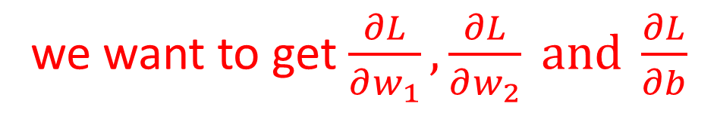









【Review】 Simple example
$$x_{1}$$
$$w_{1}$$
$$t$$
Sigmoid
$$p$$
$$y$$
$$x_{2}$$
$$w_{2}$$
MSE
$$LOSS$$
$$b$$
1
we want to get $\frac{∂L}{∂w_{1}},\frac{∂L}{∂w_{2}} and \frac{∂L}{∂b}$

Slide 12
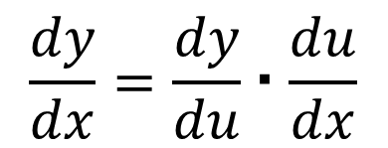
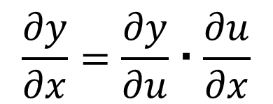
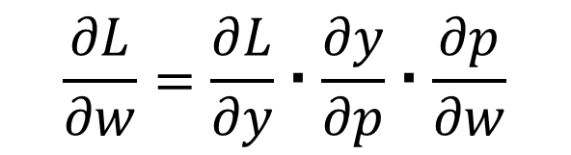
【Review】 The Composite Function Rule (Chain Rule)
If $y$ is a function of $u$ and $u$ is a function of $x$ i.e, $y=f\left(u\right), u=g\left(x\right)$, then
$$\frac{dy}{dx}=\frac{dy}{du}・\frac{du}{dx}$$
・・・Chain rule
Similarly,
$$\frac{∂y}{∂x}=\frac{∂y}{∂u}・\frac{∂u}{∂x}$$
Furthermore,
$$\frac{∂L}{∂w}=\frac{∂L}{∂y}・\frac{∂y}{∂p}・\frac{∂p}{∂w}$$

Slide 13
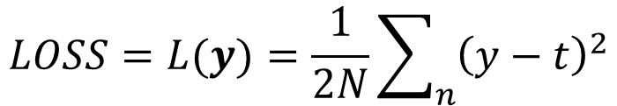
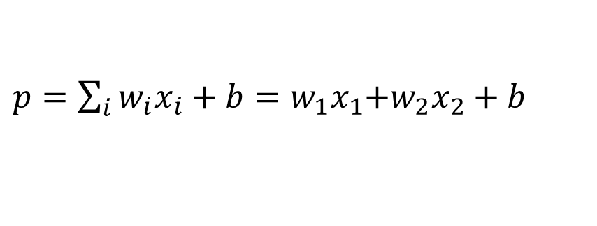
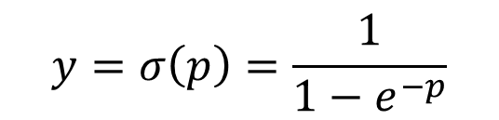









【Review】 Simple example
Forward calculation
$$x_{1}$$
$$w_{1}$$
$$t$$
Sigmoid
$$p$$
$$y$$
$$x_{2}$$
$$w_{2}$$
MSE
$$LOSS$$
$$b$$
1
$p=\sum_{i}{w_{i}x_{i}}+b=w_{1}x_{1}$+$w_{2}x_{2}+b$
$$y=σ\left(p\right)=\frac{1}{1−e^{−p}}$$
$$LOSS=L(y)=\frac{1}{2N}\sum_{n}{{\left(y−t\right)}^{2}}$$
MSE is always positive value.

Slide 14
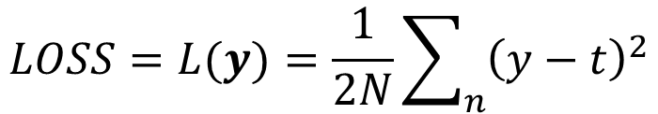
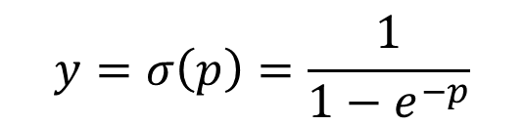

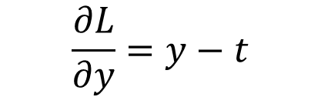
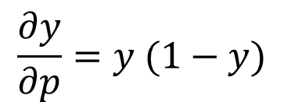
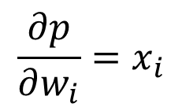
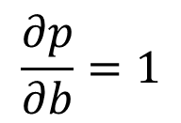
【Review】 Simple example
Forward calculation
$$x_{1}$$
$$w_{1}$$
$$t$$
Sigmoid
$$p$$
$$y$$
$$x_{2}$$
$$w_{2}$$
MSE
$$LOSS$$
$$b$$
1
$$\frac{∂p}{∂w_{i}}=x_{i}$$
$$\frac{∂p}{∂b}=1$$
$p=\sum_{i}{w_{i}x_{i}}+b=w_{1}x_{1}$+$w_{2}x_{2}+b$
$$y=σ\left(p\right)=\frac{1}{1−e^{−p}}$$
$$\frac{∂y}{∂p}=y (1−y)$$
$$LOSS=L(y)=\frac{1}{2N}\sum_{n}{{\left(y−t\right)}^{2}}$$
$$\frac{∂L}{∂y}=y−t$$

Slide 15

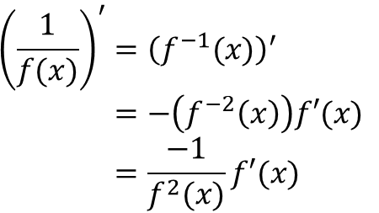

【Appendix】 Differencial of Sigmoid Function
$$y=σ\left(p\right)=\frac{1}{1+e^{−p}} \\ σ^{′\left(p\right)}=\frac{−1}{{\left(1+e^{−p}\right)}^{2}}{\left(1+e^{−p}\right)}^{′} \\ =\frac{e^{−p}}{{\left(1+e^{−p}\right)}^{2}} \\ =\frac{1}{1+e^{−p}}\frac{e^{−p}}{1+e^{−p}} \\ =\frac{1}{1+e^{−p}}\left(\frac{1+e^{−p}}{1+e^{−p}}−\frac{1}{1+e^{−p}}\right) \\ =\frac{1}{1+e^{−p}}\left(1−\frac{1}{1+e^{−p}}\right) \\ =σ\left(p\right)\left(1−σ\left(p\right)\right)$$
reference
$${\left(\frac{1}{x}\right)}^{′}={\left(x^{−1}\right)}^{′} \\ =−\left(x^{−2}\right) \\ =\frac{−1}{x^{2}}$$
$${\left(\frac{1}{f(x)}\right)}^{′}={\left(f^{−1}(x)\right)}^{′} \\ =−\left(f^{−2}\left(x\right)\right)f′(x) \\ =\frac{−1}{f^{2}(x)}f′(x)$$

Slide 16
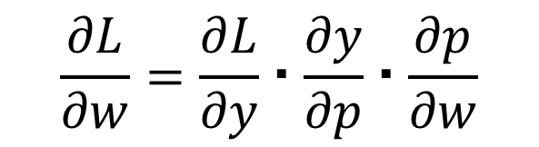
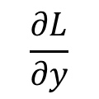

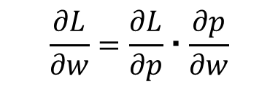







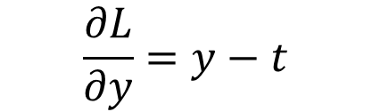
【Review】 Simple example
Backward calculation
$$\frac{∂L}{∂w}=\frac{∂L}{∂p}・\frac{∂p}{∂w}$$
$$x_{1}$$
$$\frac{∂L}{∂p}＝\frac{∂L}{∂y}・\frac{∂y}{∂p}$$
$$\frac{∂L}{∂y}$$
$$t$$
Sigmoid
$$x_{2}$$
MSE
$$LOSS$$
1
$$\frac{∂p}{∂w_{i}}=x_{i}$$
$$\frac{∂p}{∂b}=1$$
$$\frac{∂y}{∂p}=y (1−y)$$
$$\frac{∂L}{∂y}=y−t$$
Chain rule
$$\frac{∂L}{∂w}=\frac{∂L}{∂y}・\frac{∂y}{∂p}・\frac{∂p}{∂w}$$

Slide 17
【Review】 Implementation for Backward Calculation
MSE.m
z
classdef MSE < handle
properties
z;
t;
end
methods
function loss = forward(obj, z, t)
obj.z = z;
obj.t = t;
[row, col] = size(z);
loss = sum(sum((z-t).^2)) / (2*col);
end
function dL = backward(obj)
dL = obj.z - obj.t;
end
end
end
In this class we use variable “z” instead of “y”.
$$t$$
MSE
$$LOSS$$
$$\frac{∂L}{∂y}=y−t$$

Slide 18



【Review】 Implementation for Backward Calculation
Sigmoid.m
z
dL
dL0
classdef Sigmoid < handle
properties
y;
end
methods
function y = forward(obj, x)
y = 1 ./ (1 + exp(-x));
obj.y = y;
end
function dL = backward(obj, dL0)
dL = dL0 .* obj.y .* (1.0 - obj.y);
end
end
end
$$\frac{∂L}{∂p}＝\frac{∂L}{∂y}・\frac{∂y}{∂p}$$
$$\frac{∂L}{∂y}$$
Sigmoid
$$\frac{∂y}{∂p}=y (1−y)$$

Slide 19



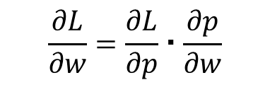


【Review】 Implementation for Backward Calculation
Affine.m
z
This script is applicable to matrix calculation.
I will explain tomorrow for details!
classdef Affine < handle
properties
weights;
bias;
x;
dw;
db;
end
methods
function obj = Affine(w,b)
obj.weights = w;
obj.bias = b;
end
function y = forward(obj, x)
obj.x = x;
p = obj.weights * x;
y = p + obj.bias;
end
function dL = backward(obj, dL0)
dL = obj.weights' * dL0;
obj.dw = dL0 * obj.x';
obj.db = sum(dL0, 2);
end
function update(obj, learning_rate)
obj.weights = obj.weights - learning_rate * obj.dw;
obj.bias = obj.bias - learning_rate * obj.db;
end
end
end
dL
dL0
$$\frac{∂L}{∂w}=\frac{∂L}{∂p}・\frac{∂p}{∂w}$$
$$\frac{∂L}{∂p}$$
$$x_{1}$$
$$x_{2}$$
1
$$\frac{∂p}{∂w_{i}}=x_{i}$$
$$\frac{∂p}{∂b}=1$$

Slide 20






















【review】Outline of Learning Neural Network
$$w_{1,1}$$
Calculation for outputs
from inputs
$$y_{1,1}$$
Feedforward calculation
$$x_{1}$$
$$w_{1,2}$$
$$u_{1,1}$$
$$b_{1}$$
$$u_{1,2}$$
$$z_{1}$$
$$w_{2,1}$$
$$y_{1,2}$$
$$x_{2}$$
$$w_{2,2}$$
$$c_{1}$$
LOSS Calculation
$$b_{2}$$
$$w_{1,1}$$
Updating weights and biases
to reduce LOSS
$$y_{1,1}$$
backwards propagation of LOSS
$$x_{1}$$
$$w_{1,2}$$
$$u_{1,1}$$
$$w_{2,1}$$
$$b_{1}$$
$$u_{1,2}$$
$$z_{1}$$
$$y_{1,2}$$
$$x_{2}$$
$$w_{2,2}$$
$$c_{1}$$
$$b_{2}$$

Slide 21


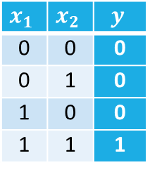

【Review】 Let’s make AND function by learning
example2_4.m
z
AND
clear all
xdata = [0,0,1,1;
0,1,0,1];
labels = [0,0,0,1];
data_num=4;
w = 2.0*rand(1,2) - 1.0;
b = 2.0*rand(1,1) - 1.0;
layer1 = Affine(w,b);
layer2 = Sigmoid();
layer3 = MSE();
% a number of training
EPOCH=1000;
% learning rate
LAMBDA=0.1;
$$x_{1}$$
for epoch=1:EPOCH
p = layer1.forward(xdata);
y = layer2.forward(p);
loss(epoch) = layer3.forward(y,labels);
%calculate gradient
dy = layer3.backward();
dp = layer2.backward(dy);
dx = layer1.backward(dp);
%learning weights and biases
layer1.update(LAMBDA);
end
loss
% Display loss change graph
figure(1);
plot(loss)
xlabel('Epoch');
ylabel('LOSS');
$$y$$
$$x_{2}$$
$$x_{1}$$ | $$x_{2}$$ | $$y$$
0 | 0 | 0
0 | 1 | 0
1 | 0 | 0
1 | 1 | 1

Slide 22



【Review】 Exercise2.9
Check the values of output y, layer1.weights and layer1.bias after learning in example2_4.m.
$$w=$$
$$b=$$
$$y=$$

Slide 23
【Review】 Let’s make XOR function by learning
example2_5.m
z
clear all
xdata = [0,0,1,1;
0,1,0,1];
labels = [0,1,1,0];
data_num=4;
IU = 2; % a number of input neurons
HU = 2; % a number of hidden neurons
OU = 1; % a number of output neurons
% initialize weights and biases
% as random numbers between -1.0 and 1.0.
w = 2.0*rand(HU,IU) - 1.0;
b = 2.0*rand(HU,1) - 1.0;
u = 2.0*rand(OU,HU) - 1.0;
c = 2.0*rand(OU,1) - 1.0;
layer1 = Affine(w,b);
layer2 = Sigmoid();
layer3 = Affine(u,c);
layer4 = Sigmoid();
layer5 = MSE();
EPOCH=1000; % a number of training epochs
LAMBDA=0.1; % learning rate
for epoch=1:EPOCH
p = layer1.forward(xdata);
y = layer2.forward(p);
q = layer3.forward(y);
z = layer4.forward(q);
loss(epoch) = layer5.forward(z,labels);
%calculate gradient
dz = layer5.backward();
dq = layer4.backward(dz);
dy = layer3.backward(dq);
dp = layer2.backward(dy);
dx = layer1.backward(dp);
%learning weights and biases
layer1.update(LAMBDA);
layer3.update(LAMBDA);
end
loss
% Display loss change graph
figure(1);
plot(loss)
xlabel('Epoch');
ylabel('LOSS');

Slide 24




【Review】 Exercise2.10
Check the values of weights and biases after learning in example2_5.m and write down these values to one places of decimals. Then, calculate XOR output by your hand calculation with step function.
$$w=$$
$$b=$$
$$u=$$
$$c=$$

Slide 25




【Review】 Exercise2.11
At first, freely define a 3 input 1 output logic function. Then freely design the neural network and make the logic function by learning.
$$x_{1}$$
Neural Network
X1 | X2 | X3 | Y
0 | 0 | 0
0 | 0 | 1
0 | 1 | 0
0 | 1 | 1
1 | 0 | 0
1 | 0 | 1
1 | 1 | 0
1 | 1 | 1
$$x_{2}$$
$$y$$
$$x_{3}$$
For example
・Only 1 neuron
・Single layer NN with 3 neuron
・Two layer NN with 3 neuron in in hidden layer and 3 neuron in output layer

Slide 26




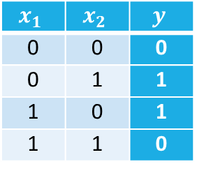









Exercise 3.1
Construct a neural network with 2 input neurons, 2 hidden neurons and 1 output neuron as follows. Then learning the neural network for 2-input XOR function. Truth table for 2-input XOR is shown below. After learning, please check loss value, obtained weights and biases and check feed forward calculation with step function by yourself.
Truth table for 2-input XOR
$$w_{j,i}$$
$$y_{1}$$
2-input XOR
$$x_{1}$$ | $$x_{2}$$ | $$y$$
0 | 0 | 0
0 | 1 | 1
1 | 0 | 1
1 | 1 | 0
$$x_{1}$$
$$x_{1}$$
$$u_{1,j}$$
$$b_{1}$$
$$z$$
$$z$$
$$y_{2}$$
$$x_{2}$$
$$x_{2}$$
$$c_{1}$$
$$b_{2}$$

Slide 27




Exercise 3.2
Construct a neural network with 2 input neurons and only 1 output neuron as follows. Then learning the neural network for 2-input XOR function. Truth table for 2-input XOR is shown below. After learning, please check obtained weights and biases and check feed forward calculation with step function by yourself.
Truth table for 2-input XOR
$$x_{1}$$
2-input XOR
$$x_{1}$$ | $$x_{2}$$ | $$y$$
0 | 0 | 0
0 | 1 | 1
1 | 0 | 1
1 | 1 | 0
$$w_{j,i}$$
$$x_{1}$$
$$y_{1}$$
$$z$$
$$z$$
$$x_{2}$$
$$x_{2}$$
$$b_{1}$$

Slide 28








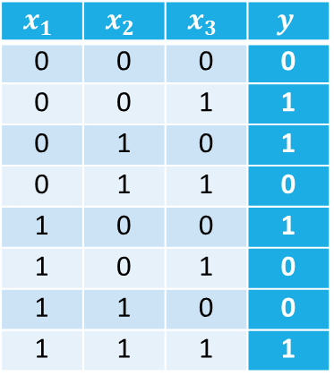





Exercise 3.3
Construct a neural network with 3 input neuron, 3 hidden neuron and 1 output neuron as follows. Then learning the neural network for 3-input XOR function. Truth table for 3-input XOR is shown below. After learning, please check obtained weights and biases and confirm feed forward calculation with step function by yourself.
3-input XOR
$$x_{1}$$
$$w_{j,i}$$
$$x_{2}$$
$$z$$
Truth table for 3-input XOR
$$x_{1}$$
$$y_{1}$$
$$x_{3}$$
$$x_{1}$$ | $$x_{2}$$ | $$x_{3}$$ | $$y$$
0 | 0 | 0 | 0
0 | 0 | 1 | 1
0 | 1 | 0 | 1
0 | 1 | 1 | 0
1 | 0 | 0 | 1
1 | 0 | 1 | 0
1 | 1 | 0 | 0
1 | 1 | 1 | 1
$$b_{1}$$
$$u_{1,j}$$
$$x_{2}$$
$$y_{2}$$
$$z$$
$$b_{2}$$
$$c_{1}$$
$$x_{3}$$
$$y_{3}$$
$$b_{3}$$

Slide 29
Exercise 3.4
Construct a neural network with 3 input neuron, 2 hidden neuron and 1 output neuron as follows. Then learning the neural network for 3-input XOR function. Truth table for 3-input XOR is shown below. After learning, please check obtained weights and biases and confirm feed forward calculation with step function by yourself.
3-input XOR
$$x_{1}$$
$$x_{2}$$
$$z$$
Truth table for 3-input XOR
$$x_{1}$$
$$w_{j,i}$$
$$x_{3}$$
$$x_{1}$$ | $$x_{2}$$ | $$x_{3}$$ | $$y$$
0 | 0 | 0 | 0
0 | 0 | 1 | 1
0 | 1 | 0 | 1
0 | 1 | 1 | 0
1 | 0 | 0 | 1
1 | 0 | 1 | 0
1 | 1 | 0 | 0
1 | 1 | 1 | 1
$$y_{1}$$
$$u_{1,j}$$
$$x_{2}$$
$$b_{1}$$
$$z$$
$$c_{1}$$
$$y_{2}$$
$$x_{3}$$
$$b_{2}$$

Slide 30


Exercise 3.5
Construct a neural network with 3 input neurons and only 1 output neuron as follows. Then learning the neural network for 3-input XOR function. Truth table for 3-input XOR is shown below. After learning, please check obtained weights and biases and confirm feed forward calculation with step function by yourself.
3-input XOR
$$x_{1}$$
$$x_{2}$$
$$z$$
Truth table for 3-input XOR
$$x_{1}$$
$$x_{3}$$
$$x_{1}$$ | $$x_{2}$$ | $$x_{3}$$ | $$y$$
0 | 0 | 0 | 0
0 | 0 | 1 | 1
0 | 1 | 0 | 1
0 | 1 | 1 | 0
1 | 0 | 0 | 1
1 | 0 | 1 | 0
1 | 1 | 0 | 0
1 | 1 | 1 | 1
$$w_{j,i}$$
$$x_{2}$$
$$z$$
$$b_{1}$$
$$x_{3}$$

Slide 31
3-input XOR
[0, 1, 1]
[1, 1, 1]
[0, 1, 0]
[1, 1, 0]
[0, 0, 1]
[1, 0, 1]
[0, 0, 0]
[1, 0, 0]

Slide 32
3-input XOR
[0, 1, 1]
[1, 1, 1]
[0, 1, 0]
[1, 1, 0]
[0, 0, 1]
[1, 0, 1]
[0, 0, 0]
[1, 0, 0]

Slide 33
NN Learning for Mathematical Functions

Slide 34















Learning sin function using neural network
$$w_{1,1}$$
$$y_{1}$$
Random value between 0 and 15
$$b_{1}$$
$$u_{1,1}$$
$$w_{2,1}$$
$$y_{2}$$
$$u_{2,1}$$
$$x$$
$$z_{1}$$
$$u_{3,1}$$
$$w_{3,1}$$
$$b_{2}$$
$$y_{3}$$
$$c_{1}$$
Training data from sin finction
$$b_{3}$$

Slide 35
Generating sin data and display the result graph
Example3_1.m
The labels are normalized to a value from 0 to 1 because output value (output of sigmoid function) is between 0 and 1.
z
data_num=50;
xdata = 15*rand(1,data_num);
labels = (sin(xdata)+1)/2; % between 0 and 1
figure(1);
scatter(xdata, labels);
Neural network construction
and learning code.
( Please substitute various values ​​for hidden neuron size, epoch number, learning rate and try.)
% Display loss change graph
figure(2);
plot(loss)
axis([0 EPOCH 0 max(loss)])
xlabel('Epoch');
ylabel('LOSS');
% Display output graph
xt = [0:0.01:15];
pt = layer1.forward(xt);
yt = layer2.forward(pt);
qt = layer3.forward(yt);
zt = layer4.forward(qt);
figure(3);
plot(xt,zt)
Input data
learning result

Slide 36
Exercise 3.6
Construct neural network with 1 input, 3-30 hidden, 1 output neurons. Then, learning neural network for sin function normalized to a value from 0 to 1.
Change a number of hidden neuron, learning rate, a number of epoch and a number of xdata (input data) and consider about the output results.

Slide 37


Exercise 3.7
Construct neural network with 2 input ($x_{1},x_{2}$), 3-30 hidden, 1 output neurons. Then, learning neural network for following function.
Change a number of hidden neuron, learning rate and a number of epoch and consider about the output results.
$$z=x_{1}e^{x_{1}^{2}−x_{2}^{2}}+\frac{1}{2}$$
Tips for exercise3_7.m
z
%data generation
data_num=300;
xdata = 4*rand(2,data_num)-2;
labels = xdata(1,:).*exp(-xdata(1,:).^2 - xdata(2,:).^2) + 0.5;

Slide 38
Tips for exercise3_7.m
z
%display input data
figure(1);
scatter3(xdata(1,:), xdata(2,:), labels, 10);
title('input data');
z
% Display output graph
[X1 X2] = meshgrid(-2:0.1:2);
pt = layer1.forward([X1(:)';X2(:)']);
yt = layer2.forward(pt);
qt = layer3.forward(yt);
zt = layer4.forward(qt);
figure(3);
zsize = sqrt(size(zt));
mesh(X1,X2,reshape(zt,[zsize(2),zsize(2)]));
title('learning results')
?
Learning result

