Slide 1
101DB-Modelling

Slide 2
Relational-databases
Entities have relations
Logical data structures
Entities resides one or more tables
Tables contain parameters (columns)
Basic rules called Normalforms

Slide 3
Content in Relational Databases
Database
Tables
Fields
Primary-Keys
Foreign-Keys
One-To-One Relationship (very rare)
One-To-Multiple Relationship
Multiple-To-Multiple Relationship
Stored procedure

Slide 4
Normalforms
Atomization
Every field contains exactly one information
Full-Key-Dependencies
Every field depends on ALL primary keys of the Table
Non-Attribute-Dependencies
No field depends on another non-primary-key field

Slide 5
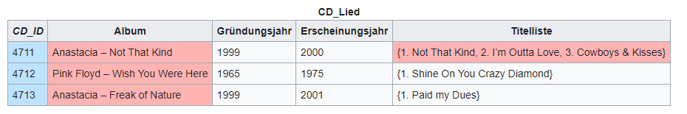
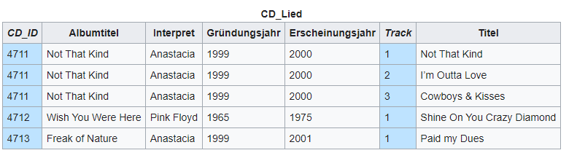
1. NF - ATomization

Slide 6
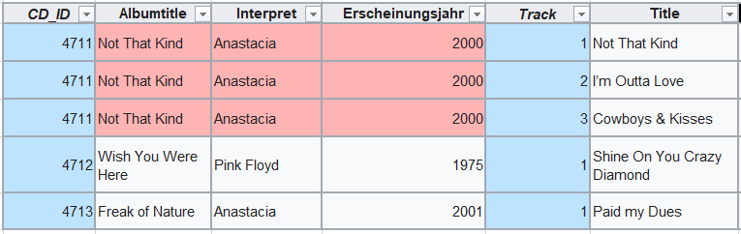
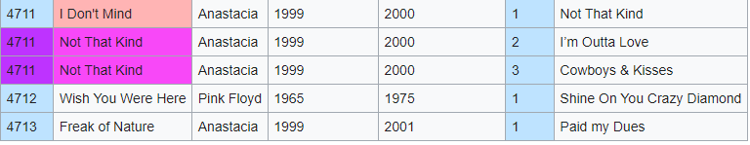
2. NF - Full-Key-Dependencies

Slide 7
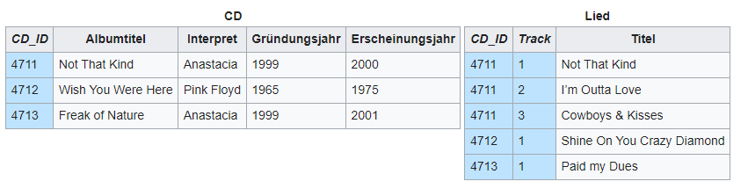
2. NF - Full-Key-Dependencies

Slide 8
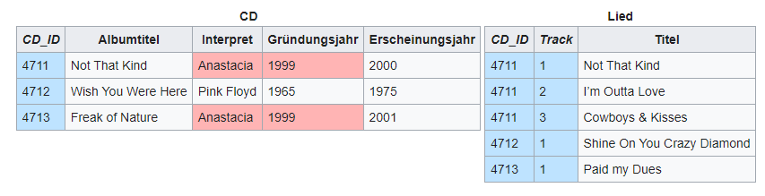
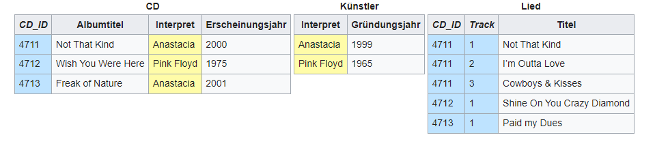
3. NF - Non-Attribute-Dependencies

Slide 9
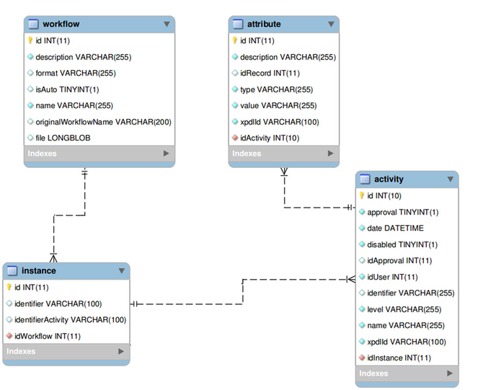
Module Database
Add if NULL is possible
Yellow dot = PK (Primary Key)
Red dot = FK ( Foreign Key)

Slide 10
Task 00
Create Module for following Tasks

Slide 11
Tasks 01
Karl Störzel is 81 years old, lives in berlin ordered one pizza salmi
Niklas Scheffler is 12 years old, lives in hamburg ordered one steak
Klaus Peter is 36 years old lives in Berlin ordered nothing
Sophia sponso is 23 years old lives in Brandenburg ordered salat and coke

Slide 12
Task 02
Karl lives in Berlin but wants to get delivered the spaghetti to düsseldorf
Niklas lives in the frühaufsteher straße 31
Kevin is 37 years old lives in wiesbaden and wants to send the bill to zahlnich straße 69, 80331 München

Slide 13
Create Databases

Slide 14
Task
Create the databases from previus tasks via sql commands inside the repo – mydb.sql
git@github.com:ImCookiieZ/101DB-Modelling.git
Tell me when there are questions problems or you are done
References:
https://www.w3schools.com/sql/sql_create_db.asp
https://www.w3schools.com/sql/sql_create_table.asp
https://www.w3schools.com/sql/sql_alter.asp
…

Slide 15
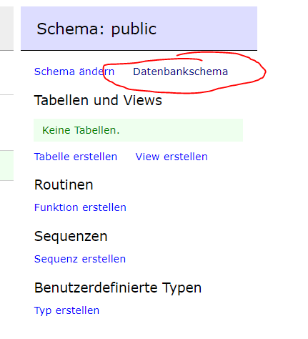
GiTHUB
See your db: http://localhost:8082/?pgsql=db&username=postgres&db=mytestdb&ns=public
Password: password
If you click on “database shema” it should look nearly the same as your model

