Slide 1
PG LEVEL ADVANCED CERTIFICATION PROGRAM IN VLSI CHIP DESIGN Project: Implementation of an ASIC for a Neural Network inference engine for classification of handwritten digits
DANIEL MARK ISAAC

Slide 2
Introduction
Problem Statement:
Design and implement an ASIC for a Neural Network inference engine.
Dataset description:
• Semeion Handwritten Digit Dataset (UCI ML Repository)
• Reference: https://archive.ics.uci.edu/ml/datasets/semeion+handwritten+digit
• Details:
➢ Dataset is a 1593 x 256 Matrix
➢ 1593 images
➢ Each image is 16x16 binary – vectorized to 256 bits
➢ 10 Classification outputs – one-hot encoded (1-out-of-10 is 1, rest are 0)

Slide 3
Network Description
• Network architecture [feed-forward, fully connected]
• Network parameters -
Number of Inputs, 256
Outputs, 10
Number of neurons in hidden layer, 30
Activation function for hidden layer, Leaky ReLU
Output format, One - hot encoded [Software], Predicted digit [Hardware]

Slide 4
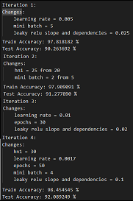
Software Implementation
Tasks performed in MATLAB:
1. Ran the training code multiple times with many different configurations, Until good accuracy is achieved in floating point.
The picture on the right side shows few good iterations obtained.

Slide 5
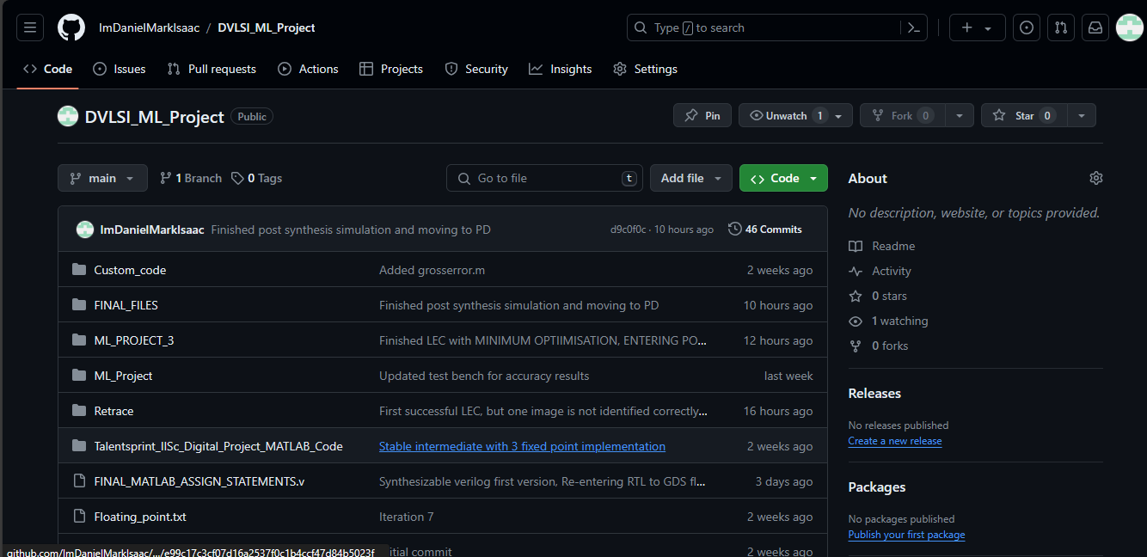
Software Implementation Contd.
Tasks performed in MATLAB:
2. Whenever good set of weights and biases were obtained, those were saved to a git repo created specifically for this project.
Link to the repo: ImDanielMarkIsaac/DVLSI_ML_Project (github.com)

Slide 6

Software Implementation Contd.
Tasks performed in MATLAB:
3. Then, maximum and minimum values present in w12,w23,b12,b23 were found.
With this knowledge, the lower bound on number of bits needed for representing integer portion for w12, w23, b12, b23 can be known.

Slide 7
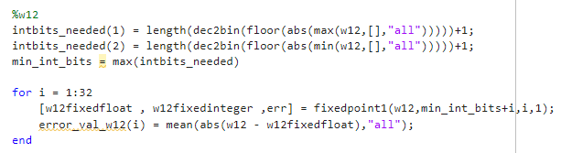
Software Implementation Contd.
Tasks performed in MATLAB:
4.Next, a MATLAB code is written, which will sweep the number of fractional bits while keeping the number of integer bits as found in the previous step. And it will find the average absolute error between input floating values and floating values converted back from fixed point integers.
Below image shows a example of the fractional bit width sweep done for w12.
The same sweep is done for w23, b12, b23 and slope parameter in Leaky ReLU also.

Slide 8
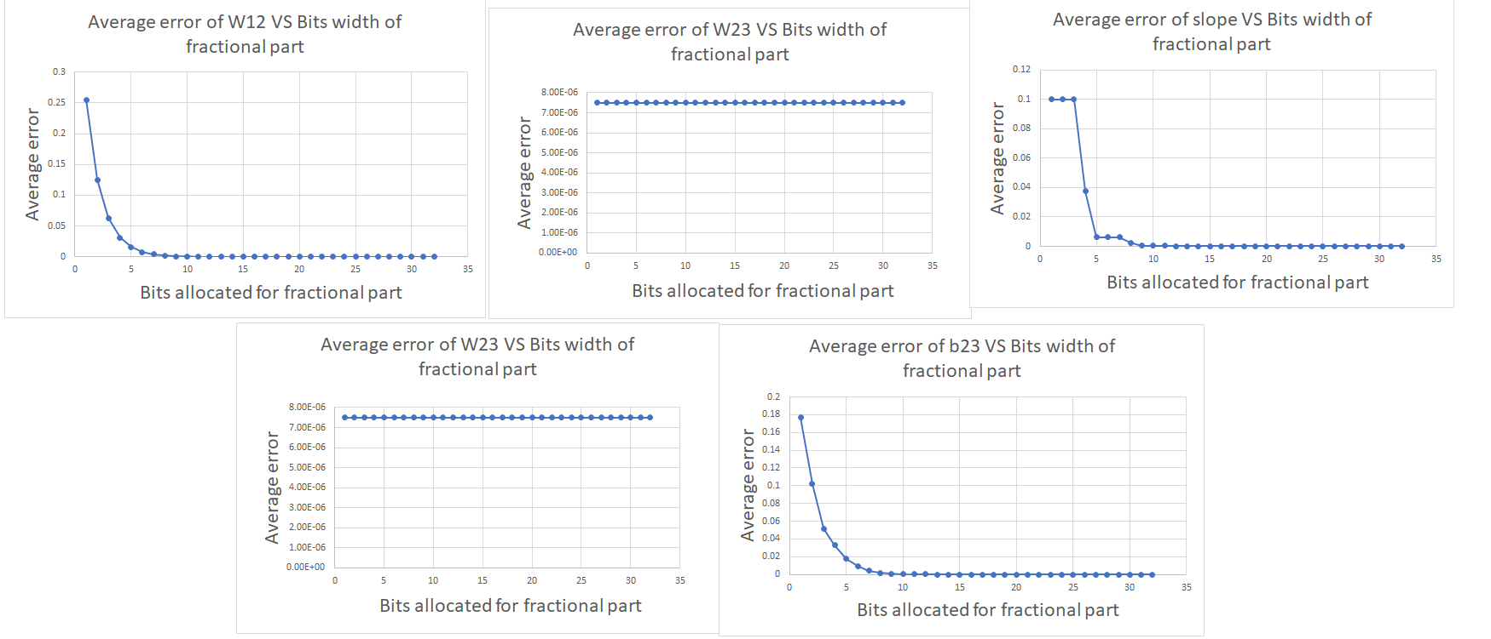
Software Implementation Contd.
Tasks performed in MATLAB:
5. The following graphs were plotted using the values obtained from previous step.

Slide 9
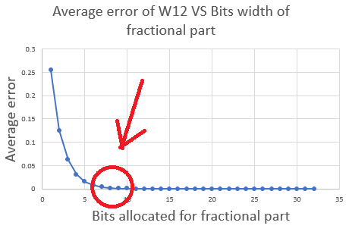
Software Implementation Contd.
Tasks performed in MATLAB:
6. Optimal number of fractional bits were obtained from the graphs.
The bit width is chosen
When the Average error nearly
Touches zero the first time.
This is regarded as the
Optimal number of bits.
The image in the right
explains the concept. The red arrow
and red circle denotes the fractional bit width chosen.
The same is done for w23, b12, b23 and slope parameter in Leaky ReLU, to obtain optimal bit widths.

Slide 10
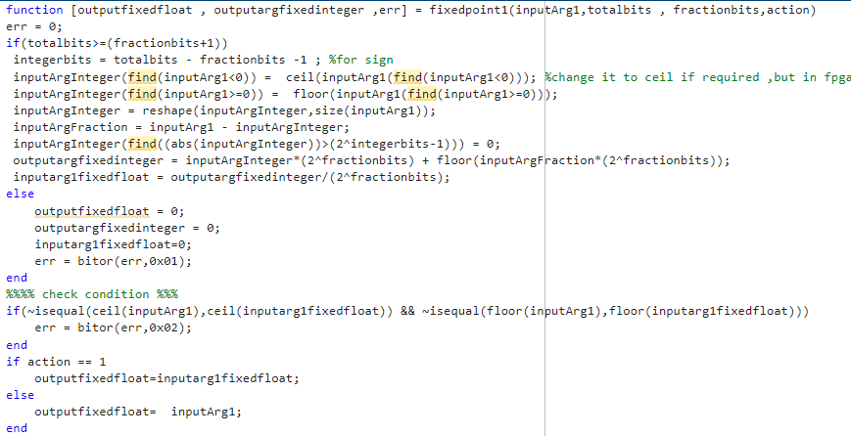
Software Implementation Contd.
Fixed point design approach:
The following function is used to convert floating point to fixed point.

Slide 11
Software Implementation Contd.
Fixed point design approach:
Bit widths allocated for integer and fraction part:
w12: Bit width for integer part = 3, Bit width for fractional part = 8
w23: Bit width for integer part = 2, Bit width for fractional part = 8
b12: Bit width for integer part = 3, Bit width for fractional part = 12
b23: Bit width for integer part = 2, Bit width for fractional part = 11
Size of multiplier needed (Ex: 8 bit x 8 bit)
Scripting to get HW compatible data.
NOTE: Do not add any accuracy results here, there is a section for that
later.

Slide 12
Software Implementation Contd.
Fixed point design approach:
Total memory needed for weights and biases (in bits):
Number bits used to store w12 = 30 x 256 x (3+8) = 84480 bits
Number bits used to store w23 = 10 x 30 x (2+8) = 3000 bits
Number bits used to store b12 = 30 x 1 x (3+12) = 450 bits
Number bits used to store b23 = 10 x 1 x (2+11) = 130 bits
Total memory needed in bits = 84480 + 3000 + 450 + 130 = 88060 bits

Slide 13
Software Implementation Contd.
Fixed point design approach:
First stage multiplier = 11 bit x 1 bit
ReLU_1 stage multiplier = 14 bit x 15 bit
Second stage multiplier = 10 bit x 29 bit
ReLU_2 stage multiplier = 14 bit x 39 bit
Scripting to get HW compatible data.
NOTE: Do not add any accuracy results here, there is a section for that
later.

Slide 14
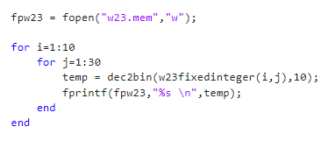
Software Implementation Contd.
Scripting to get HW compatible data:
The below MATLAB script is written to get .MEM files for using $readmemb() in vivado presynthesis simulations, This is shown for w23 for example. The same is done for w12,b12,b23 with appropriate changes to number of iterations in the nested loops.

Slide 15
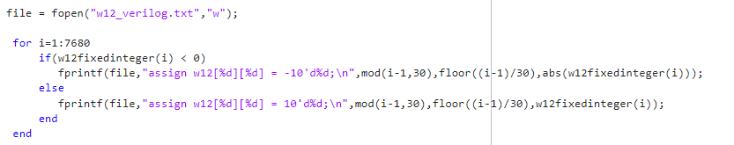
Software Implementation Contd.
Scripting to get HW compatible data:
The below MATLAB script is written to print out the Verilog statements needed to initialize the weights and biases.
This is needed because $readmemb() is not synthesizable during synthesis.
The output of the below code is copy pasted in the Verilog RTL.
The below snippet is shown for w12. But the same idea is used to generate for w23, b12, b23 as well.

Slide 16
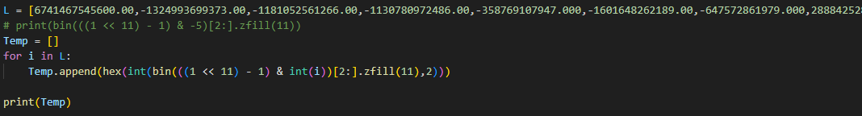
Software Implementation Contd.
Following python script is written to be used to convert intermediate data in the calculations of feed forward, into hexadecimal representations according to different bit widths used.
This is used as a reference model to check whether Verilog is giving correct answers in each and every stage of the calculation.

Slide 17

Software Implementation Contd.
Following python script is written as a reference model for matrix multiplication.
This is used to check whether we are getting proper answer in matrix multiplication in Verilog.

Slide 18
Hardware Specifications
Frequency of operation – 50 MHz ( 20 ns time period)
Latency – For 1 input image, the total cycles needed to complete the processing – from the clock cycle on which 1st part of input data is sent to design, till the cycle when output calculation is done and output can be read from design = 341 cycles
Initiation interval – The minimum interval (in clock cycles) between 2 successive images being sent to HW such that they can be correctly recognized = 1 cycle
I/Os of your design in tabular form – with bit widths, direction, and description of the signals.

Slide 19
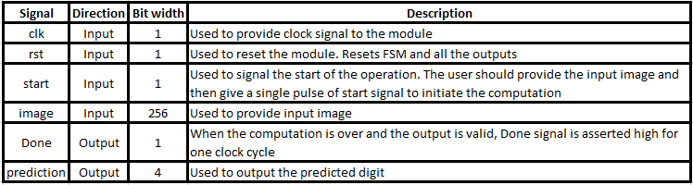
Hardware Specifications
I/Os of the design in tabular form:

Slide 20
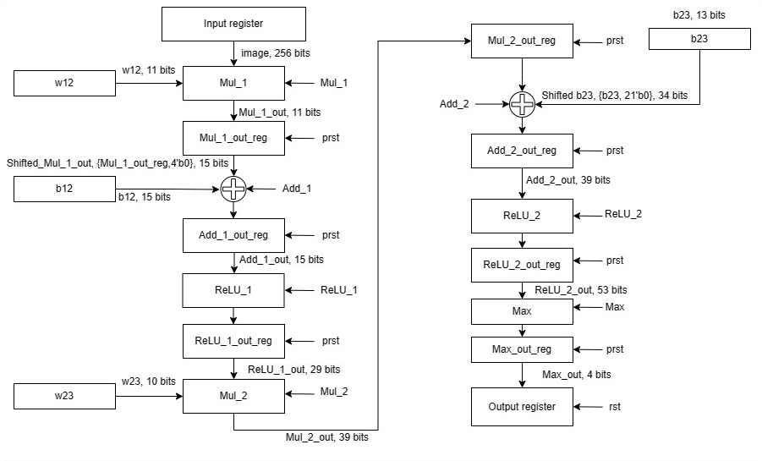
Hardware Architecture
Overall Block diagram - Datapath

Slide 21
Hardware Architecture
Input register : User provides the input image to this register.
W12: Group of registers to store w12 weights.
Mul_1: Multiplication block, multiplies w12 and image (Matrix multiplication), multiplies when Mul_1 control signal is received from Control unit.
Mul1_out_reg: Stores the result of multiplication, and will reset on receiving prst signal from the control unit.
B12 : Group of registers to store b12 biases.
Add_1: Adder which will add values from mul_1_out_reg which is shifted left 4 times, and b12, on receiving Add_1 control signal from control unit.
Add1_out_reg: Stores the result of Add_1, resets on prst control signal from control unit.

Slide 22
Hardware Architecture
ReLU_1: Performs Leaky ReLU function over the values present in Add_1_out_reg, on receiving ReLU_1 control signal from the control unit.
ReLU_1_out_reg: Stores the result of ReLU_1, resets on receiving prst from the control unit.
W23: Group of registers to store w23 weights.
Mul_2: Multiplication block, multiplies values from w23 and ReLU_1_out_reg (Matrix multiplication), multiplies when Mul_2 control signal is received from Control unit.
Mul_2_out_reg: Stores the result of mul_2 multiplication, resets on receiving prst control signal from control unit.
B23: Group of registers to store b23 biases.

Slide 23
Hardware Architecture
Add_2: Adder which will add values from mul_2_out_reg and b12 which is shifted left 21 times, on receiving Add_2 control signal from control unit.
Add_2_out_reg: Stores the result of Add_2 addition, resets on receiving prst control signal from the control unit.
ReLU_2: Performs Leaky ReLU function over the values present in Add_2_out_reg, on receiving ReLU_2 control signal from the control unit.
ReLU_2_out_reg : Stores the result of ReLU_2, resets on receiving prst from the control unit.
Max: Finds the maximum value present in the ReLU_2_out_reg, outputs it to max_out_reg on receiving Max control signal from the control unit.

Slide 24
Hardware Architecture
Max_out_reg: Stores the result of Max operation, resets on receiving prst signal from the control unit.
Output register: Output register which will send the predicted digit to outside world, resets on receiving rst signal externally.

Slide 25
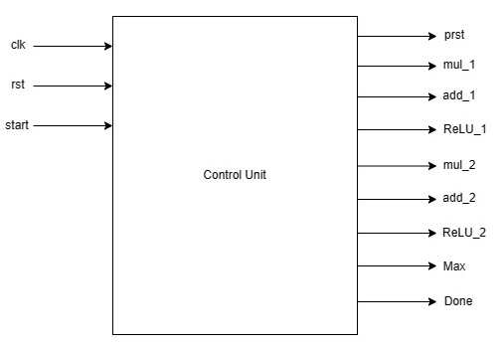
Controller
The following diagram illustrates the controller block which will issue all the control signals like prst, mul_1, add_1, ReLU_1, mul_2, add_2, ReLU_2, Max, Done.
The inputs to the controller are clk, rst, start signals.
The controller issues signals
Based on the FSM present within it.

Slide 26
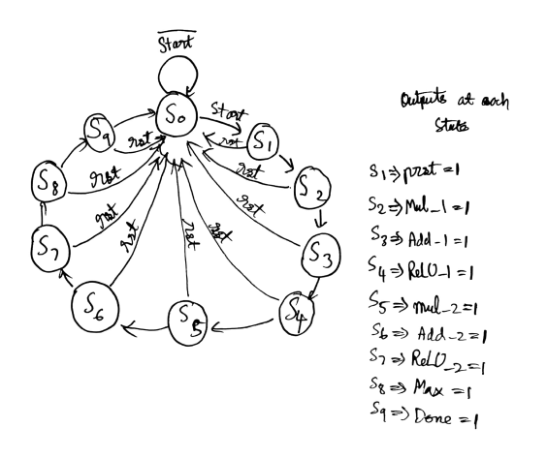
Control FSM

Slide 27
Control FSM
S0: The starting state, wait till start signal, when start signal comes moves to s1.
S1: prst state, issues prst control signal. Stays in this state for 1 clock cycle. Then moves to s2.
S2: mul_1 state, issues mul_1 control signal. Stays in this state for 256 clock cycles. Then moves to s3.
S3: add_1 state, issues add_1 control signal. Stays in this state for 1 clock cycle. Then moves to s4.
S4: ReLU_1 state, issues ReLU_1 control signal. Stays in this state for 30 clock cycles. Then moves to s5.
S5: Mul_2 state, issues Mul_2 control signal. Stays in this state for 30 clock cycles. Then moves to s6.
S6: add_2 state, issues add_2 control signal. Stays in this state for 1 clock cycle. Then moves to s7.

Slide 28
Control FSM
S7: ReLU_2 state, issues ReLU_2 control signal. Stays in this state for 10 clock cycles. Then moves to s8.
S8: Max state, issues Max control signal. Stays in this state for 9 clock cycles. Then moves to s9.
S9: Done state, issues Done control signal. Stays in this state for 1 clock cycle. Then moves to s0.
There is a counter within the controller which takes care of the clock cycles for which each state has to last.
Rst signal will reset to the FSM start state s0 regardless of present state.

Slide 29
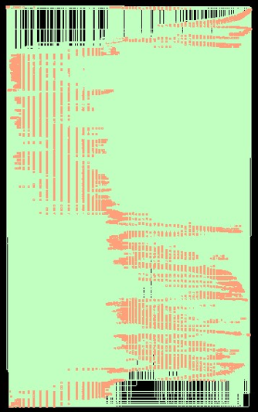
Hardware Schematic
Picture of Schematic from Genus (post-synthesis)

Slide 30
HW Simulation
The test bench gives 10 sample images to the neural network.
The ten images are obtained from semeion database, and loaded into a array.
The input digits are passed in sequential order: 0,1,2,3,4,5,6,7,8,9.
A for loop is used to iterate.
At each iteration, rst, image and start is given and it waits till output is ready.
It compares whether the predicted output matches the iteration count, if yes , a register called correct is incremented.
A register called tot keeps track of the number of inputs passed.
At the end of test, correct/ tot will be the accuracy

Slide 31
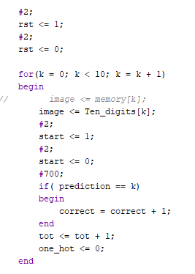
HW Simulation
The image on the right captures the gist of what is explained in previous slide.

Slide 32
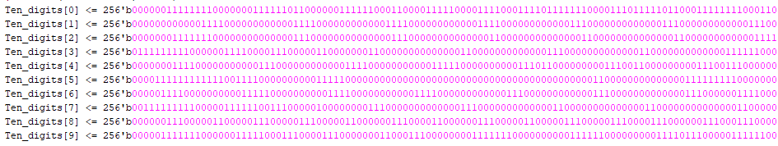
HW Simulation
Below is a sample picture of how the HW inputs looks like.
The binary values of the images are copied from the semeion dataset file in MATLAB.

Slide 33
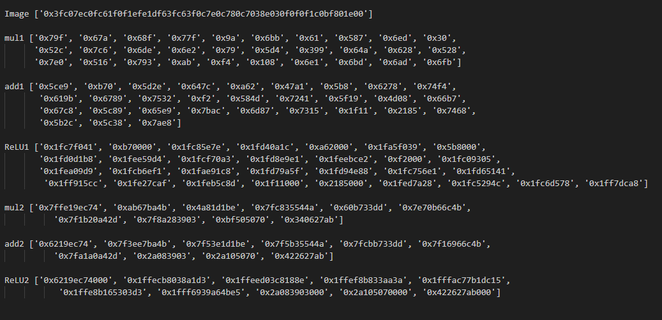
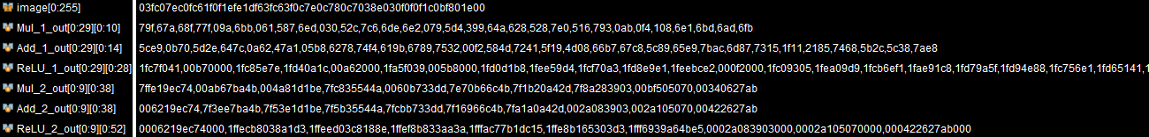
HW Simulation
MATLAB output for particular image
Presynthesis output from Verilog in vivado

Slide 34
HW Simulation
From the previous slide we can conclude that the fixed point implementation is working properly in Verilog, presynthesis simulation

Slide 35
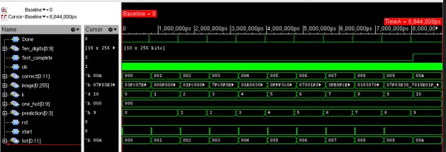
Pre-synthesis Simulation Waveform

Slide 36
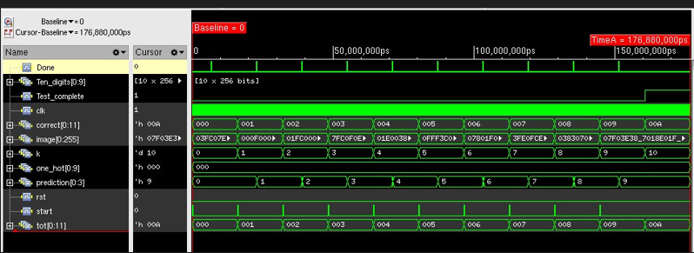
Post-synthesis Simulation Waveform

Slide 37
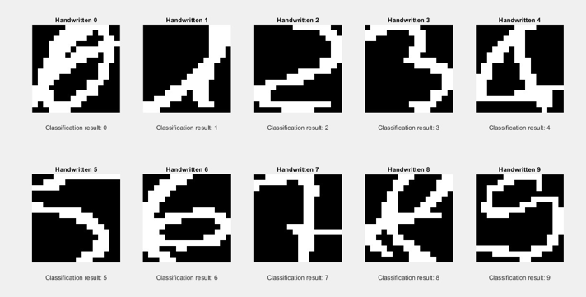
Accuracy Results
Software Accuracy:
Train data: 98.454545 %
Testing with floating point weights: 92.089249 %
Test data with fixed point weights: 89.452333 %

Slide 38
Accuracy Results
Accuracy on HW:
Pre-synthesis: (10 images) Classified all 10 images correctly
But test set when given as input will give accuracy of 88.7%

Slide 39
Accuracy Results
Accuracy on HW:
Post-synthesis: (same 10 images) Classified all 10 images correctly
The accuracy drop is due to loss in precision during fixed point conversion.

Slide 40
Synthesis Reports
QOR and Power Reports from Synthesis.

Slide 41
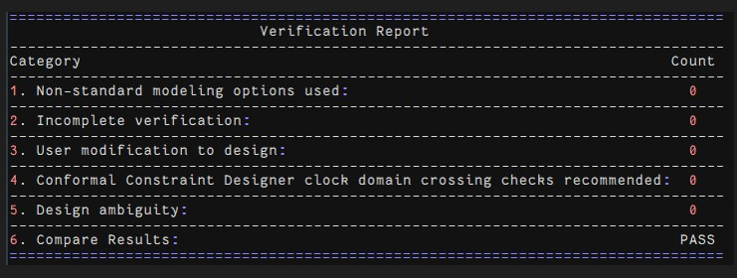
LEC Report
Picture of LEC report
Implies that the synthesised netlist is logically equal to input rtl

Slide 42
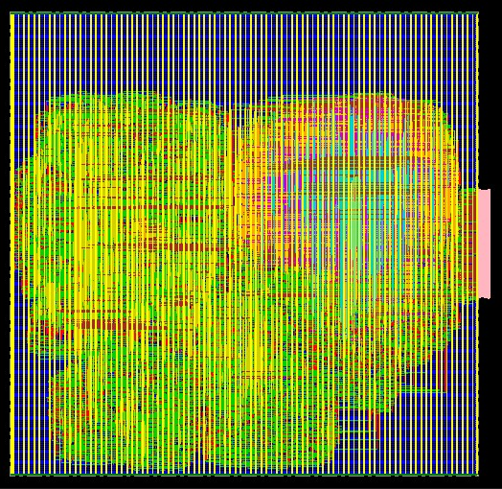
Placement
Picture of Placed Design

Slide 43

Routing
Picture of Routed Design

Slide 44
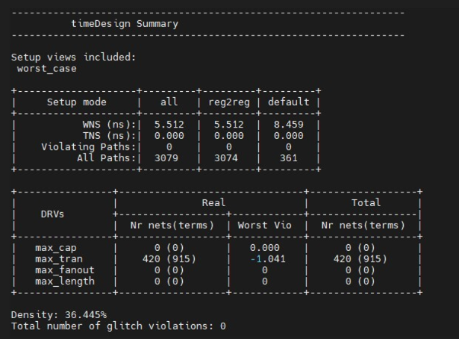
Post-Routing Reports
Setup Report post-route

Slide 45
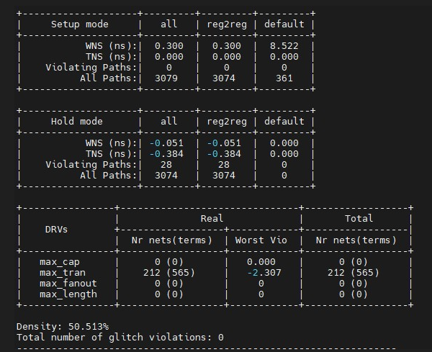
Post-Routing Reports
Hold Reports post-route

Slide 46
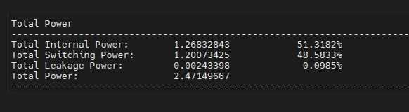
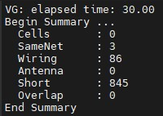
Post-Routing Reports
Power report
Geometry report

Slide 47
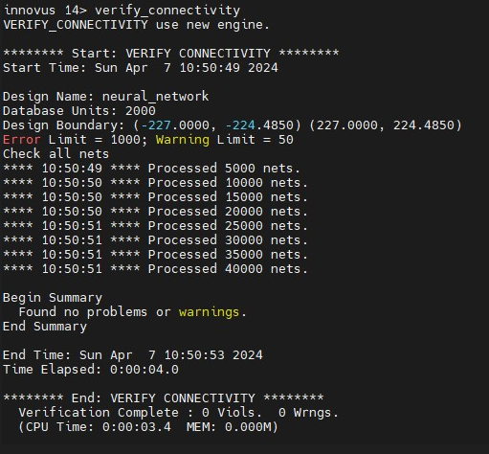
Post-Routing Reports
Connectivity report

Slide 48
Design Highlights
Sweeped fractional bit widths in MATLAB to get optimal bit width.
Experimented with the MATLAB software code to get high accuracy to account for the drop in accuracy during fixed point conversion.
Used github version control to work effectively.

Slide 49
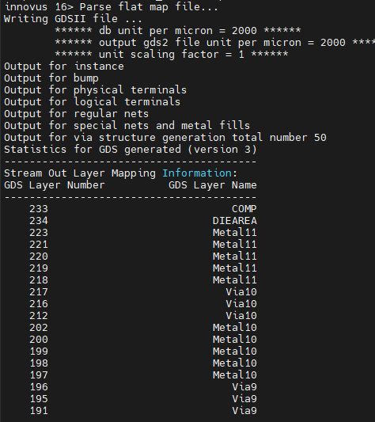
GDS
Picture of successful GDS streamout from the terminal.

Slide 50
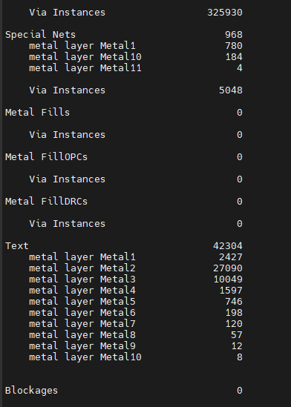
GDS

Slide 51
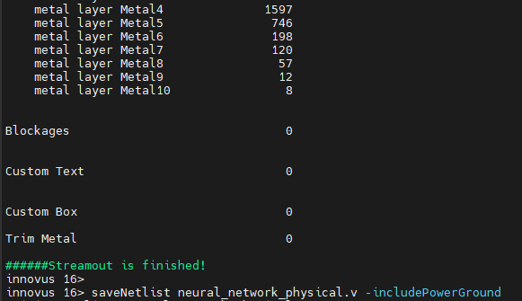
GDS

Slide 52
Conclusions
Number of neurons in hidden layer = 30 neurons
Accuracy on synthesized HW = 88.9%
Clock Frequency = 50 MHz
Latency = 341 cycles
Initiation Interval = 1 cycle
Total Area = 59522.022
Total Power (post-routing) = 2.4 mW
Setup TNS and WNS (post-routing) = 0 and 5.512
Hold TNS and WNS (post-routing) = -0.384 and -0.051
NOTE: Keep the format given here. Only fill the values

Slide 53
Learning Outcomes
What did you learn from this project?
Learnt the required things to do a chip design

Slide 54
Thank You

