Slide 1
Course Name Project: Title Name
Author

Slide 2
Introduction
Problem Statement:
Design and implement an ASIC for a Neural Network inference engine.
Dataset description:
• Semeion Handwritten Digit Dataset (UCI ML Repository)
• Reference: https://archive.ics.uci.edu/ml/datasets/semeion+handwritten+digit
• Details:
➢ Dataset is a 1593 x 256 Matrix
➢ 1593 images
➢ Each image is 16x16 binary – vectorized to 256 bits
➢ 10 Classification outputs – one-hot encoded (1-out-of-10 is 1, rest are 0)

Slide 3
Network Description
• Network architecture [feed-forward, fully connected]
• Network parameters -
Number of Inputs, 256
Outputs, 10
Number of neurons in hidden layer, 30
Activation function for hidden layer, Leaky ReLU
Output format, One - hot encoded [Software], Predicted digit [Hardware]

Slide 4
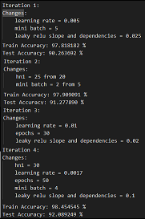
Software Implementation
Tasks performed in MATLAB:
1. Ran the training code multiple times with many different configurations, Until good accuracy is achieved in floating point.
The picture on the right side shows few good iterations obtained.

Slide 5
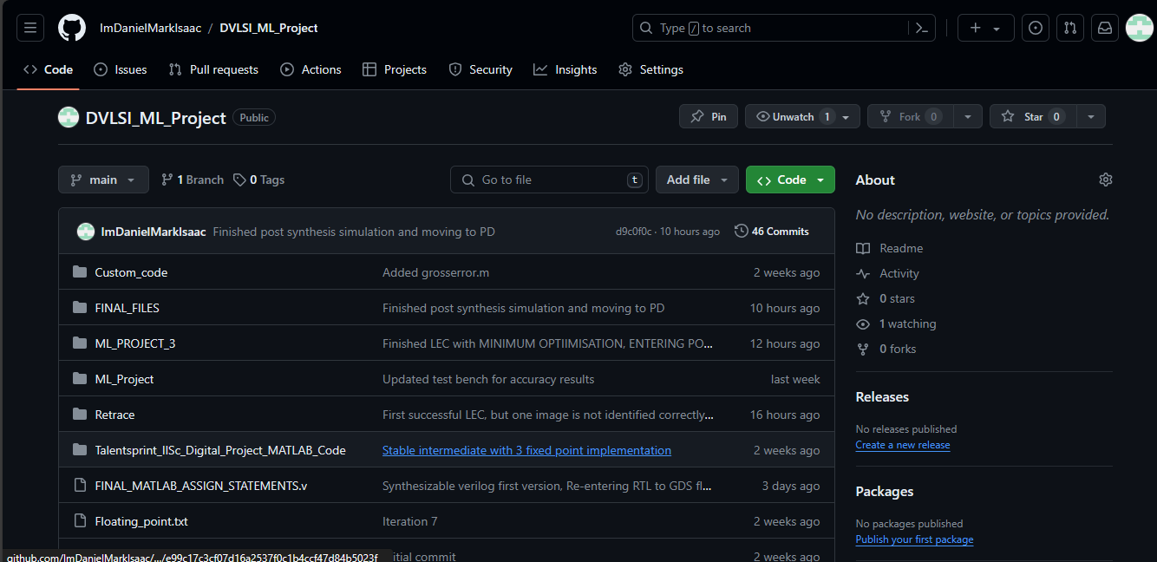
Software Implementation Contd.
Tasks performed in MATLAB:
2. Whenever good set of weights and biases were obtained, those were saved to a git repo created specifically for this project.
Link to the repo: ImDanielMarkIsaac/DVLSI_ML_Project (github.com)

Slide 6

Software Implementation Contd.
Tasks performed in MATLAB:
3. Then, maximum and minimum values present in w12,w23,b12,b23 were found.
With this knowledge, the lower bound on number of bits needed for representing integer portion for w12, w23, b12, b23 can be known.

Slide 7
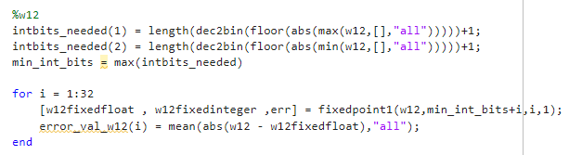
Software Implementation Contd.
Tasks performed in MATLAB:
4.Next, a MATLAB code is written, which will sweep the fractional bits while keeping the number of integer bits as found in the previous step. And it will find the average absolute error between input floating values and floating values converted back from fixed point integers.
Below image shows a example of the bit width sweep done for w12.
The same sweep is done for w23, b12, b23 and slope parameter in Leaky ReLU also.

Slide 8
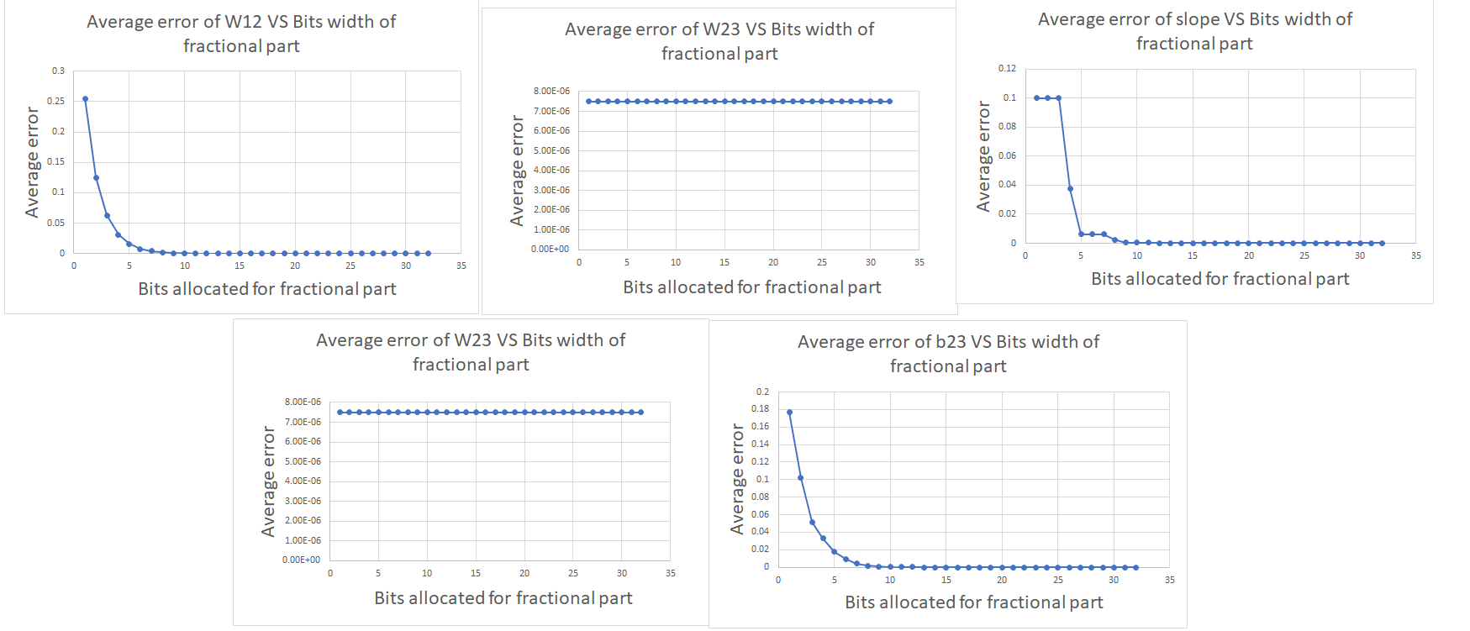
Software Implementation Contd.
Tasks performed in MATLAB:
5. The following graphs were plotted using the values obtained from previous step.

Slide 9
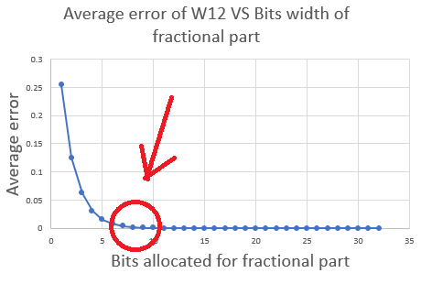
Software Implementation Contd.
Tasks performed in MATLAB:
6. Optimal number of fractional bits were obtained from the graphs.
The bit width is chosen
When the Average error nearly
Touches zero the first time.
This is regarded as the
Optimal number of bits.
The image in the right
explains the concept. The red arrow
and red circle denotes the fractional bit width chosen.
The same is done for w23, b12, b23 and slope parameter in Leaky ReLU, to obtain optimal bit widths.

Slide 10
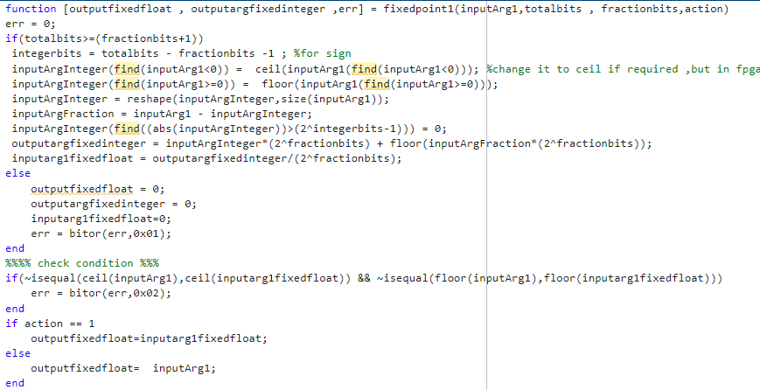
Software Implementation Contd.
Fixed point design approach:
The following function is used to convert floating point to fixed point.

Slide 11
Software Implementation Contd.
Fixed point design approach:
Bit widths allocated for integer and fraction part:
w12: Bit width for integer part = 3, Bit width for fractional part = 8
w23: Bit width for integer part = 2, Bit width for fractional part = 8
b12: Bit width for integer part = 3, Bit width for fractional part = 12
b23: Bit width for integer part = 2, Bit width for fractional part = 11
Size of multiplier needed (Ex: 8 bit x 8 bit)
Scripting to get HW compatible data.
NOTE: Do not add any accuracy results here, there is a section for that
later.

Slide 12
Software Implementation Contd.
Fixed point design approach:
Total memory needed for weights and biases (in bits):
Number bits used to store w12 = 30 x 256 x (3+8) = 84480 bits
Number bits used to store w23 = 10 x 30 x (2+8) = 3000 bits
Number bits used to store b12 = 30 x 1 x (3+12) = 450 bits
Number bits used to store b23 = 10 x 1 x (2+11) = 130 bits
Total memory needed in bits = 84480 + 3000 + 450 + 130 = 88060 bits

Slide 13
Software Implementation Contd.
Fixed point design approach:
First stage multiplier = 11 bit x 1 bit
ReLU_1 stage multiplier = 14 bit x 15 bit
Second stage multiplier = 10 bit x 29 bit
ReLU_2 stage multiplier = 14 bit x 39 bit
Scripting to get HW compatible data.
NOTE: Do not add any accuracy results here, there is a section for that
later.

Slide 14
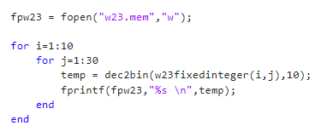
Software Implementation Contd.
Scripting to get HW compatible data.
The below MATLAB script is written to get .MEM files for using $readmemb() in vivado presynthesis simulations, This is shown for w23 for example. The same is done for w12,b12,b23 with appropriate changes to number of iterations in the nested loops.

Slide 15
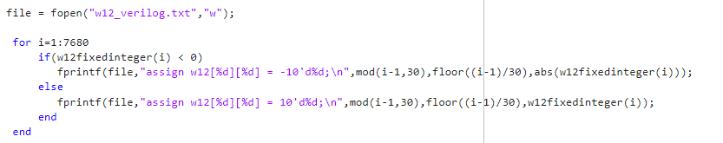
Software Implementation Contd.
Scripting to get HW compatible data.
The below MATLAB script is written to print out the Verilog statements needed to initialize the weights and biases.
This is needed because $readmemb() is not synthesizable during synthesis.
The output of the below code is copy pasted in the Verilog RTL.
The below snippet is shown for w12. But the same idea is used to generate for w23, b12, b23 as well.

Slide 16
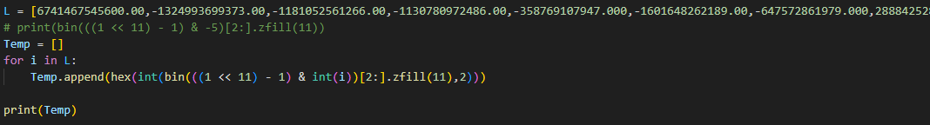
Software Implementation Contd.
Following python script is written to be used to convert intermediate data in the calculations of feed forward, into signed hexadecimal representations according to different bit widths used.
This is used as a reference model to check whether Verilog is giving correct answers in each and every stage of the calculation.

Slide 17

Software Implementation Contd.
Following python script is written as a reference model for matrix multiplication.
This is used to check whether we are getting proper answer in matrix multiplication in Verilog.

Slide 18
Hardware Specifications
Frequency of operation
Latency – For 1 input image, measure the total cycles needed to complete the processing – from the clock cycle on which 1st part of input data is sent to design, till the cycle when output calculation is done and output can be read from design.
Initiation interval – Measure the minimum interval (in clock cycles) between 2 successive images being sent to HW such that they can be correctly recognized.
I/Os of your design in tabular form – with bit widths, direction, and description of the signals.

Slide 19
Hardware Architecture
Overall Block diagram of your design – showing all main sub-modules and data paths between them, and appropriate info (bit widths, signal names).
Describe in 1 line what each block does – Describe how inputs get processed to outputs/ what operation that block performs.

Slide 20
Control FSM
FSM diagram
Explain the control path very briefly – how many cycles does each state of the fsm take

Slide 21
Hardware Schematic
Picture of Schematic from Genus (post-synthesis)

Slide 22
HW Simulation
Description of testbench – How you are providing inputs to your design, how you are checking if output matches the expected value.
A sample picture of how the HW inputs looks like – if you have stored them in array, add a picture of part of that text file.

Slide 23
HW Simulation
Hidden Layer Output
Take a hidden layer neuron, show its output over a series of clock cycles in pre-synthesis simulation.
Compare it with MATLAB hidden layer output.
Justify your floating to fixed point conversion.

Slide 24
Pre-synthesis Simulation Waveform
Add picture of a sample simulation waveform of 1 input image (pre- synthesis) that has the important signals and captures from the moment input is provided to design till the output calculation is completed.
Add some labelling to help us understand what is happening.

Slide 25
Post-synthesis Simulation Waveform
Add picture of a sample simulation waveform 1 input image (post- synthesis) with the same input as earlier (pre-synth) picture for comparison. What is your conclusion from the 2 waveforms.

Slide 26
Accuracy Results
Software Accuracy:
Train data:
Testing with floating point weights:
Test data with fixed point weights:
Accuracy on HW:
Pre-synthesis: (10 images)
Post-synthesis: (same 10 images)
If there is an accuracy drop, why has it happened?
NOTE: Do not change this slide

Slide 27
Synthesis Reports
QOR and Power Reports from Synthesis.

Slide 28
LEC Report
Picture of LEC report, and your conclusion from it.

Slide 29
Placement
Picture of Placed Design

Slide 30
Routing
Picture of Routed Design

Slide 31
Post-Routing Reports
Setup and Hold Reports post-route
Power report
Geometry and Connectivity reports

Slide 32
Design Highlights
Describe key features/optimizations that you have done that can make your design stand out w.r.t. your peers.

Slide 33
GDS
Picture of successful GDS streamout from the terminal.

Slide 34
Conclusions
Number of neurons in hidden layer =
Accuracy on synthesized HW =
Clock Frequency =
Latency =
Initiation Interval =
Total Area =
Total Power (post-routing) =
Setup TNS and WNS (post-routing) = … and ….
Hold TNS and WNS (post-routing) = … and …
NOTE: Keep the format given here. Only fill the values

Slide 35
Learning Outcomes
What did you learn from this project?
NOTE: Keep it to 1 slide.

Slide 36
Thank You

