Slide 1
Go Rest API with MUX and GORM

Slide 2
Three type of package to install in Go
What is MUX?
Implements a request router and dispatcher for matching incoming requests to their respective handler.
Package:
go get -u github.com/gorilla/mux
What is gorm?
Provides CRUD operations and can also be used for the initial migration and creation of the database schema.
Package:
go get -u gorm.io/gorm
go get -u gorm.io/driver/mysql

Slide 3
Step 1: In main.go - Initialize Router with MUX :
//initialize router
func initializeRouter() {
r := mux.NewRouter()
//Implementing different routes
r.HandleFunc("/users", GetUsers).Methods("GET")
r.HandleFunc("/users/{id}", GetUser).Methods("GET")
r.HandleFunc("/users", CreateUser).Methods("POST")
r.HandleFunc("/users/{id}", UpdateUser).Methods("PUT")
//passing the port information
log.Fatal(http.ListenAndServe(":8081", r))
}
func main() {
//enable MySQL
InitialMigration()
//calling the router
initializeRouter()
}
HandleFunc - provides route information
Method (“GET”) - will get a list of users
Method (“POST”) - creating user by passing data into json format
Method (“PUT”) - able to update information
{id} - to enable us to update information we will need to pass the id
InitialMigration()- After define Initial Migration properties in user.go

Slide 4
Step 2: Define function to prevent compilation error in main.go by creating a file user.go
Function to define:
GetUsers
GetUser
CreateUser
UpdateUser
//Handle method
func GetUsers(w http.ResponseWriter, r *http.Request) {
w.Header().Set("Content-Type", "application/json")
var users []User
DB.Find(&users)
json.NewEncoder(w).Encode(users)
}
func GetUser(w http.ResponseWriter, r *http.Request) {
w.Header().Set("Content-Type", "application/json")
params := mux.Vars(r)
var user User
DB.First(&user, params["id"])
json.NewEncoder(w).Encode(user)
}
func CreateUser(w http.ResponseWriter, r *http.Request) {
w.Header().Set("Content-Type", "application/json")
var user User
json.NewDecoder(r.Body).Decode(&user)
DB.Create(&user)
json.NewEncoder(w).Encode(user)
}
func UpdateUser(w http.ResponseWriter, r *http.Request) {
w.Header().Set("Content-Type", "application/json")
params := mux.Vars(r)
var user User
DB.First(&user, params["id"])
json.NewDecoder(r.Body).Decode(&user)
DB.Save(&user)
json.NewEncoder(w).Encode(user)
}

Slide 5
Step 3: Define gorm and struct to store different data type to the database in user.go
type User struct {
gorm.Model
Type string `json:"type"`
FirstName string `json:"firstname"`
LastName string `json:"lastname"`
PhoneNumber string `json:"phonenumber"`
Email string `json:"email"`
LicenseNumber string `json:"licensenumber"`
}
`json’ - sending and receiving data working as rest api (defining the property)
gorm.Model - convert struct to gorm object/model, it will seal and get the data from database

Slide 6
Step 4: Creating method to initialize database, enable auto migration in user.go
Define database detail
pass url to connect to database
//Enable database
var DB *gorm.DB
var err error
const DNS = "root:admin@tcp(127.0.0.1:3306)/godb?charset=utf8mb4&parseTime=True&loc=Local"
Const DNS (Database URL):
"root:admin@tcp(127.0.0.1:3306)/godb?charset=utf8mb4&parseTime=True&loc=Local"
root (username)
Admin (password)
Schemas name in MySQL:
godb

Slide 7
Step 5: Define Initial Migration properties
//Define properties
func InitialMigration() {
DB, err = gorm.Open(mysql.Open(DNS), &gorm.Config{})
if err != nil {
fmt.Println(err.Error())
panic("Connect connect to DB")
}
DB.AutoMigrate(&User{})
}
gorm.Open(mysql.Open(DNS), &gorm.Config{}) - Enable gorm to open in MySQL
After define Initial Migration properties in user.go, input InitialMigration() in main.go

Slide 8
Step 6: In user.go func CreateUser
func CreateUser(w http.ResponseWriter, r *http.Request) {
w.Header().Set("Content-Type", "application/json")
var user User
json.NewDecoder(r.Body).Decode(&user)
DB.Create(&user)
json.NewEncoder(w).Encode(user)
}
NewDecoder
taking data from the request module
whatever data we getting from the body of this request we are decoding to the reference of this particular user struct all data we have will be converted to this particular struct we have
DB.Create(&user)
pass reference of the user
json.NewEncoder(w).Encode(users)
passing data back to browser
Terminal:
go build
.\ETIRestAPI.exe is created
Running executable .\ETIRestAPI.exe in Terminal
user is created in MySQL under godb with User struct properties

Slide 9
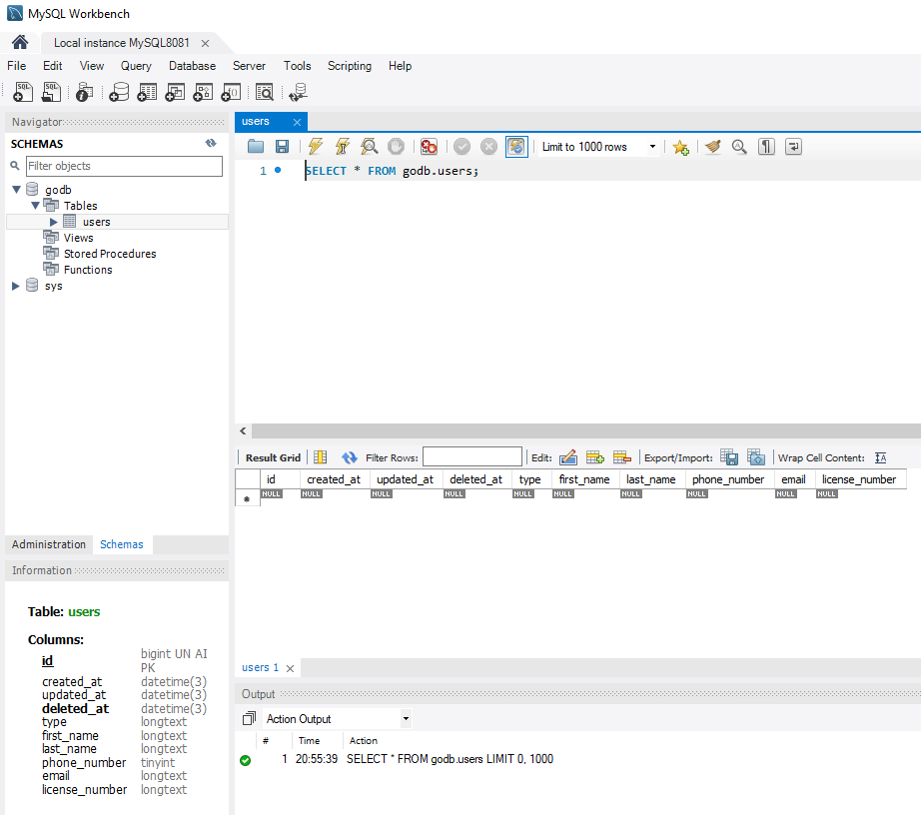
After execute .\ETIRestAPI.exe in user.go Terminal user database is created with User struct properties.

Slide 10
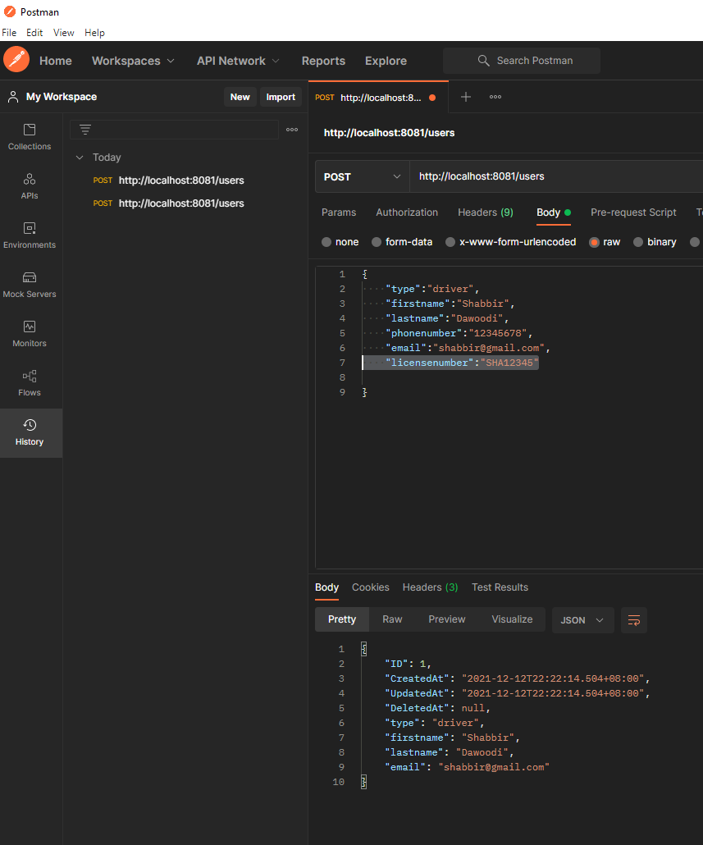
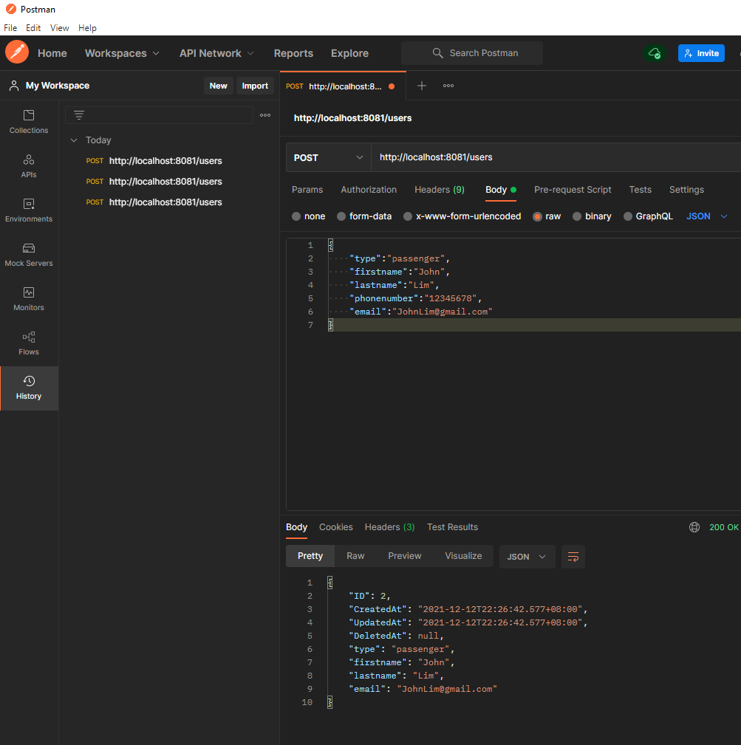
Postman Application using POST to input data
POST http://localhost:8081/users , Body: Raw , Text: JSON
Driver
Passenger

Slide 11
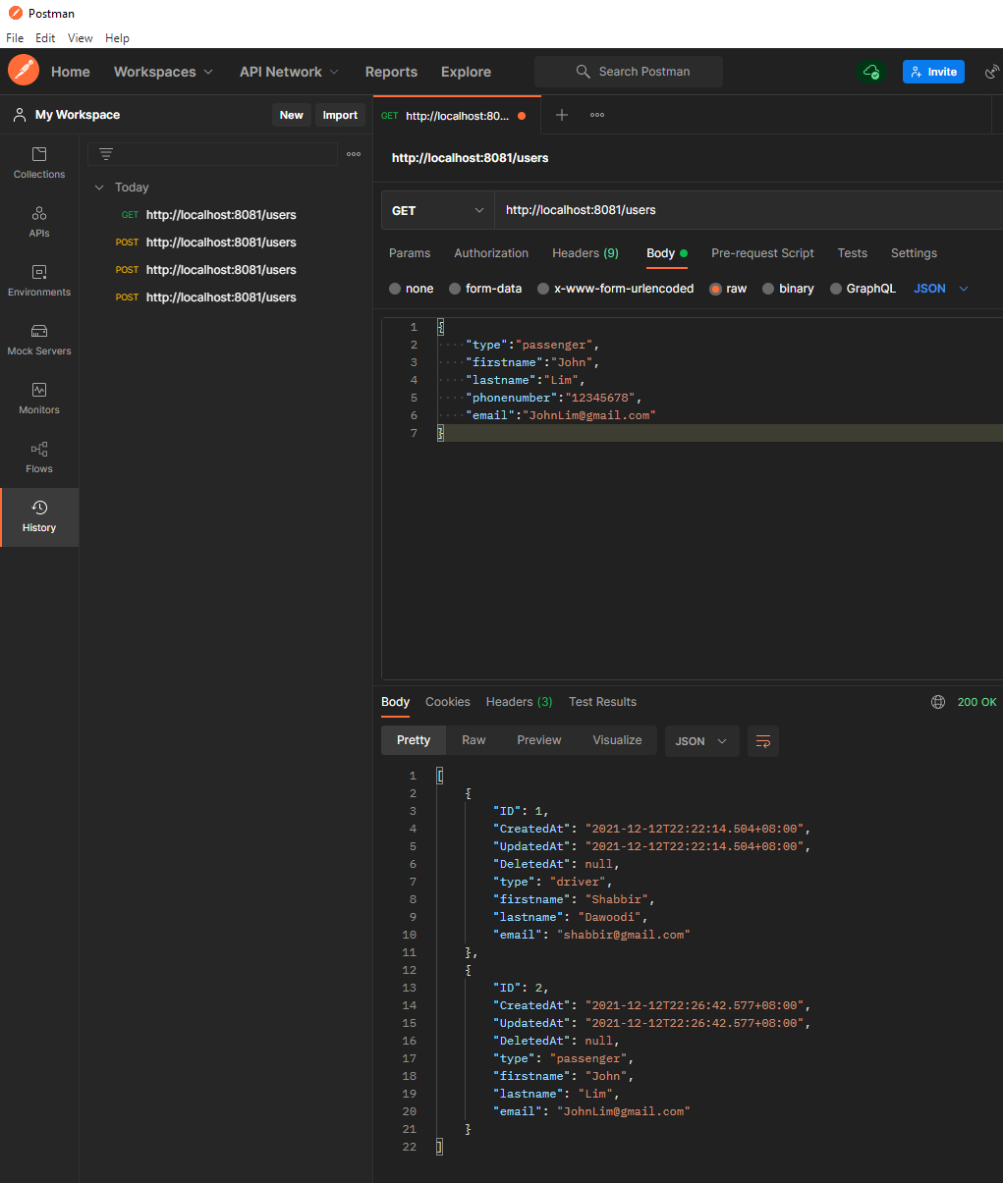
Postman Application using GET to Display all data
GET http://localhost:8081/users , Body: Raw , Text: JSON

Slide 12
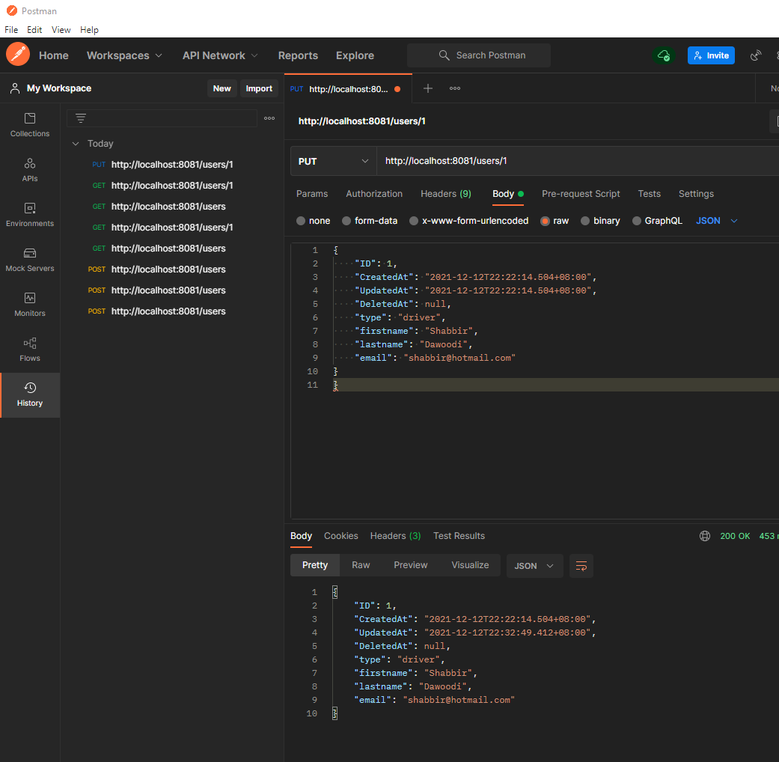
Postman Application using PUT to Update information
GET Then PUT http://localhost:8081/users/1 , Body: Raw , Text: JSON
Driver from @gmail.com to @hotmail.com

Slide 13
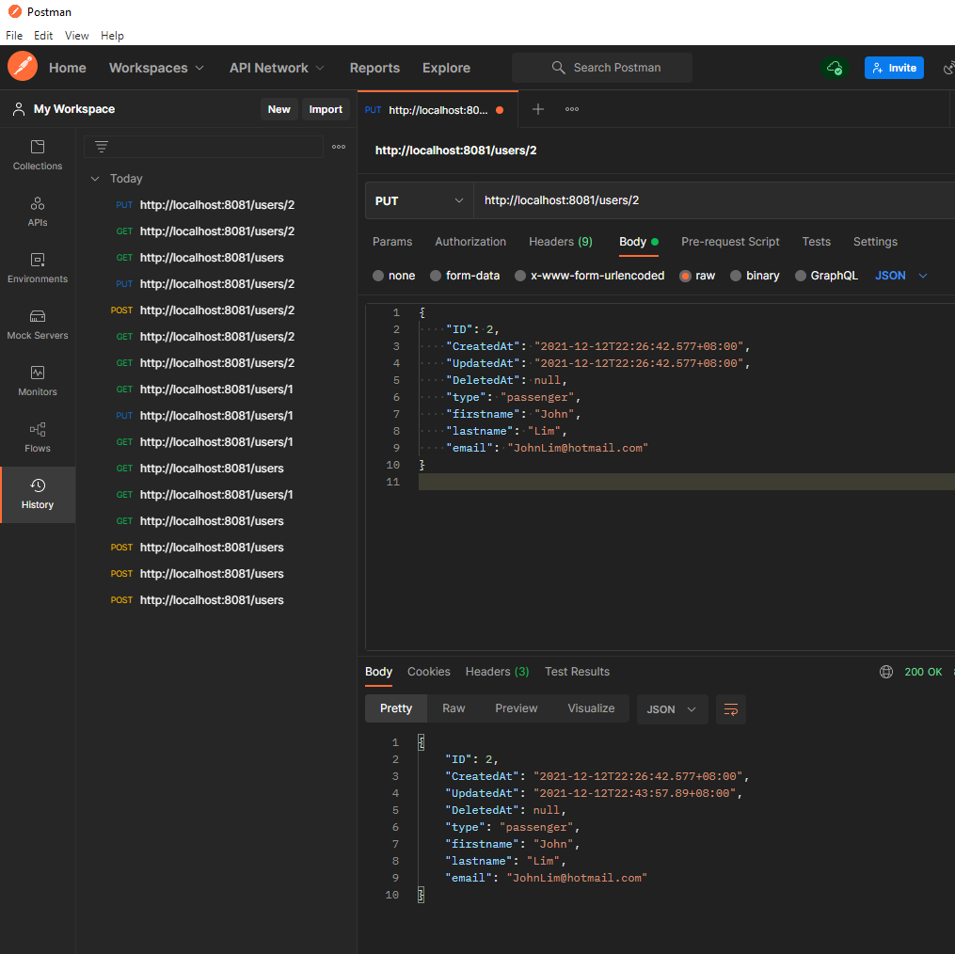
Postman Application using PUT to Update information
GET Then PUT http://localhost:8081/users/2 , Body: Raw , Text: JSON
Passenger from @gmail.com to @hotmail.com

Slide 14
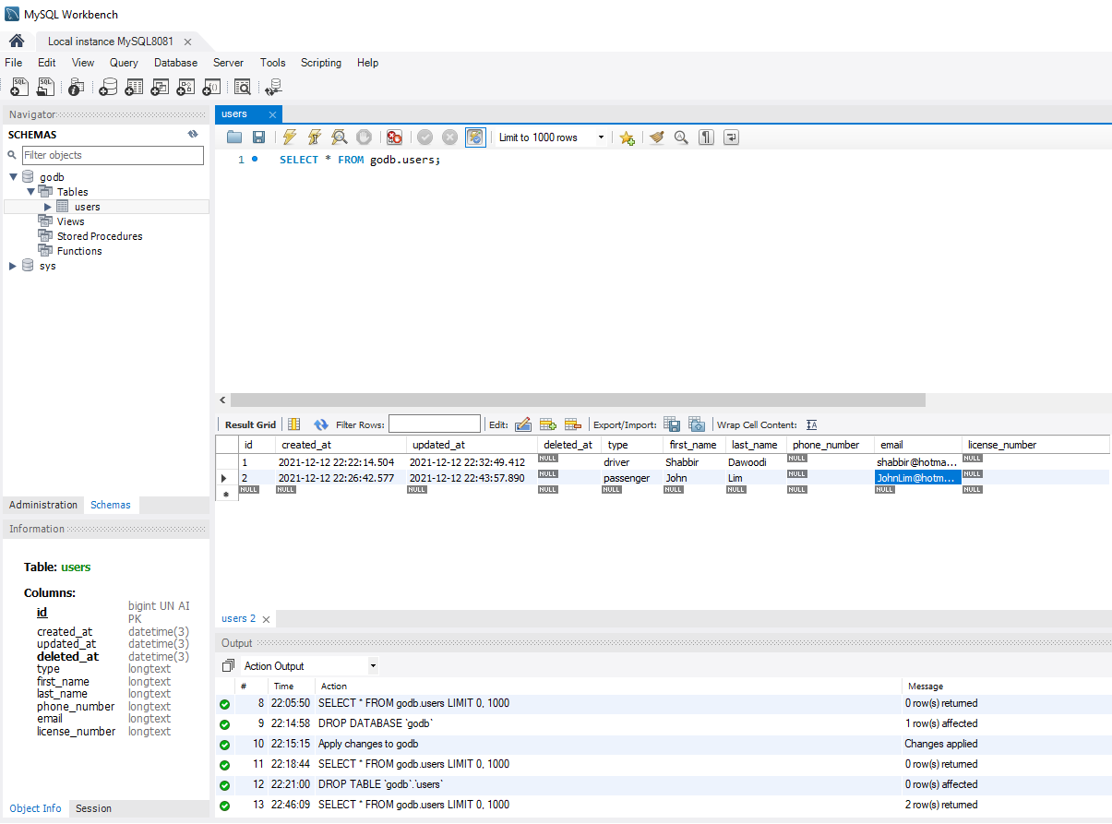
After execute POST http://localhost:8081/users in Postman it will pass data to MySQL

